Slide 1
Innovations in policy and financing for HIV and Global Health Security
Ian Sanne – Global Chief Medical Officer Palladium
University of the Witwatersrand
Unlocking Synergies: Exploring Policy and Financing Trends for HIV and Global Health Security ​

Slide 2
Sustained HIV Response
Innovations in policy and financing for HIV and Global Health Security​
HIV Diagnosis and Treatment
95:95:95 diagnosis, treatment and outcome targets
Combined health financing in public, private sectors with donor support for LMIC countries
Sustained health systems strengthening, supply-chain management and distribution
Monitoring evaluation and learning
Prevention interventions such as treatment of STIs, condom distribution, U=U, PREP and in future vaccine
Social behaviour change communication focused today on U=U

Slide 3
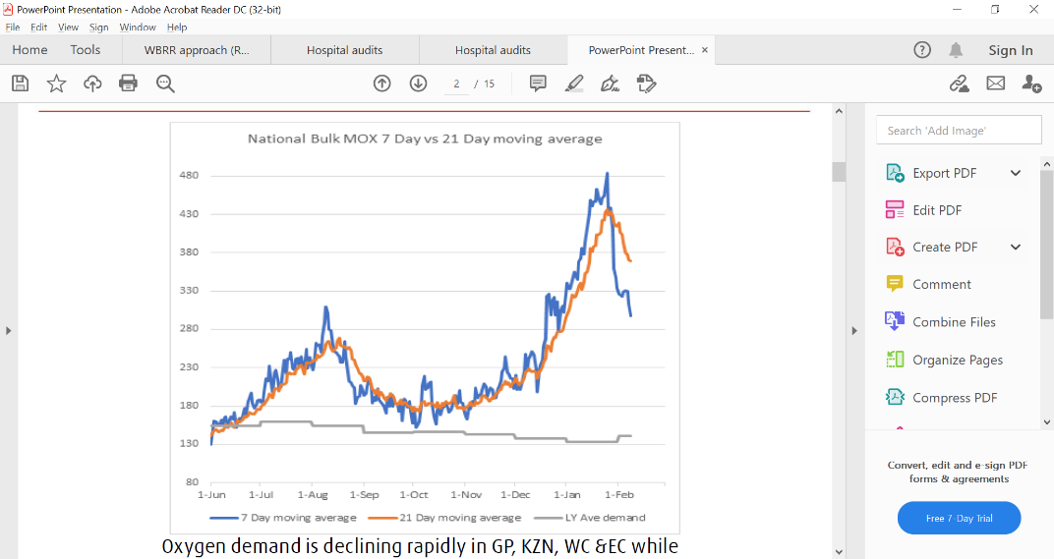
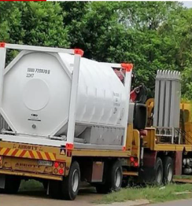

COVID-19 Response
The rapid COVID-19 response
Initial response of movement restriction, masking to prevent transmission
Integration of diagnostic, admission and outcome data leading visualised in dashboard reporting
Rapid scaling of treatment response
Commodities such as Oxygen, PPE, Ventilators
Prevention interventions such as vaccine
Social behaviour change communication throughout with an emphasis on social distancing and vaccination
South Africa Bulk Oxygen 7-21 Day Supply & 2019 Average

Slide 4
Reminder what HIV brought to COVID-19 response
HIV activities
COVID-19 Impact
Public Health and Infectious diseases expertise
Disseminated through health care worker cadres at point of first contact, distributing diagnosis, treatment and prevention messages
Diagnostic capacity focused on HIV molecular techniques and platforms
Metagenomics and whole genome sequencing
Vaccine platforms and development
All clinicians on board
SBCC heavily reliant on community health workers, volunteers and the message
COVID-19 diagnosis, viral load, cycle-time thresholds as predictors of event rates
Identified COVID-19 types, genetic mutations, transmission and vaccine
Development of vaccines

Slide 5
The HIV leadership has the same opportunity in GHS and One Health
HIV activities
GHS and AMR – public health networks
Public Health Infectious Diseases expertise
Disseminated through health care worker cadres at point of first contact, distributing diagnosis, treatment and prevention messages
Diagnostic capacity focused on HIV molecular techniques and platforms
Metagenomics, Bioinformatics and whole genome sequencing
Vaccine platforms and development
“One Health” approach
Public health emergency, SBCC
disseminating prevention and treatment interventions
Laboratory diagnosis, collation of incidence data, surveillance epidemiology, reporting
Identify diseases, genetic mutations, transmission modality, outbreaks
Development of vaccines

Slide 6
X-Incident Hotspots
Innovations in policy and financing for HIV and Global Health Security​
Disease independent
Coordination of government policy framework at national, regional and community level
Clinicians and Community Health Workers (Animal Health Workers)
Diagnosis and reporting mechanisms
MEL: Rapid accumulation of field data, data integration, routine reporting through data dashboards
Change management - allocation of resources
Treatment initiation and retention in care
Prevention to reduce transmission
Approach applied to
Tuberculosis – DS/DR
Malaria
Priority infections of pandemic potential

Slide 7
Sustainable Financing Initiative
Innovations in policy and financing for HIV and Global Health Security​
Private Section Engagement - Universal Health Access
Government to Government (G2G) transfer program and cost to the local governments
Localisation – cost efficiency
Proportional investment
Efficiency and savings
Health Systems Strengthening
Human Resources for Health
Integrated with PHC, MCH and GHS

Slide 8
Do GHS, PHC and HIV compete
Innovations in policy and financing for HIV and Global Health Security​
The innovation of the HIV response has impacted all public health fields
The health systems strengthening has a reach far beyond the HIV pandemic response
In the interface between epidemiology and health economics, the use of data
=> generate health finance modelling
=> impact guideline budget and management decisions
=> progressive policy development
The “world will be as one”, living within the global risks of expanding infectious disease, climate change and migration

