Slide 1

How economic evaluation improves policy:
The HIV Investment Case Example From South Africa
Gesine Meyer-Rath, Health Economics and Epidemiology Research Office (HE²RO)
University of the Witwatersrand, South Africa/ Boston University, US
HIV and Global Health Security: Policy, Financing and Data
Notes:
Good morning, I might be the first economist to speak in this forum, and I am glad to do so as part of our attempt at preparing for the future. I will summarise the evidence that we have on the economic impact of HIV and the HIV response in order to help us bridge research and policy.

Slide 2
Why South Africa?
Country with the largest number of people with HIV and the largest HIV programme
20% of the global population living with HIV
20% of the global population on ART
20% of the global population who have initiated PrEP
Mostly domestically funded:
  South African government (69% of total expenditure)
  PEPFAR (24%)
  Global Fund (2%)
Excellent data availability
Local analytical capacity
Since 2008, strong political commitment
Notes:
South Africa is home not only of 20% of the world’s people with HIV, but also 20% of the world’s people on ART- most of it funded from its own tax money

Slide 3
Why an HIV Investment Case?
Technical efficiency
Lowest number of inputs per outcome generated
Inputs:
  Staff
  Test
  Drugs
  …
Economic efficiency (“Cost efficiency”)
Lowest cost per outcome generated
Notes:
Measuring the immediate effects of an intervention on economic activity (e.g., as captured by GDP growth) does not capture health gains that extend beyond the lifetime of beneficiaries
Full income
The “Value of statistical life” (VSL) is obtained from estimates of the willingness to pay for reductions in mortality or improved health, derived from

Slide 4
Why an HIV Investment Case?
Technical efficiency
Allocative efficiency
Lowest number of inputs per outcome generated
Inputs:
  Staff
  Test
  Drugs
  …
Optimal distribution of cost across different options funded from same budget to achieve maximum outcome
Production at the point on the production possibility frontier that is optimal for society
# on ART
Economic efficiency
Lowest cost per outcome generated
# on CAB-LA

Slide 5
Why an HIV Investment Case?
Technical efficiency
Allocative efficiency
Lowest number of inputs per outcome generated
Inputs:
  Staff
  Test
  Drugs
  …
Optimal distribution of cost across different options funded from same budget to achieve maximum outcome
Production at the point that is optimal for society
# on ART
Economic efficiency
Lowest cost per outcome generated
# on CAB-LA

Slide 6
Why an HIV Investment Case?
Technical efficiency
Allocative efficiency
Lowest number of inputs per outcome generated
Inputs:
  Staff
  Test
  Drugs
  …
Optimal distribution of cost across different options funded from same budget to achieve maximum outcome
Production that is optimal for society
# on ART
Economic efficiency
Lowest cost per outcome generated
# on CAB-LA

Slide 7
An optimal HIV/ TB planning and budgeting
cycle
New interventions/ effectiveness data
National and provincial (Thembisa)
Service statistics
Epidemiological estimates
Cost estimates
District
(NAOMI)
Implementation
Cost effectiveness
Budget execution tracking
Provincial plans
Optimised interventions and targets
Provincial budgets
Policies and guidelines
National budget
National plans
(eg, National Strategic Plans)
Source: Murphy and others 2021
Notes:
In South Africa, we have incorporated economic analysis into HIV and TB programme planning, target setting and budgeting in a way that allows the South African government to use the same data for all purposes, and enables programme planners at all levels to track outcomes and expenditure within the budget year. These are then used to update existing models and projections for the next budget year.

Slide 8







An optimal HIV/ TB planning and budgeting
cycle
New interventions/ effectiveness data
National and provincial (Thembisa)
Service statistics
Epi model estimates
& others
Cost estimates
District
(NAOMI)
& others
Implementation
Cost effectiveness
Budget execution tracking
Provincial plans
Optimised interventions and targets
Provincial budgets
Policies and guidelines
National budget
National plans
(eg, National Strategic Plans)
Source: Murphy and others 2021
Notes:
Ths cycle is maintained mostly by staff at the national and provincial departments of health, the national AIDS council, and UNAIDS, with support from a number of academic institutions such as ours.

Slide 9
The South African HIV Investment Case
Optimised interventions and targets
Iterative exercise to establish the most cost effective mix of interventions and optimal coverage (allocative efficiency) under country’s given HIV budget from
Optimisation routine
  considers cost-effectiveness of each intervention (cost per life year saved)
  iteratively adds the most cost effective intervention to a rolling baseline
Rank all options by ICER (cost per LYS)
Add most cost effective intervention to baseline
Baseline
Baseline
+Option
1
1
Condoms (90%)
1
ART (90%)
2
MMC (90%)
2
HTS (90%)
3
ART (90%)
3
PrEP (90%)
50
Condoms (30%)
50
Condoms (30%)
Notes:
A central part of this exercise is the South African HIV Investment Case

Slide 10
The South African HIV Investment Case
Optimised interventions and targets
Rank all options by ICER (cost per LYS)
Add most cost effective intervention to baseline
Iterative exercise to establish the most cost effective mix of interventions and optimal coverage (allocative efficiency) under country’s given HIV budget from
Optimisation routine
  considers cost-effectiveness of each intervention (cost per life year saved)
  iteratively adds the most cost effective intervention to a rolling baseline
Baseline
Baseline
+Option
1
1
Condoms (90%)
1
ART (90%)
2
MMC (90%)
2
HTS (90%)
3
ART (90%)
3
PrEP (90%)
50
Condoms (30%)
50
Condoms (30%)
Constrained: mix of interventions given current budget
Unconstrained: scales up interventions regardless of funding envelope
Cost and impact over a 20 year period
Impact modelled using Thembisa model (www.thembisa.org)
Notes:
A central part of this exercise is the South African HIV Investment Case

Slide 11

2016 | 2018 | 2019 | 2021 | 2023
Affordable under current budget
Condom provision | Condom provision | Condom provision | Condom provision | Condom provision
MMC | SBCC 1 | ART initiation | ART initiation | HIVST (500k)
ART (CD4<500) | ART (UTT) | General HTS | PCR at birth | PCR at 10 weeks
PMTCT | General HTS | HCT for FSW | PrEP for MSM | ART re-linkage (81%)
ART (UTT) | HCT for FSW | PrEP for FSW | General HTS | if more budget, +
PCR at 6 weeks | PrEP for FSW | MMC 20+ | ART retention (95%) | ART re-linkage (95%)
SBCC 1 | SBCC 3 | PCR at birth | HTS for adolescents | HIVST (1 mil)
SBCC 2 | PrEP for HR fem adolescents | PrEP for HR F adol’ | HIVST optimized | HTS at 18 months
if more budget, + |  |  | PrEP in pregnancy | PCR at 6 months
General HTS | PrEP for MSM | PrEP in pregnancy | PrEP for FSW | General HTS
SBCC 3 | MMC | PrEP for MSM | MMC | HTS for adolescents
HCT for FSW | HTS for adolescents | PrEP for HR young women | PrEP for fem adolescents | MMC
PCR at birth | SBCC campaign 2 | PrEP for HR young men | PrEP for young women | Oral PrEP to FSW/MSM/AGYW
PrEP for FSW | PrEP for HR young women | PrEP for HR M adolescents | if more budget, + | CABLA to FSW/MSM/AGYW
HTS for adolescents | PrEP in pregnancy | MMC 15-19 | PrEP for young men | CABLA in pregnancy
PrEP for young women | PrEP for HR young men | MMC 10-14 | PrEP for male adolescents | Oral PrEP in pregnancy
EIMC | PrEP for HR male adolescents | EIMC | EIMC | EIMC
 | EIMC
Source: Author

Slide 12






Uses of economic analyses in the South African HIV programme
ART: Supported ART roll-out and increases in eligibility
Supported switch from TEE to TLD as first-line ART
TESTING: Optimised HIV testing strategies
Supported HIV self-testing roll-out
PrEP: Cost-effectiveness of different PrEP strategies
Threshold price for injectable cabotegravir and lenacapavir
ENABLERS: U=U messaging for increasing testing in men
ART through public-private partnerships
Differentiated models of care and adherence strategy

Slide 13
South African government HIV expenditure has increased above inflation for twenty years…
Source: Ndlovu and others, 2024
Source: Author

Slide 14
…until COVID-19
COVID-19 related spending
Decrease in HIV budget as a result of decreasing fiscal space after COVID-19

Slide 15
A COVID-19 planning and budgeting
cycle
Short-term projections
Epidemiological estimates
Resurgence metrics
Service statistics, esp. hospitalisations (length of stay), tests
National COVID-19 Epi Model
New interventions/ effectiveness data
Cost effectiveness
Cost estimates
Choice of interventions
Implementation
Policy advice and guidelines
National budget
Quantifications of drugs, O2, beds, staff, vaccines
Notes:
During COVID-19, we used a similar systems to rapidly scale up epidemiological and economic modelling for decision making and policy advice

Slide 16



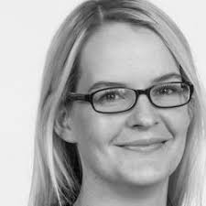

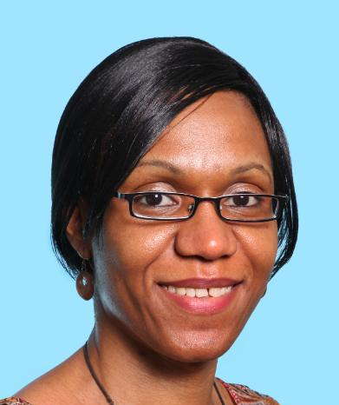
South African COVID-19 Modelling Consortium
Established 23 March 2020 by request of Department of Health
Initially funded through existing grants (HIV, malaria); from 2021 through BMGF, Wellcome, WHO
Models developed jointly by
  Prof Sheetal Silal, Modelling and Simulation Hub, Africa (MASHA), University of Cape Town
  Prof Juliet Pulliam, South African DSI-NRF Centre of Excellence in Epidemiological Modelling and Analysis (SACEMA), Stellenbosch University
  Prof Gesine Meyer-Rath, Dr Lise Jamieson, Health Economics and Epidemiology Research Office (HE²RO), University of the Witwatersrand
  Dr Harry Moultrie, National Institute for Communicable Diseases (NICD) - convener
  Additional economic analysis by Dr Ijeoma Edoka, University of the Witwatersrand

Slide 17
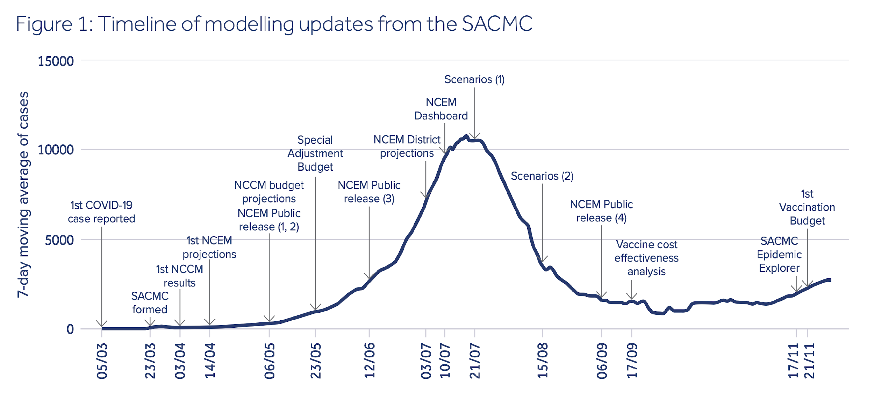
Wave 1: A busy time
2020
  Silal SP, Pulliam J, Jamieson L, Nichols B, Moultrie H, Meyer-Rath M. The role of modelling in planning and budgeting for South Africa's COVID-19 response. In: Govender K, George G, Padarath A, Moeti T, editors. South African Health Review 2021. Durban: Health Systems Trust; 2021. (2022)
Notes:
Situational awareness and planning resources through numerous reports and analyses

Slide 18
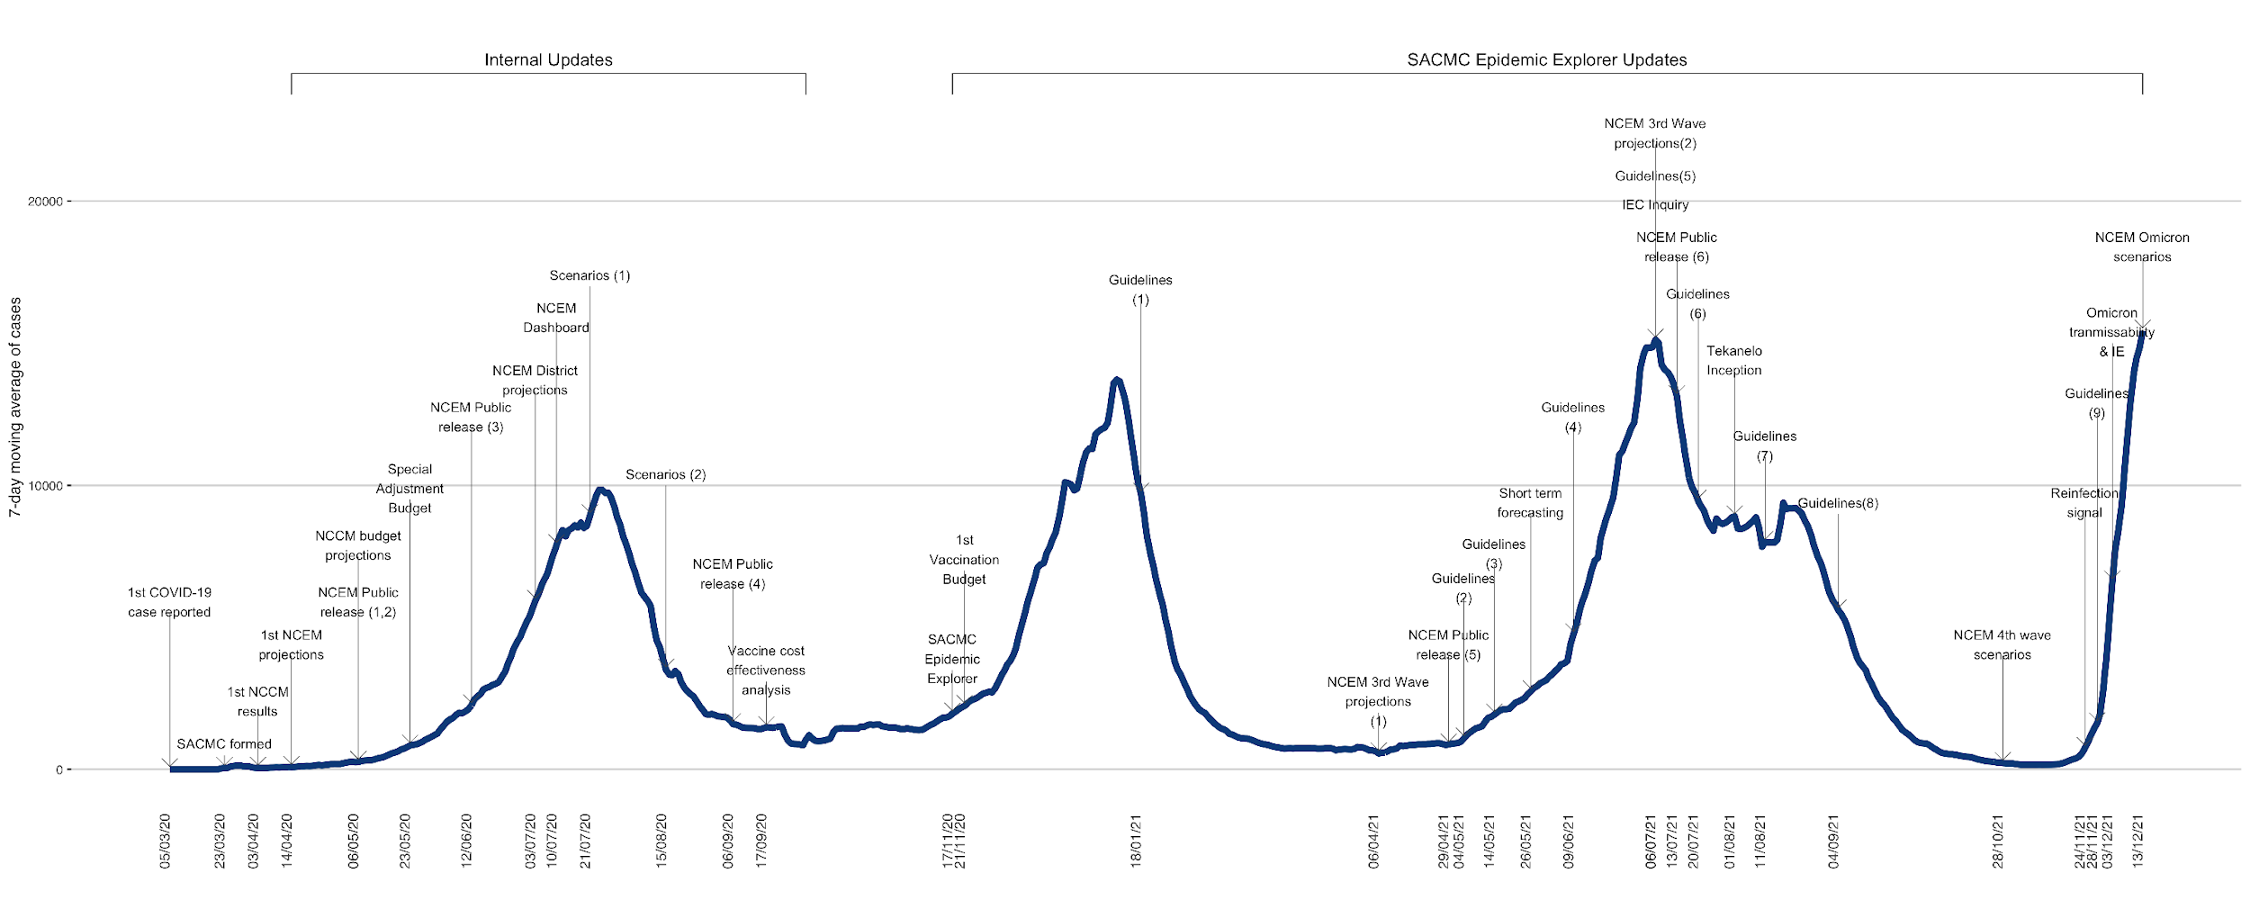
And beyond…
2020
Notes:
As the waves continued, we continued to produce new analyses to address the pertinent questions as they arose

Slide 19
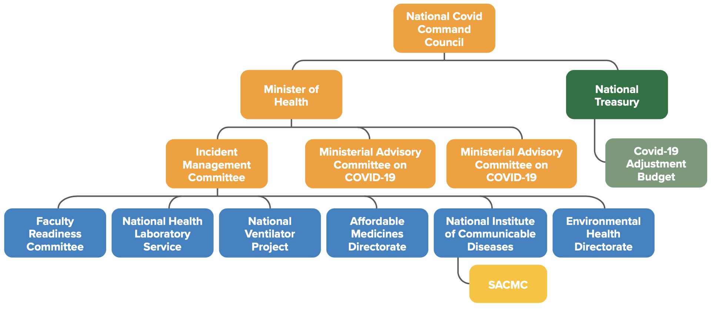
Recipients of SACMC outputs for decision-making, planning, and budgeting
Notes:
The model output was shared with numerous stakeholders at various levels of government; this diagram shows the main recipients of SACMC outputs within national government

Slide 20
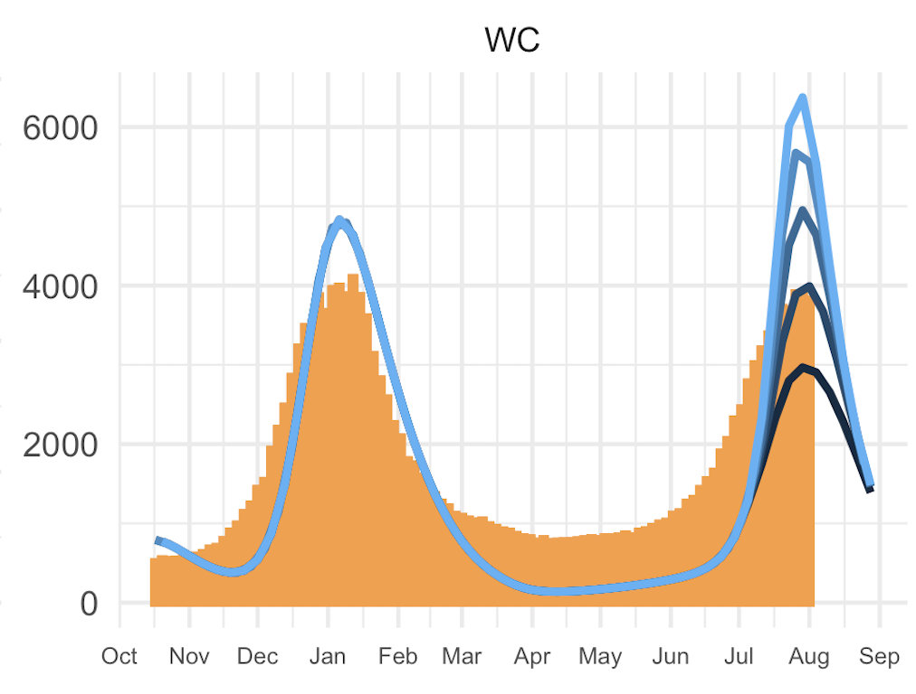
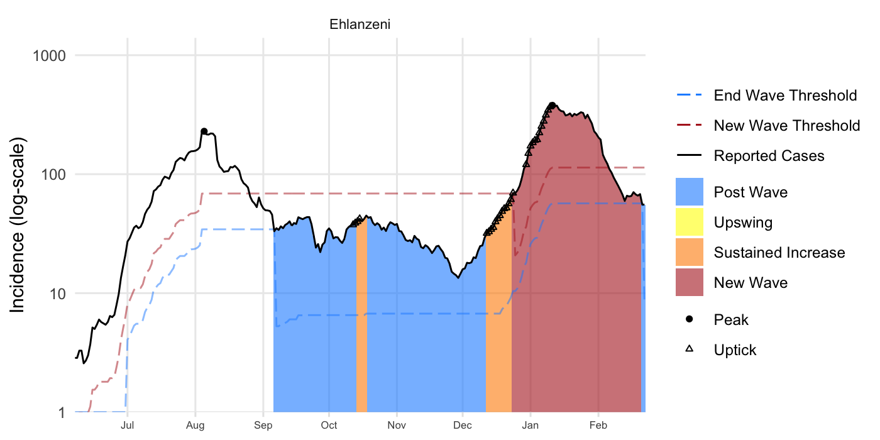
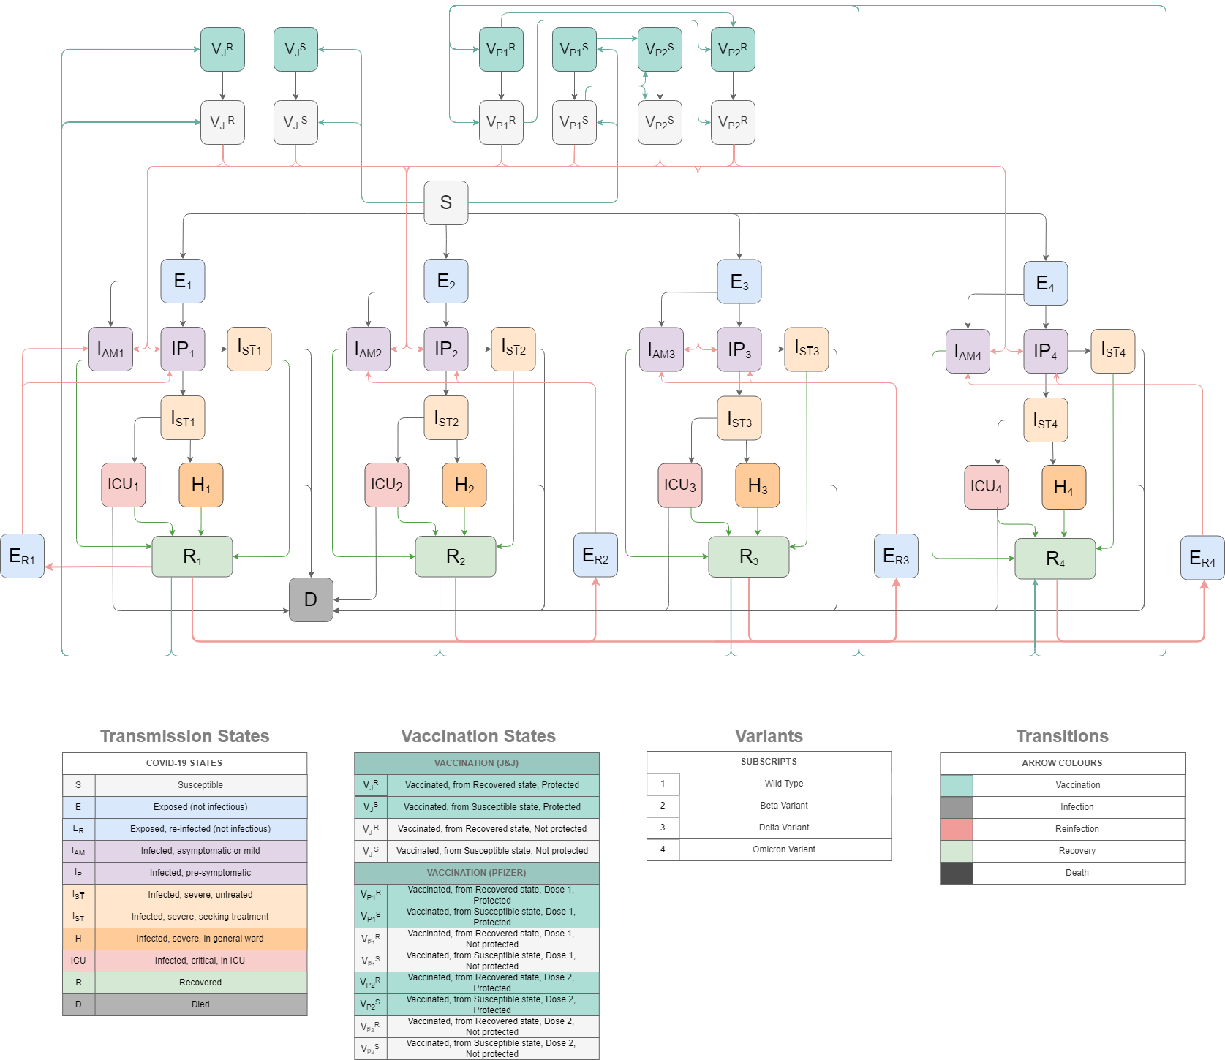
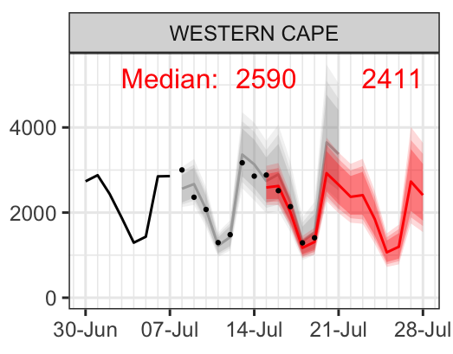
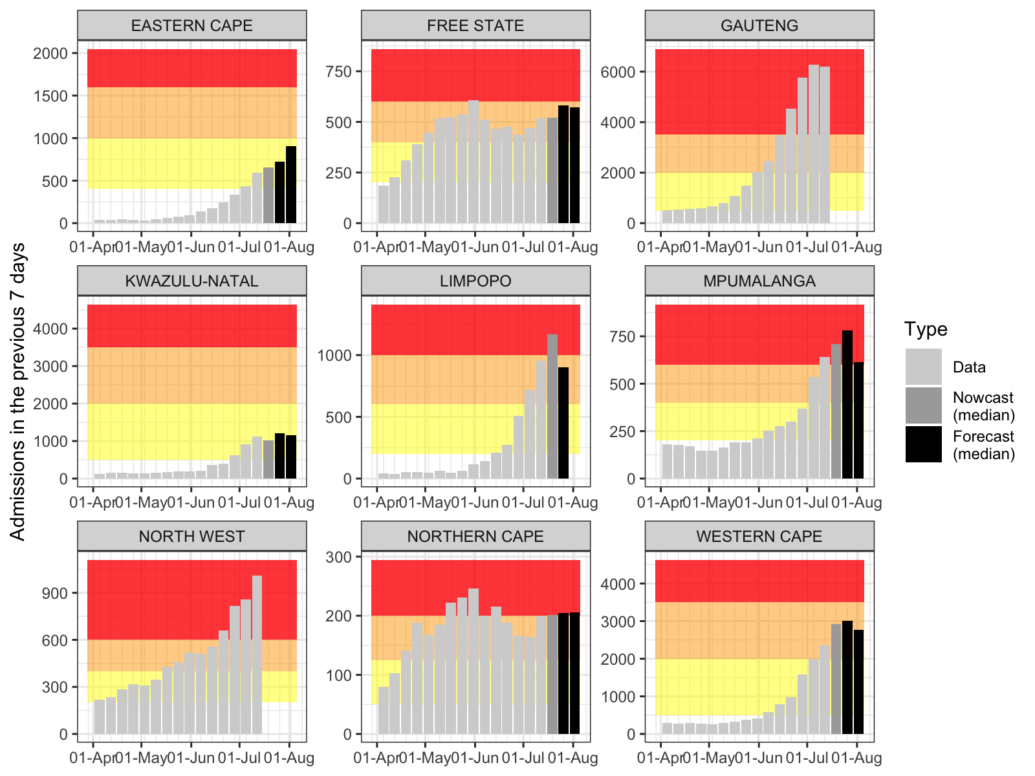
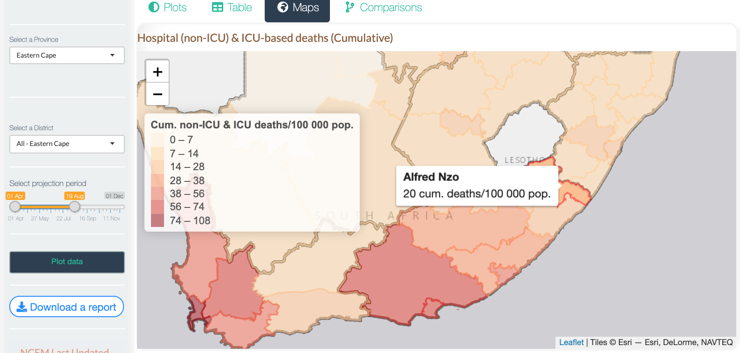
The National COVID-19 Epi Model (NCEM)
Agility and adaptability is key to remaining useful
Scenario modelling
Epidemic metrics
Regular model updates
NCEM v4-6: Variants & vaccines
Weekly admissions
Case reports
Spatial modelling
Short-term projections
Source: SACMC Modelling Reports. https://www.nicd.ac.za/diseases-a-z-index/covid-19/surveillance-reports/modelling-consortium-projections/
Notes:
23 March 382k cases and 16,800 confirmed deaths

Slide 21
Lessons learned
Investing in data-model-budget-policy systems and capacity
enables early pandemic response
increases trust and uptake of evidence by policy and public
optimises use of scarce resources capacity
improves data quality and availability
provides a platform for South-South capacity building
…but: capacity needs to be built in pandemic peace times
Notes:
South Africa is home not only of 20% of the world’s people with HIV, but also 20% of the world’s people on ART- most of it funded from its own tax money

