Slide 1
Integrating Data Systems Across HIV, GHS, and PHC
Teddy Berihun, Director- Information Systems, Palladium
HIV, Primary Health Care and Global Health Security: Data and Systems Integration
Notes:
10 minutes

Slide 2
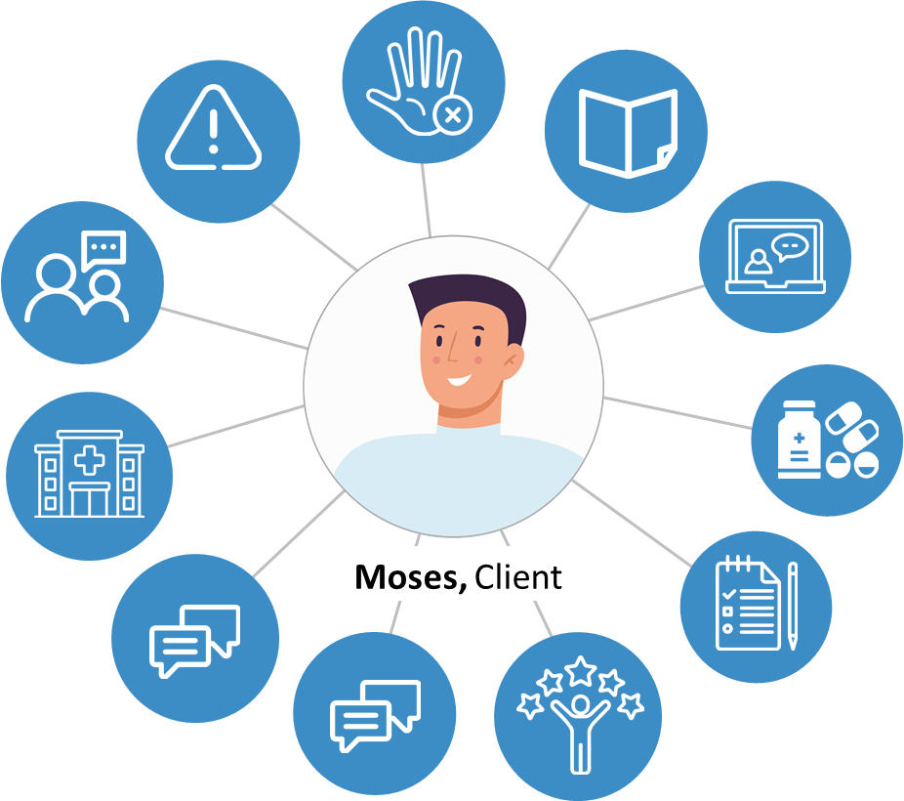
Treating the Whole Person- Integrating Systems and Services
Multiple parallel data systems exist in silos.
COVID-19 painfully reminded us that the gains of past decades can be easily disrupted.
To promote more resilient and equitable health services, we must have an integrated approach to information systems.
When health systems find ways to integrate HIV services with other services (PHC, GHS, etc.) their ability to reach and address the health concerns of all individuals improves—regardless of whether those individuals are HIV positive.
One way to achieve this is by investing in primary health care and integrating multiple health services within a single access point.

Slide 3
Why Data and System Integration?
HIV, PHC, GHS, supply chain, laboratory, etc. systems can be integrated and made interoperable, increasing efficiencies and enabling patient-centered care
Optimized resource allocation:
Cross-functional insights:
A unified system eliminates redundancies and streamlines resource allocation by avoiding the duplication of efforts and resources across different silos. This optimization leads to cost-effectiveness.
Integrating data from diverse sources facilitates cross-functional insights. Decision makers gain a comprehensive understanding of issues leading to more informed and targeted strategies for support.
Scalability and adaptability:
Holistic view of client needs:
A comprehensive system design allows scalability and adaptability, accommodating evolving needs.
The system can grow and evolve, scaling up to meet expanding requirements.
Integrating data from various systems offers a more holistic understanding or client, facility, and community needs. This enables tailored interventions and more effective and targeted support.

Slide 4
Best Practices
Lessons from implementation
Localize global solutions
Extend, optimize, and adapt the technology applicable within local contexts:
- Enable in-country technical teams
- Pursue private sector engagement
Client centered
The client should always be at the center of the initiative.
The goal is to provide a holistic view of the client/patient.
v
Balance with data collection WITH data use
The concept of "collect once, use many times”. Move away from redundant collection.
Promote collaborative and
responsive data use practices.
Governance
Work with the Ministry of Health or other country leadership; champion the decision makers.
Prioritize national health data collaboratives and governance structures.

Slide 5
Three Examples of Impact in Action

Slide 6
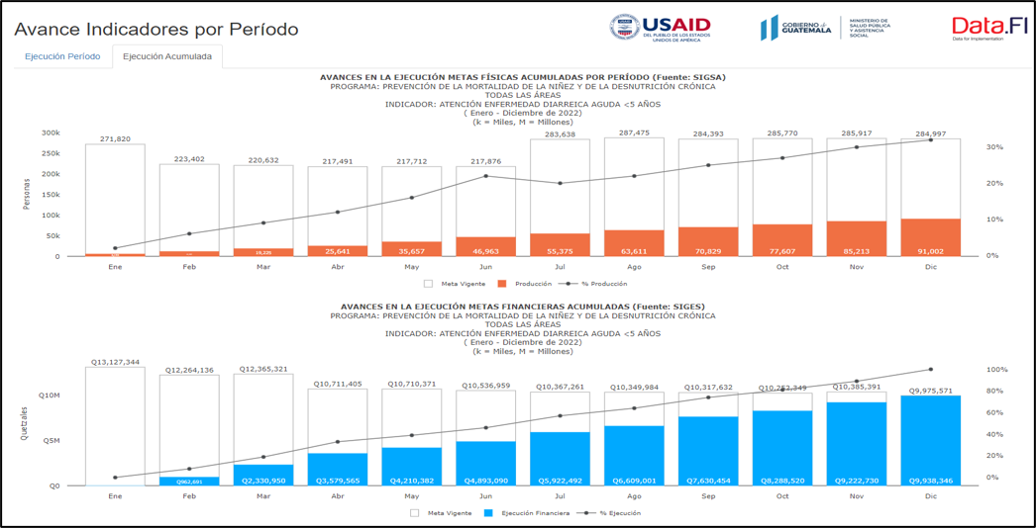
Data Integration for Primary Health Care Decision Making in Guatemala
This enhanced the quality of expense budgeting, enabling targeted investments in basic medical services
In Guatemala, Palladium implemented a digital solution for seamless information integration between the Ministry of Health (MOH) and Ministry of Public Finances (MOPF).
Collaboration with and between both ministries was prioritized to devise a feasible process, ensuring sustainability as a core consideration.
The solution extracts information from the MOPF via an API and integrates it for use by the MOH Health Information System. The system addresses challenges faced during MOH's monthly expenditure reviews. ​​
The Vice Minister of Primary Health Care led the initiative to develop a Shiny dashboard visualizing integrated financial data and health service delivery data on the prevention of maternal, childhood, and neonatal mortality.
Notes:
Key achievements encompass improved data accessibility and integration, enhanced communication and collaboration between institutions, as well as timely and accurate data updates, thereby bolstering financial data analysis capabilities.​
​
Of notable significance, these achievements have a positive impact on Primary Health Care in Guatemala by enhancing the quality of budget expense, enabling targeted investments and expenses in basic medical services, as well as in infrastructure and equipment​

Slide 7
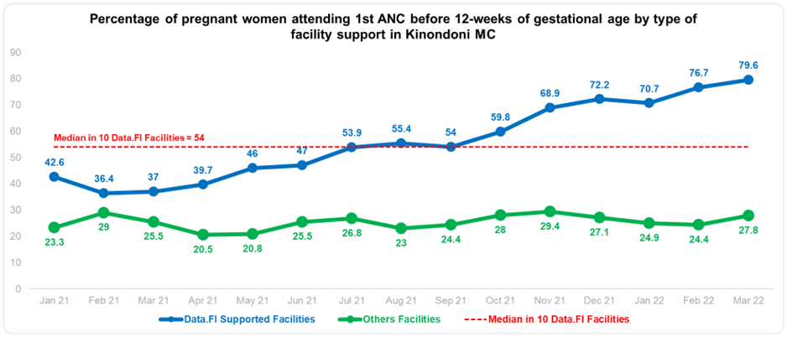
Catalyzing Maternal and Child Health (MCH) Transformation in Tanzania
PORALG adapted situation room methodology to support quality improvement at site level
Council Health Management Teams (CHMTs) in selected regions are using Situation Rooms to review facility-level performance against agreed indicators.
​CHMTs agree and track implementation of change ideas to improve performance.
Clear impact is documented across facilities compared to controls.
CHMTs are working to scale these solutions to other facilities in their council.
QI Initiative on UPT linkage started
Design workshop held
Situation rooms allow decision makers to analyze data in real time for continuous program improvement supported by change management practices. These can be adapted for variety of programs such as MCH, HIV, Routine Immunization, NCDs, etc.
Notes:
In Tanzania, with government leadership, Data.FI has helped to stand up a national quality improvement initiative across primary health care. QI is managed through government-run situation rooms at the sub-national (council) level. To date, have documented improvements in a range of MCH indicators. We leveraged national health information systems data to review facility performance metrics and develop quality improvement (QI) action plans which are reviewed weekly to enable continuous feedback and learning for ongoing program adaptation and accountability for course corrections

Slide 8
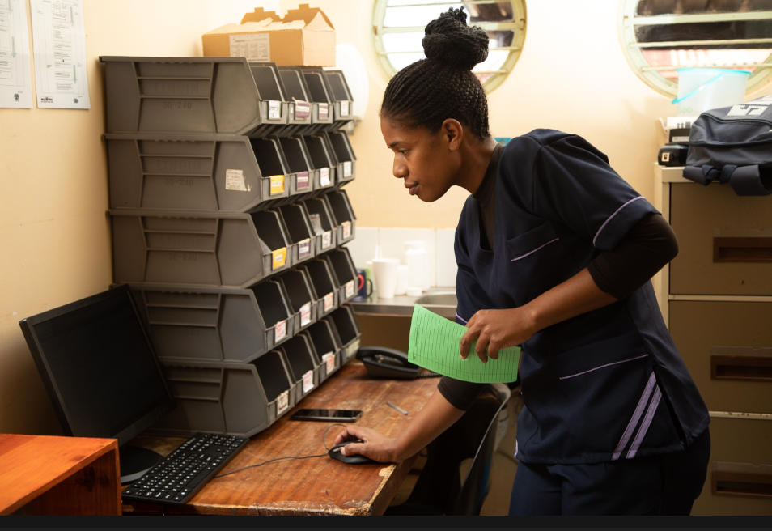
EMR Optimized and Scaled-up to Integrate PHC in Eswatini
Eswatini is enhancing and scaling an integrated primary health care EMR: the Client Management Information System (CMIS)
95% of health facilities in Eswatini use CMIS
Compatible with data on HIV, TB, non-communicable diseases, prevention, immunization, etc.
Data dashboards for nutrition, cervical cancer, SRH-FP, under development
CMIS offers:
Effective linkage of clients/client information across health facilities
Easy access to comprehensive patient history for clinicians
Enhances portability of patient records to support patient referral
Real-time access to laboratory diagnostic test results
A healthcare worker in Eswatini uses the client management information system (CMIS) to access client records at the service point. Photo by Data.FI/Eswatini.

Slide 9
Artificial Intelligence and Machine Learning

Slide 10

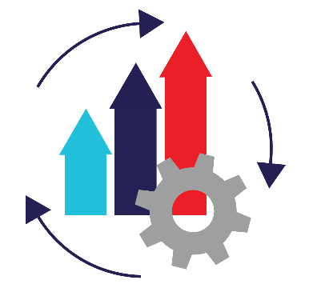

AI/ML Applications along the
Data Lifecycle
Data Capture
Collect/extract open unstructured data, including geospatial and surveillance data, to complement programmatic data.
Data Transformation
Apply algorithmic approaches to identify anomalous data points not captured by rules-based tools, enabling interventions to improve data quality before it is used for decision making.
Knowledge Generation
Generate insights and analysis via natural language interfaces using large language models, text2sql, and text2code, empowering a broader set of stakeholders to become consumers of data rather than only data providers.
Data Modeling
  Integrate predictive models as clinical decision support tools within point of care systems, even in low-resource settings.

Slide 11
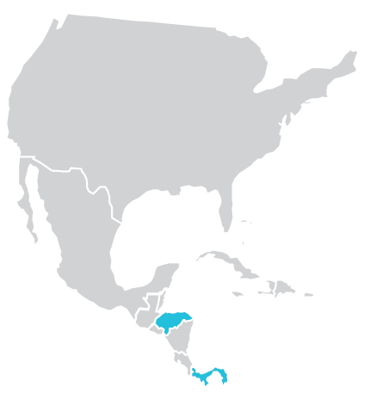
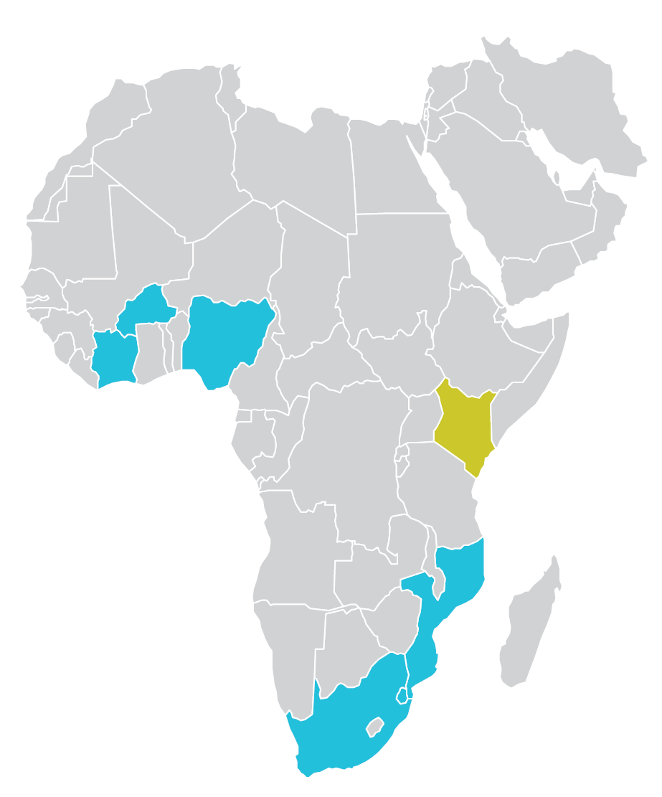
Where We Implement AI Solutions
Burkina Faso
COVID-19 social-listening dashboard
USAID HQ
Anomaly detection
Generative artificial intelligence (AI) for unstructured data
Market segmentation
Cote d’Ivoire
COVID-19 Vaccine Allocation Tool
Kenya
IIT risk prediction
HTS risk prediction
Nishauri chatbot
AI self-service analytics
Honduras
COVID-19 Vaccine Allocation Tool
Nigeria
High-throughput screening (HTS) risk prediction
IIT risk prediction
PEPFAR target generation
COVID-19 geographic information system (GIS) network analysis
Mozambique
IIT risk prediction
Panama
Interruption in Treatment (IIT) risk prediction
Eswatini
Feasibility assessment of AI-enabled apps in client management information system
South Africa
Patient record deduplication

Slide 12


Sustainable Solutions!

