Slide 1
Responding to challenges and expanding HIV prevention and treatment services in conditions of war
Resilience Amid Conflict: AHF Ukraine's Continuity and Expansion of Medical Services
Dr. Yaroslava Lopatina,
Country Program Director, Ukraine
AIDS Healthcare Foundation

Slide 2
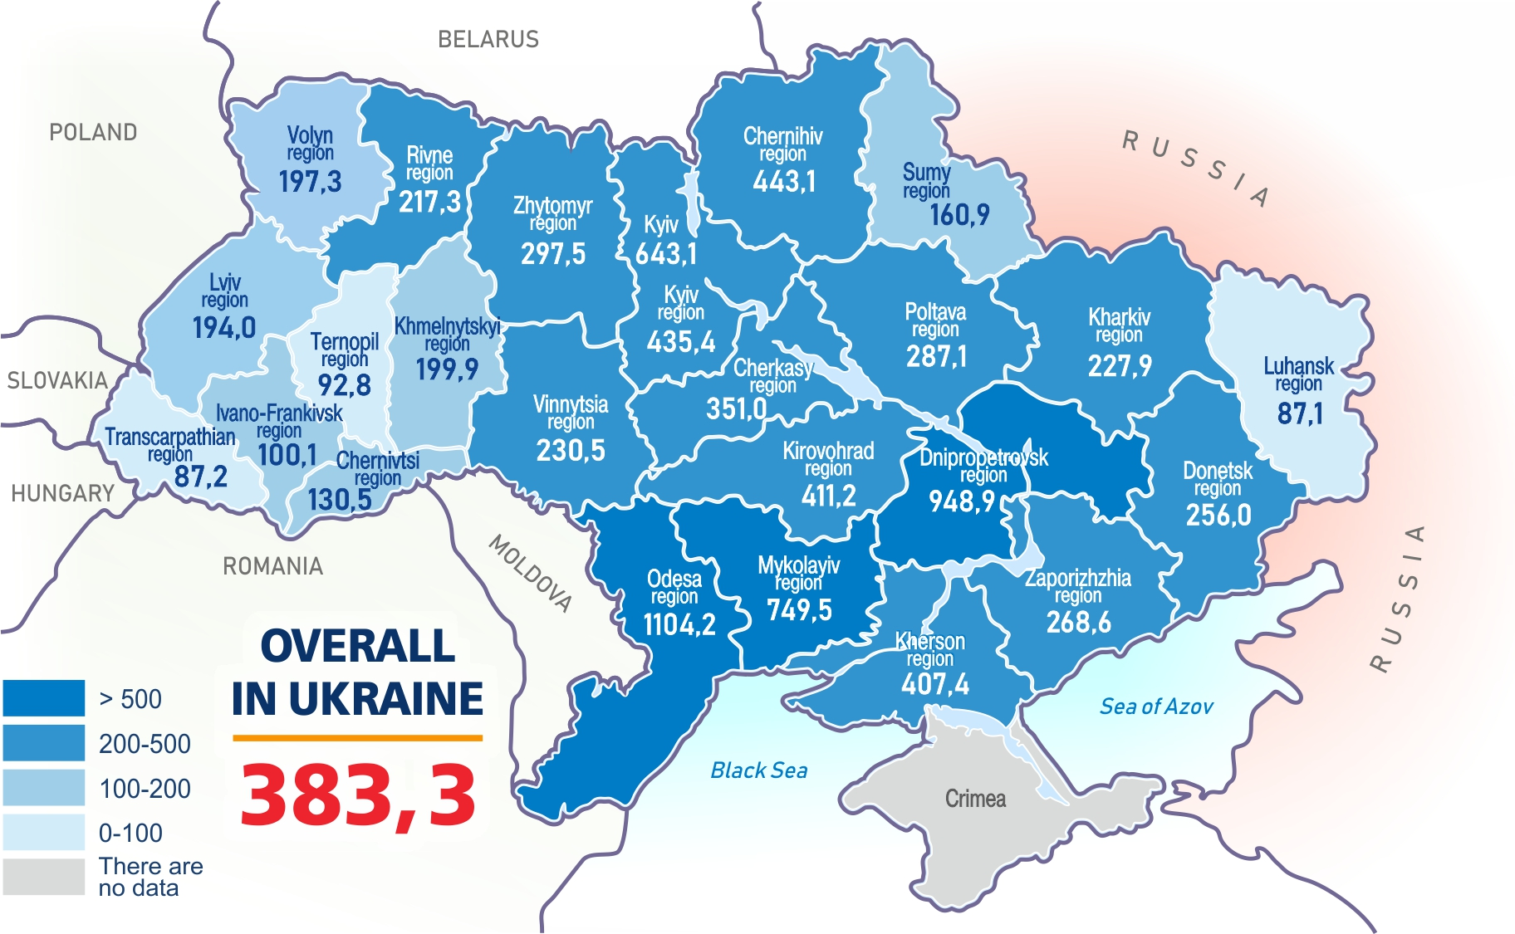
Prevalence of HIV Infection in the Regions of Ukraine as of April 1, 2024

Slide 3
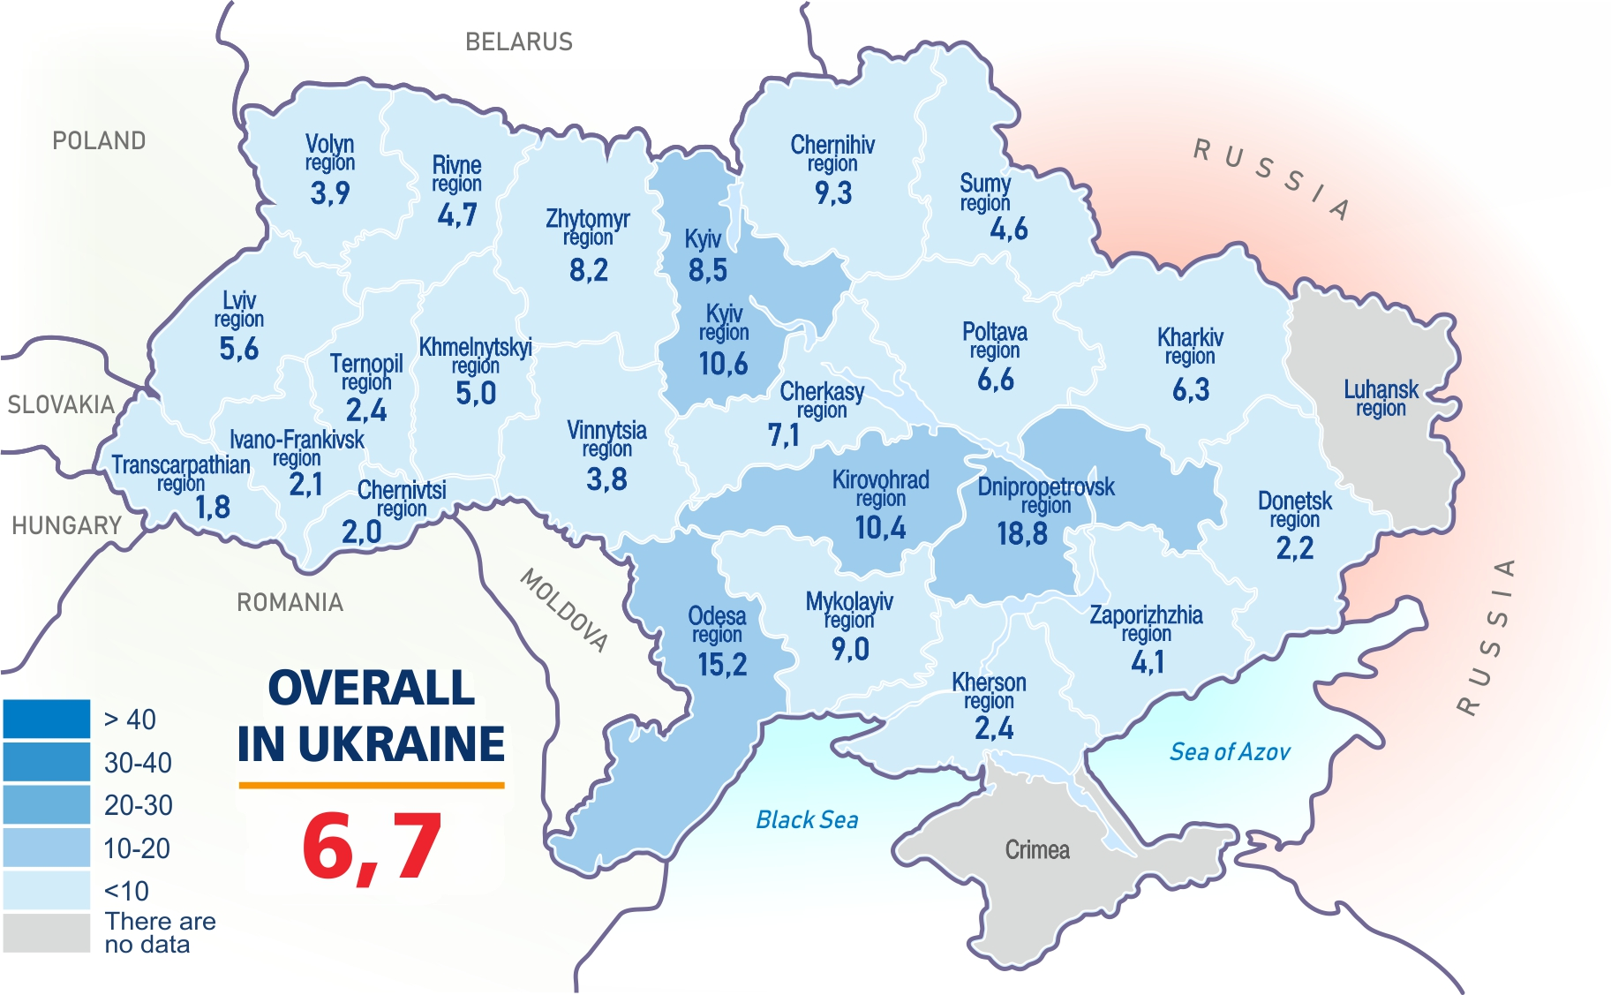
Incidence of HIV infection in the regions of Ukraine as of April 1, 2024

Slide 4
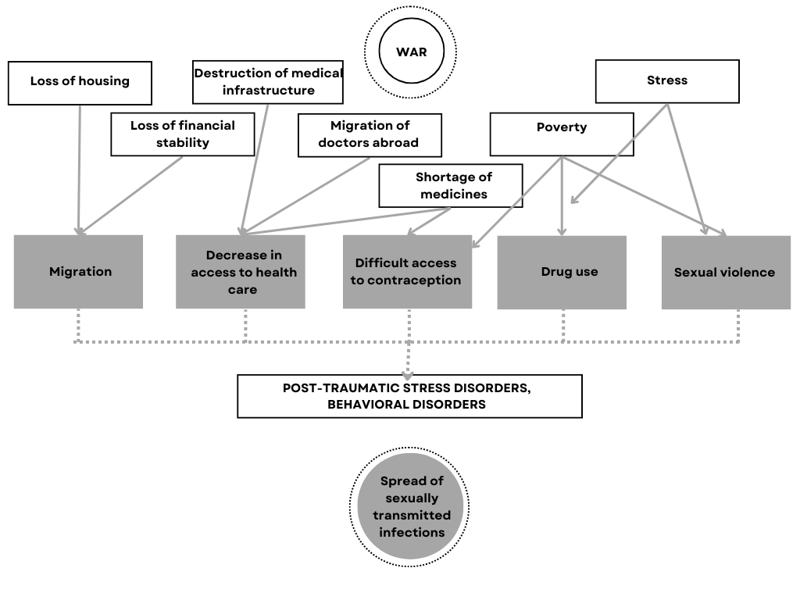
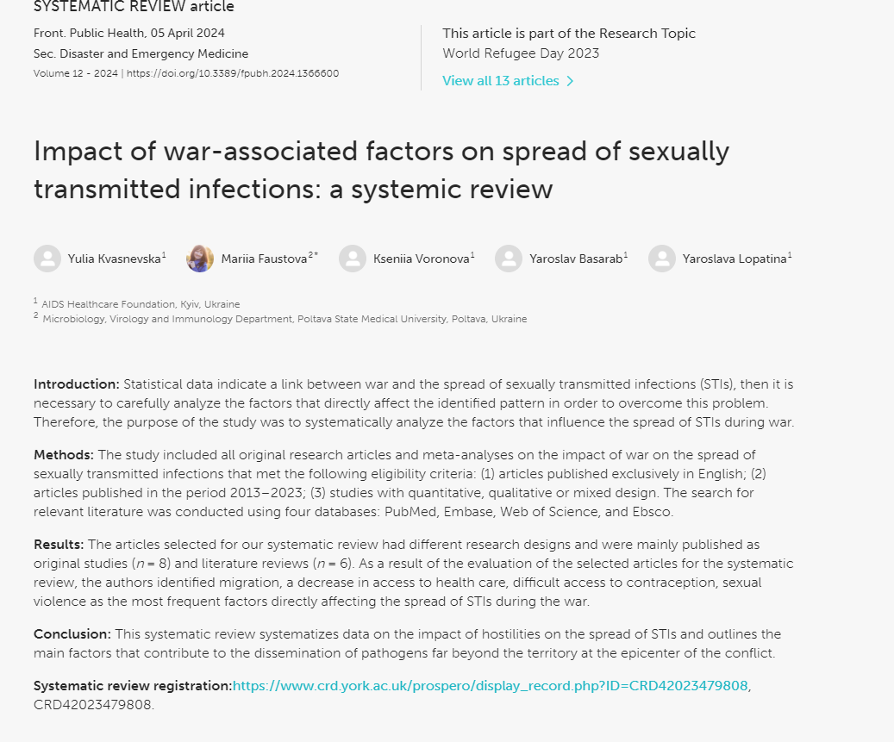
Impact of war-associated factors on spread of sexually transmitted infections: a systemic review

Slide 5
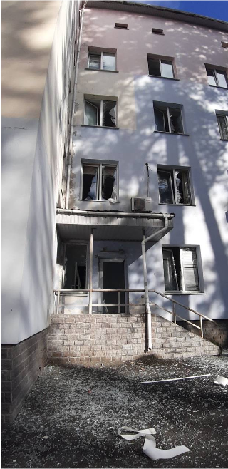
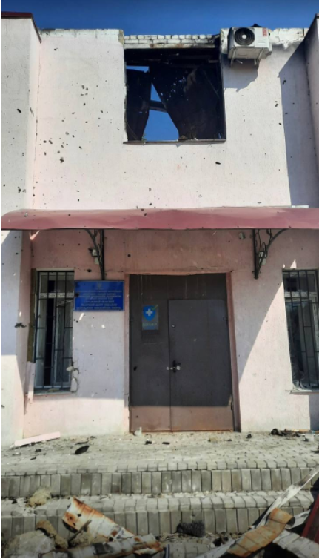
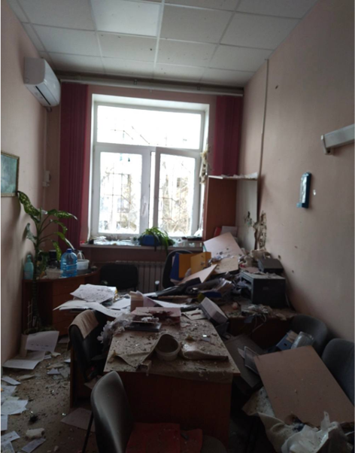
Decrease in access to health care
1570 attacks on health facilities
630 health facilities damaged, where 454 768 people are treated monthly on average.
Over 30 medical institutions providing HIV services have ceased operations due to destruction or occupation, and logistical chains have been significantly affected​
UNDP

Slide 6
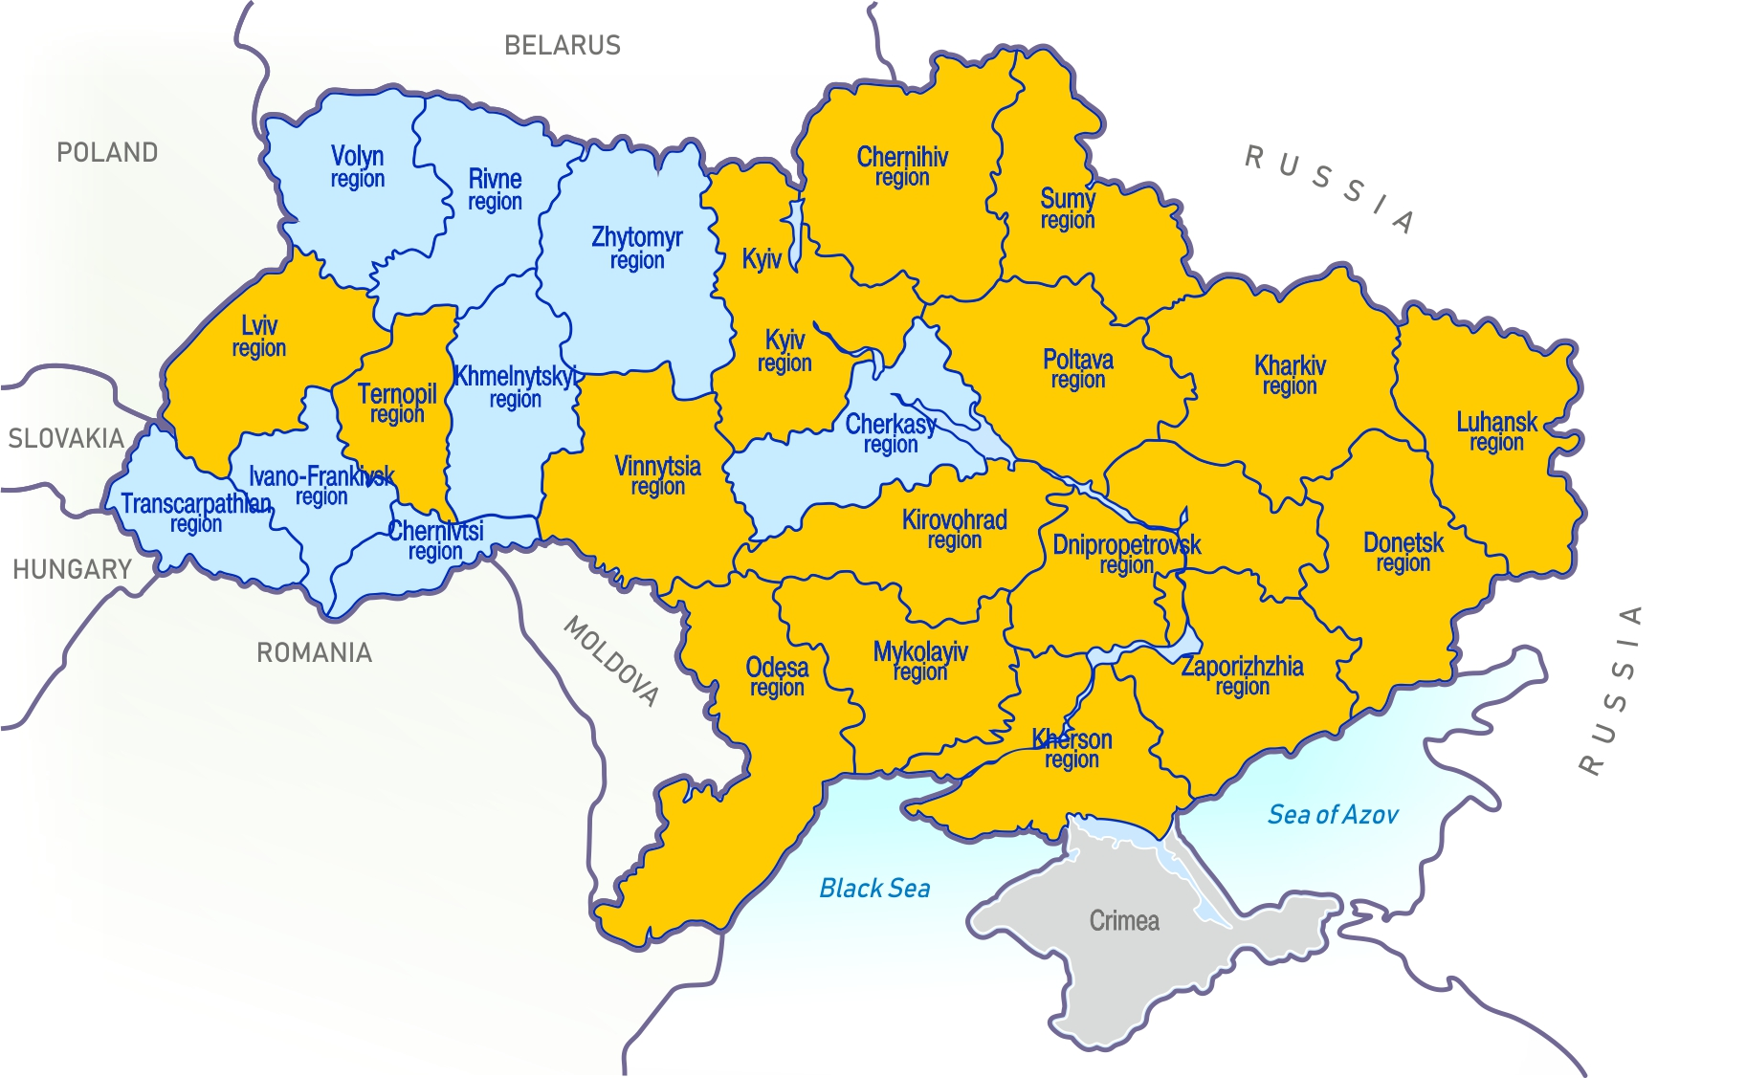





AHF services before 24.02.22 (2021 data)
Clients tested
127,188
Positive result
7,407
PLWHIV in care
52902
Condom distributed
400 000
38 partners HCF in 17 region

Slide 7
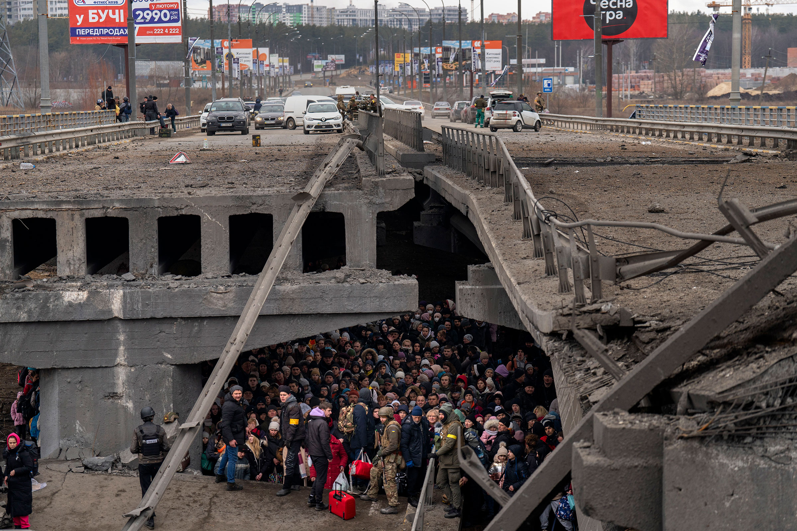
Migration
6.4 million refugees have fled the country
3.6 million people are internally displaced

Slide 8

Migration
6.4 million refugees have fled the country
3.6 million people are internally displaced

Slide 9
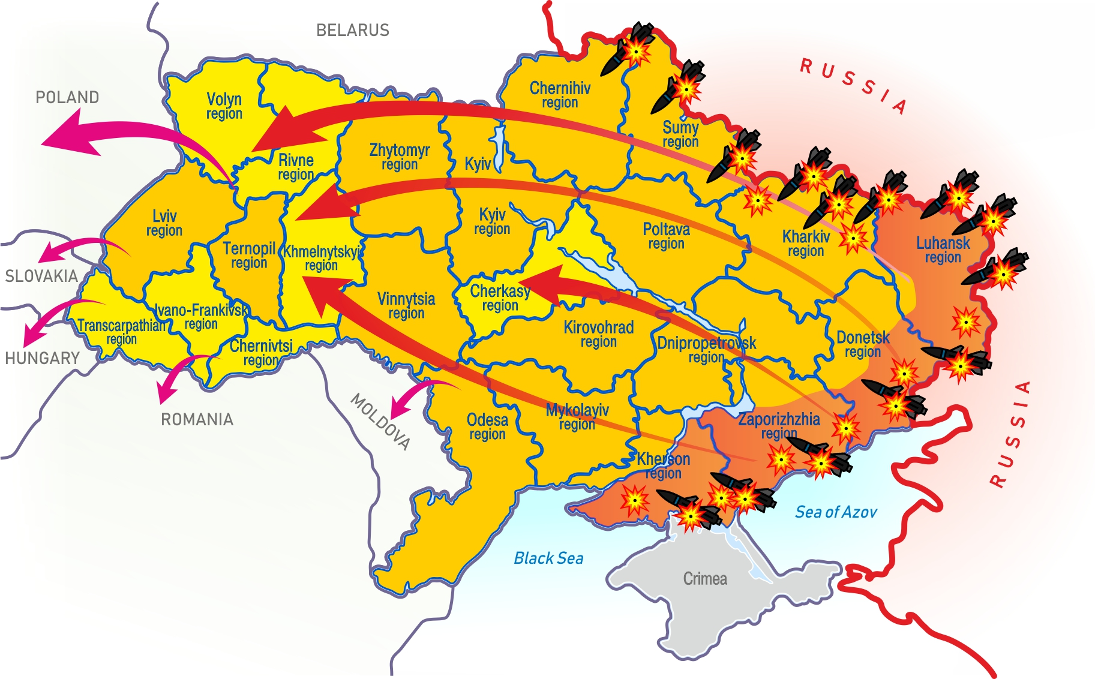

AHF services 2022 – April 1, 2024
Clients tested
288,797
Positive result
13653
PLWHIV care 74378
47 partners HCF in 23 region
1320 000
> 3 000

Slide 10

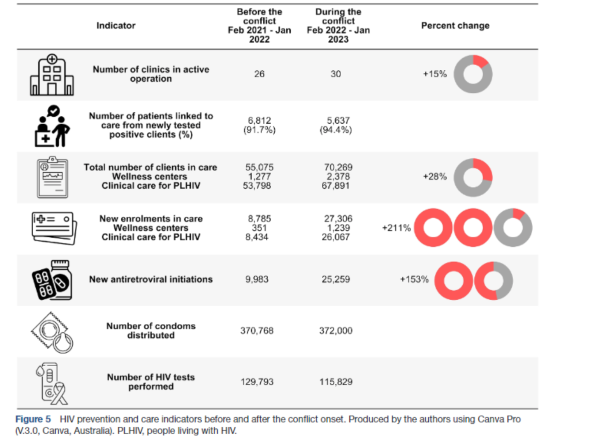

Safeguarding HIV prevention and care services amidst military conflict: experiences from Ukraine

Slide 11
Results of implementation of integrated rapid testing for HIV, hepatitis B and C and Syphilis on the base of healthcare facilities and community level in Ukraine
118 774 tests used during 2023 –2024
Positive results detected

Slide 12
Results of implementation of integrated rapid testing for HIV, hepatitis B and C and Syphilis on the base of healthcare facilities and community level in Ukraine

Slide 13
Results of implementation of integrated rapid testing for HIV, hepatitis B and C and Syphilis on the base of healthcare facilities and community level in Ukraine

Slide 14

Thank you for your attention!

