Slide 1
Resilience of AHF prevention services and AHF infrastructure support for facilities providing services to people living with HIV
Resilience Amid Conflict:
AHF Ukraine's Continuity and Expansion
of Medical Services
Dr. Kseniia Voronova Advocacy & Marketing Manager, Ukraine AIDS Healthcare Foundation

Slide 2

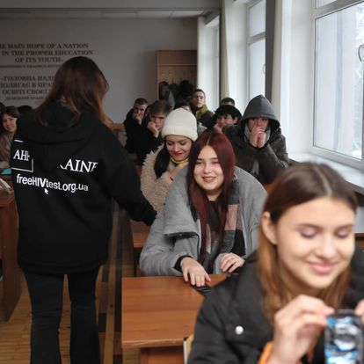


Access to prevention programs
Condoms distributed for free: 1 000 000 (2022-2023yy)
More than 50 sessions of sex education for teenagers
2022-2024
Notes:
Despite the fact that armed conflicts and the stress associated with them lead to a decrease in sexual desire and, consequently, a decrease in sexual intercourse, meeting the needs of the population for contraception is an important key to preventing the spread of sexually transmitted diseases. As the experience of countries such as Libya, Ethiopia, Rwanda, Uganda, and Ukraine, which have experienced war in recent years, shows, a significant portion of the population does not have free access to condoms . This is primarily due to the destruction of logistics chains and the occupation of territories, which makes it difficult or impossible to supply free contraceptives, and the decline in the population’s ability to pay makes it impossible to buy them, if they are available.

Slide 3


Trends of condom use in Ukraine 2023
Reasons for using condoms
42% of respondents used condoms with regular partners during the latest sexual intercourse within the resent 12 months
Reasons for not using condoms
70% of respondents used condoms with occasional partners during the latest sexual intercourse within the resent 12 months

Slide 4
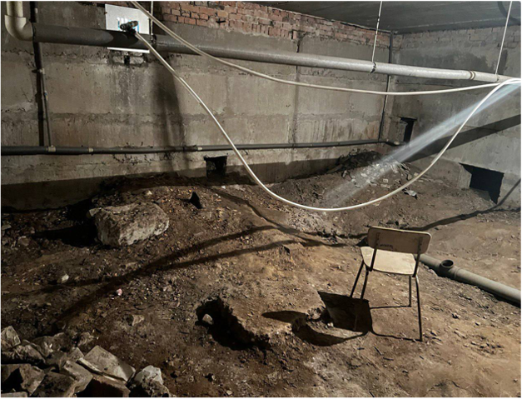
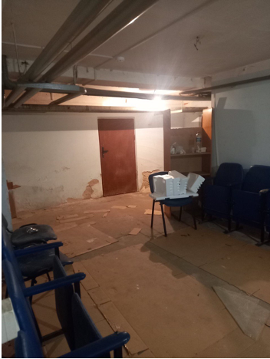
Ensuring Continuous Medical Care
Over the two years of the full-scale invasion in Ukraine, more than 33,000 air raid alarms were sounded
The longest alarm lasted 18 hours and 43 minutes in Nikopol, Dnipropetrovsk region.
Since the beginning of the full-scale invasion, Russian forces have launched over 7,500 missiles at Ukraine.
Before
Notes:
Due to the persistent shelling and consequent damage to the energy infrastructure, healthcare facilities must be equipped with adequate shelters and reliable power sources to ensure they can continue providing essential medical services. Recognizing the critical need for safety and uninterrupted care, our organization has undertaken comprehensive efforts to refurbish bomb shelters and procure generators for healthcare institutions.
These initiatives are crucial in maintaining operational capabilities during emergencies, ensuring that patients receive the necessary treatment regardless of external conditions. By repairing and upgrading bomb shelters, we provide a secure environment for both patients and medical staff. Additionally, the installation of generators ensures that vital medical equipment remains functional, and essential services can be sustained even during power outages caused by infrastructure damage.
Our commitment to these improvements underscores our dedication to supporting healthcare providers in these challenging times, enabling them to deliver continuous and safe medical care under any circumstances.

Slide 5
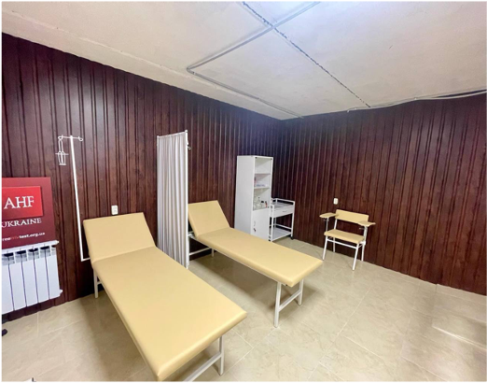
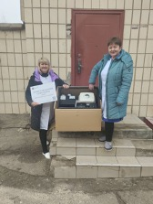
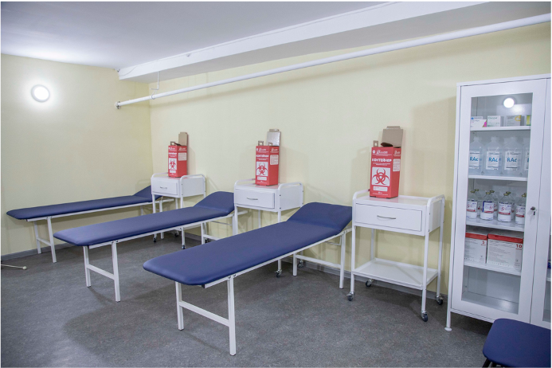
Ensuring Continuous Medical Care
After
Notes:
Due to the persistent shelling and consequent damage to the energy infrastructure, healthcare facilities must be equipped with adequate shelters and reliable power sources to ensure they can continue providing essential medical services. Recognizing the critical need for safety and uninterrupted care, our organization has undertaken comprehensive efforts to refurbish bomb shelters and procure generators for healthcare institutions.
These initiatives are crucial in maintaining operational capabilities during emergencies, ensuring that patients receive the necessary treatment regardless of external conditions. By repairing and upgrading bomb shelters, we provide a secure environment for both patients and medical staff. Additionally, the installation of generators ensures that vital medical equipment remains functional, and essential services can be sustained even during power outages caused by infrastructure damage.
Our commitment to these improvements underscores our dedication to supporting healthcare providers in these challenging times, enabling them to deliver continuous and safe medical care under any circumstances.

Slide 6


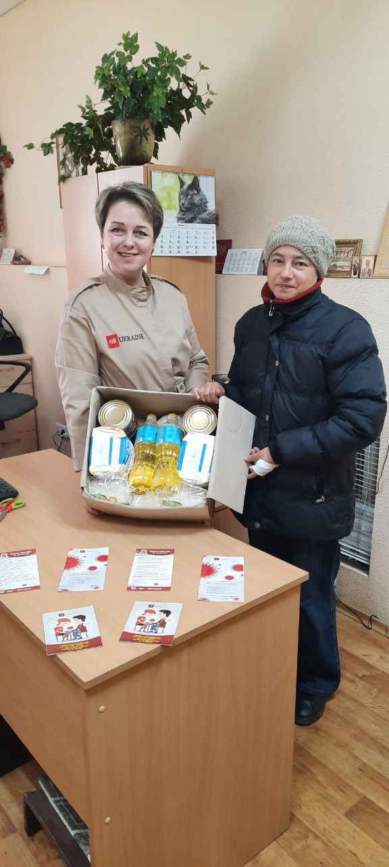

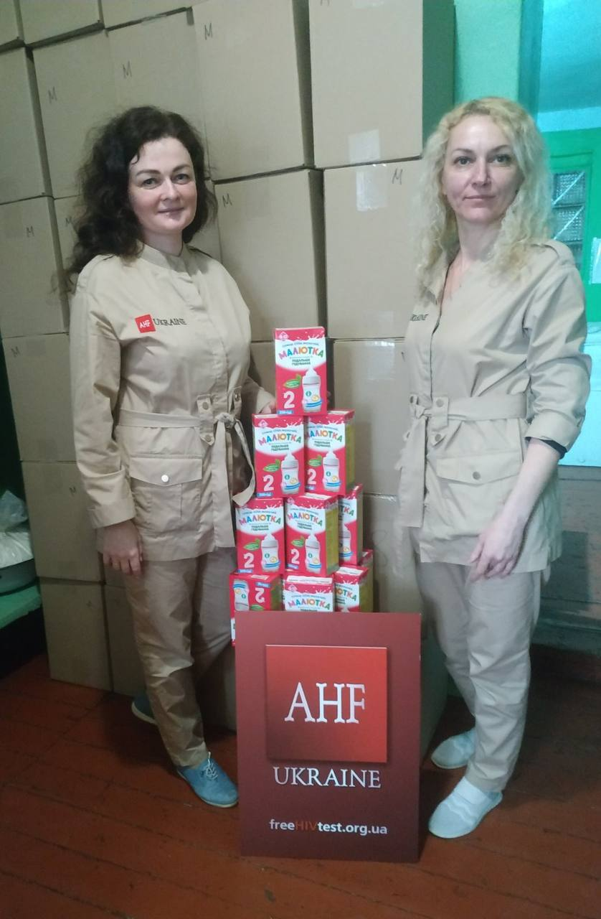
«Girls Act» and «Food for Health» initiatives
Girls Act program aims to provide tools for girls’ agency to use in difficult contexts and thus avoid acquiring HIV, unwanted pregnancies, violence.
3,000 food kits for people living with HIV and their family members, as well
as milk formulas for children

Slide 7
"We believe that access to healthcare is a basic human right. It's not just about treating HIV; it's about providing comprehensive healthcare to those in need."
Michael Weinstein is the president of AIDS Healthcare Foundation (AHF), the largest global AIDS organization

