Slide 1
GAT Ти не один
You are not alone
Ricardo Fernandes - GAT
GAT Project to Support People Affected by the War in Ukraine

Slide 2
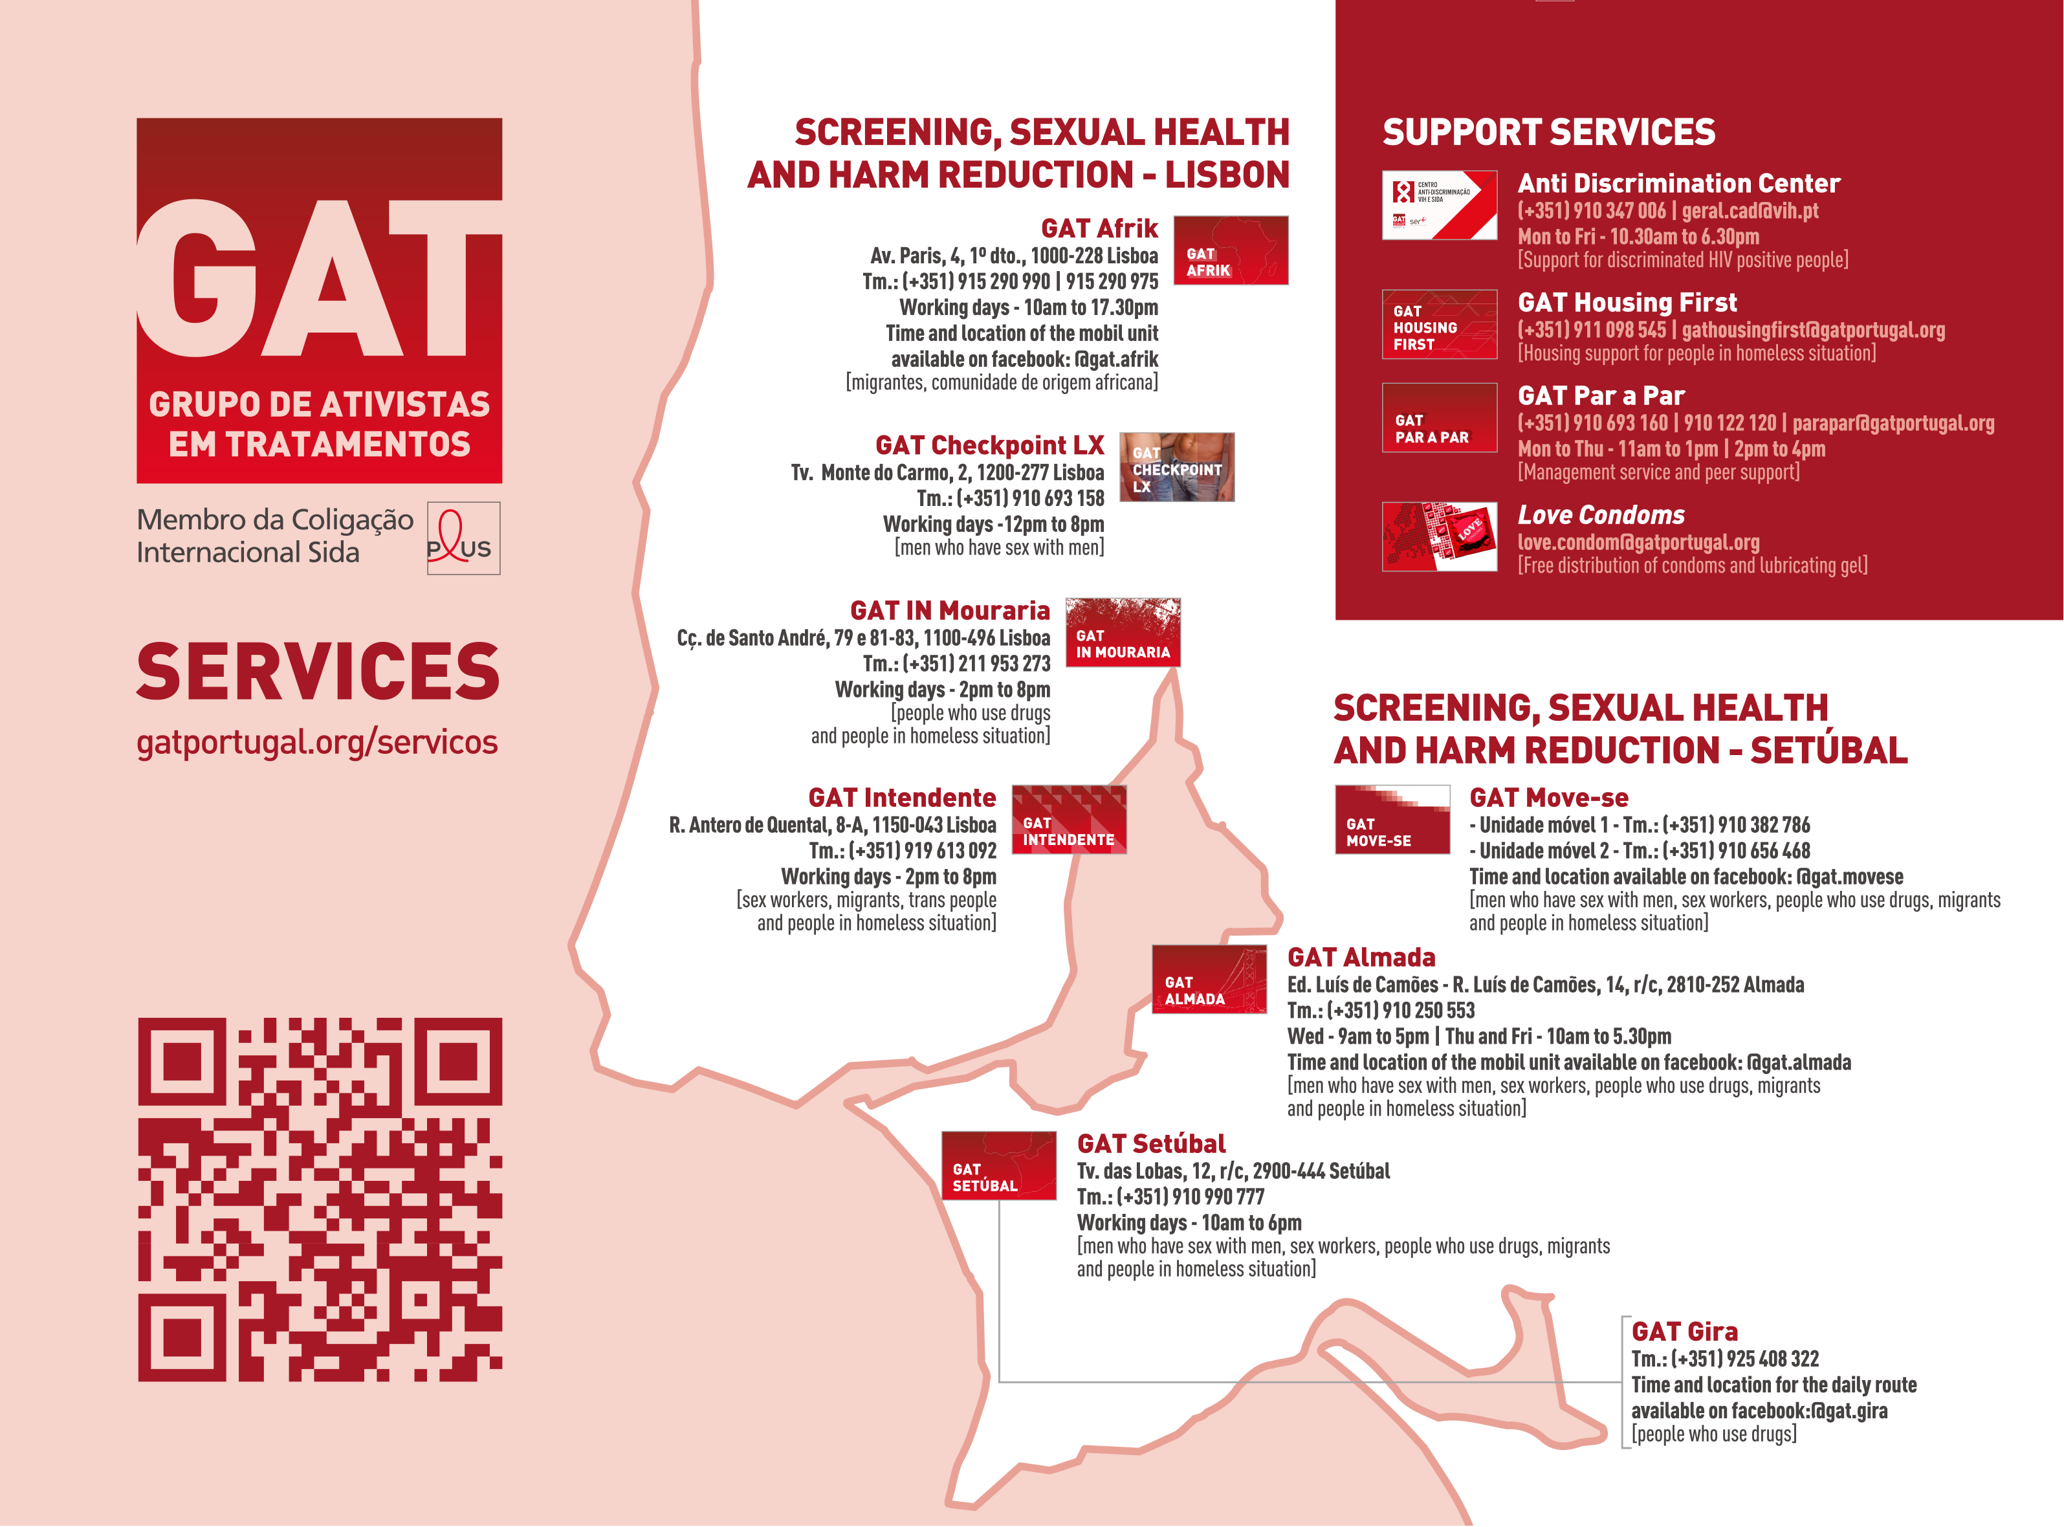
GAT – Grupo de Ativistas em TRATAMENTOS

Slide 3
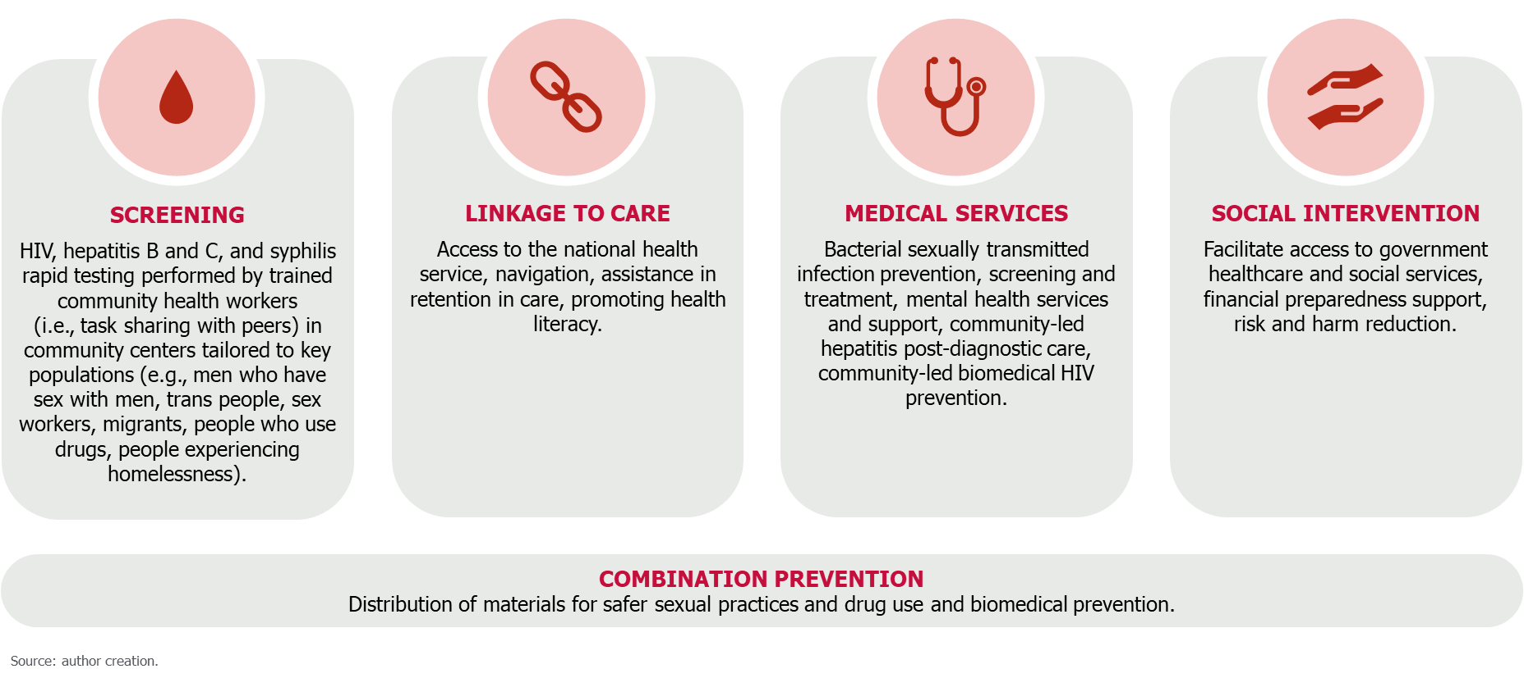
Services provided

Slide 4
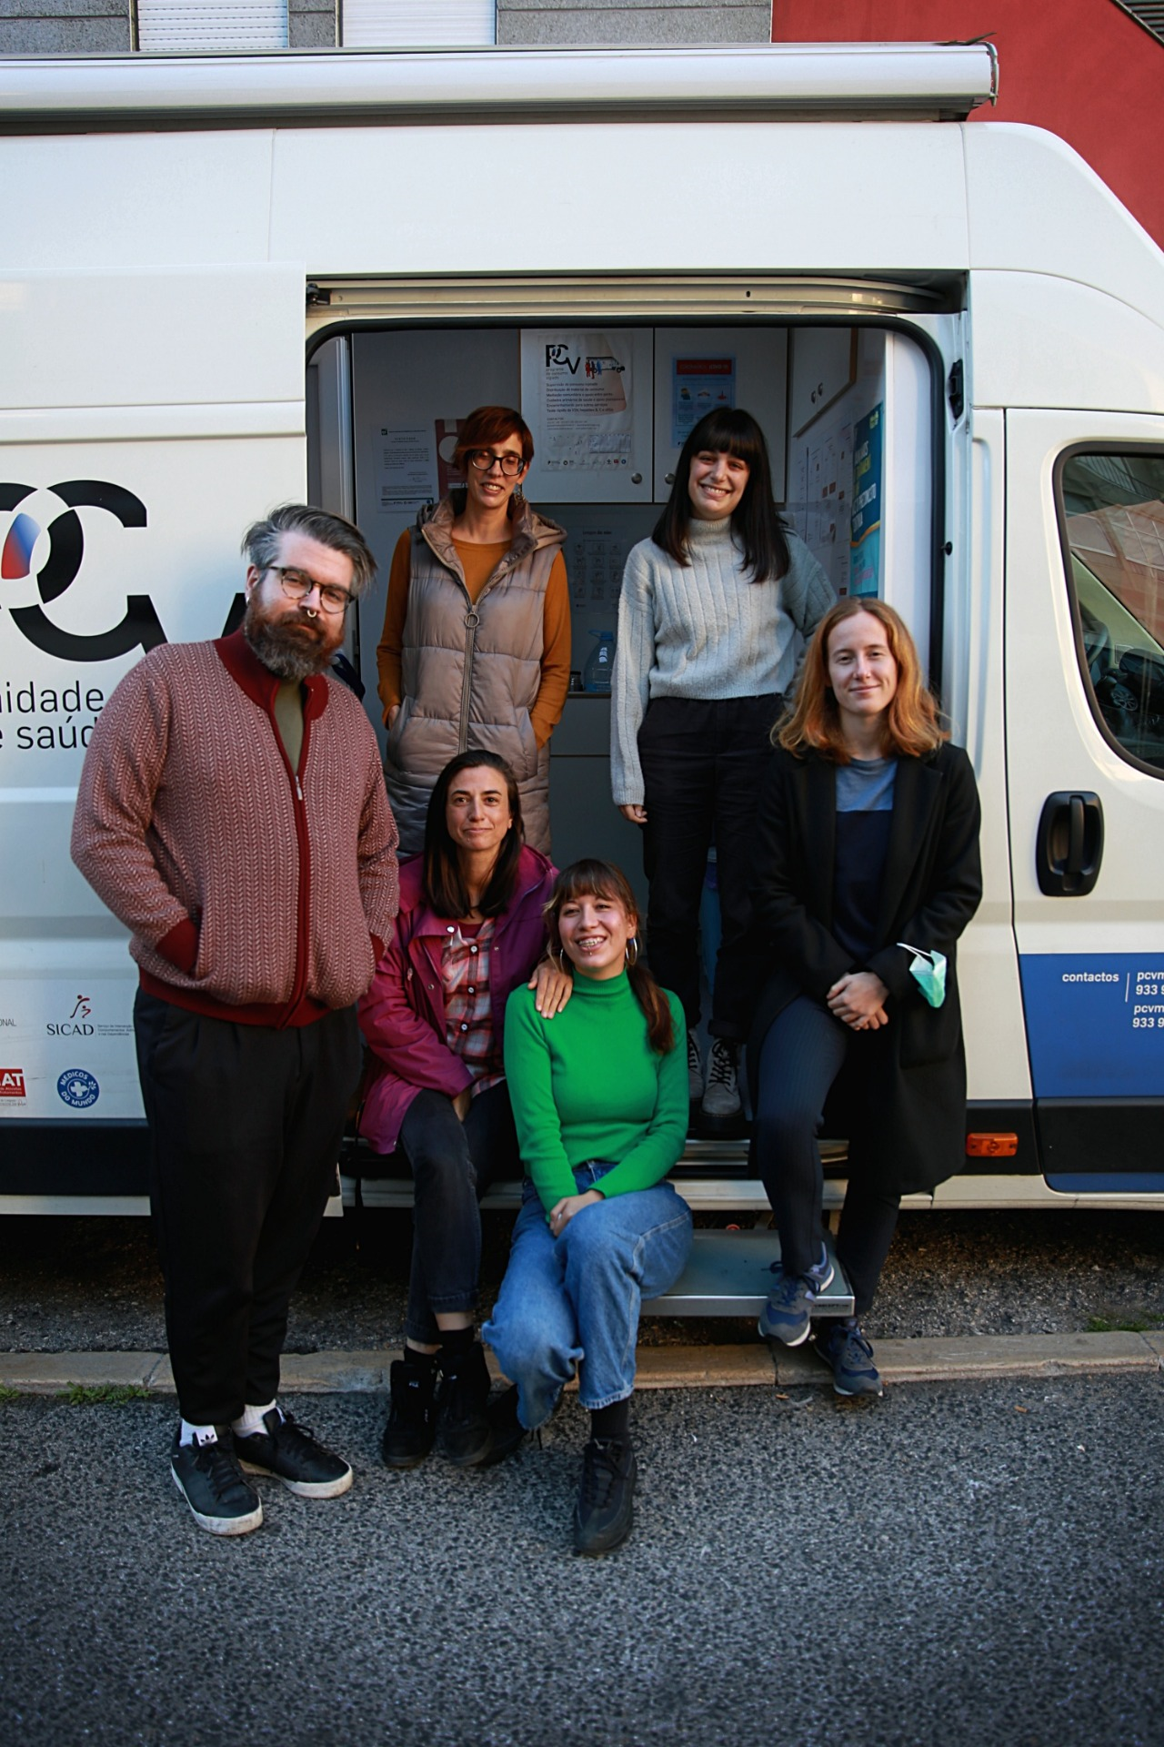
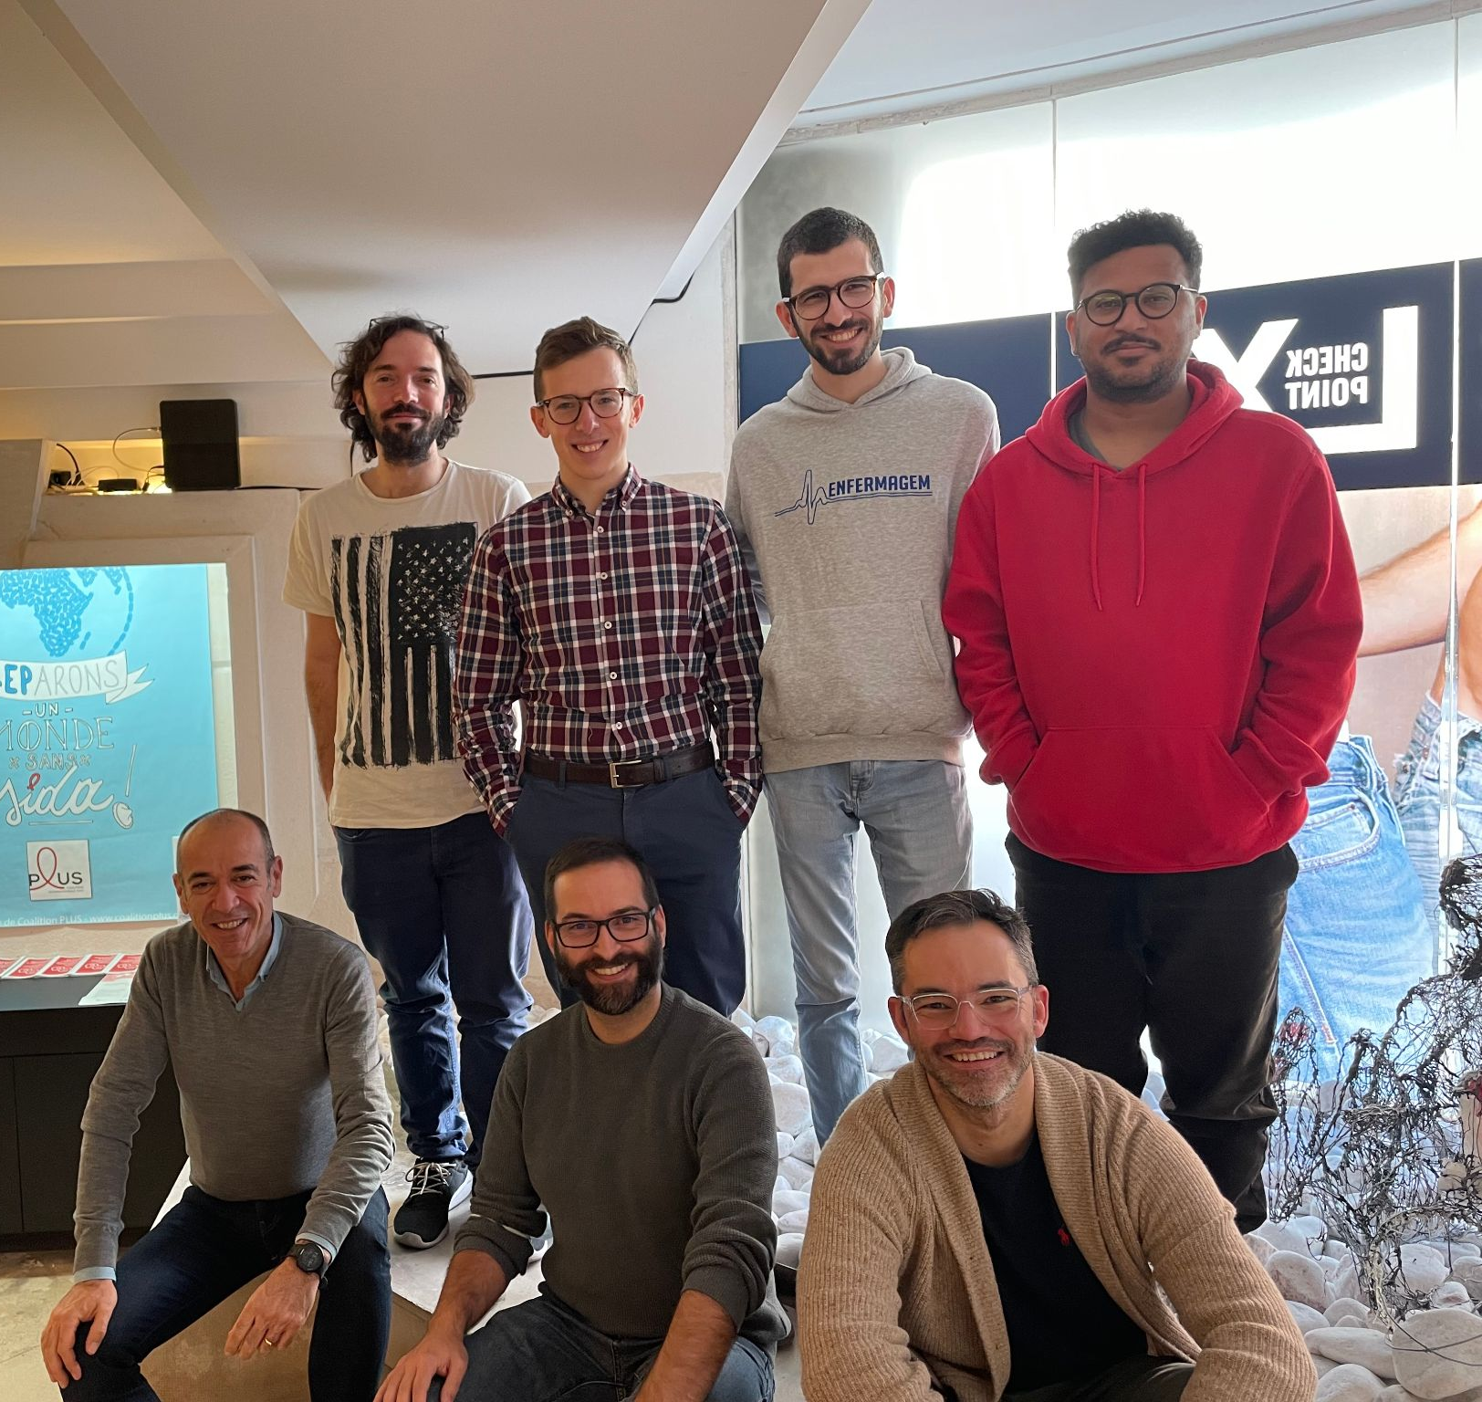
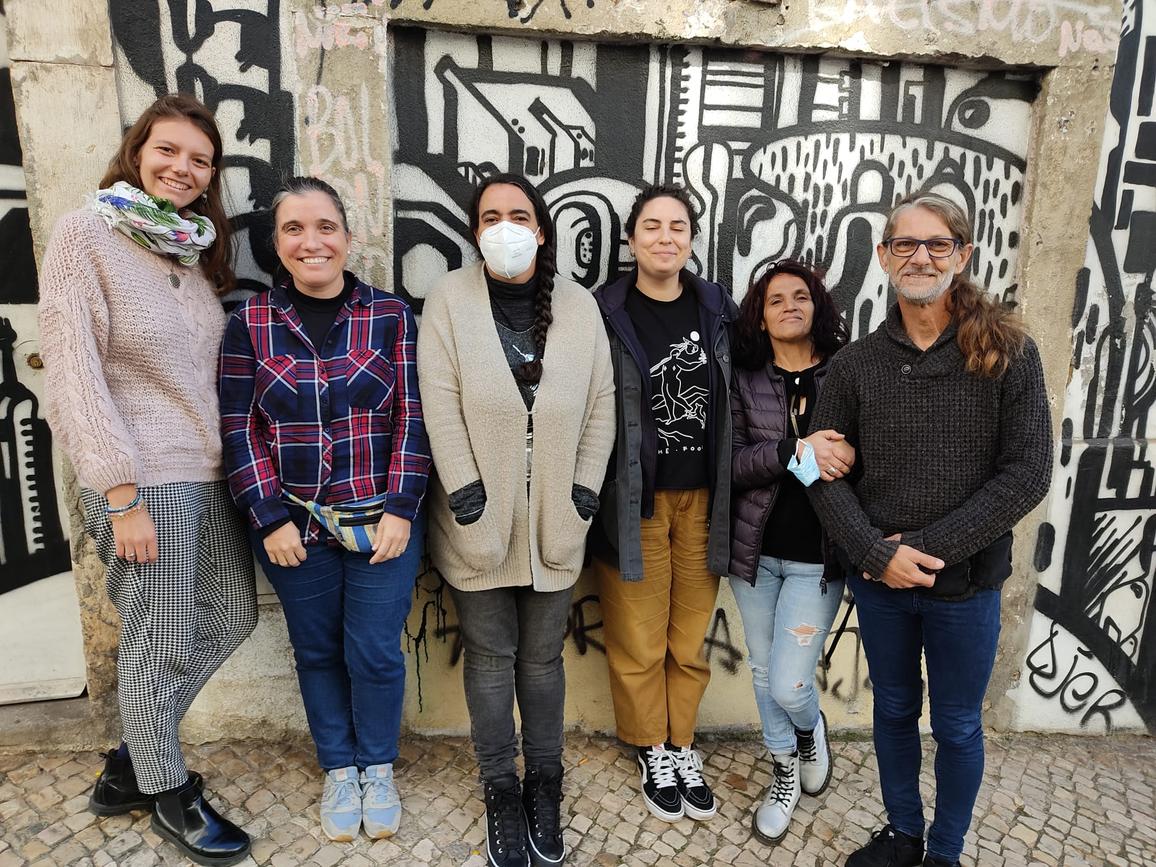
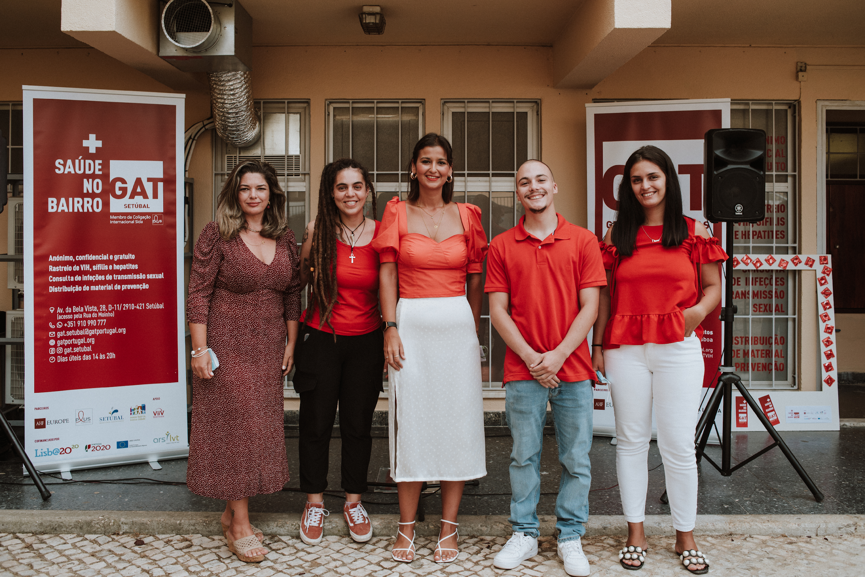
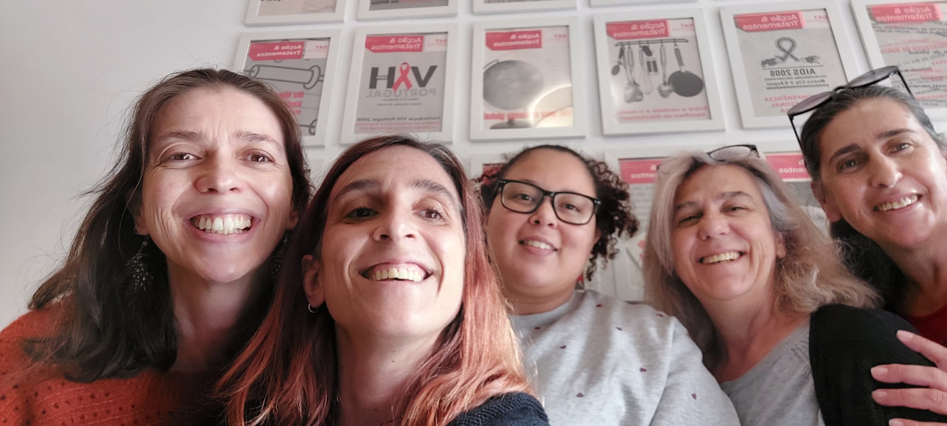
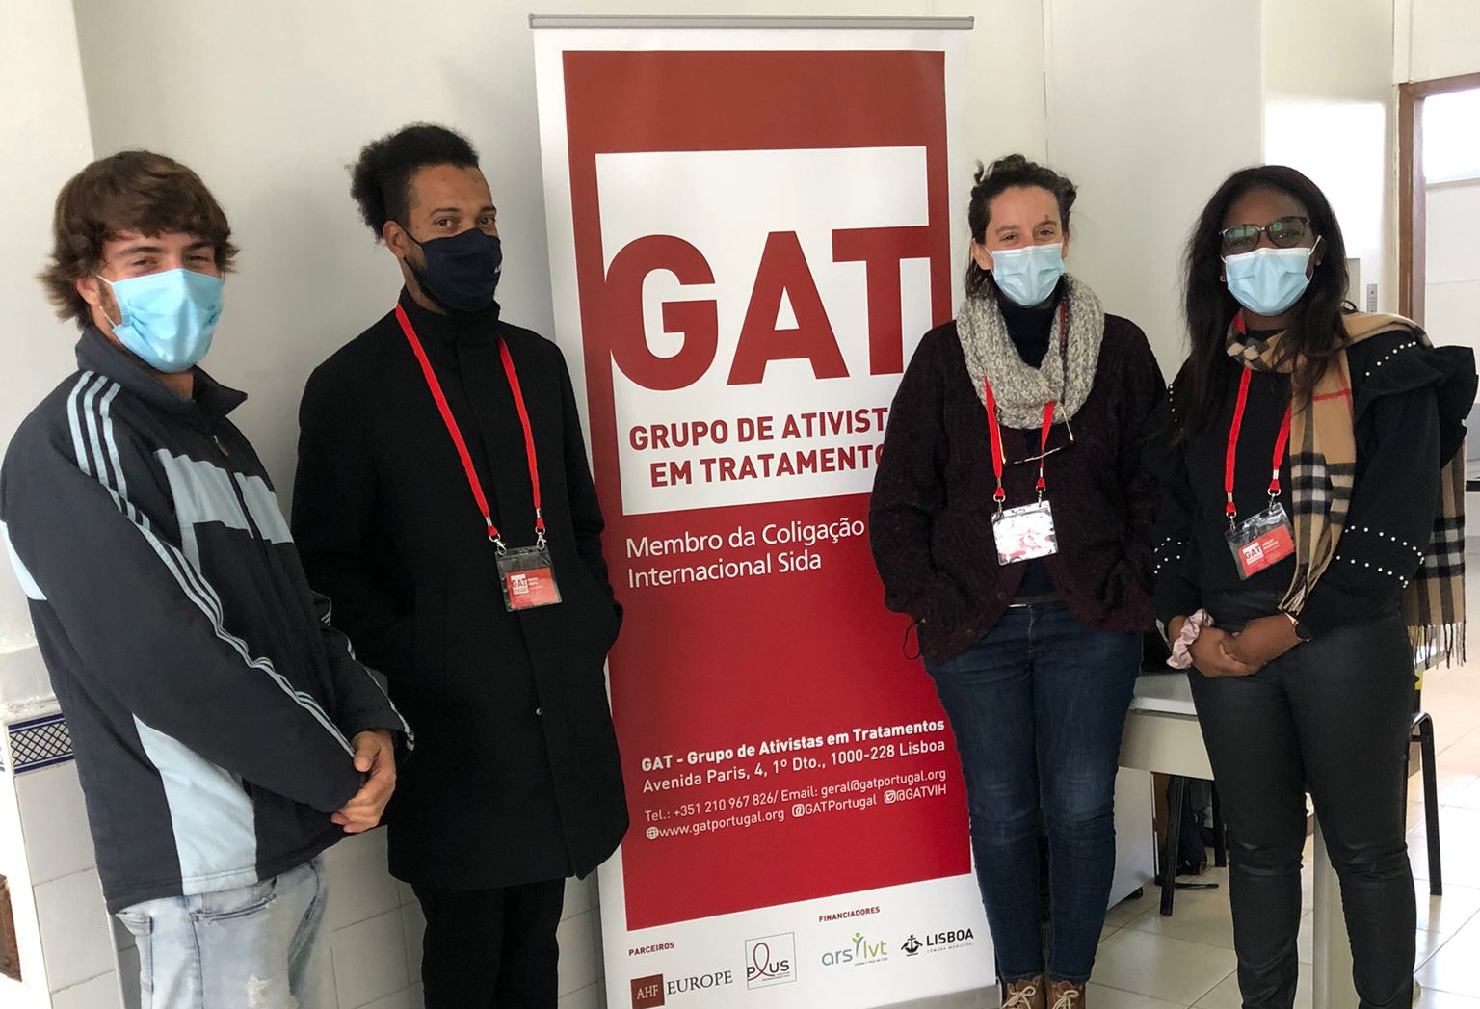
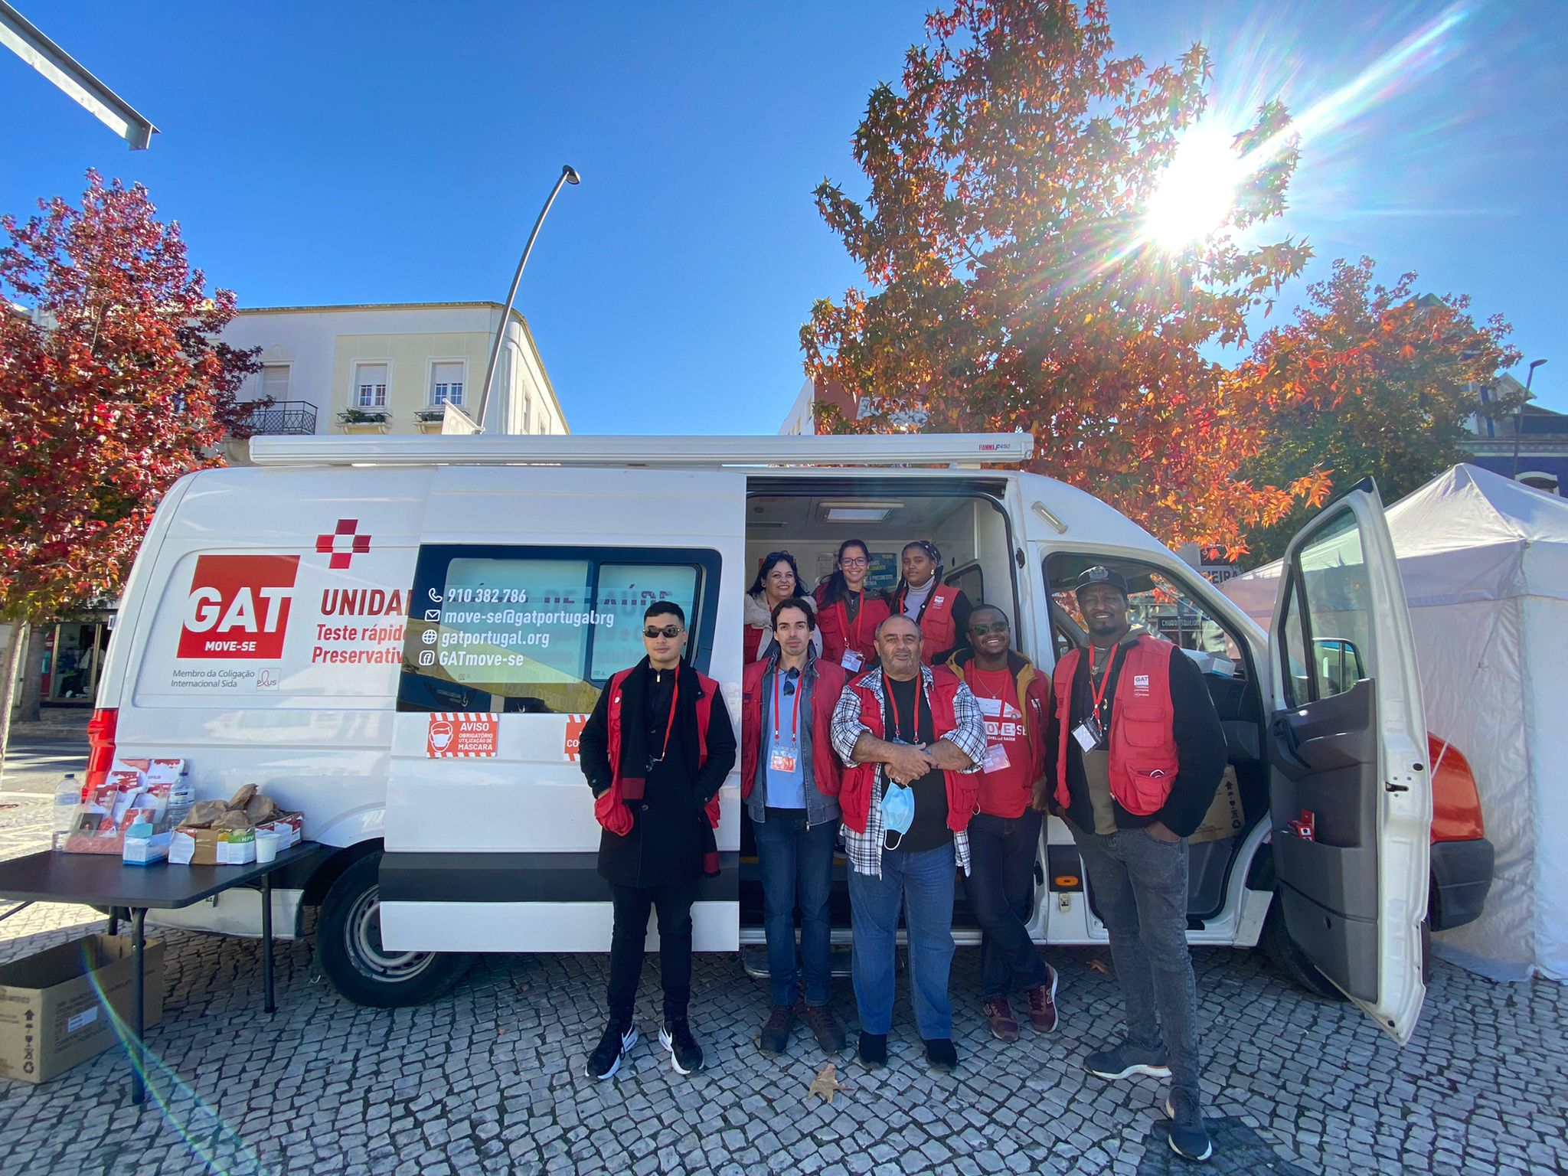
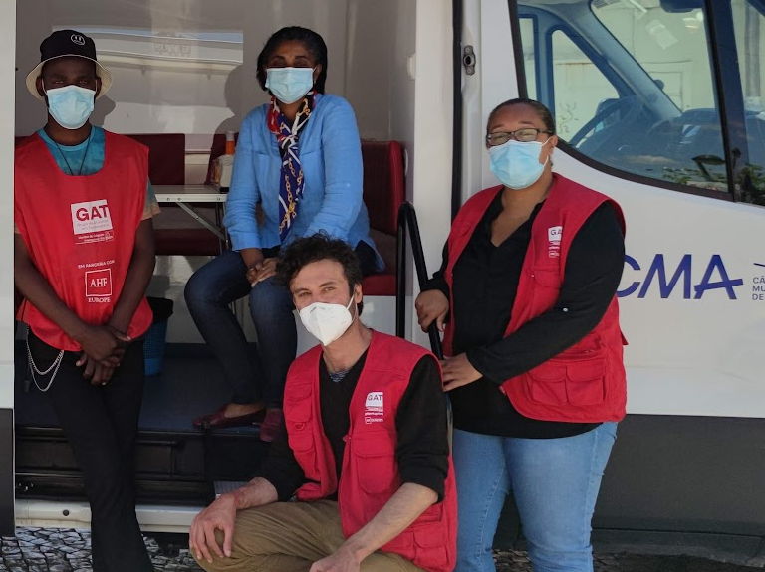
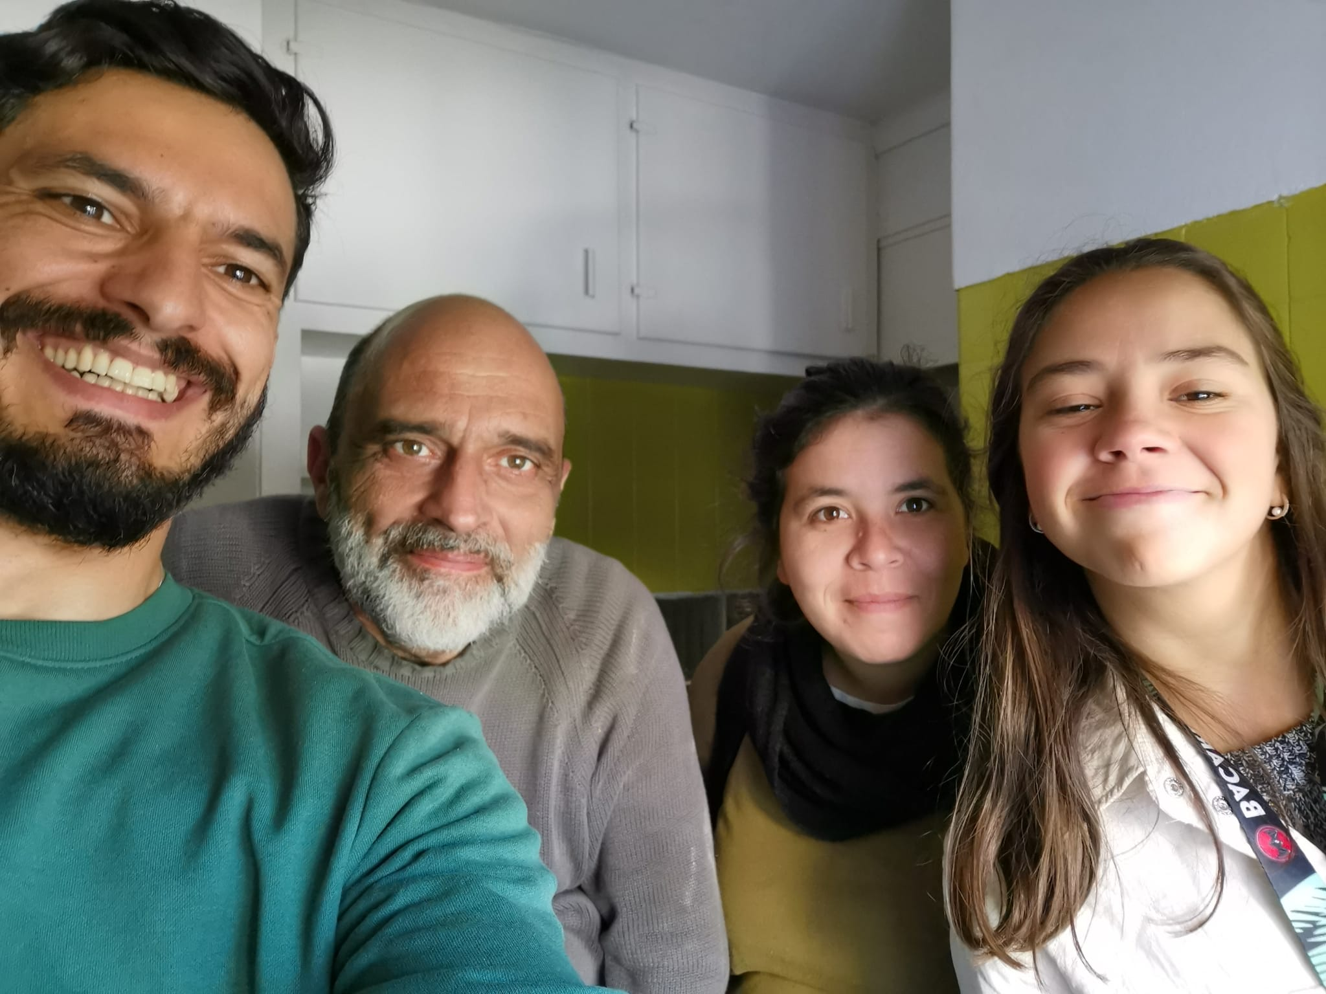
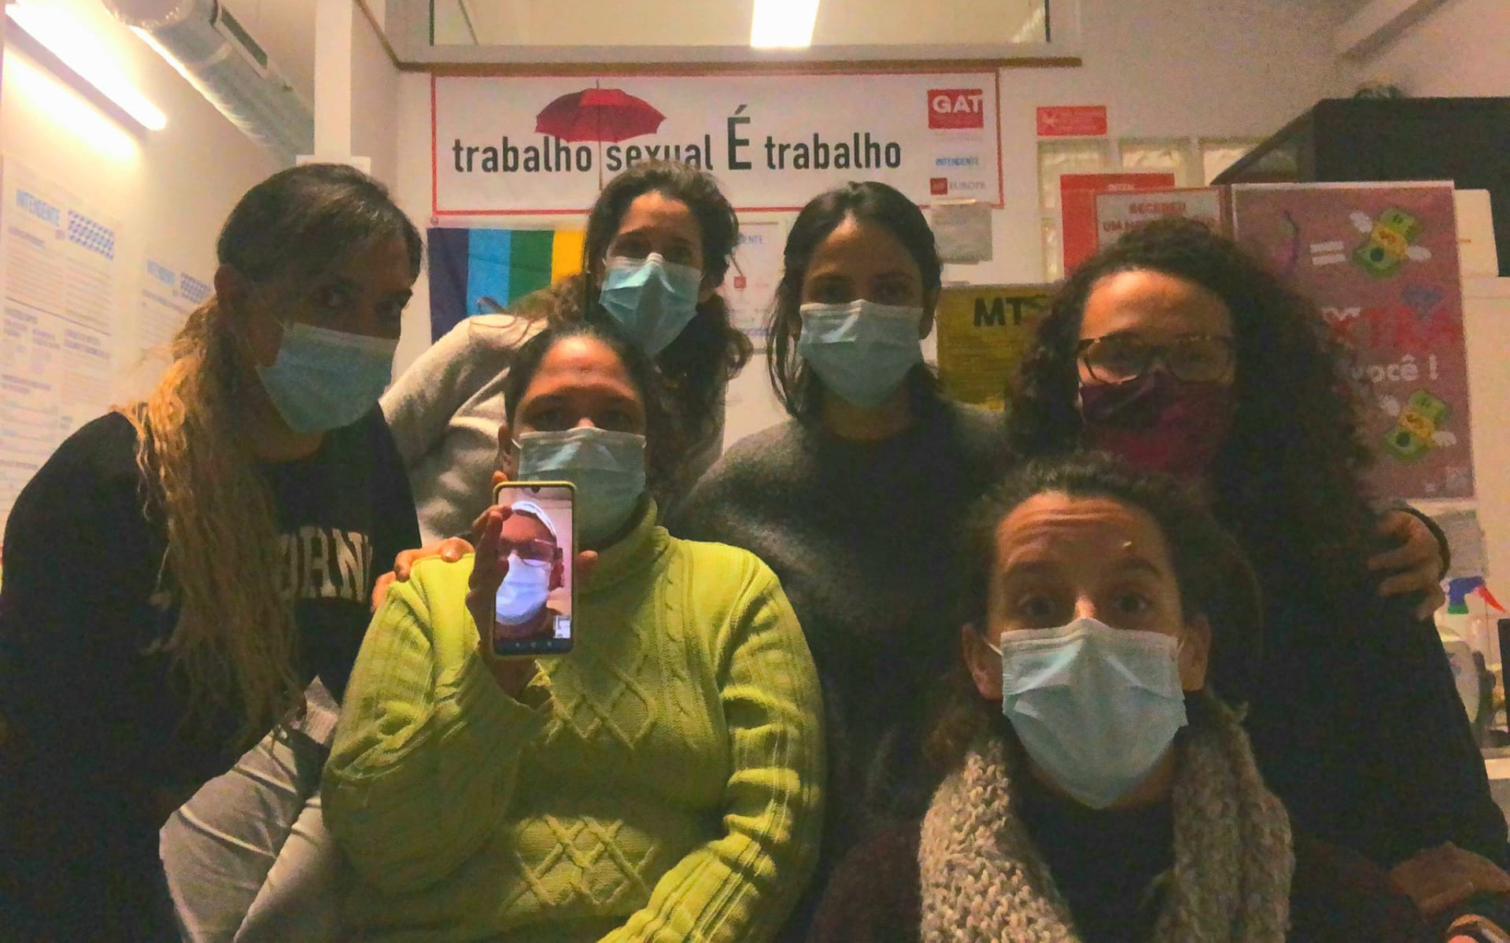
GAT Staff

Slide 5

GAT Ти не один
You are not alone

Slide 6

Activities
Access to health
Navigation to social and health services
Project support
Translation/ Interpretation
Peer support
Integration
Development of informative materials
Workshops
Financial support
(food, transportation and medication)

Slide 7






Communication

Slide 8

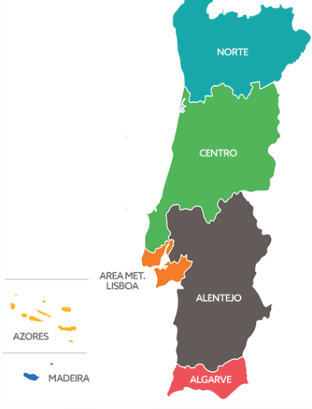


Key Figures
Beneficiary = 194
Geographical area
121 Male
72 Female
1 Other
7
North
182 Refugees
Key groups
  116 Men who have sex with men
  76 People Living with HIV
  16 People who use drugs
  14 Sex worker
3
Centre
175
1
2
Alentejo
Average age = 36
1
Algarve

Slide 9


Key Figures
Integrated testing sessions = 160​
3 HIV reactive
2 HCV reactive
2 Syphilis reactive
    73 people first time tested
Consultation at GAT
19 Medical
14 Nursing
Health linkages = 88
    40 HIV
    26 PrEP
    10 General medicine
    6 VHC (2 new diagnoses)
    2 Syphilis
    2 Methadone
    2 Post-Exposure Prophylaxis
Distribution
    1971 Condoms

Slide 10


Key Figures
233 Peer to Peer support
6 volunteers

Slide 11
Challenges
Access to the Ukrainian community
Collaborate with Ukrainian organizations

Slide 12
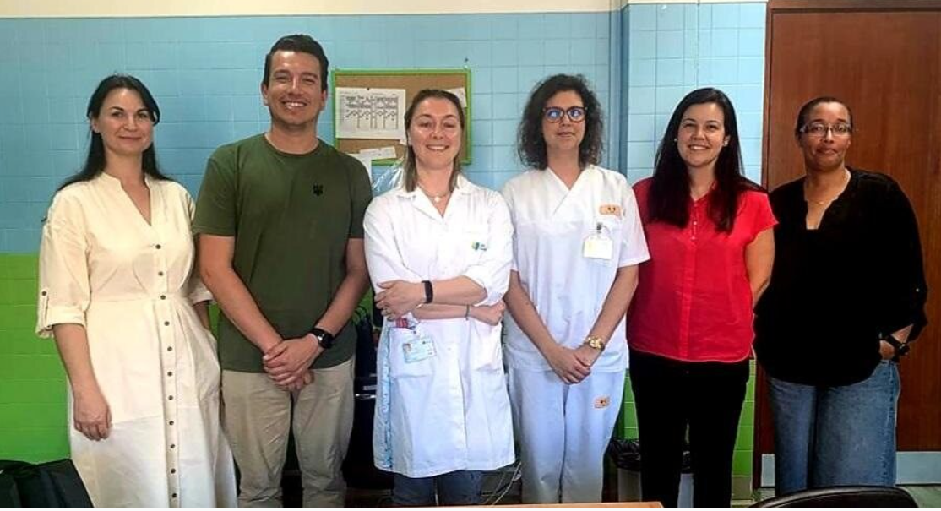
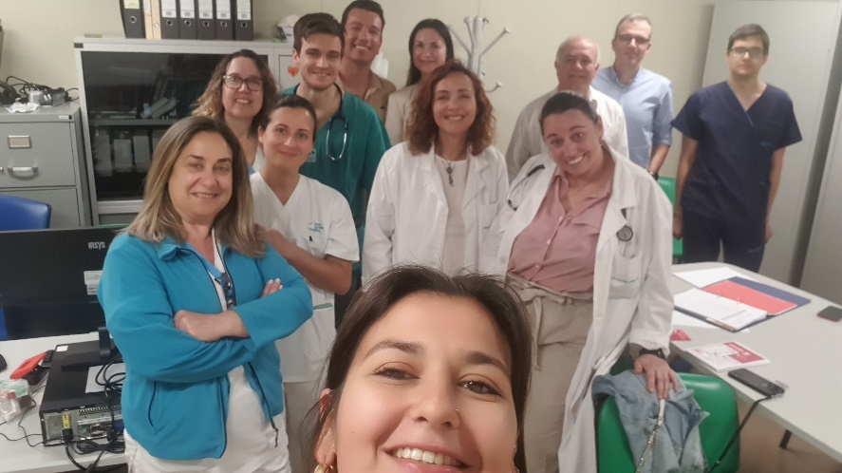
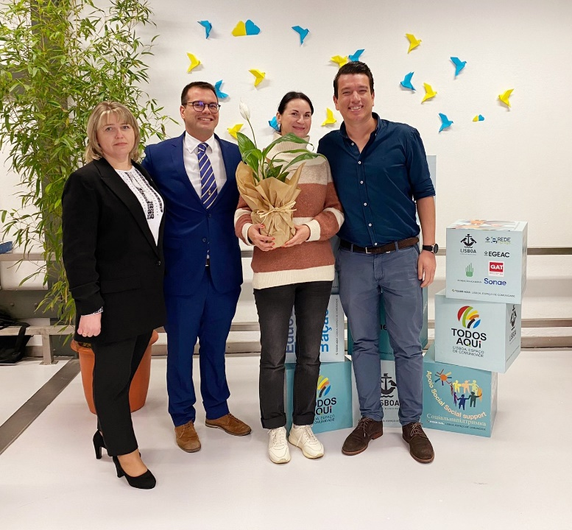
Close collaboration / partners
Health Center - Via verde Almada
Infectious disease services - Setubal Hospital
Ukrainian local organization - Spilka

Slide 13
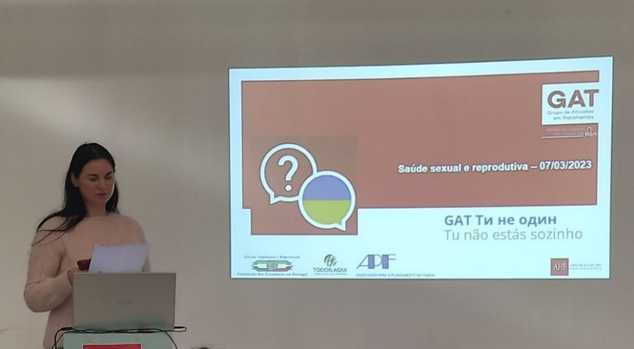
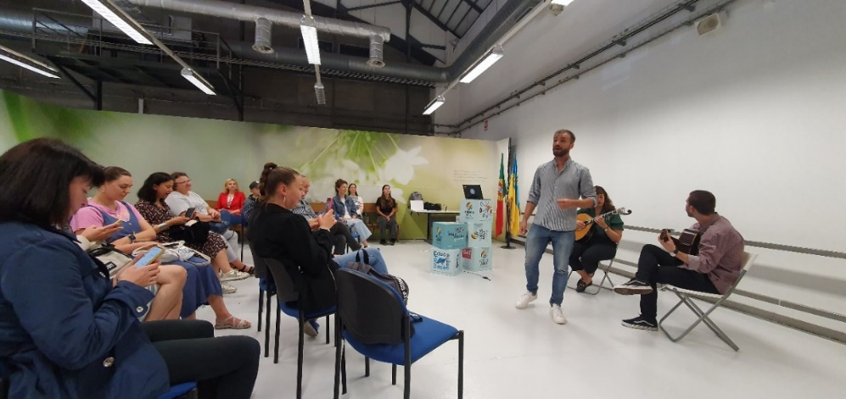
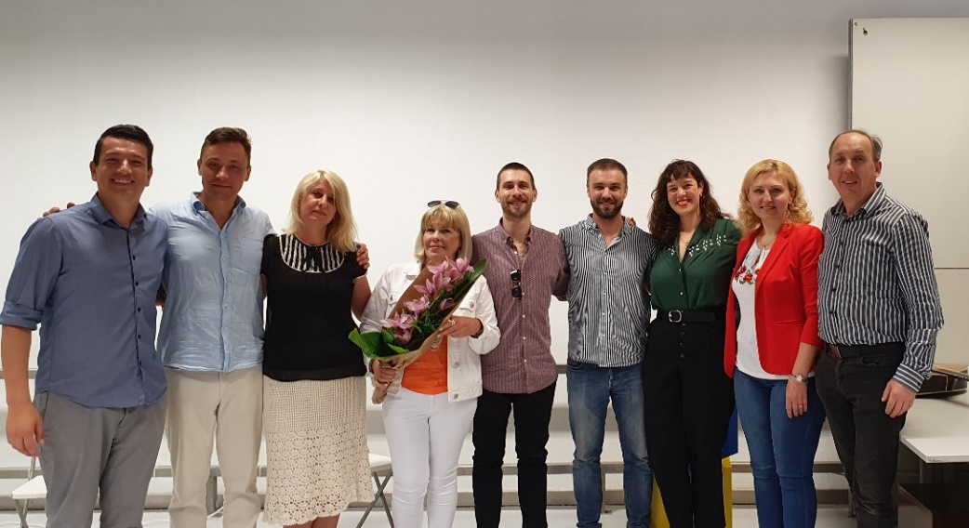
Workshop – Access to health
2 workshops
96 participants (total)
4 Ukrainian volunteers
Topics: Access to Health, Regularization and Harassment
Coffee break with Ukrainian food
Cultural moment with Fado (Portuguese traditional music)

Slide 14
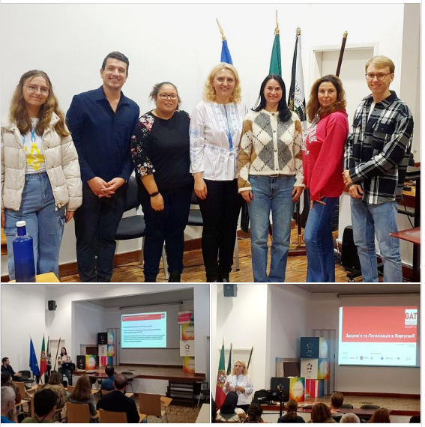
Workshop for institutions that provide support for Ukrainians with Temporary Protection
2 workshops
54 participants (total)
4 Ukrainian volunteers
Topics: Access to Health, Regularization and Harassment
Coffee break with Ukrainian food

Slide 15

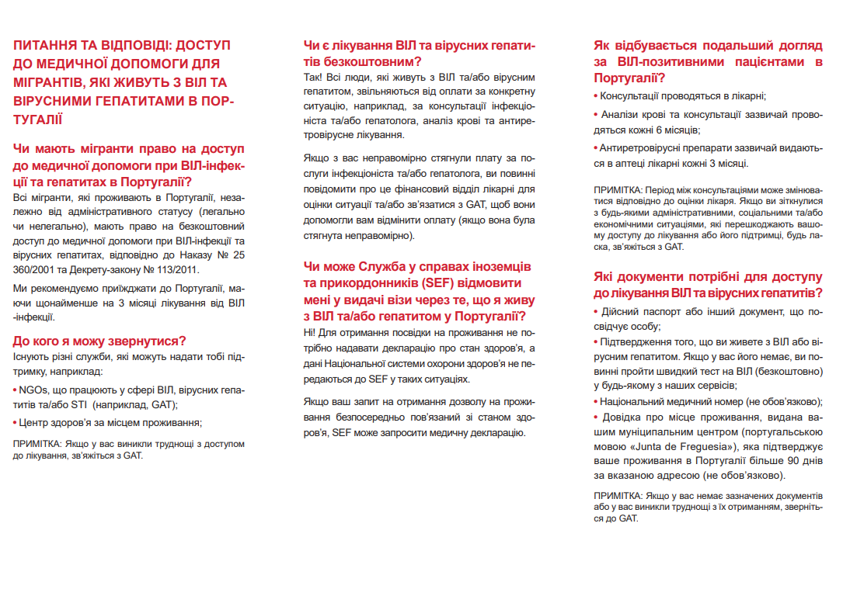


Informative materials

Slide 16
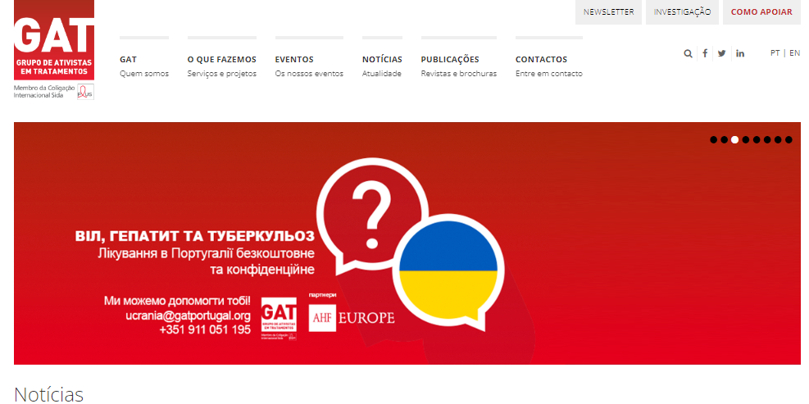
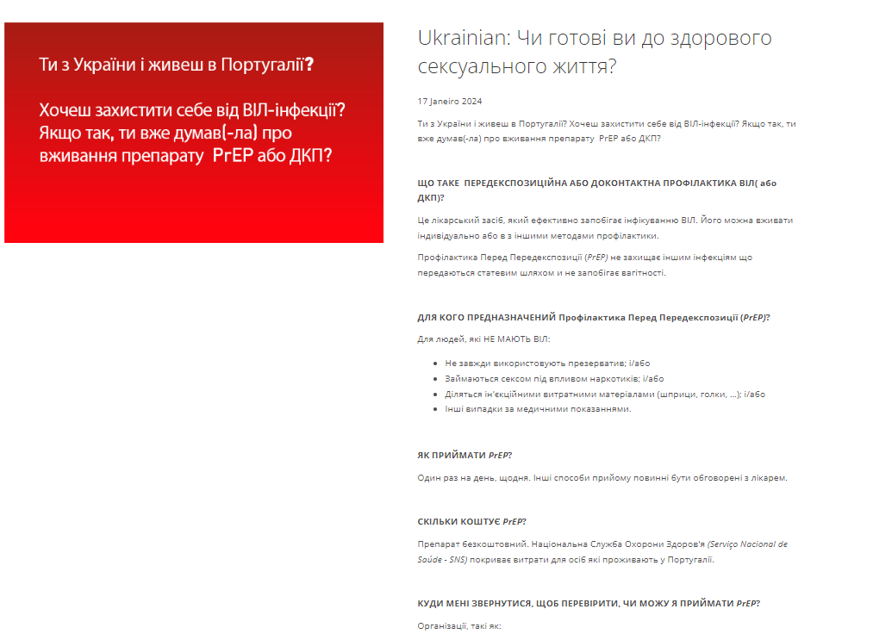
Informative materials

Slide 17


Informative materials
Migrant Kit – Access to Health in Portugal

Slide 18
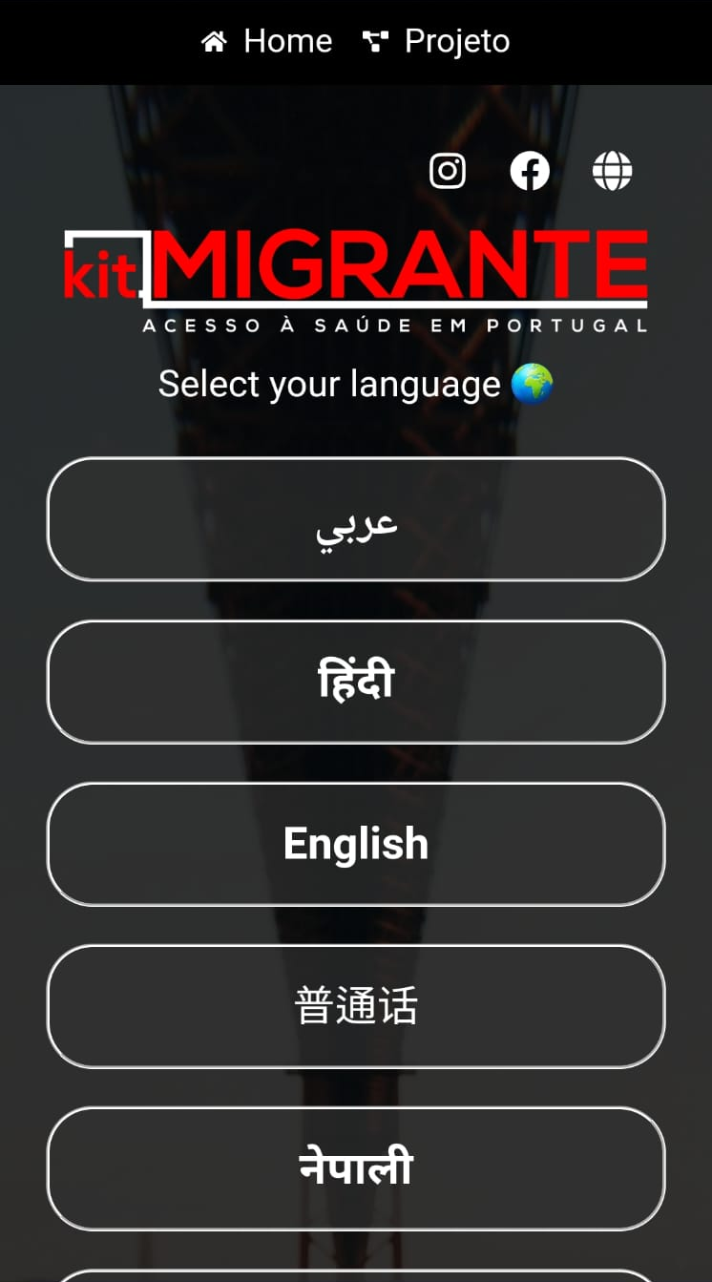
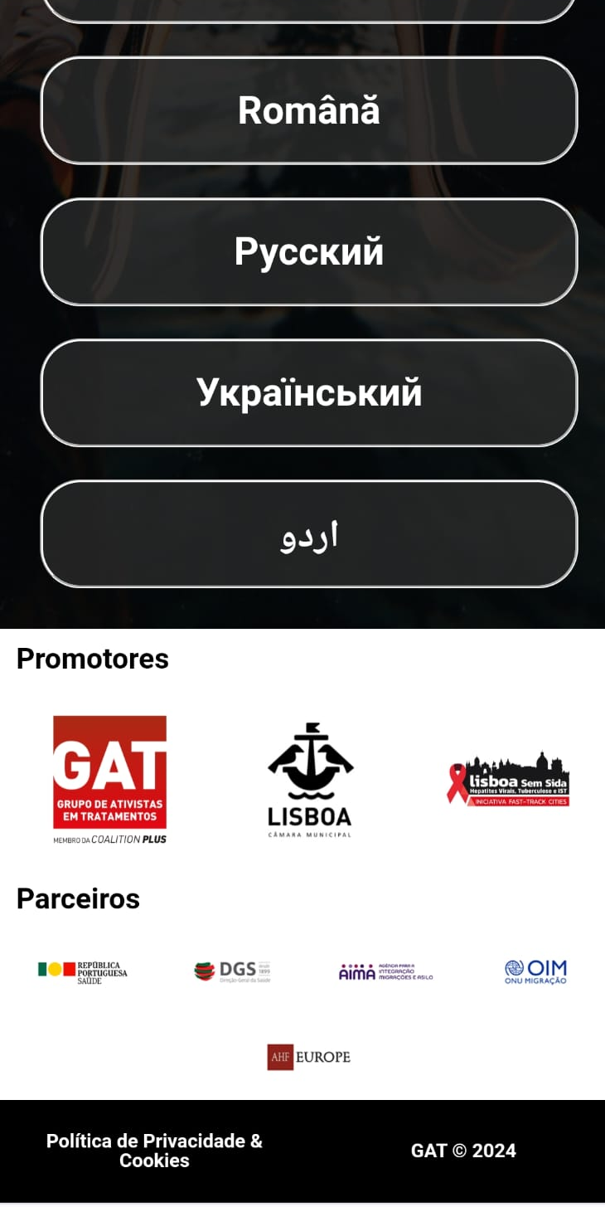
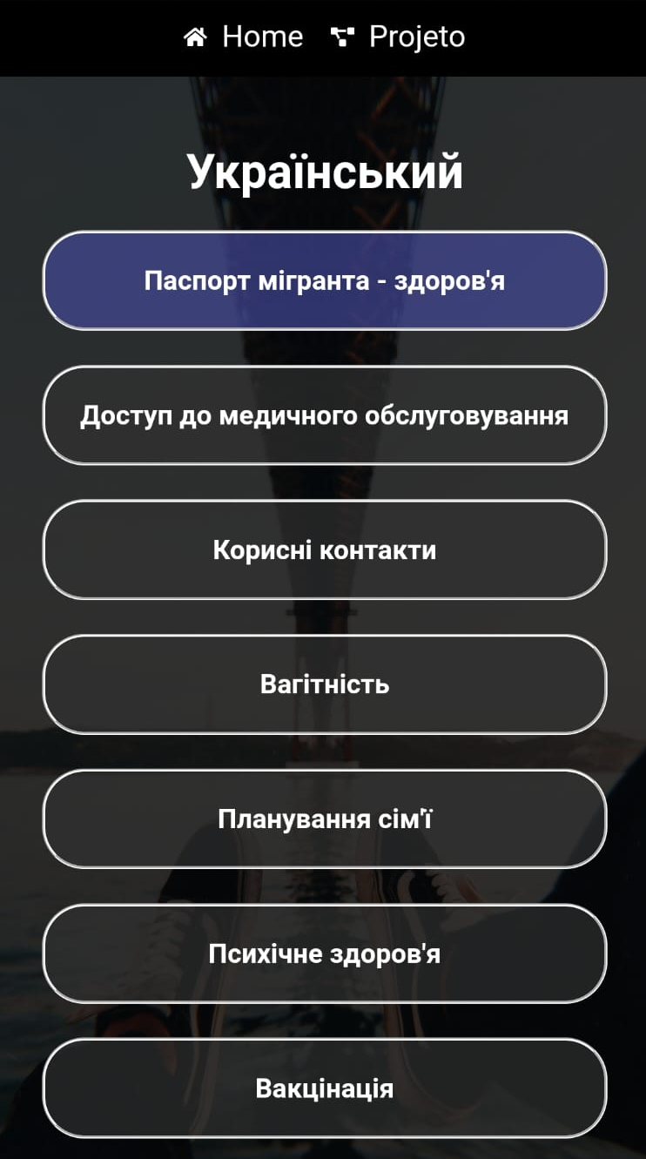
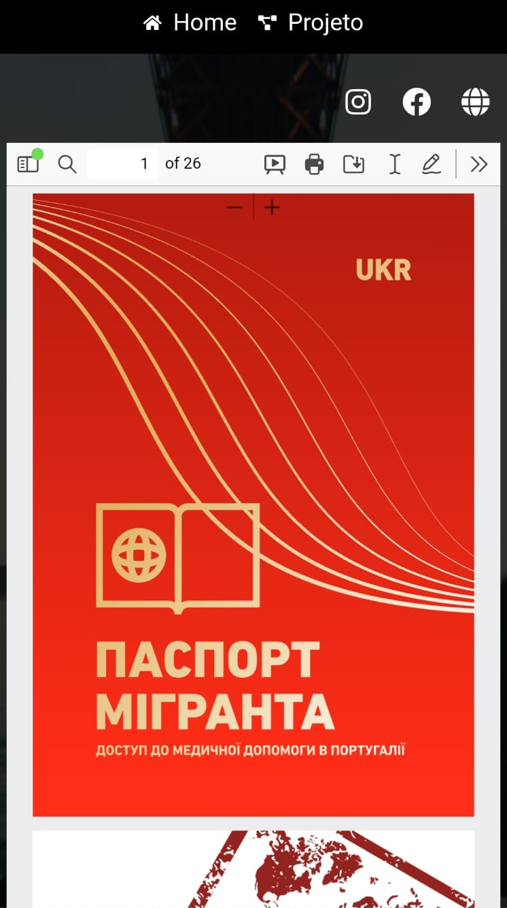
Informative materials
Migrant Kit – Access to Health in Portugal
More than 80 informative materials (8 in UA)
12 languages

Slide 19

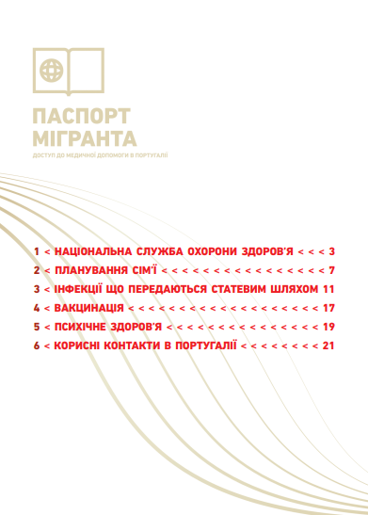
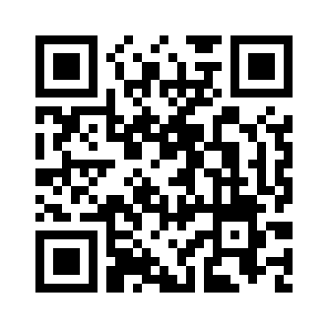
Informative materials
Migrant Kit – Access to Health in Portugal

Slide 20
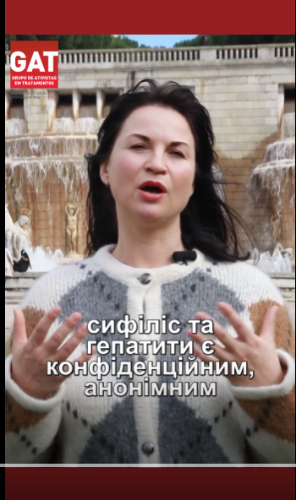
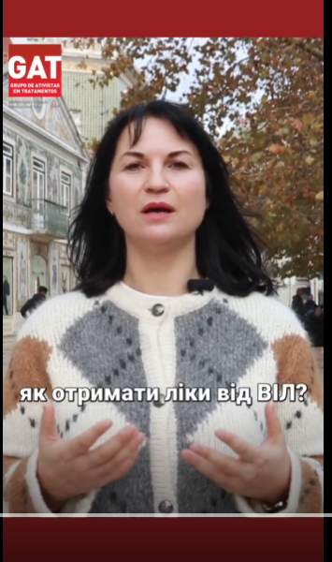
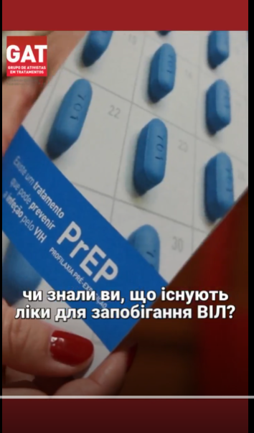
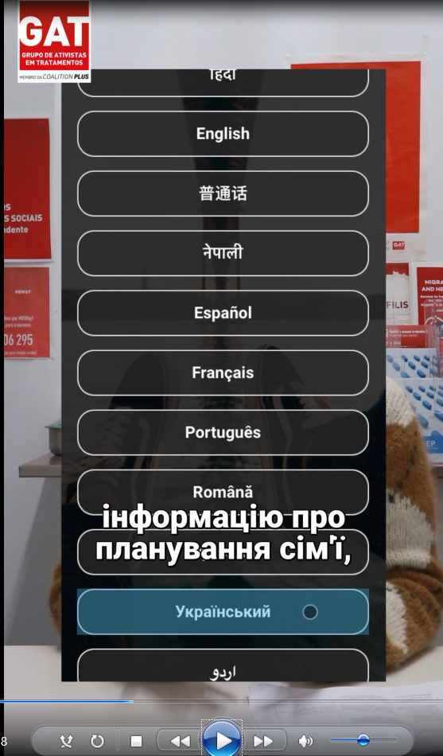
Informative materials
Videos
Rapid tests
Access to HIV treatment
PrEP
Migrant Kit

Slide 21


Slide 22
Community current challenges
Support - Organizations closing due to lack of funding;
Communication;
Lack of financial resources for Transportation, Non-hospital medication and food;
Regularization (?);
Housing.

Slide 23
Activities
Access to health
Project support
Phase II
Navigation to social and health services
Translation/ Interpretation
Peer support
Integration
Dissemination of informative materials
Workshops
Financial support
(food, transportation and medication)

Slide 24
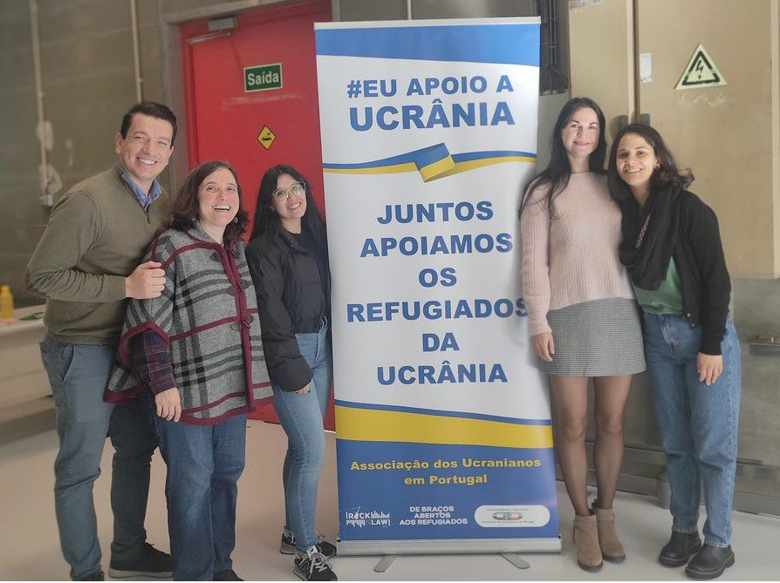

Дякую!
Ricardo Fernandes
Executive Director
Ricardo.fernandes@gatportugal.org

Slide 25
The words we use matter in the response to HIV
This slide is a note to the author – please read, then delete
Do… | Don't...
use: people or person living with HIV; person or people with COVID-19; person or people with TB; person or people living with HIV and TB; healthcare seekers or clients. | label people as: HIV-infected; infected; co-infected; cases; carriers; victims; patients; sufferers.
spell out the names of key populations: gay men and other men who have sex with men sex workers and their clients trans people people who inject drugs people in prisons and other closed settings | use acronyms for key and vulnerable populations unless you have genuine space constraints, possibly in a graphic.
talk of the response to HIV or COVID-19 and ending the HIV pandemic as a public health threat. | use war talk and fearmonger.

