Slide 1
Performance characteristics of
HIV RNA screening with
CAB-LA PrEP in HPTN 083
R.J. Landovitz, F. Gao, J.M. Fogel, B. Hanscom, M. Clement, H.V. Tran, A.H. Gaur, C.J. Fichtenbaum,
E. Piwowar-Manning, A. Moser, M.A. Marzinke, J. Mellors, E.K. Halvas, M. McCauley, K. Gomez-Feliciano, A. Jennings, L. Soto-Torres, S. Zwerski, J.F. Rooney, C. Acuipil, A.R. Rinehart, M.S. Cohen, B. Grinsztejn,
S.H. Eshleman, For the HPTN 083 Study Team

Slide 2
Disclosures
Raphael J. Landovitz reports consulting agreements and/or Scientific Advisory roles for Gilead Sciences, Merck Inc, RedQueen Therapeutics, and ViiV Healthcare (Financial Interest)

Slide 3


Background
HPTN 083 is an ongoing phase 3 study of CAB-LA vs daily oral TDF/FTC for PrEP in cisgender men and transgender women
  Stopped early by DSMB for superiority of CAB-LA; continues as an open-label extension (OLE)
  CAB-LA approved by US FDA and other global regulatory agencies
CAB-LA PrEP delays detection of HIV infection compared to standard HIV testing algorithms
In retrospective analyses, RNA testing identified HIV infection earlier and often prior to INSTI resistance
The OLE HIV testing algorithm was designed to evaluate whether prospective HIV RNA testing at each injection could reliably identify HIV infection earlier

Slide 4
Methods
Analysis Period
OLE entry through November 30, 2023
  OLE activation date varied by site
Testing Procedures in OLE (all visits)
Site-based rapid testing (RT), antigen/antibody testing (Ag/Ab), and HIV RNA testing
HIV status determined by an independent committee that reviewed results from site testing and retrospective testing at a central laboratory
  Review triggered by any positive/reactive HIV test result at site
In this preliminary analysis, we calculated the positive predictive value (PPV) and false positive rate (FPR) of isolated positive RNA results, and assessed the sensitivity of HIV RNA screening

Slide 5

Study Design
May 2020
DSMB stops randomized, blinded study for superiority
~95% of participants
chose CAB-LA
Randomized, blinded study
Unblinded follow-up
Open-label Extension
TDF-FTC
TDF-FTC
TDF-FTC
RANDOMIZATION
CAB-LA
CAB-LA
CAB-LA
Screening
Rapid test
Ag/Ab
RNA
Enrollment and
All Follow-up
Rapid test
Ag/Ab
All Follow-up
Rapid test
Ag/Ab
Enrollment
Rapid test
Ag/Ab
RNA
All Follow-up
Rapid test
Ag/Ab
RNA

Slide 6
Population Characteristics
 | Participants | # of visits with an RNA screening test | Person-years of follow-up
Overall | 2,619 | 26,528 | 3,892
Per participant median (min-max) | - - - | 12 (1-22) | - - -
Randomization Arm
Cabotegravir | 1,334 | 13,268 | 1,998
TDF/FTC | 1,285 | 13,260 | 1,894
Region
Africa | 72 | 519 | 141
Asia | 525 | 5,716 | 801
Latin America | 1,213 | 11,831 | 1,733
United States | 809 | 8,462 | 1,217
Participants choosing CAB in OLE | 2,483
w/ Visits with CAB-LA in past 6m | 2,461 | 23,300 | 3,684
w/ Visits with no CAB-LA in past 6m | 1,925 | 3,228 | 209

Slide 7



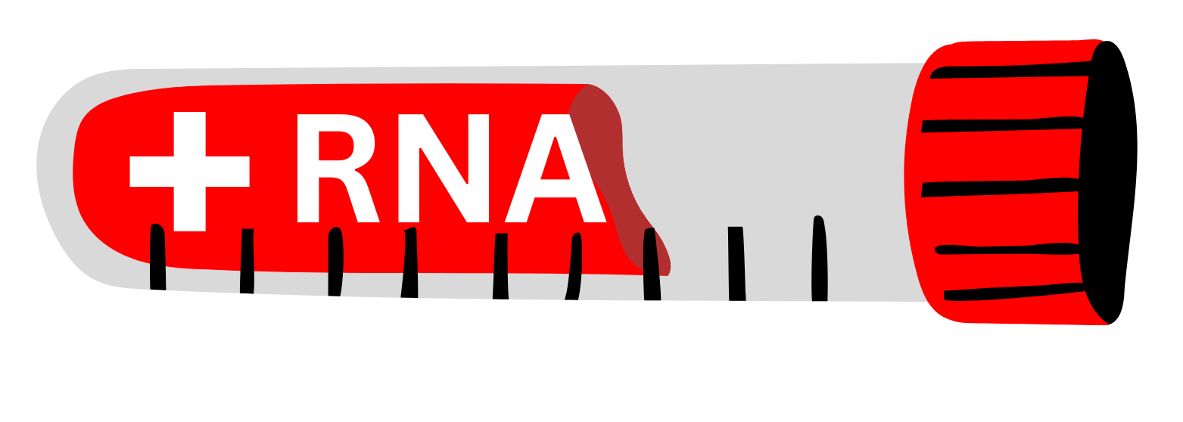
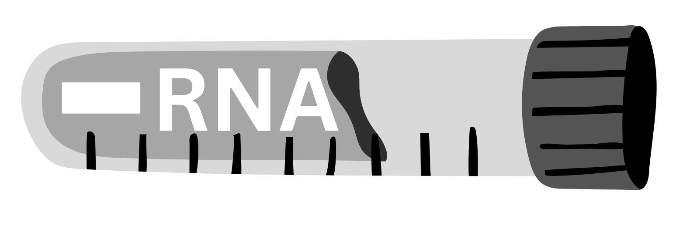


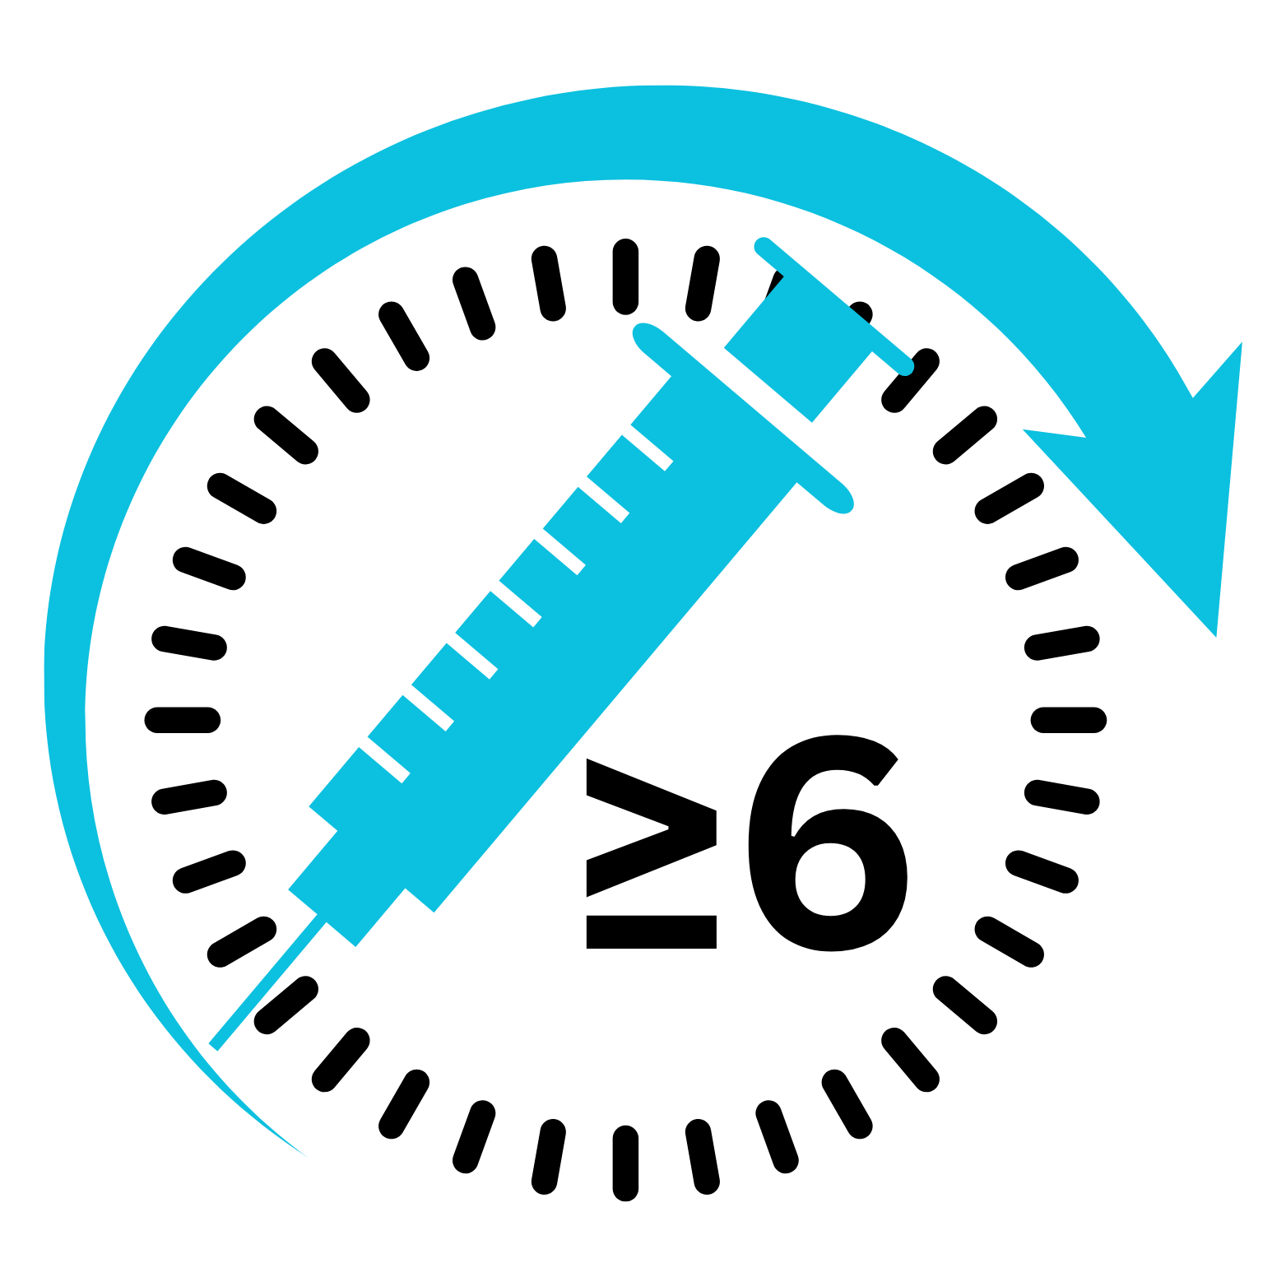

Results
ADJUDICATED
NEGATIVE
ADJUDICATED
POSITIVE
ADJUDICATION STATUS
NOT DETERMINED
POSITIVE HIV
RNA TEST
NEGATIVE HIV
RNA TEST
POSITIVE NON-RNA
HIV TEST
NEGATIVE NON-RNA
HIV TEST
–
–
NO CAB-LA W/ IN
THE LAST 6 MONTHS
CAB-LA W/ IN
THE LAST 6 MONTHS

Slide 8
26,528
Visits with an RNA screening test at sites
73
(One or more reactive/positive HIV test result)
or
or
42
2
29
ADJUDICATED
NEGATIVE
ADJUDICATED
POSITIVE
ADJUDICATION STATUS
NOT DETERMINED
POSITIVE HIV
RNA TEST
NEGATIVE HIV
RNA TEST
POSITIVE NON-RNA
HIV TEST
NEGATIVE NON-RNA
HIV TEST
NO CAB-LA W/ IN
THE LAST 6 MONTHS
CAB-LA W/ IN
THE LAST 6 MONTHS

Slide 9
26,528
Visits with an RNA screening test at sites
73
(One or more reactive/positive HIV test result)
or
or
42
2
29
20
22
ADJUDICATED
NEGATIVE
ADJUDICATED
POSITIVE
ADJUDICATION STATUS
NOT DETERMINED
POSITIVE HIV
RNA TEST
NEGATIVE HIV
RNA TEST
POSITIVE NON-RNA
HIV TEST
NEGATIVE NON-RNA
HIV TEST
NO CAB-LA W/ IN
THE LAST 6 MONTHS
CAB-LA W/ IN
THE LAST 6 MONTHS

Slide 10
26,528
Visits with an RNA screening test at sites
73
(One or more reactive/positive HIV test result)
or
or
42
2
29
20
22
5
24
3
2
17
7
ADJUDICATED
NEGATIVE
ADJUDICATED
POSITIVE
ADJUDICATION STATUS
NOT DETERMINED
POSITIVE HIV
RNA TEST
NEGATIVE HIV
RNA TEST
POSITIVE NON-RNA
HIV TEST
NEGATIVE NON-RNA
HIV TEST
NO CAB-LA W/ IN
THE LAST 6 MONTHS
CAB-LA W/ IN
THE LAST 6 MONTHS

Slide 11
26,528
Visits with an RNA screening test at sites
73
(One or more reactive/positive HIV test result)
or
or
42
2
29
20
22
27
5
24
Isolated RNA-positive
visits
False positive
True positive
3
2
17
7
ADJUDICATED
NEGATIVE
ADJUDICATED
POSITIVE
ADJUDICATION STATUS
NOT DETERMINED
POSITIVE HIV
RNA TEST
NEGATIVE HIV
RNA TEST
POSITIVE NON-RNA
HIV TEST
NEGATIVE NON-RNA
HIV TEST
NO CAB-LA W/ IN
THE LAST 6 MONTHS
CAB-LA W/ IN
THE LAST 6 MONTHS

Slide 12
Performance Characteristics
Out of 26,528 RNA tests,
22 were false positive
1.0%
False positive rate for Isolated HIV RNA+ results by site
PPV (95% CI)*
FPR (95% CI)*
Sensitivity (95% CI) †
0.8%
18.5%
(7.0%, 38.7%)
0.08%
(0.05%, 0.13%)
96.4%
(79.8%, 99.8%)
11
0.6%
0.64%
9.1%
(1.6%, 30.6%)
0.09%
(0.05%, 0.14%)
87.5%
(46.7%, 99.3%)
False-positive Rate
2
0.47%
2
60%
(17%, 92.7%)
0.06%
(0.01%, 0.25%)
100%
(80%, 100%)
0.4%
1
0.39%
0.36%
1
1
0.2%
0.27%
0.26%
1
0.20%
22
2
1
Overall
No CAB-LA w/ in
the last 6 months
CAB-LA w/ in
the last 6 months
0.08%
0.08%
0.05%
0
(0%)
0.0%
*Isolated positive RNA results
† RNA screening with other tests
1 - 43
1
2
3
4
5
6
7
8
9
10-43
Site Number

Slide 13
Performance Characteristics
Out of 26,528 RNA tests,
22 were false positive
1.0%
False positive rate for Isolated HIV RNA+ results by site
PPV (95% CI)*
FPR (95% CI)*
Sensitivity (95% CI) †
0.8%
18.5%
(7.0%, 38.7%)
0.08%
(0.05%, 0.13%)
96.4%
(79.8%, 99.8%)
US Sites
Non-US Sites
11
0.6%
0.64%
9.1%
(1.6%, 30.6%)
0.09%
(0.05%, 0.14%)
87.5%
(46.7%, 99.3%)
False-positive Rate
2
0.47%
2
60%
(17%, 92.7%)
0.06%
(0.01%, 0.25%)
100%
(80%, 100%)
0.4%
1
0.39%
0.36%
1
1
0.2%
0.27%
0.26%
1
0.20%
22
2
1
Overall
No CAB-LA w/ in
the last 6 months
CAB-LA w/ in
the last 6 months
0.08%
0.08%
0.05%
0
(0%)
0.0%
*Isolated positive RNA results
† RNA screening with other tests
1 - 43
1
2
3
4
5
6
7
8
9
10-43
Site Number

Slide 14
HIV viral load at
isolated RNA-positive visits
Median (Range)
1597 (124 – 4,120)
1,000
Isolated RNA+ Test Result (copies/mL)
200 copies/mL
100
Median (Range)
BLQ (BLQ - 149)
BLQ
False Positive (n=22)
True Positive (n=5)
RNA Test Status
No CAB-LA w/ in
the last 6 months
CAB-LA w/ in
the last 6 months

Slide 15
26,528
Visits with an RNA screening test
73
(One or more reactive/positive HIV test result)
or
or
42
2
29
20
22
5
24
ADJUDICATED
NEGATIVE
ADJUDICATED
POSITIVE
ADJUDICATION STATUS
NOT DETERMINED
POSITIVE HIV
RNA TEST
NEGATIVE HIV
RNA TEST
POSITIVE NON-RNA
HIV TEST
NEGATIVE NON-RNA
HIV TEST
NO CAB-LA W/ IN
THE LAST 6 MONTHS
CAB-LA W/ IN
THE LAST 6 MONTHS

Slide 16
26,528
Visits with an RNA screening test at sites
73
(One or more reactive/positive HIV test result)
or
or
42
2
29
20
22
5
24
False positive isolated RNA
True positive isolated RNA
#1
#1
2nd consecutive
RNA test at site
2nd consecutive
RNA test at site
#2
#2
or
22
5
NPV: 100%
PPV: 100%
PPV: 0%
FPR: 0%
ADJUDICATED
NEGATIVE
ADJUDICATED
POSITIVE
ADJUDICATION STATUS
NOT DETERMINED
POSITIVE HIV
RNA TEST
NEGATIVE HIV
RNA TEST
POSITIVE NON-RNA
HIV TEST
NEGATIVE NON-RNA
HIV TEST
NO CAB-LA W/ IN
THE LAST 6 MONTHS
CAB-LA W/ IN
THE LAST 6 MONTHS

Slide 17
26,528
Visits with an RNA screening test at sites
73
(One or more reactive/positive HIV test result)
or
or
42
2
29
20
22
5
24
Negative Clinical Outcomes
of false positive RNA testing
7
15
Subsequent CAB Delays
No CAB Delays
  4 CAB-LA >70 days
  2 Discontinued
  1 26-day oral CAB gap
To date, none of these 7 individuals has evidence of HIV acquisition
ADJUDICATED
NEGATIVE
ADJUDICATED
POSITIVE
ADJUDICATION STATUS
NOT DETERMINED
POSITIVE HIV
RNA TEST
NEGATIVE HIV
RNA TEST
POSITIVE NON-RNA
HIV TEST
NEGATIVE NON-RNA
HIV TEST
NO CAB-LA W/ IN
THE LAST 6 MONTHS
CAB-LA W/ IN
THE LAST 6 MONTHS

Slide 18
Conclusions
In this preliminary analysis, single isolated positive HIV RNA result at sites performed poorly for detecting HIV infection with CAB-LA PrEP
  Performance was better without CAB-LA in the past 6 months
  Repeat RNA testing was able to discriminate true from false positive cases
Although infrequent, most single isolated positive RNA test results were false-positive results
Guidelines for HIV testing algorithms for detecting HIV infections in the setting of long-acting PrEP should consider these performance characteristics

Slide 19
Acknowledgements
Sponsors
HPTN 083 Study Team
Community Program Managers
Community Educators & Recruiters, CAB Members
Our 43 study sites in 7 countries
And most of all, our study participants
U.S. National Institute of Allergy and Infectious Diseases (NIAID), National Institute of Mental Health (NIMH), National Institute on Drug Abuse (NIDA), and the National Institute of Child Health and Human Development (NICHD) all components of the U.S. National Institutes of Health (NIH)
Additional funding from ViiV Healthcare
HIV Prevention Trials Network (HPTN)
Laboratory Center (Johns Hopkins University)
SCHARP (Fred Hutchinson Cancer Research Center)
Leadership and Operations Center (FHI360)
Pharmaceutical Support
ViiV Healthcare
Gilead Sciences, Inc.

