Slide 1




D²EFT: Dolutegravir and Darunavir Evaluation in Adults Failing Therapy-
Final 96-week results
Gail Matthews, Margaret Borok, Nnankelu Eriobu, Richard Kaplan, Nagalingeswaran Kumarasamy, Anchalee Avihingsanon, Marcelo Losso, Iskandar Azwa, Muhammad Karyana, Sounkalo Dao, Mohamed Cisse, Emmanuelle Papot, Jolie Hutchinson, Simone Jacoby and Matthew Law on behalf of the D²EFT study team

Slide 2
The D²EFT study
Stage 2 (Commenced in May 2018)
A prospective, multicenter, open-label international RCT
Evaluation of 3 second-line regimens
Standard of care
DRV/r + 2NRTI
NRTI selection by genotyping or WHO algorithm
Drug class but not drug recycled
Intervention Arm
DTG + DRV/r
No NRTI
No genotyping required
Intervention Arm
DTG + TDF/XTC
Recycled NRTI (TDF/XTC)
Co-formulated
No coformulation possible
No drug class or drug recycled
Potential coformulation
No genotyping required
Stage 1 (Commenced in April 2017)
Notes:
Originally conceived as a 2 arm RCT (Phase 1) commencing in April 2017.
In response to a changing therapeutic landscape and after extensive stakeholder consultation (and additional funding) a third arm was added in May 2018.
Treatment arms
DRV/r+2NRTIs (SOC) arm: DRV/r (800 mg of darunavir + 100 mg of ritonavir) once daily plus 2NRTIs (dosed once or twice daily) for 96 weeks
DTG+DRV/r arm: DTG (50 mg) once daily plus DRV/r (800 mg of darunavir + 100 mg of ritonavir) once daily for 96 weeks
DTG+TDF/XTC arm: DTG (50 mg) in combination with TDF (300 mg) plus either 3TC (300 mg) or FTC (200 mg), all once daily for 96 weeks.
The choice of NRTI backbone in DRV/r+2NRTIs arm only was guided by genotypic resistance testing if locally available or according to WHO recommended algorithm in the absence of genotyping.

Slide 3
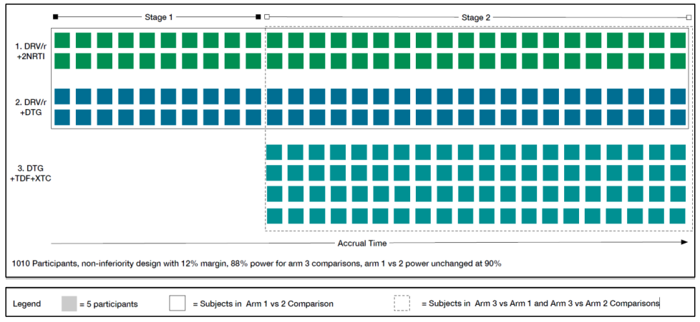
Trial design and adaptations
Non-inferiority of intervention arms against SOC
96-week follow-up study
Primary endpoint (pVL <50 c/ml) at week-48 mITT analysis, excluding participants randomised but did not commence ART
Notes:
48-week results has been published in Lancet HIV.
In stage 1 of the study, participants were randomly allocated to either DRV/r+2NRTIs or DTG+DRV/r in a ratio of 1:1. Following progression to stage 2 with three arms including DTG+TDF/XTC, patients were randomly allocated to receive one of the three regimens in an allocation to be determined by accrual to that point. More participants were recruited to DTG+TDF/XTC arm in stage 2 to have equal power across comparisons.
When the third arm (DTG+TDF/XTC) was added in stage 2 the sample size was re-evaluated. Under the hypothesis of no difference between randomised treatment arms a virological suppression rate of 75%, and 5% lost to follow-up, to have 90% power to demonstrate non-inferiority in the ITT analysis using a 12% margin, a total of 1010 patients were required, 305 in each of the original 2 arms, and 400 in the third arm.
Recruitment was decided to halt before the target sample size was reached due to the prolonged timeframe of enrolment into the study for stage 2 due to COVID-19 pauses and the increasingly small pool of individuals with first-line NNRTI failure due to TLD transition. A recalculation of sample size was performed to provide at least 80% power to show non-inferiority for the primary endpoint.

Slide 4
Key study eligibility
Inclusion
> 18 years old
Failed first-line NNRTI + 2NRTIs (at least two consecutive HIV RNA > 500 c/ml at least 7 days apart after a minimum 24-week exposure)
Exclusion
Prior PI/INSTI exposure
HBsAg positive
Significant co-morbidity/active coinfection
Pregnancy/breast feeding
Notes:
Full eligibility criteria
Inclusion: (positive HIV-1 by a licensed diagnostic test, aged ≥18 years, failed first-line NNRTI + 2NRTIs combination therapy, defined as at least two consecutive (≥7 days apart) plasma viral load (pVL) results >500 copies/mL after a minimum period of exposure to continuous first-line therapy for 24 weeks and able to provide written informed consen)
Exclusion: (absolute neutrophil count <500 cells/µL, haemoglobin <7.0 g/dL, platelet count <50,000 cells/µL, aspartate transaminase (AST) and/or alanine transaminase (ALT) ≥3 times upper limit of normal and bilirubin ≥1.5 times upper limit of normal, change in antiretroviral therapy within 12 weeks prior to randomization, prior exposure to HIV protease inhibitors and/or HIV integrase inhibitors, patients with chronic viral hepatitis B infection, unstable liver disease, anticipated need for hepatitis C virus (HCV) therapy during the study, creatine clearance of <50 mL/min, current use of rifampicin or rifabutin, use of contraindicated medications, intercurrent illness requiring hospitalization, an active opportunistic disease not under adequate control in the opinion of the investigator, pregnant or nursing mothers, patients with current alcohol or illicit substance use that is in the opinion of the site investigator might adversely affect participation in the study, and patients deemed unlikely by the site investigator to be able to remain in follow-up for the protocol-defined period)

Slide 5
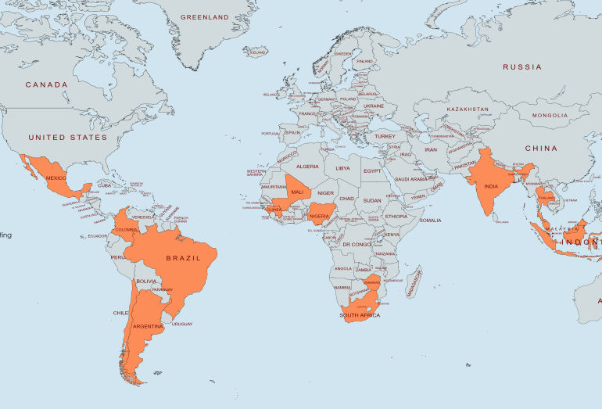
Recruitment
826 participants from 14 countries (28 sites)
107 in stage 1and 721 in stage 2
Exceptional retention and engagement of participants despite external challenges: 2 withdrawals and 4 LTFU
Notes:
Participating countries were Argentina, Chile, Colombia, India, Malaysia, Mexico, South Africa, Thailand, and Zimbabwe (in Stage 1) and Brazil, Guinea, Indonesia, Mali, and Nigeria (added in Stage 2).
During the study two screening pauses occurred; the first between June 2018 and September 2018 whilst the third arm adaptation was implemented, the second between April 2020 and November 2020 due to the impact of the COVID-19 pandemic.

Slide 6
Baseline characteristics
Characteristics | Stage 1 (n=107) |  | Stage 2 (n=719) |  |  | Total (n=826)
 | DRV/r + 2NRTI (n=52) | DRV/r + DTG (n=55) | DRV/r + 2NRTI (n=209) | DRV/r + DTG (n=216) | DTG + TDF/XTC (n=294)
Age at randomisation (years), mean (SD) | 39.2 (9.6) | 40.0 (10.6) | 39.7 (9.6) | 39.2 (9.6) | 39.0 (9.6) | 39.4 (10.0)
BMI (kg/m²), median [IQR] | 22.5 [20.1, 24.7] | 21.6 [19.3, 25.1] | 23.6 [21.0, 27.4] | 22.5 [19.8, 26.7] | 23.5 [20.4, 27.1] | 23.0 [20.3, 26.8]
Male | 23 (44.2) | 29 (52.7) | 96 (45.9) | 93 (43.5) | 134 (45.7) | 376 (45.5)
Ethnicity
Asian | 19 (36.5) | 19 (34.6) | 51 (24.4) | 51 (23.6) | 67 (22.8) | 207 (25.1)
Black | 32 (61.5) | 36 (65.5) | 145 (69.4) | 149 (69.0) | 208 (70.8) | 570 (69.0)
CD4 T-cell count (cell/µL), median [IQR] | 186 [92, 345] | 166 [61, 298] | 195 [85, 355] | 213 [93, 350] | 222 [111, 375] | 206 [93, 354]
HIV-RNA (copies/mL), median [IQR] | 17000 [2200, 49561] | 21500 [5209, 87744] | 14195 [3109, 70923] | 13162 [3600, 72661] | 16000 [4100, 57891] | 15400 [3600, 65986]
Duration ART (years), median [IQR] | 5.1 [2.9, 7.5] | 5.8 [2.7, 8.0] | 4.7 [2.5, 7.9] | 4.4 [1.8, 8.2] | 5.4 [2.3, 8.9] | 5.0 [2.2, 8.3]
Notes:
Full baseline table is the same as the one from published week-48 paper <https://www.thelancet.com/journals/lanhiv/article/PIIS2352-3018(24)00089-4/fulltext>.
NNRTI at first line failure: 82.7% EFV, 11.4% Nevirapine.
NRTIs used in second line with DRV/r: 76% ZDV/3TC, 19% TDF/XTC.

Slide 7
Virological efficacy at week-48 and 96
194/257
222/264
147/206
177/209
227/291
191/251
215/251
146/201
175/203
230/283
Percentage with HIV RNA <50 copies/ml at week 48
Percentage with HIV RNA <50 copies/ml at week 96
Notes:
Undetectable HIV RNA at week 48 (with available data)
Study Arm N with data N miss <50 copies/mL (n, % N with data) <200 copies/mL (n, % N with data) <400 copies/mL (n, % N with data)
SOC: stage 1+2 257 4 194 (75.5) 222 (86.4) 227 (88.3)
DTG+DRV/r: stage 1+2 264 7 222 (84.1) 246 (93.2) 250 (94.7)
SOC: stage 2 206 3 147 (71.4) 174 (84.5) 179 (86.9)
DTG+DRV/r: stage 2 209 7 177 (84.7) 194 (92.8) 198 (94.7)
DTG+TDF/XTC: stage2 291 3 227 (78.0) 252 (86.6) 262 (90.0)
Undetectable HIV RNA at week 96 (with available data)
Study Arm N with data N miss <50 copies/mL (n, % N with data) <200 copies/mL (n, % N with data) <400 copies/mL (n, % N with data)
SOC: stage 1+2 251 10 191 (76.1) 210 (83.7) 215 (85.7)
DTG+DRV/r: stage 1+2 251 20 215 (85.7) 233 (92.8) 239 (95.2)
SOC: stage 2 201 8 146 (72.6) 163 (81.1) 168 (83.6)
DTG+DRV/r: stage 2 203 13 175 (86.2) 189 (93.1) 193 (95.1)
DTG+TDF/XTC: stage2 283 11 231 (81.6) 249 (88.0) 253 (89.4)

Slide 8
Virological efficacy at week-96
Difference % [95% CI], p value
SOC vs DTG+DRV/r
<50 c/ml <200 c/ml <400 c/ml | 9.6 [2.7, 16.4], P=0.01 9.2 [3.6, 14.7], P=0.002 9.6 [4.5, 14.6], P=0.004
SOC vs DTG+TDF/XTC
<50 c/ml <200 c/ml <400 c/ml | 9.0 [1.4, 16.6], P=0.02 6.9 [0.3, 13.5], P=0.04 5.8 [-0.4, 12.1], P=0.07
Notes:
DTG+DRV/r and DTG+TDF/XTC arms met the noninferiority and superiority thresholds compared to DRV/r+2NRTI.
Both arms also met non-inferiority thresholds in sensitivity analyses, where missing week-96 viral load was set as failure, and where only participants who were still on randomised ART regimen with undetectable viral load at week-96 were set as viral suppression.

Slide 9
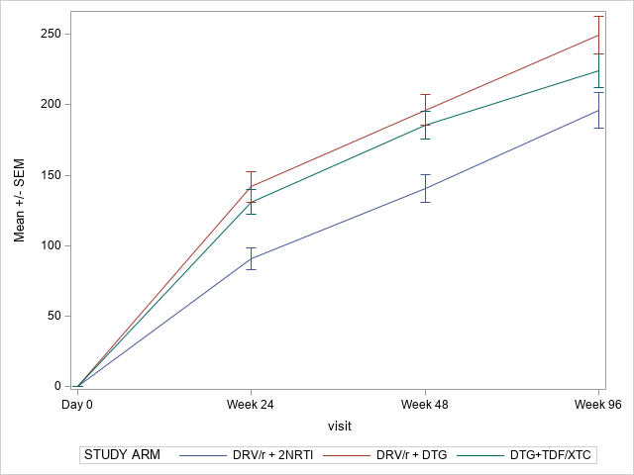
Mean CD4 change (cells/µL) at week-96
Arm | Stage | Mean CD4 change at week-96 (cells/µL) | Mean Difference [95% CI] | P-value
DRV/r + 2NRTI | 1+2 | 196 (194) | 56 [26, 85] | P<0.001
DRV/r + DTG |  | 250 (208)
DRV/r + 2NRTI | 2 | 189 (204) | 42 [11, 72] | P=0.01
DTG+TDF+XTC |  | 224 (195)
Mean CD4 change at week-96 (Stage 2 only)
Notes:
Immunological response was robust in all arms.
Significantly higher CD4 rise in DTG+DRV/r and DTG+TDF/XTC arms compared to DRV/r+2NRTI.

Slide 10
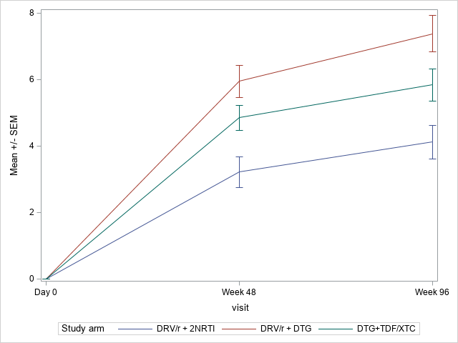
Mean body weight change (kg) at week-96
Arm | Stage | Mean weight change at week-96 (kg) | Mean Difference [95% CI] | P-value
DRV/r + 2NRTI | 1+2 | 3.9 (6.8) | 3.4 [2.1, 4.7] | P<0.001
DRV/r + DTG |  | 7.3 (7.9)
DRV/r + 2NRTI | 2 | 4.1 (7.2) | 1.7 [0.3, 3.1] | P=0.01
DTG+TDF+XTC |  | 5.8 (8.1)
Mean body weight change at week-96 (Stage 2 only)
Notes:
Body weight increased progressively from baseline through week 48 and 96 across all three arms, with significantly higher rises in DTG containing arms.

Slide 11
Safety including pregnancies
 | DRV/r + 2NRTI (n=261) | DRV/r + DTG (n=271) | DTG + TDF/XTC (n=294) | Total (n=826)
Deaths | 6 | 2 | 3 | 11
SAEs | 40 | 24 | 30 | 94
AIDS defining conditions | 5 | 3 | 8 | 16
Grade 3 or 4 ALT elevations | 5 | 2 | 1 | 8
Grade 3 or 4 creatinine events | 5 | 8 | 12 | 25
Grade 3 or 4 anaemia | 9 | 2 | 3 | 14
Treatment switch due to AEs | 9 | 4 | 6 | 19
37 pregnancies (27 in DTG containing arms), no documented birth defects.
Notes:
SAEs: serious adverse events (A SAE is any untoward medical occurrence that at any dose: • Results in death; • Is life-threatening; • Requires in-patient hospitalisation or prolongation of existing hospitalisation; • Results in persistent or significant disability/incapacity; • Is a congenital anomaly/birth defect; • Is a medically important event or reaction that may not be immediately life-threatening or result in death or hospitalisation but, in the judgement of the investigator, may jeopardise the participant or may require intervention to prevent one of the outcomes listed in the definition above; • Grade 4 events (not limited to a laboratory abnormality) not already reportable in one of the above categories; • Is an overdose of either study drug; • Is a cancer (a pre-existing cancer should only be reported if it worsens after study entry).)
ALT events: Grade 3: [≥5.0 to <10.0] x ULN; Grade 4: ≥ 10.0 x ULN, ULN = Upper limit of normal
Creatinine events: Grade 3: [ ≥ 1.8 to < 3.5] x ULN; Grade 4: ≥ 3.5 x ULN, ULN=Upper Limit of Normal
Treatment switches listed in the table: do not include switches due to virological failure, minor changes in NRTI backbone, interruptions due to pregnancy or stock outs.

Slide 12
Conclusions
DTG+DRV/r and DTG+TDF/XTC demonstrated superiority in terms of virological efficacy and immunological recovery compared to SOC following failure of NNRTI-based first-line therapy.
The novel second-line strategy, DTG+DRV/r, exhibited excellent antiviral efficacy at week-96.
Recycling TDF as DTG+TDF/XTC in the second-line regimen is as efficacious as WHO recommended algorithmic NRTI switch even if genotypic resistance testing is inaccessible.
Both intervention arms demonstrated greater CD4 gains compared to SOC at week-96.
Weight gain was significantly greater in both intervention arms.
All arms are generally well tolerated with few treatment switches due to toxicity.

Slide 13






Acknowledgements
The D2EFT study groups
Protocol Steering committee: Iskandar Azwa, Margaret Borok, Mohamed Cisse, Soukalo Dao, Simone Jacoby, Richard Kaplan, Muhammad Karyana, Anthohey Kelleher, Nagalingeswaran Kumarasamy, H Clifford Lane, Matthew Law, Johnnie Lee, Marcelo Losso, Gail v Matthews, Nnakelu Eribou, Carmen Peres-Casas (Observer), Leonardo Perelis, Kiat Ruxrungtham, Dannae Brown,Bryn Jones, Jean Van WYK, Melynda Watkins (observer).
Country teams: Argentina (Patricia Borgoa, Marcelo Losso, Sergio Lupo, Luciana Peroni, Renzo Moretto, Ana Melisa Solari, Silvina Tavella, Maria Ines Vieni Deboran Vanina Villegas); Brazil (Kelly Gama, Beatriz Grinsztejn); Chile (Gladys Allendes, Marcelo Wolff); Colombia (Ana Julia Rojas, Otto Sussmann); Guinea (Mohamed Cisse, Thierno Mamadou Tounkara); India (Faith Beulah, Nagalingeswaran Kumarasamy, Poonpulali Selvamuthu); Indonesia (Yusrina Adani, Dona Arlinda, Yufi Aulia Azmi, Usman Hadi, Sudirman Katu, Munawir Muhammad, Nur Herda Wati Nisa, Yunri Wijayanti Subronto, Evy Yunihastuti); Malaysia (Iskandar Azwa, Farhana Nadiah Abd Ghani, Chow Ting Soo, Margaret Tan); Mali (Sounkalo Dao, Yacouba Cissoko); Mexico (Jaime Andrade-Villanueva, Juan Luis Mosqueda Gomez, Fernando Amador Lara, Juan Sierra Madero, Sergio del Moral Ponce, Jorge Morale Varges); Nigeria (Maryam Al-Mujtaba, Eriobu Nnakelu, Peter Ekele, Ernest Ekong); Thailand (Anchalee Avihinosanon, Ploenchan Chetchotisakd, Sivaporn Gatechompol, Suwimon Khusuwan, Weerawat Manosuthi, Supawadee Pongprapass, Kanitta Pussadee, Supeda Thonoyen, Anchalee Tiyabut); South Africa (Desiree Van Amsterdam, Jaclyn Ann Bennet, Richard Daplan, Lerato Mohapi, Suri Moonsamy, Mary Sihlanou); Zimbabwe (Margaret Borok, Ennie Chidziva-Chikuse, James Hakim).
The Kirby Institute: Lucienne Bamford, Eamon Brown, Michelle Burns, Ai Caldis, Cate Carey, Selina Cheng, Megan Clewett, David Cooper, Daren Draganic, Sean Emery, Yuvaraj Ghodke, Ben Hui, Jolie Hutchison, Simone Jacoby, Anthony Kelleher, Matthew Law, Margaret Lowe, Gail V Mathews, Dmmanuelle Papot, Mark Polizzotto, David Regan, David Silk.
Community advisory board members
Funding partners and study product donors: Unitaid, NIH, NHMRC, ViiV Healthcare and Janssen
Study participants
DSMB members

