Slide 1



2024 WHO HBV Guidelines for prevention, diagnosis, and treatment of people with chronic hepatitis B infection
Dr. Polin Chan
Regional Advisor HIV/Hepatitis/STI/EMTCT
WHO South-east Asia Regional Office (SEARO)
New Delhi, India

Slide 2

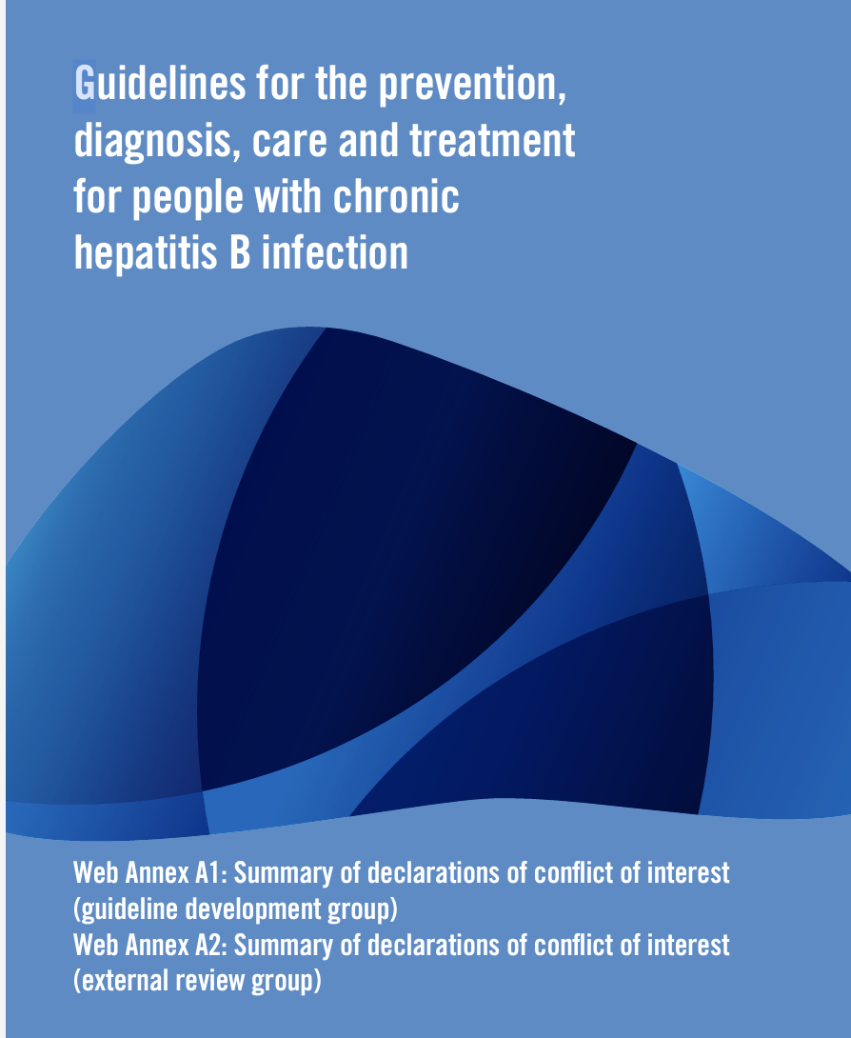



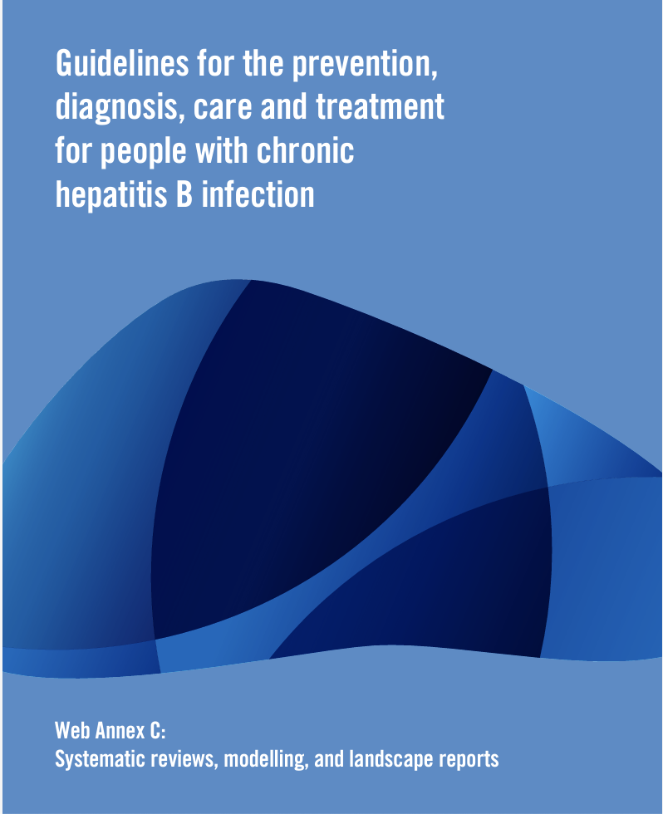
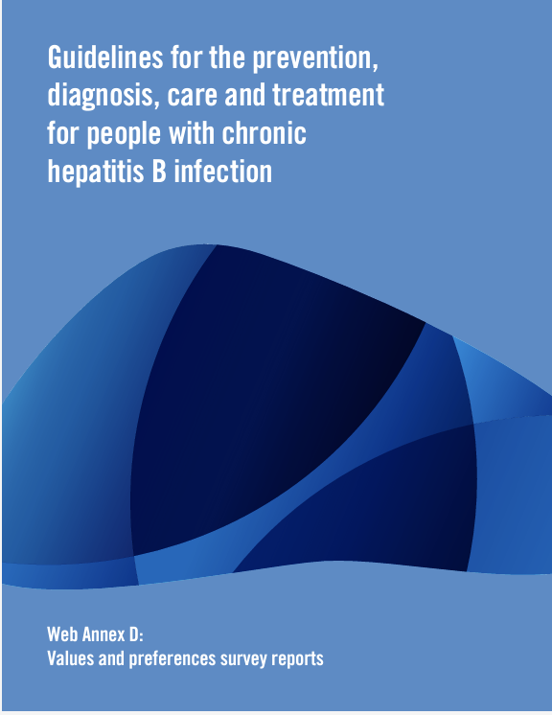
guidelines
Web annexes
Resources available
https://www.who.int/publications/i/item/9789240090903

Slide 3
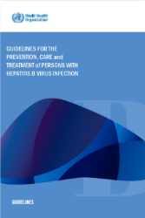

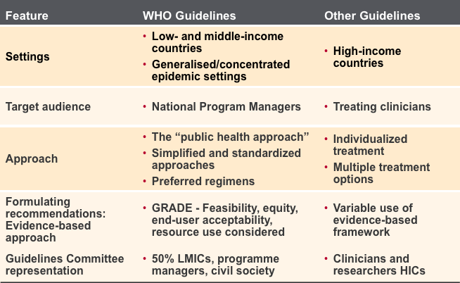


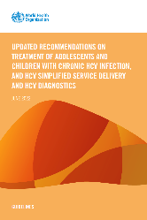


Distinctive Features of WHO Guidelines

Slide 4
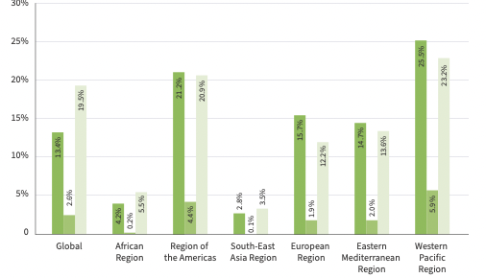
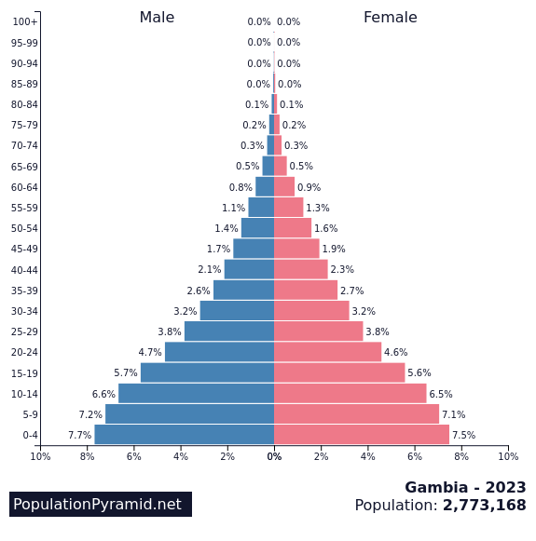
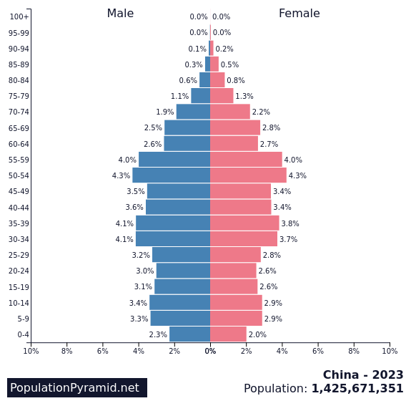
Why the need for updated WHO HBV guidelines?
In 2022, 13% of 254 million people with chronic HBV infection were diagnosed + 3% treated
Still major gaps in testing and treatment uptake
  Expanded and simplified treatment criteria
Guidelines complex
Regional differences in
demographics + epidemiology
  Emerging evidence
  Access challenges
  Progressive simplification
High birth rate and high % of population<20yrs (25% of all HBsAg+ve in SSA)
Liver cancers at younger age in SSA
75% HBsAg+ve HBV DNA <2000 IU/mL in SSA
  Ongoing HBV DNA integration –oncogenicity
  Significant rate of ongoing new infections through MTCT in SSA
  More cohort data now available from SSA
  Limited access to HBV DNA in LMIC
  Low uptake of Hep BD in SSA
Population Pyramid-Gambia & China, 2023

Slide 5
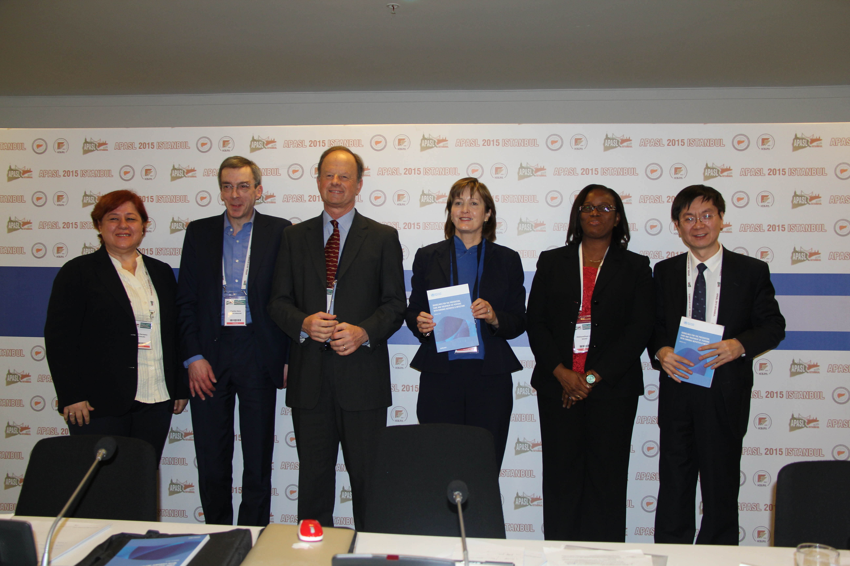
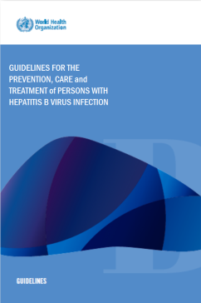
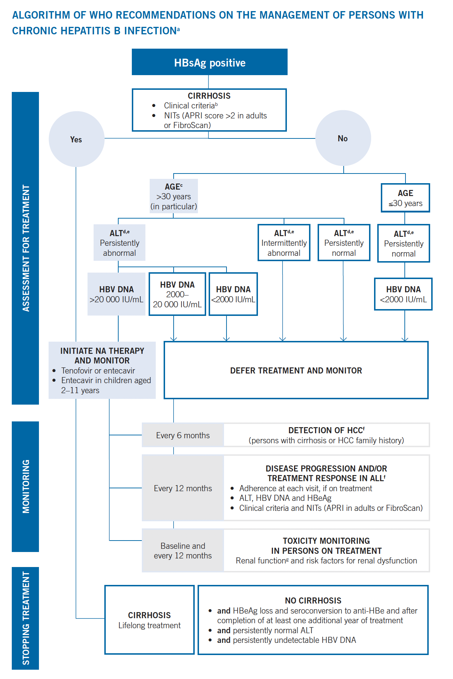
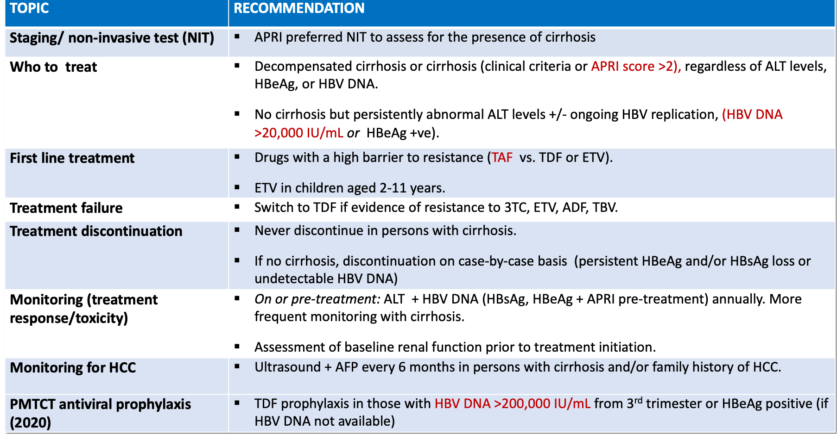
HBV Guideline Recomendations (2015) and PMTCT update (2020)

Slide 6
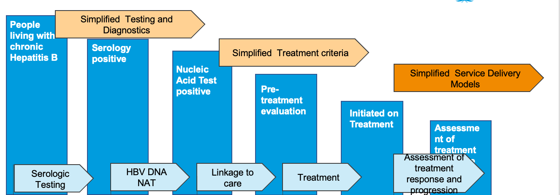
Key topics of new Hepatitis B Guidelines across the cascade of prevention, diagnosis, treatment & care - WHO hepatitis B guidelines 2024
1. Non invasive fibrosis assessment
2. Who to treat
3. First-line treatment
4. PMTCT
5. Simplifying diagnosis
6. Simplifying service delivery
29
Recommendations
14 New (including updated)

Slide 7
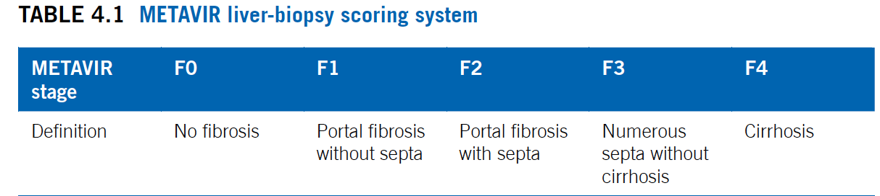
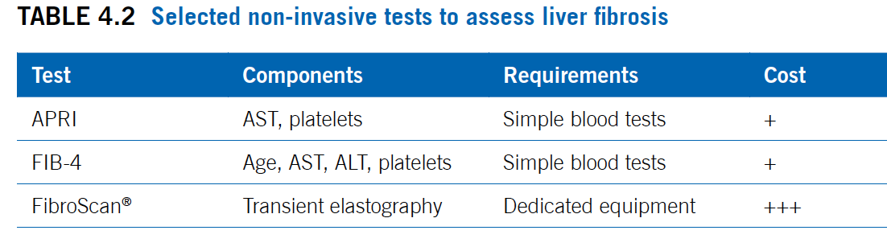
1. RECOMMENDATIONS – Non-invasive tests for liver fibrosis
Updated recommendation:
APRI (aspartate aminotransferase-to-platelet ratio index) is recommended as the preferred non-invasive test to assess for the presence of significant fibrosis or cirrhosis among adults in resource-limited settings.
Transient elastography (FibroScan®) may be a preferable non-invasive test in settings where it is available and cost is not a major constraint.
(strong recommendation, moderate-certainty evidence)
New recommendation:
Evidence of significant fibrosis (≥F2) should be based on an APRI
score of >0.5 or transient elastography value of >7.0 kPa, and cirrhosis (F4) should be based on clinical criteria (or an APRI score of >1.0 or) transient elastography value of >12.5 kPa.
(adults: strong recommendation, moderate-certainty evidence; adolescents: strong recommendation, low-certainty evidence)
Notes:
Over the past decade, the use of non-invasive tests has emerged as the gold standard for staging of liver disease globally, and with ready access to well validated non-invasive serum tests such as APRI and FIB-4 that are indirect markers of liver fibrosis score in low- and middle-income countries, or ultrasound that measures liver stiffness (transient elastography (FibroScan®)
We have an updated recommendation from the 2015 guidelines - it is now a strong recommendation supported by a substantive moderate-certainty evidence base.
We also have a new recommendation - In the 2015 hepatitis B guidelines, the cut-off of >2 for APRI was used for diagnosing cirrhosis.
This cut-off had a sensitivity of 35% and a specificity of 89%. Although, the choice of a high cut-off was to reduce false-positive results, it was increasingly recognized that at least 50% of those who had cirrhosis were being missed by such a high cut-off.
In the 2024 guidelines, the focus is now on detecting the presence of significant fibrosis (≥F2) as well as cirrhosis (F4) using non-invasive tests since this is now a priority criteria for treat

Slide 8
2. RECOMMENDATIONS – Who to treat?
Treatment is recommended for all adults and adolescents (aged ≥12 years) with CHB (including pregnant women and girls and women of reproductive age) with:
Evidence of significant fibrosis (≥F2) based on APRI score of >0.5 or transient elastography value of >7 kPa or evidence of cirrhosis (F4) (based on clinical criteria or APRI score of >1 or transient elastography value of >12.5 kPa^{c}), regardless of HBV DNA or ALT levels. (Adults: Strong/Mod, Adolescents Strong/Low)
OR
HBV DNA >2000 IU/mL and an ALT level above upper limit of normal (ULN) (30 U/L for men and boys and 19 U/L for women and girls). For adolescents, this should be based on ALT>ULN on at least two occasions in a 6- to 12-month period. (Adults: Strong/high; [HBV DNA >20 000 IU/mL] & Low [HBV DNA 2000–20 000]; Adolescents: Conditional/Low)
OR
Presence of coinfections (such as HIV, hepatitis D or hepatitis C); family history of liver cancer or cirrhosis; immune suppression; comorbidities (such as metabolic-associated steatotic liver disease); or extrahepatic manifestations, regardless of the APRI score or HBV DNA or ALT levels. (Adults: Strong/Mod; Adolescents: Conditional/Low)
OR
In the absence of access to an HBV DNA assay:
Persistently abnormal ALT levels (defined as two ALT values >ULN at unspecified intervals during a 6- to 12-month period), regardless of APRI score. (Adults and adolescents: Conditional/very Low)
20-25% of HBsAg +ve
1
2
20-35% of HBsAg +ve
3
5-8% of HBsAg +ve
4
20% of HBsAg +ve

Slide 9

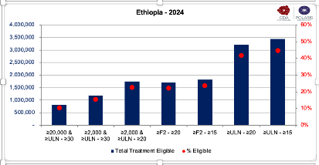
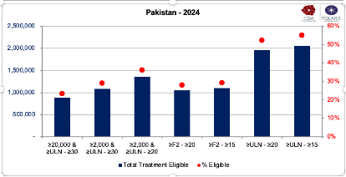
Expanded treatment eligibility - Key messages
  Recommendations now focus mainly on who to treat
  Inclusion of all age groups (adults and adolescents, including women of reproductive age (pregnant and non-pregnant)
  Allows a common entry point for treatment, simplifying guidelines and implementation
  Will mean many more pregnant and non-pregnant women will be on treatment for their own health. Complements expanded eligibility for antiviral prophylaxis – option for continuous treatment post-partum
  Four and/or options for meeting treatment eligibility
  Will capture high proportion (≈ 50%) of all HBsAg vs. 8-15% previously.
  Applicable to all settings – where there is ready or limited or no access to HBV DNA assays. Majority of HBsAg +ve will meet criteria for treatment without need for HBV DNA assay. Only 1 of 4 options requires access to HBV DNA.
  Use of non-invasive tests (APRI/TE) (≥F2): greatest individual benefit in reducing liver cancer, cirrhosis and liver related mortality
Modelling: impact of changing age, HBV DNA and ALT levels eligibility for treatment
Proportion eligible according to different hypothetical treatment eligibility criteria

Slide 10
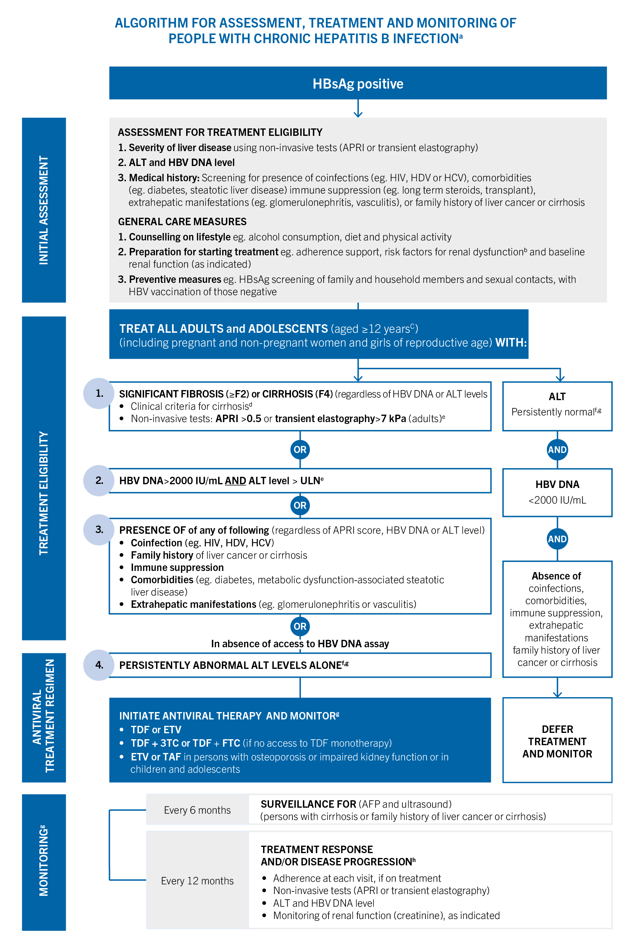
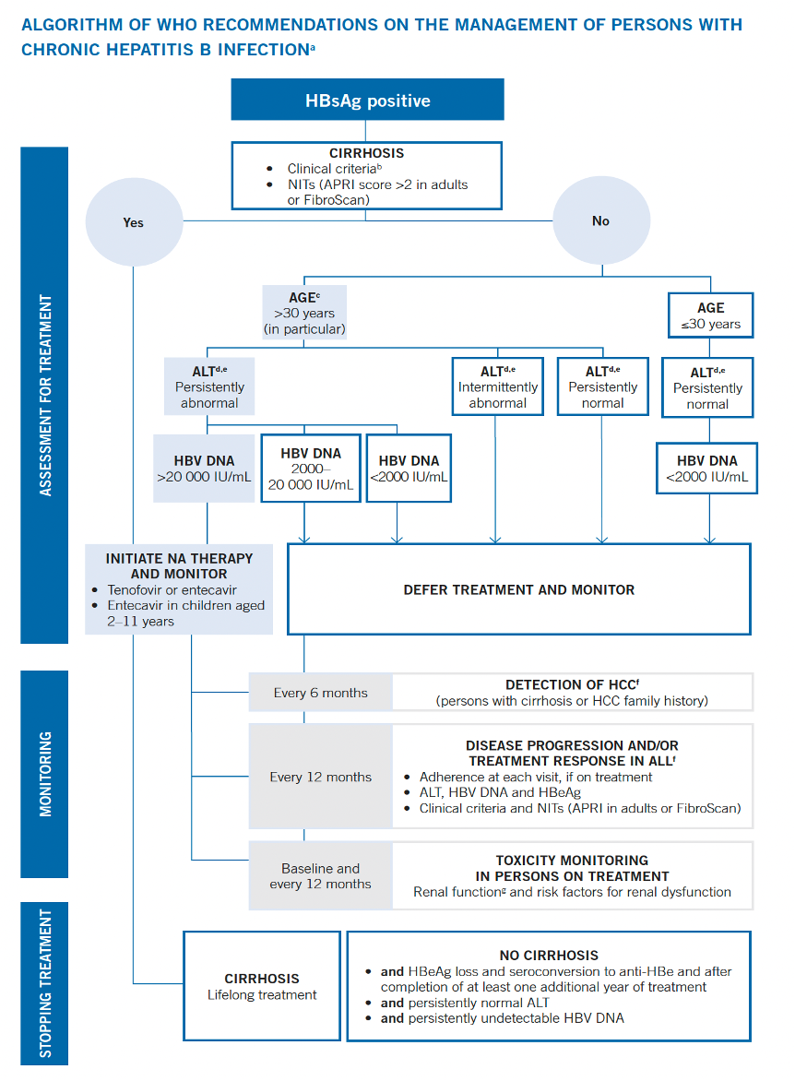
2015
2024 – NEW

Slide 11
3. RECOMMENDATIONS and RATIONALE – First line antiviral therapies
Updated recommendation
tenofovir disoproxil fumarate (TDF) or entecavir (ETV) – are recommended as preferred regimens and
TDF + lamivudine (3TC) and TDF + emtricitabine (FTC) as
alternative regimens (where TDF monotherapy is not available).
(strong recommendation, moderate-certainty evidence)
Evidence-base and Rationale
Systematic review of 5 RCTs of TAF vs. TDF
  Similar outcomes for undetectable HBV DNA.
  No differences in adverse events- TAF less decline in renal function and BMD but changes small (1-3%)
  Limited evidence on effects on clinical outcomes.
Systematic review of 5 RCTs of dual therapy (TDF+FTC) vs. TDF monotherapy
  Similar outcomes (HBV DNA suppression, ALT normalisation, HBsAg and eAg loss, and adverse events)
Expanding access through dual therapy: In countries with limited availability of TDF monotherapy esp. LMICs/SSA - use of dual therapy available through HIV/ART programmes may expand treatment access
New recommendation:
Entecavir (ETV) or tenofovir alafenamide fumarate (TAF) (if available) is recommended for people with established osteoporosis and/or impaired kidney function and
for children or adolescents for whom antiviral therapy is indicated (ETV aged ≥ 3 years and TAF aged ≥12 years)
(strong recommendation, moderate-certainty evidence)

Slide 12
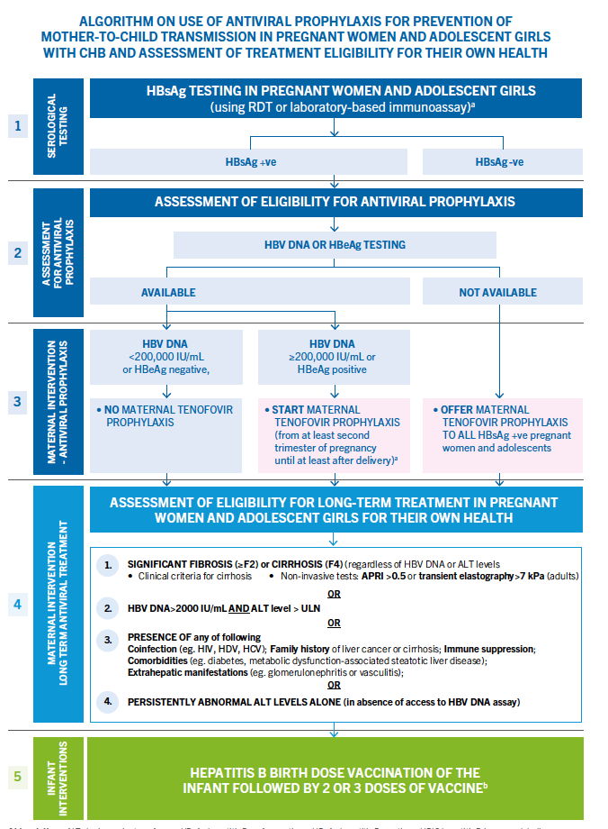
4. RECOMMENDATIONS - Preventing mother to child transmission of HBV using antiviral prophylaxis
Updated recommendation
In settings where HBV DNA or HBeAg testing is available, *Prophylaxis with TDF is recommended for HBV-positive (HBsAg-positive) pregnant women with HBV DNA ≥200 000 IU/mL or positive HBeAg
(strong recommendation, moderate-certainty evidence)
New 2024 recommendation
In settings where neither HBV DNA nor HBeAg testing is available,
*Prophylaxis with TDF for all HBV-positive (HBsAg-positive) pregnant women may be considered
(conditional recommendation, low-certainty evidence)
*Preferably from the second trimester of pregnancy until at least delivery or completion of the infant HBV vaccination series), to prevent MTCT of HBV.
All interventions should be given in addition to at least three doses of hepatitis B vaccination for all infants, including a timely birth dose.

Slide 13
IMPLEMENTATION CONSIDERATIONS – Antiviral prophylaxis for PMTCT
Increased coverage of HepBD vaccination should be priority: Funding for introducing and scaling up hepatitis B birth-dose vaccination is now available through Gavi for eligible countries.
Universal testing for HBsAg, HIV and syphilis for pregnant women: WHO recommends that all pregnant women are tested routinely for HIV, syphilis and HBsAg during pregnancy as part of a triple mother-to-child transmission elimination strategy
Increased health-care worker capacity: Increased number of trained health-care workers in antenatal clinic settings will be required to support expanded HepB antiviral prophylaxis and monitoring after treatment.
Simplified, integrated HIV, HBV and syphilis ANC testing and treatment pathways, ideally in the context of triple elimination of MTCT, will be key to support implementation of HBV DNA or universal hepatitis B prophylaxis

Slide 14
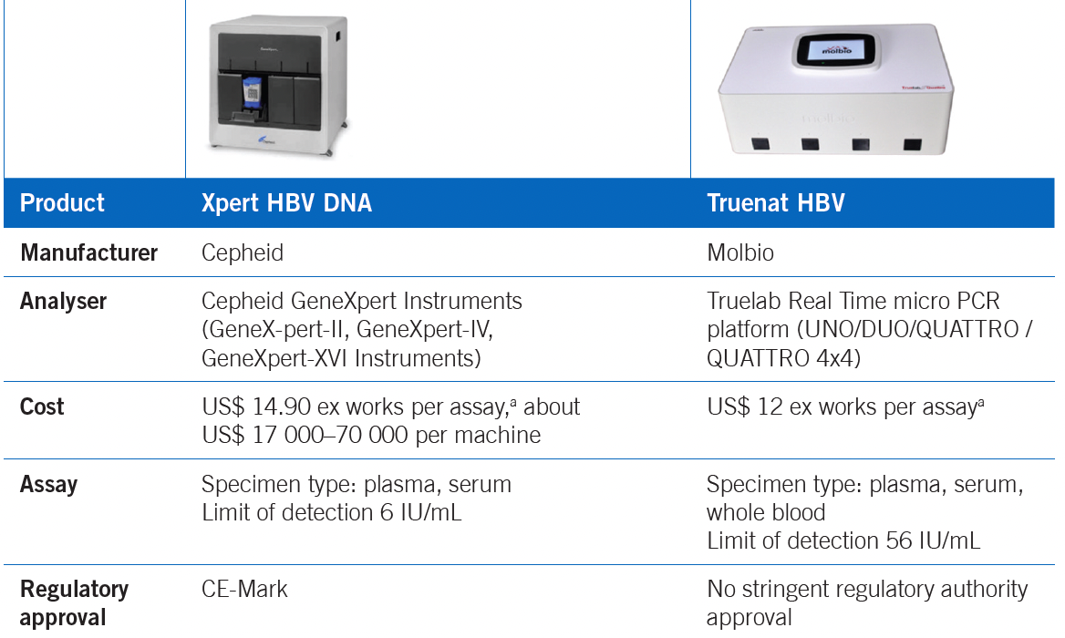
5. RECOMMENDATIONS AND RATIONALE – HBV DNA testing and Reflex testing
New recommendations
Point-of-care (POC) HBV DNA assays:
POC HBV DNA nucleic acid testing (NAT) assays may be used as an alternative approach to laboratory-based HBV DNA testing to assess HBV DNA level for treatment eligibility and to monitor treatment response.
(conditional recommendation, low-certainty evidence)
Reflex HBV DNA testing:
Reflex testing for those testing positive on HBsAg may be used as an additional strategy to promote linkage to care and treatment.
This can be achieved through either laboratory-based reflex HBV DNA testing using a sample already held in the laboratory or clinic-based reflex testing in a health-care facility through immediate sample collection following a positive HBsAg rapid diagnostic test (RDT).
(conditional recommendation, low-certainty evidence)
Three systematic reviews
Diagnostic accuracy of POC assays review (15 studies): high sensitivity (96–98%) and specificity (98–99%))
Clinical impact review of POC assays (7 studies) showed high uptake of testing (89% (95% CI 55–100%) and of treatment initiation (88% (95% CI 66–100%).
Clinical impact review of Reflex HBV DNA testing (8 studies) showed high uptake of HBV DNA testing and treatment initiation.

Slide 15
5. RECOMMENDATIONS AND RATIONALE – HDV testing - Who to test?
New recommendations
Priority population testing approach
In settings in which a universal anti-HDV antibody testing approach is not feasible because laboratory capacity or other resources are limited, testing for anti-HDV may be given priority in specific populations of HBsAg-positive individuals:
people born in HDV-endemic countries, regions and areas;
people with advanced liver disease, those receiving hepB treatment; and those with features suggesting HDV infection (such as low HBV DNA with high ALT levels); and
people considered to have increased risk of HDV infection (haemodialysis recipients, people living with HCV or HIV, people who inject drugs, sex workers and men who have sex with men).
(conditional recommendation, very-low-certainty evidence)
Universal testing approach
Serological testing for anti-HDV antibodies may be performed for all individuals who are HBsAg positive, as the preferred approach to scale up access to HDV diagnosis and linkage to care
(conditional recommendation, very-low-certainty evidence)
Narrative review
No studies directly evaluated impact and cost-effectiveness of different anti-HDV testing approaches.
Observational studies from high income settings show poor testing uptake and case-finding based on risk-based approach, and marked increase with laboratory-based universal anti-HDV testing
Effective case-finding crucial to implement preventative interventions eg. enhanced HCC surveillance, and access new treatment options

Slide 16
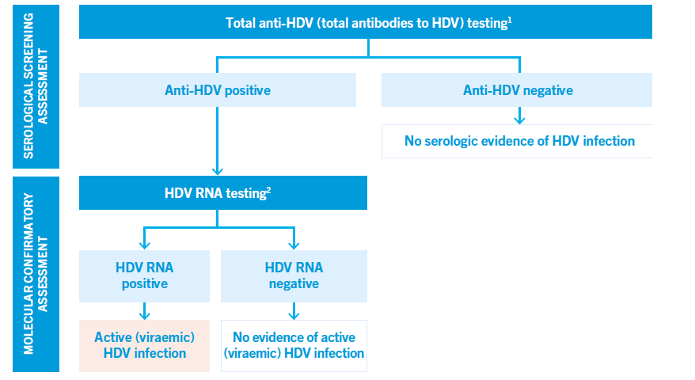
5. RECOMMENDATIONS – HDV testing How to test?
Diagnostic pathway
People with CHB (HBsAg positive) may be diagnosed with hepatitis D by using a serological assay to detect total anti-HDV followed by an NAT to detect HDV RNA and active (viraemic) infection among those who are anti-HDV positive.
Assays should meet minimum quality, safety and performance standards.
(conditional recommendation, low-certainty evidence)
Available commercial anti-HDV and molecular PCR assays have good diagnostic accuracy and correlate well with one another.
Key limitation is lack of established gold standard assays and of an RDT for anti-HDV antibody.
Reflex testing
Reflex testing for anti-HDV antibody testing following a positive HBsAg test result and also for HDV RNA testing (where available) following a positive anti-HDV antibody test result, may be used as an additional strategy to promote diagnosis.
(conditional recommendation, low-certainty evidence)
Systematic review of reflex testing
11 studies of reflex anti-HDV Ab testing (3 had non-reflex comparator arm) in those HBsAg positive
Increased uptake of serology testing (97% (95% CI: 92–100%) vs. 45% (95% CI: 0.3–98%) vs. non-reflex testing
Very high uptake of reflex HDV RNA in those anti-HDV positive - 98% (95% CI: 77–100%) in 8 studies.

Slide 17
6. IMPLEMENTATION CONSIDERATIONS – HBV DNA POC + Reflex testing
HBV DNA POC assays
Strategic choice - use of lab-based vs POC NAT platforms: will depend on characteristics of testing site. eg. (storage facilities, infrastructure, level of staff skills) and costs. Priority settings for placement of HBV DNA POC platforms eg. antenatal clinic sites for PMTCT antiviral prophylaxis, where fast-tracking confirmation of high HBV DNA can improve timely uptake of antiviral prophylaxis. Optimal placement of a POC instrument is where testing and treatment are at the same site – a “one-stop shops” Opportunity for diagnostic integration across programmes using multi-disease testing platforms. Countries with existing platforms for HIV or HCV viral load or TB testing, can consider collaboration and integration of HBV DNA testing.
HBV DNA Reflex and Delta serology and RNA testing
Choice of laboratory-based reflex testing or clinic-based reflex HBV DNA testing for different country contexts Laboratory-based reflex testing approach - settings with large testing volumes for HBsAg supported by extensive sample transport networks. Clinic-based reflex specimen collection approach - settings where RDTs used and limited access to lab services, and for populations such as PWID. Train laboratory staff - procedures for sample collection and processing for reflex testing (to minimize cross-contamination), and planning for additional costs

Slide 18







EVIDENCE-BASE AND RATIONALE – Range of observed HBV service delivery models
MODEL CATEGORY | DEFINITION AND EXAMPLES
Community testing | Education and rapid POCT for general or targeted populations, with or without “linkage” to local care, sometimes vaccination for HbsAg negative
General populations
Hospital-based | Inpatient or ambulatory care attached to a hospital, secondary/district and tertiary levels
Speciality clinic | Specialist care in ambulatory setting, including referral from testing camp or other community followed by visiting specialist or specialist clinic
Integrated | Hep B care delivered alongside other services, e.g., HIV, NCDs, harm reduction/OSA
Co-managed | Care led by non-specialist physicians/nurses/teams with input from or access to specialists via variety of platforms (e.g., virtual, case conference, visiting specialists)
Primary care | Care solely in primary care facilities by non-specialist physicians, nurses or teams
Outreach | Pop-up clinics, mobile clinics
Key populations | Pregnant/post-partum, PLHIV, migrants, Indigenous, PWID, prison populations

Slide 19
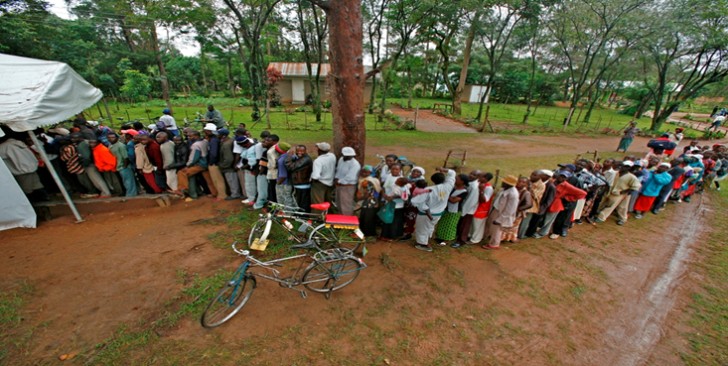
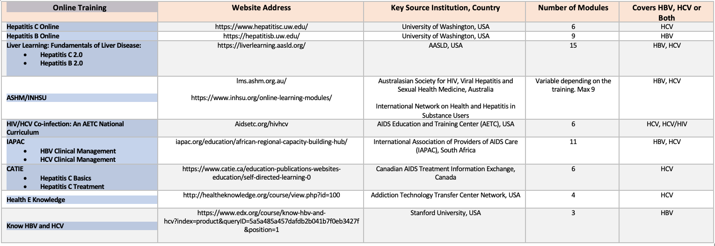
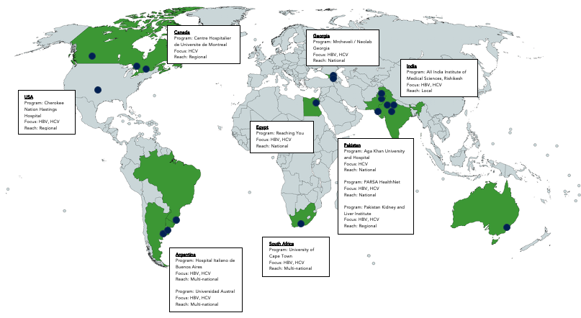
Implementation priorities
I
Scale-up of testing and case-finding
II
Updating of national Guidelines with adoption of recommendations informed by local context*and implementation considerations
III
Widespread education and awareness raising campaigns among community and healthcare workers
IV
Promote wide access to training and capacity building of healthcare workers to provide adherence support and retention
V
Opportunities for cost reductions for HBV meds and diagnostics
*Local context including national HBV epidemiology, health systems and laboratory capacity, supply systems for drugs and other commodities, availability of financial resources, the organization and capacity of the health system and the anticipated cost–effectiveness of the various interventions

Slide 20


Acknowledgements
Guidelines Development Group and
WHO Steering Committee
Co-chairs: Saeed Sadiq Hamid (The Aga Khan University, Pakistan), Wendy Spearman (University CapeTown, South Africa) and GRADE methodologist: Roger Chou (Oregon Health and Science University, Portland, USA).
GDG: Danjuma Adda (World Hepatitis Alliance), Suna Balkan (Médecins Sans Frontières, France), Ajeet Singh Bhadoria (All India Institute of Medical Sciences, Rishikesh, India), Yap Boum (Pasteur Institute of Bangui, Cameroun), Maria Butí (Hospital Universitario Valle Hebron, Spain), Vladimir Chulanov (National Medical Research Centre for TB and Infectious Diseases, Russian Federation), Chari Cohen (Hepatitis B Foundation), Naranjargal Dashdorj (Onom Foundation, Mongolia), Hailemichael Desalegn Mekonnen (St Paul’s Hospital Millennium Medical College, Ethiopia), Manal Hamdy El-Sayed (Ain Shams University, Egypt), Jordan Feld (Toronto General Hospital, University of Toronto), Jin-Lin Hou (Southern Medical University, China), Saleem Kamili (Centers for Disease Control and Prevention, United States), Patrick Kennedy (Queen Mary’s University, UK), Giten Khwairakpam (TREAT Asia, Thailand), David Muljono (Eijkman Institute for Molecular Biology, Indonesia), Wongani Mzumara (Ministry of Health, Malawi), Edith Okeke (Jos University Teaching Hospital, Nigeria), Janus Ong (University of the Philippines, Philippines), Christian B. Ramers (Clinton Health Access Initiative, USA), Tânia Reuter (Federal University of Espírito Santo, Brazil), Cielo Yaneth Ríos-Hincapié (Ministry of Health and Social Protection, Colombia), Lewis Roberts (Mayo Clinic, United States), Cao Thi Thanh Thuy (Clinton Health Access Initiative, Vietnam), Su Wang (Center for Asian Health and Viral Hepatitis, United States)
Paediatrics sub-group: Alasdair Bamford ( Great Ormond Street Institute of Child Health, UK), Mei Hwei Chang (College of Medicine National Taiwan University and Children Hospital, Taiwan (China), Geoffrey Dusheiko (King’s College Hospital, United Kingdom), Giuseppe Indolfi (Anna Meyer Children's University-Hospital of Florence, Italy), Simon Ling (The Hospital For Sick Children, Canada), Fatima Mir (Department of Pediatrics and Child Health, Aga Khan University, Pakistan), Tammy Meyers (School of Women's and Children's Health, UNSW, Sydney, Australia
Delta co-infection sub-group: Segolene Brichler (French National Reference Centre for Hepatitis B, C and Delta, France), You Hong (Capital Medical University, China), Will Irving (University of Nottingham, UK), Francesco Negro (University of Geneva, Switzerland), Cirley Maria de Oliveira Lobato (Faculdade de Medicina da Universidade Federal do Acre, Brazil), Cihan Yurdaydin (University of Ankara, Turkey)
WHO Steering Committee
WHO headquarters staff: (GHP) Philippa Easterbrook, Olufunmilayo Lesi, Niklas Luhmann, Sandi Myat Min, Catherine de Martel; and Meg Doherty, Nathan Ford, Morkor Newman, Marco Vitoria, Lara Vojnov
WHO regional office staff: Kiyohiko Izumi (WPRO), Casimir Mingiedi Mazengo (AFRO), Joumana Hermez (EMRO), Marcelo Naveira (EURO), Bharat Bhushan Rewari (SEARO), Leandro Soares Sereno (PAHO).

