Slide 1
A New Approach to Prevent, Diagnose and Treat Hepatitis B in Africa
CWN Spearman
Division of Hepatology
Department of Medicine
Faculty of Health Sciences
University of Cape Town &
Groote Schuur Hospital

Slide 2
Outline of Talk
Epidemiology of Hepatitis B in Africa
Challenges: Management of Hepatitis B in Africa
Addressing the Challenges of Diagnosis and Linkage to care

Slide 3
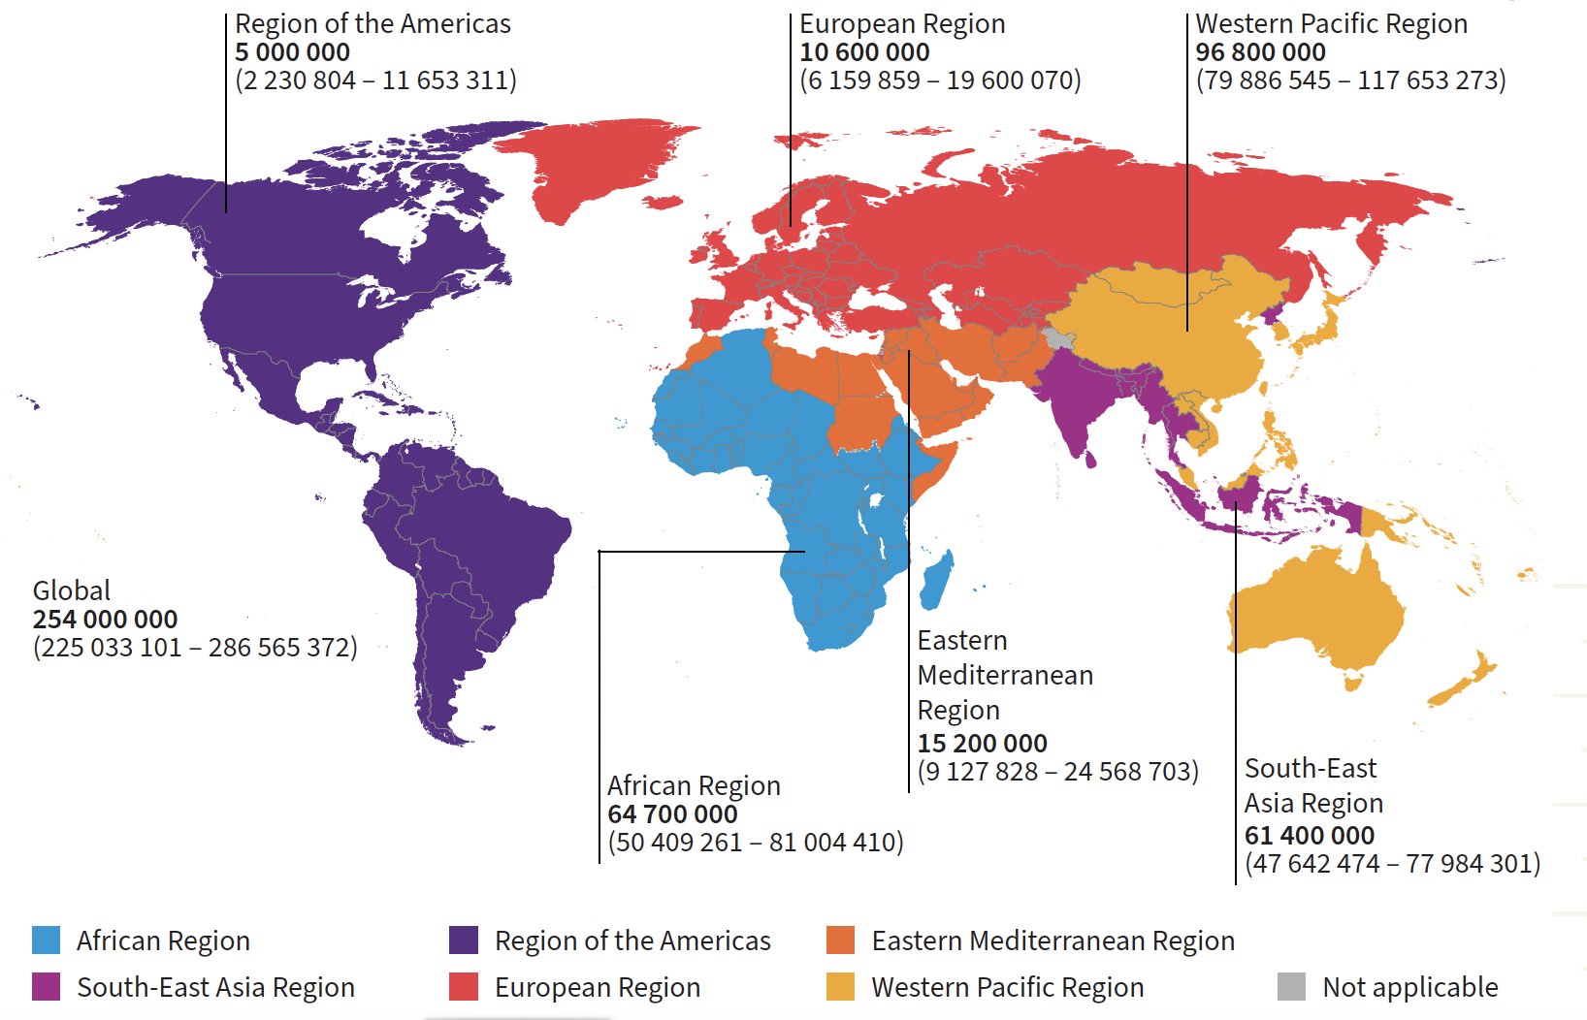
Hepatitis B in Africa
HBsAg modelled prevalence in 2022: 5.8% in WHO AFRO region
WHO Africa: Accounts for 63% of all new HBV infections
WHO Africa 2022: 64.7 M (50.4-81.0 M)
New infections: 771 000
Deaths: 272 000
Further compounded by:
Co-infections
1.9 M people living with HIV-HBV
1.6 M [95% CI 1.1–2.5] living with HDV-HBV
Increasing alcohol consumption & metabolic risk factors
Accelerate risk of HBV-related cirrhosis & HCC
https://immunizationdata.who.int/pages/coverage/hepb.html
WHO Global Hepatitis Report 2024

Slide 4
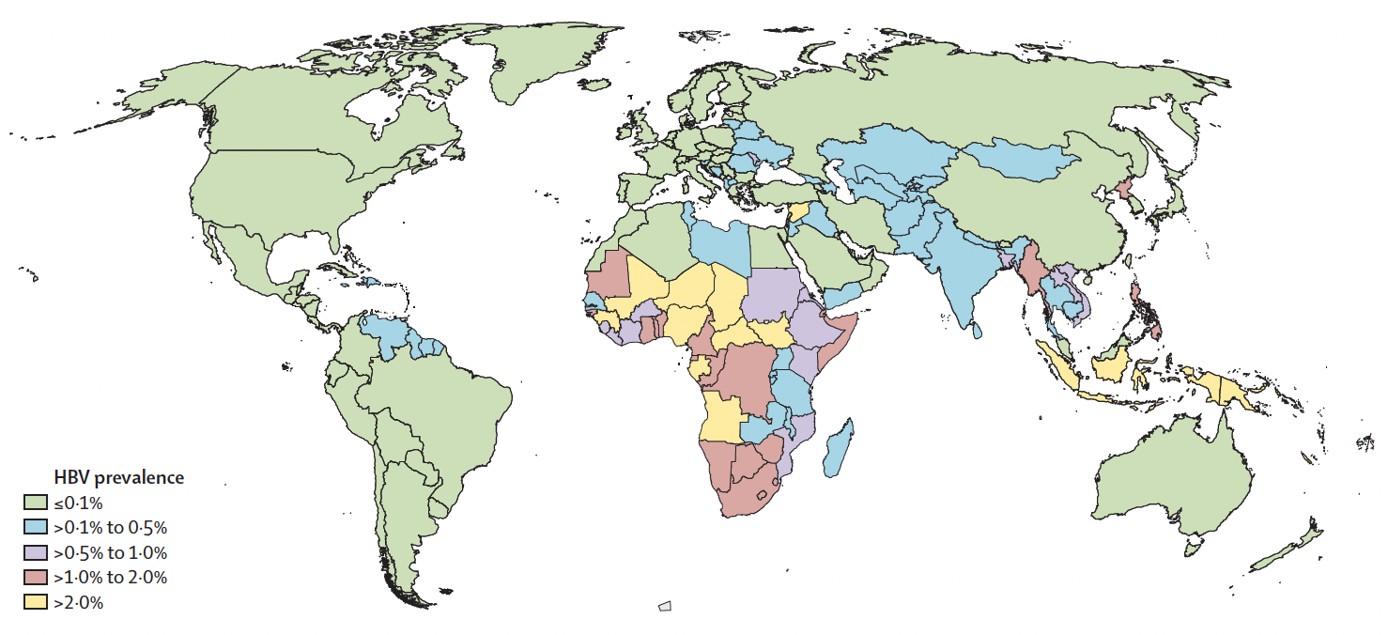
Hepatitis B in Africa: Children <5years old
Global: 2020 target: <1.0% 2030 target: $≤$0.1%
WHO AFRO 2020 target: <2%
HBsAg positive children <5 years: 2022
Global: 5.6 M (4.5-7.8)
0.7% (0.6-1.0) prevalence
WHO AFRO: 3.6 M (2.9-4.9)
1.7% (1.3-2.3) prevalence
2.4-fold higher than global prevalence
Highest prevalence in WHO AFRO region
64% of all children living with chronic HBV reside in WHO AFRO
Only 15 countries: <1.0% HBsAg me
Failure of Maternal and Child health services to identify HBsAg positive pregnant women and prevent HBV MTCT and early childhood HBV acquisition
Polaris Observatory: Lancet Gastroenterol Hepatol 2023;8:879

Slide 5
Prevention of Perinatal HBV Infection
Systematic review:
Earlier age at infection
associated with:
Increasing probability of
chronic HBV infection
Worse liver outcomes
Shimakawa et al;
PlosOne 2013; 8(7): e69430
Longitudinal study in The Gambia: HBV MTCT was a risk factor for:
Persistent high viral replication
Significant fibrosis
HCC
Shimakawa et al; Gut 2016;65(12):2007

Slide 6
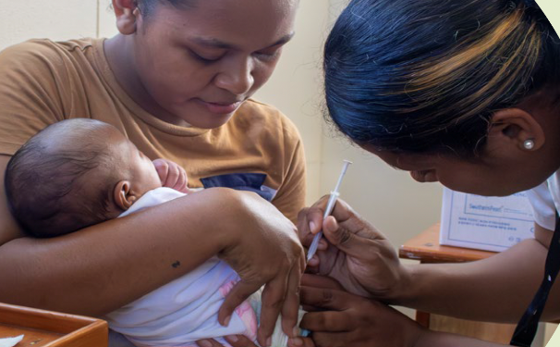
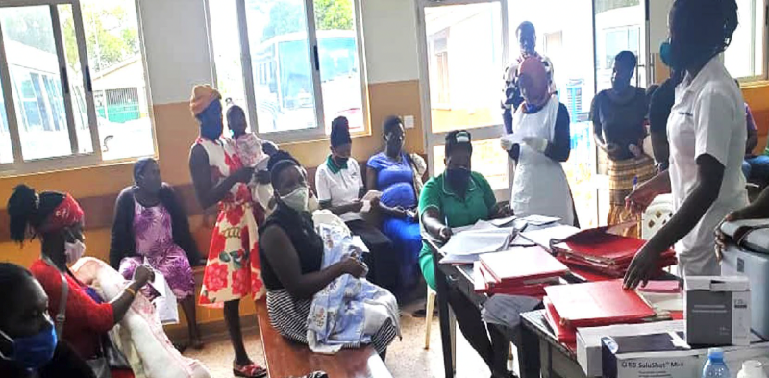
Hepatitis B
is vaccine preventable & treatable
BUT
Only 15 (32%) WHO African countries have implemented the HB-Birth dose vaccine
18% timeous HB-BD coverage
Full HBV-3 vaccine coverage: 72%
Diagnosed: 2.7 M (4.2%)
Treated: 150 000 (0.2%)
Traditionally, decisions to initiate treatment were dependent on assessing the ALT level, HBV DNA (replication) and the stage of the liver disease (severity of fibrosis)
WHO Global Hepatitis Report 2024

Slide 7
Hepatitis B: Challenges in Africa
28 countries in WHO Africa have National Viral Hepatitis Strategic Plans
Integration into healthcare services and dedicated domestic funding for implementation
Central to any Elimination strategy is diagnosis and linkage to care
Limited access to affordable & funded diagnostics: POC tests: HBsAg and HBV DNA quantification
HBeAg is poor proxy for high HBV viral load: West Africa: HBV GT E: HBeAg negative Southern Africa: Subgenotype A1: Loses HBeAg early
12-16% HBeAg-negative women have HBV DNA ≥5 log₁₀ IU/mL
Failure to prevent, diagnose & treat HBV: Major factor contributing to cirrhosis & HCC burden
2017 Global burden of disease: Lancet Gastroenterol Hepatol 2020; 5(3): 245
SSA: Highest cirrhosis-related age-standardized death rate: GBD super-regions
32.2 [95% UI 25.8–38.6] deaths per 100,000: Almost double global level of 16.5 [15.8– 18.1]
HBV leading cause of cirrhotic deaths: West Africa (48.9%); Central Africa (31.2%), East Africa (25.9%) & Southern Africa (21.9%)
GLOBOCAN 2020: CA Cancer J Clin 2021; 71: 209
HCC: 2nd leading cause of cancer deaths in men, 3rd in women in WHO Africa: HBV 65.8%

Slide 8
Hepatitis B: Challenges in Africa
Epidemiology
25% of all HBsAg positive individuals are <20 years in SSA
75% of HBsAg positive individuals have HBV DNA levels <2 000 IU/ml
Lack of longitudinal natural history studies
HCC, often multifocal and inoperable, presents at a young age: Early HBV DNA integration
Low levels of awareness amongst healthcare workers and the public
Transmission risks: Predominantly Mother-to-child transmission or early childhood
Silent but preventable and treatable disease with devastating consequences in young adults
Siloed healthcare structures: Dedicated International funding: HIV, malaria and TB
Complex treatment algorithms: High threshold for treatment
Stigma and discrimination impair healthcare seeking
Vulnerable groups: Refugees, IDPs, Incarcerated, SWs, LGBTQ: Underserved
Out-of-pocket payment: HB-Birth dose vaccine, diagnostics and antivirals

Slide 9
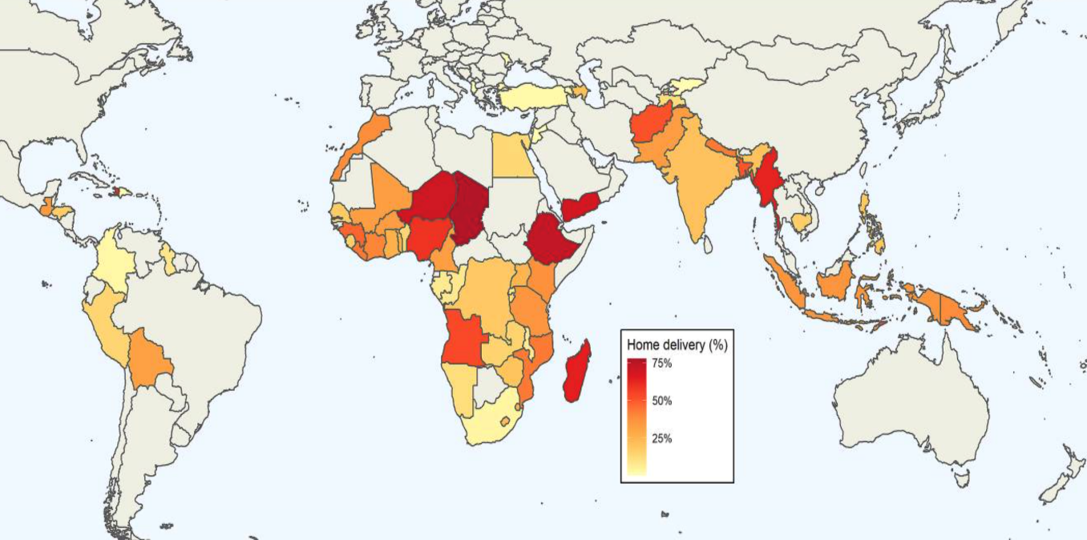
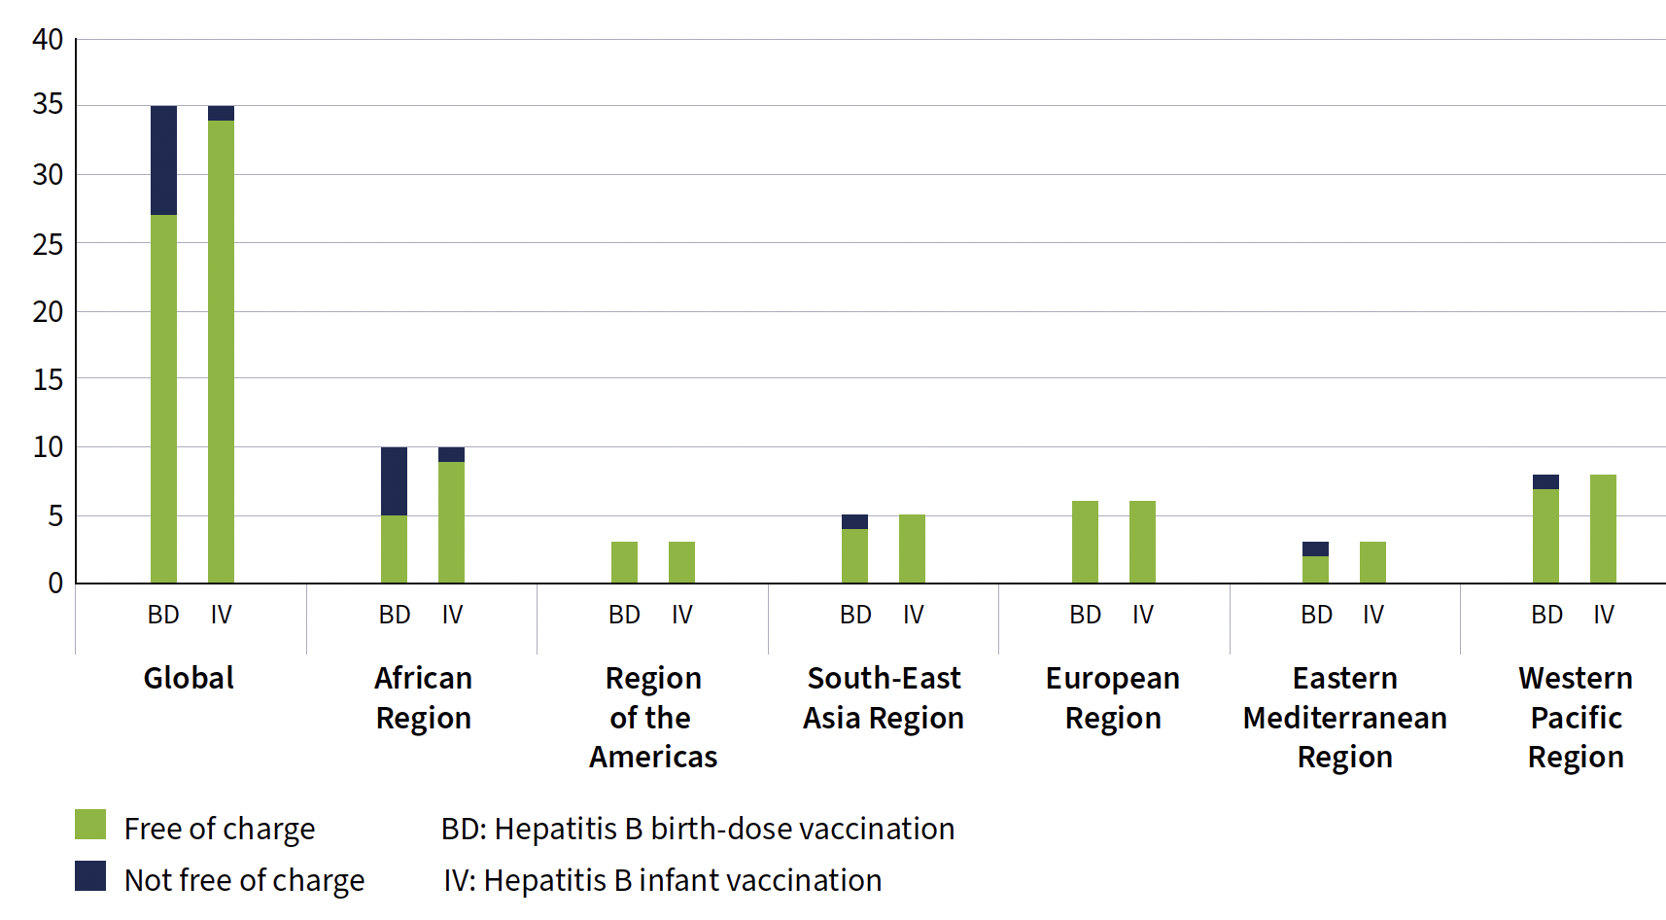
Prevention of HBV MTCT : Challenges to HB-BD Vaccination in Africa
Cost of Hepatitis B Vaccination
Home Deliveries: Sub-Saharan Africa: 31%,
(95% CI: 0.25–0.39)
7 Countries >50% home births
Chad: 78% (95% CI: 0.77–0.79)
Ethiopia: 73% (95% CI: 0.73–0.74)
Niger: 70% (95% CI: 0.69–0.71)
WHO 2024 Global Hepatitis Report
SSM Popul Health 2021 Dec; 16: 100955

Slide 10
Addressing the Challenges
Role of Advocacy
Contextualizing HBV education and treatment guidelines, within the beliefs, behaviours, experiences, and expectations of PLWHB in different settings
HBV champions and peer supporters
Enhance the profile of HBV, education, and tackle stigma
Women in Hepatitis Africa: Trained >5 000 African women (18 countries) as ‘Hepatitis Champions’
>90% uptake of HB-Birth dose vaccination by low literacy women for their babies, and improved overall health outcomes for mothers and infants: Makoko community in Nigeria
Sharing stories: Hepatitis B Foundation (‘HepBStories.Org’) & the World Hepatitis Alliance (‘Stories’)
Develop culturally and regionally targeted communication strategies for HBV that enhance knowledge and reduce stigma
BMC Global & Public Health
2023: 1:24

Slide 11
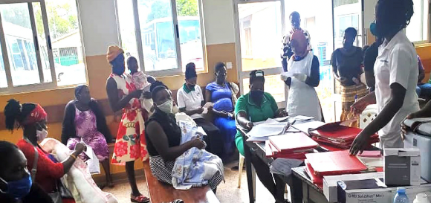
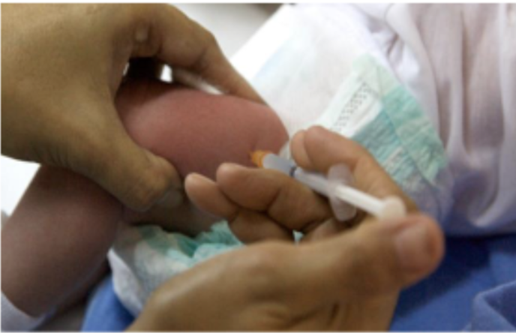
Addressing the Challenges
Improved HBV prevention strategies
Vaccination, esp HB-Birth dose Vaccination is cornerstone of HBV prevention
June 2023: Gavi: Recommitted HB-BD vaccine support for LICs: Sustainable implementation
Modelling studies repeatedly shown HB-BD vaccination to be cost-effective
Home deliveries and HB-Birth dose Vaccination: China, Indonesia and Vietnam
Increasing capacity for auxiliary health workers or community health workers to administer HB-BD vaccines at home
Pregnancy tracking to improve HB-BD coverage: Village health workers inform community health workers of births
Anti-viral prophylaxis for highly viraemic HBsAg-positive pregnant women
<1% of pregnant women screened and treated to prevent HBV MTCT in Africa
Limited access to HBV viral load quantification
WHO triple elimination initiative (HIV, syphilis and HBV) ensuring universal access to affordable POC screening, treatment, and follow-up of all women is key
Follow-up HBsAg screening of partners & families: Break cycles of infection within communities

Slide 12
Addressing the Challenges
Improved access to HBV diagnostics
Prevention strategies and expanded treatment access programmes can only be realized if affordable and reliable diagnostics are available
HBV molecular diagnostics often more expensive than costs of 1-year TDF (32 USD/annum)
WHO prequalified HBsAg POC tests must be available at primary care level
To identify and link PLWHB to care
HBV DNA POC testing has potential to risk-stratify PLWHB
Transient elastography to assess liver fibrosis and risk of cirrhosis and HCC
Novel screening approaches: Active screen all approach
Community screening initiatives: Raise awareness of viral hepatitis & increase early case finding
Linking HBV screening to other events: Census initiatives and village festivals: Rwanda
Cooperation with religious leaders: Linkage of campaigns & public education with major religious festivals
National screening: Egypt screened 60 M people for HCV

Slide 13
Addressing the Challenges
Simplified and expanded access to HBV treatment: Integrate care
Mother-to child prevention and HBV treatment algorithms that can be implemented at primary care/community level
Sustainable access to Tenofovir and ensure retainment in care and adherence to treatment
WHO 2024 HBV Treatment Guidelines: Demystify the management of Hepatitis B
4 options for meeting treatment eligibility: Captures at least 50% of all PLWHB people versus previous 8–15%
New APRI (AST to Platelet Ratio Index) criteria for staging liver disease: >0.5 for F2 fibrosis
Alternative antiviral regimens for treatment of Hepatitis B
Expanded access to antiviral prophylaxis for HBsAg positive pregnant women
Use of point-of-care HBV DNA assays at primary care level
Reflex Hepatitis D co-infection testing if HBsAg positive: Need to address access to Bulevirtide

Slide 14
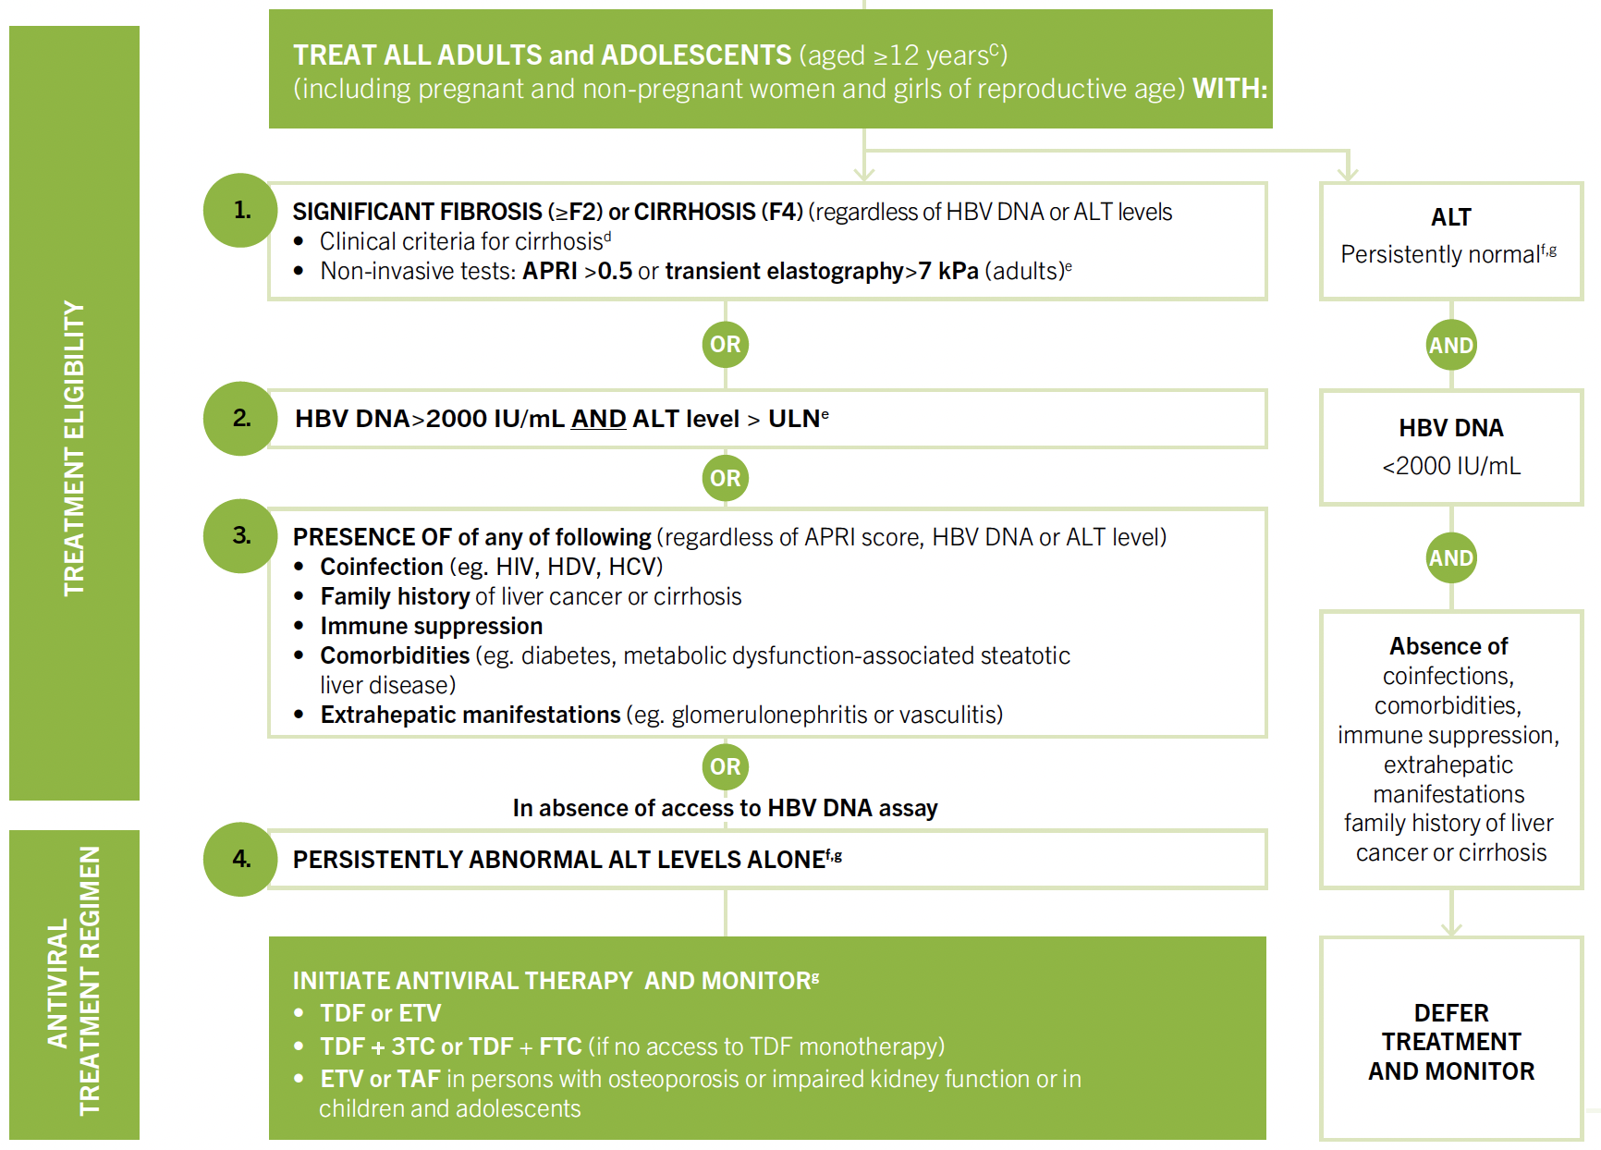
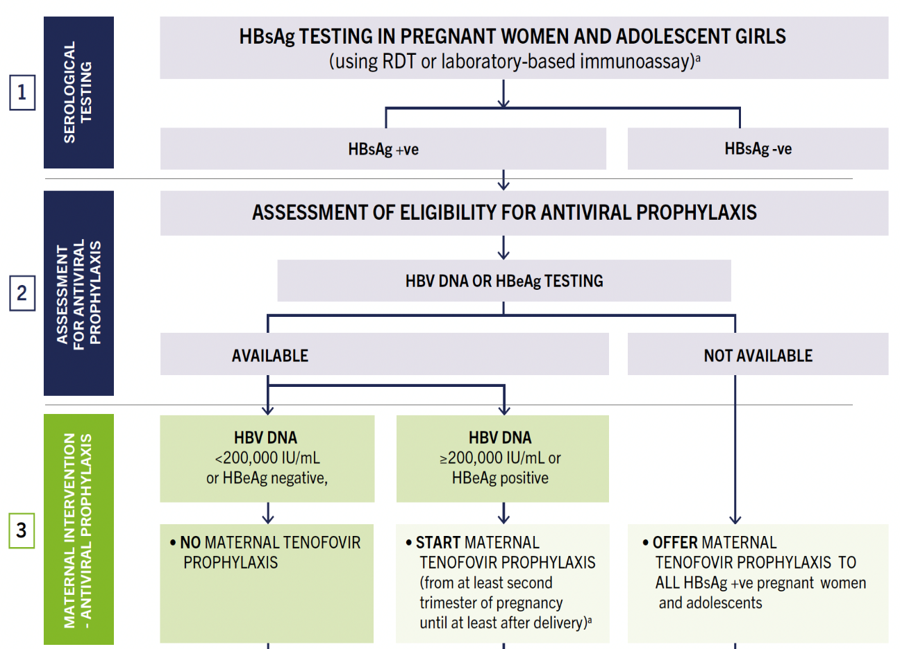
WHO 2024 Hepatitis B Guidelines
4 options for meeting treatment eligibility will capture at least 50% of all HBsAg-positive people versus previous 8–15% PLWHB
TDF prophylaxis for preventing HBV MTCT no longer dependent on HBV DNA quantification

Slide 15
Hepatitis B in Africa: Addressing the Challenges
Increase HCW and public awareness of HBV transmission routes
Educate that it is a silent but vaccine preventable disease with devastating consequences of cirrhosis and hepatocellular carcinoma
Know your status
Address stigma and discrimination: Hepatitis B champions
Increase diagnosis and linkage to care
Ensure access to affordable POC diagnostics
Implement simplified treatment algorithms that enable decentralised care
Ensure sustainable access to lifelong Tenofovir
Need Domestic-funded implementable National Viral Hepatitis Strategic Plans

