Slide 1
Hepatitis C elimination: Sharing best practices
Akaki Abutidze MD, MPH, PhD
Deputy Director for Research, Infectious Diseases, AIDS and Clinical Immunology Research Center. Associate Professor, faculty of medicine, Tbilisi State University. Tbilisi, Georgia
Viral hepatitis: Not gone, not forgotten

Slide 2
Declaration of conflict of interest
I have nothing to disclose.

Slide 3
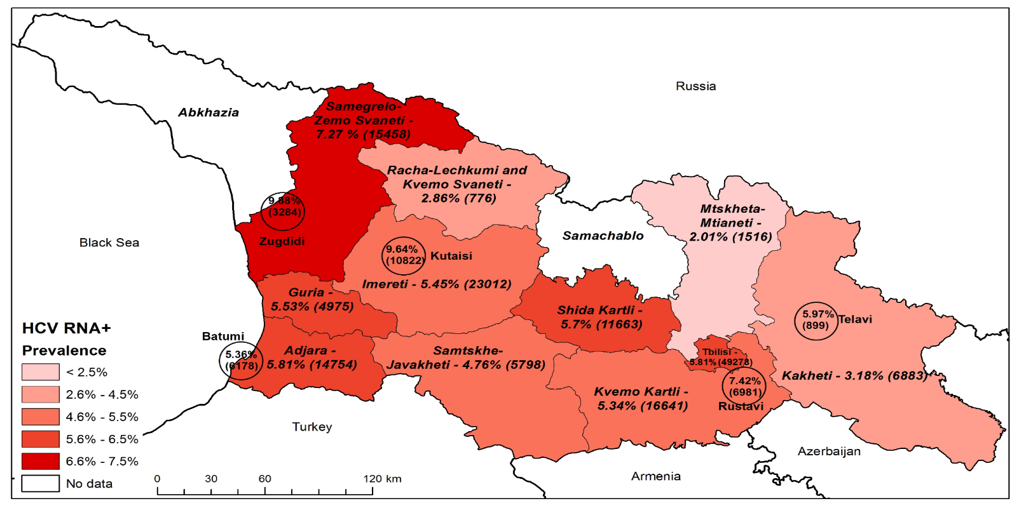
Epidemiology of hepatitis C in Georgia, 2015-2021
The initial serosurvey on Hepatitis C conducted in Georgia in 2015 showed a prevalence rate of HCV RNA in 5.4% of the adult population.
In 2021, the NCDC in close partnership with the U.S. CDC conducted the 2nd nationwide serosurveys on hepatitis B and C.
In 6 years, the prevalence of chronic HCV infection has decreased by 67% (from 5.4% in 2015 to 1.8% in 2021).
Prevalence and Estimated Number of HCV RNA+ Individuals by Regions and Cities, 2015
2015 and 2021 National Serosurvey for Hepatitis B and C in Georgia
Characteristics | Adults 2015 | Adults 2021 | Children 2021
Anti-HCV+ | 7.7% | 6.8% | 0%
HCV RNA + | 5.4% | 1.8% | 0%

Slide 4
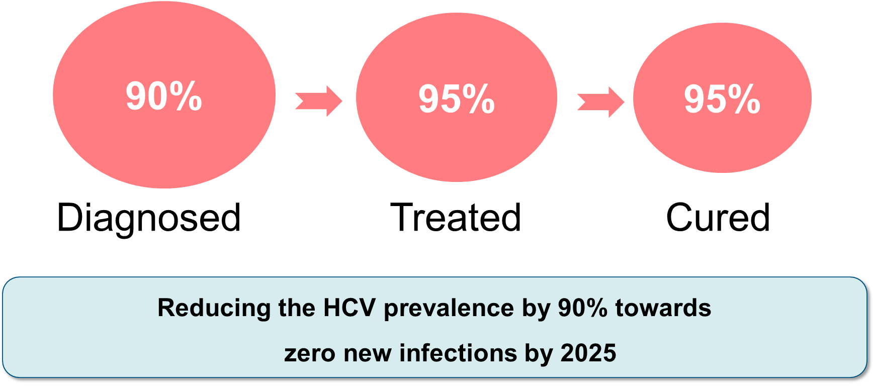
National Hepatitis C Elimination Program
Launched in April 2015
Targets: 90-95-95 by 2025
Georgia
Gilead committed to supply the elimination program with
Sofosbuvir, Ledipasvir/Sofosbuvir and Velpatasvir/Sofosbuvir free of charge.

Slide 5
Georgia’s HCV elimination program builds on delivering a comprehensive response
Nationwide HCV screening
Baseline and follow-up
sero-prevalence surveys
Active case finding
Treating (including retreatment) all HCV-infected persons
Web-based information system
HCV
Elimination
Public awareness and education
Infection control
Surveillance
Harm reduction
Blood safety

Slide 6
Timeline of key activities under the Hepatitis C Elimination program in Georgia
Diagnostics available and free of charge
Decentralization
of HCV Diagnostic, Care, and Treatment Services to PHC and HR services
Georgia named EILF Center of Excellence in Viral Hepatitis Elimination
All diagnostics free of charge
Showed by conducted Population-based Serosurvey of Prevalence and Risk Factors for SARS-CoV-2, HCV, and HBV
67% decrease In prevalence
A 10-year agreement between Gilead and the GOG signed
First National Strategy 2016–2020 approved
HBV state program drafted
2016
2018
2020
2022
2024
2015
2017
2019
2021
2023
Launch of the elimination Program
Nationwide serosurvey: 5.4% adults with chronic HCV
Beginning of National screening program
A pilot project – Integration of HCV, TB, and HIV Detection at PHC level initiated
The linkage-to-care program initiated
NCDC is designated as the WHO CC on Viral Hepatitis Elimination
National Strategy 2021–2025 updated
HBV workgroup established
HBV state program approved

Slide 7
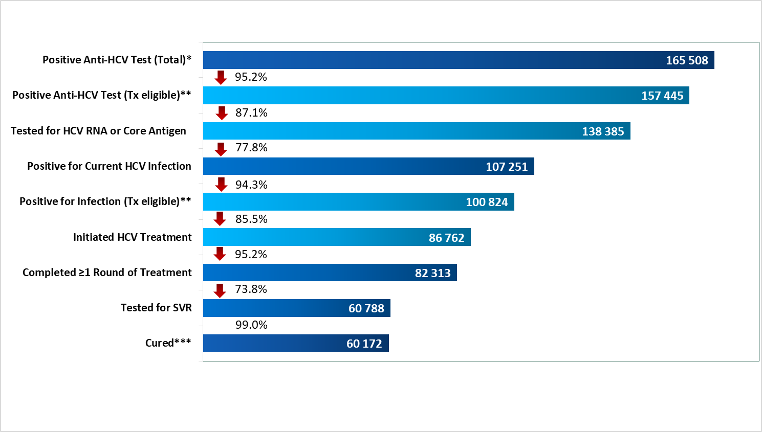
19,060
Since 2015:
· over 6,7 million HCV screenings
· over 2,8 million persons tested
· 165 508 anti-HCV positive cases identified
· 19,060 anti-HCV+ individuals to follow-up and link to care
· Over 86,762 patients started treatment
· Cure rate – 99%
-14,062

Slide 8
HCV Micro-elimination Among PLHIV Aware of Their HIV Status
Free HCV treatment since 2011
6.6-fold decrease in viremic infections
Prevalence decreased from 27% to 4.1% − 85% reduction
Reinfection rate: 2.55/100 PY

Slide 9
Hepatitis C Elimination Program in Georgia: Best Practices
Infection prevention and control
Electronic registries
Integrated TB/HIV/HCV screening
Decentralisation of testing and treatment
The Technical Advisory Group (TAG)
Established to collect real-time data for testing and treatment progress of the enrolled individuals
implemented at primary healthcare centers and Harm Reduction Centers.
Point-of-care viremic testing and initiation of HCV treatment are free of charge and widely available
Composed of 12 international experts, providing the monitoring and evaluation of indicators, as well as recommendations on long-term elimination strategy.
Established in the medical and non-medical facilities;
Blood Safety - All screenings using Nucleic Acid Testing (NAT)
1
2
3
4
5

Slide 10
Challenges & Next Steps
5. Apply for the validation of path to hepatitis C elimination
05
1. Strengthen linkage-to-care
Diagnose remaining 19 060 individuals
Treat remaining 14 062 individuals
01
04
4. Raising awareness
about hepatitis B and C, treatment availability and National Elimination Program
2. Strengthen infection transmission prevention
Both in general and key populations
02
03
3. Increase Hepatitis B vaccination coverage
among target and key populations

Slide 11
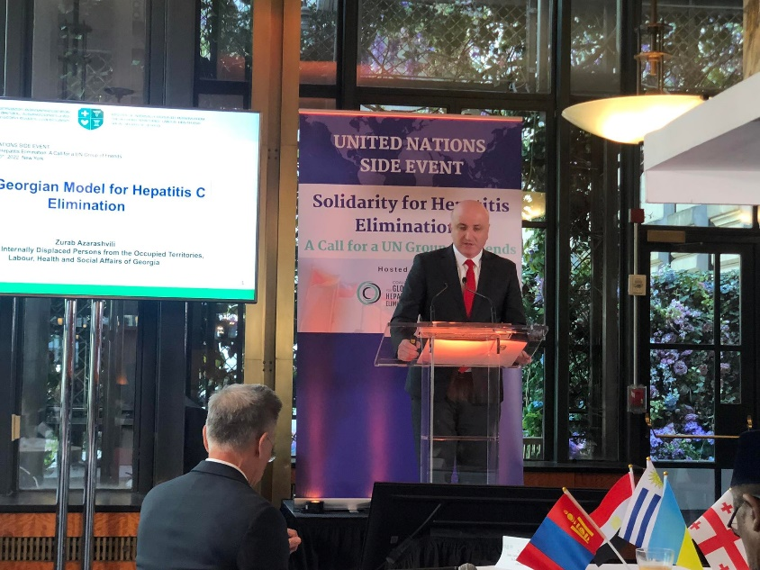
A UNITED NATIONS SIDE EVENT Solidarity for Hepatitis Elimination: A Call for a United Nations Group of Friends. September 20th, 2022. New York.
Georgia invited all Member States to join formation of the UN Charter/Group of Friends to
Eliminate Hepatitis

Slide 12
Acknowledgement

