Slide 1
Under threat: Findings and recommendations from the IAS–Lancet Commission on Health and Human Rights
Marlène Bras, International AIDS Society
Lancet Health and Human Rights
Notes:
Thank you very much for joining us today and welcome to this symposia session Under threat: Findings and recommendations from the IAS–Lancet Commission on Health and Human Rights.
When it was launched in 2021, this Commission was charged with using innovative thinking to explore the state of health and human rights and the reasons for global backtracking. As we all have witnessed, the COVID-19 pandemic has highlighted significant inequities in vaccine access. Although we have seen a considerable achievement in the development of safe and effective vaccines, the distribution was shown to be profoundly unequal, leaving many vulnerable populations and geographic areas without protection. These inequalities emphasize the urgency to champion human rights and ensure that healthcare services and progress are inclusive and accessible to everyone.
This IAS-Lancet Commission emphasizes the importance of integrating human rights at the centre of global health initiatives. Our success as an international global health community requires that everyone has the right to dignity, healthcare and to benefit from scientific progress. We need to remember that only inclusive societies with acceptance, mutual respect and solidarity as their guiding principles can withstand the complex challenges of our time. By embracing global solidarity, urging for peace in all regions and for equitable distribution of healthcare, we can build a healthier, more just world.

Slide 2
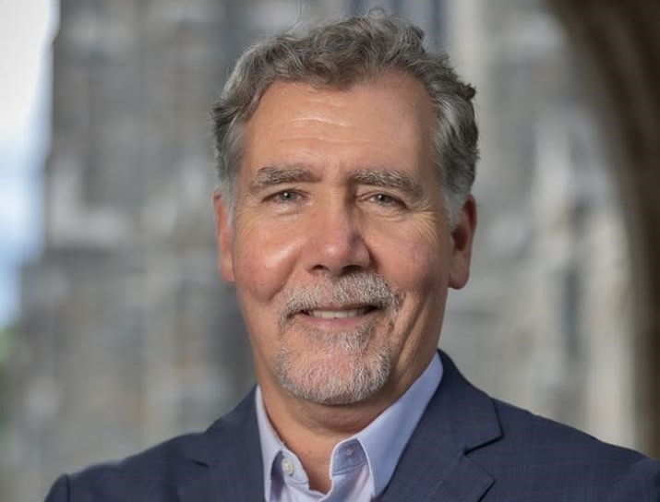
Introducing the session chair
Chris Beyrer is the Director at the Duke Global Health Institute, Gary Hock Distinguished Professor in Global Health, Professor of Medicine at Duke University and Associate Director for Global HIV at the Duke Center for AIDS Research (CFAR).
Chris is also past president of the International AIDS Society and Co-Chair of IAS–Lancet Commission on Health and Human Rights with Adeeba Kamarulzaman, MD.
Notes:
I am now giving the floor to our next speaker and moderator for this session Chris Beyrer, Director at the Duke Global Health Institute, Gary Hock Distinguished Professor in Global Health, Professor of Medicine at Duke University and Associate Director for Global HIV at the Duke Center for AIDS Research. Chris is also a past president of the International AIDS Society and he Co-Chaired the IAS–Lancet Commission on Health and Human Rights process along with our immediate IAS past president Adeeba Kamarulzaman. We are very thankful to the important contribution that they and all of the commissioners have made through the work of the commission over a number of years.
Thank you

