Slide 1
Under Threat:
The IAS-Lancet Commission on Health and Human Rights
Chris Beyrer MD, MPH
Director, Duke Global Health Institute
Gary Hock Distinguished Professor in Global Health
Lancet Health and Human Rights

Slide 2
Committee Members
Co-Chairs: Chris Beyrer and Adeeba Kamarulzaman
Michael Isbell, Joseph Amon, Stefan Baral, Mary T. Bassett, Javier Cepeda, Harriet Deacon, Lorraine Dean, Lilianne Fan, Rita Giacaman, Carolyn Gomes, Sofia Gruskin, Sandra Hsu Hnin Mon, Samer Jabbour, Michel Kazatchkine, Carrie Lyons, Allan Maleche, Natasha Martin, Martin McKee, Vera Paiva, Dainius Puras, Gerson Smoger, Lucy Stackpool-Moore, Peter Vickerman, Leonard Rubenstein.

Slide 3
The Universal Declaration of Human Rights at 75
Human rights principles and practices have led to major advances in health care access—in the HIV response, in child survival and now in the movement for Universal Health Coverage (UHC)
Yet the COVID-19 pandemic underscored how little equity, justice and the right to health have mattered
Climate change is impacting the health of the world’s poorest people—who contributed almost nothing to the climate crisis
Impunity for rights violations is becoming a new norm of war and a threat to the principle of medical neutrality
Rising racism, xenophobia, anti-immigrant policies and politics all threaten the human rights consensus and undermine the right to health

Slide 4
Framing Questions
What is the future of the health and human rights movement?
How can the health and human rights framework be re-vitalized and re-invigorated to achieve healthy communities?
What domains of the health and human rights framework are most relevant for ensuring robust health systems and universal access to care?

Slide 5
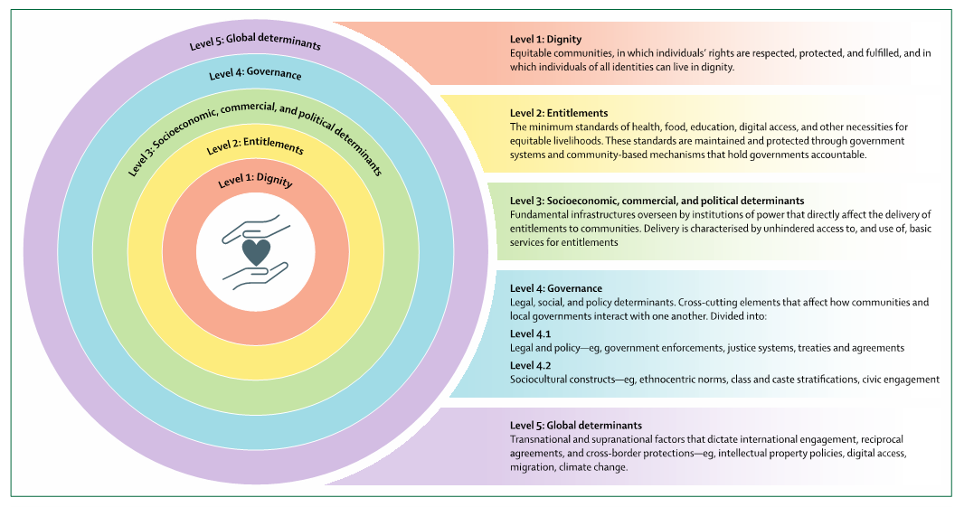
Social-Ecological Model for Health and Human Rights

Slide 6
Domains of Health and Rights Interaction
The Commission reviewed available evidence and developed actionable recommendations in 8 health and human rights domains:
Pandemics and equitable access to essential interventions
The climate crisis, health and rights
Conflict, displacement, migration, and refugees
Structural racism, inequity, and discrimination against devalued minorities
Sexual and reproductive health and rights
Misinformation, disinformation and the right to benefit from science
Artificial intelligence
The economic and commercial determinants of the right to health

Slide 7
The impact of vaccine misinformation on SARS-CoV-2 infections and COVID-19 related deaths in Texas: a modeling study
Misinformation was widespread during the pandemic and was associated with political ideology in the United States¹. Although misinformation reduces vaccine acceptability, its impact on COVID-19 mortality had not been quantified².
Three scenarios were modelled:
    status quo
    misinformation among Republicans equaled that of Democrats
    no misinformation
1. Jones and McDermott. Polity 2022. 2. Loomba et al. Nat Hum Behav 2021
Notes:
We developed models to estimate the impact of misinformation on vaccination uptake by political ideology and subsequent SARS-CoV-2 infections and mortality in Texas.
We estimated SARS-CoV-2 infections and deaths in Texas between 1 July - 8 October 8th 2021

Slide 8
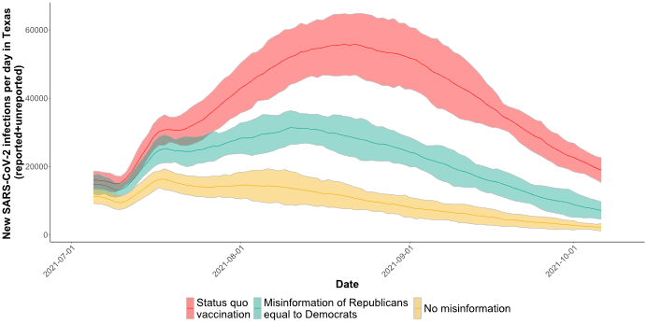
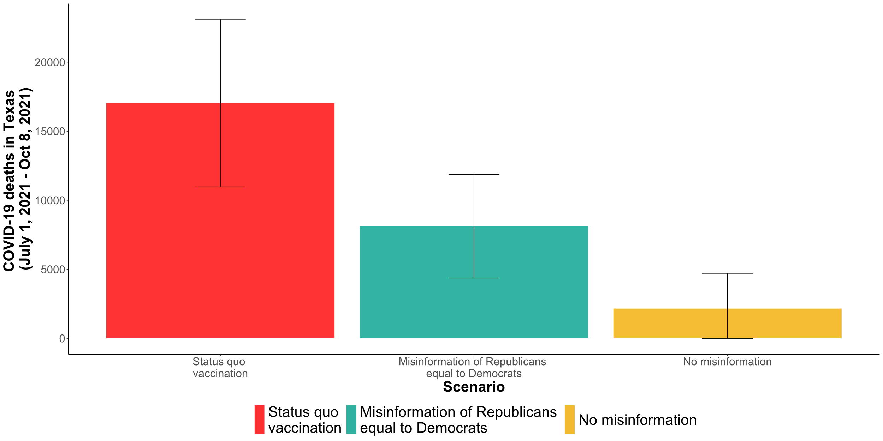
Key Findings
New SARS-CoV-2 infections in Texas
COVID-19 deaths
Notes:
Equal misinformation spread/consumption between Republicans and Democrats: 44% of SARS-CoV-2 infections (1.6 million infections) and 52% of COVID-19-related deaths (9K) could have been prevented in Texas from July-Oct 2021.
No misinformation: 75% of infections (2.7 million infections) and 87% of deaths (15K) could have been prevented in Texas.
Misinformation was an important driver of SARS-CoV-2 transmission and death.

Slide 9



Modelling the effect of homelessness and police displacement on violence among female sex workers in London, UK
19-44%¹ of sex workers experienced physical violence in past year
Risk of violence related to:
  Health and social inequalities, including poverty, homelessness, racial inequalities, and drug use
  Criminalization of sex work - repressive policing associated with 3-times higher odds of violence²
  Work setting (indoor vs outdoor)
1. Deering KN, et al. Am J Pub Health 2014;104:e42-e54.
2. Platt L, Grenfell al. PLoS Med 2018;15:e1002680
Notes:
Parent study in East London: Participatory, mixed-method study on how police enforcement affects sex workers’ safety, health, and access to services,
Dynamic model of violence among street-based sex workers and how affected by homelessness and repressive policing

Slide 10
Results
% experiencing recent violence
% experiencing recent violence
66% decrease
% recent homeless
% Police displacement
Notes:
Removing police displacement and/or homelessness - reduce violence by up to two-thirds
If interventions partially reduce homelessness or displacement:
Less impact
Hard to achieve [need 70-80% decrease in rates to halve prevalence of homelessness/ displacement]

Slide 11
Modeling impact and cost-effectiveness of police education program on HIV and overdose outcomes among people who inject drugs in Tijuana

Slide 12
Background
Certain policing behaviors, such as syringe confiscation and arrest, are associated with HIV and overdose risk in Tijuana, Mexico (and elsewhere).
Over 1,800 police officers in Tijuana received a public health and human rights-oriented education program to align policing with public health practice.
We developed a mathematical model to estimate the impact and cost-effectiveness of this police education program on HIV incidence and overdose among people who inject drugs in Tijuana.
Notes:
from Feb 2015- May 2016

Slide 13
Key Findings
Pre-training
Training
Post-Training
acquisitions
Notes:
Incarceration reported by people who inject drugs significantly declined after police in Tijuana received the training
Over two years, the intervention could have averted 2% new HIV infections and 12% of fatal overdoses
The intervention was cost-effective. Investing in public health and human rights-oriented police education has good value for money.

Slide 14
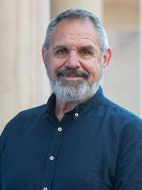
Introducing James Ward
James Ward is an Aboriginal man from Australia and Professor of Indigenous health and Director of the University of Queensland Poche Centre for Indigenous health with a long track record of working in HIV, STIs and viral hepatitis.
Notes:
I am now pleased to introduce James Ward. James Ward is an Aboriginal man from Australia and Professor of Indigenous health and Director of the University of Queensland Poche Centre for Indigenous health with a long track record of working in HIV, STIs and viral hepatitis.

