Slide 1
Under threat: Findings and recommendations from the IAS–Lancet Commission on Health and Human Rights
Human Rights Indigenous Australians and HIV
Professor James Ward University of Queensland
Lancet Health and Human Rights

Slide 2
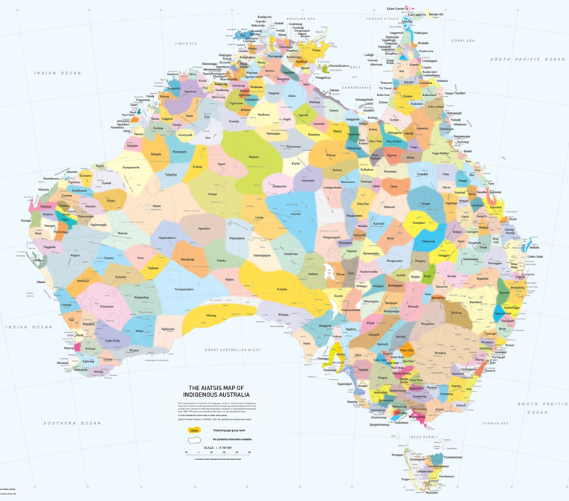
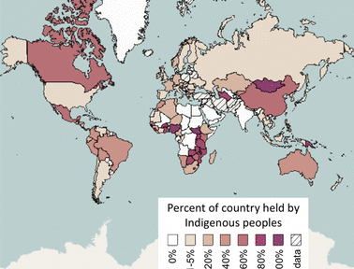

Slide 3
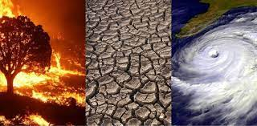
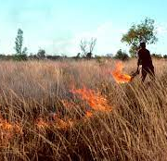
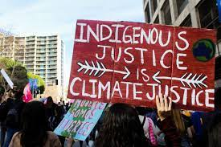
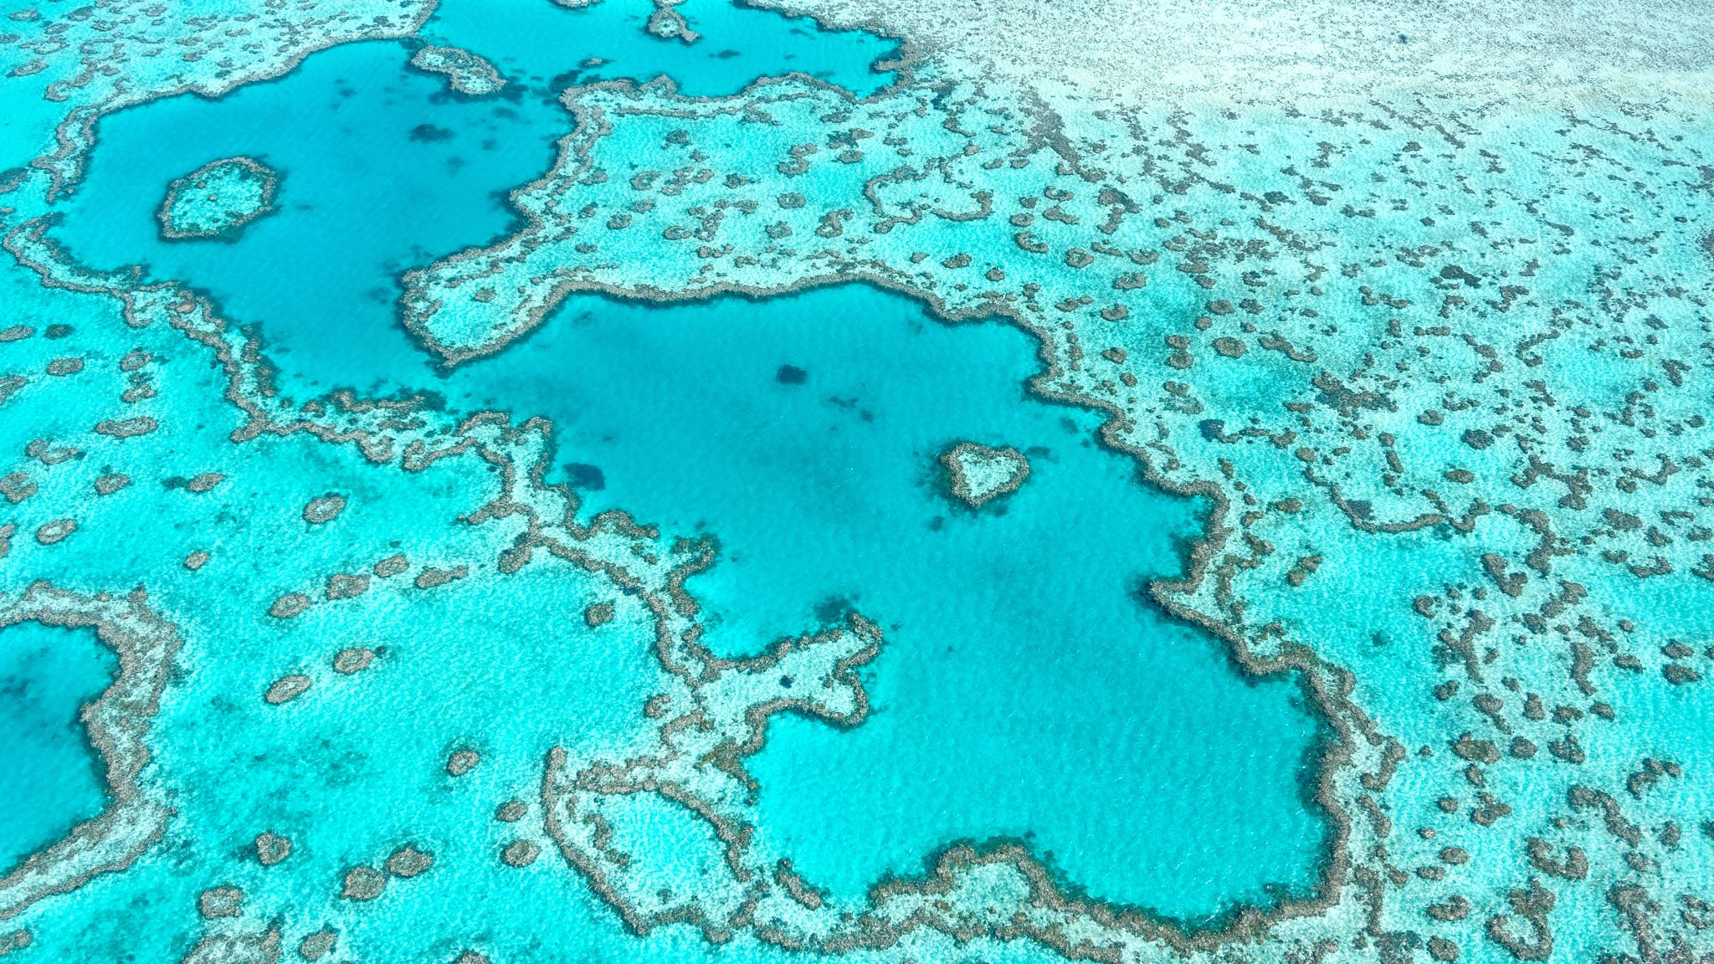
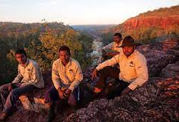
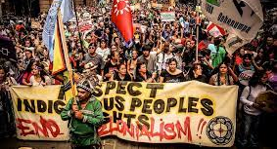

Slide 4


Slide 5

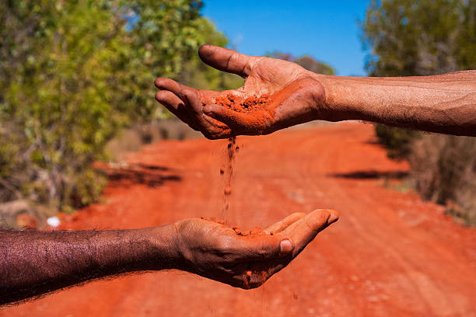

Slide 6
HIV Cases by Population Groups

Slide 7
Sexual & Reproductive rights
ASR of Gonorrhoea by Indigenous status and remoteness 2022
ASR of Infectious Syphilis by Indigenous status and remoteness 2022

Slide 8
