Slide 1
General Members’ Meeting July 2024 Secretariat Update

Slide 2
13,123
25.5%
12.5%
3,347
1,640
16.8%
2,204
37.8%
4,961
7.4%
971
Notes:
46.62% female, 45.42% male, 1.71% non-binary or gender non-conforming. 0.1% of members identify as trans.
Most IAS Members are healthcare workers at 38%, followed by researchers at 15.7% and professionals working in policy and administration at 13.4%.
Thank you for feedback on our 2026-2025 strategy!

Slide 3
Convene
Advocate
Educate
Address key knowledge gaps
Share latest research
Improve services
Notes:
A world in which HIV no longer presents a threat to public health and individual well-being.
The IAS unites the global HIV response because progress happens when science, policy and activism come together.

Slide 4
Notes:
Numbers
Highlights/coverage
Scholz if successful

Slide 5
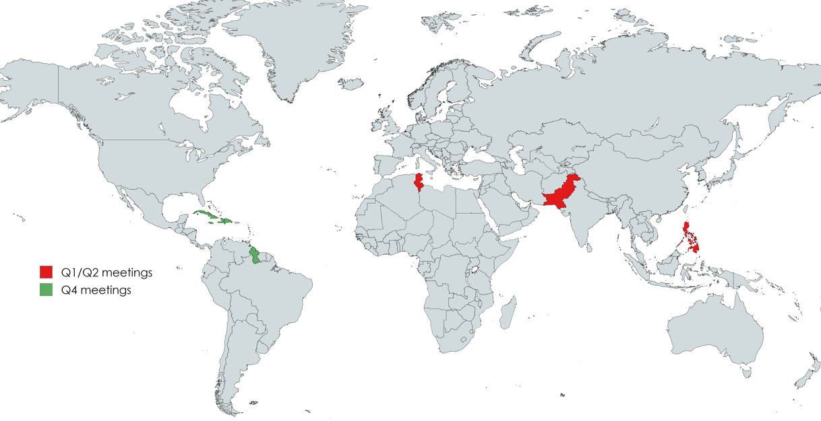
Notes:
300 HIV professionals reached in Q1/2 – not about the numbers but the calibre of people:
Q4 (Regional meetings)
Trinidad & Tobago (Caribbean)
Moldova (EECA)

Slide 6
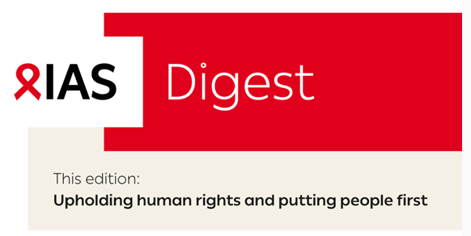
April - May 2024
June - July 2024
August – Sept. 2024
Upholding human rights and putting people first
Uniting the HIV response
Promoting the latest research
October – Nov. 2024
Dec. 2024 – Jan. 2025
February - March 2025
Advancing prevention
Improving access
Integrating services
Notes:
6

Slide 7
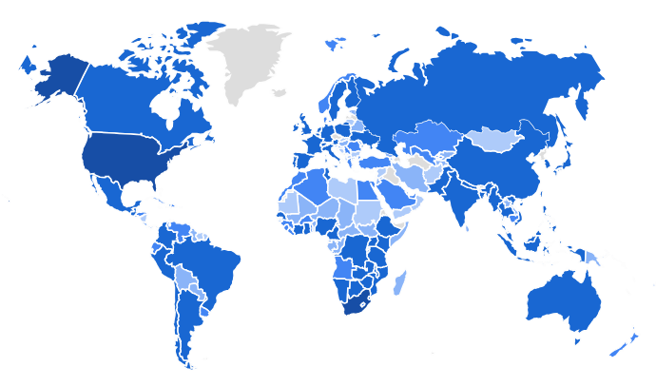
plus.iasociety.org
Notes:
Vehicle for annual themes
More than 1,660 resources in 13 different languages.
Almost 16,000 unique users from 171 different countries since launch at the end of October last year
New features in 2024 include:
Ability to host IAS Member-only content.
New in Q3/4 :
Translation into multiple languages to increase access for all.
Prize for Best Education or Professional Development Offering
7

Slide 8
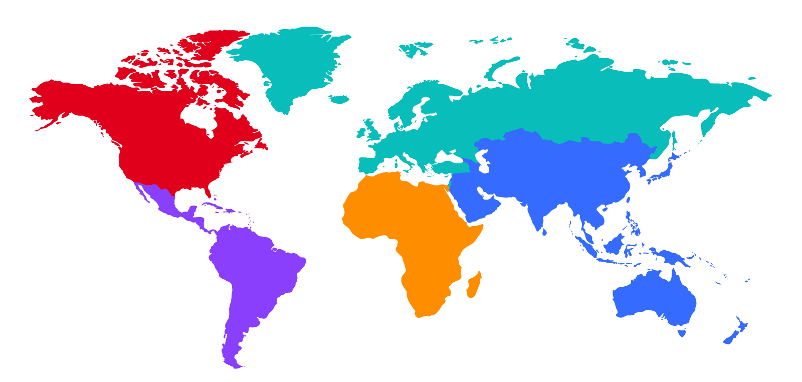
🎀HIVR4P 2026
🎀IAS 2025
🎀HIVR4P 2024
🎀AIDS 2026

Slide 9
Celebrating 20 years of global impact and scientific excellence!
Notes:
Hello everyone, I am Marlène Bras and I am the Executive Editor of the Journal of the International AIDS Society – the journal of our Society and all its members worldwide.
Today we are celebrating an important milestone: 20 years of publications! (and my 10 years with the journal)

Slide 10
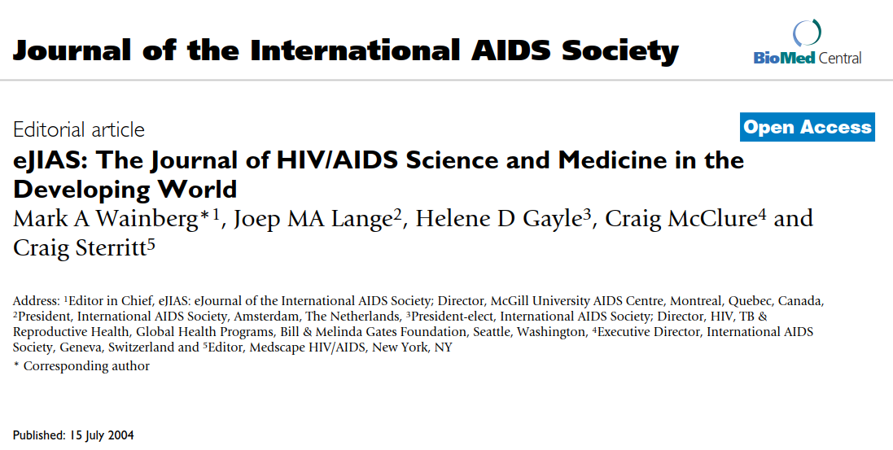
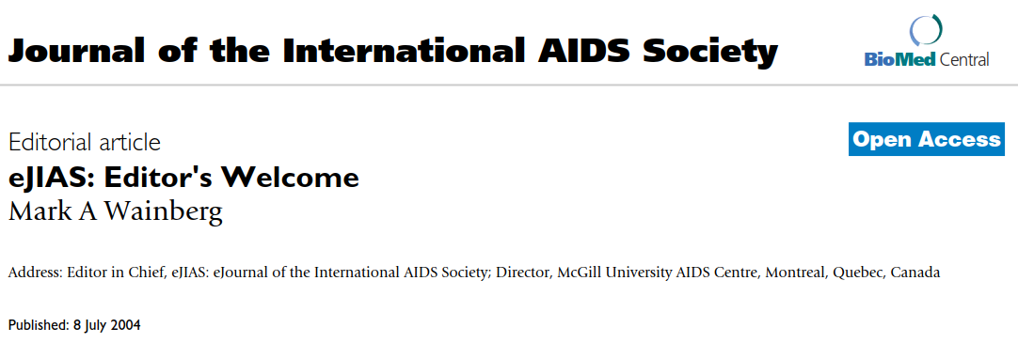
Founded by Dr. Mark A. Wainberg, past President of the International AIDS Society, and first launched during AIDS 2004 in Bangkok, Thailand
Notes:
JIAS was founded by our beloved past IAS president Dr. Mark Wainberg, and launched at the 15th International AIDS Conference in Bangkok, Thailand in 2024.
Mark had a visionary and revolutionary idea at that time: he wanted our journal to be open access so that the most impactful science could reach as many people as possible.

Slide 11
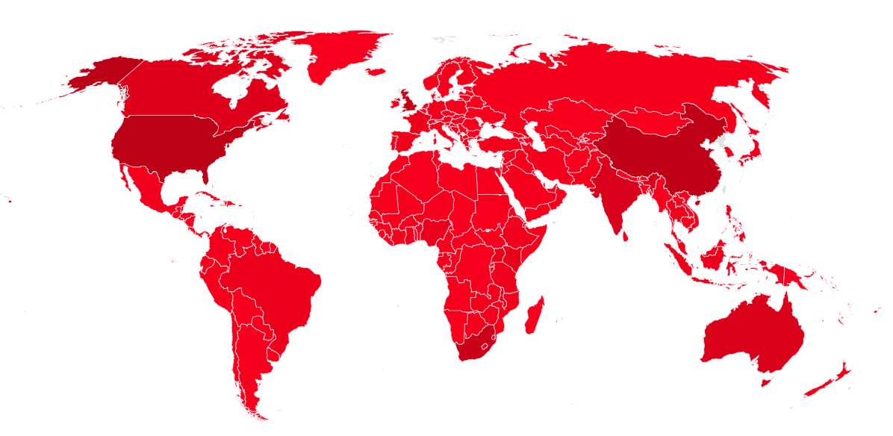
>2500 articles published!
Global reach!
79 supplements published!
>5000 participants attended our virtual workshops in the period 2022-2024!
Country of JIAS readers in 2023
Notes:
Today, at AIDS 2024, we are celebrating 20 years of global impact and scientific excellence of our Society journal!
We have published >2500 articles, all available for free to anyone without restrictions.
The map shows the countries where our readers were based in 2023, showing a truly global reach, with virtually every country in the world reading our articles – believe it or not, we had readers from Vatican City!
We have published 79 supplements on various timely and important issues
and just in the past 3 years, we provided scientific capacity-building opportunities to >5000 users globally, both IAS members and non-members!

Slide 12
We are thankful to our Editors-in-Chief who all served with passion and dedication, and to the numerous Editorial Board members, Deputy Editors, Reviewers, Authors and Readers!
Editors in Chief:
Mark Wainberg: 2004–2017
Elly Katabira: 2004–2009
Papa Salif Sow: 2009–2017
Susan Kippax: 2009–2019
Kenneth H. Mayer: 2017–present
Annette Sohn: 2018–present
Notes:
Last but not least, we, the JIAS team would like to thank the International AIDS Society for its continuous and unconditional support through its leadership and members worldwide.
And express our gratitude to our Editors-in-Chief, past and present, who all served with passion and dedication, and to the numerous Editorial Board members, Deputy Editors, Reviewers, Authors and Readers!

Slide 13
Thank you!
Notes:
Intro Marlene
Then Jen

