Slide 1
2023 Annual Accounts
IAS Members’ Meeting
23 July 2024
Jennifer Kates, IAS Treasurer

Slide 2
AGENDA
2023 audit
  2023 Consolidated Financial statements (FOR APPROVAL)
  IAS 2023 Conference
  Auditor’s report
Reappointment of auditor for 2024 (FOR APPROVAL)
Notes:
Good morning.
I am presenting to you the 2023 accounts.
Before we proceed, unless there are any objections, the auditors KPMG will not be calling in for the meeting today. But please note that the Finance Committee met with the auditors in June.
Any questions can be addressed today to me and Emmanuel Flamand, Finance director. Are there any objections?
The audited accounts include the 2023 consolidated financial statements of the IAS and the statement of the IAS 2023 conference.
You can find all the details online, and I will focus here on the main points.
Finally we will have to approve the appointment of the auditor for 2024.

Slide 3
2023 Audit Overview
Consolidated Financial Statements
  Net result $ 3,084k deficit
Conference
  IAS 2023 Conference $ 1,057k deficit
Auditor’s report
  Unqualified opinion on the 2023 Financial Statements
  Recommends approval by the Members
Notes:
The 2023 net result is a deficit of 3,084k.
The IAS2023 conference had a deficit of 1M. This does not add up to the result of the IAS (it is within).
The annual audit was very positive, and KPMG, our auditor, issued an unqualified opinion with no significant control deficiency.

Slide 4
Statement of Financial Activities
(Figures in thousand USD)
Notes:
In 2023 the total income is 15M, and total expenditure is 19M. These are higher than in 2021, as IAS2021 was much cheaper (virtual). We need to remember that we alternate every other years between a small and a big conference.
The operating result is a deficit of 4M.
Then we have an outstanding financial result of 847k that we will explain.
Then for the first time we are using the scholarship fund that allows to reduce the deficit, that it still 3M.

Slide 5
Statement of Financial Activities
(Figures in thousand USD)
Notes:
The result for governance, management and administration, the Secretariat, is a surplus of 331k. This is due to the outstanding financial result of 862k.
The forex gain of 106k represents the difference in exchange rates, primarily USD/CHF, at the end of the year. This is beyond our control.
The money market reflects what we do with our cash, and the gain is due to the interest rate.
Finally, we have an investment portfolio.
Overall, this amounts to an exceptional gain of 862k.
In 2022:
Forex -218
Money market 207
Investment -100

Slide 6

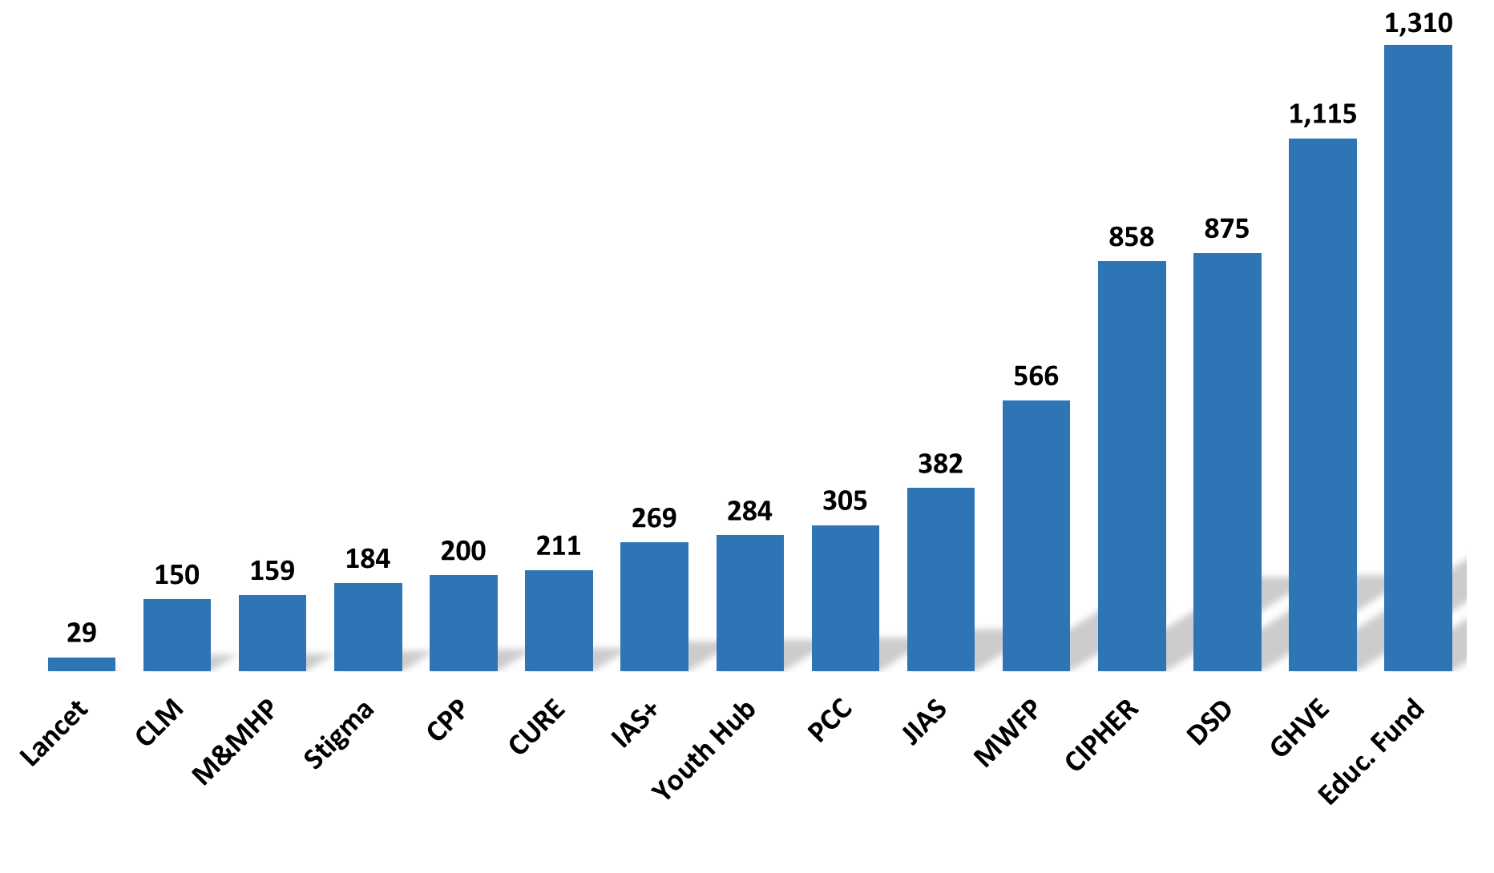
Statement of Financial Activities
(Figures in thousand USD)
Expense per programme
Notes:
For programmes, income amounts to 6.5 M dollars, and the expense to 6.9M.
Our main programme was the Educational Fund, followed by Global HIV Vaccine Enterprise and the Differentiated Service Delivery.

Slide 7
Statement of Financial Activities
(Figures in thousand USD)
Expense per programme
Notes:
The operating result is a deficit of 339k.
This is mostly due to the IAS+ that went live I October 2023. We are now looking for external funding.

Slide 8
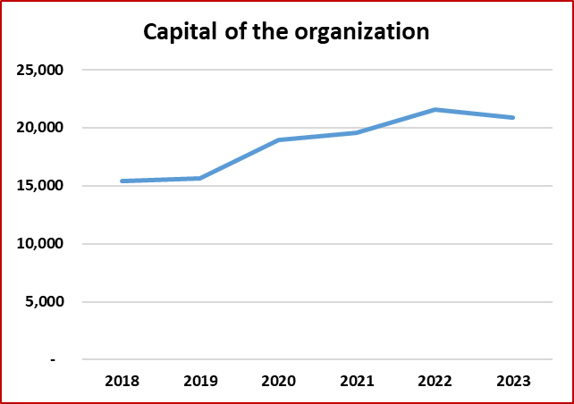
Capital of the organization excluding conf. pre-funding
(Figures in thousand USD)
Notes:
Let’s look now at the capital of the organization.
We used the scholarship reserve for IAS 2023 scholarship costs. These are restricted funds coming from delegates at the time of registrations.
We decided last year to modify the way we present and allocate our reserve.
All revolving funds were canceled, and are now at zero (right column), and we created a Risk reserve and a Fund for organizing conferences in LMIC. This fund will be used to compensate for lower local funding.
In 2023, the general reserve was used to cover the deficit of the conference and of Programmes. On the other hand, the secretariat surplus was added to it. All in all, the General reserve went from 4.5M to 1.8M, and the capital is now 20.8M.
If we look at longer perspective, we can see on the chart on the left, that the capital of the organization remains comfortable.

Slide 9

IAS 2023, Statement of Income & Expenditures
(Figures in thousand USD)
Notes:
Let’s now move to the Statement of Income and Expenditure of IAS 2023.
This table shows not only the expense and income incurred in 2023, but the full statement of the conference. Expenditures started in 2022.
This conference was expensive, and the number of paying delegates less than expected. The operating result is a deficit of 1M, and we used the scholarship reserve and the general reserve to cover it.

Slide 10

2023 Comprehensive Auditor’s Report
Unqualified opinion
No significant control deficiency
Recommends approval by the Members

Slide 11
Members approval
The GC recommends the Members to :
  Approve the 2023 consolidated financial statements
  Reappoint KPMG as IAS auditor for 2024

