Slide 1
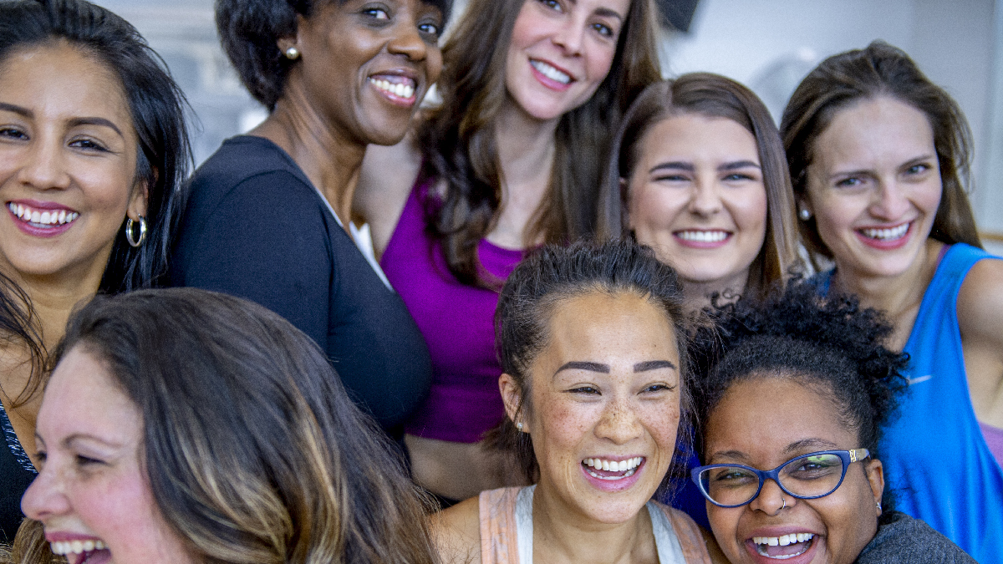
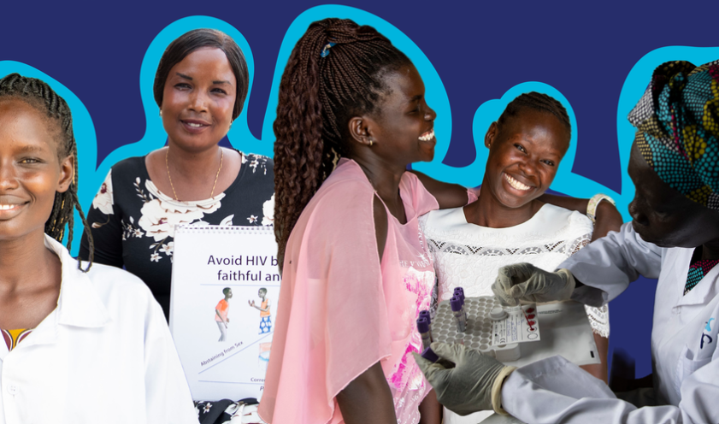
Women and HIV: Triumphs and Tribulations
Wafaa El-Sadr, MD, MPH, MPA
ICAP at Columbia University
Columbia Global

Slide 2
Outline of Presentation
Women and HIV
Triumphs and tribulations
Ending the epidemic
Conclusions
Reflections

Slide 3
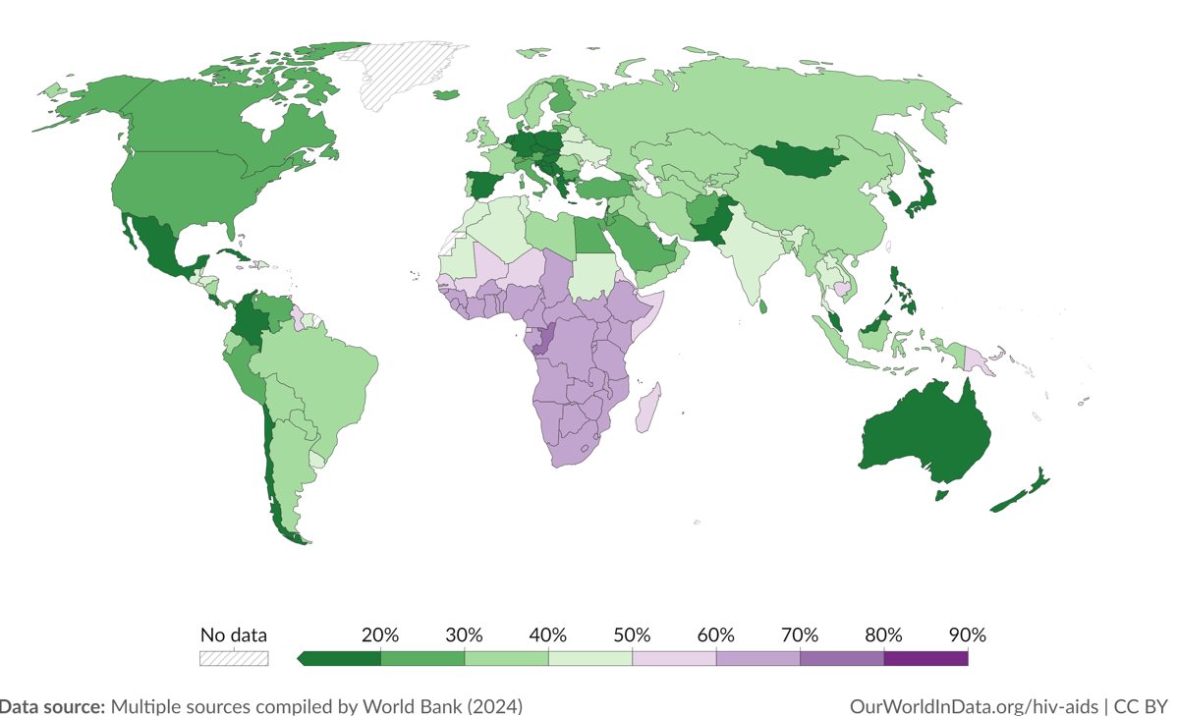
Global Burden of HIV Among Women
In 2022, there were 39 million [33.1 million–45.7 million] people with HIV
37.5 million [31.8 million–43.6 million] adults (15 years or older)
1.5 million [1.2 million–2.1 million] children (0–14 years)
53% of all people living with HIV were women and girls
Share of the population living with HIV (15 years and older) – women

Slide 4
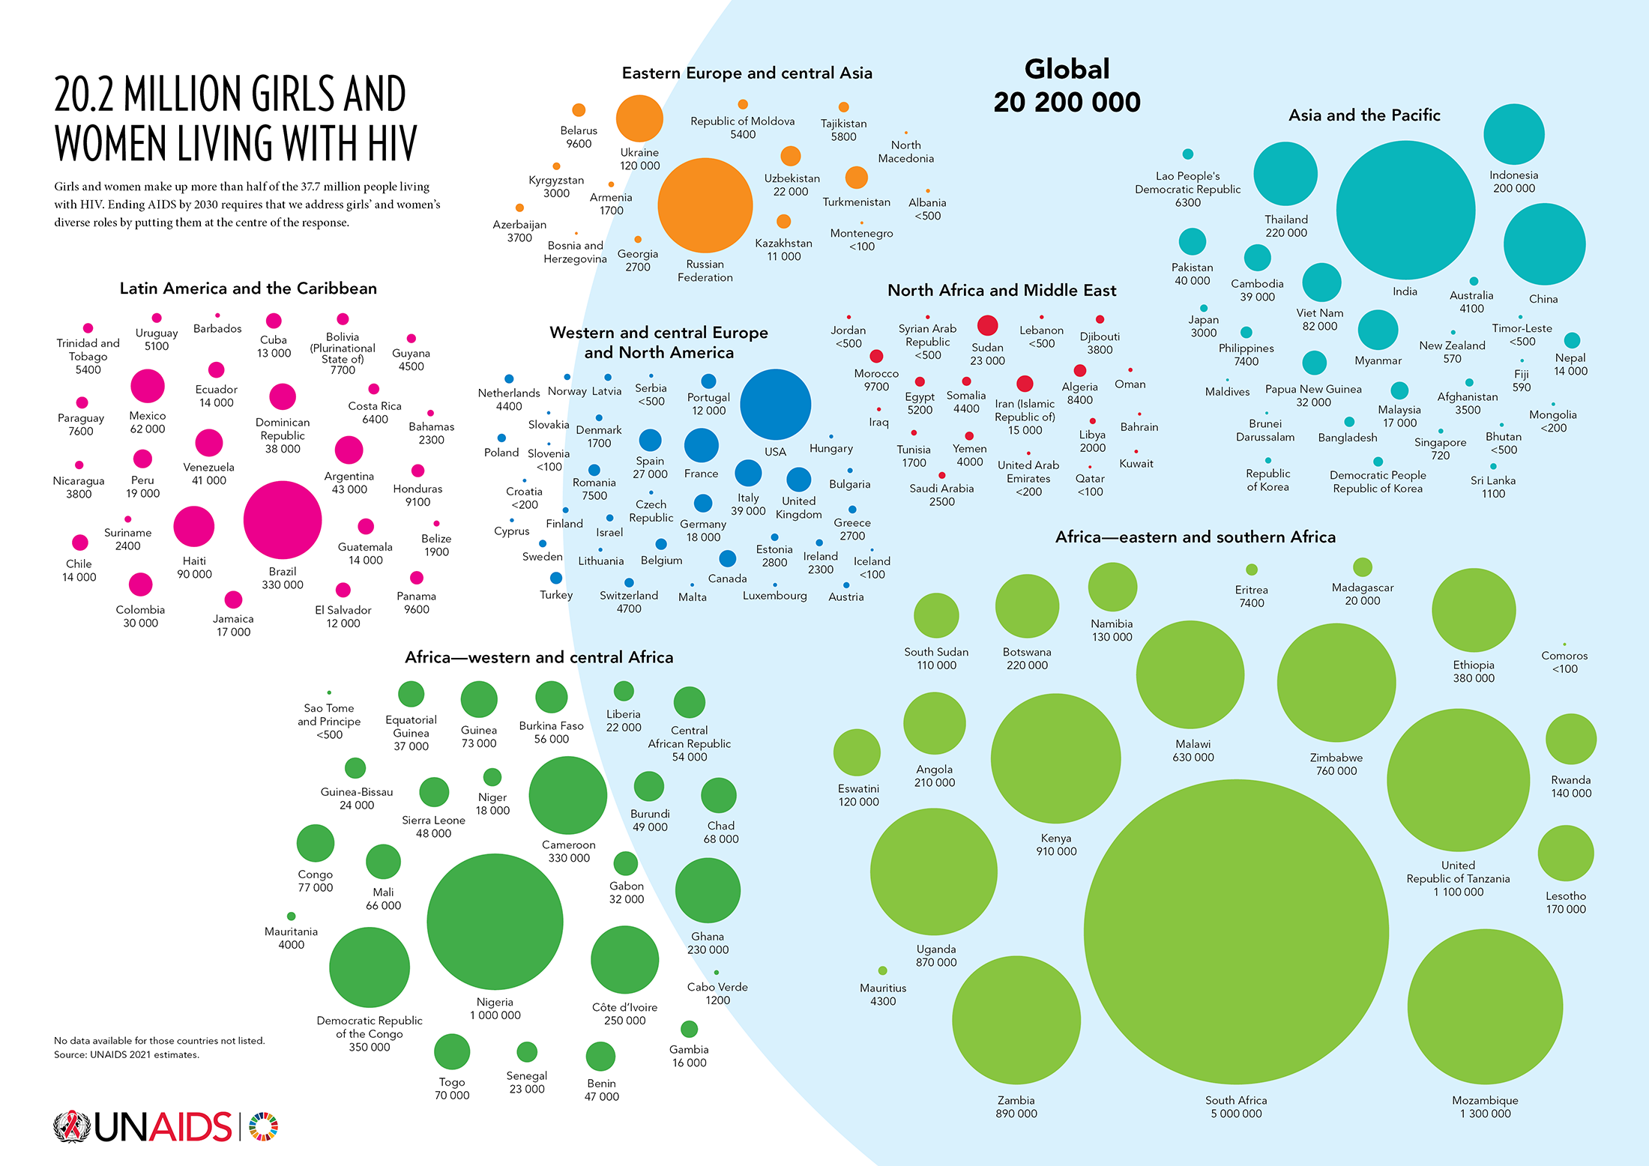

Slide 5
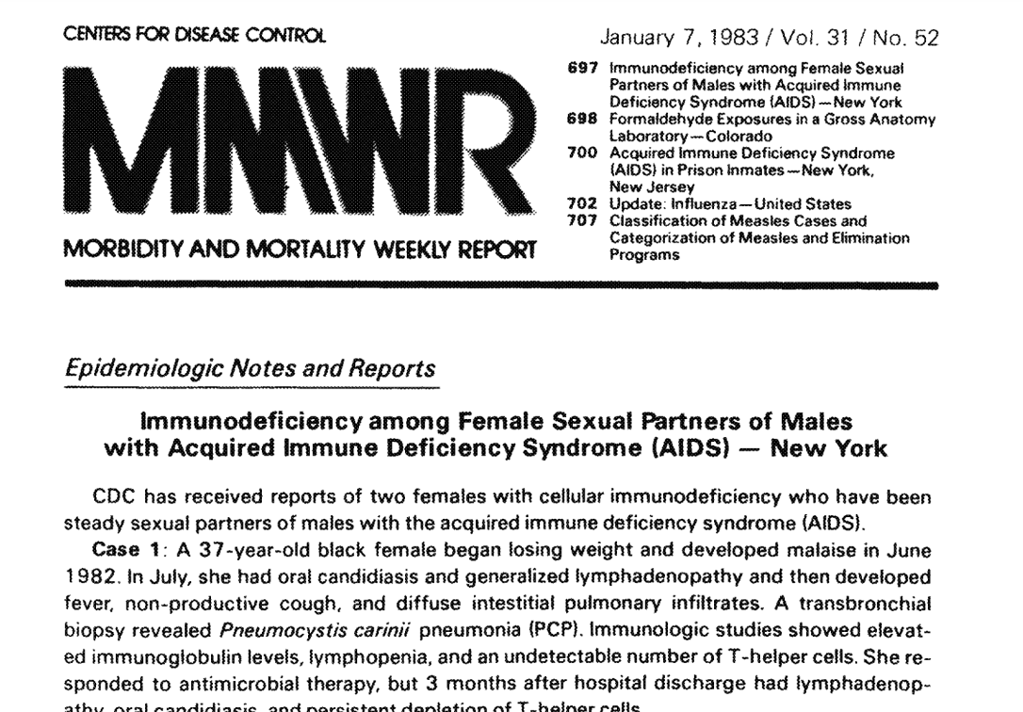
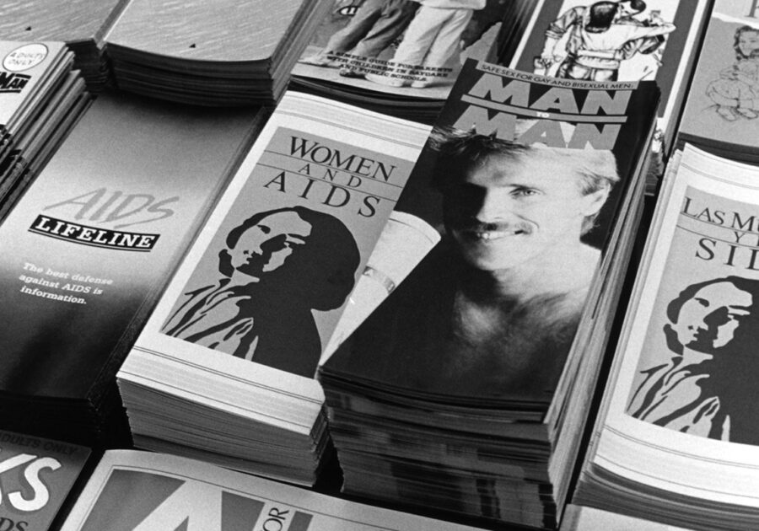
A Look Back
1985 – San Francisco AIDS Foundation produces first brochure about women and AIDS
1983 – CDC’s Morbidity and Mortality Weekly Report (MMWR) reports the first cases of AIDS in women

Slide 6
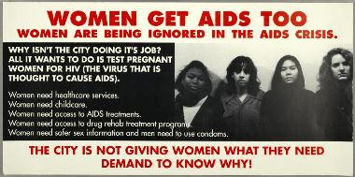
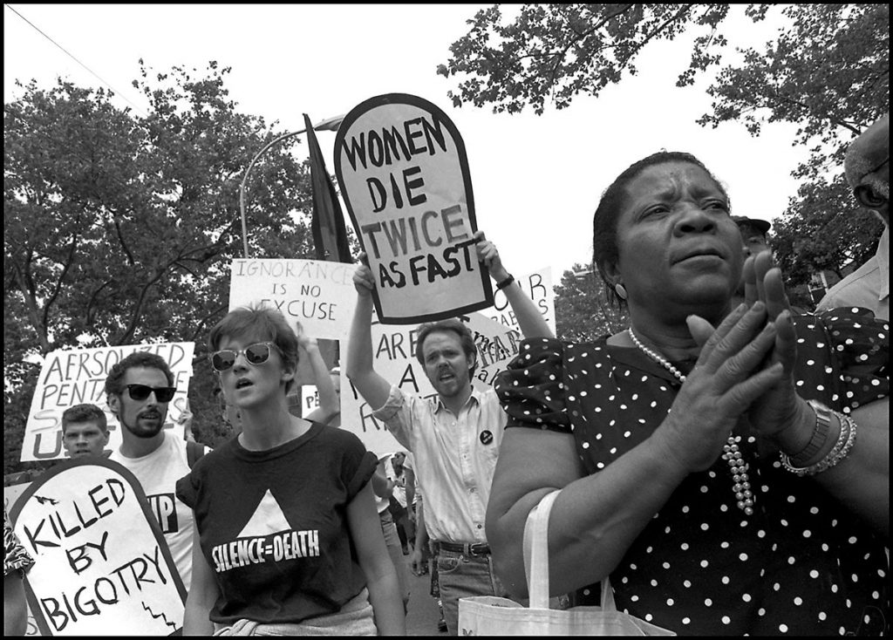
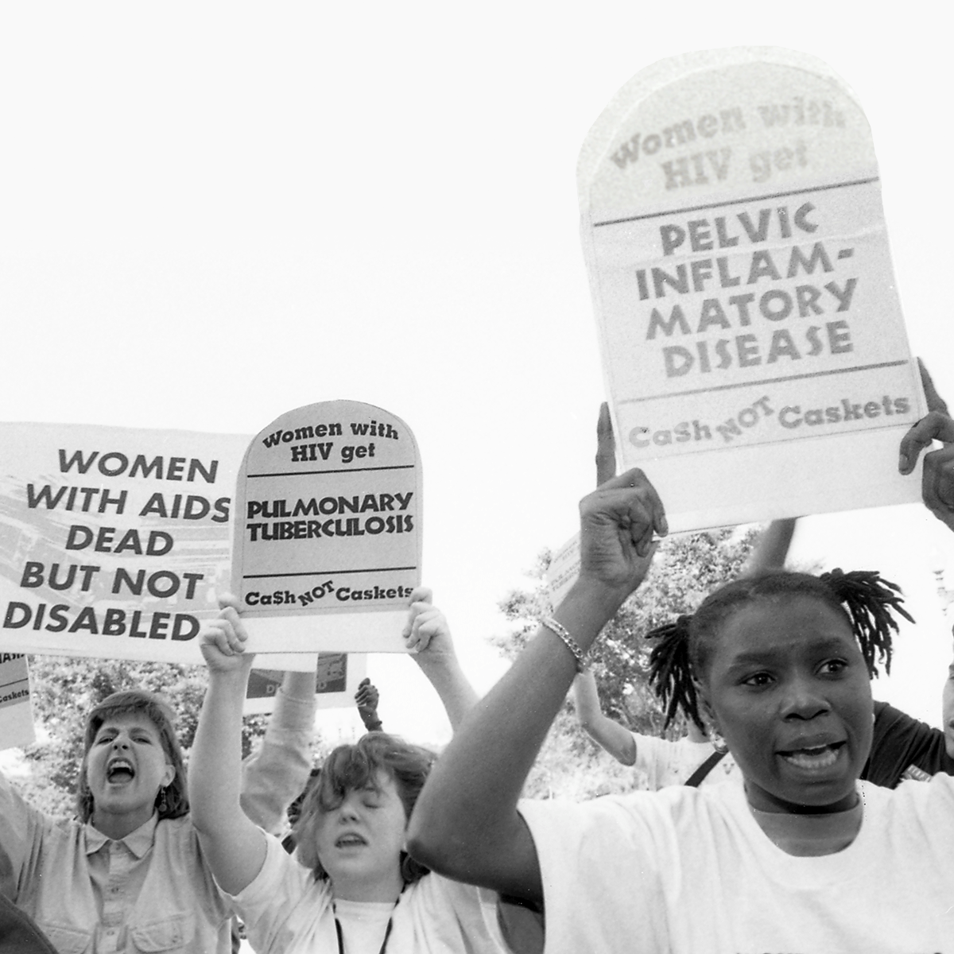
An Epidemic Ignored
1989 - Members of ACT UP demand improved HIV care
New York, NY
1990 - AIDS protest
National Institutes of Health Washington, DC
Photos: Donna Binder, ACT UP, NY Public Library

Slide 7
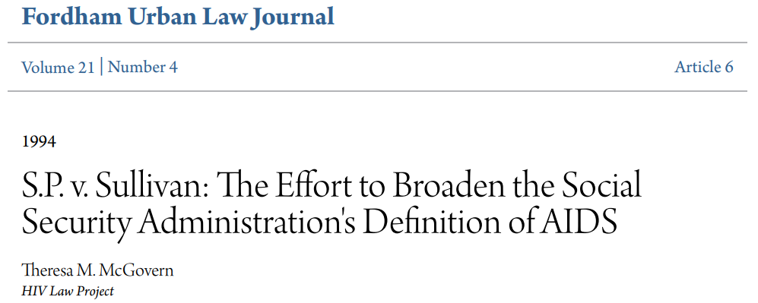
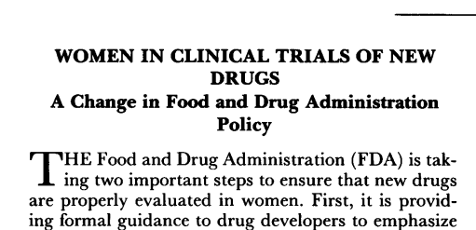
A Call for Recognition and Equity
Rate of reported AIDS cases, per 100,000 population - US
 | Non-Hispanic Black Women | Non-Hispanic White Women
1991-1992 | 31.3 | 1.8
1993 | 73 | 5
1993 – CDC changes its case definition of AIDS to include HIV-related risks and illnesses specific to women
1994 - Lawsuit filed against Social Security Administration that enables women with AIDS to receive government benefits
1993 – Inclusion of women in clinical trials

Slide 8
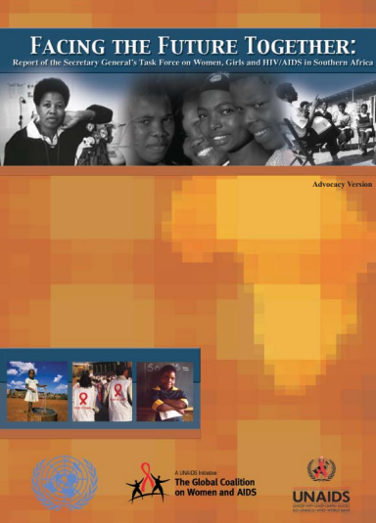
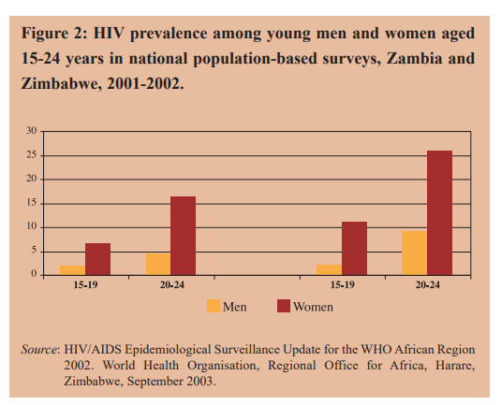
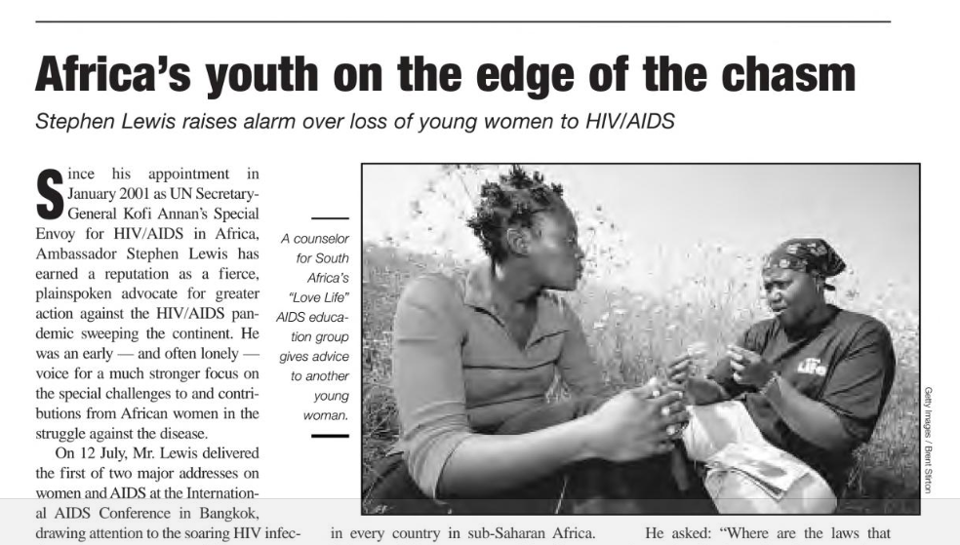
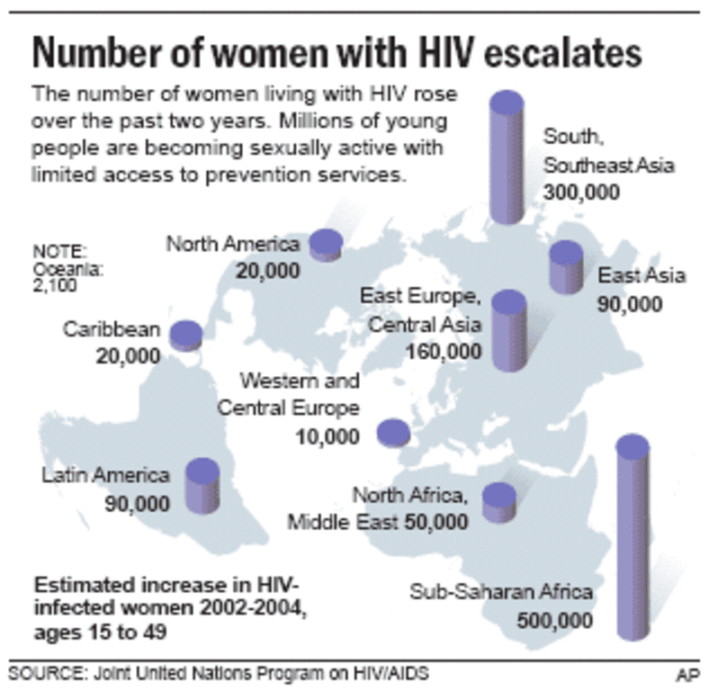
A Crisis Among Women and Children Unfolds Globally
2003
2004
"If the international community had done the things we know we need to do around women's empowerment issues, the impact of HIV and AIDS wouldn't be as severe as it is today.“ –
Ms. Sibongile Msimela, UNAIDS Gender Adviser for East and Southern Africa, 2004
2004

Slide 9
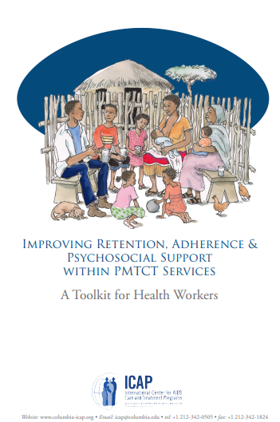
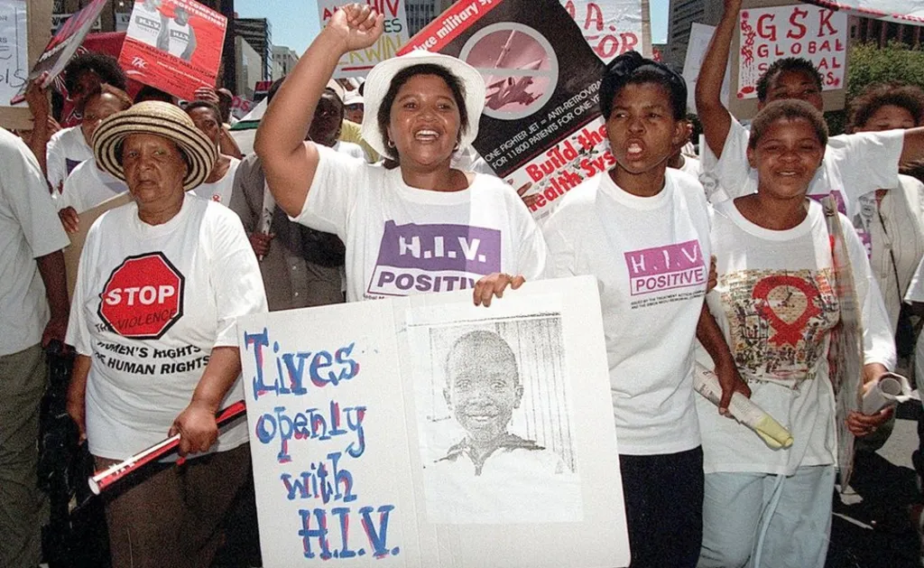
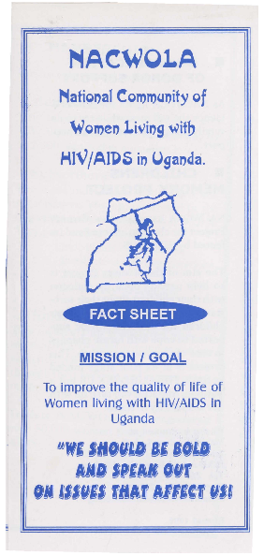
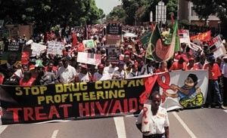
Turning the Tide
AP Photo/Christian Schwetz, BBC

Slide 10
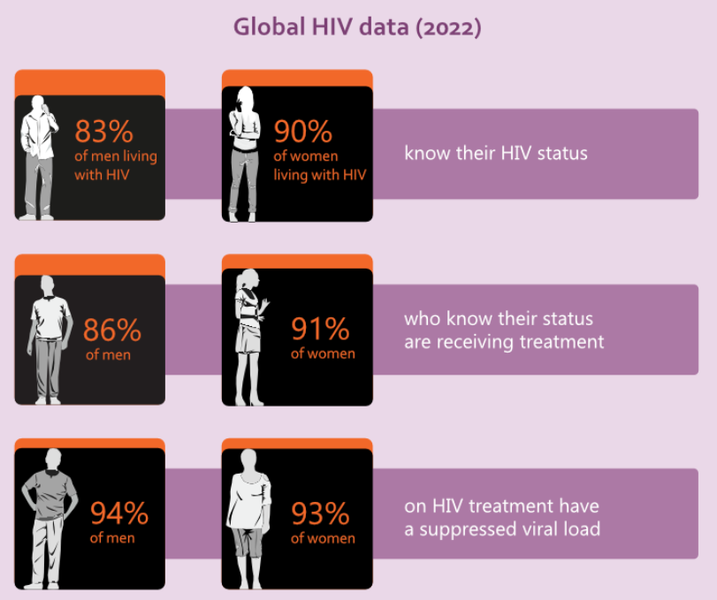
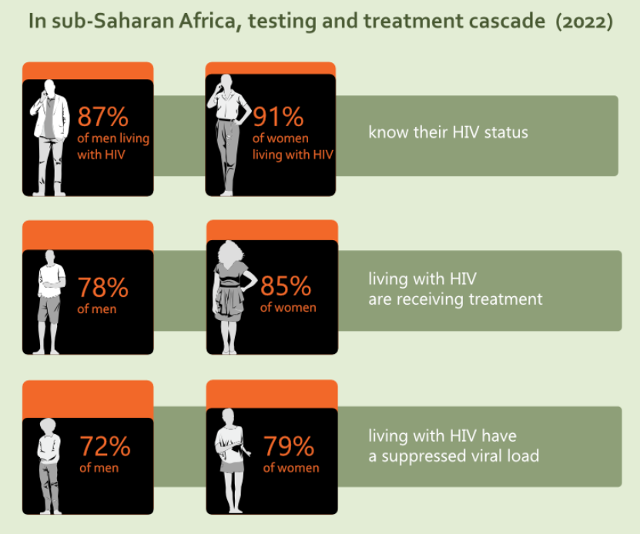
Progress Towards 95-95-95 Targets
Women slightly ahead of men in testing and treatment cascade targets
WHO (2022)

Slide 11
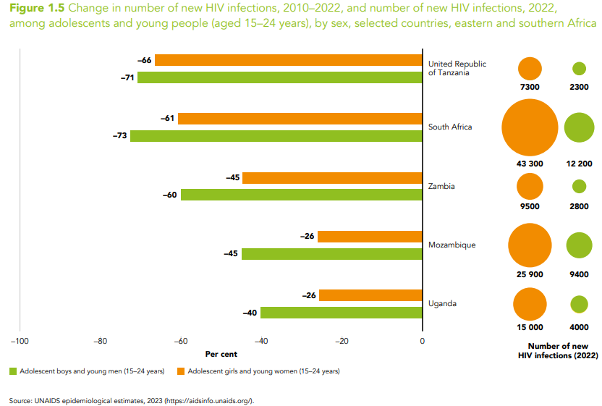
New HIV Infections – Women and Girls in Eastern and Southern Africa
46% of all new HIV infections among women and girls
Numbers of new infections among adolescent girls and young women are declining, but not as quickly as among their male counterparts

Slide 12
HIV Treatment Cascade Among Women – US
HIV care continuum among women with diagnosed HIV in 44 states and DC, 2019
HIV care continuum among adult and adolescent men with HIV in 50 states and DC, 2018
US CDC: Fast Facts: HIV and Women
US CDC: HIV men care continuum

Slide 13
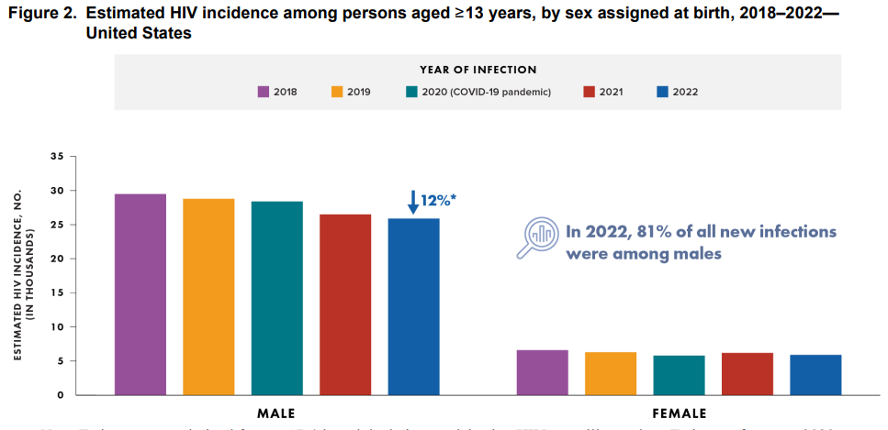
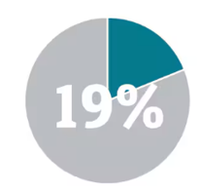
Estimated number of new HIV infections – US
Of all new infections were among people AFAB in 2022
US CDC HIV Surveillance Report (2024)

Slide 14
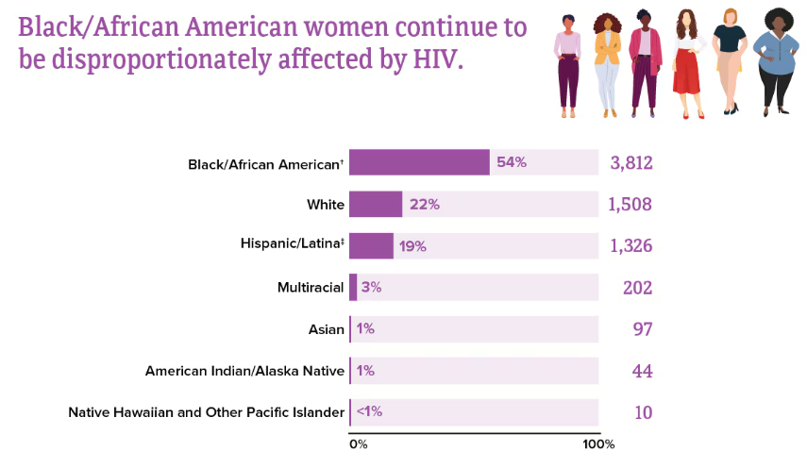
Racial Disparities in HIV Diagnoses
US CDC: Fast Facts: HIV and Women
HIV diagnoses among women by race/ethnicity in the US and dependent areas, 2019*

Slide 15
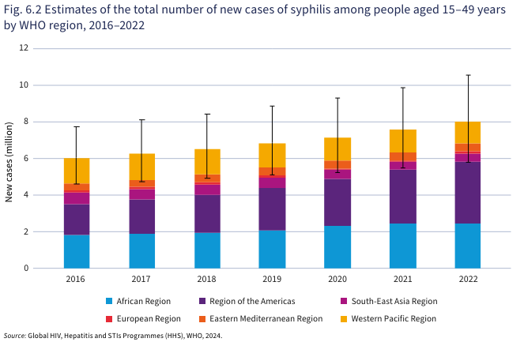
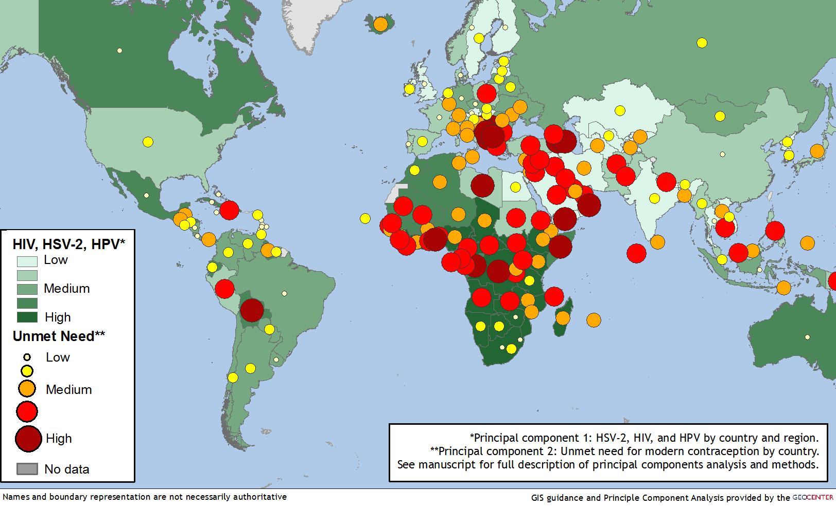
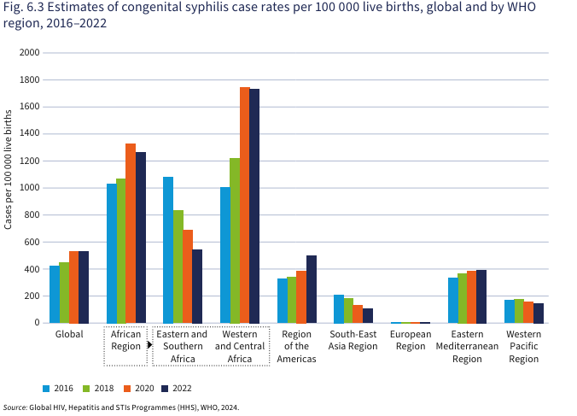
HIV is Part of a Complex "Syndemic"
Concerning rise in syphilis
1.3 million acquired HIV in 2022
Over 1 million people contract a sexually transmitted infection every day
67% of pregnancies are "unintended"
Source: WHO

Slide 16
Issues Faced by Diverse Women
Transgender Women
Stigma and discrimination
Psychological trauma
Gender power dynamics
Violence
Decreased economic opportunities
Women of Reproductive Age
Comprehensive reproductive care that addresses contraception and HIV needs
Stigma for women with HIV regarding pregnancy and formula feeding
Post-partum ART adherence for women living with HIV
Older Women
Lower risk of getting pregnant and thus, reduced condom usage and HIV prevention measures
Biological changes for post-menopausal women that increase risk for HIV acquisition
14x
HIV prevalence among trans women versus cis-gender women
25%
Women virally suppressed 24 months post-partum
47%
People diagnosed with HIV in the US are aged 50 years or older
1. Adimora et al., Lancet (2021), 2. Chen et al., AIDS (2019)

Slide 17
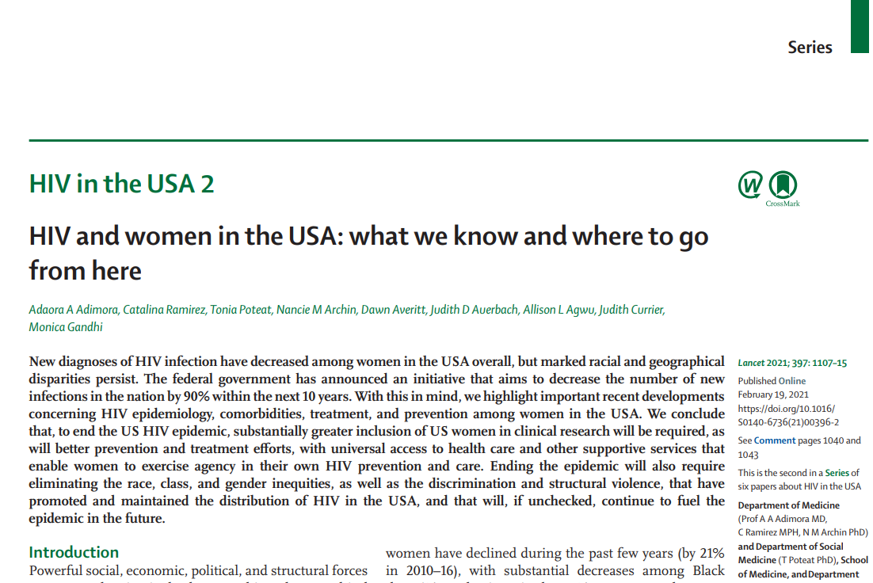
HIV and Women in US Key Recommendations
Treatment: ensure sustained, high-quality health coverage
Prevention: improve integration of services and maintain the reproductive rights of women
Research: increase inclusion of women and enforce the requirement of the FDA for their enrolment in trials
Adimora et al. Lancet, 2021

Slide 18
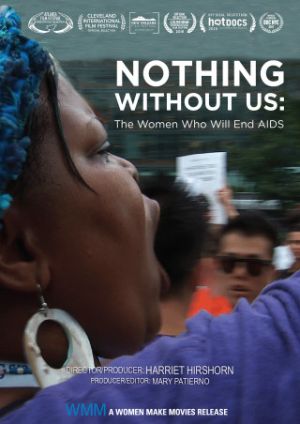
Conclusions
Important strides have been made in the fight against HIV among women
Social and structural inequities, whether gender-related, racial, geographical, or the intersectionality of all, are root causes for the health disparities that diverse women face
Addressing these barriers through combination of socio-behavioral, structural and biomedical strategies will be key to addressing the HIV epidemic among women globally

Slide 19
Celebrating Ada Adimora May 5, 1956 – January 1, 2024

Slide 20
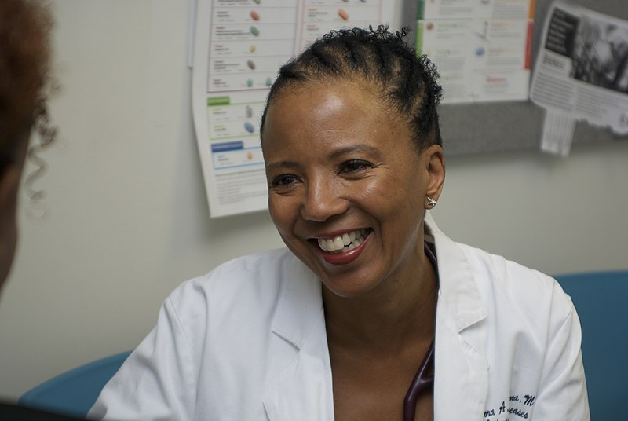
Thank you, Ada.

