Slide 1
Harm reduction and HIV response challenges and innovations in the EECA region
Alexei Lakhov, European Network of People who Use Drugs
Person-centred and integrated healthcare and harm reduction services for people living with and affected by HIV, hepatitis C and tuberculosis in eastern Europe and central Asia

Slide 2
Conflict of interest disclosure
I have no relevant financial relationships with ineligible companies to disclose.

Slide 3
Challenges
Geopolitical turmoil
Rising authoritarianism
Shrinking spaces for civil society
Criminalization of key populations
Threats to harm reduction programmes
Funding issues
Notes:
Geopolitical turmoil: mass migration caused by wars in the region
Rising authoritarianism: guess who?
Shrinking spaces for civil society: laws on “foreign agents”, “undesirable organizations”, etc.
Criminalization of key populations (gay men and other men who have sex with men, sex workers and their clients, trans*people, people who inject drugs, people in prisons and other closed settings): “LGBT movement” – an extremist entity; laws against “LGBT propaganda” and gender affirming surgery; laws against “drug propaganda”
Threats to harm reduction programmes: closure of OAT services
Funding issues: dependence on several large international donors; decrease in domestic funding

Slide 4

“Rise & Decriminalize” movement
Five pillars for decriminalization:
bodily autonomy and integrity
access to justice
freedom from legal restrictions
community-led interventions
availability of comprehensive services
Notes:
Unites 5 largest regional networks – ECOM, EHRA, ENPUD, EWNA & SWAN – and is tailored to commonly advocate for the rights of vulnerable populations.
Builds on intersectionality of communities and acknowledges that all networks should direct their efforts to advocating for decriminalization.
Decriminalization should focus on five pillars:
bodily autonomy and integrity,
access to justice,
freedom from legal restrictions,
community-led interventions,
availability of comprehensive services.

Slide 5
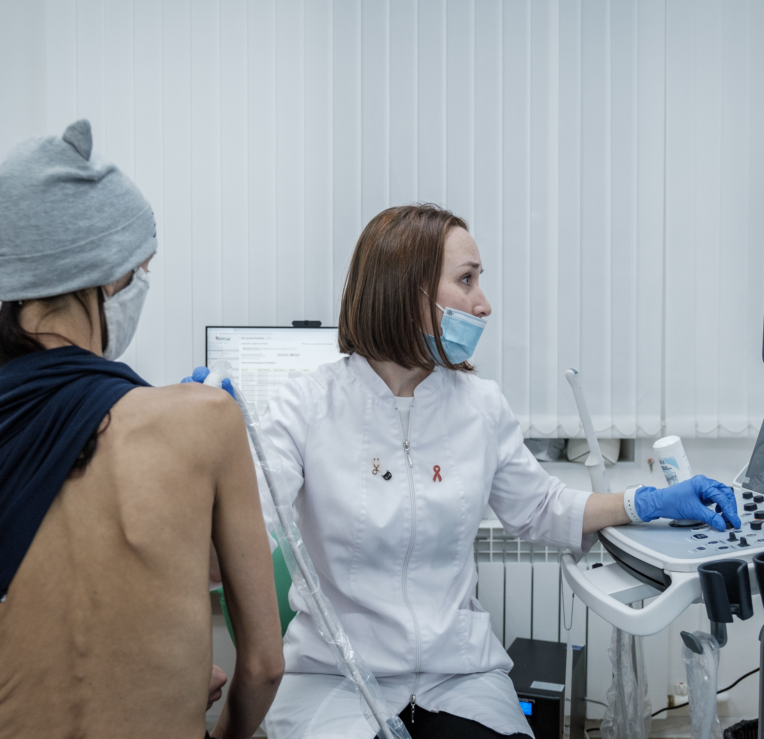
Community-based medicine in St. Petersburg, Russia
Results in 2023:
3,100 medical consultations
945 HIV tests
906 HCV tests
Notes:
Low-threshold community-based medical centre in Saint Petersburg, Russia. Operated by Humanitarian Action Fund.
Beneficiaries: people who use drugs, sex workers, gay men and other men who have sex with men, homeless, refugees, people living with HIV.
Doctors: therapist, surgeon, neurologist, narcologist, ultrasound specialist, dermatovenerologist, and others.
Results in 2023: more than 3,100 medical consultations, 945 HIV tests, 906 HCV tests

Slide 6

Web outreach among people who use new psychoactive substances
Online drug trafficking and communications among people who use drugs are increasing
Web outreach is used to contact, counsel, engage and retain people who use drugs in harm reduction services via websites, social networks, messenger apps and specialized forums
Notes:
Due to an ongoing increase in online drug trafficking and communications among people who use drugs, including new psychoactive substances, a web outreach approach has been developed and utilized by NGOs from the EECA region.
A method for contacting, counseling, engaging, and retaining people who use drugs in harm reduction programs and other services through websites, social networks, messengers, and specialized forums.
Implemented in Kazakhstan, Kyrgyzstan, Moldova, Russia, Uzbekistan, Ukraine, etc. In Ukraine, AI is being used for case management!
Driven by regional teams of UNODC, UNDP, and UNAIDS.

Slide 7

UNITAID programme on Hepatitis C innovations in low- and middle- income countries
Core areas of innovation:
Low dead space syringes and needles
Long-acting depot buprenorphine
Simplified hepatitis C testing and treatment care pathway
Notes:
3 core areas of innovation – Low Dead Space Syringes and Needles (LDSS/N); Long Acting Depot Buprenorphine (LADB); simplified Hepatitis C Testing and Treatment Care Pathway
3 consortiums in 10 countries (including Armenia, Georgia, Kyrgyzstan, Ukraine)
Modelling impact – effectiveness and cost effectiveness
Commitment to community-led responses, including community advisory board (CAB)
Findings contribute to WHO and country guidelines

Slide 8
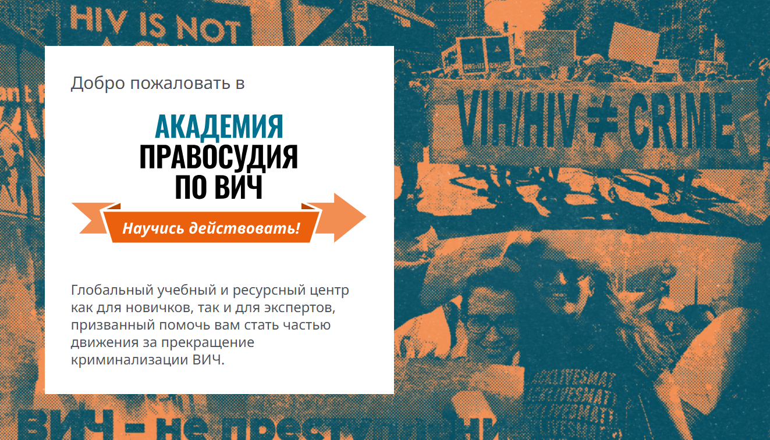
Course on HIV criminalization
The HIV Justice Academy implemented by HIV Justice Network is a free online platform that provides access to information for advocates and activists working to end HIV criminalization.
Notes:
As of June 2024, more than 600 learners enrolled in the online course including from the EECA region. The average completion rate of the HIV Criminalization Online Course has been around 20%.
Some users have incorporated the materials into their own training programmes. For example, the Eurasian Women’s Network on AIDS (EWNA) included materials from the HIV Justice Academy in their workshops, including with government officials and society representatives in Eastern Europe and Central Asia.

Slide 9
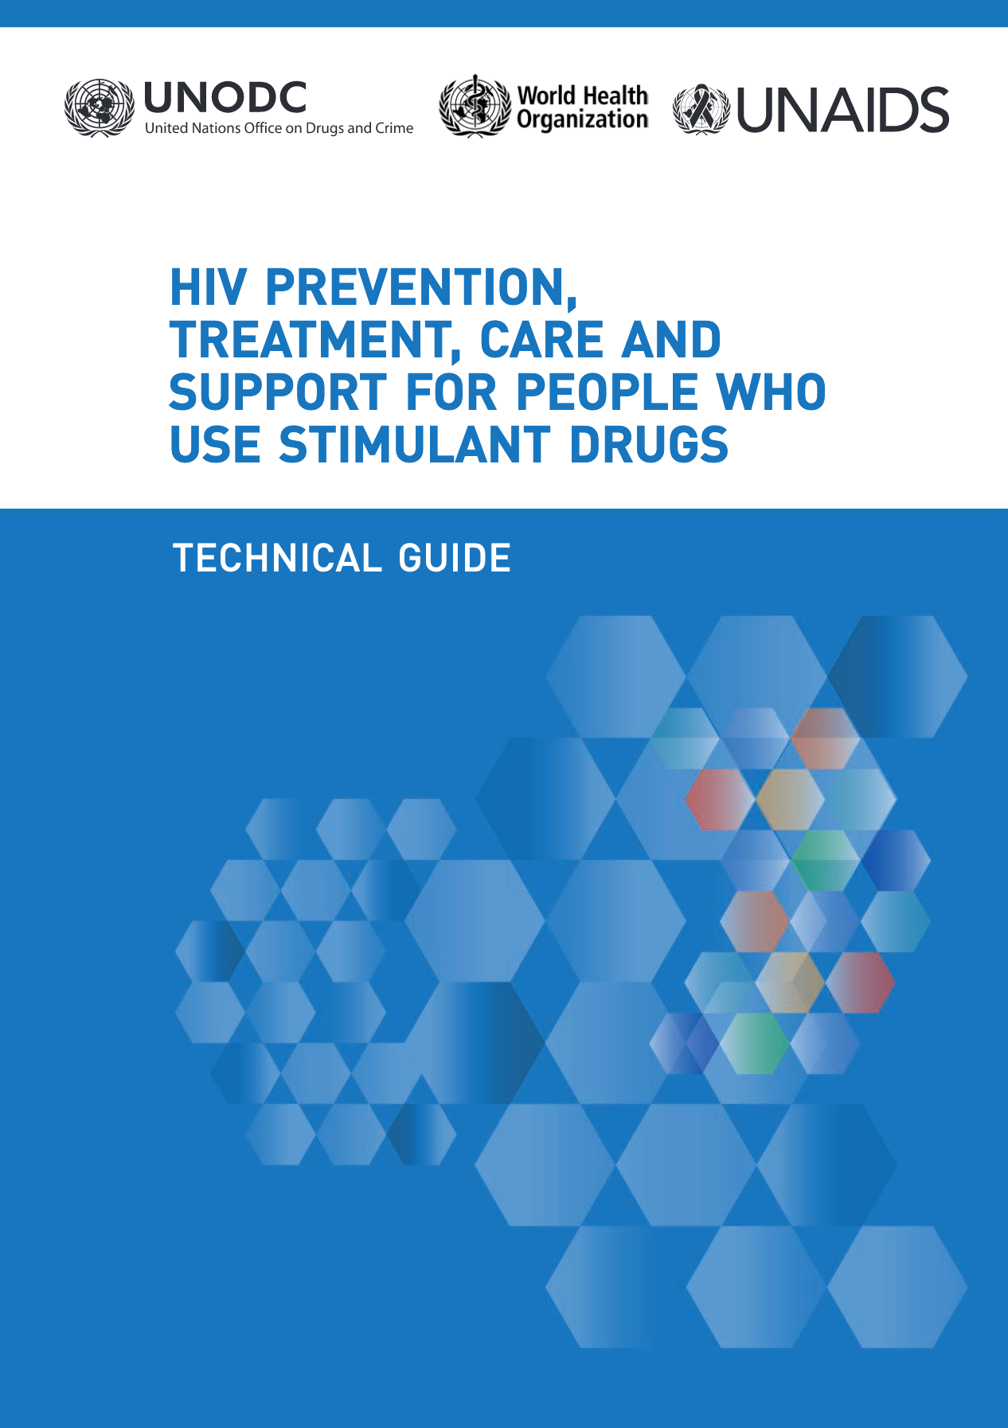
Course on HIV prevention among people who use stimulants
HIV Prevention, Treatment, Care and
Support for People Who Use Stimulant Drugs course was developed by UNODC with the meaningful involvement of communities.
Notes:
Can be done in both virtual and in-person formats.
Easily adaptable to local contexts. Has already been presented in Kyrgyzstan and Kazakhstan, will be delivered in Belarus and Ukraine in the near future.

Slide 10
Thank you to donors and partners!
UNDP
UNODC
UNAIDS
Sidaction
Aidsfonds
ViiV Healthcare
The Global Fund
Robert Carr Fund
Médecins du Monde
Médecins Sans Frontières
Open Society Foundations
Elton John AIDS Foundation and many, many more…

Slide 11
“Let us continue to work together, sharing knowledge, resources, and support to ensure that no one is left behind. Thank you for your dedication and commitment to this vital cause. Together, we can make a difference.”
ChatGPT

