Slide 1
Overview of community-led approaches and barriers to the MDR-TB response in the EECA region
Natalia Sidorenko
ANO Center for Promoting Partnerships in the Healthcare Sphere “Zdorovye.ru”, Kazakhstan
Person-centred and integrated healthcare and harm reduction services for people living with and affected by HIV, hepatitis C and tuberculosis in eastern Europe and central Asia
Notes:
Hello, everyone. It is a great honor [o] for me to speak at this conference and in this hall.
Tuberculosis has been a part of my life for quite a long time [куаяРа]; my grandmother underwent surgery to remove a tuberculoma, after which she lived only with one third of her lung. So, even before I was born, tuberculosis was present in my family. In 2004 (two thousand four), I had the good fortune to get to know the work of Partners in Health in Tomsk, a small city in Siberia, which was among the pioneers in implementing an MDR-TB treatment.
Within my work, I was delivering TB medication to my friends who were using drugs. This was 20 years ago. Unfortunately [ч], tuberculosis (TB) still remains a significant issue in many countries for now.
I continue to engage in social work and provide counseling to people who have TB or a TB infection. I visit hospitals, travel to homes, respond to messages, and train charity organization staff.

Slide 2
Conflict of interest disclosure
I have no relevant financial relationships with ineligible companies to disclose.
Notes:
I have no relevant financial relationships with ineligible [уИðынЭлиджибл] companies to disclose.

Slide 3
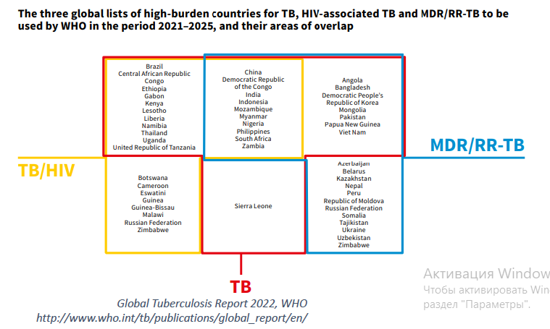
High burden of MDR-TB in 8 countries of EECA:
Azerbaijan
Belarus
Kazakhstan
Republic of Moldova
Russian Federation
Tajikistan
Ukraine
Uzbekistan
Notes:
Our global threats [θрэтс] are HIV, TB, and MDR-TB. In this slide, we see three global lists of countries with a high burden of TB, HIV-associated [ши] tuberculosis, and MDR-TB.
These lists are for 2021-2025 period, and their territories partially [пАрШали] overlap.
High MDR-TB burden countries in the EECA [ИИСИЭЙ] region include: Azerbaijan, Belarus, Kazakhstan, Moldova, Russia, Tajikistan, Ukraine, Uzbekistan.

Slide 4
People living with TB/HIV
A new model of TB care involving the community of people affected by TB and/or HIV has been actively developing in the EECA region since 2016.
Developing awareness
Linking people to care
Improving service delivery
Notes:
We will not be able to defeat tuberculosis without the active involvement [В] of people affected by TB and their Families. I am happy to be part of this work. Since [синс] 2016 [сиксТИИИН], a new model of TB care has been actively [Эктивли] developing in the EECA region, involving the community of people affected by tuberculosis and/or HIV. [____] What do we do? We talk about tuberculosis, participate in providing assistance to the most vulnerable [ВАлнэрабл] communities, and strive [страйв] to improve services and care.

Slide 5
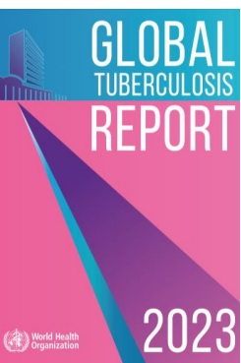
Number of TB deaths are significant
Tuberculosis is 2nd leading cause of death from infectious diseases
One of top 10 causes of death worldwide, particularly among women and people living with HIV
In 2023, 1.3 million people died from tuberculosis (including 167,000 people living with HIV)
Without treatment, the mortality rate from tuberculosis reaches 50%. However, following the 4-6 month treatment course recommended by WHO, around 85% of patients can be cured
Notes:
People with HIV are more likely than people without HIV to develop active TB disease. This is because HIV weakens [УИкенз] the immune system, which makes it harder for the body to fight TB germs.
Despite [ай] all efforts, people are still dying of tuberculosis. [__] Why is this happening?
HIV and TB [__] form a lethal [θ] combination, speeding up each other's progress. Without proper treatment, 50% [пёрСЭНТ] of HIV-negative people with TB, [__] on average, [__] will die, and nearly all HIV-positive people with TB [__] will die too.

Slide 6
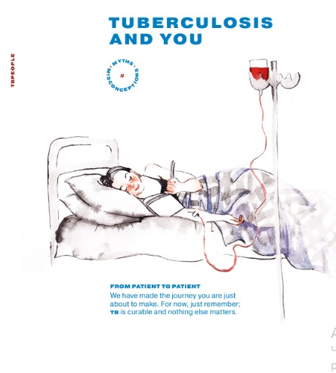
Many people do not realize TB still exists
How does the community respond?
Promotes public awareness about tuberculosis.
Combats stigma through information campaigns, educational activities and initiatives led by participants, such as the brochure "You and Tuberculosis“.
Chatbot "We can cure tuberculosis“.
Notes:
Many people do not realize that TB still exists.
What can the community do? Talk about tuberculosis everywhere. Talk openly.
Since 2018, I interview [вью] people who have recovered from TB. And some of these interviews are still anonymous. People often don’t want to openly discuss their experiences.
Some people affected by TB become activists despite the common stigma, helping to raise awareness [аУЭарнес] about the disease. The brochure "Tuberculosis and You" is a prime example. This guide, designed for those experiencing tuberculosis, [__] was initiated [инищиЭйтид] by Paulina Siniatkina and Ksenia Shchenina. These women collected the most popular myths [θс] about tuberculosis in the EECA region [__] and, with the help of world-renowned [ринАунд] doctors and experts [__], debunked them. The creation of this brochure [брошУар] was followed by a tour across Russian cities, where activists distributed the brochures, visited hospitals, and introduced their work to patients, medical workers, and city administrations. They also organized educational events for the public, based on the brochure's content. Such activities help bridge the gap between society [сосАяти] and the medical field, contributing to the reduction [a] of stigma associated with tuberculosis. The brochure “TB and You” was launched at HLM TB in 2018 and is now available in 13 different languages.

Slide 7
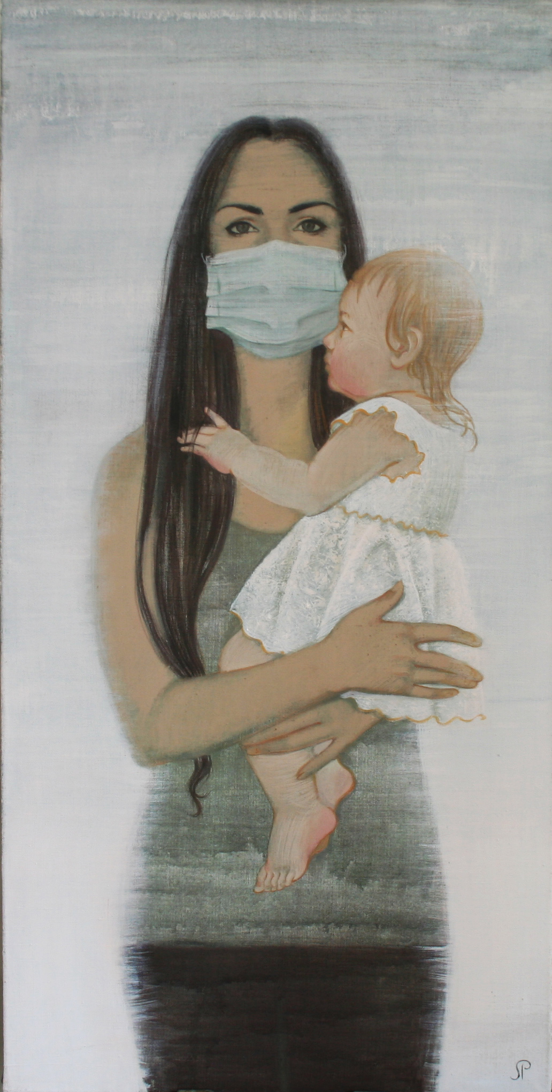
People seek help for TB too late
How does the community respond?
Case finding among vulnerable groups (people living with HIV, people who use drugs)
Adherence support for TB treatment
Social, legal and psychological support to people living with TB and their families.
Assistance in securing financial and legal aid, facilitating employment, and integrating affected individuals and families into social activities
Artwork by Paulina Siniatkina, artist and TB survivor
Notes:
People start to seek help too late. Everyone has a different reason for this:
Single mothers with small children can’t get help because there might be no one to stay with the child.
Men seek medical help too late [__] due to fear of losing their income. In many families only men make money. Lack of medication-assisted drug dependence treatment [__] during TB treatment. In Russia and Uzbekistan there is no opioid substitution therapy; in Kazakhstan, methadone is issued only in the narcological service.
What does the community do? Works with key [кИИ] populations - with people living with HIV, with people who use drugs, also they assist doctors in identifying [айдэнтифАинг] TB within the general population and especially in isolated [ай] groups. Provides support to ensure adherence [адхИренс] to TB treatment. Offers social, legal, and psychological support [__] to people with TB and their families, protecting their rights, combating stigma and discrimination. Provides psychological support through peer consultations, support groups, and community hubs to encourage treatment continuation. Assists in securing financial and legal aid, facilitating employment, and integrating affected individuals and families into social life. Their efforts span Kazakhstan, Ukraine, Georgia, Tajikistan, and Russia and other countries of the EECA region.

Slide 8
TB treatments in region are outdated
How does the community respond?
Developing conditions for formal participation of people affected by TB in healthcare decisions
Budget advocacy
Monitoring the quality of TB services
Identifying barriers to timely and high-quality TB diagnosis and treatment
Gender analysis of TB services
Promotion of new, more convenient (or patient-friendly) TB diagnostic methods and treatment regimens
Advocacy for changes in WHO clinical recommendations: moving away from injectable forms and adopting shorter treatment regimens
Artwork by Paulina Siniatkina, artist and TB survivor
Notes:
Treatment of TB in our region is outdated. People are still isolated in hospitals for a long time, modern treatment regimens [рЭджименз] are not available for everyone, and we see a slow transition to short treatment regimens [рЭджименз] .
What can we do about it?
Advocacy: Creating conditions for people affected by TB to participate in healthcare decisions. Promotion of new TB diagnostic methods and treatment regimens that are people oriented. Help to implement WHO clinical recommendations, such as moving away from injectable forms [__] and adopting shorter treatment regimens [рЭджименз] in every hospital.
Examples in EECA region:
-Within the CCM there is a dedicated space for the TB-affected community in Kazakhstan, Tajikistan, Moldova, Belarus, Ukraine, and others.
-Budget advocacy efforts are underway in Belarus and Moldova.
- In Russia, monitoring of the quality of TB services is provided to individuals with [__] or affected by TB.
- Identifying barriers [_] to timely and high-quality TB diagnosis and treatment [__] is a focus in Russia and Kazakhstan. Kazakhstan conducts [кондАкст] gender analysis of TB services.

Slide 9
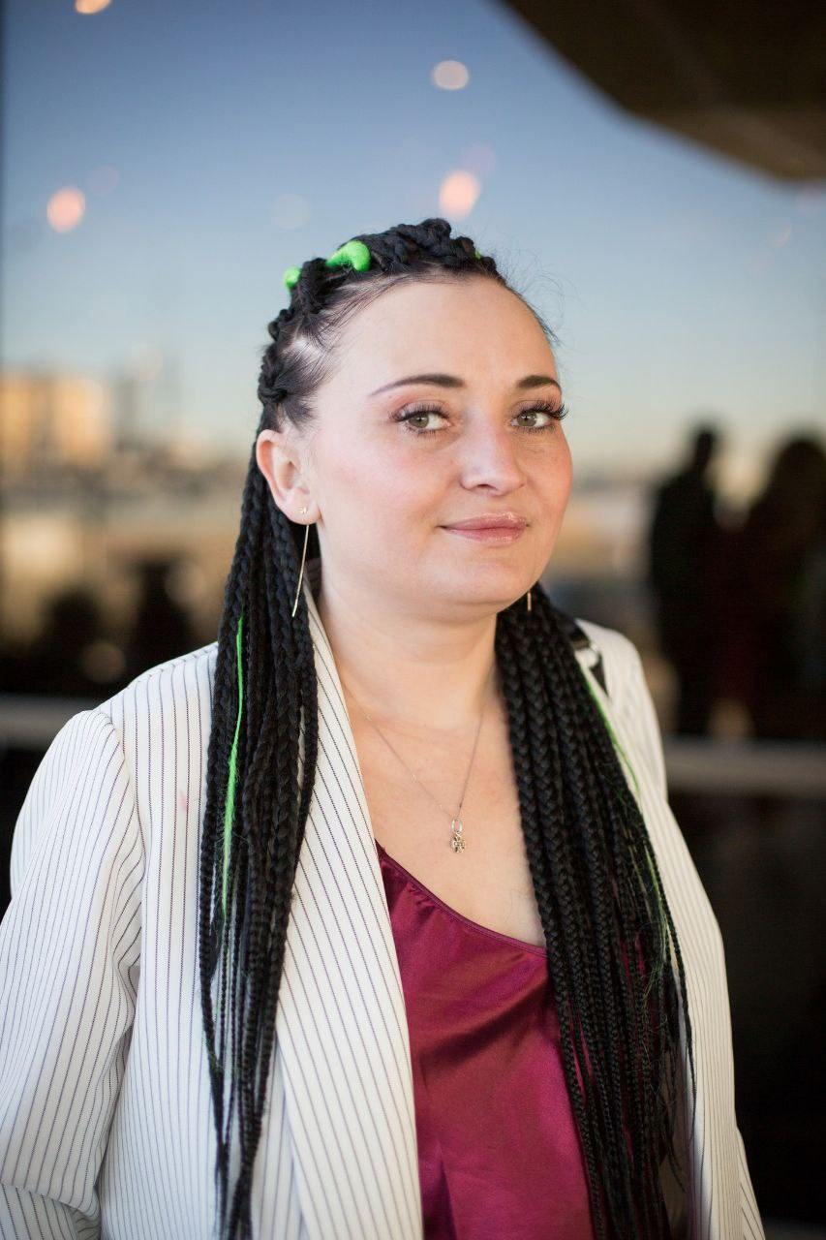
“The support from the community is invaluable and incomparable to any other. While the contribution of medical professionals is significant, the support from TB/HIV peers is a unique form of assistance. Discussing painful issues with someone who truly understands your experiences can be incredibly beneficial. This kind of peer support is crucial for maintaining adherence to treatment and a stable psycho-emotional state. It helps in accepting the diagnosis and reduces internal stigma.”
Maria Petrova, peer consultant on HIV and tuberculosis
Notes:
I want to express my gratitude to communities and civil society for their engagement into TB and HIV service delivery [_] where conventional health care is beyond the reach of people who are living with HIV, [_] who have been using drugs [_] and others.
I believe [_] that people will stop dying [_] from this absolutely curable disease.

