Slide 1
Put people first in EECA prisons - is it possible?
Anna Koshikova, Eurasian Movement for the Right to Health in Prisons
Person-centred and integrated healthcare and harm reduction services for people living with and affected by HIV, hepatitis C and tuberculosis in EECA

Slide 2
Conflict of interest disclosure
I have no relevant financial relationships with ineligible companies to disclose.

Slide 3
Context
Limitation of freedom = limitation of access to health services
Lower access to essential services compared to people in the community
Access to services in prisons is not a priority on the global agenda
Insufficient funding, high dependency on donor support
Security and compliance with regime restrictions prevail over provision of people-oriented health services
PEOPLE IN PRISONS DO NOT HAVE ACCESS TO MANY VITAL HEALTH SERVICES

Slide 4
Current situation
HIV
Tuberculosis (TB)
Hepatitis C (HCV)
High ART coverage and retention rates
High % of state funding
Irregularity of treatment monitoring
Lack of adherence programs
Regime restrictions do not count for people’s needs
Timely diagnosis and treatment
Improvement of infection control
High rates of MDR TB (40%)
Lengthy escort for in-patient treatment
Regime restrictions do not count for people’s needs
Lost to follow up people after release
Equal access to treatment in some countries
High prevalence rates (40%)
Limited access to treatment in many countries
Lengthy process of treatment prescription and start

Slide 5
Current situation
Opioid Agonist Therapy (OAT)
Harm reduction
Significant progress in some countries
Absence of OAT in many countries → treatment interruption at imprisonment
Stigma, myths, prison sub-culture influence
Significant progress in some countries, including peer-to-peer service provision
Absence of services in many countries
Prison sub-culture influence

Slide 6
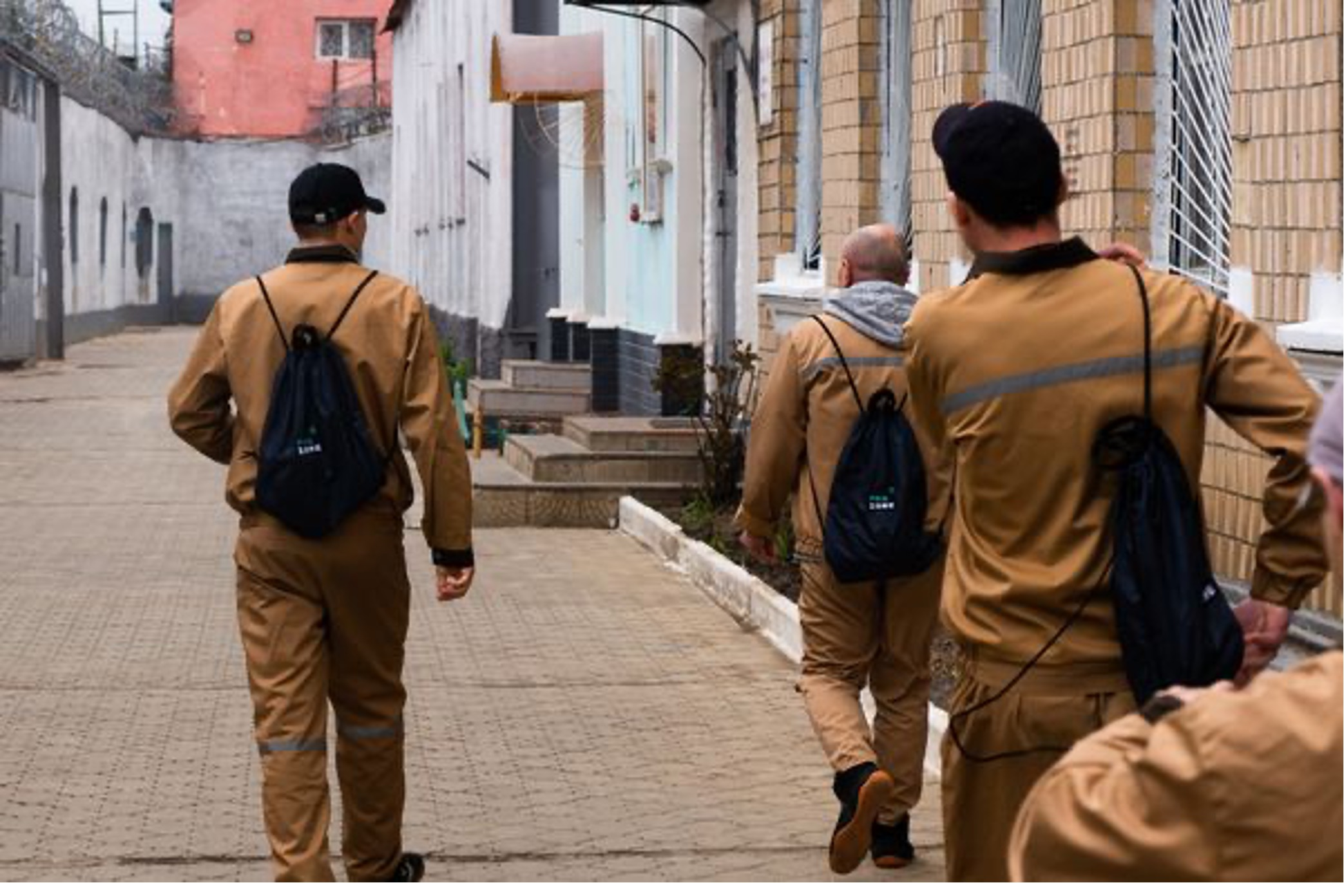
Best practices: Ukraine
Life skills training courses 3 months prior to release
Social patronage after release (HIV, TB, OAT)
Peer to peer harm reduction services
Mobile application FREELIFE

Slide 7
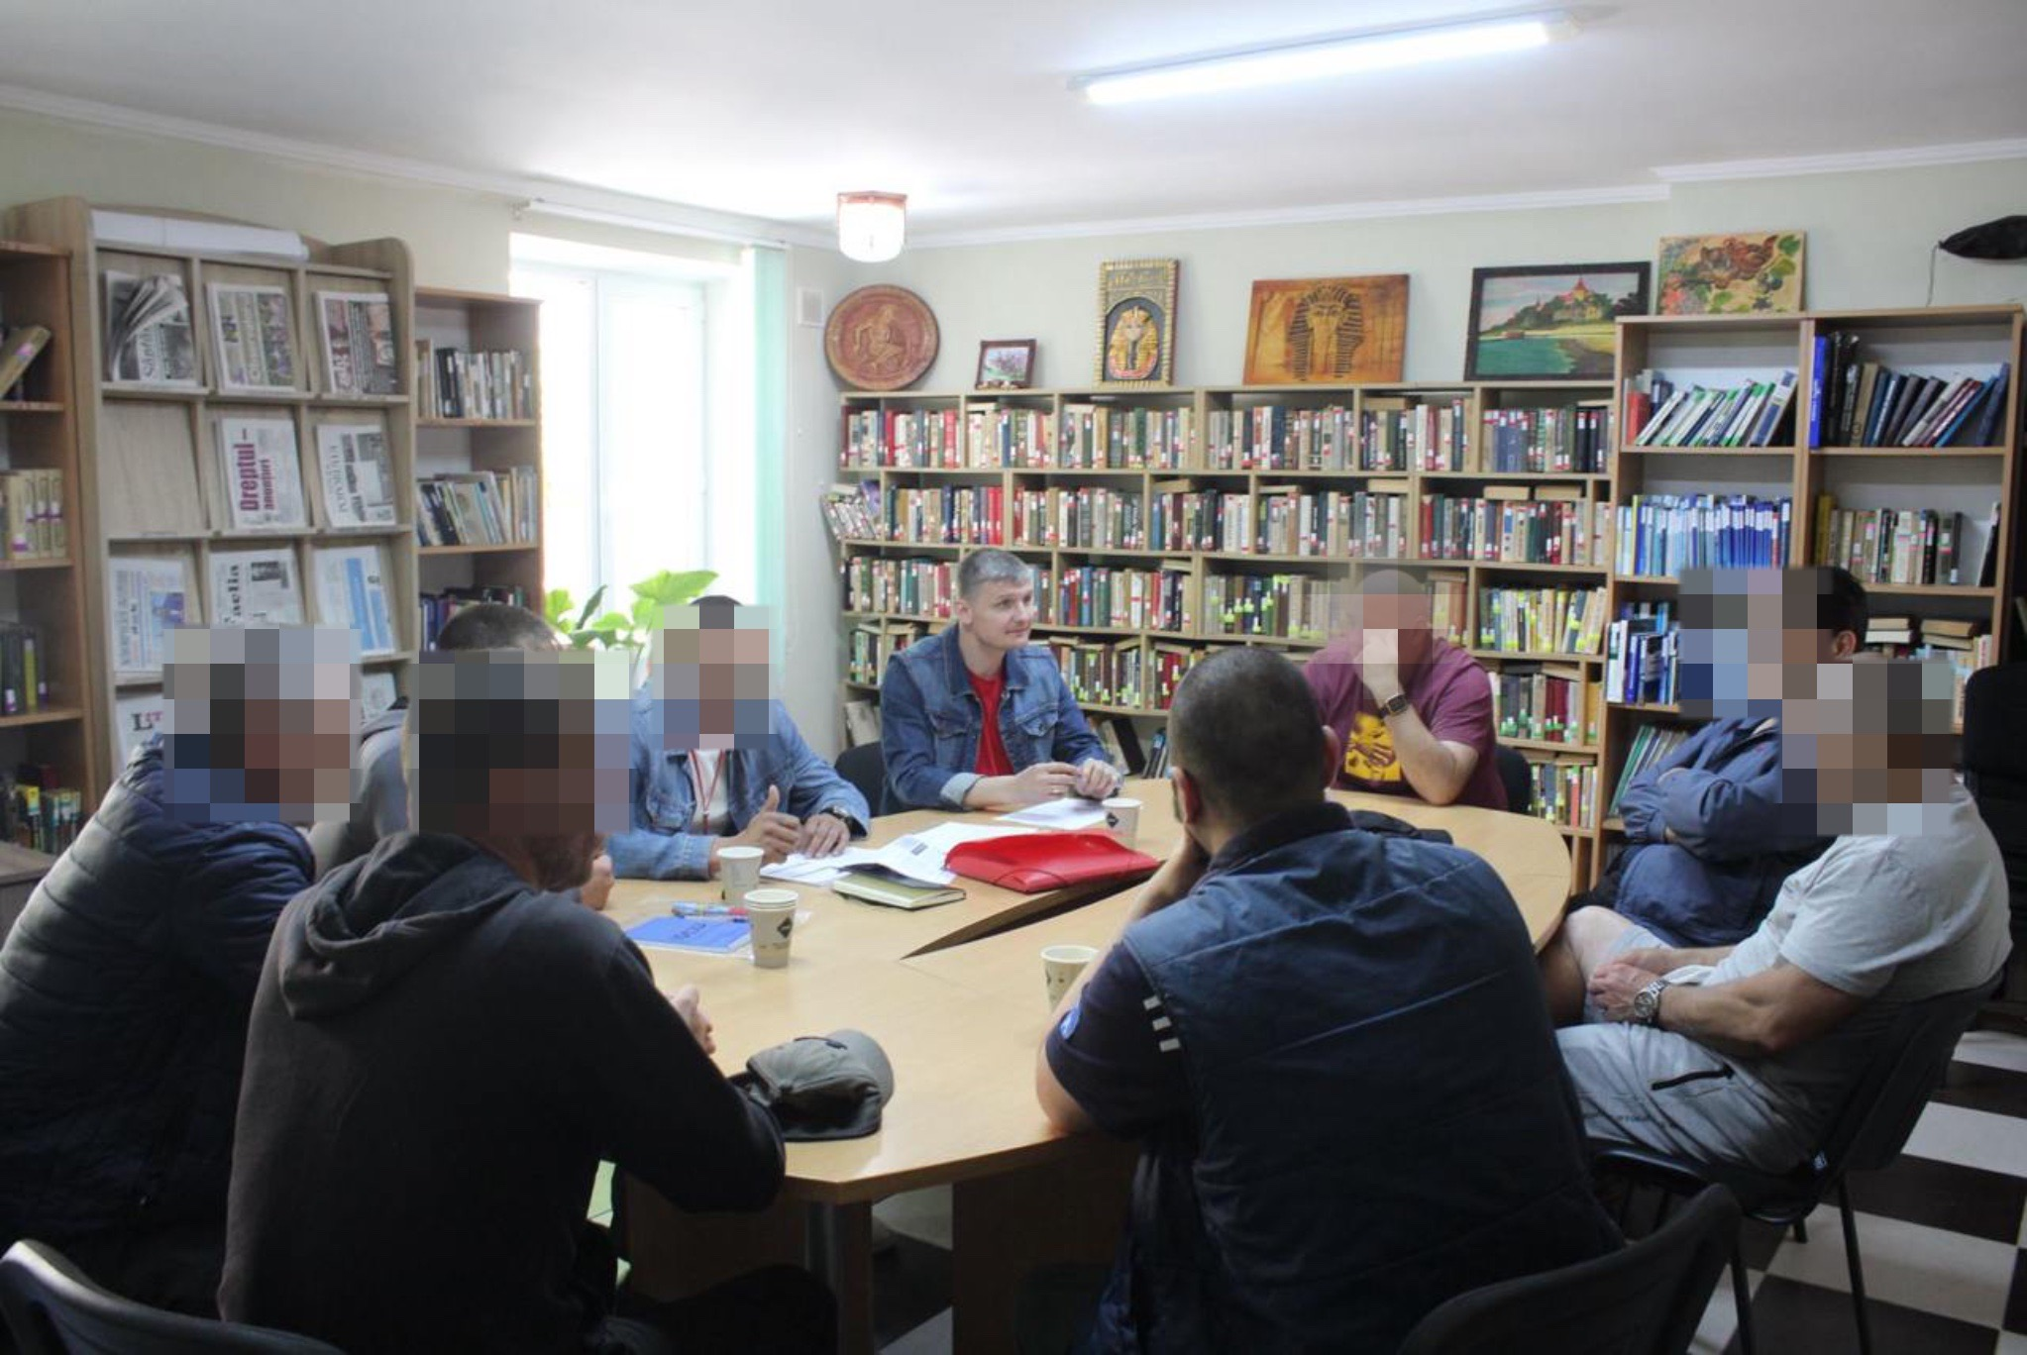
Best practices: Moldova
Rehabilitation on the basis of therapeutic communities
Vending machines
Social business in prisons

Slide 8
Best practices:
Kyrgyzstan
Armenia
Peer to peer harm reduction services
Social patronage after release (HIV, TB)
Shelters for people released from prisons
Information & counseling for people in prisons on HIV, TB, HCV, legal basis of healthcare service provision and prisoners’ rights

Slide 9
Solutions
State level: equivalency of services in prisons and community must be provided at strategy, policy and practice levels
International community: access of prisoners to services must be among the priorities of donors, international organizations and technical partners
Community level:
building a strong community of people with living experiences in prisons of EECA region
potential of prisoners is fully used for 24/7 peer to peer service provision

Slide 10
“It is said that no one truly knows a nation until one has been inside its jails. A nation should not be judged by how it treats its highest citizens, but its lowest ones.”
Nelson Mandela

Slide 11
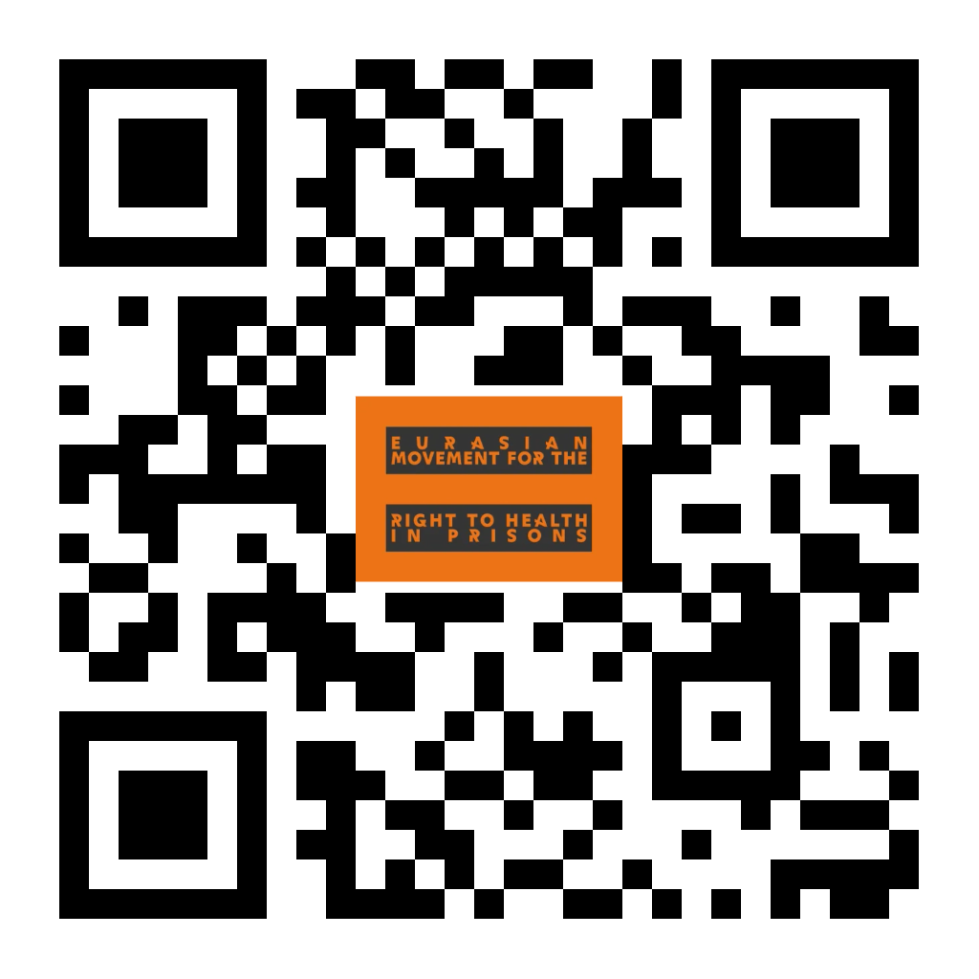
Put people in prisons first!

