Slide 1
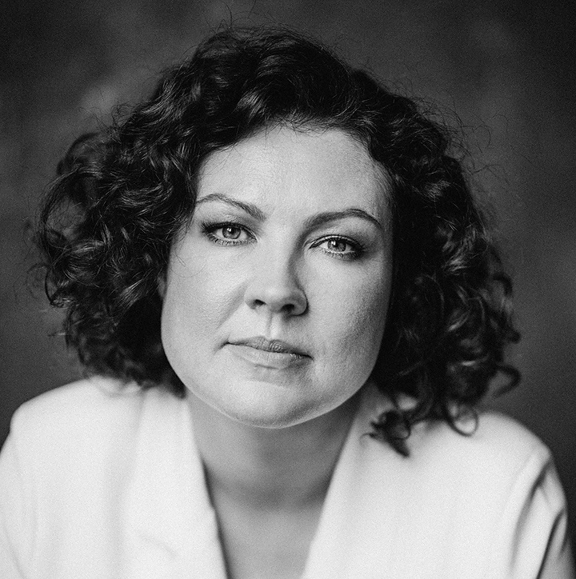
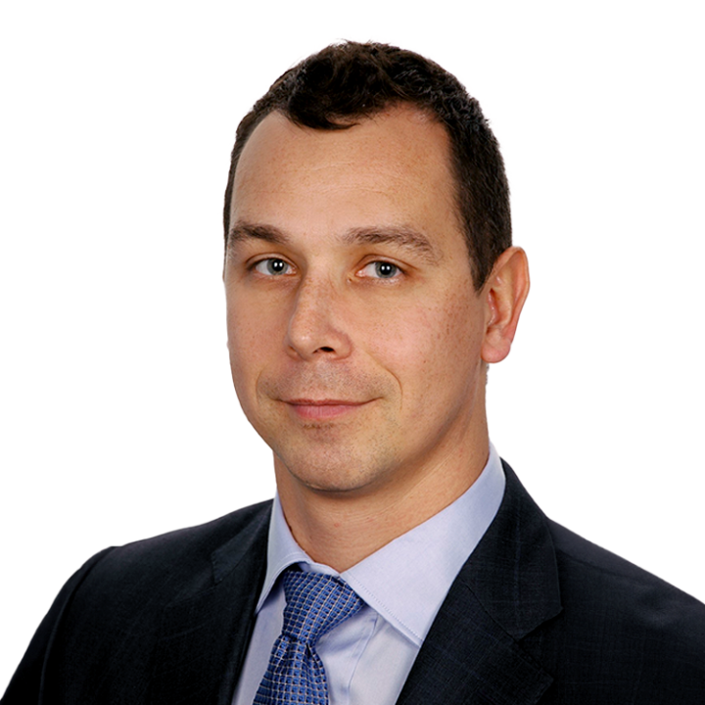
Q and A with speakers (part one)
Alexei Lakhov
European Network of People Who Use Drugs,
Germany
Natalia Sidorenko
ANO Center for Promoting Partnerships in the Healthcare Sphere “Zdorovye.ru”, Kazakhstan
Anna Koshikova
Eurasian Movement for the Right to Health in Prisons,
Ukraine
Milosz Parczewski
Pomeranian Medical University,
Poland

