Slide 1
Integrated services for gender-based violence, HCV and innovations for users of psychoactive substances in Moldova
Ala Iatco, Union for Equity and Health, Republic of Moldova
Person-centred and integrated healthcare and harm reduction services for people living with and affected by HIV, hepatitis C and tuberculosis in eastern Europe and central Asia

Slide 2
Conflict of interest disclosure
I have no relevant financial relationships with ineligible companies to disclose.

Slide 3
The evolution of harm reduction in Moldova
Until 2021
Now
No harm reduction services for non injectable users of psychoactive substances in Moldova
No consistent gender-based violence (GBV) activities for women who inject drugs and sex workers
No shelters for women who inject drugs
No age sensitive aproaches in harm reduction services and support projects for people living with HIV
No focused interventions on HCV treatment and care among people who inject drugs
3000 people who use psychoactive substances became harm reduction clients
community-led PrEP, which ensured scaled up acess to key pops, including people who use drugs to PrEP
More than 6000 women covered with specific informational and educational interventions (due to humanitarian work linked with war in Ukraine, ex. UNAIDS )
3 specialised shelters opened for women who inject drugs (UNODC support)
In development – specialised toolkit to address linkage of people who use drugs with HCV care and treatment facilities

Slide 4
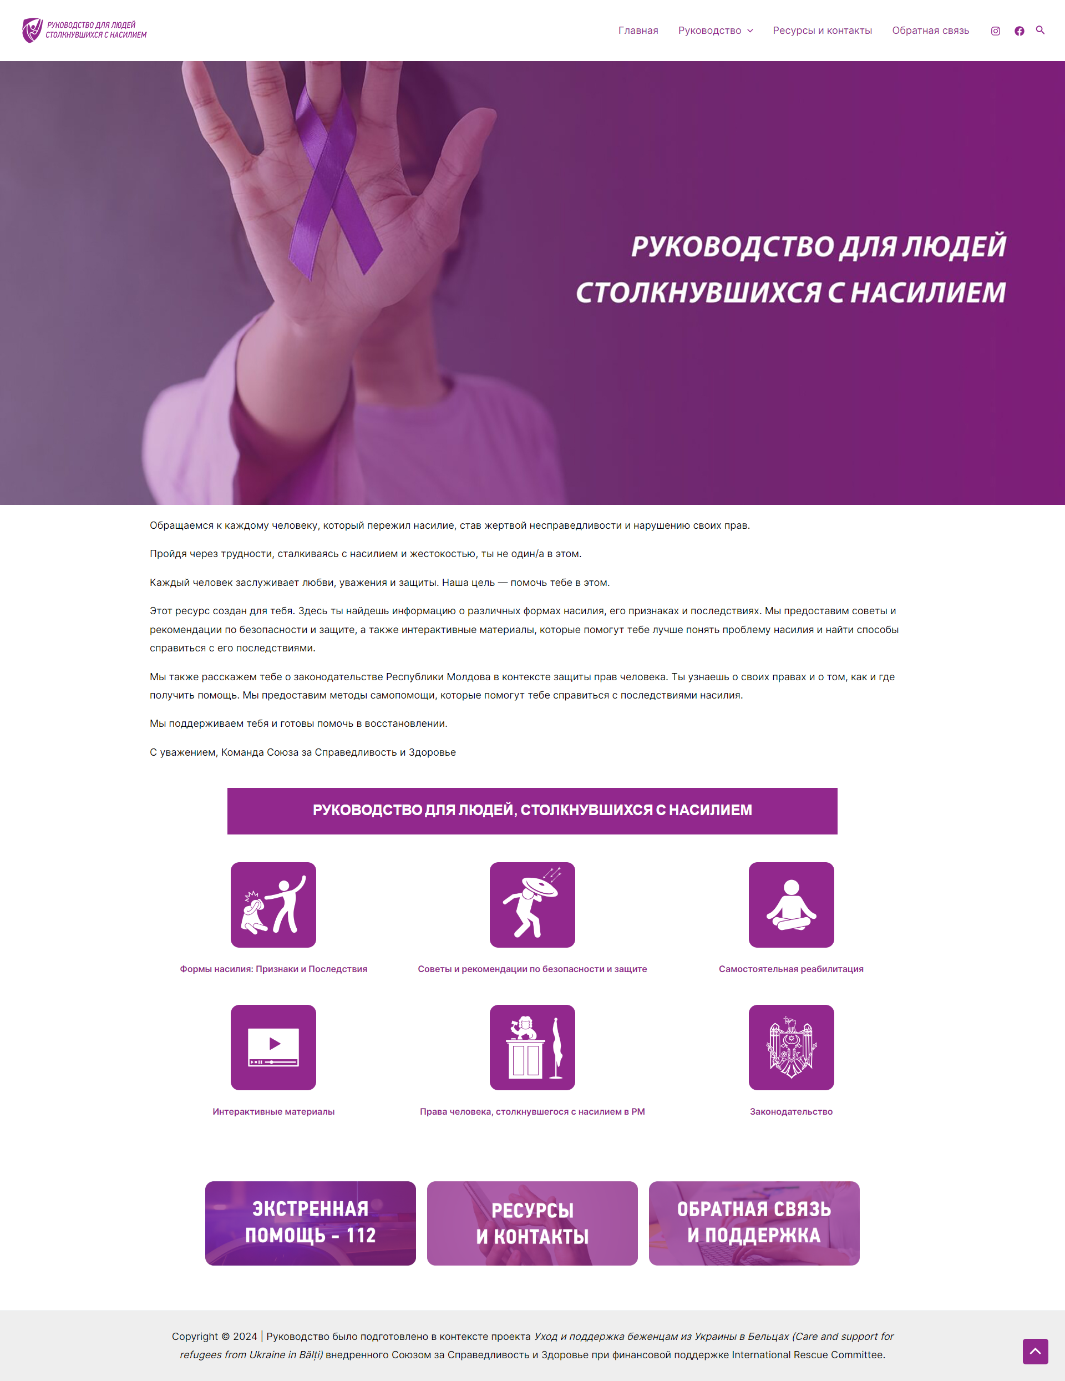
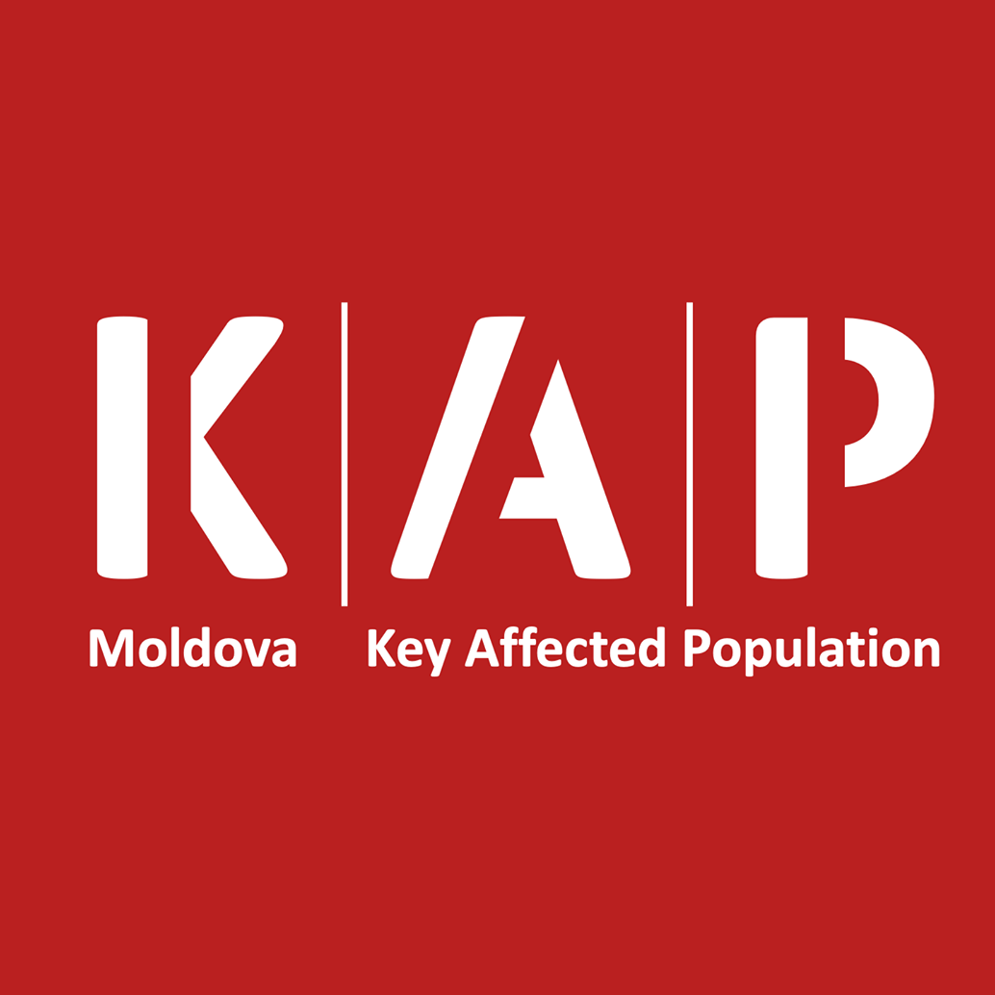
Three Pillars
Human Rights
Gender Equity
Community involvement
Gender based Violence response: GBV Apps gbv.formare.md
E-learning platform: www.youtube.com/watch?v=FJelDyhMrLc
KAP Committee (the informal platform for key populations)
Online harm reduction interventions, including paralegal support
Innovations

Slide 5
We work on…
Harm Reduction:
quality
accesibility
sustainability
Drug policy:
public health
social policies
justice
Migrants :
rights
accessibility

Slide 6
Conceptual transition in supporting clients: from needs associated with HIV & drug use to universal human needs!
Universal coverage
Harm reduction
Sex work
Legal services
SRH
ТБ
HIV
Hepatitis
ВИЧ
Гепатиты
STI
Mental Health
Drug use
ИППП
Non-communic. diseases
TB
Професс. Интеграция
Передозировка
Security

Slide 7
“Harm Reduction is a comprehensive approach with positive influence in health and social spheres and for setting measurable targets for the impact on health, social and legal aspects of the life of people who use drugs”
Eurasian Harm Reduction Association Position Paper on the Quality of Harm Reduction Services

Slide 8
What helps us?
Global Fund support
Domestic support
Funds addressing refugees needs
Local support

Slide 9
The way forward
Integration of services and clients into national social and health reforms
Financial diversification
Synergies with regional and global strategies and approaches
Organizational development
Client safety, satisfaction and well-being

Slide 10
“I'm Kolya! Of course... I take syringes and naloxone, condoms and ointments, and I take a lot of other things here. My friend takes pipes to smoke. But the most important thing for me is that in the summer I have somewhere to hide from the heat, and in the winter from the cold, I can have a snack here, I can lower my temperature or blood pressure... watch the news on TV or on the Internet. This is all important to me!
Anonymous client

