Slide 1
The simplified HCV integrated management model in OAT clinics in Ukraine
Myroslava Filippovych, MPH, Researcher at Ukrainian Institute on Public Health Policy
Person-centred and integrated healthcare and harm reduction services for people living with and affected by HIV, hepatitis C and tuberculosis in eastern Europe and central Asia

Slide 2
Conflict of interest disclosure
I have no conflict of interest to declare.

Slide 3
Hepatitis C is chronically undiagnosed & untreated
Notes:
It is estimated that about 70 million people are infected with HCV globally, and the majority are not aware of their infection.
2015 - 3.7% (0.9-6.7%) of the population of Ukraine was infected with HCV and are viremic (RNA positive).
2017 - 1 368 300 individuals infected, majority with genotype 1:
83,000 were registered in medical care
about 35,000 are fully diagnosed and were on the waiting list at regional health authorities

Slide 4
People who use drugs need integrated services
High burden of HCV (nearly 83%) of people receiving opioid agonist therapy (OAT) are also living with hepatitis C
Stigmatization, low awareness of recent guidelines majority are not included in the direct-acting antiviral (DAA) waiting lists
DAA is non-affordable from pharmacies
Growing availability of DAA medications
Ongoing healthcare reform context in Ukraine
Opportunity to build and evaluate a simplified integrated HCV care model at OAT clinics.
Notes:
People who inject drugs have high burden of HCV and due to multiple individual and structural barriers suffer from suboptimal access to life-saving treatments.
Nearly 83% of people receiving OAT are HCV-infected. Due to stigmatization from medical providers and low awareness of recent guidelines, majority are not included in the DAA waiting lists, and due to low income cannot afford medications from pharmacies. - Dumchev K, Kornilova M, Saliuk T, Varetska O. Estimation of the Number of People Who Inject Drugs and Live with HIV And Viral Hepatitis Co-Infection in Ukraine. 7th International Symposium on Hepatitis Care in Substance Users; Sep 20. Lisbon, Portugal: Oral Abstract #360; 2018.
The growing availability of DAA medications and ongoing healthcare reform context in Ukraine presented a unique and time-sensitive opportunity to build and evaluate a simplified integrated HCV care model at OAT clinics.
The number of people on OAT increasing each year, and the majority are treated at specialized addition treatment facilities. Thus, a large number of OAT clients can benefit from integrated HCV services using a model we are implementing.

Slide 5
Study objectives
Stage 1 – completed in 2021
Develop a simplified HCV care and treatment model (SHIM) integrated into OAT programs in Ukraine and demonstrate its feasibility
(Pilot with 20 patients in one OAT clinic)
Stage 2 – ongoing since 2022
To examine the client, clinician and organizational factors that contribute to SHIM adoption and clinical outcomes
To evaluate the effectiveness of SHIM in improving the HCV treatment cascade outcomes using a cluster-randomized three-arm trial design
(480 participants at 12 OAT clinics)
SHIM implementation is strengthened by Project ECHO (Extension for Community Healthcare Outcomes)
Notes:
Goal is to evaluate feasibility and effectiveness of a simplified HCV care and treatment model integrated into OAT programs in Ukraine. The simplified HCV integrated model (SHIM), if shown effective, would be relevant for other non-specialty healthcare facilities.
Stage 2 – ongoing since 2022
To examine the client, clinician and organizational factors that contribute to SHIM adoption and clinical outcomes.
To evaluate the effectiveness of SHIM in improving the HCV treatment cascade outcomes using a cluster-randomized three-arm trial
SHIM implementation is strengthened by Project ECHO (Extension for Community Healthcare Outcomes), a collaborative telehealth learning process, supporting and empowering OAT clinicians to develop knowledge and self-efficacy about HCV care

Slide 6
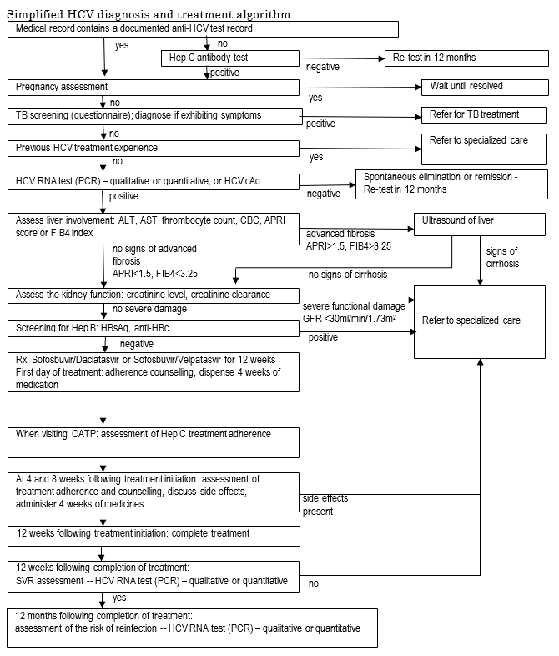
SHIM algorithm
Key features:
Simplified diagnosis (no genotyping, fibrosis assessment by APRI/FIB)
Pan-genotypic DAA regimens
Referral of patients with more complicated conditions (HBV, advanced fibrosis, kidney impairment) to specialized facilities
Notes:
APRI - AST to Platelet Ratio Index
The FIB-4 index is a simple non-invasive approach using selected laboratory measures (AST, ALT, platelet count) in combination with patient age to assess if an individual is at higher risk for advanced liver fibrosis (F3-F4).

Slide 7
Stage 1 Results Lviv OAT clinic (completed in 2021)
Sustained virologic response (SVR) = 95% treatment effectiveness
conforms with data from other studies
Notes:
SVR - Sustained virologic response (means that the hepatitis C virus is not detected in the blood 12 weeks or more after completing treatment)
All patients who have received full treatment course have been tested for SVR confirmation at 12 weeks after completion. All but one patient received negative results, corresponding to 95% (19/20) treatment effectiveness, which conforms with data from other studies

Slide 8
Stage 2: design
Hybrid type 2 implementation study
mixed methods (quantitative + qualitative)
cluster-randomized three-arm clinical trial, with 12 OAT sites randomized to:
standard of care (N=160)
SHIM with ECHO facilitation (N=160)
SHIM with ECHO facilitation + P4P (N=160)
Total 480 participants living with HCV
Monthly online ECHO sessions
facilitated by a national HCV expert
guest speakers from related disciplines like gastroenterology, infectious diseases
combines didactic sessions + case presentations & discussions
Notes:
Hybrid type 2 implementation science approach
Coprimary aim*: determine effectiveness of a clinical intervention Coprimary aim: determine feasibility and potential utility of an implementation intervention/strategy
ECHO (Extension for Community Healthcare Outcomes) -

Slide 9
Methods
Quantitative data collection
Structured questionnaires for participants (on the REDCAP platform)
Paper-based questionnaire to assess adherence to treatment and side effects - every 4 weeks
Qualitative data collection
Focus group interviews with study participants
In-depth interviews with clinicians and clinic administration

Slide 10
Stage 2: Progress
All 12 sites have been included into the study
Re-distribution of medications was made
Enrolling participants from March 2023
Monthly ECHO sessions are being conducted from April 2023

Slide 11
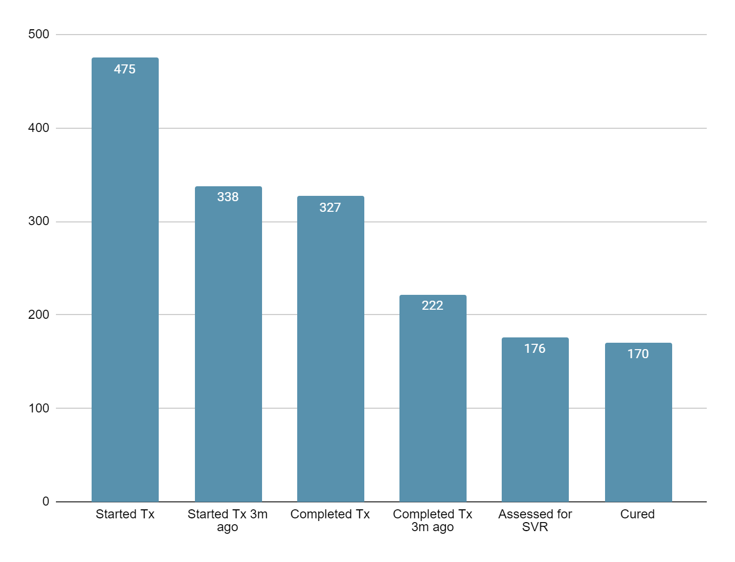
Stage 2: Current status (as of July 10, 2024)
Sustained virologic response (SVR) = 96,6%

Slide 12
Participants feedback and experience
“to get cured and to be healthy”.
R1: I am very happy! My condition became much better. My liver is not bulging as it was before. My skin has lightened. I really feel much better.
R2: And I feel myself better. Now I have energy. And the face is not so yellow. Even some people noticed... (FG 2, Lviv)
***
I: If people knew that hepatitis C can be treated at the OAT site, would that increase interest in the OAT program?
R1: Yes, of course! And if they learn about the prices of the medicines...
P2: Yes, yes, yes.
R3: That would be a motivation for many people to start OAT, one hundred percent! (FG 2)
“a wonderful chance”
“a good luck”
Notes:
Participants attitude to the opportunity to treat hepatitis C for free with the best available medicines was cited as “a good luck” and “a wonderful chance”. The main motivation to start treatment was “to get cured and to be healthy”.

Slide 13
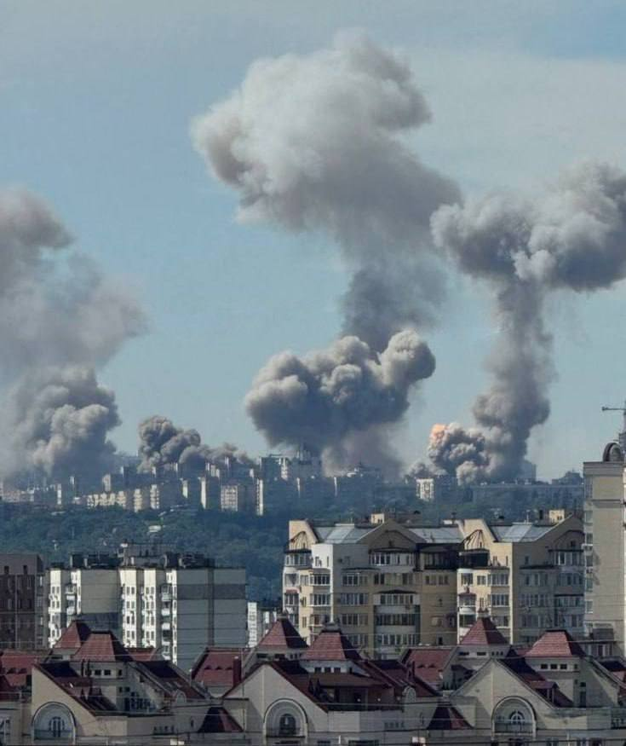
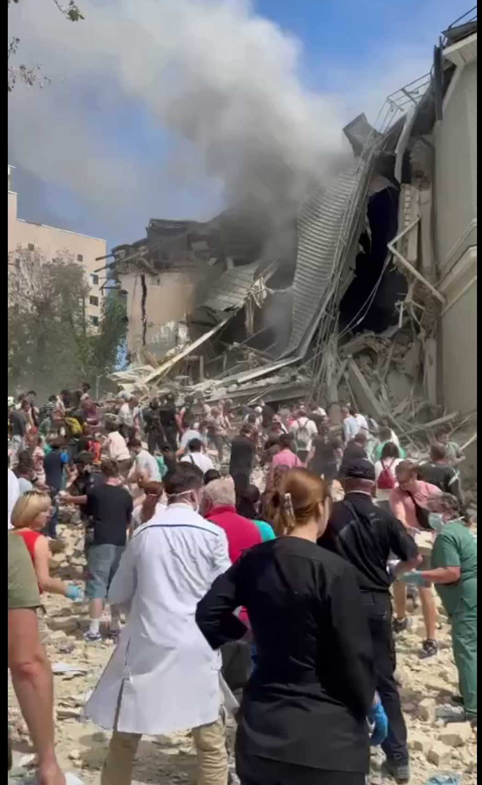
Current context
Daily shelling of Ukraine brings more and more destruction and complicates the functioning of the healthcare system
Notes:
While I was preparing this presentation, on July 8th Russia launched another major missile attack on Ukraine, deliberately targeting hospitals, and killing at least 44 people, including 5 children

Slide 14
Funding and partners
Funding:
The Western-Eastern European Partnership Initiative on HIV, Viral Hepatitis and TB (Project ID 472020). No pharmaceutical grants were received in the development of this study.
Partner:
Public Health Center of the Ministry of Health of Ukraine

Slide 15
Thank you!
Myroslava Filippovych filippovych@uiphp.org.ua
Tetiana Kiriazova kiriazova@uiphp.org.ua
Kostyantyn Dumchev dumchev@uiphp.org.ua

