Slide 1
RADIAN’s Mission and Impact in the EECA region
Anne Aslett, Chief Executive Officer, Elton John AIDS Foundation
Person-centred and integrated healthcare and harm reduction services for people living with and affected by HIV, hepatitis C and tuberculosis in eastern Europe and central Asia

Slide 2
CONFLICT OF INTEREST
RADIAN Programme is a collaboration between Gilead Sciences Europe Limited and the Elton John AIDS Foundation.
RADIAN is funded by Gilead Sciences Europe.
Project funding is provided through grants which are assessed and administered by the Elton John AIDS Foundation.
Gilead has no involvement in the selection and assessment of award applicants and winners.

Slide 3
PERSON-CENTERED CARE IN RADIAN
RADIAN is a 5-year (2020-2025) $25M partnership between Gilead Sciences and the Elton John AIDS Foundation to support HIV initiatives across 25 countries in EECA
Meeting a person where s/he is in their needs AND
Strengthening government and community systems to provide key population-friendly services
Support local partners in the region who know what is feasible, safe and best for their clients
Meeting the needs of all key populations with the focus on those neglected and persecuted

Slide 4
MIGRANT HEALTH IN EECA
Meeting people where they are across Kazakhstan, Kyrgyzstan, Russia, Tajikistan & Uzbekistan:
Before, during and after migration
In places where they live, work and spend their time
Meeting people’s needs:
Speaking their native languages
Counseling on safe migration and health
Peer outreach to key populations
HIV and STI testing services
Pre- and post-exposure prophylaxis of HIV
ART and STI treatment even when not provided by host country
Distant ART initiation and treatment from home country

Slide 5
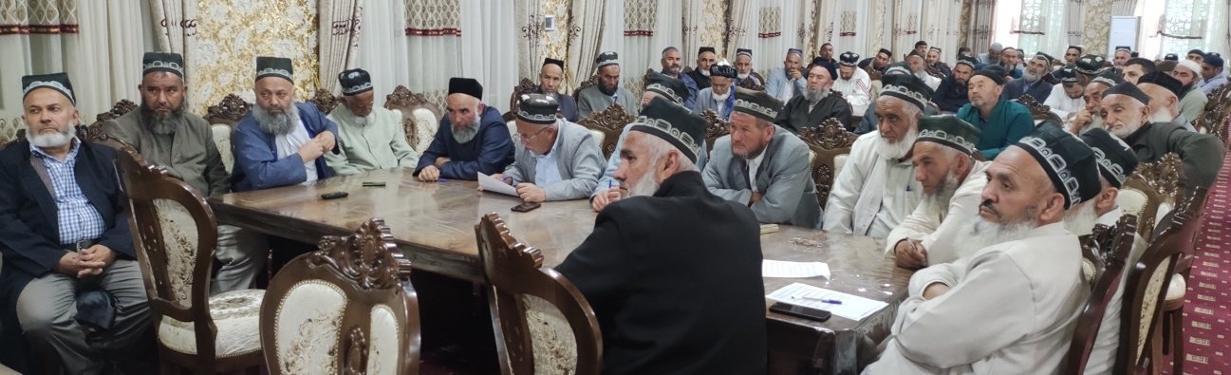
PROTECTING THE RIGHTS OF PEOPLE LIVING WITH HIV AND KEY POPULATIONS, TAJIKISTAN
Of 16 countries in EECA, 15 criminalize HIV transmission or exposure; People living with HIV in Tajikistan are actively prosecuted
Men who have sex with men and trans people are extorted by law enforcement
NGOs serving LGBTQ communities are shut down by authorities
Meeting people where they are:
24-hour hotline with lawyers
Cross-referral of clients by NGOs for legal and psychosocial assistance
Legal attorney services in investigation and trial
Reducing stigma and discrimination towards people living with HIV in the community through religious leaders

Slide 6
RADIAN RESULTS TO DATE
In 2020-2024, RADIAN partners:
Reached over 271,000 people from key populations and their partners with HIV services;
Tested for HIV, STIs, HBV and HCV more than 114,000 people;
Identified almost 8,000 people living with HIV;
Traced over 24,000 people living with HIV who had been lost to follow-up;
(Re-)initiated on ART over 26,500 people living with HIV;
Trained more than 14,000 frontline workers to reduce stigma and discrimination, and provide person-centered care for key populations

Slide 7
ANNOUNCING RADIAN EXTENSION
A new 5-year (2024-2029) $25 Million programme
Continue support to local initiatives:
Meeting the evolving needs of people living with HIV and key populations
Addressing structural drivers of the HIV epidemic
Strengthening health systems to improve HIV care
Strengthening community systems to deliver community-led care and increase access to sustainable funding
Expand programme geography to support services for people living with HIV and key populations among refugees from Ukraine
Launch the “Innovations Fund” to increase the effectiveness of the HIV response in EECA by supporting emerging innovations on a rolling basis

Slide 8
Please learn more about RADIAN
and see a live request for applications at
eltonjohnaidsfoundation.org/radian

