Slide 1
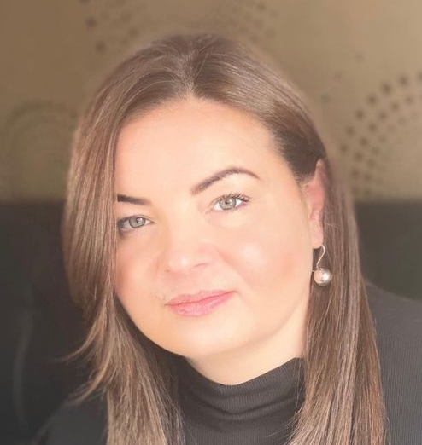
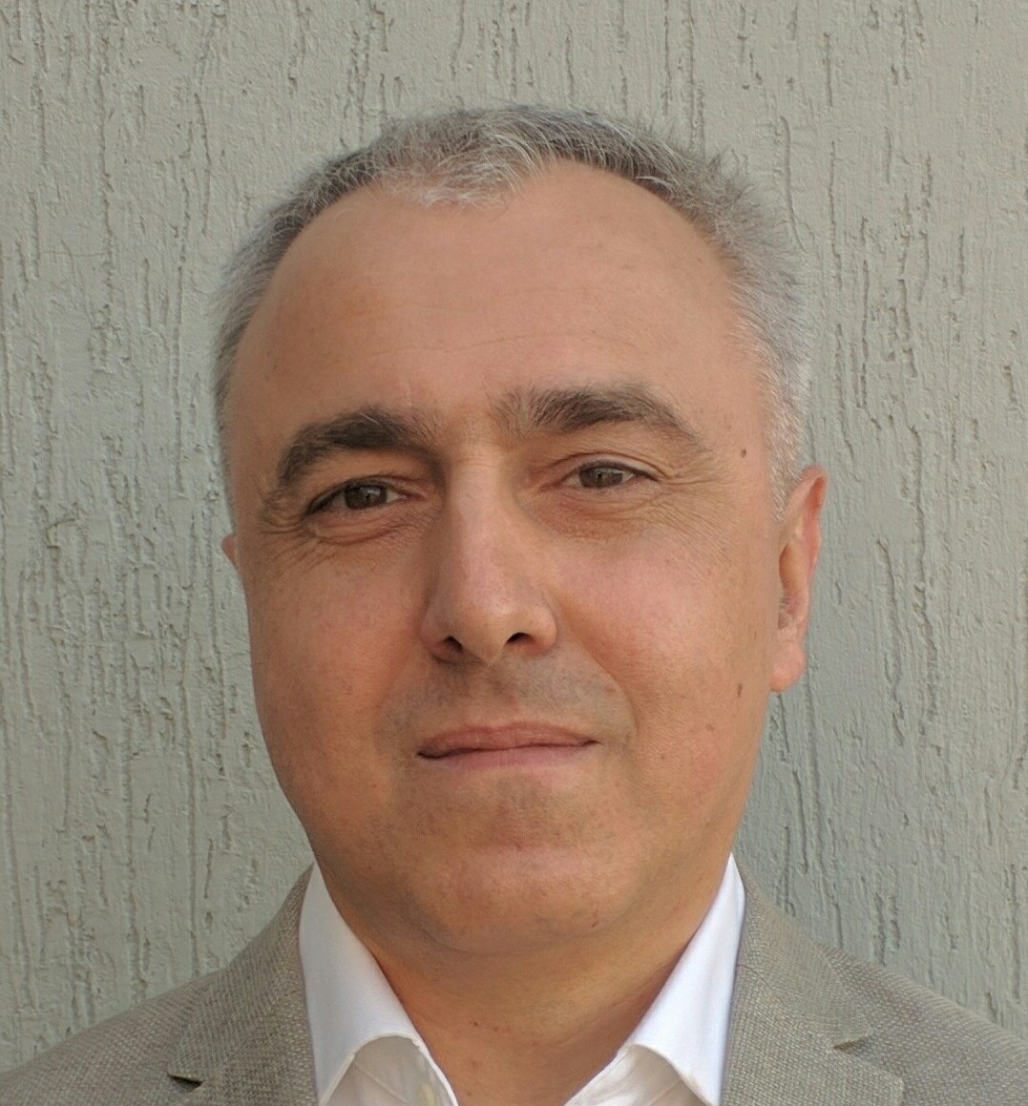
Q and A with speakers (part two)
Ala Iatco
Union for Equity and Health, Republic of Moldova
David Otiashvili
Alternative Georgia,
Georgia
Myroslava Filippovych
Ukrainian Institute on Public Health Policy,
Ukraine
Anne Aslett
Elton John AIDS Foundation,
United Kingdom

