Slide 1
Viral persistence in different populations
Much known, much to learn
Rose Nabatanzi - PhD
Makerere University College of Health Sciences
Uganda
Notes:
Good morning!
My name is Rose Nabatanzi
I am from Makerere University College of Health Sceinces , Kampala Uganda
Today I am presenting on Viral persistence in different populations where much in known but theres still much to learn.

Slide 2
I declare no conflict of interest.

Slide 3
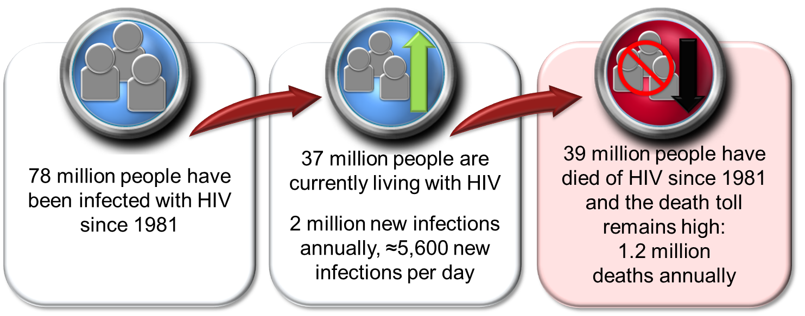
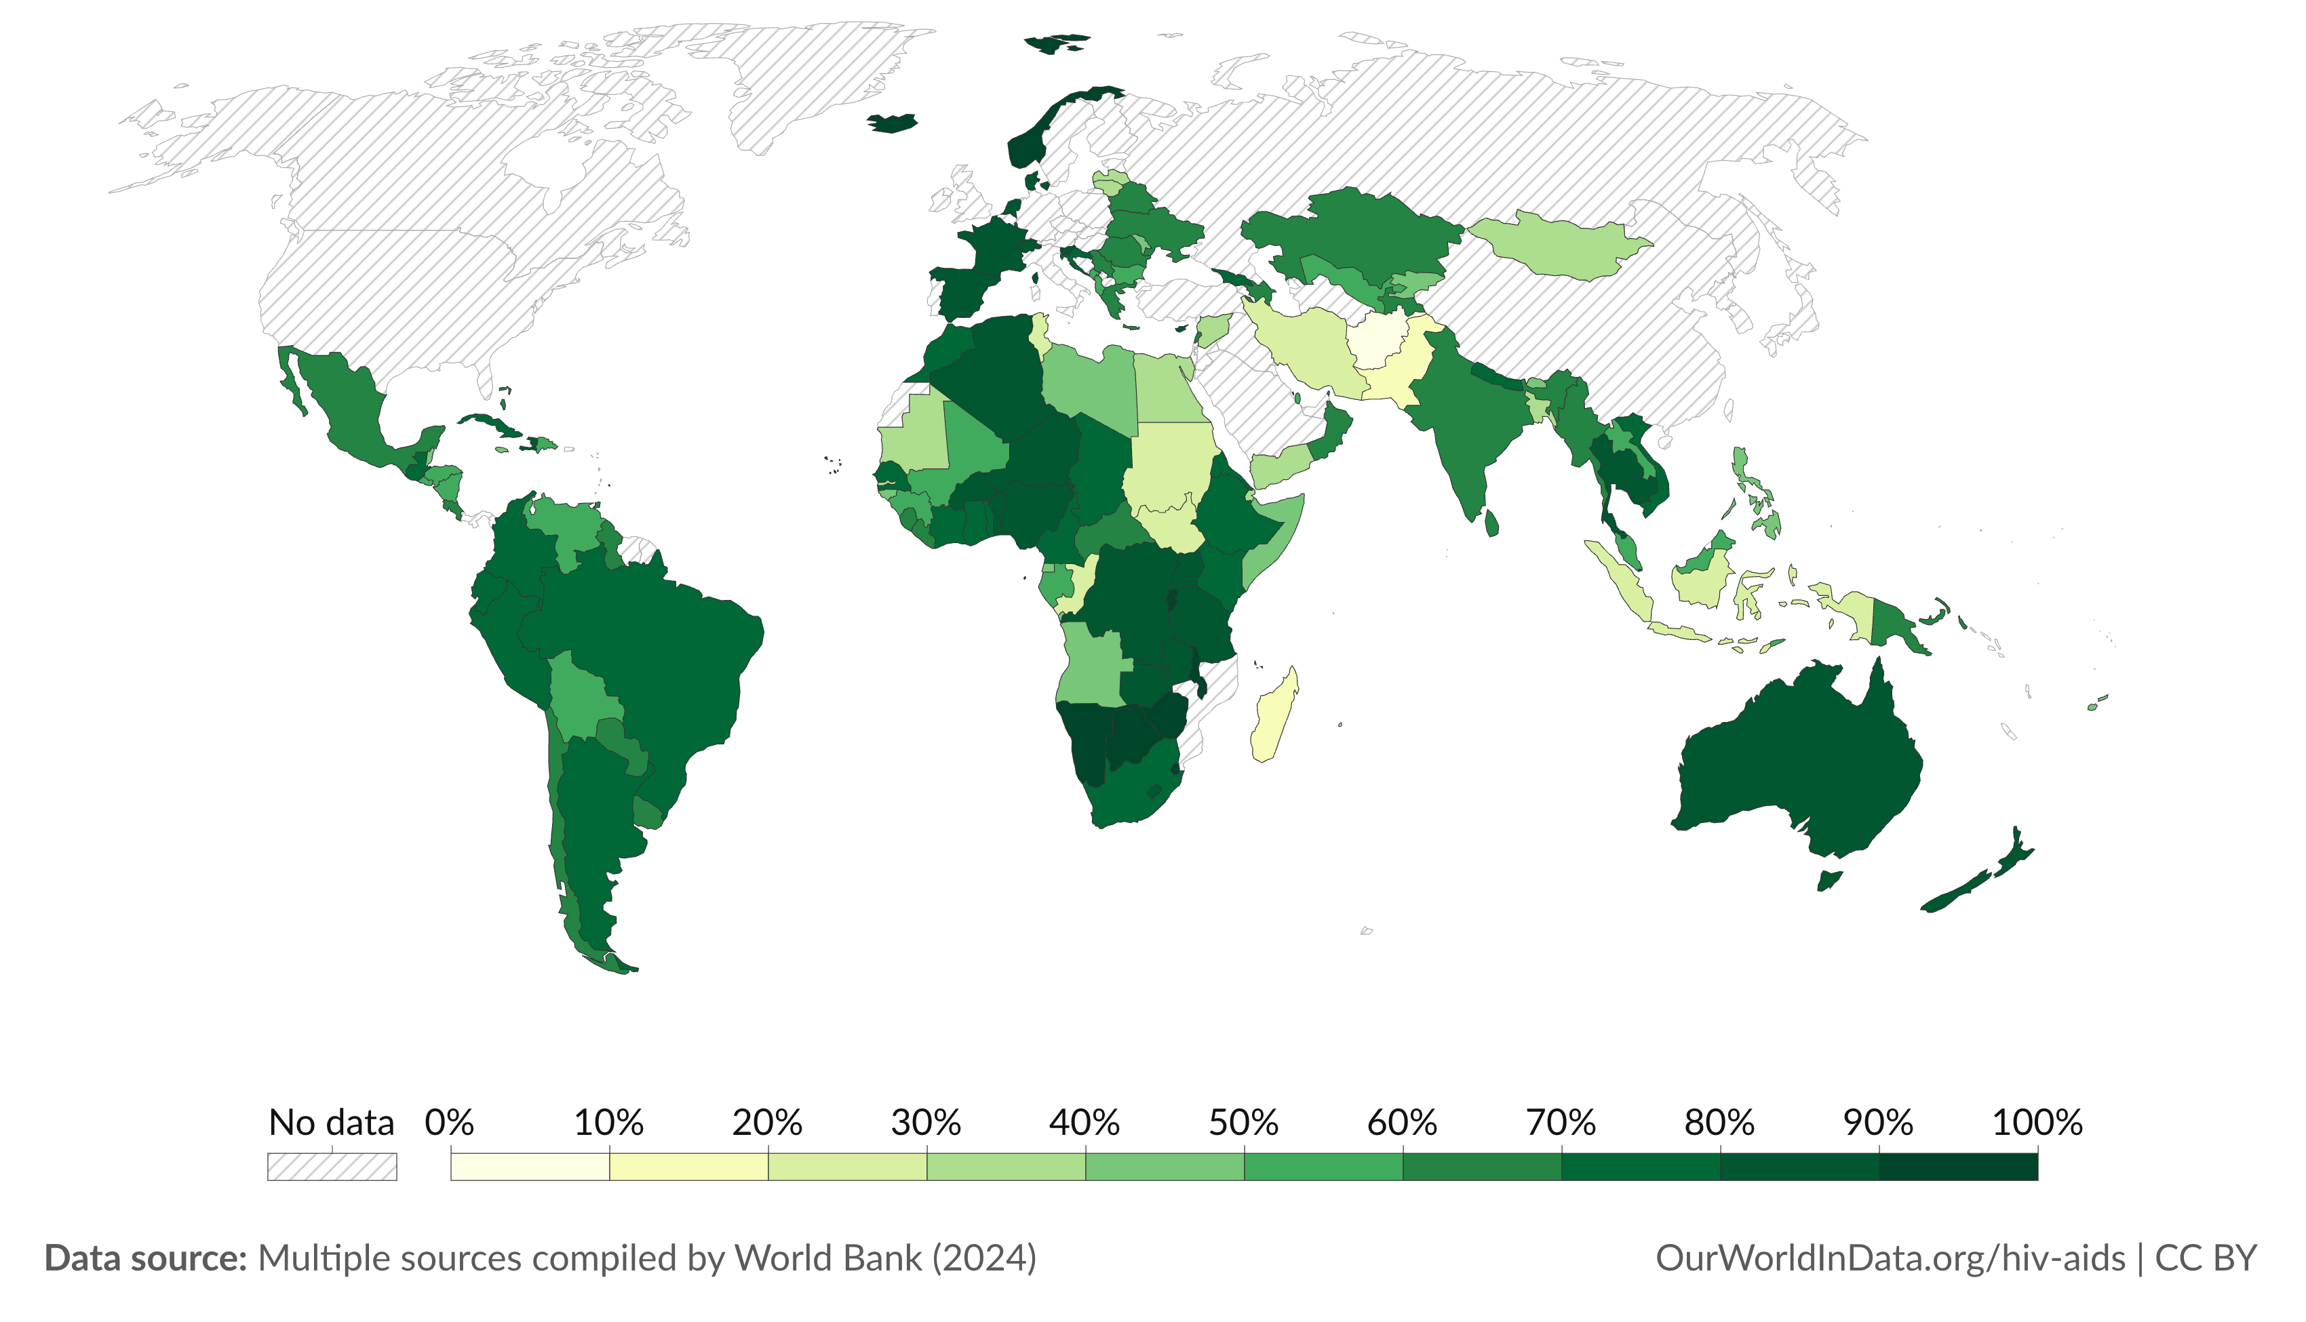
HIV still a global health crisis
ART Coverage
Although nearly all countries have experienced progress in the roll-out of ART, outcomes are uneven
Of the ~40 million with HIV, ~ 10 million are not on ART, and many of those on ART have detectable viremia; increasing rates of morbidity and mortality
Notes:
One of the greatest accomplishments of basic and clinical research has been the development of effective antiretroviral therapy (ART. Widespread availability of ART has greatly improved the livelihood of people living with HIV globally.

Slide 4
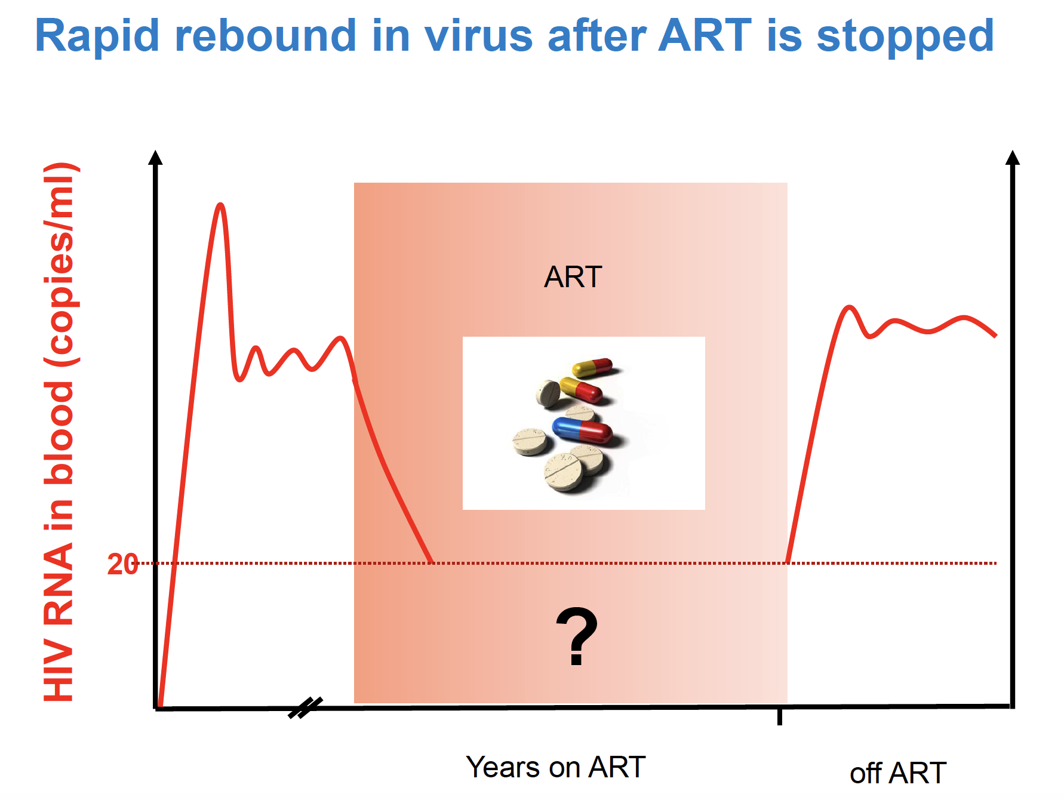
Why does HIV persist on ART?
ART prevents all (or nearly all) new infection events
HIV integrates as a provirus into the cellular DNA of resting memory CD4 T cells
Transcriptionally silent and dormant and evade detection by the immune system
When reactivated or once ART is stopped, the cells begin to produce HIV again
Notes:
Before ART initiation early on in infection, HIV integrates as a provirus into the cellular DNA of resting memory CD4 T cells. The cells containing HIV DNA persist within PLWH and are transcriptionally silent, remain dormant and evade detection by the immune system However, when reactivated or once ART is stopped, they can begin to produce HIV again. This is a major barrier to curing HIV

Slide 5
HIV is persistent despite effective ART
Some known mechanisms by which the virus persists
The reservoir is maintained by memory cell proliferation
Massive clonal expansion of infected cells
Cohn et al. Cell Host & Microbe 2020
Notes:
HIV persistence is not yet fully understood, however there some known mechanisms by which the virus persists.
The reservoir is largely maintained by the proliferation and expansion of memory CD4⁺ T cells.
HIV reservoir is also believed to persist primarily through massive clonal expansion of the infected cells
HIV-1 preferentially integrates into introns of actively transcribed genes

Slide 6
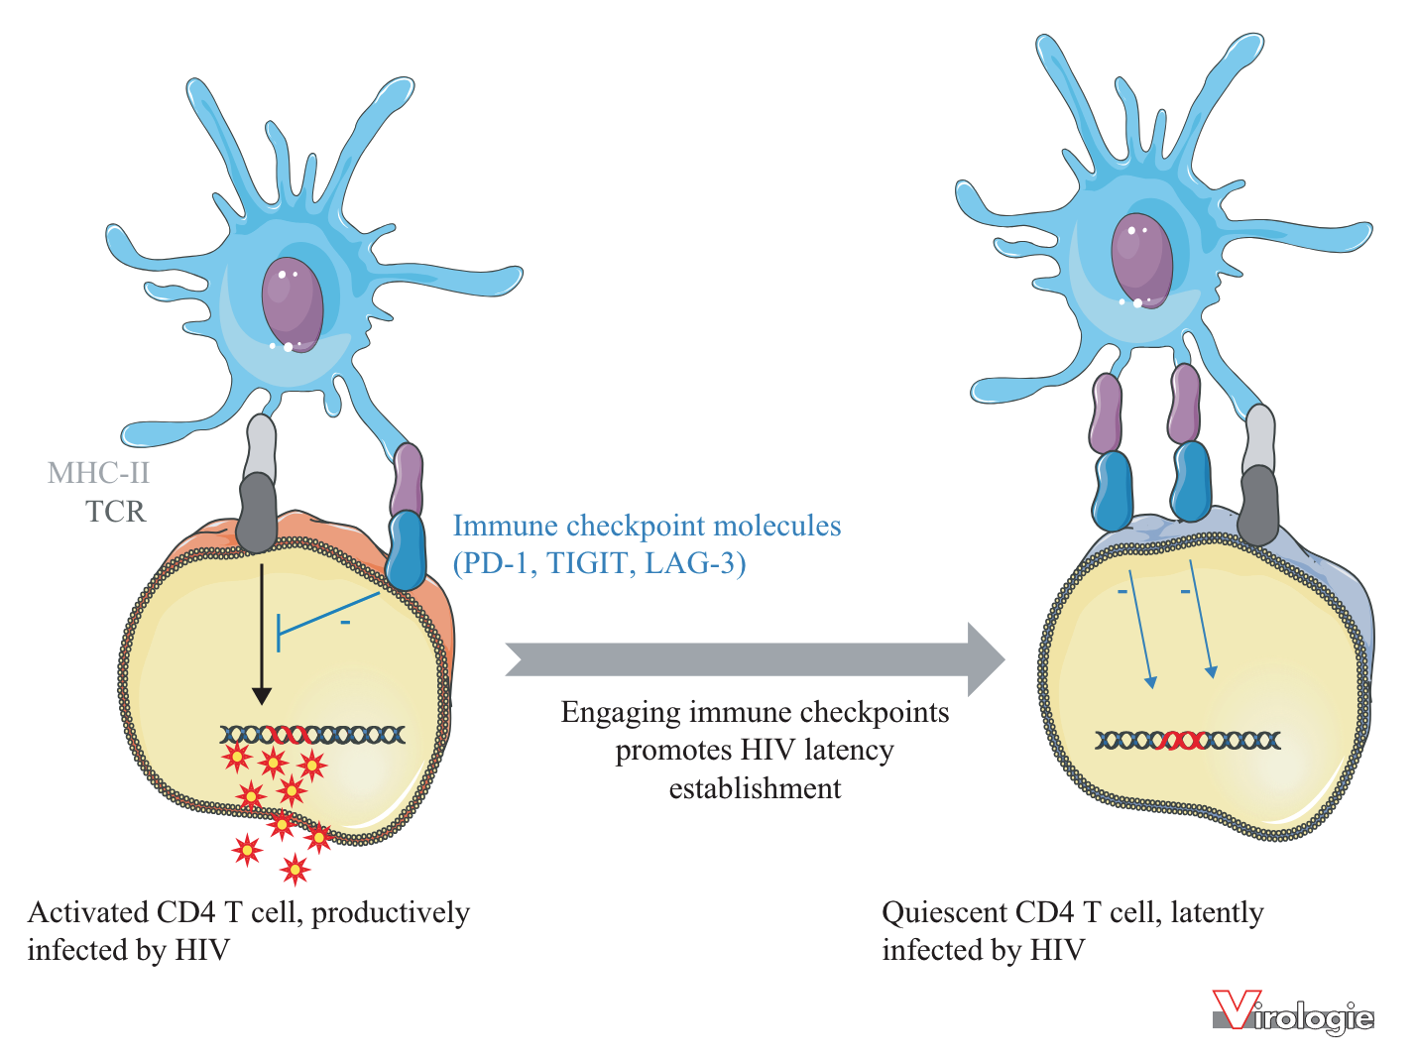



HIV is persistent despite effective ART
Latently infected cells preferentially express immune checkpoint molecules that allow them to remain invisible to the immune system
Armando Espinosa Ortiz et al
Notes:
The virus can also persist when cells highly express immune checkpoint inhibitors like PD-1 that allows infected cells to remain invisible to the immune system

Slide 7
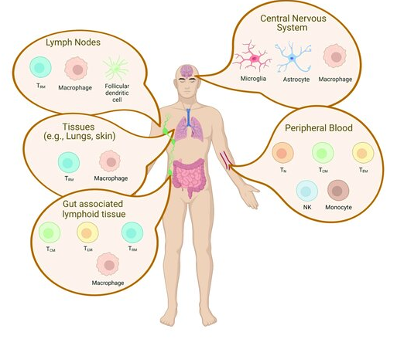

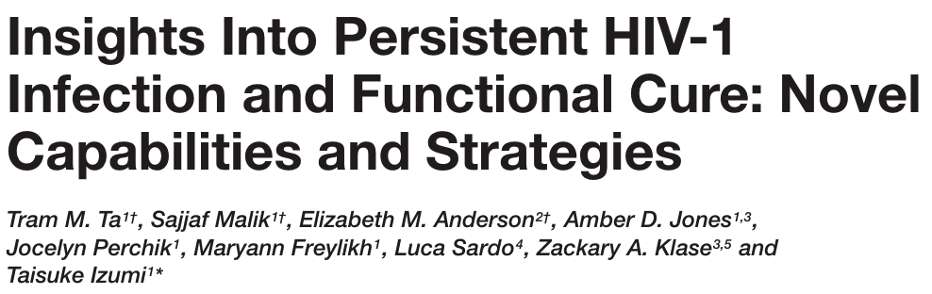
Reservoir cells can persist in different tissues
Lymphoid organs, the CNS, the GALT , female genital tract and peripheral blood continue to express viral genes despite suppressive ART
Tissue cells contribute to viral rebound and development of escape mutations once ART is stopped
Notes:
Latently infected cells can be found within the peripheral blood, the CNS, lymphoid organs and throughout the different body tissues. These continue to express viral genes despite ART and once ART is stopped, these tissues contribute to viral rebound and development of escape mutation.

Slide 8
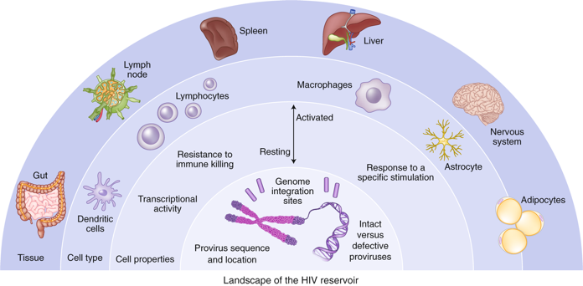

Reservoir cells can persist in different
immune microenvironments
Memory CD4+ T cell subsets predominant cellular compartment of the HIV reservoir
Monocytes, macrophages and dendritic cells play a role in persistent virus infection
Nat Med. 2021 Dec;27(12):2085-2098.
Notes:
As we can see, HIV can continue to persist in different immune microenvironments.
Memory CD4+ T cell subsets are regarded as the predominant cellular compartment of the HIV reservoir, but monocytes and derivative macrophages or dendritic cells also play a role in the persistent virus infection.

Slide 9


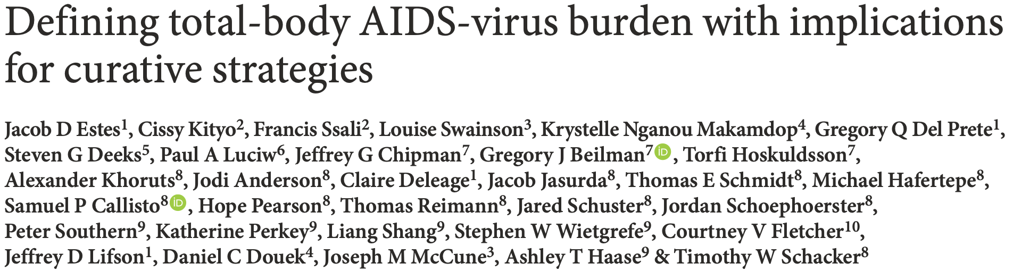
Can the reservoir be determined?
HIV reservoir is rare (< 1 in 1000 CD4+ T cells) and resides in difficult-to-reach tissues
<5–10% are fully intact
Small proportion are readily inducible
Notes:
HIV reservoir is rare, ≈ 0.01–1% of circulating CD4⁺ T cells contain an integrated genome, only a small proportion (<5–10%) of which are fully intact and only a small proportion of intact genomes may be readily inducible and able to support virus replication post-ART

Slide 10
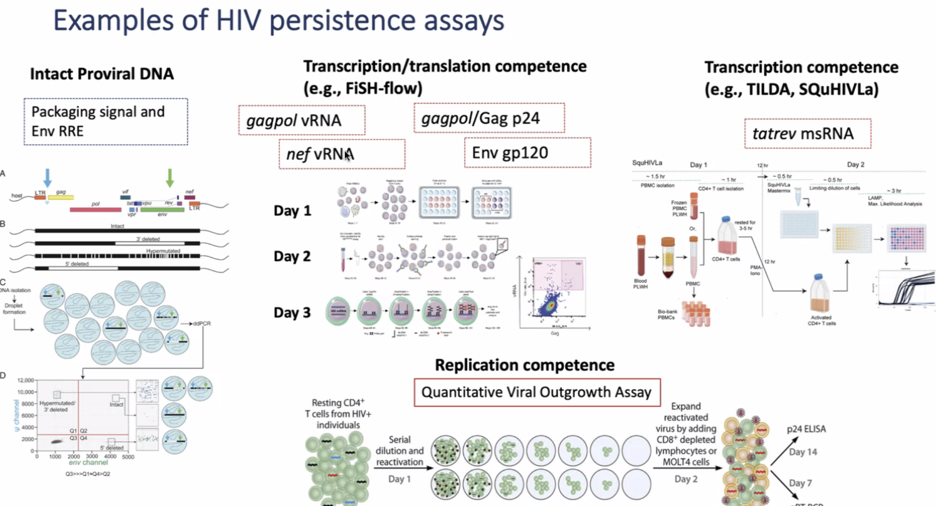
Can the Reservoir be determined?
High-throughput assays to characterize size and distribution of the rebound reservoir underway (IPDA, VIPSPOT, SQuHIVLa etc.)
We can now for the first time measure the virus that matters: intact and in the right place
Notes:
High-throughput assays designed to characterize the size and distribution of the rebound-competent reservoir are underway, with some progress (IPDA, VIPSPOT, SQuHIVLa and others)
We can now for the first time measure the virus that matters: intact and in the right place in different populations

Slide 11
HIV persistence in different populations;
What do we know?
Children, adults, men, women, controllers, subtypes
Notes:
Delving deeper into todays presentation, HIV persistence in different populations
What do we know in the children, what about adults, men, women, among groups that control the virus either naturally of post treatment, what about subtypes, do they matter?

Slide 12
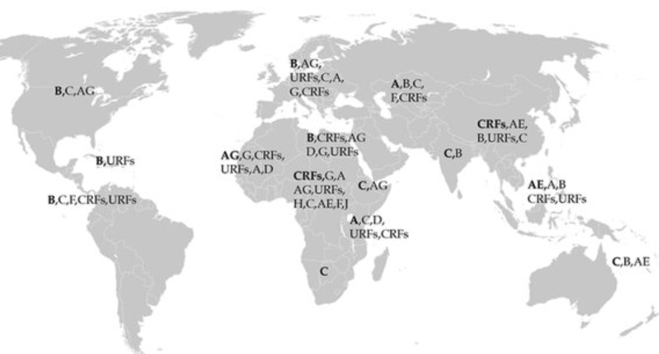

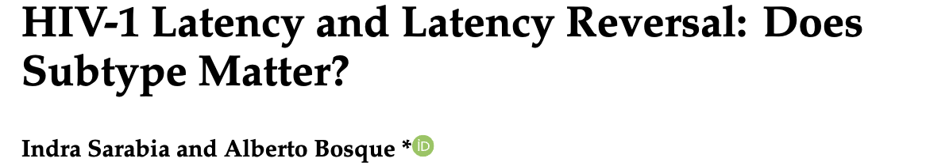


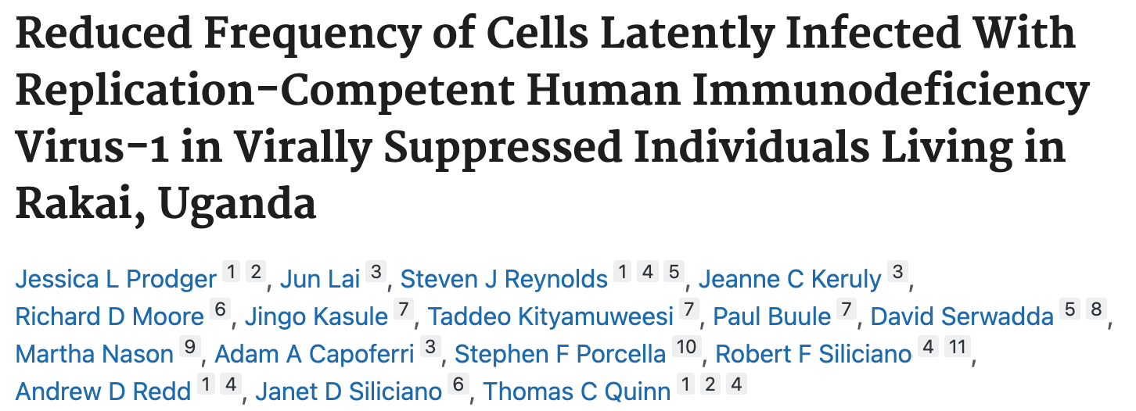
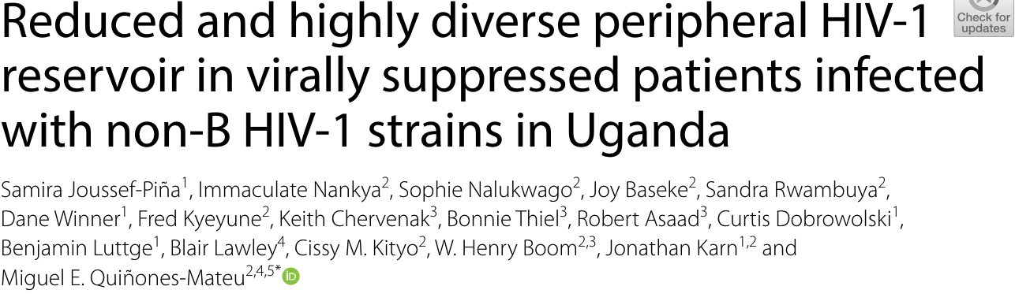


HIV-1 persistence in B and non-B subtypes
HIV-1 is highly genetically diverse (10 subtypes)
Much is known for subtype B
HIV-1 Subtypes A1/D three-fold lower reservoir than B and D pathologically different
Notes:
HIV-1 is highly genetically diverse, with over 10 subtypes and numerous recombinant forms circulating worldwide. Inspite of this vast diversity, much of our understanding of HIV-1 persistence is largely based on subtype B viruses. potential differences in reservoir sizes across viral subtypes
latent reservoir was approximately three-fold lower in people infected with HIV-1 Subtypes A1/D living in Uganda compared to those with subtype B living in Baltimore, MD
Also pathological differences have been observed between HIV-1 subtypes, with subtype D being associated with faster disease progression, faster rate of CD4+ T-cell decline, lower pre-treatment CD4+ T-cell count, and higher mortality indeed Subtypes do matter.

Slide 13

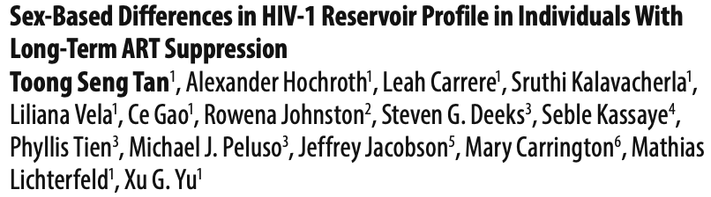
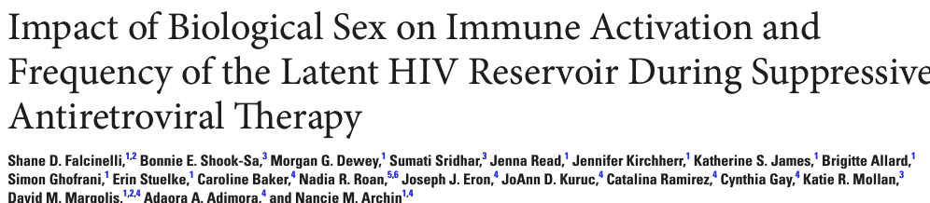

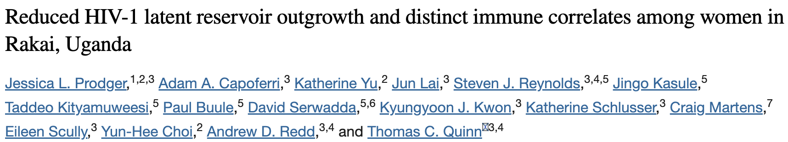
HIV-1 persistence in men and women
Need to understand the biological sex-specific differences in HIV-1 infection for the development of therapies that are efficacious in both sexes, especially in the quest for an HIV-1 cure
Notes:
Do reservoir size and dynamics differ in men and women.
In untreated infection women have lower plasma viral loads. Women also have higher T-cell activation compared to men
Contradictions surround this subject of reservoir sex differences in men and women. Toong and Shane did not observe sex differences in the frequency of persistent HIV in resting CD4 T cells.
Jessica Prodger found significantly fewer resting CD4+ T cells harbouring replication-competent virus,

Slide 14
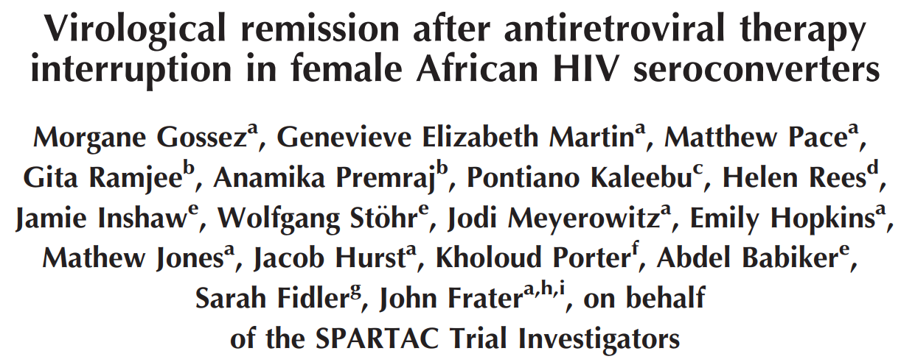
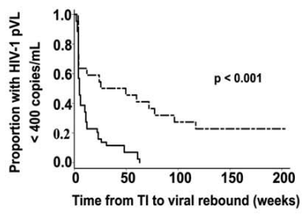
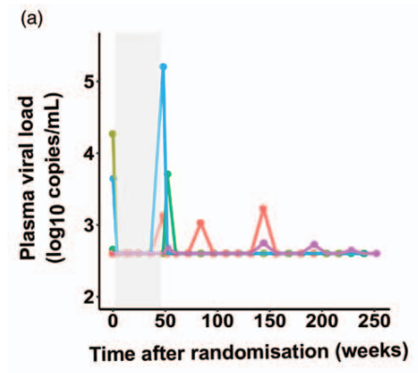
SPARTAC: Treatment interruptions
African women more likely to exhibit post-treatment control than non-African men
Five of 22 African women who started ART early (22.7%) maintained VL less than 400 copies/ml over a median of 188 weeks following treatment interruption
None of the 44 non-African men exhibited post-treatment control

Slide 15
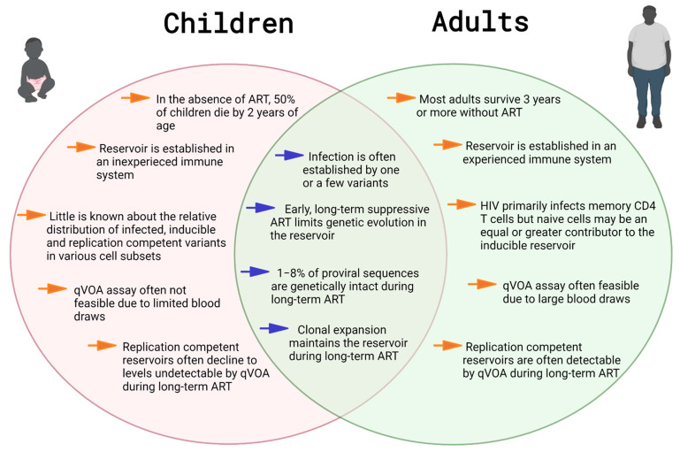

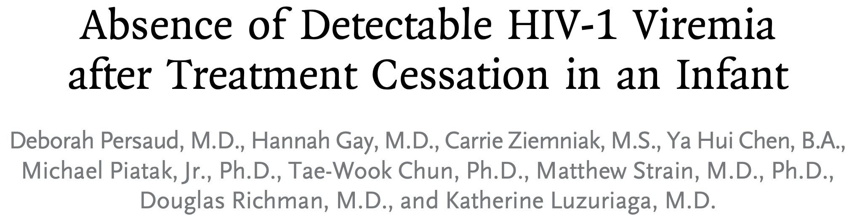
HIV-1 persistence by age
The environment in which HIV infection is established in children and adults is different but clinically relevant
In absence of ART, 50% of children born with HIV die before two years
Immune system is inexperienced in children
Relative distribution of infected cells is unknown in children
Adopted from HIV persistence in Children during suppressive ART, Mary Grace Katusiime, et al
Notes:
The setting in which HIV infection develops in children and adults is therapeutically significant.

Slide 16
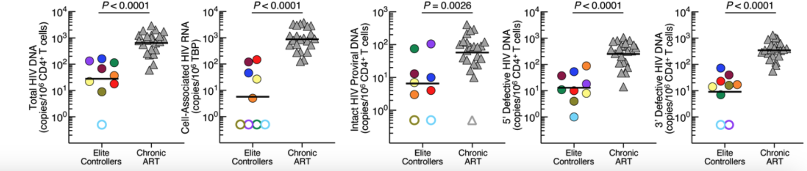
HIV-1 persistence in controllers
Kennedy et al, 2023 JCI
Natural controllers and post-treatment controllers are a unique population
Reservoir shaped by immune pressure
  Humoral responses (memory B cells, bNABS)
  HLA polymorphisms (a robust immune response)
No single mechanism explains viral control in controllers
Immune-mediated virologic control without ART a realistic goal to achieving a cure
Notes:
Elite controllers/natural controllers and post-treatment controllers are a unique population.
Humoral immune responses (higher memory B cell frequency, better neutralization titers, improved breadth of bNAbs)
This polymorphism may be required for a robust immune response that's necessary for nonprogressive HIV infection.

Slide 17
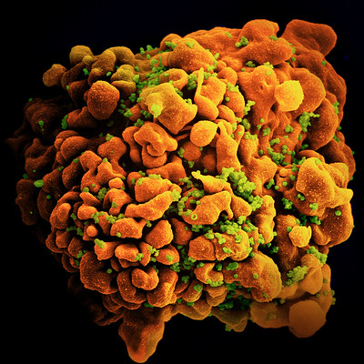
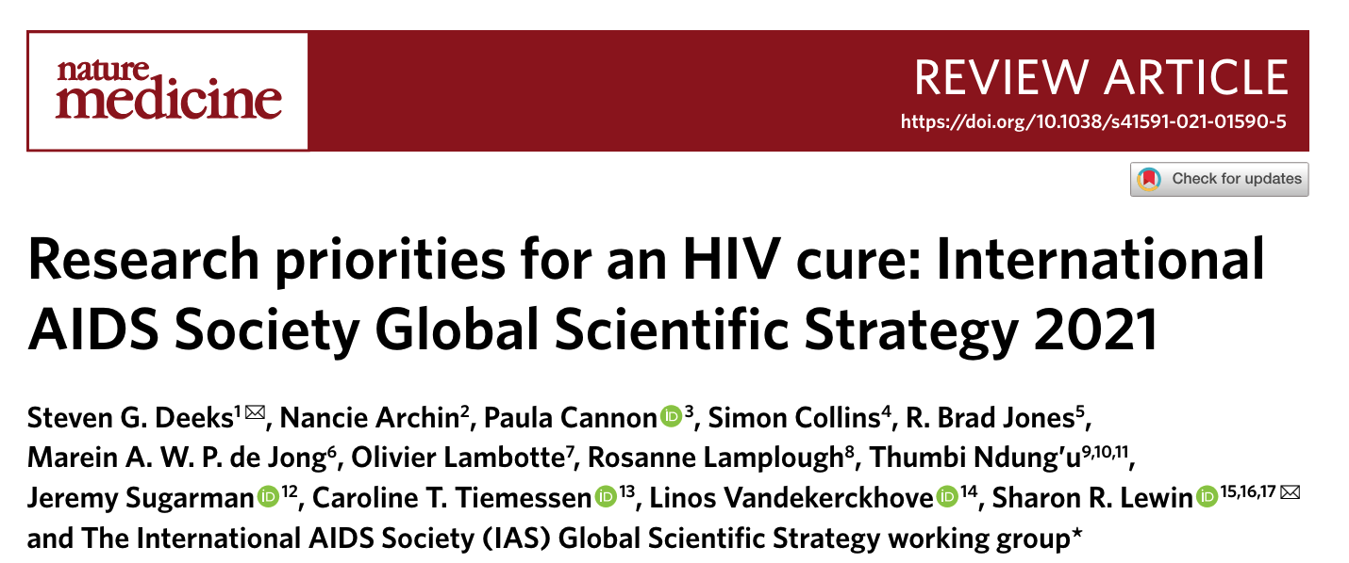
Knowledge gaps?
Knowledge gaps as guided by research priorities for an HIV cure 2021 strategy
Notes:
A lot of this has been guided by research priorities for an HIV cure. 2021 strategy.

Slide 18
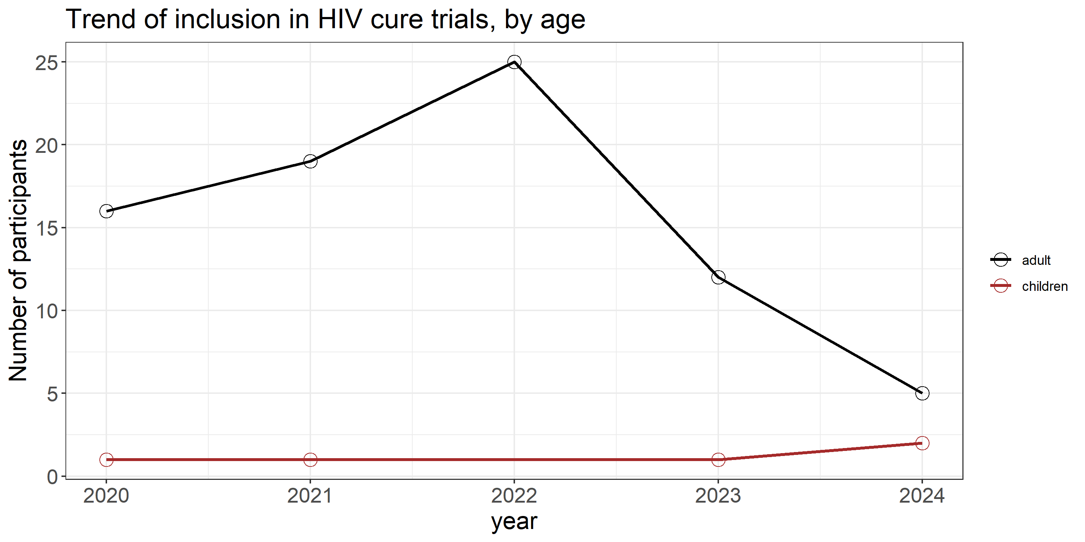
Research priorities
Little knowledge about the nature of reservoirs at the cellular level in children
    Size
    Persistence over time
    Evolution (different stages)
    Influence on the pathogenesis
    lack of diversity of combinations of antiretroviral agents approved
Test HIV immunotherapies and other strategies in infants and children
No of Clinical trials
Notes:
Compared to the situation in adults, we know very little about the nature of reservoirs at the cellular level in children
Certain cases of spontaneous remission of HIV infection in children in the absence of treatment have also fuelled hopes of discovering avenues leading to a functional cure for HIV-AIDS in both children and adults

Slide 19
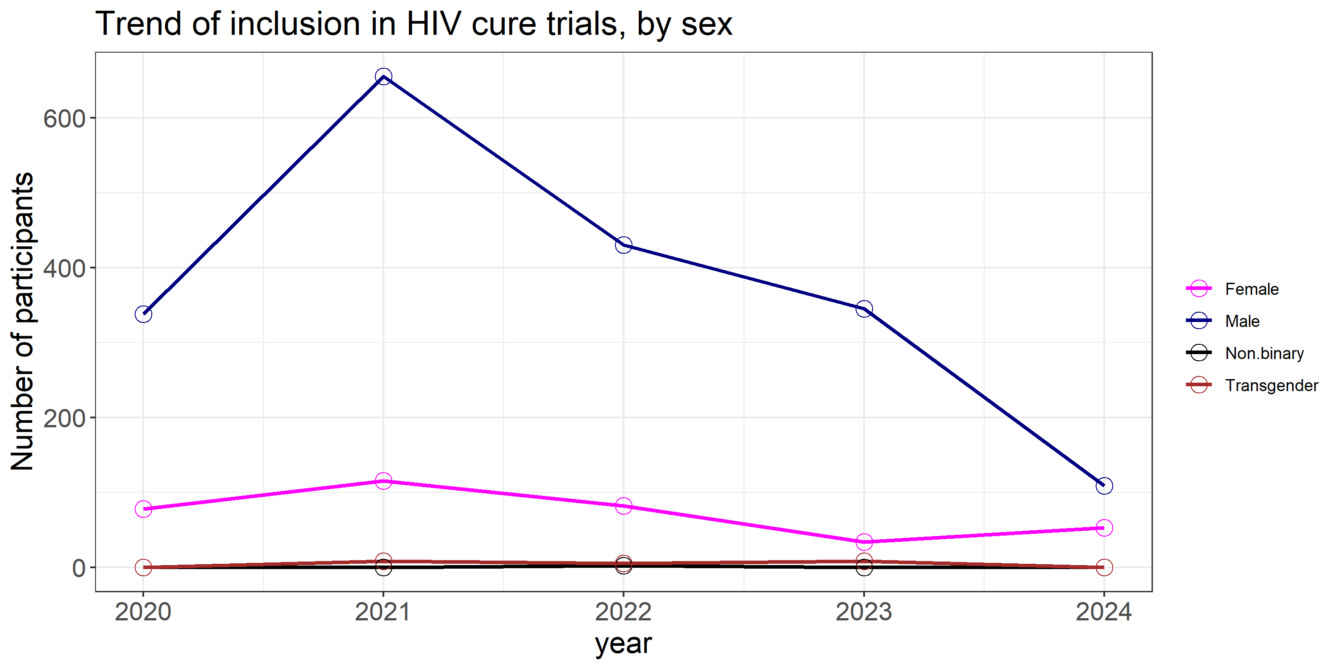
Research priorities
Little is known about the potential effect of biological sex on HIV persistence
Females represent only approximately 11% of the participants in HIV cure studies
Females constitute approximately 52% of people living with HIV
Test HIV immunotherapies and other strategies among women and other gender
Notes:
Little is known about the potential effect of biological sex on HIV-1 persistence. To date, the vast majority of research examining HIV-1 proviral genome-intactness has been done using samples from males
Yet females constitute approximately 52% of people living with HIV-1.

Slide 20
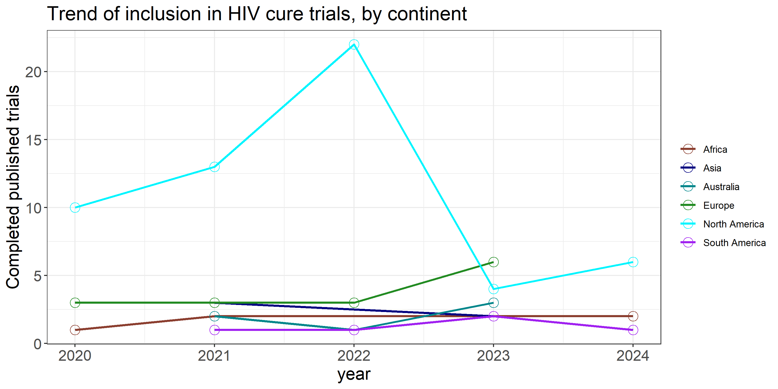
Research priorities
Test HIV immunotherapies and other strategies among those most affected by the epidemic
Role of co-infections and the viral reservoir
Define the role of viral subtype on the effectiveness of interventions

Slide 21
Research priorities
HIV reservoir dynamics in controllers
 | ELITE CONTROL |  |  |  |  |  |  |  | PTC
 | Zimbabwe | South Africa | Sweden | UK | Ireland | USA | Total |  | Spain | UK | Total
2010 | 1 |  |  |  |  |  | 1
2011 |  |  |  |  |  | 2 | 2
2015 |  |  |  | 1 |  |  | 1 |  |  | 6 | 6
2017 |  |  | 19 |  |  |  | 19
2018 |  | 2 |  |  |  |  | 2
2019 |  |  |  |  | 1 | 40 | 41
2022 |  |  |  |  |  |  |  |  | 3 | 9 | 12
Total | 1 | 2 | 19 | 1 | 1 | 42 | 66 |  | 3 | 15 | 18
Immune-mediated virologic control without ART a realistic goal for HIV cure strategies
Need for more analytic treatment interruption (ATI) data from Africa to help interpret ATI studies in Africans
Notes:
HIV reservoir dynamics in controllers (Elite and Post treatment controllers)

Slide 22
Research priorities
Development and use:
  bNABS and therapeutic vaccines targeted to different population groups considering subtype differences
Research that will look at:
  Development of assays to monitor and identify biomarkers to predict efficacy of HIV-1 cure therapeutics
  HIV reservoir dynamics in pregnancy
  Standardization of reservoir measurement assays across different subtypes
  Immune aging and the HIV-1 reservoir
  More potent LRAs for different populations with different subtypes

Slide 23
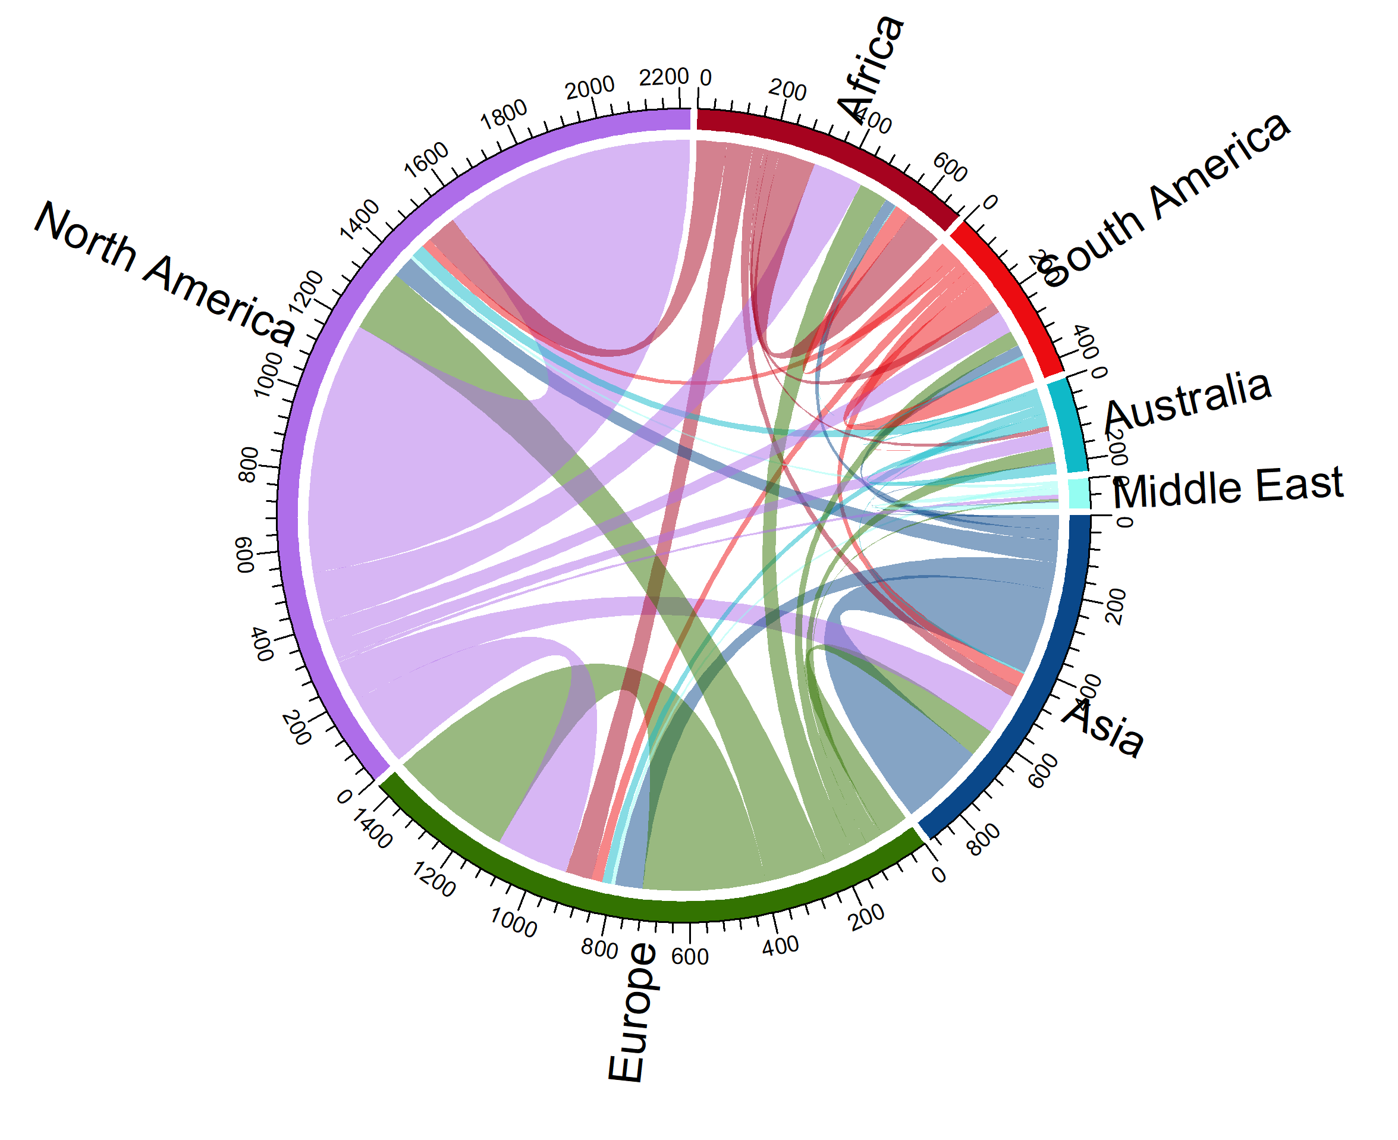
Researchers collaboration
Increased collaboration among the researchers on the different continents will bridge gaps in the HIV persistence research
Notes:
Strengthening international collaborations to ensure a multidisciplinary approach for the development of a cure that is accessible and scalable in diverse settings
Promoting the involvement of early career researchers and researchers from countries most affected by HIV

Slide 24
Conclusion
Finding a cure for HIV remains an ambitious yet uncertain goal, necessitating extensive and innovative research efforts (Mark Dybul et al. )
An ideal HIV cure should be safe, effective, durable, scalable, and cost-effective for all people, everywhere. Moreover, it should ideally confer protection against reinfection (Thumbi Ndung’u et al. )
It is crucial to keep an open mind and explore various potential mechanisms of viral persistence among all people, everywhere undergoing ART (Martinez-Picado et al.)

Slide 25
Take home
Investigating HIV persistence in different populations, and early inclusion of different populations in testing of candidate therapies, will save time and costs and yield a broadly applicable cure

Slide 26










Acknowledgements
Mentors
Funding

Slide 27
Thank you for listening

