Slide 1
Design of HIV cure trials : including all key partners
Sarah Fidler
Professor in HIV Medicine
Imperial College London UK
Flash talk

Slide 2
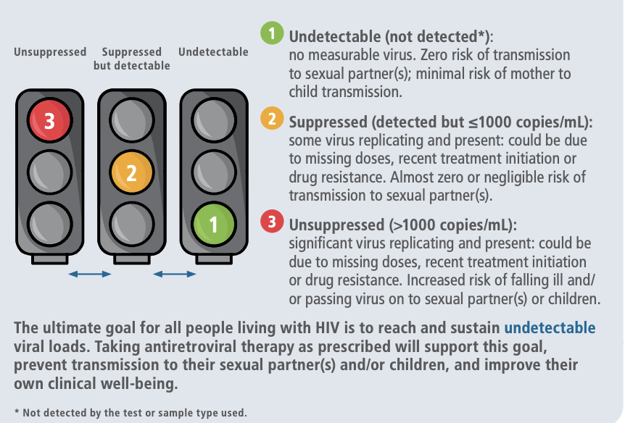
Global context
ART coverage
Viral load testing
29.8/39 million people globally are on ART (76%)
65% sex workers,
78% MSM,
69% injection drug users,
44% transgender populations
Global HIV viral suppression 68% (2022)
HIV drug resistance to integrase inhibitors 3.9-8.6% up to 19.6% amongst people with unsuppressed VL (WHO survey 2024)

Slide 3
How do we design HIV cure trials the RIGHT intervention for the RIGHT people
Setting:
Gender
Race
Ethnicity
Age
Clinical characteristics; treated since acute infection, grown up with HIV, intact immune system, viral sequencing (bNAbs), clade
Safety features,
Co-infections (HBV, HCV, TB)
Co-morbidities (heart disease, cancer)
Environment: access to HIV testing, VL monitoring, safety monitoring, partner testing, partner PrEP, pregnancy
Type of study
Phase I new treatments; small number of people and frequent measurements, start at low dose and increase dosing and number of doses
Phase II bigger studies, often RCT can have an efficacy outcome as well as safety
Phase III; larger studies, less intensive, known efficacy data testing in wider populations more people broader groups
Analytical treatment interruption to test efficacy

Slide 4
Risks of stopping ART
Risks for the individual
Risks to partners and infants
Viral rebound symptoms
Decline in immune function whilst off ART
Inflammation associated with stopping ART and risks of non-HIV associated illnesses
Will the ART regimen still suppress ART when restarted
Safety of investigational product
Safety of participant stopping ART
Risks of onward viral transmission to partners and infants whilst off ART
Psychosocial, anxiety
Higher rate of clinical events (non-AIDS) after ATI n= 181 HR 2.43 Richart et al AIDS 2021
Shift in medication from study participant who stops ART to their partners who may not be living with HIV to taking PrEP
Offer free access to HIV testing and PrEP provision to any partner of study participant, but requires safe HIV status disclosure to partners

Slide 5
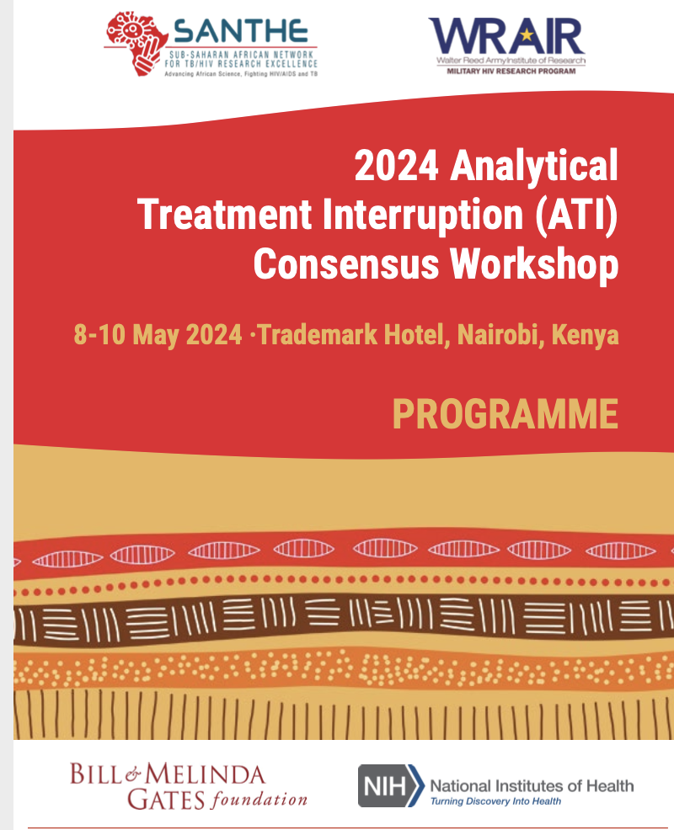
How do we safely interrupt ART?

Slide 6
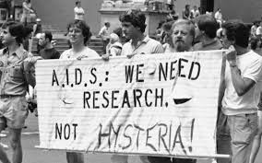
Who are the key partners?
People with HIV globally and their partners and families
Funders
Industry partners, exploring safety, efficacy and effectiveness of novel interventions
Policy makers, WHO, UNAIDS,
Government ministries of health who will implement new technologies or strategies
Researchers, universities, scientists
Advocates
HIV care providers
Regulators

Slide 7
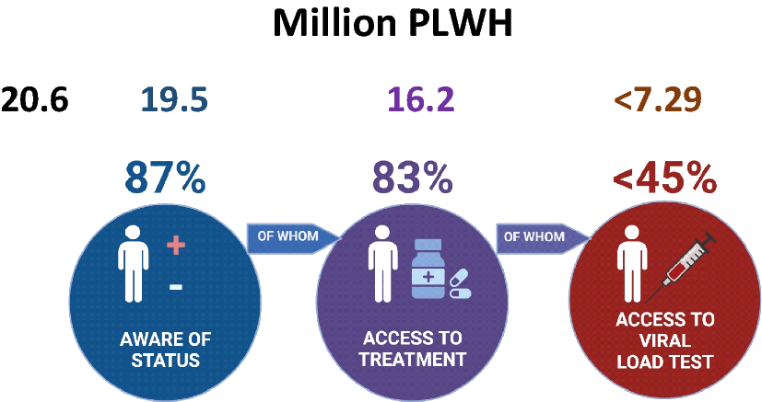
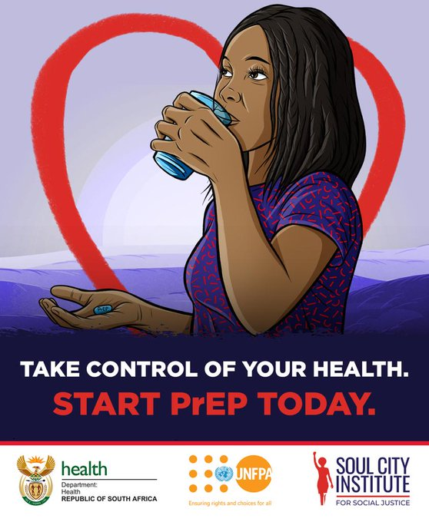
The right cure for the right people in the right setting
The people
The setting
The intervention
The intervention needs to
fit the characteristics of the
population, virus variants
Older people: concerns about immune senescence with age. Concern is around the ATI rather than the intervention
Young people and children
Cis-women of child-bearing potential
Stage of HIV at ART start
Co-infection risks (TB)
Co-morbidity
Lifestyle
Viral load testing
Access to PrEP

Slide 8
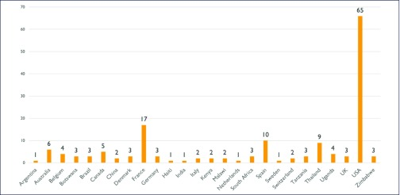
Where are the gaps in cure research ?
Landscape of HIV cure trials
Bar and Jefferys Journal HIV Eradication 2019
Cis-women (20%) enrolled in cure trials across 124 cure trials globally
Trans people 19 trans people across 124 trials
Non-white Black people made up 23% of cure study participants 2023
LMIC 75% of HIV cure trials are conducted in Europe and North America
Older people >60 years
Global ART coverage is NOT equal ranging from 41-78% adults 43% of children living with HIV are not on ART, and of those on ART 46% are virally suppressed PEPFAR 2024
HIV Viral load testing critical during ATI period
VL threshold of assays, 30% CDC supported labs have 1,000 cpm cut off
Scientific gaps
people with oestrogen may have hormonally influenced differences in reservoirs, and immune function; optimal interventions may be different from testosterone

Slide 9
Barriers to participation; cis-women
Women: 11-23% of all cure research
Globally women are under-represented in trials
Family responsibilities and time commitments
Pregnancy risk and regulatory challenges for people of childbearing potential
HIV specific issues
Stigma: ACTG 5366 Dube et al AIDS research and human retroviruses 2020 (US)
Partner dynamics and risks of violence: Dube et al AIDS Res Hum Retroviruses 2022
Access to partner testing
Access to PrEP for partners
Psychosocial support (FRESH)
Economic support (FRESH)
Communications: trust HCP, research literacy Courvoisier et al HIV Medicine 2022 (Swiss)
What do women want?
Notes:
Despite disproportionate incidence and prevalence of HIV among transgender individuals, cisgender women, and racial and ethnic minority groups, all remain underrepresented in HIV cure research.

Slide 10
Barriers to participation; Age
Children and infants
Global ART coverage (57%) viral suppression (46%)
Engagement in research; consent/assent, parental complex lives
Safety of intervention
Older age > 60 years; co-morbidities
714 people median age 64yrs
(40.5%) participants median eGFR < 60mL/min/1.73m
Immune dysfunction

Slide 11
Barriers to participation; Industry partners
Placement of product: correct “fit” for the setting
Financial gain vs investment
Context: what additional costs would need to be supported to ensure safe and effective outcomes. eg in settings where ART coverage is poor
Multiple interventions cross industry partners IP challenges

Slide 12
Call for justice informed HIV cure trials with ATI Dube and Perez-Brumer Lancet HIV 2024

Slide 13
What do we need to safely run a cure trial
challenges
Suggested solutions
This is in place globally
Look creatively at safe space testing for partners, self testing, thoughtful of domestic violence
PrEP all trials including an ATI should offer referral to PrEP provision to all partners of study participants: oral, injectable Cabotegravir ?? Lenacapavir
Free access to viral load & CD4 count testing where results are turned around in 24-48 hours
Medical care from study teams needs to be part of any trial
Formative socio-behavioural research to inform design and implementation, mental health support
Free access to effective ART
Free open access to HIV testing
Open access to HIV prevention for all partners of people off ART
HIV viral load testing; thresholds of assays and delays in results turnaround
Free access to health care for any complications
Design of the right intervention for the right groups with the right support

Slide 14
“You can’t live on hope alone, but without hope, life isn’t worth living” Harvey Milk 1978
Thank you
Steve Deeks
Karine Dube
Simon Collins

