Slide 1
Cure Studies with Broadly Neutralizing Antibodies in Africa Wadzanai Samaneka MBChB, MSc University of Zimbabwe
Session title: Towards a truly global HIV Cure

Slide 2
HIV Cure-Related Research Strategies Under Investigation
Slide Credit:Nicolas Chomont
Notes:
There are different strategies being explored to achieve ART-free HIV suppression or HIV cure.
Each of these strategies takes a different approach to the challenge of bringing HIV under control without ART

Slide 3
Why bNAbs for Cure Strategies in Africa?
Clinical research in HIV remission and cure research has largely occurred in US or
Europe where sub type B is predominant
The African continent carries the greatest burden of the HIV pandemic where non-subtype B viruses are in circulation-subtype C most common in LMIC
Key differences between HIV epidemic in African countries, age and sex distribution, prevalence of comorbidities
May affect impact of a cure intervention
Gossez AIDS 2019, Kinloch 2019, Lee AIDS 2019, ProdgerClin Inf Dis 2017, Prodger JCI Insight 2020, Hsu Front Immunol 2021

Slide 4
bNAbs in Cure Strategies
Broadly- neutralizing HIV-specific monoclonal antibodies (bNAbs) have been shown in pre-clinical and some clinical studies to:
Exert antiviral activity
Limit reservoir seeding
Reduce reservoir size
Enhance antigenic specific immune responses (vaccinal effect)
bNAbs may facilitate long-term viral control after bNAb exposure
Demonstrated in a subset of animals who received 3BNC117 and 10-1074 during early SHIV-AD8 infection
Viral RNA (copies/mL)
Weeks after Infection
Caskey, Nature 2015; Lynch, Sci Trans Med 2015; Caskey, Nature Med 2017; Stephenson, CROI 2019; Bolton, J Virol 2015; Nishimura, Nature 2017; Gaebler, Nature 2022; Mendoza, Nature 2018; Borducchi, Nature 2018; Nishimura, J Exp Med 2020, Gunst, Nat Med 2022, Gunst, Nat Med 2023
Notes:
A number of Strategies for Using bNAbs for Cure are being investigated include i)Combination immunotherapy ii) bNAbs at ART initiation and iii) Therapeutic vaccines

Slide 5
bNAbs at ART Initiation
eCLEAR study showed that 3BNC117 administration at ART initiation was associated with viral load decay and enhanced immune responses:
3BNC117 treatment accelerated clearance of infected cells compared to ART only
Enhanced HIV gag-specific CD8 T cell responses were observed among 3BNC117-treated individuals
Delayed time to viral rebound after ATI among participants harboring 3BNC117 sensitive pre-ART viruses
Gunst Nat Med 2022
Notes:
eCLEAR study to investigate whether early intervention with monoclonal antibody in newly diagnosed PWH would alter the course of HIV infection
randomized
controlled trial using a four-group factorial design, we investigated whether
early intervention in newly diagnosed people with HIV-1 with a monoclonal
anti-HIV-1 antibody with a CD4-binding site, 3BNC117, followed by a histone
deacetylase inhibitor, romidepsin, shortly after ART initiation altered
the course of HIV-1 infection (NCT03041012).
Investigated whether early intervention in newly diagnosed people with HIV-1 with a monoclonal
anti-HIV-1 antibody with a CD4-binding site, 3BNC117, followed by a histone
deacetylase inhibitor, romidepsin, shortly after ART initiation altered
the course of HIV-1 infection

Slide 6
A5417:ACACIA
A Randomized, Placebo-Controlled Study of the Combination of two Long-Acting Broadly Neutralizing Antibodies at ART Initiation in Adults Living with HIV in Sub-Saharan Africa
Short Title: Antiretrovirals Combined with Antibodies for HIV-1 Cure In Africa (ACACIA)
(Chairs: Crowell/Samaneka/Caskey/Bar)
Notes:
Antiretrovirals Combined with Antibodies for HIV-1 Cure In Africa (ACACIA)
we aim to address some of the open questions following the 3BNC117 and romidepsin eCLEAR study: (1) will the observed effects be enhanced by a combination of long-acting bNAbs to provide greater breadth of activity?; (2) will the decay rate of the intact proviral reservoir be accelerated by longer exposure to the bNAbs?; (3) will the virologic and immunologic effects be similar among individuals harboring non-B subtypes

Slide 7
Rationale and Hypotheses
Rationale
Interventions targeting the viral reservoir at ART initiation may alter the course of HIV infection
3BNC117-LS and 10-1074-LS are two bNAbs that have shown promising characteristics in pre-clinical and limited clinical studies
Cure interventions need to be tested in sub-Saharan Africa, the region most affected by the global HIV pandemic
Hypotheses
Administration of a combination of two long-acting bNAbs, 3BNC117-LS and 10-1074-LS, at ART initiation will:
Be safe and well tolerated in people living with HIV in sub-Saharan Africa
Interfere with the establishment of the viral reservoir and modulate anti-HIV-1 immune responses
Lead to long-term ART-free virologic control in a subset of participants

Slide 8
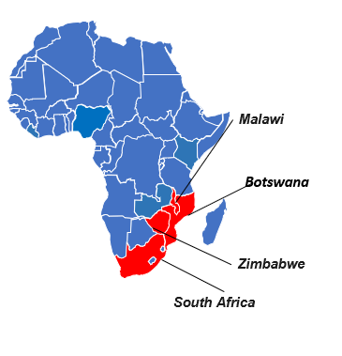
Participating Sites
ACTG sites in SSA with demonstrated capacity to administer bNAbs (such as through prior participation in AMP)
Sites have demonstrated ability to recruit newly-diagnosed/viremic PWH and familiarity with local regulatory environment surrounding ATI
Access to PrEP for partners – initial survey
9 interested and pre-selected sites:
Notes:
Cure TSG and SASC recommended to limit to subtype C regions
The protocol team limited the study to sites with subtype C predominance (to reduce the chances of resistance to one or both antibodies). It was noted that coverage of 10-1074 is lower for subtype D. The sites in Kenya and Uganda are not included in the site selection as clades A and D circulate more frequently in those countries.
AMP ATI trial
Participating sites: Gaborone CRS, Botswana
UNC Project Malawi CRS, Malawi
Blantyre CRS, Malawi
Durban CRS, South Africa
Aurum Institute NPC – Rustenburg CRS, South Africa
WITS, South Africa
Soweto CRS, South Africa
CAPRISA eThekwini CRS, South Africa
Milton Park CRS, Zimbabwe

Slide 9
Study Design
Population: 135 participants living with HIV, aged 18-60 years, from ACTG sites in sub-Saharan Africa (9 sites in South Africa, Malawi, Botswana, Zimbabwe)
Interventions: (Randomized 2:1)
Group 1 (n=90): 3BNC117-LS and 10-1074-LS and INSTI-based ART
Group 2 (n=45): Placebo infusions and INSTI-based ART
Follow-up: After a bNAb wash-out period (60-84 weeks; duration guided by PK data from sentinel participants), participants will undergo ATI
Primary efficacy endpoint: Time from ART discontinuation to sustained VL ≥1000 c/mL over a 4-week period
Primary safety endpoint: Grade ≥2 bNAb-related AE or SAEs
Notes:
An ATI is a temporary pause in standard HIV-1 treatment.
Step 1 (ART ± Combination bNAbs): Day 0 to week 56 with option to extend to week 68 or 80, depending on the early PK modeling. ART will be discontinued at least 60 weeks after the bNAb or placebo infusions.
Step 2Participants who have received the bNAb or placebo infusions and have an HIV-1 RNA <200 copies/mL and CD4⁺ T cell count of ≥450 cells/mm³ will enter Step 2 and begin the analytic treatment interruption (ATI) at week 60 after Step 1 entry (Step 2, ATI weeks 0-24). By the time of ATI, it is expected that bNAbs will no longer be present in sufficient quantities to exert direct antiviral activity. During ATI, ART will be held and HIV-1 RNA and CD4⁺ T cell count will be monitored for up to 24 weeks, and clinical and immunologic parameters will be monitored closely
Step 3-Extended ATI-Participants who do not meet ART restart criteria (post intervention controllers) for at least 24 weeks after ART is discontinued will be followed for up to another 48 weeks
Step 4Participants who meet ART restart criteria will enter Step 4 and will be followed for 24 weeks after ART restart (Step 4, ART restart weeks 0-24).
ATI (Start of Step 2): If the observed 3BNC117-LS and 10-1074-LS concentrations are within the expected ranges to reach <10 µg/mL by the start of the ATI, or if there is a shorter observed half-life for the antibodies, then the ATI (Step 2) will be initiated at week 64. If the concentrations are appreciably higher than expected, then Step 1 will be extended and the ATI period (Step 2) will start at week 76 or 88, depending on the early PK modeling.
Extended ATI (Step 3): Participants who do not meet ART restart criteria (i.e., post-intervention controllers) will continue monitoring off ART up to another 48 weeks or will transition to protocol A5385.

Slide 10
Key Eligibility Criteria
Inclusion Criteria
PWH, aged 18-60 years
ART Naïve
CD4 count > 200 cells/mm³
Willingness to use 2 methods contraception if childbearing
Ability/willingness to use barrier protection during ATI
Exclusion Criteria
Malignancy, AIDS defining conditions, immunosuppression
History of severe allergic reaction or chronic urticaria requiring treatment daily
Known Active Hep B or C
History of cardiovascular disease
Pregnancy or breastfeeding
Receipt of monoclonal Ab, or therapeutic vaccines
Abnormal safety labs
Notes:
Partner protection during the ATI phase when participant could become viremic and transmit HIV to partner

Slide 11
Primary Objectives and Endpoints
Primary Objective | Endpoint
Primary Safety Objective: Evaluate the safety and tolerability of 3BNC117-LS and 10-1074-LS at ART initiation and during the first two years of ART in adults living with HIV in sub-Saharan Africa. | Grade ≥2 AE or SAE that are possibly, probably, or definitely related to the study bNAbs during Step 1 (judged by the blinded CMC).
Primary Efficacy Objective: Evaluate the impact of combination bNAb therapy plus ART as compared to placebo plus ART on the time to sustained VL ≥1000 c/mL over a 4-week period. | Time from ART discontinuation to sustained VL ≥1000 c/mL over a 4-week period (through Step 2).
Notes:
A number of Secondary objectives

Slide 12
Secondary Objectives and Endpoints
Secondary Objective | Endpoint(s)
Evaluate time from ART discontinuation to meeting virologic, immunologic, or clinical criteria (i.e., viral load, CD4 cell count, or development of severe acute retroviral syndrome) for ART restart. | Time from ART discontinuation to meeting virologic, immunologic or clinical criteria for ART restart.
Determine ability of 3BNC117-LS and 10-1074-LS at ART initiation and during the first two years of ART to induce post-intervention control. | Frequency of participants who do not meet ART restart criteria for 24 or more weeks after ART interruption (placebo vs. bNAbs).
Notes:
A number of secondary objectives !!

Slide 13
Safety Monitoring
Analytic treatment interruption
Safety monitoring and ART resumption criteria harmonized with other ACTG studies
Participants screened for hepatitis B before undergoing ATI
HIV transmission to sexual partners
STI monitoring
Plan is to facilitate PrEP access to partners, if interested; team surveyed potential sites to understand services already in place
Disclosure of participation in ATI study
Pregnancy and breastfeeding
People who are pregnant or breastfeeding will not be enrolled
People who can become pregnant must agree to use two methods of contraception, if participating in sexual activity that could lead to pregnancy
People who become pregnant or are breastfeeding will not undergo ATI
If pregnancy occurs during ATI, this will be an indication for ART resumption

Slide 14
ACTG Cure TSG Pipeline
In Development
Open
Completed
Disrupt
Latency
A5420: Ixazomib
A5366: Vor/Tamoxfn in women
A5413: Dasatinib
Scully et al, CID 2022
A5410: Vorinostat at ART start
A5428: Alendronate
Immuno
Therapies
A5369: CE-DNA Vaccine
A5386: bNAb/N-803
Jacobson et al, AIDS 2023
A5374: Vax/TLR7/bNAb
A5388: bNAb at acute HIV
A5416: bNAb in SSA
A5417: bNAb at ART start in SSA
A5389: bNAb on ART or ATI
A5422: B-cell Vax
Gene Editing
A5419: CAR-T/CCR5-Δ32 + Vax
Destination cohort
A5385: Post-intervention Controller Study

Slide 15
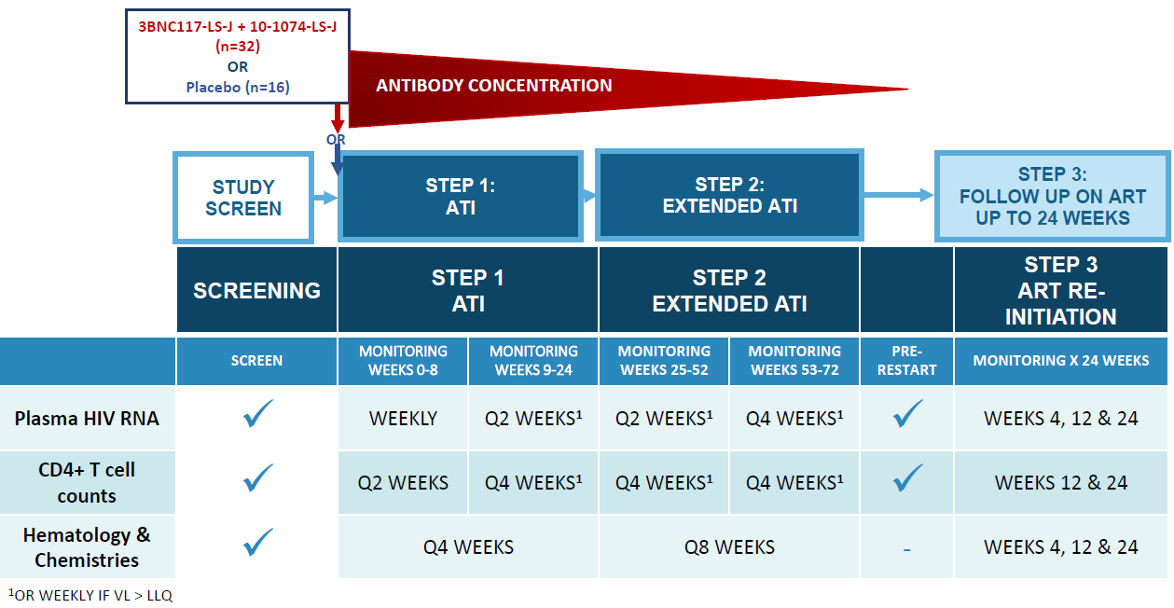
A5416/HVTN806/HPTN108: Phase I, Randomized, Placebo-Controlled Study of of bNAbs (3BNC117-LS-J and 10-1074-LS-J) in ART-treated Adults living with HIV-1 in SSA during ATI.
Short Title: Pausing ART Under Structured Evaluation (PAUSE)
(Chairs: Hosseinipour/Maboa/Hahn/Caskey)
Open May 2024
9 sites: South Africa, Malawi, Botswana
6 ppt enrolled
Study Population (n=48):
18 -70 yrs of age
Current CD4 > 450
On ART w/ VL < LLOQ x > 2yrs
Goal to enroll ~ 50% women
Primary objective: Prevent return of viremia x 24 weeks
In vivo evaluation of bNAb combination breadth against non-B viruses
Gain better understanding of relationship between bNAb activity + serum concentration AND rebound (“breakthrough”) viruses sensitivity/resistance to bNAbs
Notes:
Enrolled by Soweto-Bara site.

Slide 16
Summary
bNAbs have potential in HIV Cure, but
Long-term ART-free virologic control has not been achieved consistently in bNAb studies performed to date
The effects of bNAb combinations at ART initiation have not yet been evaluated
bNAb cure studies have been primarily limited to subtype B geographic areas (with the exception of the ongoing FRESH cohort study in South Africa)
Introduction of bNAbs may contribute greatly to HIV control in SSA, the region with highest burden and this may help to reshape the course of the epidemic

Slide 17
Acknowledgements

