Slide 1
Take aways from 2nd Consensus Workshop on ATI in HIV Cure Trials
Lydie Trautmann, EngD, PhD
Director of Translational Research
Henry M. Jackson Foundation/US Military HIV Research Program
LTrautmann@Global-ID.org
AIDS 2024 HIV cure pre-conference
Towards a Truly Global HIV Cure

Slide 2
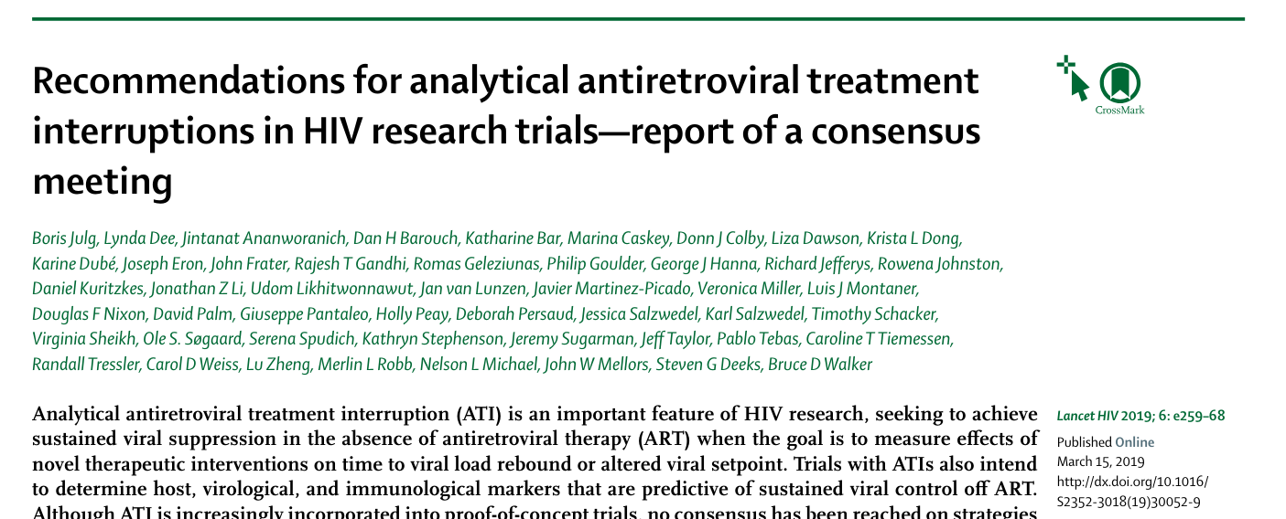
1st Consensus Workshop on ATI in HIV Cure Trials 2019

Slide 3
Past, Current and Future Cure Trials with ATIs
Past ATIs informed on safety & importance of diverse study populations
Few completed ATI trials done outside US and Europe but more active or planned studies in countries most affected by HIV
35 ongoing studies per US NCT registry
21 countries across Africa, Asia, Europe, North and South America, Pacific Islands
>1,200 projected participants of active trials
Data from Richard Jeffreys and Treatment Action Group
2024 Revision of ATI recommendations for HIV cure trials

Slide 4
2024 Analytical Treatment Interruption (ATI) Consensus Workshop
8-10 May 2024 ·Trademark Hotel, Nairobi, Kenya

Slide 5
Drafting updated international recommendations for ATI trials
~100 Participants from 5 continents (half from Africa): scientists, clinicians, community advocates, persons living with HIV and representatives of funding, regulatory, and industry organizations

Slide 6
2024 ATI Consensus Workshop Agenda & Topics
Pre-workshop (1 day) :
Preparation for implementation of HIV cure trials involving ATIs in low- and middle-income countries
Workshop (2 days) organized around 4 topics:
1. ATI entry criteria
2. ATI trial design
3. Participant Considerations
4. Pediatric ATI trials

Slide 7
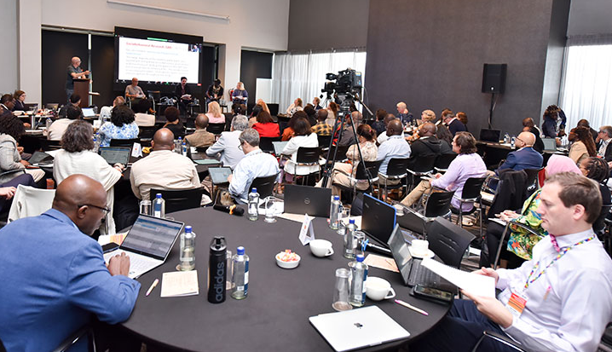
2024 ATI Consensus Workshop Proceedings
Four subcommittees (one for each topic area):
8-12 members including experts, PLWH and community members
Drafted questions on issues of importance that were presented at the workshop
Led the discussion and voting on each question
All participants voted on a total of 63 questions at the workshop

Slide 8
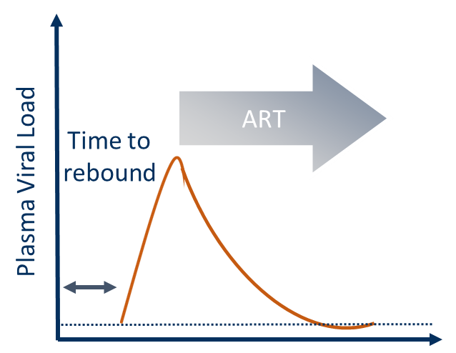
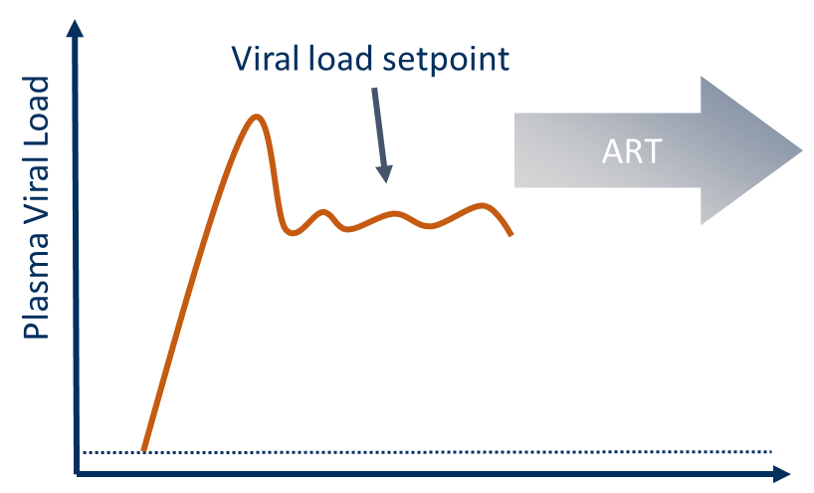
Time to Rebound ATI versus Setpoint ATI
 | Time to Rebound ATI | Viral Setpoint ATI
Duration of viremia | Minimal | Potentially prolonged
ART resumption | At viral rebound | If agreed set point is not reached
Risks Transmission Inflammation Reservoir reseeding | Low Low Low | Possible Possible Unknown
Knowledge gained | Limited Size of the reservoir (?) | Significant Insights into post treatment control Viremia needed for some immunotherapies (?)
Courtesy of Sharon Lewin

Slide 9
ATI trial entry criteria
New criteria not previously included in recommendations:
Upper age threshold: Not necessary, as age-associated morbidities are in exclusion criteria; protocols should define age criteria based on the profile of investigational products being studied (69%)
Long-acting ART: When available, define drug-specific recommendations based on established PK data for each long-acting agent (68%)
Latent TB: - People with latent TB should be included but only if they have evidence of prior treatment, or are willing to be treated before study entry (25%)
- Latent TB is not an issue; subclinical TB is the main concern (39%)
History of antiretroviral drug resistance or treatment failure:
- Exclude only those who have no other options than their current regimen (30%)
- Too context dependent; recommendations that the study follows local guidelines (24%)
Percentages in parentheses represent the majority options voted on by the workshop attendees

Slide 10
ATI trial entry criteria
 | 2019 | 2024
CD4 T cell count | ≥500 cells per μL | Region-specific thresholds
CD4 nadir | Exclusionary < 200 cells/mm3 | Non-exclusionary
h/o AIDS | exclusionary | Less restrictive
h/o cancer | exclusionary | Less restrictive
Cardiovascular risk | exclusionary | Less restrictive
Episodes of low-level viremia | exclusionary | Less restrictive

Slide 11
ATI trial design
Are ATI studies appropriate: Yes if the risks to participants are understood, these risks are minimized, and the study design will answer a research question that cannot be addressed without ATI (98%)
Participants who do not meet ART restart criteria and reach the end of study: Should be followed in a separate study protocol to allow close monitoring as long as they are off ART (98%)
Reporting of adverse events related to ATIs: Should be included in standardized reporting of study results (Specific criteria listed, 71%-94%)
Inclusion of a placebo group in ATI studies: May be appropriate based on the study hypothesis and trial design, if no historical control is available, and if scientifically justified by a sample size analysis (91%)
Percentages in parentheses represent the majority options voted on by the workshop attendees

Slide 12
ATI trial design
 | 2019 | 2024
Viral load monitoring | Weekly for 12 weeks, then every 2 weeks | Once a week for the first 8-12 weeks, then every two weeks
Viral load monitoring in post-treatment controllers | N/A | Every 4 weeks until week 48 of post-intervention control, then every 8-12 weeks
CD4 monitoring | Every 2 weeks | Every 4-12 weeks
STI monitoring | N/A, but monthly common | Every 8-12 weeks
Viral load ART restart criteria | >1,000 cps/mL x 4 wks | >1,000 cps/mL x 8 wks

Slide 13
Participant Considerations
To bring more voices to the workshop...
N=179, 18 countries

Slide 14
Participant Considerations
 | 2019 | 2024
Engage community/CABs early | N/A | Recommended
Set enrolment equity targets | N/A | Recommended
Mental health screening | N/A | Recommended
Support for HIV disclosure | N/A | Recommended
Counseling pre-, during, post-ATI | N/A | Recommended
Socio-behavioral research | Recommended | Specific topics listed

Slide 15
PrEP, PEP & Partner Protection
Group 2 – Trial Design
How should investigators approach PrEP for the sexual partners of ATI trial participants? | Partners are not enrolled in the study, so investigators have no responsibility to them
 | Partners should be referred to PrEP services that are available and accessible in the area | 84%
 | If no local PrEP services are available or readily accessible, then the investigators have the responsibility to provide or pay for PrEP
 | All ATI studies should provide PrEP services free to all sexual partners of participants
Group 3 – Participant Considerations
What should sites provide to reduce HIV transmission risk to sexual partners of ATI participants? | 2019 guideline recommendation to provide participants with information to give their sexual partners about HIV counseling and testing, PrEP, and PEP
 | Referral to programmes known to reliably provide HIV counseling and testing, PrEP, long-acting PrEP where available, and PEP | 85%
 | On site provision of barrier protection (condoms) | 88%
 | On site provision of free PrEP/PEP for sexual partners without HIV
Percentages represent the majority options voted on by the workshop attendees

Slide 16
Pediatric ATI Trials
Placebo arm: ATI trials in infants, children and adolescents could include a placebo arm if there is a reasonable chance of success in any arm
Adolescents: - Can be included in ATI trials
- Those with behaviorally acquired HIV, with appropriate resources in the research team, could be considered in adult ATI trials
Extensive psychosocial support for ATI study participants & families should be provided by personnel within the study team who have training in ATI studies
Notes:
statement important for the management of minors, but also for all participants.

Slide 17
Pediatric ATI Trials
 | 2019 | 2024
Age <2yo exclusion criterion for ATI studies | Yes | Yes
Support for HIV disclosure | N/A | Recommended
Specific entry criteria | N/A | Listed
Specific ART restart criteria | N/A | Listed

Slide 18
Summary
More regional considerations
Less restrictive recommendations based on current knowledge
Inclusion of new recommendations e.g. pediatrics and adolescents
The steering committee is discussing the feasibility of implementing the recommendations
Recommendations will continue to be updated while more data are generated by future trials
Look for the consensus statement to be published in Lancet HIV in 2025

Slide 19
Acknowledgments
2024 ATI Consensus Workshop Organizing Committee
2024 ATI Consensus Workshop Subcommittees Members and Participants
The views expressed are those of the authors and should not be construed to represent the positions of the the DoD or HJF.

