Slide 1



Slide 2

Challenges to sustaining and strengthening CLM in a changing world: Examples from Ritshidze
Ndivhuwo Rambau, Ritshidze, South Africa
What does CLM need to survive and thrive in a changing world?

Slide 3
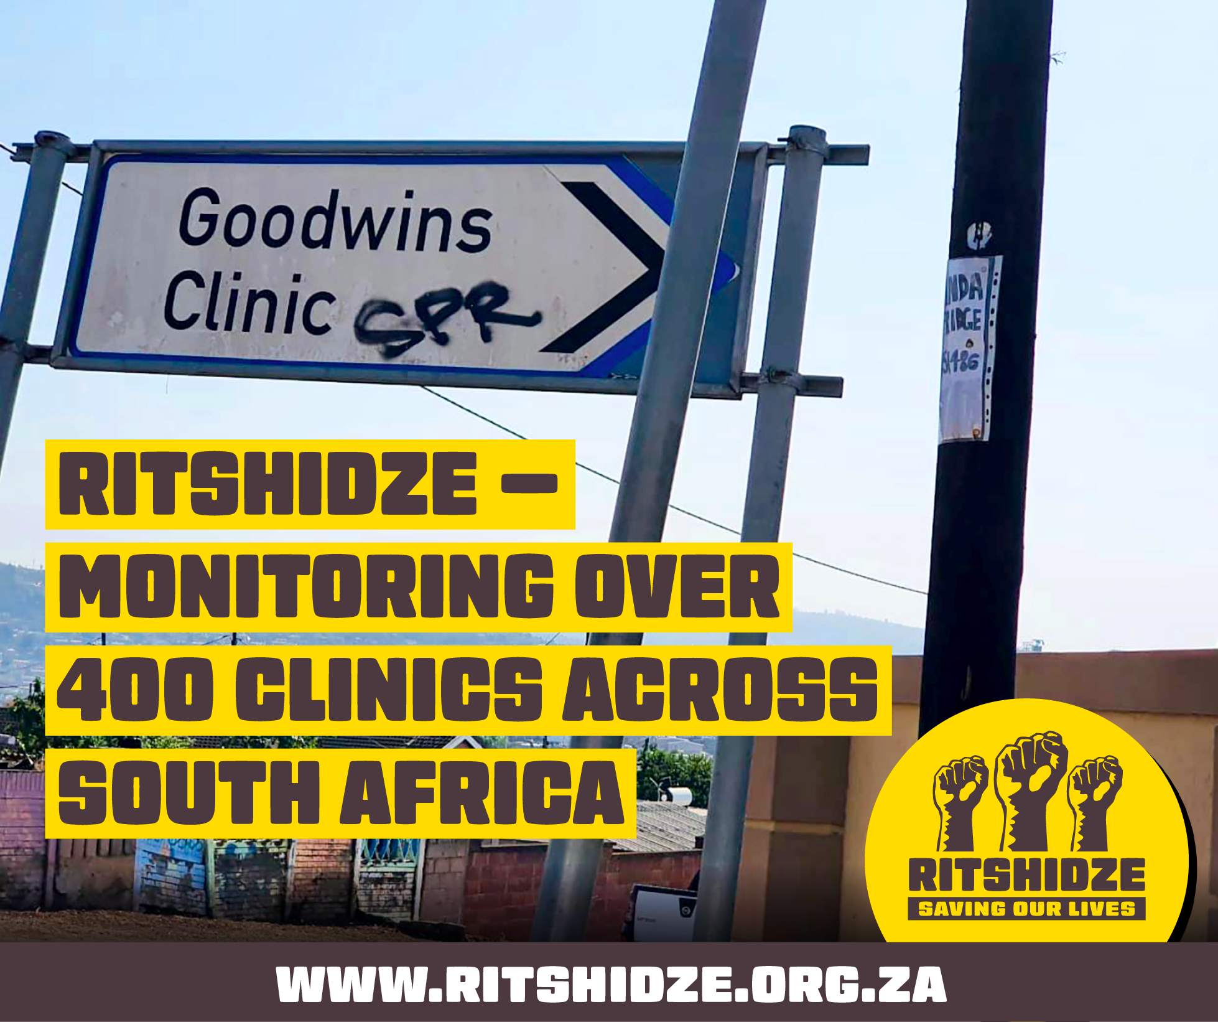
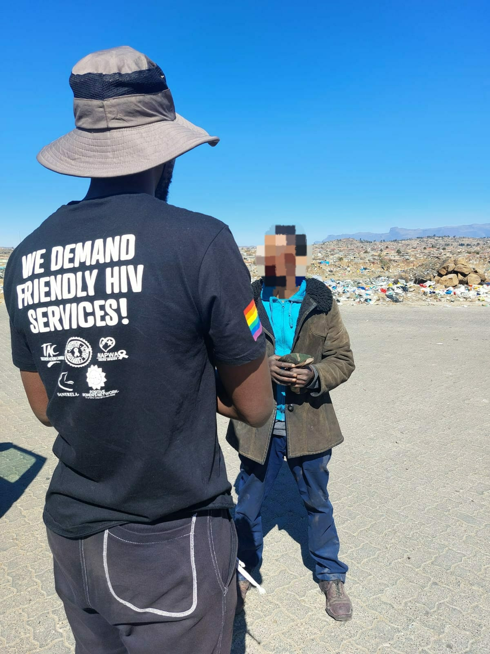
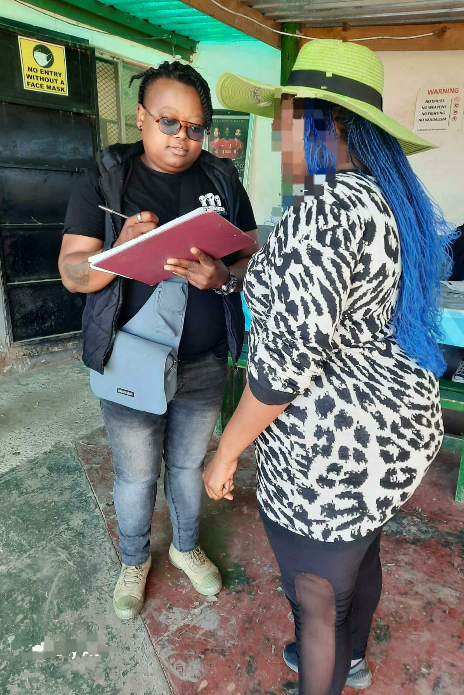
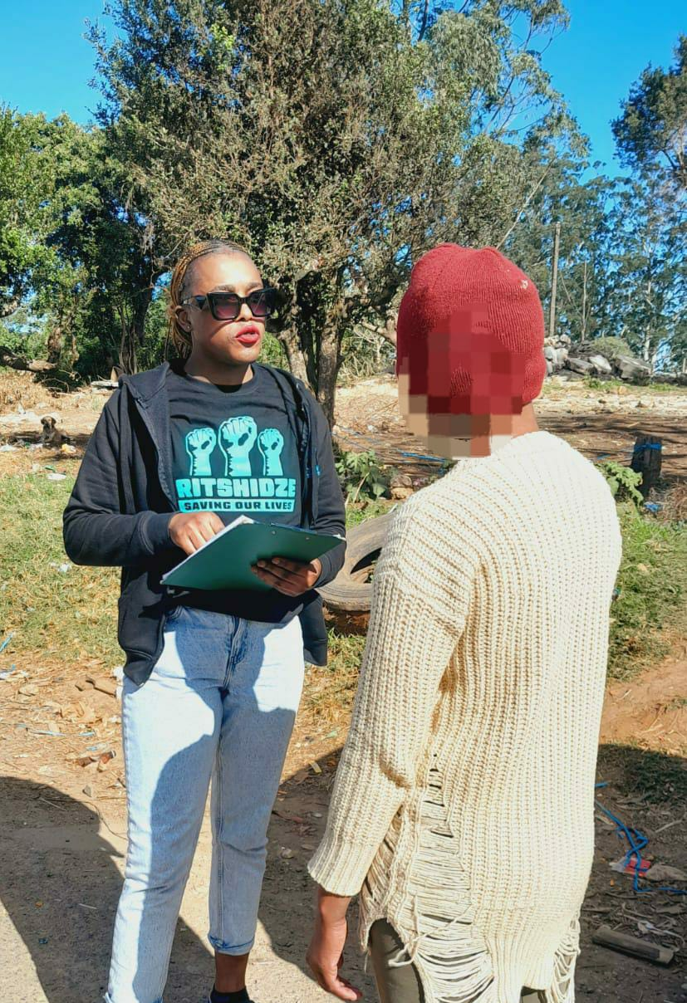
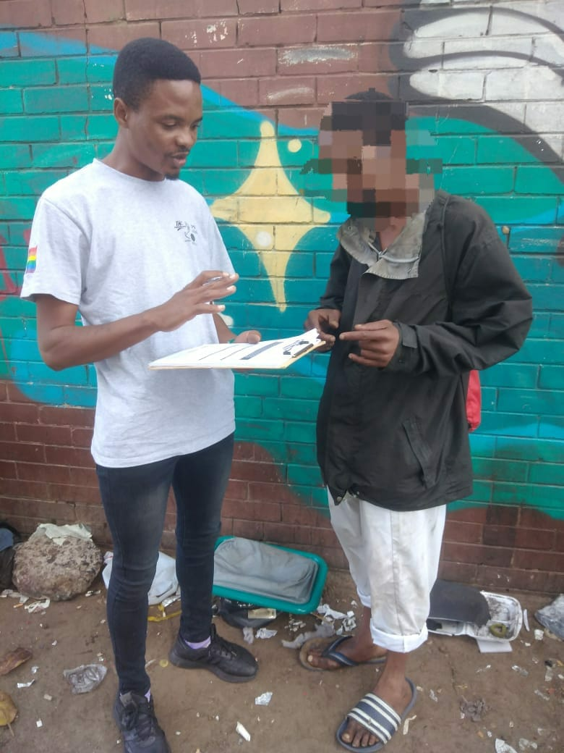
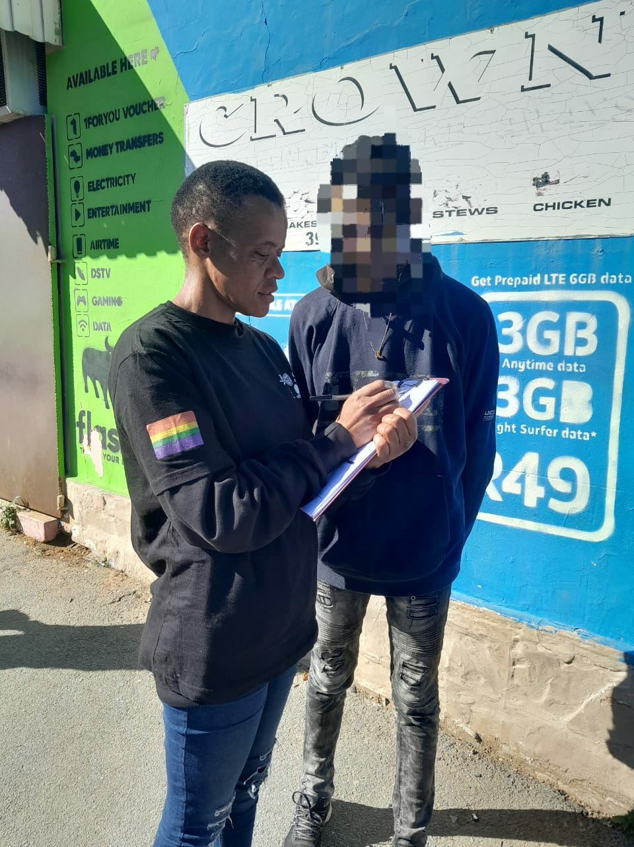
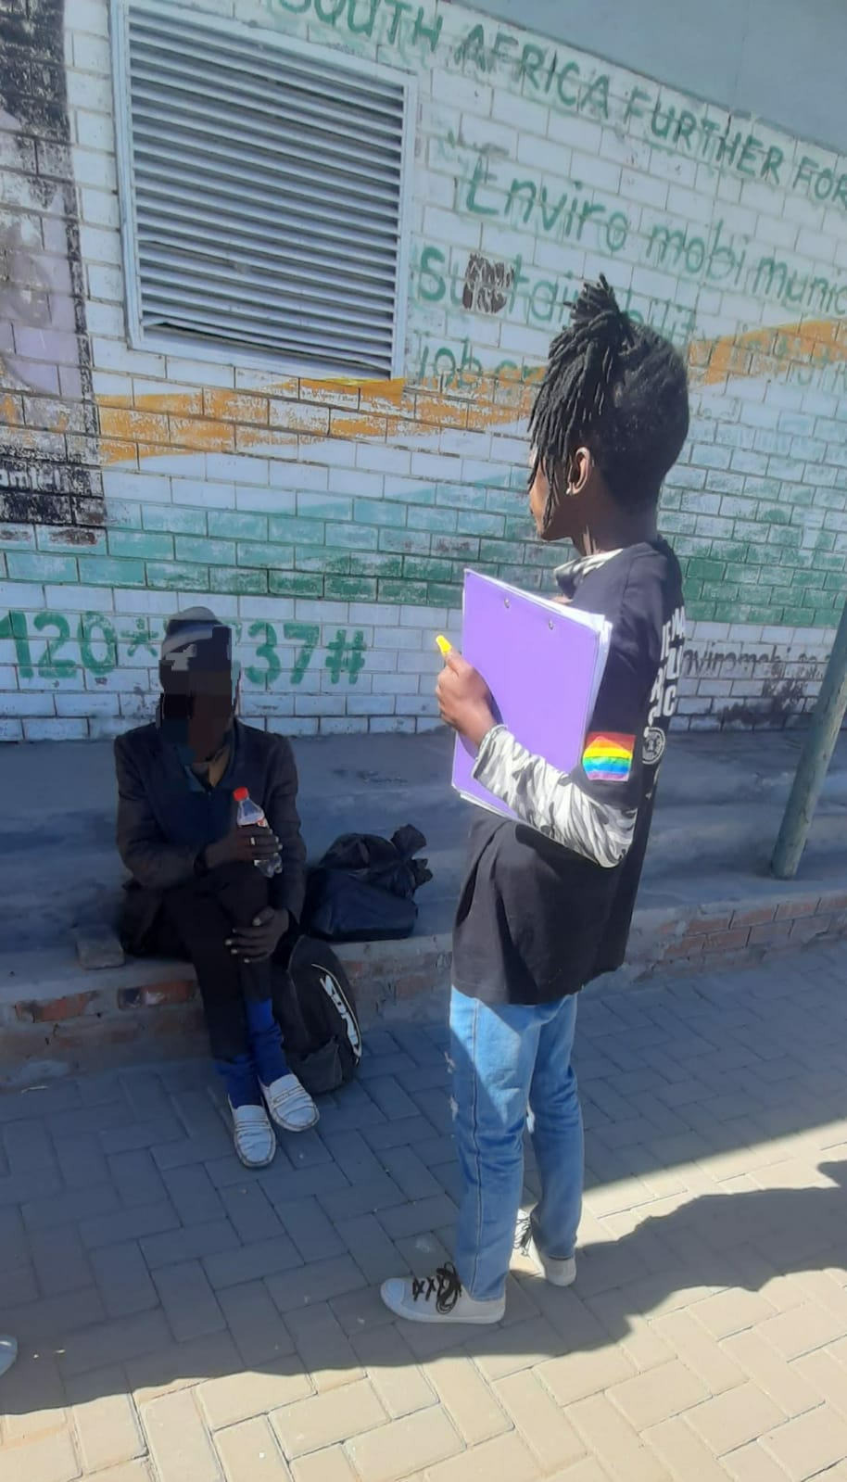
Overview of
Ritshidze
Established in 2018 — Ritshidze was developed by people living with HIV. It unites the entire PLHIV sector in South Africa.
Ritshidze monitors over 400 clinics & community healthcare centres across 29 districts in 8 provinces in South Africa
Ritshidze has a MOU in place with the National Department Of Health and authorization letters from the province.
Ritshidze is NOT a research project. We are not testing hypotheses. CLM is more akin to independent M&E than research.
Community-led clinic monitoring is one way to hold PEPFAR accountable to ensure this — and improve overall HIV and TB service delivery.

Slide 4
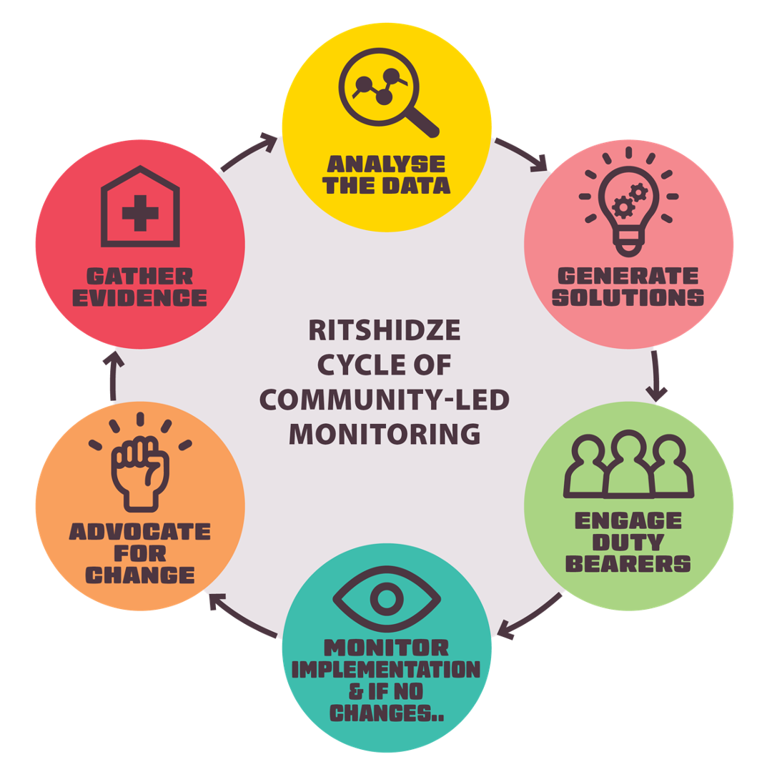
The Ritshidze CLM model
Meaning “Saving our Lives” in Tshivenda, Ritshidze will highlight challenges where HIV and TB services are actually delivered — at public clinics and community healthcare centres — in order to hold decision makers like the Department of Health and PEPFAR accountable to fixing them.
The objective of the Ritshidze project is to improve the quality of HIV and TB service delivery for people living with HIV in South Africa.
We do this by:
Gathering evidence about quality of services provided at clinics;
Analysing the data to identify challenges;
Generating solutions that respond to the evidence collected;
Engaging duty bearers on the challenges and proposed solutions; and
Where no improvement, advocating for change.

Slide 5
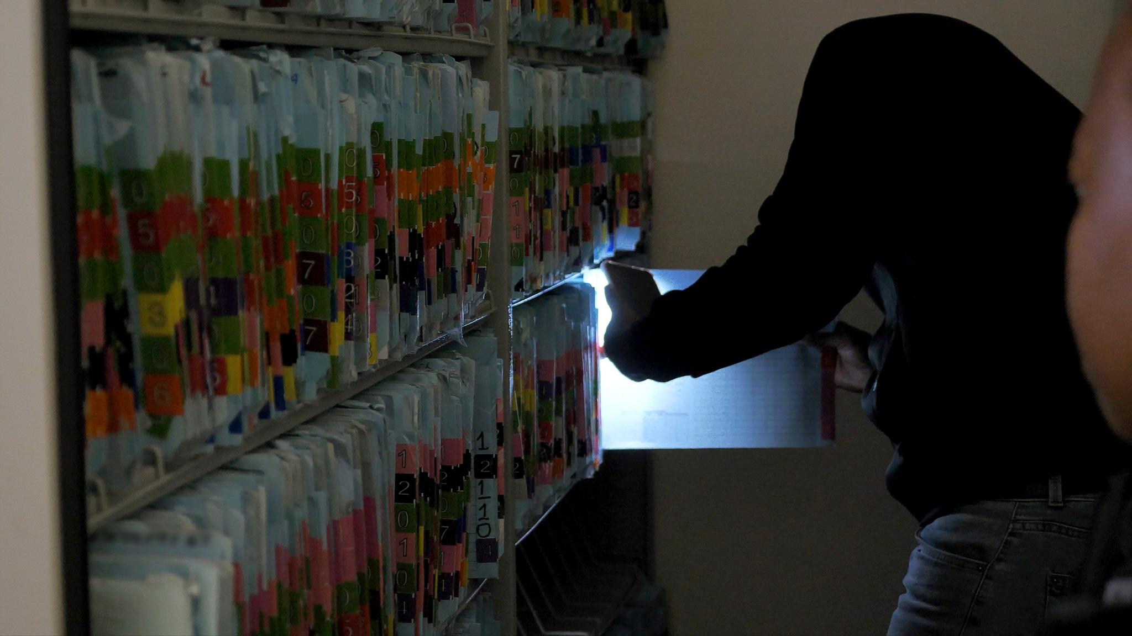

What are the challenges to sustaining and strengthening CLM in a changing world?

Slide 6
Challenges
1.Communities differ – as does their access to health services
2. Timely and accessible CLM data
3. CLM programmes need independence from funders
4. CLM should recognise diverse partnerships
5. CLM data needs to triangulated with programmatic data

Slide 7
Challenge 1:
Communities differ – as does their access to health services

Slide 8
Solution - Different CLM models to reach the communities and understand their needs
Facility Monitoring
Key Populations Annual Drive
400+ public health clinics
To date in 2024 (through Q3), Ritshidze has interviewed
74,933 public healthcare users
37,991 people living with HIV
11,440 young people (under the age 25)
1,415 Facility Managers
and conducted observations
Between July and September each year, a large scale quantitative data collection effort takes place, across 24 districts in 7 provinces.
Monitoring tools were developed and updated after consultation with KPs.
A team of more than 175 KP data collectors recruited to support the data collection effort, including mobilisation and implementation of tools. KPs who were interviewed were identified through snowball sampling where initial participants were asked to refer those they know, who in turn refer those they know, to participate in the survey.
In 2023, nearly 14,000 quantitative surveys were collected. Further qualitative data was collected among key populations including 70 in-depth interviews.
Snapshot surveys on HIV Prevention & Stockouts
Notes:
disconnect between policy at national level and its implementation, failure of the facilities to adhere to those guideline

Slide 9
Challenge 2. Timely and accessible CLM data

Slide 10
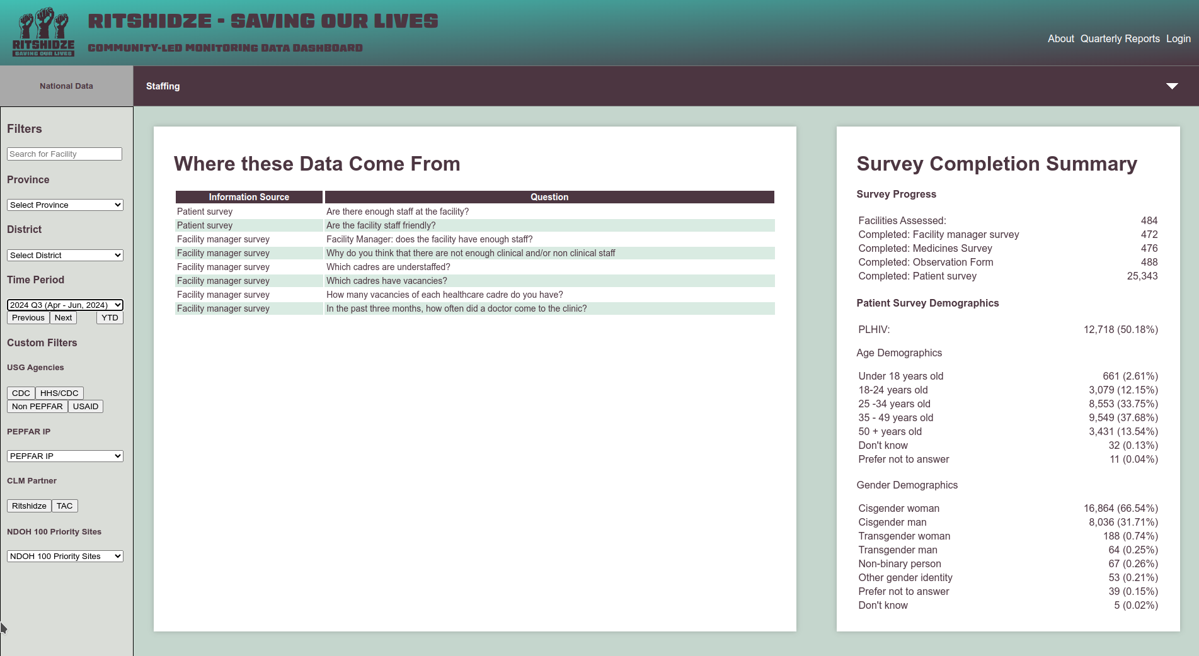
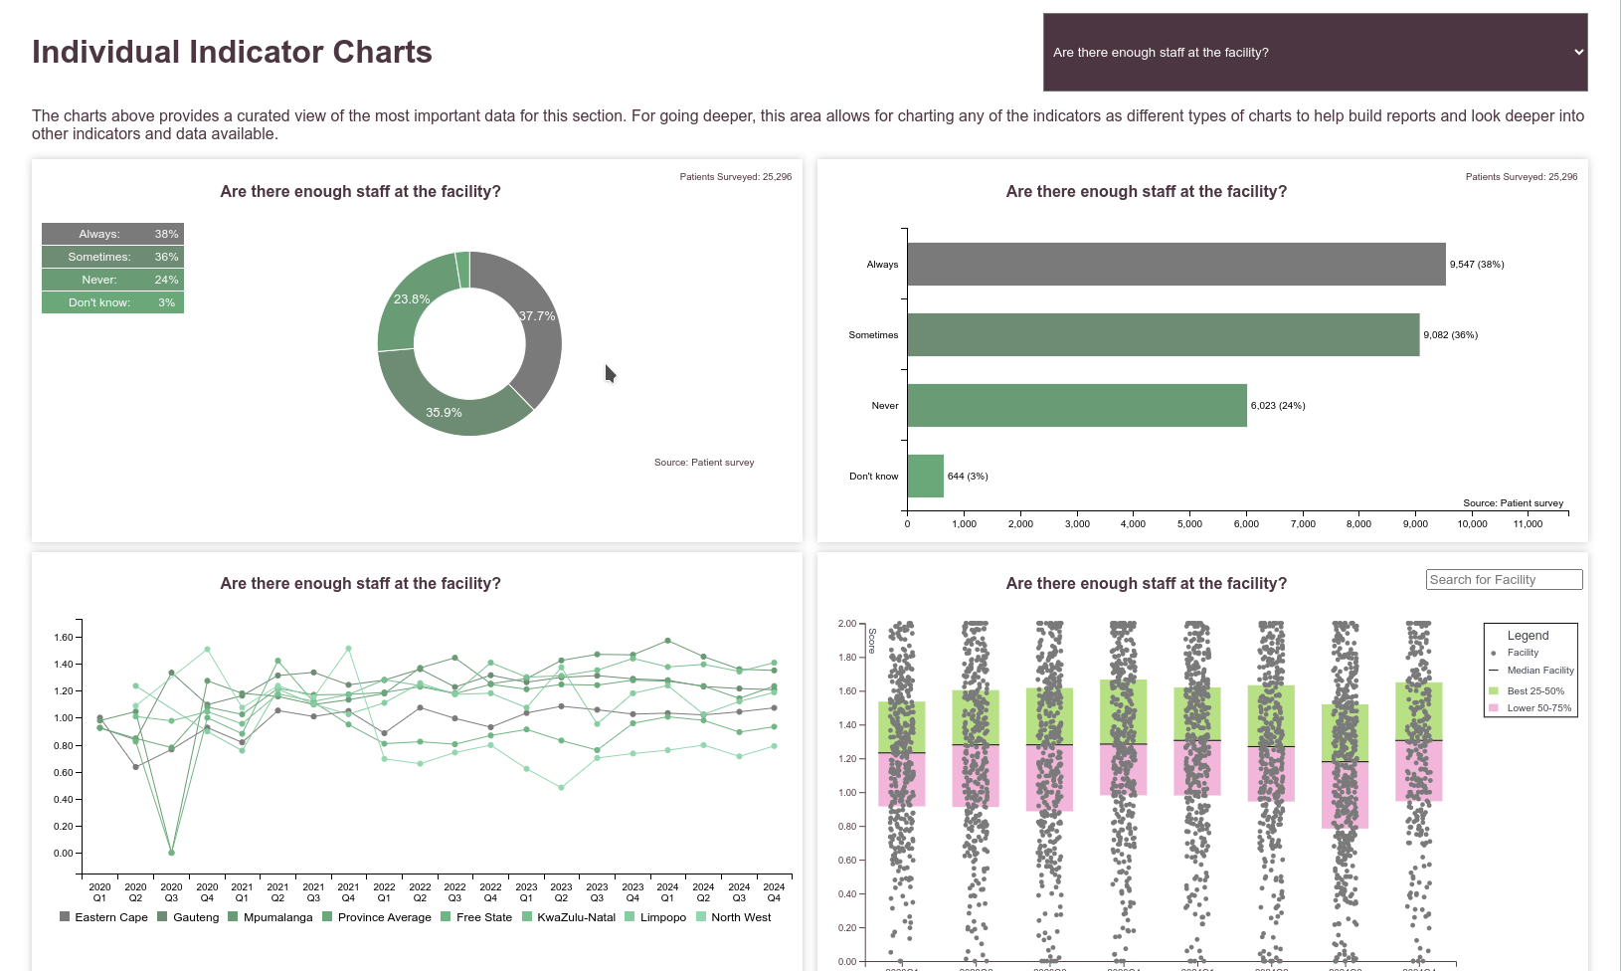
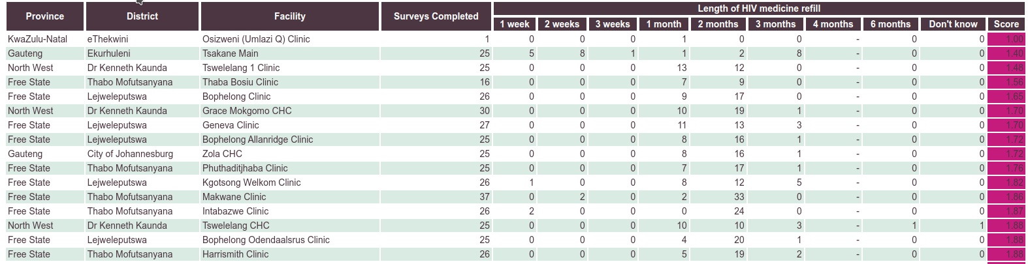
Solution: Automation is essential for programs at scale
Electronic data collection is essential for programs at scale - especially to complete quarterly analyses.
Without automated analysis, it’s extremely time and resource intensive to do analyses comprehensively.
Data that aren’t used do no one any good. Collecting data for data’s sake is wasteful expenditure. Data systems must facilitate the advocacy cycle of CLM.
The problems service users face at health facilities are highly heterogeneous. Aggregated data do little to help direct duty bearers to where their intervention is necessary.
https://data.ritshidze.org.za

Slide 11
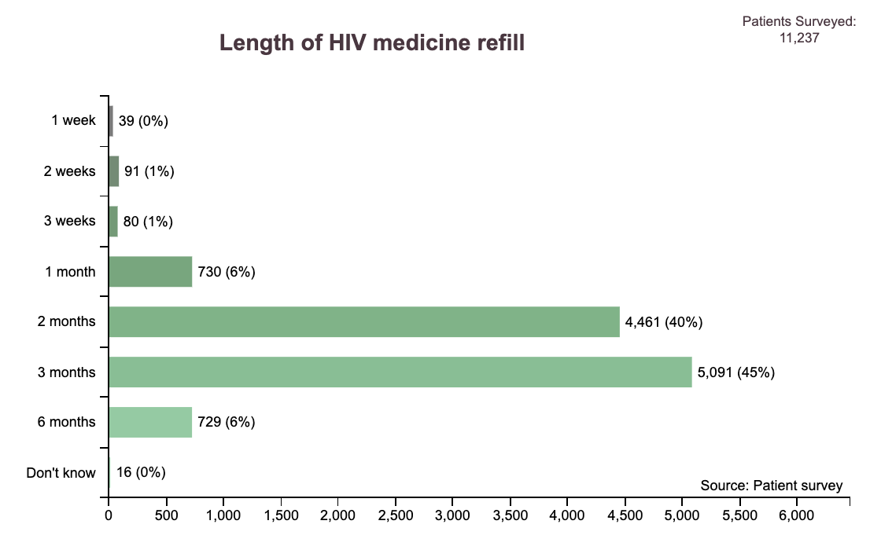
Aggregated data are insufficient for duty bearers

Slide 12
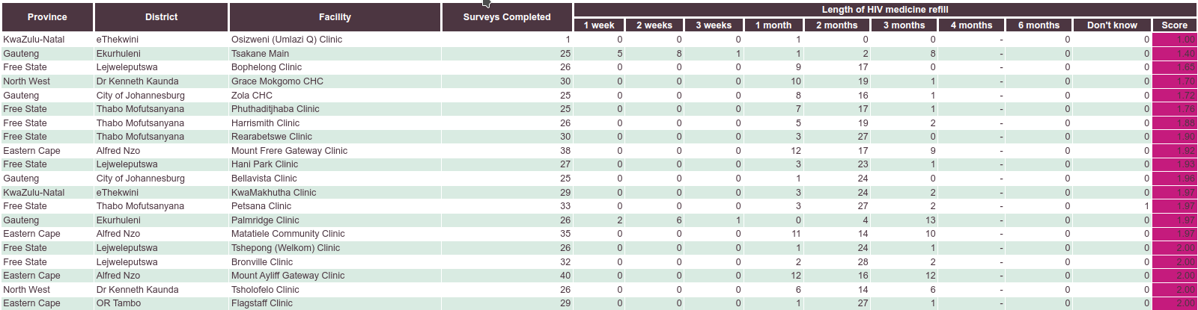
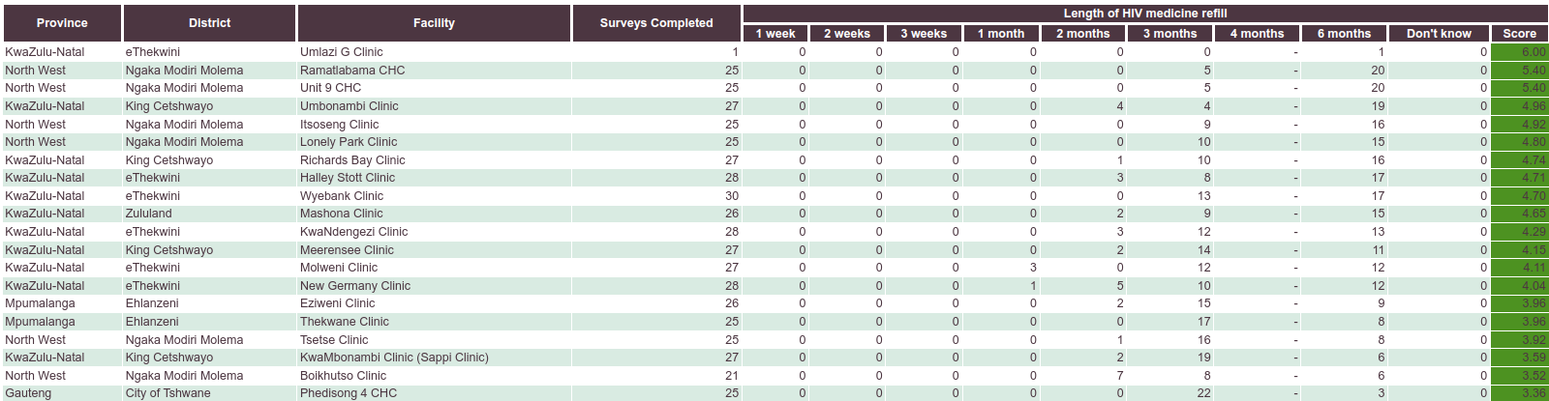
Aggregated data are insufficient for duty bearers

Slide 13
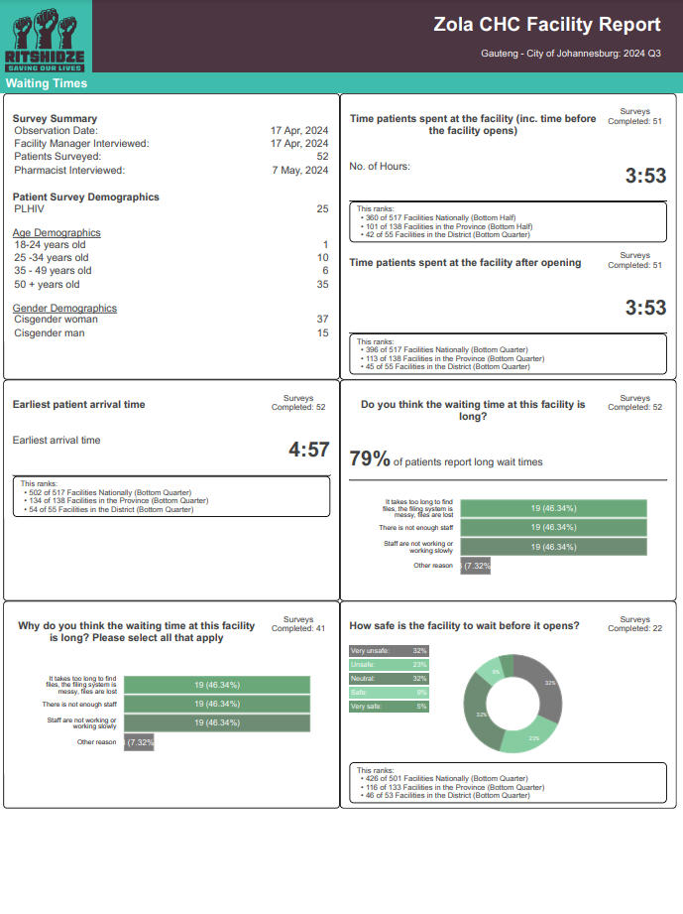
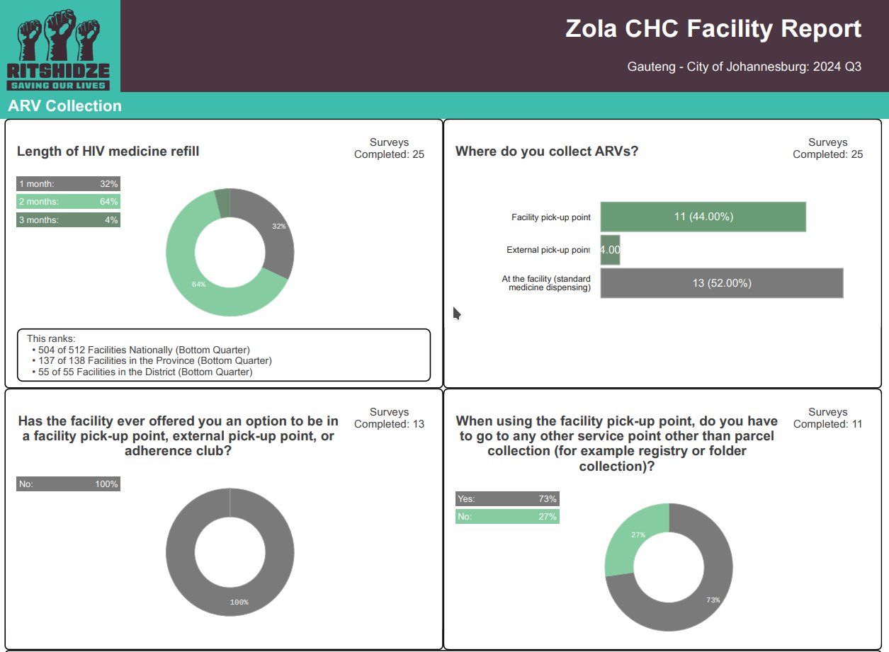
Aggregated data are
insufficient for duty bearers

Slide 14
Challenge 3. CLM programmes need independence from funders – communities need to choose their priorities for monitoring

Slide 15
Solution - Funding mechanisms that allow independence and for communities to do proper CLM
Ritshidze is funded through UNAIDS - which helps provide independent support
Sustainable funding
Ritshidze has matured and successfully refined its processes and tools, we urge donors to consider extending the funding cycle to ensure stability and retention of critical expertise.
"Sufficiently resource CLM to scale and put into action community-led solutions to further address programmatic gaps and policies across the HIV programme."

Slide 16
Challenge 4. CLM should recognise diverse partnerships

Slide 17
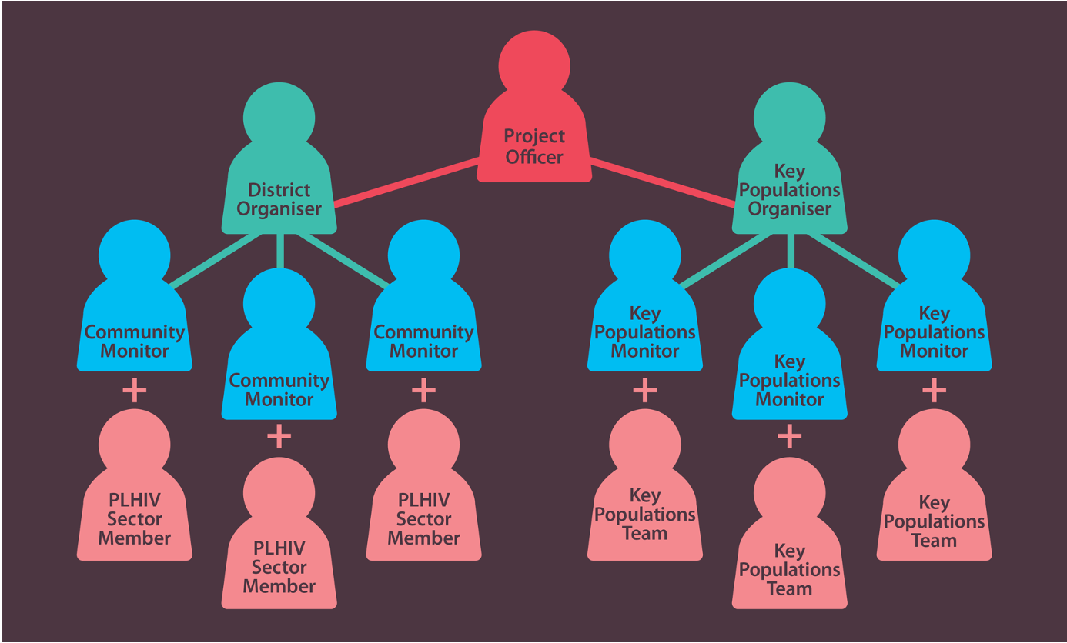








Solution: Partnerships between community-led organizations towards consortia to lead national CLM
Ritshidze is a consortium made up of 5 people living with HIV organizations in SA
The sector came together and worked out structure and responsibilities as the consortium
The consortium dealt with all political issues internally before implementation
Identified like minded comrades and activists to partner with in terms of technical partnerships

Slide 18
Challenge 5. CLM data needs to triangulated with programmatic data

Slide 19
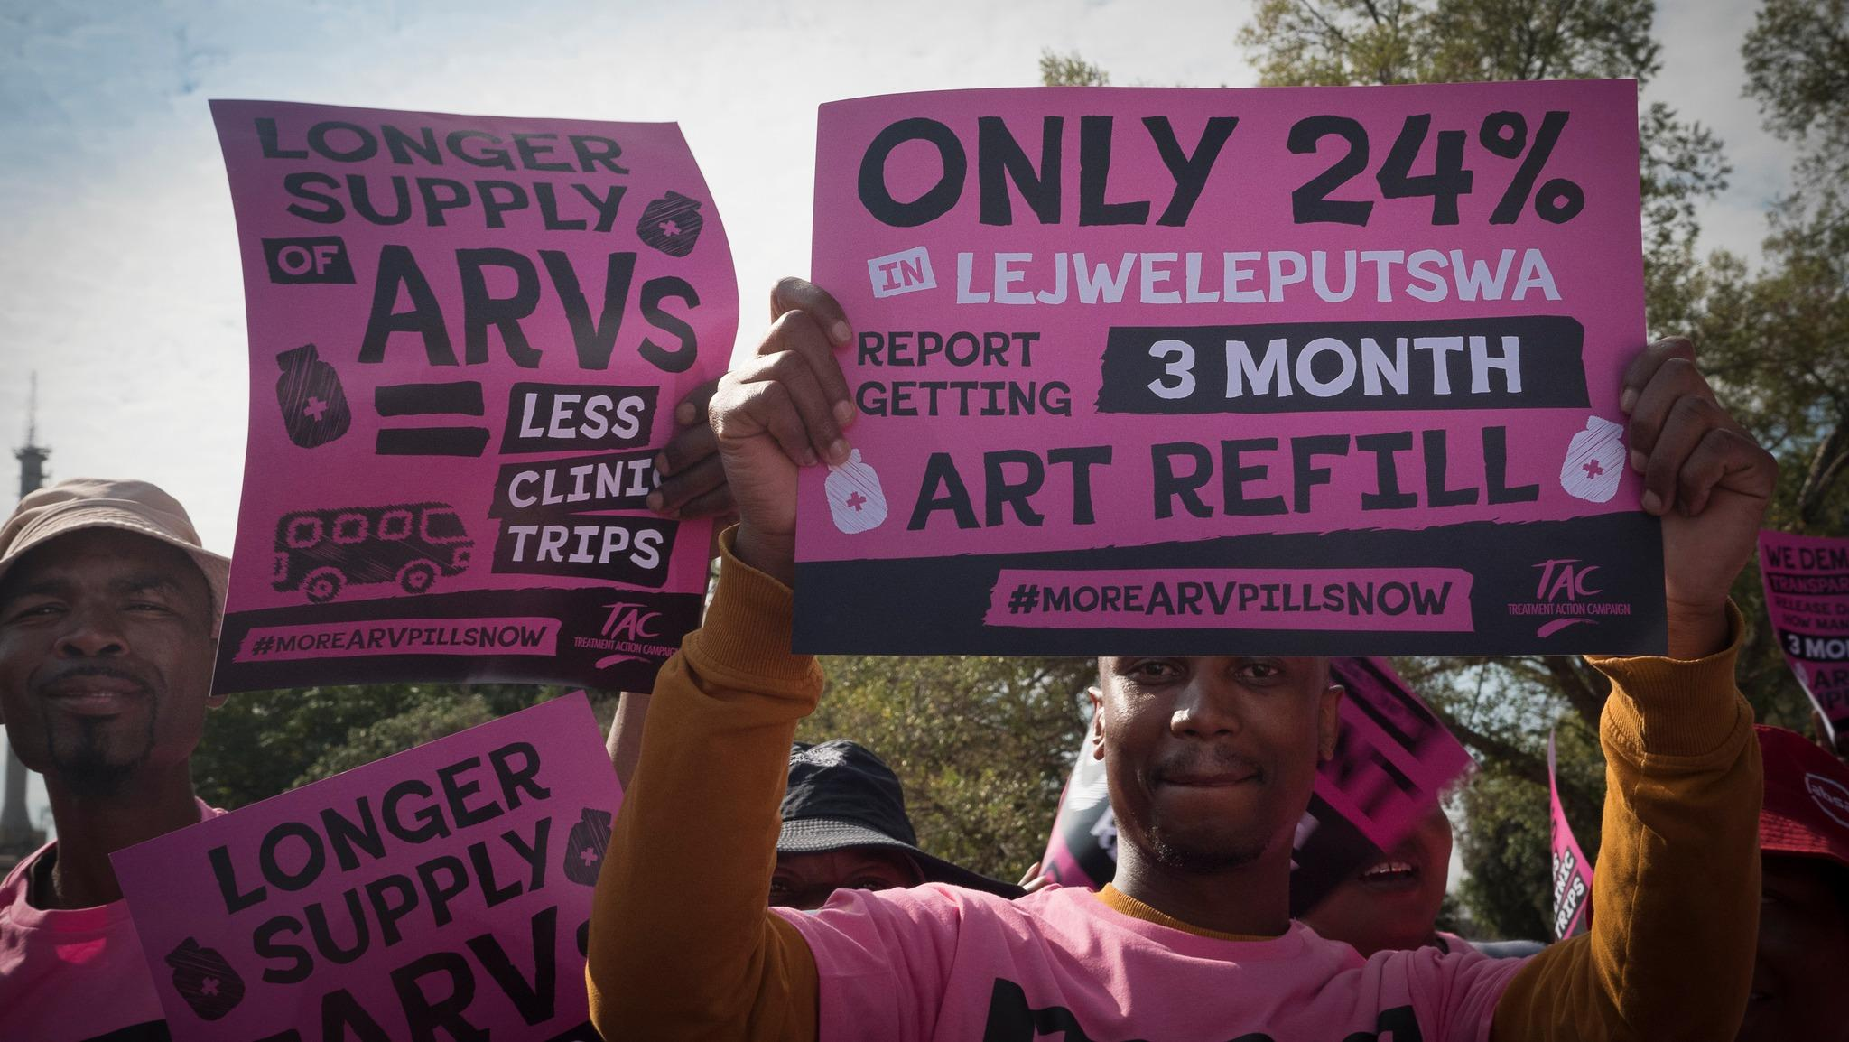
Solution: Work with national government to have access to anonymised, aggregate HIV programme data
Ritshidze struggles, as do others, to access for programmatic data from sites where we monitor services
Without this, cannot be sure of the challenges and the best action to address them
When we did have access to multi-month dispensing data, we were able to see the differences between what CLM and programme data were saying

Slide 20

Key takeaways –
What does CLM need to thrive and survive?
Establish a fieldwide mechanism for defining and ensuring independence
Ensure sufficient funding for CLM through 2030 and beyond so we can monitor progress in this crucial time
Build in technical partnerships that are functional, durable and meet evolving needs

