Slide 1
Pharmacy PrEP in Malaysia
Yan Nee Gan, Universiti Malaya | Ministry of Health Malaysia
Achieving scale and equity: models to simplify, normalize, and diversify PrEP service delivery
Disclosure: I have no relevant financial relationships with ineligible companies to disclose.
Notes:
Good morning, everyone. My name is Yan Nee from Universiti Malaya and the Ministry of Health Malaysia. I am very honored and grateful to the co-organizers, for the opportunity to speak about Pharmacy PrEP in Malaysia. This is my PhD research project, and I am very happy to share about our work.

Slide 2
Background
In Malaysia, the number of reported new infections in 2022 was 3,177.¹
Highest in the Klang Valley - an urban region including the state of Selangor and Federal Territory of Kuala Lumpur.
Mainly among MSM – prevalence 12.9%.²
Existing PrEP service delivery models:
  Free-of-charge: Public health clinics (since Jan 2023)
  Out-of-pocket: Private clinics and university hospitals
2024: Less than 5,000 people have accessed PrEP.²
Community pharmacists are highly trained healthcare professionals and well-suited to provide PrEP service through effective task-shifting.
  >3,000 pharmacies with extended operating hours ³
  Adults visit them on average 31 times annually ⁴
Pharmacy PrEP: Opportunity to increase PrEP access and uptake.
References: 1. Ministry of Health Malaysia. 2023 Global AIDS Monitoring: Country Progress Report - Malaysia. 2. Ministry of Health Malaysia. IBBS survey 2022. 2. Ibrahim J, et al. Ten more govt clinics to start dispensing HIV prevention drugs, says Dr Dzulkefly | The Star [Internet]. 2024. 3. Tew MM, et al. Geospatial analysis of distribution of community pharmacies and other health care facilities providing minor ailments services in Malaysia. J Pharm Policy Pract. 2021;14:1–11. 4. Hamidi N, et al. Determinants of community pharmacy utilisation among the adult population in Malaysia: findings from the National Health and Morbidity Survey 2019. BMC Health Serv. Res. 2021;21:1–11.
Notes:
Now let’s start with some context in Malaysia. In 2022, the number of new HIV infections was 3,177, with the highest concentration in the Klang Valley, an urban region that includes Selangor and Kuala Lumpur and new infections are mainly among MSM with prevalence of 12.9%. Currently, PrEP is available free-of-charge in public health clinics since last year and on an out-of-pocket basis in private clinics and university hospitals. However, less than 5,000 people have accessed PrEP as of 2024. Community pharmacists, with their extensive training and accessibility, present an opportunity to expand PrEP services through task-shifting. There are more than 3,000 pharmacies in Malaysia, operating beyond office hours until 9 or 10 pm, including weekends. Adults visit them about 2-3 times each month. In the era of PrEP choice, it makes sense to explore pharmacy PrEP as an additional option for accessing PrEP.

Slide 3
Aims of the intervention
To measure the implementation outcomes of pharmacy PrEP service implemented at 6 selected community pharmacies in the Klang Valley, Malaysia.
Acceptability
Appropriateness
Feasibility
Fidelity
Sustainability
Adoption / Uptake
Online survey (post-study)
Electronic database & Study record
Notes:
The aim of our intervention is to measure the outcomes of implementing pharmacy PrEP services at six selected community pharmacies in the Klang Valley. As this is an implementation research study, the key outcomes we are focusing on include acceptability, appropriateness, feasibility, fidelity, sustainability, and uptake. These measures will help us understand the implementation effectiveness and scalability of this model.

Slide 4
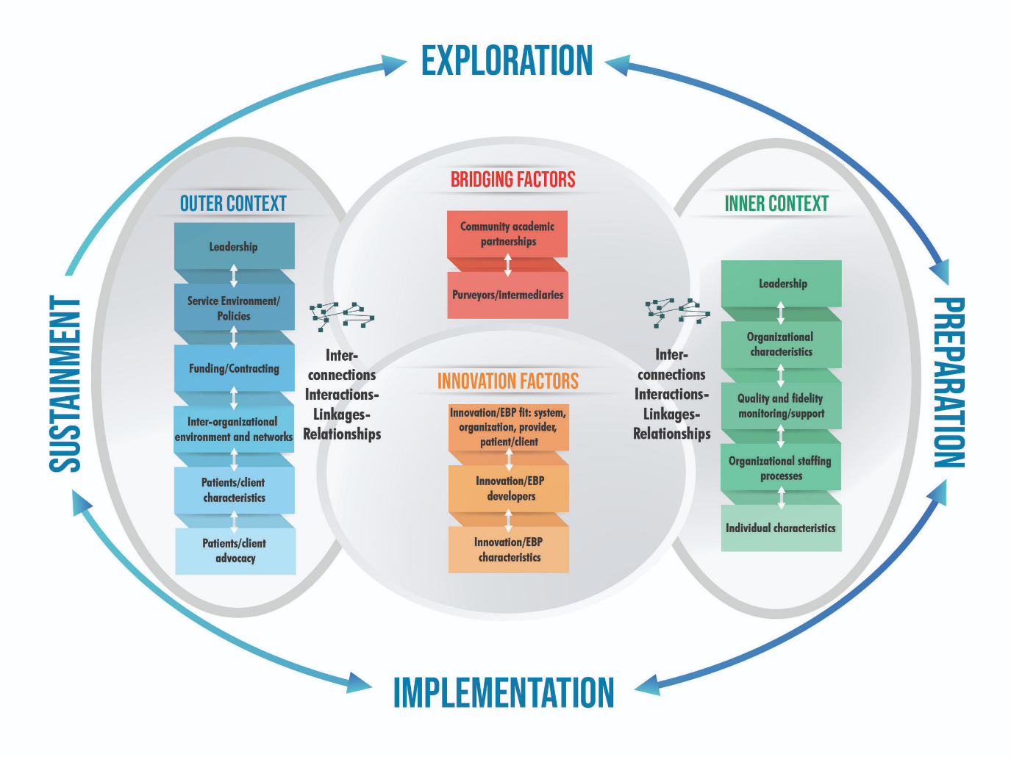
Pre-Implementation
Phase 1: Exploration (4 months)
Semi-structured in-depth interviews: 18 key population members, 10 PrEP prescribers & 10 community pharmacists.
Barriers – Privacy, confidentiality, affordability, poor awareness about PrEP & pharmacy service, lack of training / staff / time / private space / lab testing service.
Facilitators – Availability of private space, assurance of confidentiality, affordable pricing, adequate training, digitalized assessment, collaboration with physicians & NGOs.
Phase 2: Preparation (6 months)
Stakeholder consultation (n=31) on implementation plan.
Online self-paced training (total duration 1 hr 30 min; n=18) –Mean (SD) scores for pre- & post-training knowledge scores: 64.72 % (9.77), 78.89% (7.96). Mean difference was 14.17% (p<0.001).
In-person training (1-day workshop; n=18) – Familiarize with workflow, case scenario discussion & sensitization (role playing).
Dry-run (1 hr) – Practice session at the pharmacy with research assistant simulating as a study participant.
The Exploration, Preparation, Implementation, Sustainment (EPIS) framework (Moullin et al., 2019)
Phase 3: Implementation (12 months) [next slide]
Notes:
The project was carried out in 3 phases, designed according to the EPIS framework: Exploration, Preparation, and Implementation. In the first phase, we interviewed key population members, PrEP prescribers, and community pharmacists to identify barriers and facilitators. Barriers included privacy, confidentiality, affordability, poor awareness about PrEP and pharmacy service, lack of training, staff, time, private space, and lab testing services. Facilitators included private space availability, confidentiality assurance, affordable pricing, adequate training, digitalized assessment, and collaboration with physicians and NGOs. In the second phase, we conducted stakeholder consultation to finalize the implementation plan based on qualitative findings and training sessions. We trained a total of 18 pharmacists over the course of a month. The training started with online self-paced training which takes 1.5 hour to completeand results showed it significantly improved knowledge scores. We also had a one-day in-person workshop to help pharmacists familiarize with the workflow plus case scenario discussion, as well as sensitized them to the needs of key populations through role-playing. Prior to implementation, we also had dry runs where pharmacists got to practice with a research assistant simulating as study participant.

Slide 5



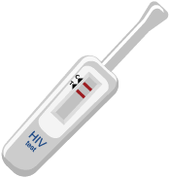
Implementation
230 study participants
(individuals aged 18-49 interested to use PrEP)
- 92% are gay men and other men who have sex with men
6 study sites:
Screening by trained pharmacist
using digitalized PrEP assessment tool
+ on-site free HIV screening using oral fluid HIV self-test kits
+ counselling
Eligible + willing to use
(new / restarting / continuing users)
Pharmacist request electronic prescription from physician via telemedicine platform
(Same-day PrEP)
Collaboration with physicians/ PrEP clinics (within 10km) for laboratory testing needs & referrals
7-month follow-up with pharmacist
(1 month after initiation then every 3 months)
Refer to doctor when necessary.
HIV screening every visit.
involving out-of-pocket expenses* to inform future viability & sustainability of service in private pharmacy setting.
Real-world implementation
354 people expressed interest.
124 did not enrol: 60% did not respond or changed their mind without providing any reason.
* Participants pay for PrEP medication (available at special rebate price) at the pharmacy & any laboratory tests done outside of pharmacy. Baseline kidney function test required within 3 months of initiation.
Notes:
The implementation phase started with recruitment. We shared flyers through social media, influencers. We also set up an Instagram account. 354 people expressed interest in participating. However, 124 did not enroll, mainly due to non-response or a change of mind. We successfully enrolled 230 participants aged 18-49 who were interested in using PrEP, with a significant proportion being MSM. Participants were given a link to book an appointment online with the pharmacy of their choice. PrEP assessment begins once the participant visited the pharmacy. This is where we simplify PrEP service through digitalized PrEP assessment tool and using an oral fluid HIV self-test kit for HIV screening. While waiting for the test results, which takes about 20 minutes, the pharmacist provided PrEP counselling. If the participant was eligible and wanted PrEP, the pharmacist then requested an electronic prescription from a physician via telemedicine platform for same-day PrEP. The physician could access the assessment information before deciding to prescribe. This process usually takes less than 5 minutes. Once there’s electronic prescription, the participant could get their PrEP at a special rebate price of 15 USD, which is 7-25 USD cheaper than usual price. Participants had follow-up visits with pharmacists one month after initiation and every three months thereafter. Collaboration with physicians for lab testing and referrals was crucial, as pharmacies do not have lab testing services. During assessment, pharmacists advised participants on the recommended lab tests, which the participants needed to get done at their own expense.

Slide 6
Challenges to Implementation
Client-level
Provider-level
Low reach → other key populations
  Trans people, sex workers, people who inject drugs
Delay in getting lab test done
  Baseline kidney function test required within 3 months of initiation
  Other tests (e.g., hepatitis B & C, STI) strongly encouraged but not compulsory
Attrition (n=30)
  Loss to follow-up (66.7%); Relocation (10%)
  Prefer getting free PrEP from public health clinics (10%)
  Prefer getting PrEP from private clinics (6.7%)
  Stopped PrEP due to sexual inactivity (6.7%)
Clinical support
  Availability of physician for clinical advice during pharmacy (extended) operating hours
Electronic prescription request denied
  Discussion between pharmacist & physician needed to clarify reasons (~6 cases) → Delay
High turnover among community pharmacists
  Need to train new pharmacists (online + hands-on training)
Scope of training beyond PrEP needed
  Training on PEP, hepatitis B & C, STI
Notes:
We faced several challenges during implementation. At the client-level, there was low reach among other key populations like trans people, sex workers and people who inject drugs. There was also delay in getting lab tests done, mainly due to busy schedule. A baseline kidney function test within 3 months of initiation was required in our study. Other tests for hepatitis B & C and STI were strongly encouraged but not compulsory. We included questions about hepatitis B infection and vaccination as well as STI screening by symptoms in our assessment tool. Lastly, there was attrition due to various reasons, mainly loss to follow-up, preference for free PrEP from public and private clinics and stopping PrEP due to sexual inactivity. At the provider-level, there were issues with availability of physicians for clinical advice during pharmacy extended operating hours and electronic prescription requests being denied which required further discussion between pharmacist and physician to clarify reasons for denial. However, we had only about 6 such cases so far. There was also high turnover among community pharmacists which necessitated training of new pharmacists and the need for broader training covering PEP, hepatitis B and C, and STIs.

Slide 7
Results achieved to date & Next steps
Results achieved to date
Next steps
Initiation rate: 96.7% (204/211)
  Withdrew/defaulted baseline visit (n=19)
  Ineligible for initiation (n=7)
      Unwilling to start PrEP (n=4)
      Reactive HIV test result (n=1)
      Reported hepatitis B infection (n=1)
      Reported kidney-related comorbidity (n=1)
Retention rate:
  1st follow-up - 85.7% (178/208)
  2nd & 3rd follow-up - pending
Average visit time ~ 30 minutes
Seroconversion (n=1)
  No symptoms, reported good adherence to on-demand PrEP, inconsistent condom use, 1 partner (unknown status), linked to care
Continuation of service:
  Online survey (June – Sep 2024): Assess no. of participants keen to continue using the service and pharmacists keen to continue providing the service
  Continued partnership between pharmacy and telemedicine providers
  Make HIVST and PrEP more affordable
  Incorporate online consultation (hybrid approach)
Present study findings to MOH:
  To be considered as one of the DSD models in the national PrEP guidelines
  Scale-up to other states
Notes:
Currently, the study is still ongoing till September. Happy to share that the initiation rate was 96%, with a good retention rate at the first follow-up. The 2nd and 3rd follow-ups are still pending. The average visit time was about half an hour. We had one seroconversion. This participant reported no symptoms, good adherence to on-demand PrEP, inconsistent condom use, 1 partner (unknown status). We successfully linked this participant to care. We have started sending out online survey to assess the implementation outcomes which includes understanding how many participants keen to continue using this service and how many pharmacists keen to continue providing the service. We are also exploring partnerships to make HIVST kits and PrEP more affordable. Some participants prefer to have hybrid consultation combining both in-person and online consultation. So, we’re looking into making this possible as well. We plan to present our findings to the Ministry of Health for the consideration of incorporating it into the national guidelines and scaling up this model across other states.

Slide 8
Recommendations for other countries
Legal framework: Local regulations / national guidelines?
Prescribing authority: Can pharmacists prescribe?
HIV testing: Allowed in pharmacies?
Laboratory testing service: Available in pharmacies?
Insurance coverage: Reimbursed by national or private health insurance?
Out-of-pocket expense: Affordability?
Referral pathways: Physicians / general practitioners, public healthcare facilities, NGOs?
Notes:
For other countries considering pharmacy PrEP, we recommend addressing the following: Firstly, consider the legal framework and prescribing authority. Are there local regulations or national guidelines regarding PrEP service? Can pharmacists prescribe PrEP? If not, can pharmacists work with physicians to enable same-day PrEP? Secondly, is HIV testing allowed in pharmacies? If yes, what type of HIV test? Is lab testing service available in pharmacies? If not, consider collaborating with nearby clinics or lab providers. Next, consider if PrEP service can be reimbursed by national or private health insurance. If not, consider what are the out-of-pocket expenses and if it’s affordable to local communities. Lastly, ensure there’s a clear referral pathways to physicians, public healthcare facilities, and NGOs.
That’s all for my presentation. Thank you for your attention. I look forward to your questions about pharmacy PrEP in Malaysia.

Slide 9
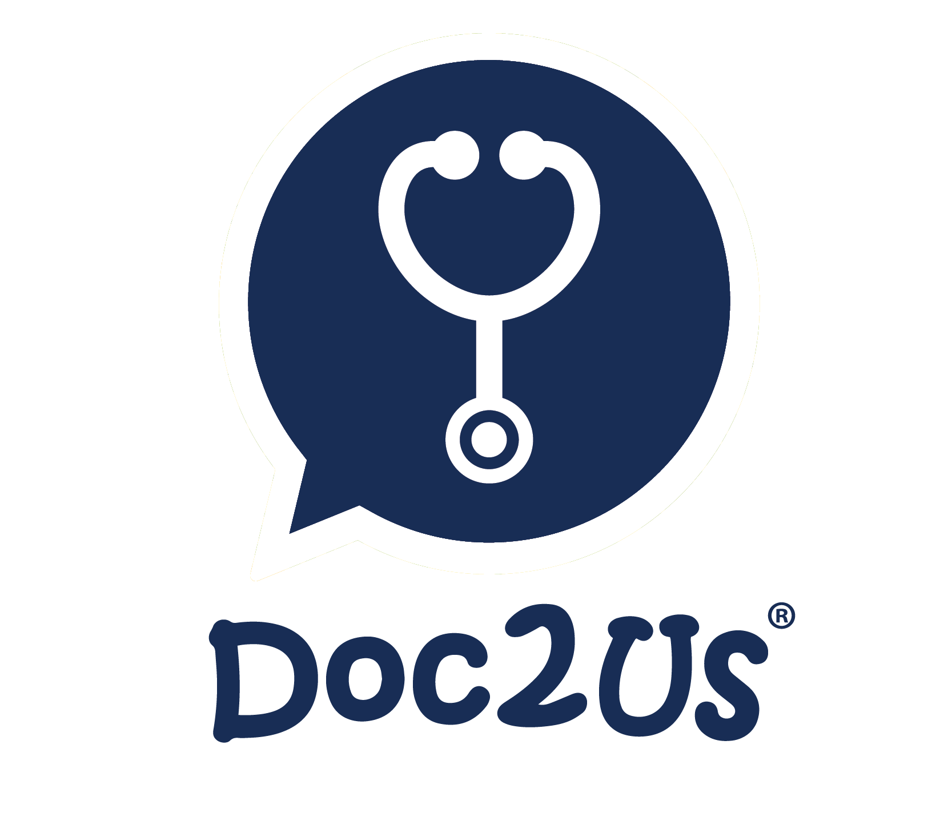















Acknowledgement
Funders:
PhD supervisors:
Research assistants:
United States National Institute of Health (NIH) Fogarty D43TW11324 training grant via the Malaysian Implementation Science Training (MIST) program, a collaboration between Universiti Malaya and Yale University
World Health Organization (WHO)
TREAT Asia
Associate Professor Dr. Raja Iskandar Shah Raja Azwa
Dr. Howie Lim Sin How
Professor Dr. Rafdzah Ahmad Zaki
Xu Qing Foo
Safia Alia Hafidzar
Sharifah Khadijah Syed Razif
Collaborators:

Slide 10

Thank you
If you’re interested to connect,
please drop me an email.
yanneegan@gmail.com

