Slide 1
Tangerine –
Trans-formative Care Model in Bangkok
Impact profiles in implementation science: Making a difference
Rena Janamnuaysook
Institute of HIV Research and Innovation
Thailand

Slide 2
Conflict of Interest
Speaker’s bureau fees and research grants to my organization from Gilead Sciences

Slide 3
Outlines
HIV and health landscapes among transgender people in Thailand before 2015
Tangerine Clinic
  Mobilizing trans leadership in healthcare
  Operationalizing trans-competent care innovations
  Diffusing the trans-competent care model
  Sustaining trans-competent care services
Lessons learned

Slide 4
HIV and health landscapes among trans people in Thailand before 2015
High HIV prevalence among trans women in Bangkok
  11.5% in 2005, 10% in 2009, 9.9% in 2014
No available data among trans men
Stigma and discrimination in healthcare settings as barriers to HIV services
Trans women categorized under MSM and not included as a distinct key population in Thailand’s national AIDS program
Lack of trans-inclusive care in public health facilities
Gender-affirming care (i.e., hormone treatment) not covered under Universal Health Coverage
A clear need to need to establish trans-competent health services across the HIV prevention, care, and treatment cascade to meet their unmet health needs

Slide 5

Mobilizing trans leadership in healthcare
The Community Consultation in 2015
Three key areas identified:
Health priorities: Hormone treatment, neovaginal care, HIV
Essential service factors: Intake forms, stigma-free and trans providers, confidentiality, safe spaces
Challenges: Trans-competent physicians, invisibility of trans men

Slide 6

Operationalizing trans-competent care innovations
Employing trans people in the healthcare team
Conducting gender sensitization and trans-competent care training
Developing community-driven implementation research
Integrating gender-affirming care in HIV services and programming
Engaging trans social influencers

Slide 7
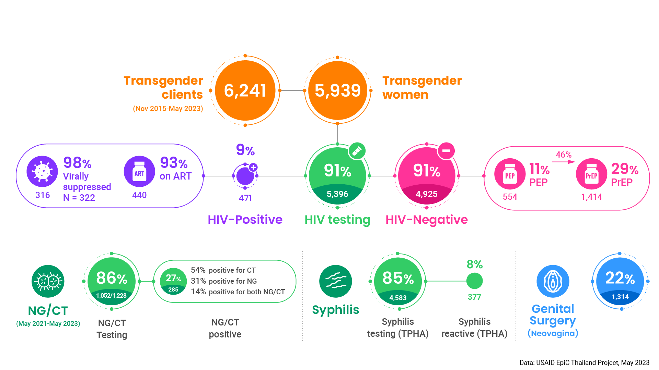
Operationalizing trans-competent care innovations (con’t)

Slide 8
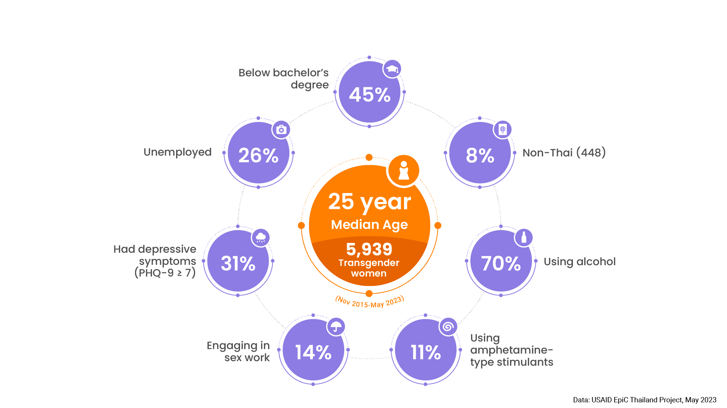
Operationalizing trans-competent care innovations (con’t)

Slide 9

Operationalizing trans-competent care innovations (con’t)
The increasing uptake of a trans-specific services, including co-located gender-affirming care, suggests this may be an effective model in engaging transgender women in primary care (van Griensven et al., 2021)
More than half managed to achieve at least one hormone concentration within target concentrations at follow-up visits, suggesting a positive effect from attending trans-led, integrated, gender-affirming care and sexual health services (Hiransuthikul et al., 2021)
Pharmacokinetic study showed lower blood plasma tenofovir exposure in the presence of feminizing hormone, suggesting that feminizing hormone may potentially affect PrEP efficacy among trans women; but estradiol exposure was not affected by PrEP (Hiransuthikul et al., 2019)
www.unaids.org/en/resources/presscentre/featurestories/2020/december/20201209_prep-transgender-Thailand

Slide 10

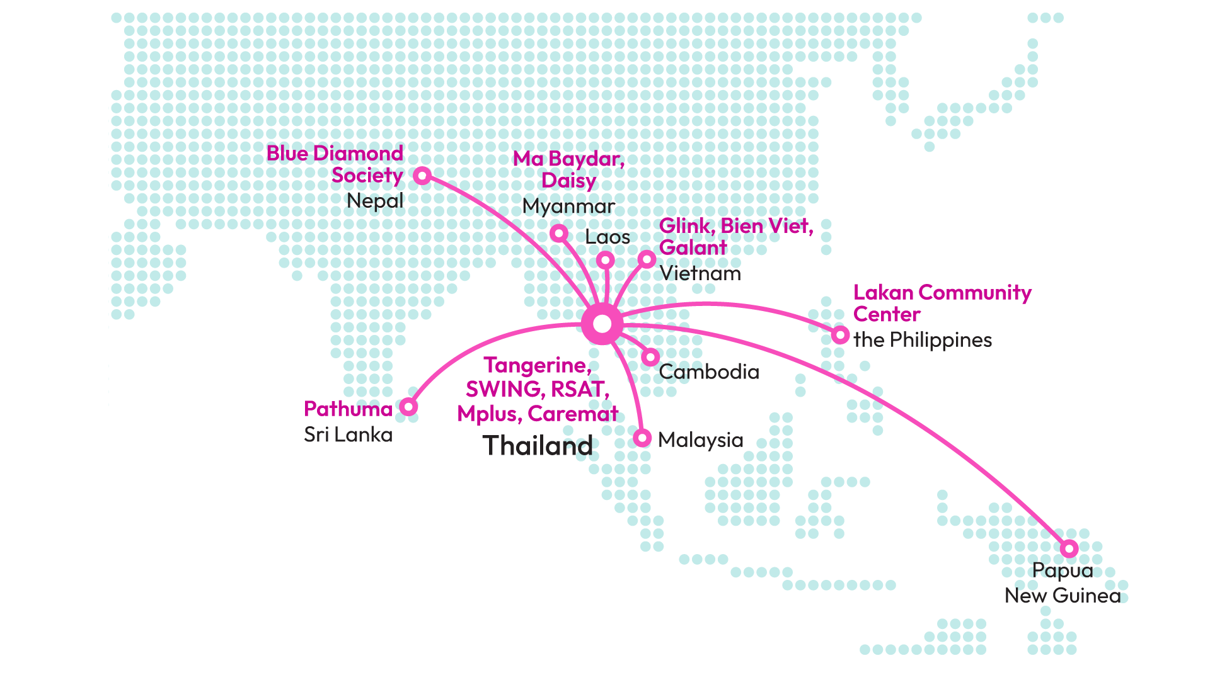
Diffusing the transgender-competent HIV care model
The Tangerine Academy for Transgender Health
86 healthcare professionals and
174 lay providers trained

Slide 11
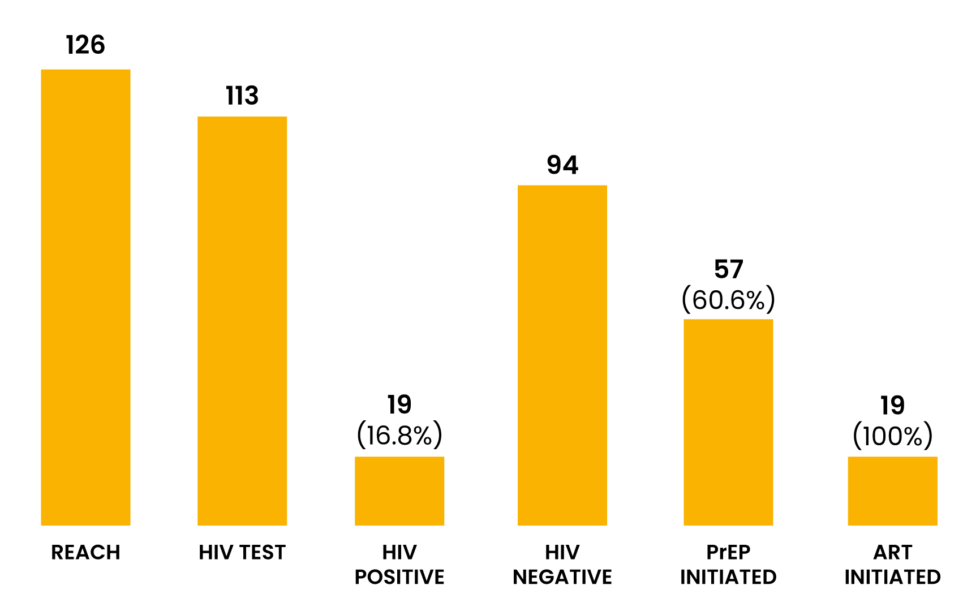
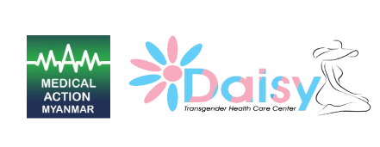

Diffusing the transgender-competent HIV care model (con’t)
Slide: Dr. Ni Ni Tun, Medical Action Myanmar, USAID EpiC Myanmar, 2022.

Slide 12

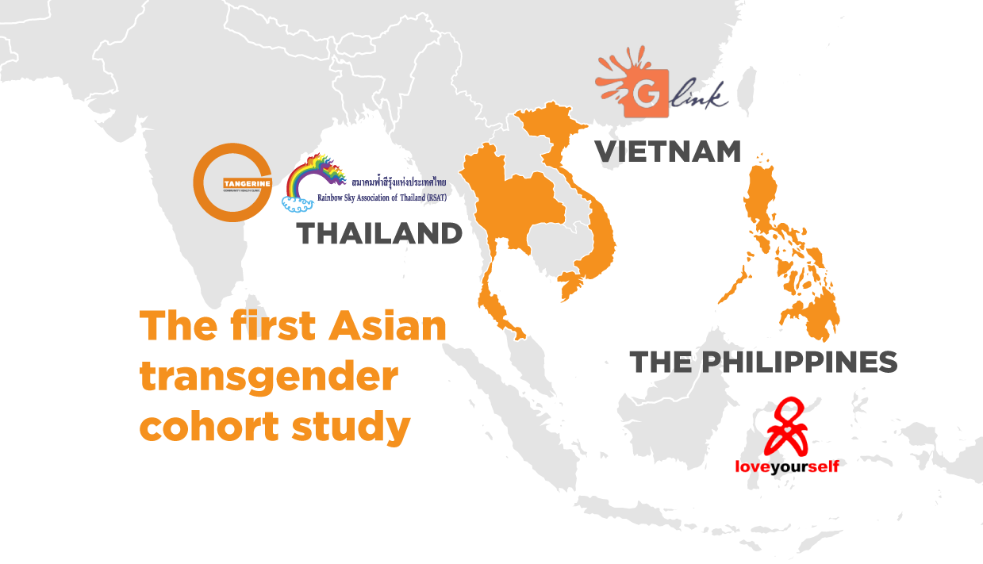
Diffusing the transgender-competent HIV care model (con’t)
The South-East Asian Transgender Health and HIV Cohort (SEATrans)
Funded by:
The US NIH through the International Epidemiology Databases to Evaluate AIDS (IeDEA), IeDEA Asia-Pacific (U01AI069907)

Slide 13
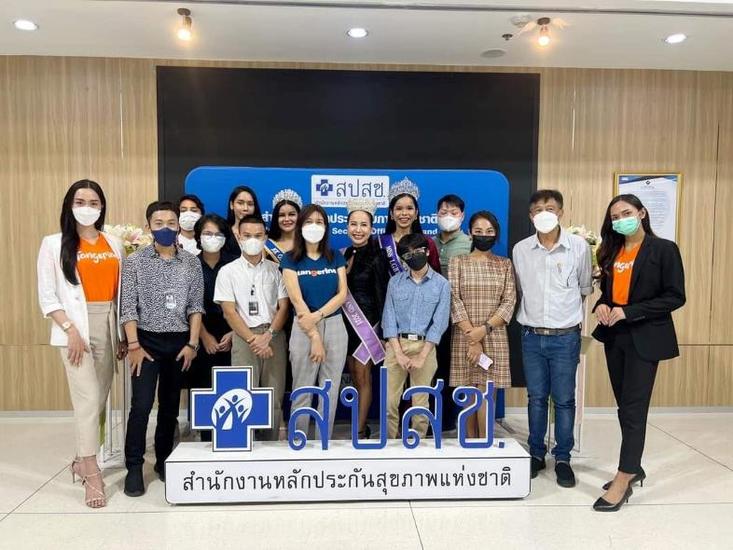
Sustaining transgender-competent HIV services in Thailand
In 2020, a petition to include gender-affirming care in the national healthcare benefit package submitted to the National Health Security Office (NHSO)
In 2021, a stakeholders’ consultation with the Medical Council to revise the regulations to simplify clinical practices for gender-affirming care
In 2023, Tangerine Clinic cohort data presented to NHSO to include gender-affirming care in the Universal Health Coverage (UHC) program
The Government announced they would prioritize support for gender-affirming care → expected to be incorporated into the national UHC program in 2025
NHSO allocated US $4M to support gender-affirming care in fiscal year 2025
Photo: Civil Societies at NHSO, IHRI, 2023

Slide 14
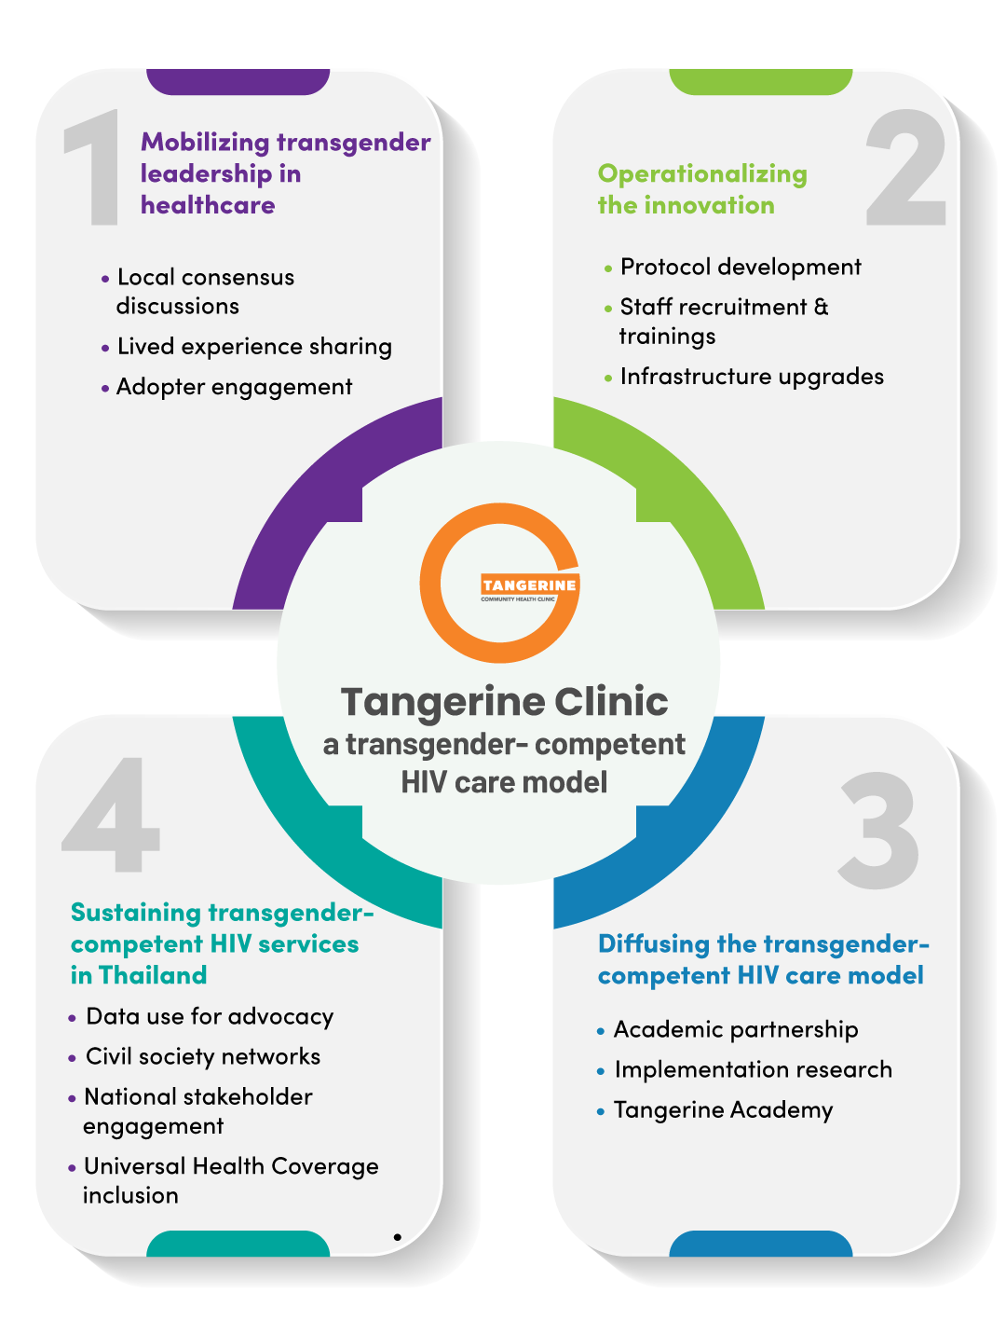
Lessons learned
People-centered health services must be adopted and organized around the health needs of people rather than diseases
Trans-led and trans-owned programming is key to the HIV community response and should be sustained.
Implementation science can be used as a vehicle to inform implementation strategies, to develop innovations, and to promote sustainability

Slide 15




















Acknowledgements

Slide 16


