Slide 1




The impact of conditional cash transfers on HIV/AIDS in Brazil
Davide Rasella,
Institute of Collective Health (ISC), Salvador, Brazil
Barcelona Institute for Global Health (ISGlobal), Barcelona, Spain
Impact profiles in implementation science: Making a difference

Slide 2
Summary
What is your main question?
Has the Bolsa Familia Program (BFP), Brazil's large-scale Conditional Cash Transfer (CCT), impacted HIV/AIDS outcomes?
What did you find?
The BFP contributed to the reduction of AIDS incidence, hospitalizations, and mortality in Brazil.
There is a clear gradient of BFP effectiveness based on poverty levels, with the BFP reducing AIDS incidence by up to 55% and AIDS mortality by up to 54% among extremely poor individuals.
Why is it important?
Poverty-reduction policies should be considered essential interventions to reduce HIV/AIDS morbidity and mortality in the most vulnerable populations.

Slide 3
The Bolsa Familia Program
The Bolsa Familia Program, one of the world's largest Conditional Cash Transfers, was created in Brazil 20 years ago and now covers over 20 million families.
BFP provides direct cash transfers to poor households with income below the poverty line (defined by the Brazilian government).
In order to continue receiving the benefits, BFP beneficiaries have to fulfil specific conditionalities related to the healthcare for pregnant women (carrying out prenatal care) and children (compliance with the national vaccination schedule, monitoring nutritional status), and education (school attendance) for children and adolescents.
The BFP has been able to improve the wellbeing of families in poverty, and to reduce social and income inequalities, improving access to education, food, and health services.
Several studies have demonstrated the positive effects of BFP on health outcomes such as child mortality, cardiovascular diseases, suicide, leprosy, and tuberculosis, among others.

Slide 4
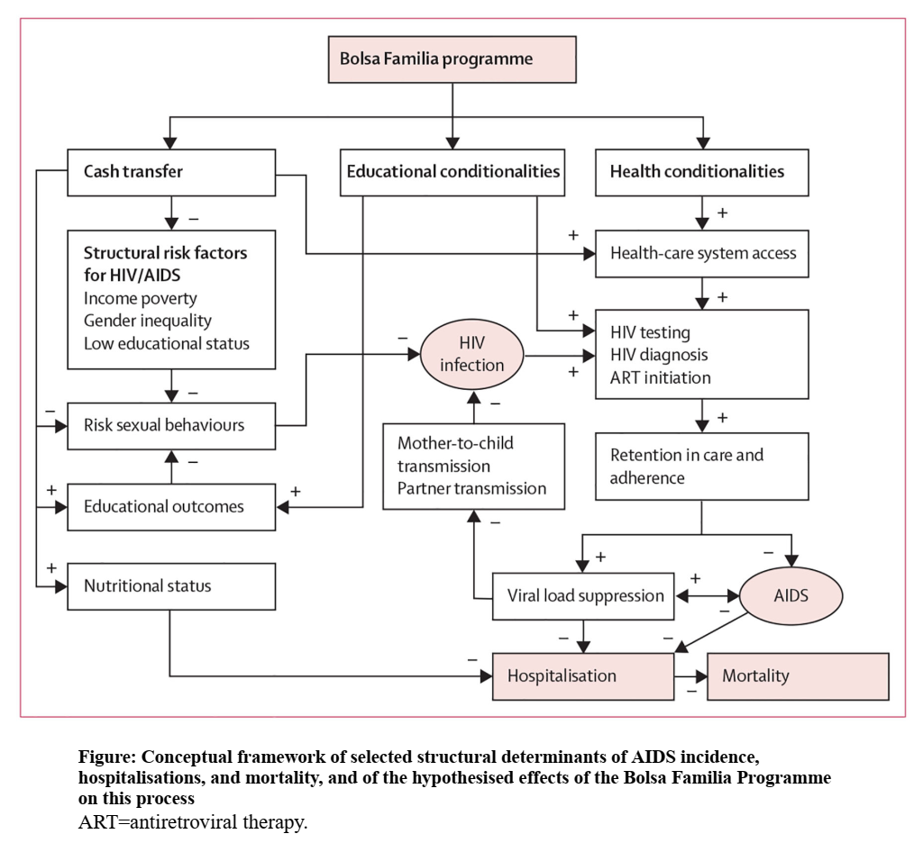
The Bolsa Familia Program

Slide 5
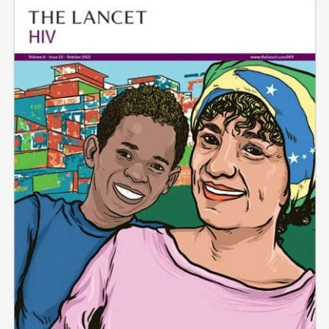
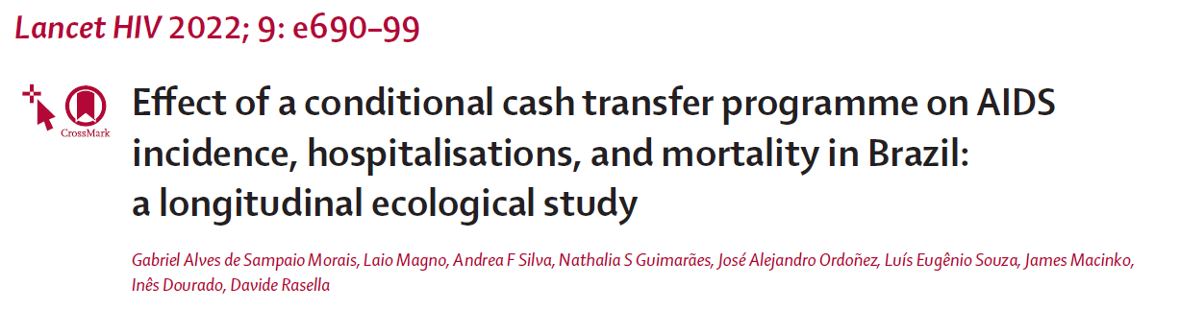
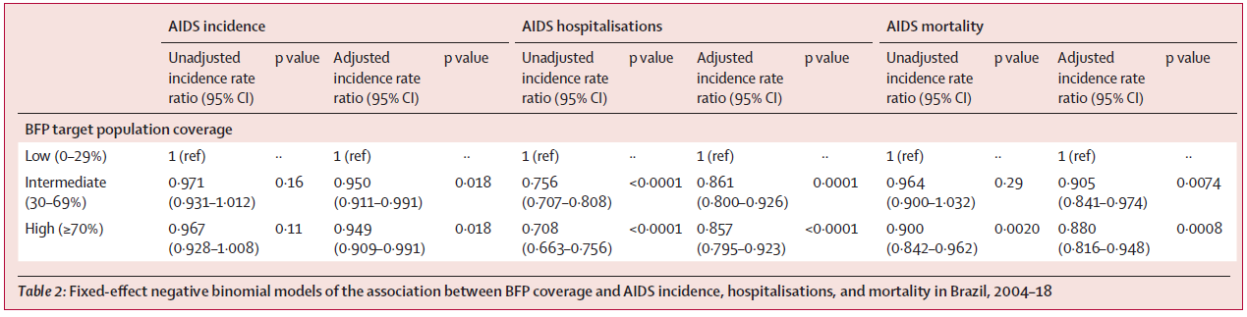

Slide 6
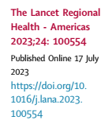
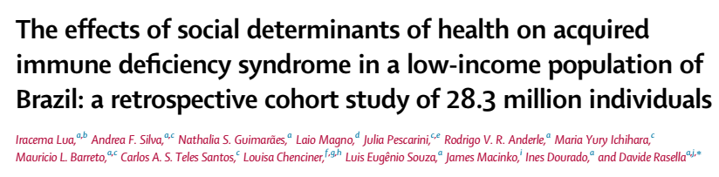
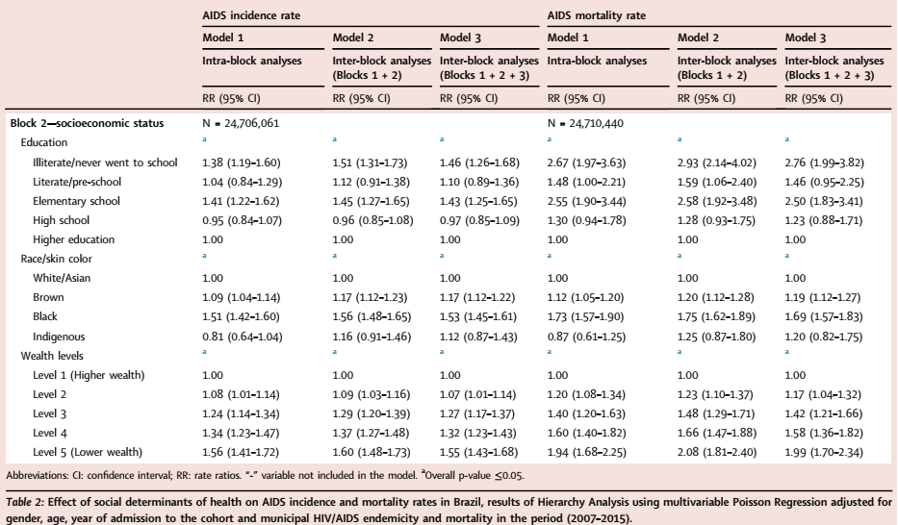

Slide 7
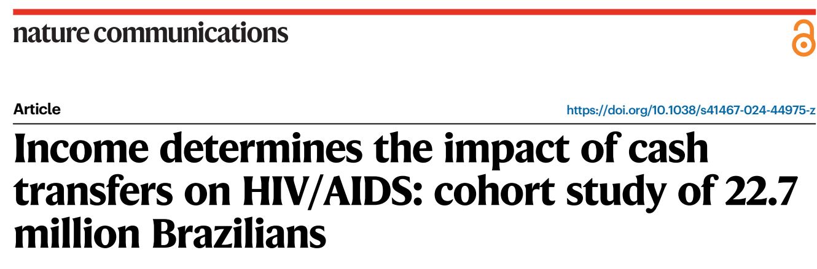
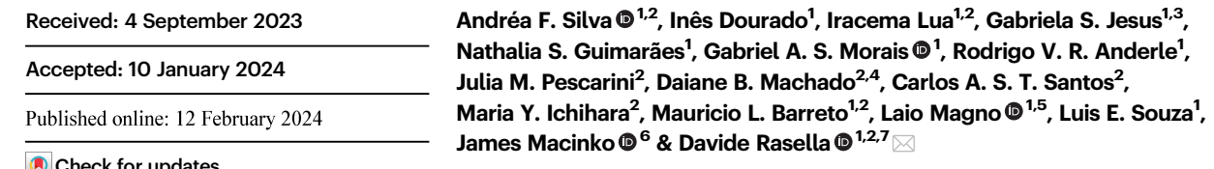
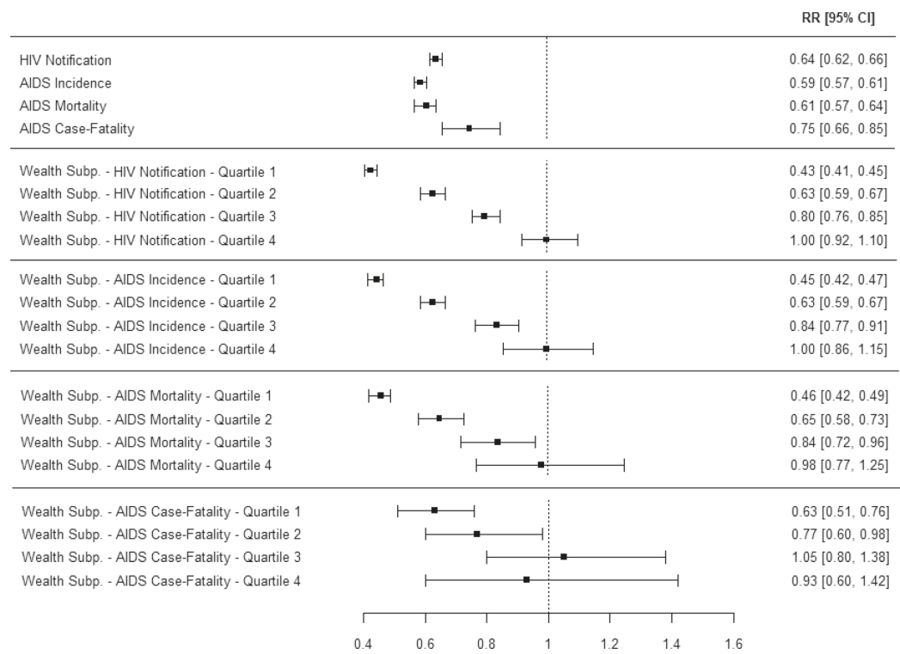




Slide 8
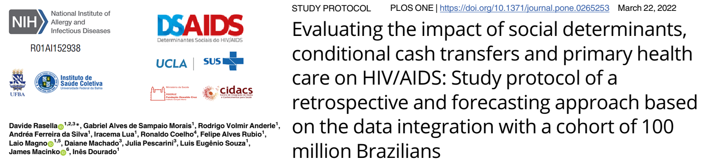
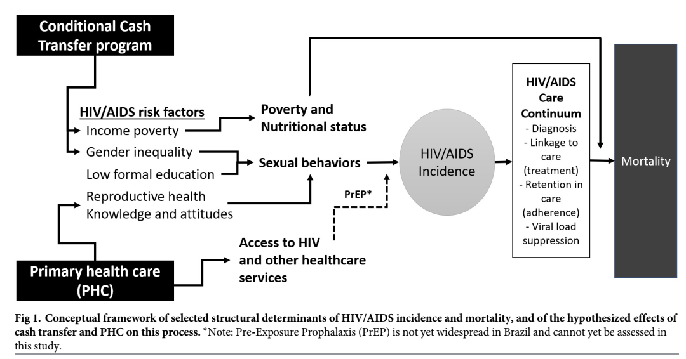
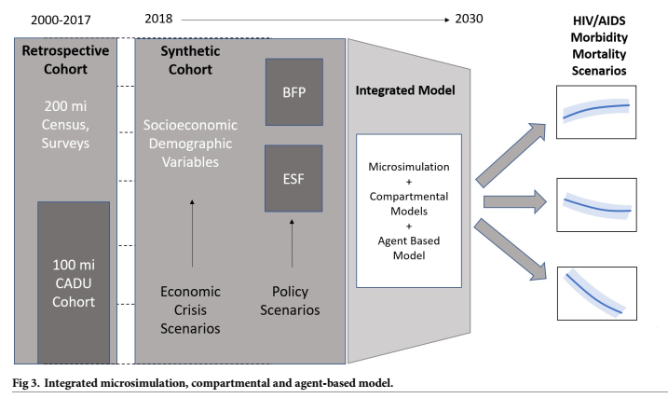

Slide 9
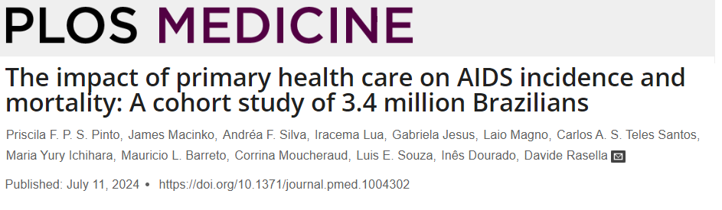
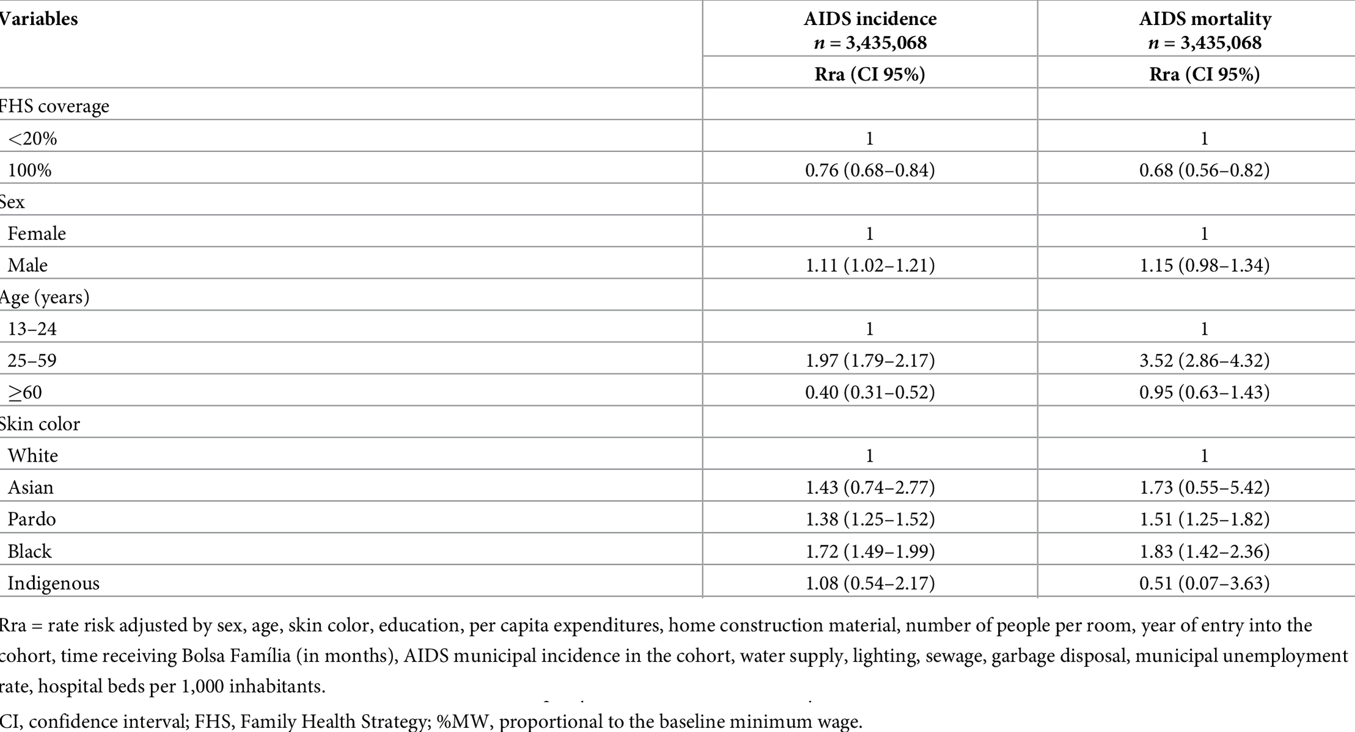

Slide 10

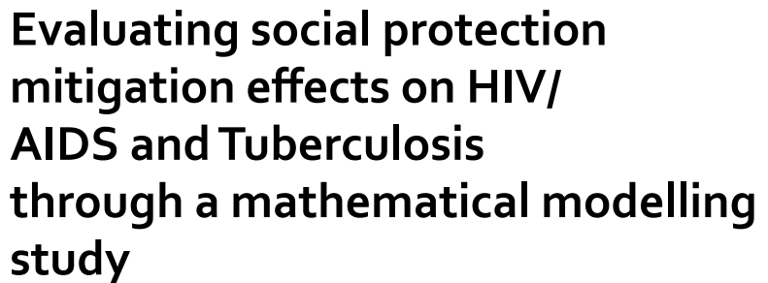
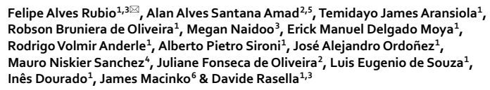
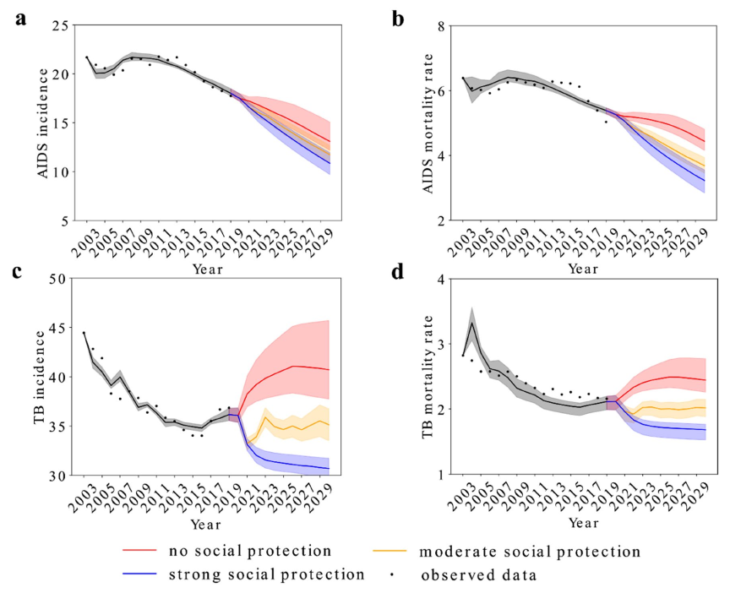
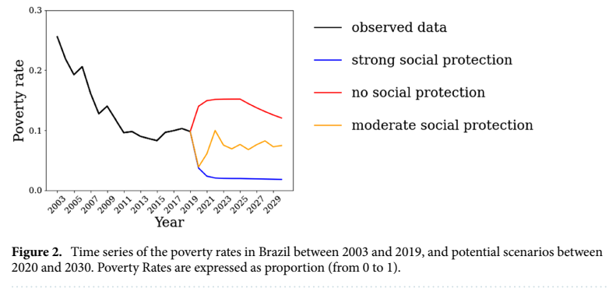
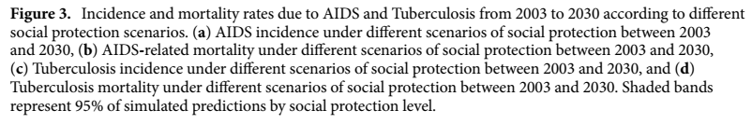

Slide 11
Conclusion
Poverty-reduction policies such as Conditional Cash Transfers should be considered essential interventions to significantly reduce morbidity and mortality from HIV/AIDS in the most vulnerable populations
Interventions addressing other Social Determinants of Health should also be effective
The expansion of Primary Health Care could contribute to the reduction of morbidity and mortality from HIV/AIDS

Slide 12
Thanks!
davide.rasella@gmail.com

