Slide 1
Implementation Science in Clinical Trials
Time to Accelerate the Science
Maggie Czarnogorski, MD, MPH
Head, Digital Innovation & Implementation Science
ViiV Healthcare
NP-GBL-HVX-PPT-240024, July 2024

Slide 2


Slide 3


Search for remission
and cure
ViiV portfolio
Pioneers in innovation¹
First LA injectable for PrEP⁸
cabotegravir
First complete LA
treatment regimen¹
cabotegravir + rilpivirine
First attachment inhibitor for HTE⁷
fostemsavir
First approved 2DRs^{5,6}
dolutegravir/lamivudine
dolutegravir/rilpivirine
First second-generation INSTI⁴
dolutegravir
dolutegravir/abacavir/lamivudine
First INSTI-based FDC for Infants
and Children^{9†}
cabotegravir *
Legacy ARV drug portfolio^{1,2,3}
zidovudine, abacavir,
lamivudine, maraviroc
*Potential new medicines not currently approved for prescription; †6 Kg or greater¹⁵
GSK. ViiV Healthcare meet the management: Getting ahead of HIV together, 2023. https://www.gsk.com/media/10566/gsk_viiv-mtm_getting-ahead-of-hiv-together_20230928.pdf. Accessed March 20
GSK. ViiV Healthcare launches: A new specialist HIV company dedicated to delivering advances in HIV treatment and care, 2009. Available at: https://www.gsk.com/en-gb/media/press-releases/viiv-healthcare-launches-a-new-specialist-hiv-company-dedicated-to-delivering-advances-in-hiv-treatment-and-care/. Accessed June 2024
Aidsmap. Zidovudine 2021. Available at: https://www.aidsmap.com/about-hiv/arv-background-information/zidovudine. Accessed March 2024
Dow DE, et al. Infect Dis Ther 2014;3:83–102
FDA press release. FDA approves first two-drug complete regimen for HIV-infected patients who have never received antiretroviral treatment, 2019. Available at: https://www.fda.gov/news-events/press-announcements/fda-approves-first-two-drug-complete-regimen-hiv-infected-patients-who-have-never-received. Accessed June 2024
FDA press release. FDA approves first two-drug regimen for certain patients with HIV, 2017 https://www.fda.gov/news-events/press-announcements/fda-approves-first-two-drug-regimen-certain-patients-hiv. Accessed June 2024
Chahine EB. Am J Health Sys Pharm 2021;78:376–88
FDA Cross-Discipline Team Leader Review. FDA approves first injectable treatment for HIV pre-exposure prevention, 2021. Available at: https://www.fda.gov/media/158566/download. Accessed June 2024
FDA press release. NDA 215413 & NDA 2055551 S-28, 2022. Available at: https://www.fda.gov/news-events/press-announcements/fda-approves-first-injectable-treatment-hiv-pre-exposure-prevention. Accessed June 2024
3
3
Notes:
Voiceover:
ViiV’s mission has always been to leave no person living with HIV behind, and a pivotal part of that mission is ensuring that children, a population that has historically fallen behind, have access to these innovations.
At AIDS, we shared data through our partnerships, on expanded dosing of DTG to neonates in IMPAACT 2023, viral suppression rates of 90%, low overall viral failure rates, and good safety outcomes with DTG-based therapy through 192 weeks among children and adolescents in the EPPICC cohort⁹. We also presented 48-week data from IMPAACT 2017 for CAB/RPV LAI that demonstrated safety and good PK in adolescents with strong participant preference for injectables¹⁶.
With regards to our pipeline, we unveiled for the first time, data from our pipeline on 4 compounds we have been working on. We have been looking for new ways to extend the dosing interval of CAB, and we shared pre-clinical data on our prodrug for cabotegravir, VH-310, which has ultra-long acting potential for twice yearly dosing.¹¹ We also presented the in vitro resistance profile and first time in human data on VH-184, a third generation INSTI, which I will share more of on the next slide¹²
And while our development strategy is founded on INSTIs at the core, we are actively looking for the best possible companion medicine to pair that with. At AIDS, we presented 3 posters on the virology and FTIH data on 2 of our long-acting capsid inhibitors, VH-280 and VH-499, that are under investigation as partner agents.^{13,14}
Slide References:
GSK. ViiV Healthcare meet the management: Getting ahead of HIV together, 2023. Available at: https://www.gsk.com/media/10566/gsk_viiv-mtm_getting-ahead-of-hiv-together_20230928.pdf. Accessed March 2024
GSK. ViiV Healthcare launches: A new specialist HIV company dedicated to delivering advances in HIV treatment and care, 2009. Available at: https://www.gsk.com/en-gb/media/press-releases/viiv-healthcare-launches-a-new-specialist-hiv-company-dedicated-to-delivering-advances-in-hiv-treatment-and-care/. Accessed June 2024
Aidsmap. Zidovudine 2021. Available at: https://www.aidsmap.com/about-hiv/arv-background-information/zidovudine. Accessed March 2024
Dow DE, Bartlett JA. Dolutegravir, the Second-Generation of Integrase Strand Transfer Inhibitors (INSTIs) for the Treatment of HIV. Infect Dis Ther. 2014 Dec;3(2):83-102. doi: 10.1007/s40121-014-0029-7. Epub 2014 Jun 24. PMID: 25134686; PMCID: PMC4269626.
FDA press release. FDA approves first two-drug complete regimen for HIV-infected patients who have never received antiretroviral treatment, 2019. Available at: https://www.fda.gov/news-events/press-announcements/fda-approves-first-two-drug-complete-regimen-hiv-infected-patients-who-have-never-received. Accessed June 2024
FDA press release. FDA approves first two-drug regimen for certain patients with HIV, 2017 https://www.fda.gov/news-events/press-announcements/fda-approves-first-two-drug-regimen-certain-patients-hiv. Accessed June 2024
Chahine EB. Am J Health Sys Pharm 2021;78:376–88
FDA Cross-Discipline Team Leader Review. FDA approves first injectable treatment for HIV pre-exposure prevention, 2021. Available at: https://www.fda.gov/media/158566/download Accessed June 2024
FDA press release. NDA 215413 & NDA 2055551 S-28, 2022. Available at: https://www.fda.gov/news-events/press-announcements/fda-approves-first-injectable-treatment-hiv-pre-exposure-prevention. Accessed June 2024
Scott K, et al. AIDS 2024. Abstract XX
Baker M, et al. AIDS 2024. Abstract XX
Rogg L, et al. AIDS 2024. Abstract XX
Griesel R, et al. AIDS 2024. Abstract XX
Thakkar N, et al. AIDS 2024. Abstract XX
Triumeq PD US Prescribing Information April 2024
Gaur A, et al. AIDS 2024. Abstract xx

Slide 4

implementation Science: translating scientific discoveries into public health action
It takes an average of 17 years for original discoveries to be integrated into clinical practice¹
Failure to translate research findings into clinical practice means:
  30–40% patients do not get treatments of proven effectiveness in a timely manner²
  20–25% patients get care that is not needed or potentially harmful²
It takes disproportionately longer in developing countries
Research
Health delivery
systems
Efficacious life-saving interventions are hard to get into health delivery systems
Efficacious life-saving interventions are hard to get into health delivery systems
1. Morris Z, et al. JR Soc Med 2011;104:510–20
2. Fischer F, et al. Healthcare (Basel) 2016;4:36
4
Notes:
A major issue in improving public health is that promising research findings are often difficult to get into health delivery systems. [Read slide points as they come onto the screen.]
Additional notes:
Interventions can fail to translate between settings for a multitude of reasons including:¹
High out-of-pocket costs or lack of convenient facilities
Socioeconomic or gender discrimination
Cultural values and preferences
Implementation issues can also arise from outside the health system, as a result of contextual factors that may not have been considered by policy makers and health system managers.¹
References:
1. USAID (2015) Idea to Impact: A Guide to Introduction and Scale of Global Health Innovations
Chahine EB. Am J Health Sys Pharm 2021;78:376–88:
Chahine EB. Fostemsavir: The first oral attachment inhibitor for treatment of HIV-1 infection. Am J Health Syst Pharm. 2021 Feb 19;78(5):376-388. doi: 10.1093/ajhp/zxaa416. PMID: 33547469.
Morris Z, et al. JR Soc Med 2011;104:510 20:
Morris, Z. S., Wooding, S., & Grant, J. (2011). The answer is 17 years, what is the question: understanding time lags in translational research. Journal of the royal society of medicine, 104(12), 510-520.

Slide 5
RESEARCH TO PRACTiCE PiPELiNE
Adoption of interventions into practice:^{1,2}
  Begins with efficacy studies
  Progresses to effectiveness studies
  Then to implementation and dissemination research studies
Implementation research
Pre-clinical
research
Safety
research
Efficacy
research
Effectiveness
research
Dissemination research
Improved public health
These types of research differ in both the research questions they seek to answer and their designs
1. Adapted from: Westfall J, et al. JAMA 2007;297:403–6
2. Adapted from: Curran GMM, et al. Med Care 2012;50:217–26
5
Notes:
Given implementation research is a fairly new field, there are often questions about where this type of work fits into the traditional medical research to practice pipeline. This image shows the research to practice pipeline and includes implementation research. Research typically starts with pre-clinical research that informs efficacy research. When an intervention is found to be efficacious, it is taken out of the lab and studied in more real world settings during effectiveness research. Traditionally, once effectiveness in the real world is demonstrated, implementation studies occur, ultimately ending with improvement in public health outcomes. These are all important research areas AND they all differ in the type of question they can answer and how they are designed.
From training deck:
NX-GBL-HVX-PPT-230021, October 2023
References:
Adapted from: Westfall J, et al. JAMA 2007;297:403 6
Westfall, J. M., Mold, J., & Fagnan, L. (2007). Practice-based research—“Blue Highways” on the NIH roadmap. Jama, 297(4), 403-406.
Adapted from: Curran GMM, et al. Med Care 2012;50:217 26
Curran, G. M., Bauer, M., Mittman, B., Pyne, J. M., & Stetler, C. (2012). Effectiveness-implementation hybrid designs: combining elements of clinical effectiveness and implementation research to enhance public health impact. Medical care, 50(3), 217-226.

Slide 6
Bringing implementation research forward through hybrid study designs
Randomised Clinical
Trials (RCTs)
RCTs are experimental clinical studies where participants are randomly assigned to intervention groups OR a control group and followed over a predetermined amount of time. There are several types of study types to bring the implementation research component forward into our traditional RCTs, including:
  Effectiveness-implementation hybrid design
  A design that allows for a focus on both clinical effectiveness and implementation
Type I
Type II
Type III
Effectiveness
Implementation
Curran GM, et al. Med Care 2012;50:217–26
6
Notes:
Randomized control trials (RCTs) are a common design and are [read definition]
[Click]
Effectiveness-implementation hybrid designs are a group of designs that have been more recently operationalized are a very efficient when wanting to examine both clinical effectiveness and implementation in the same study. There are three type of Hybrids:
Type one is about 80% focused on effectiveness and 20% focused on implementation or even pre-implementation
Type 2 is split between effectiveness and implementation about 50/50
And type 3 is about 20 focused on effectiveness and 80% focused on implementation
References:
Curran GM, et al. Med Care 2012;50:217-226
Curran, G. M., Bauer, M., Mittman, B., Pyne, J. M., & Stetler, C. (2012). Effectiveness-implementation hybrid designs: combining elements of clinical effectiveness and implementation research to enhance public health impact. Medical care, 50(3), 217-226.

Slide 7
how do the different effectiveness-implementation hybrid studies fit within the research pipeline?^{1,2}
Effectiveness-implementation hybrid studies span the effectiveness and implementation studies stages of the traditional research pipeline^{1–3}
Hybrid Type 2
Hybrid Type 1
Hybrid Type 3
Implementation research
Pre-clinical
research
Safety
research
Efficacy
research
Effectiveness
research
Dissemination research
1. Curran GM, et al. Med Care 2012;50:217–226; 2. Adapted from: Liem A, et al. Implement Sci Commun 2020;1:96; 3. Landes S, et al. Psychiatry Res 2019;280:112513
7
Notes:
References:
Curran GM, et al. Med Care 2012;50:217-226
Curran, G. M., Bauer, M., Mittman, B., Pyne, J. M., & Stetler, C. (2012). Effectiveness-implementation hybrid designs: combining elements of clinical effectiveness and implementation research to enhance public health impact. Medical care, 50(3), 217-226.
Adapted from: Liem A, et al. Implement Sci Commun 2020;1:96;
Liem, A., Garabiles, M. R., Pakingan, K. A., Chen, W., Lam, A. I. F., Burchert, S., & Hall, B. J. (2020). A digital mental health intervention to reduce depressive symptoms among overseas Filipino workers: protocol for a pilot hybrid type 1 effectiveness-implementation randomized controlled trial. Implementation science communications, 1, 1-16.
Landes S, et al. Psychiatry Res 2019;280:112513
Landes SJ, McBain SA, Curran GM. An introduction to effectiveness-implementation hybrid designs. Psychiatry Res. 2019 Oct;280:112513. doi: 10.1016/j.psychres.2019.112513. Epub 2019 Aug 9. PMID: 31434011; PMCID: PMC6779135.

Slide 8

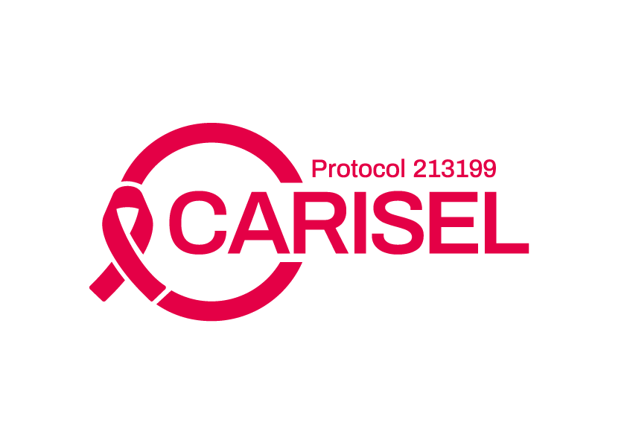










Viiv’s implementation science Research Portfolio
S T U D I E S
CATALYST
SEARCH
Mobile Men (COMBINE APP)
ImPrEP
LAPIS
AXIS
IDCAPP
AURORA
TIARAS
ALADDIN
HOLA
IMADART
ILANA
WW (CREATE)
IM-CAPABLE
Project Tara
LYFT
I-TRAINS
CHEEKY
MUSC
UCSF (LAI-ART)
HUDDLE(CHORUS)
PILLAR
EBONI
PHASE 2
PHASE 3
PHASE 4
PHASE 4 – SUPPORTED
(via ViiV Investigator-Sponsored Research Program)
CclinicalTrails.gov number or reference:
EMBRACE (NCT05996471); CUSTOMIZE (NCT04001803); CARISEL (NCT04399551); VOLITION (NCT05917509); VOGUE (NCT05979311); EYEWITNESS (NCT05911360); GLACIER (NCT04982445); PILLAR (NCT05374525); EBONI (NCT05514509); CATALYST (NCT05937698); SEARCH (NCT05549726); Mobile Men (NCT06205368); ImPrEP (NCT05674682, NCT03642314); LAPIS (NCT06250504); AXIS (NCT06138600); IDCAPP (NCT05867212); AURORA (NCT06072443); TIARAS (NCT05192434); ALADDIN (NCT06468995); HOLA (NCT06185452); IMADART (NCT06159894); ILANA (NCT05294159); WW (NCT06062979); IM-CAPABLE (NCT06451341); Project Tara (NCT06411223); LYFT (Harrison S et. al., Continuum 2024, Oral 1018.); I-TRAINS (NCT04973254); CHEEKY (NCT05979714); MUSC (Meissner et. al., ID Week 2023, Abstract 1027) UCSF (NCT05152953); HUDDLE (NCT04863261);
8
Notes:
References:
EMBRACE (NCT05996471)
https://clinicaltrials.gov/study/NCT05996471?term=NCT05996471&rank=1
CUSTOMIZE (NCT04001803);
https://clinicaltrials.gov/study/NCT04001803?term=NCT04001803&rank=1
CARISEL (NCT04399551);
https://clinicaltrials.gov/study/NCT04399551?term=NCT04399551&rank=1
VOLITION (NCT05917509);
https://clinicaltrials.gov/study/NCT05917509?term=NCT05917509&rank=1
VOGUE (NCT05979311);
https://clinicaltrials.gov/study/NCT05979311?term=NCT05979311&rank=1
EYEWITNESS (NCT05911360);
https://clinicaltrials.gov/study/NCT05911360?term=NCT05911360&rank=1
GLACIER (NCT04982445)
https://clinicaltrials.gov/study/NCT04982445?term=NCT04982445&rank=1
PILLAR (NCT05374525);
https://clinicaltrials.gov/study/NCT05374525?term=NCT05374525&rank=1
EBONI (NCT05514509);
https://clinicaltrials.gov/study/NCT05514509?term=NCT05514509&rank=1
CATALYST (NCT05937698);
https://clinicaltrials.gov/study/NCT05937698?term=NCT05937698&rank=1
SEARCH (NCT05549726);
https://clinicaltrials.gov/study/ NCT05549726?term= NCT05549726&rank=1
Mobile Men (NCT06205368);
https://clinicaltrials.gov/study/NCT06205368?term=NCT06205368&rank=1
ImPrEP (NCT05674682, NCT03642314);
https://clinicaltrials.gov/study/NCT05674682?term=NCT05674682&rank=1
https://clinicaltrials.gov/study/NCT03642314?term=NCT03642314&rank=1
LAPIS (NCT06250504);
https://clinicaltrials.gov/study/NCT06250504?term=NCT06250504&rank=1
AXIS (NCT06138600);
https://clinicaltrials.gov/study/NCT06138600?term=NCT06138600&rank=1
IDCAPP (NCT05867212);
https://clinicaltrials.gov/study/NCT05867212?term=NCT05867212&rank=1
AURORA (NCT06072443);
https://clinicaltrials.gov/study/NCT06072443?term=NCT06072443&rank=1
TIARAS (NCT05192434);
https://clinicaltrials.gov/study/NCT05192434?term=NCT05192434&rank=1
ALADDIN (NCT06468995);
https://clinicaltrials.gov/study/NCT06468995?term=NCT06468995&rank=1
HOLA (NCT06185452);
https://clinicaltrials.gov/study/NCT06185452?term=NCT06185452&rank=1
IMADART (NCT06159894);
https://clinicaltrials.gov/study/NCT06159894?term=NCT06159894&rank=1
ILANA (NCT05294159);
https://clinicaltrials.gov/study/NCT05294159?term=NCT05294159&rank=1
WW (NCT06062979);
https://clinicaltrials.gov/study/NCT06062979?term=NCT06062979&rank=1
IM-CAPABLE (NCT06451341);
https://clinicaltrials.gov/study/NCT06451341?term=NCT06451341&rank=1
Project Tara (NCT06411223);
https://clinicaltrials.gov/study/NCT06411223?term=NCT06411223&rank=1
LYFT (Harrison S et. al., Continuum 2024, Oral 1018.);
Harrison S, Hung P, Rudisill C. et al. Effects of a Rideshare Intervention on HIV Care Engagement in South Carolina [1018]. International Association of Providers of AIDS Care - Continuum 2024.June 9th-11th, 2024. Fajardo, Puerto Rico.
I-TRAINS (NCT04973254);
https://clinicaltrials.gov/study/NCT04973254?term=NCT04973254&rank=1
CHEEKY (NCT05979714);
https://clinicaltrials.gov/study/NCT05979714?term=NCT05979714&rank=1
MUSC (Meissner et. al., ID Week 2023, Abstract 1027)
Meissner E, Williams J, Young C, et al. At-Home vs. In-Clinic Receipt of Cabotegravir and Rilpivirine Long-Acting: An Implementation Science Trial [Abstract 1027]. IDWeek, October 11-15 2023, Boston MA
UCSF (NCT05152953);
https://clinicaltrials.gov/study/NCT05152953?term=NCT05152953&rank=1
HUDDLE (NCT04863261);
https://clinicaltrials.gov/study/NCT04863261?term=NCT04863261&rank=1

Slide 9
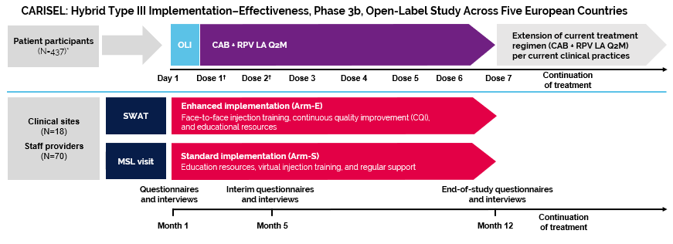
CARISEL: HYBRID Type III, Phase IIIB, Multicenter Implementation study of CAB+RPV LA In EUROPE
Clinical Sites^{1,2,3}
18
Patients¹
437
Staff^{2,3}
70
STUDY AIM^{1,2} | INTERVENTION(S)^{2,3} | PRIMARY OUTCOME(S)^{1,2} | PRIMARY UNIT OF ANALYSIS^{2,3}
Improved implementation of CAB + RPV LA Q2M | Enhanced implementation arm Study treatment injection training Toolkits Skilled-wrap around team meetings Continuous quality improvement calls | Acceptability, appropriateness and feasibility of implementation strategies | Staff and patients
*437 patient participants enrolled, 430 received CAB + RPV LA. †Dose 1 was received at Month 1, Dose 2 at Month 2, with the remaining doses Q2M thereafter.
Arm-E, Enhanced Arm; Arm-S, Standard Arm; CAB, cabotegravir; CQI, continuous quality improvement; LA, long-acting; MSL, medical scientific liaison; OLI, oral lead-in; Q2M, every 2 months; RPV, rilpivirine; SWAT, skilled wrap-around team.
1.Hocqueloux L, et al. EACS 2021. Poster PE2/37
2. Gutner C, et al. EACS 2021. Poster PE2/36
3. Gutner C, et al. EACS 2021. Poster PE2/56
Notes:
Study treatment injection training (prior to first injection)
Toolkits (PLWH/staff participant)
SWAT meeting(s)
CQI calls (monthly)
From training deck: NX-GBL-HVX-PPT-230021, October 2023
References:
Hocqueloux L, et al. EACS 2021. Poster PE2/37
Hocqueloux L, et al. Perspectives on the Acceptability, Appropriateness, Feasibility, Barriers, and Facilitators From Patients Receiving Cabotegravir + Rilpivirine Long-Acting Injectable Treatment (CAB+RPV LA): Interim Results From the Cabotegravir and Rilpivirine Implementation Study in European Locations (CARISEL). Presented at the 18th European AIDS Conference (EACS), October 27-30, 2021, Online & London, United Kingdom. ePoster Presentation.
Gutner C, et al. EACS 2021. Poster PE2/36
Gutner C, et al. Cabotegravir and Rilpivirine Implementation Study in European Locations (CARISEL): Examining Health Care Staff Attitudes During a Hybrid III Implementation-Effectiveness Trial Implementing Cabotegravir + Rilpivirine Long-Acting Injectable (CAB+RPV LA) for People Living With HIV (PLHIV). Presented at the 18th European AIDS Conference (EACS), October 27-30, 2021, Online & London, United Kingdom. ePoster Presentation.
Gutner C, et al. EACS 2021. Poster PE2/56
Gutner C, et al. Healthcare Staff Perspectives on the Implementation of HIV Injectable Treatment: Interim Results From the Cabotegravir and Rilpivirine Implementation Study in European Locations (CARISEL). Presented at the 18th European AIDS Conference (EACS), October 27-30, 2021, Online & London, United Kingdom. ePoster Presentation.

Slide 10







CARISEL: Key Takeaways
STAFF STUDY PARTICIPANTS REPORTED:
PEOPLE LIVING WITH HIV :
    Optimal implementation of CAB + RPV LA within the first 3 months¹ and barriers to implementation of CAB+RPV LA decreased from Months 1 to 12.²
    Most PLWH found clinic wait times to be extremely or very acceptable.⁴
    Clinics should consider 6 things for implementation planning.³
    Approximately 85% of PLWH found every 2-month visits extremely or very acceptable.⁴
    Wide range of PWLH may be appropriate for CAB + RPV LA including those with concerns about disclosing HIV status or experiencing anxiety with daily compliance.²
    Continuous quality improvement calls highlighted that injection training was key.³
    Using techniques like “slow speed of injection” and “ensuring the medication was room temperature” to minimize injection pain.²
¹van Welzen BJ, et al. HIV Glasgow 2022. Poster P069
²Slama L, et al. HIV Glasgow 2022. Poster P116
³Olalla J, et al. BHIVA 2022. Poster 008
⁴Lutz T, et al. HIV Glasgow 2022. Poster P123
All erroneous and missing data were excluded
Notes:
References:
van Welzen BJ, et al. HIV Glasgow 2022. Poster P069
van Welzen BJ, et al. Implementation of cabotegravir and rilpivirine long-acting (CAB+RPV LA): primary results from the CAB+RPV Implementation Study in European Locations (CARISEL). Presented at HIV Glasgow 2022, October 23-26, 2022, Glasgow, UK and virtually.
Slama L, et al. HIV Glasgow 2022. Poster P116
Slama L, et al. Overcoming barriers and achieving optimal implementation of cabotegravir and rilpivirine long-acting (CAB+RPV LA): staff study participant (SSP) results from the CAB+RPV Implementation Study in European Locations (CARISEL). Presented at HIV Glasgow 2022, October 23-26, 2022, Glasgow, UK and virtually.
Olalla J, et al. BHIVA 2022. Poster 008
Olalla J, et al. Top Practices for Implementing Cabotegravir (CAB) and Rilpivirine (RPV) Long-Acting (LA) in European Clinics. Presented at BHIVA 2022, April 20-22, 2022, Manchester, UK. Poster Presentation
Lutz T, et al. HIV Glasgow 2022. Poster P123
Lutz T, et al. Perceptions of cabotegravir and rilpivirine long-acting (CAB+RPV LA) from patients in the CAB+RPV Implementation Study in European Locations (CARISEL). Presented at HIV Glasgow 2022, October 23-26, 2022, Glasgow, UK and virtually. Poster Presentation. (poster only) (poster + author audio)

Slide 11
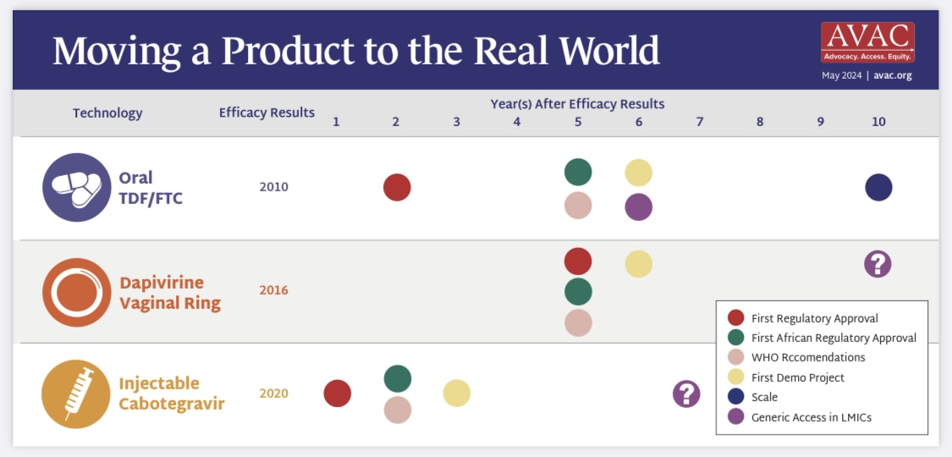
Cross-functional collaboration
A Quarterly Update on HIV Prevention Research. PxWire Volume. 14 Issue No. 2, May 22, 2024.. https://avac.org/resource/pxwire-may2024/.

Slide 12
Summary/Conclusions
Industry is in a unique position to do Hybrid Implementation-Effectiveness Studies to generate implementation data prior to availability of a medicine in the real world.
Collaborations & Partnerships with clinical leaders, policy makers, and global multi-lateral stakeholders are key to success of translating Hybrid Implementation Effectiveness Studies research results into clinical practice.
Implementation Study Results should be disseminated globally. In HIV, context is important but after doing dozens of studies globally – implementation is not very different in diverse parts of the world. Most learnings can be translated and disseminated.
ViiV is leading the world globally in industry-led HIV implementation science research with dozens of studies in various research phases and investment in the next generation of Implementation Researchers - leading the way in how to best implement novel HIV and prevention medicines.

