Slide 1
SMS Text Messaging for Retention:
From Evidence to Practice
OR
“The best way to eat an elephant is to cut him to pieces.” – African proverb
Thomas A. Odeny, MD, MPH, PhD
Assistant Professor of Medicine
Division of Oncology, Washington University in St. Louis
Notes:
Thank you for inviting me to share some of our work about the journey of SMS text messaging for retention in HIV care.

Slide 2
Research funding from Gilead Sciences
DISCLOSURES
Notes:
My disclosures

Slide 3
Text Messaging after Adult Male Circumcision
Improving Uptake of Early Infant Diagnosis of HIV
Texting Improves Testing: a cluster randomized, stepped-wedge trial to improve retention in care
Conclusions
OUTLINE
Notes:
My talk today will include an overview of three projects that highlight the journey we took to develop and scale SMS text messaging interventions to enhance the reach of HIV service delivery by improving engagement in care

Slide 4
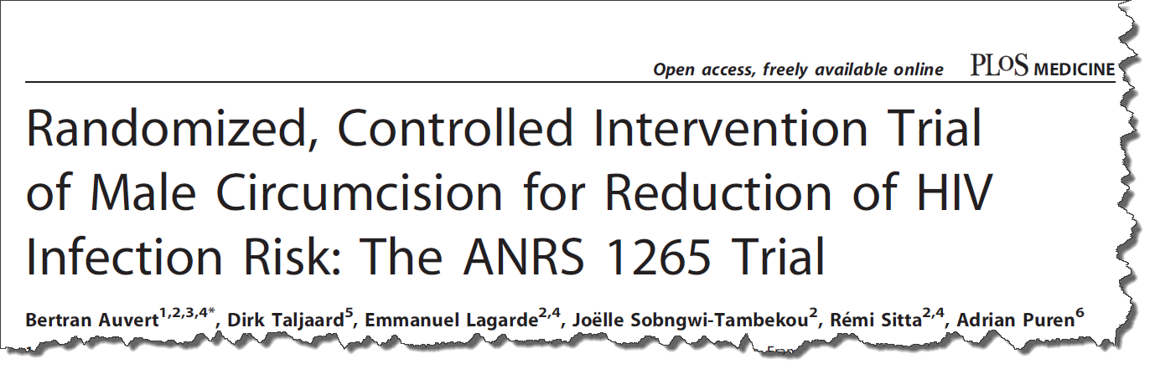
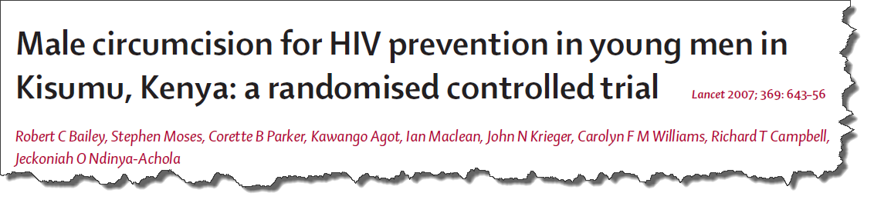
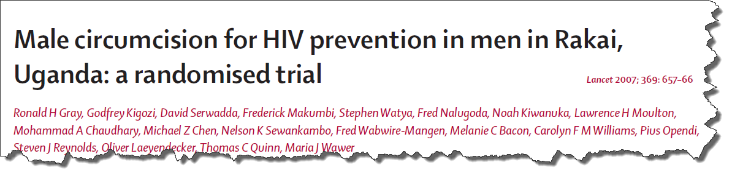
Notes:
In the early 2000s, three large randomized trials provided overwhelming evidence that male circumcision reduces the risk of HIV acquisition by up to 60%
The first one done in Orange Farm, SA, another in Kisumu, Kenya, and the third in Rakai, Uganda

Slide 5
“male circumcision should be considered an efficacious intervention for HIV prevention in countries and regions with heterosexual epidemics, high HIV and low male circumcision prevalence”
- WHO/UNAIDS, March 2007
Notes:
Based on this strong evidence, WHO and UNAIDS convened an expert panel in 2007 that recommended expansion of male circumcision services in regions with high HIV prevalence and low male circumcision prevalence

Slide 6
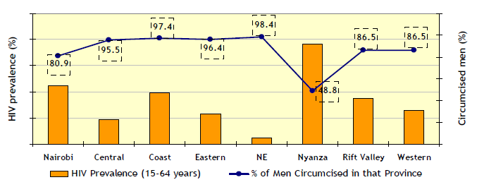
14.9%
8.8%
8.1%
6.3%
3.6%
4.6%
5.4%
0.8%
Notes:
That recommendation applied to Kenya in a special way because overall prevalence of male circumcision in Kenya was high at 85%.

Slide 7
14.9%
8.8%
8.1%
6.3%
3.6%
4.6%
5.4%
0.8%
Nyanza
  Lowest MC (48.8%)
  Highest HIV (14.9%)
Notes:
However, in the region formerly known as the Nyanza province, the setting in which the Kenyan RCT on male circumcision was conducted, only about 48% of men at that time were circumcised in a region with 15% HIV prevalence

Slide 8
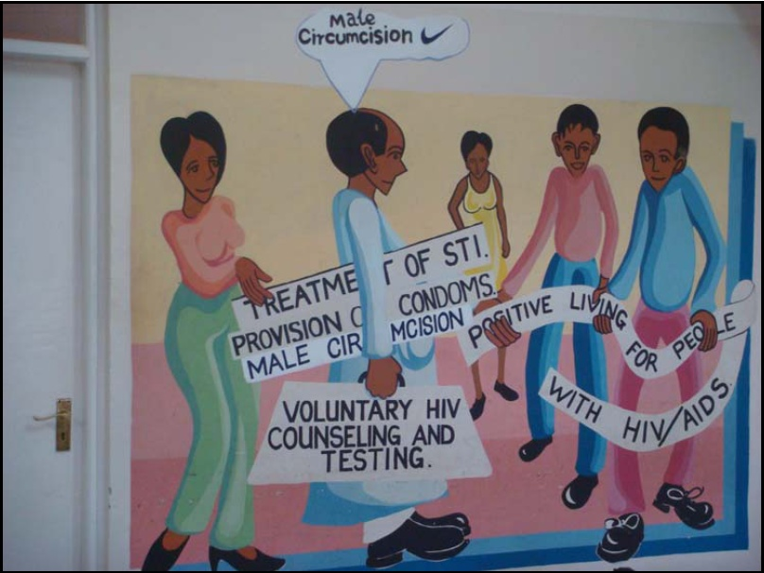
Notes:
And so in Kenya, male circumcision was swiftly added on to the armamentarium for HIV prevention

Slide 9
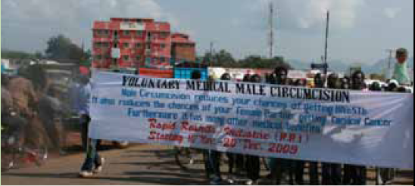
MAR 07
AUG 07
APR 08
NOV 08
JAN 10
JAN 12
MC Policy Approved Kenya MOH
Voluntary Medical Male Circumcision Program Launch
WHO/UNAIDS
Montreux
Luo Council of Elders Consulted
>320,000
> 40,000 men circumcised
Notes:
And in late 2008, the Kenya Ministry of Health launched a Voluntary Medical Male Circumcision program
In just under four years, more than 300,000 men had been circumcised in Kenya under this program – more than in all other SSA countries put together at that time!

Slide 10
Monitor wound healing
DAY 7 FOLLOW-UP
Detect and treat A/Es
Reinforce post-op care
Risk-reduction counseling
Delayed resumption of sex
Notes:
Now, this surgical intervention for HIV prevention required follow up within 7 days of the procedure in order to monitor wound healing, detect & treat A/Es, reinforce post-operative wound care instructions, provide risk-reduction counseling, and also to promote delayed resumption of sex after circumcision

Slide 11
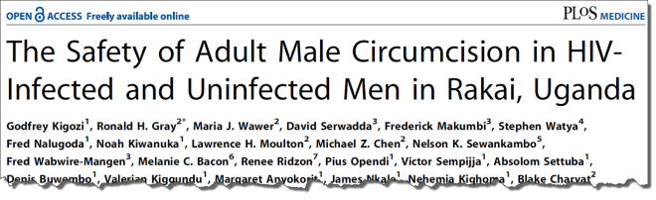
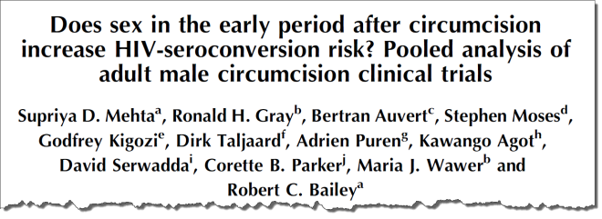
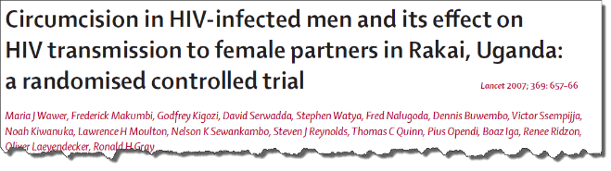
Post-op complications
1
HIV acquisition
2
HIV transmission
3
increased
increased
increased
Notes:
Importantly, early resumption of intercourse after male circumcision is associated with an increased risk of post-operative complications, increased risk for HIV acquisition, and increased risk of HIV transmission

Slide 12

Orange Farm, SA
Kisumu, Kenya
33%
Fail to return for post-op follow-up
57%
Fail to return for post-op follow-up
Notes:
However, return for follow up at the seven day visit was been suboptimal across Africa, with more than half failing to return in Kenya.
And so, thinking about potential ways to address this problem, A LIGHT WENT OF IN OUR HEADS!

Slide 13

Notes:
A LIGHT WENT OF IN OUR HEADS! Aha! Eureka!

Slide 14

Intervention: SMS after MC
Improve attendance at post-op visit
Promote delayed resumption of sex
Notes:
We proposed to send men text messages after circumcision to improve attendance of post-operative clinic visits, as well as reduce early resumption of sex after circumcision

Slide 15

Rationale
Wide coverage: 77% land mass
High access: 63% of Kenyan households
Acceptable: HIV info, ARV adherence
Notes:
We chose SMS in particular because there was high mobile phone coverage in Kenya. More than ¾ of the country is covered by a mobile phone network at the time
Access to mobile phones was high.
And qualitative studies had shown SMS to be acceptable for sending HIV-related information, and promoting antiretroviral adherence

Slide 16

SMS Software
Custom robotic SMS system
Pre-programmed content
Preferred time, language
Notes:
So we developed an automated robotic SMS software with functionality that allowed us to send pre-programmed text messages at any specified time of day, and in any preferred language

Slide 17
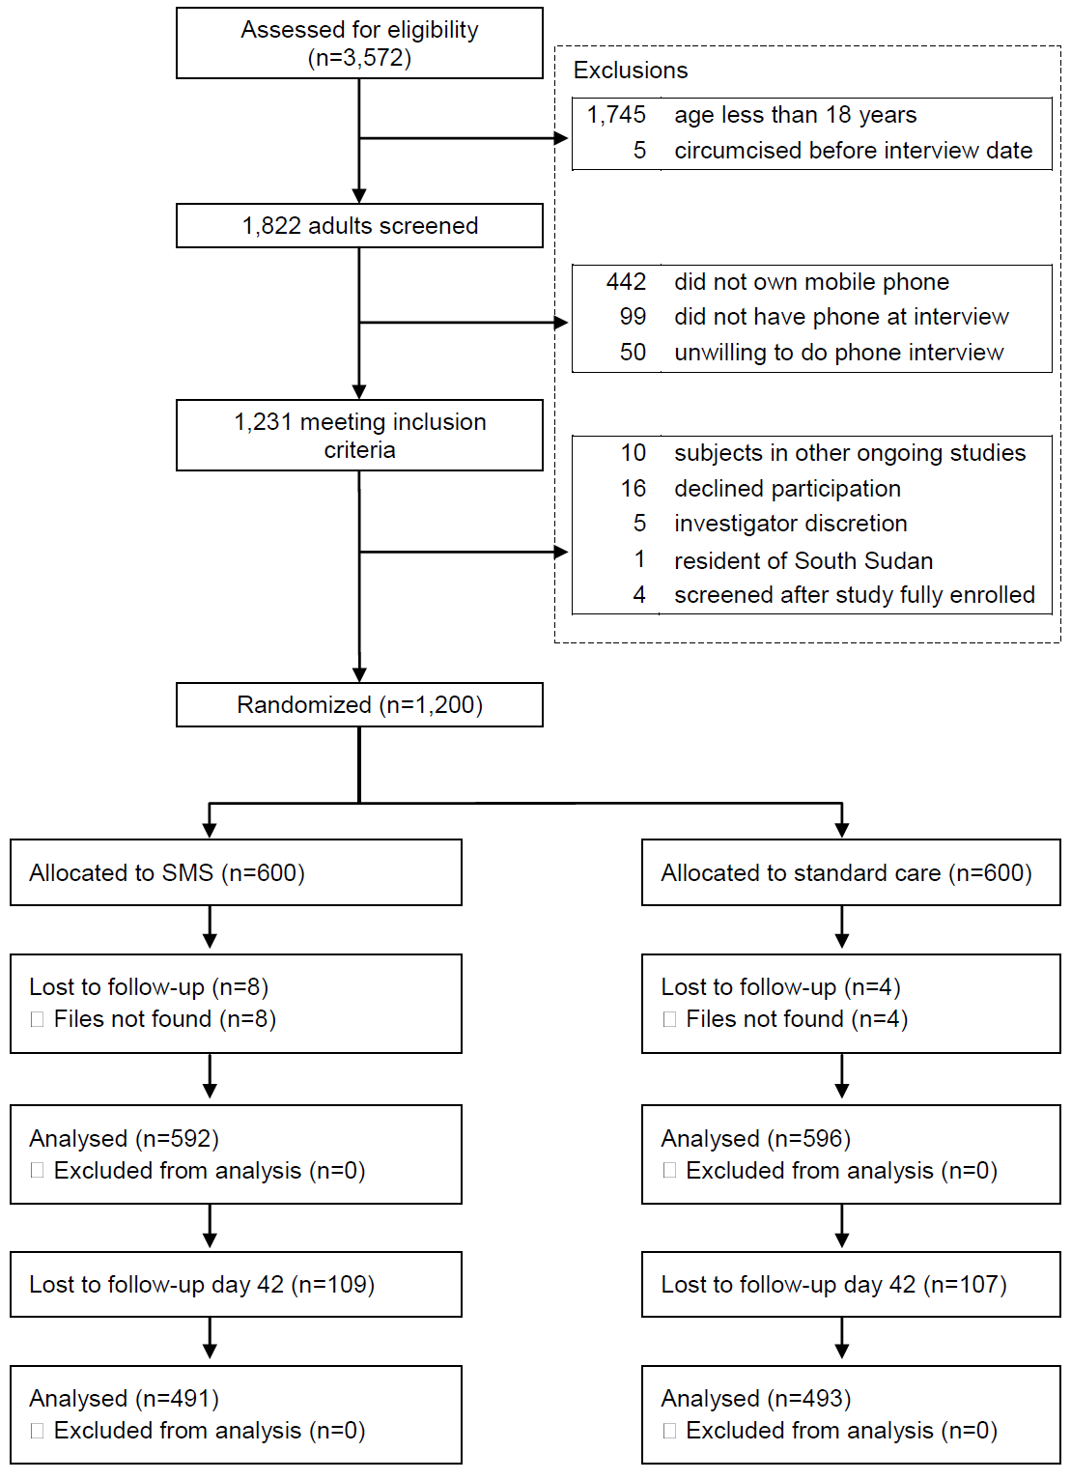
Notes:
We then conducted a randomized trial to compare SMS with standard of care
In this trial, we screened about ~3,500 men and randomly assigned 1,200 men to either the SMS or control groups

Slide 18
Notes:
And followed them up for return to clinic at day 7 and 42 days

Slide 19
 | SMS group | Control group | RR [95% CI] | p-value
Return to clinic | 387/592 (65.4%) | 356/596 (59.7%) | 1.09 [1.00-1.20] | 0.04
Resumption of sex | 139/491 (28.3%) | 124/493 (25.2%) | 1.1 [0.91-1.38] | 0.3
Notes:
We found that men who received SMS after circumcision were significantly more likely to return to clinic for follow-up, than those who did not.
The proportion reporting resumption of sex before 42 days did not differ between the SMS and control groups

Slide 20

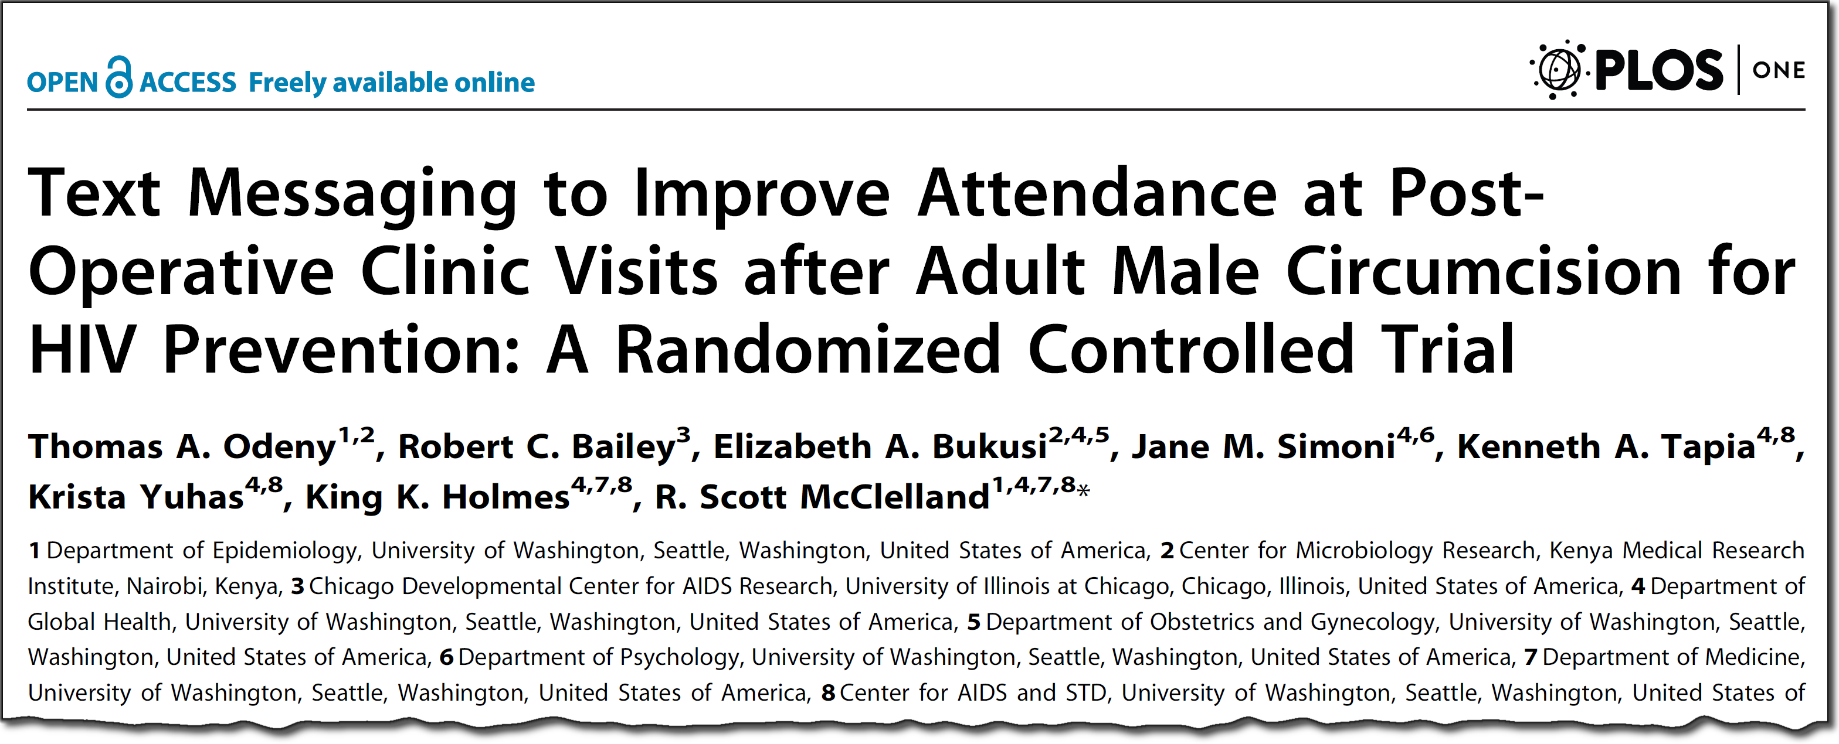

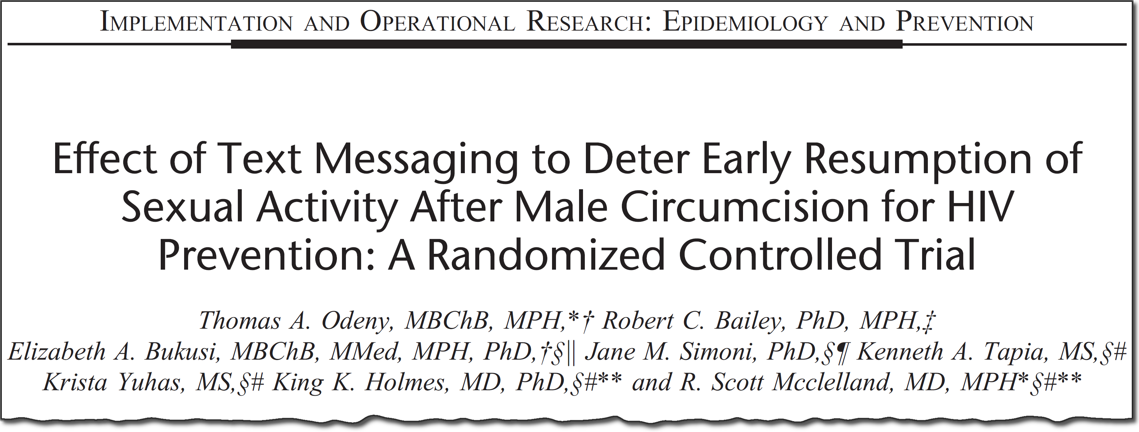
SMS improves clinic attendance after MC for HIV prevention
Notes:
And so, having demonstrated that SMS text messaging significantly improves clinic return for men undergoing male circumcision for HIV prevention, we wanted to leverage this experience and expand the use of this technology for retention in HIV care broadly

Slide 21


SMS improves clinic attendance after MC for HIV prevention
?
Notes:
And so we set to find out if we apply this technology to improve retention in care for pregnant women with HIV and their babies

Slide 22
Text Messaging after Adult Male Circumcision
Improving Uptake of Early Infant Diagnosis of HIV
Texting Improves Testing: a cluster randomized, stepped-wedge trial to improve retention in care
Conclusions
OUTLINE
Notes:
In this second part I will describe how we applied lessons learned from our male circumcision study to improve retention in care for pregnant women with HIV and their children

Slide 23



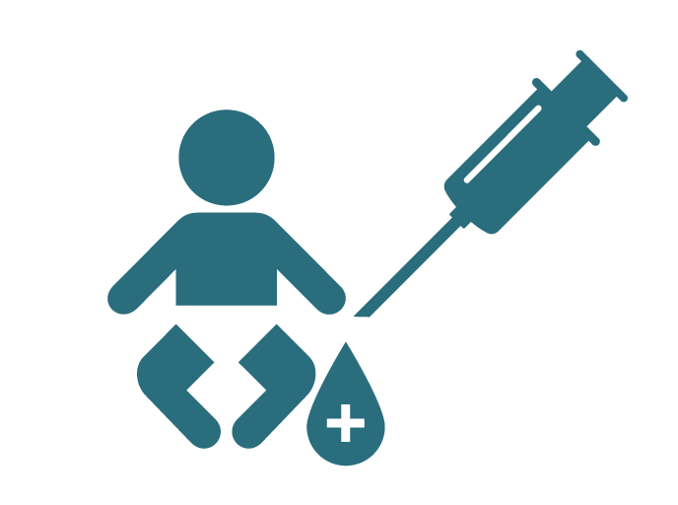


COMPLEXITY OF THE
PMTCT CASCADE
Triple Role Of ART
ART prophylaxis for baby
Early Infant Diagnosis (EID)
Continued follow-up
Notes:
The cascade of preventing mother to child HIV transmission is complex, due to the different and changing needs of the woman and her infant at each step

Slide 24
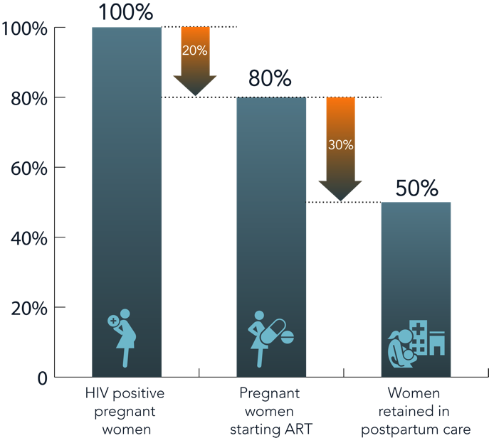
THE CASCADE OF SERVICES For Preventing Mother-to-Child Transmission of HIV
(PMTCT)
Notes:
This complex and often precarious path has resulted in high proportions of loss to follow-up during pregnancy and after delivery among pregnant women with HIV in sub-Saharan Africa

Slide 25
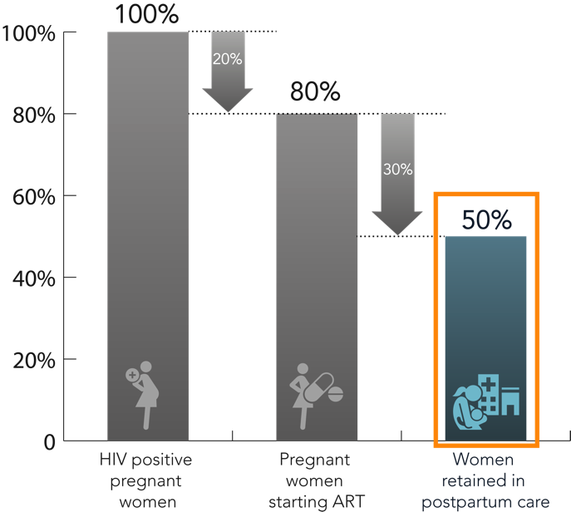
THE CASCADE OF SERVICES For Preventing Mother-to-Child Transmission of HIV
(PMTCT)
Notes:
In 2013, only an estimated 50% of these women were retained in care within 3 months after delivery.

Slide 26
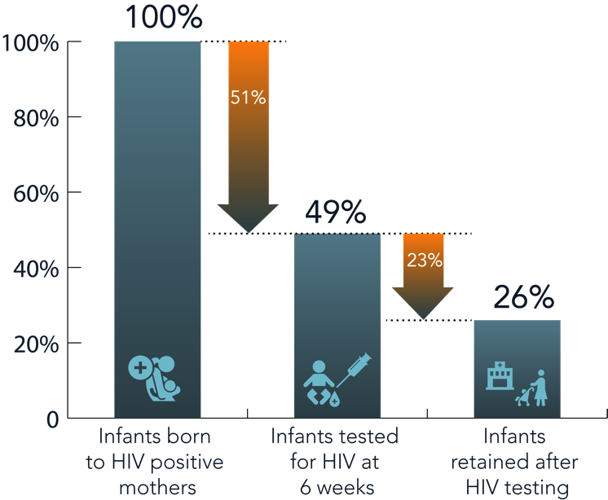
THE CASCADE OF SERVICES For Preventing Mother-to-Child Transmission of HIV
(PMTCT)
Notes:
Similar drop-offs were observed for infants born to these women

Slide 27
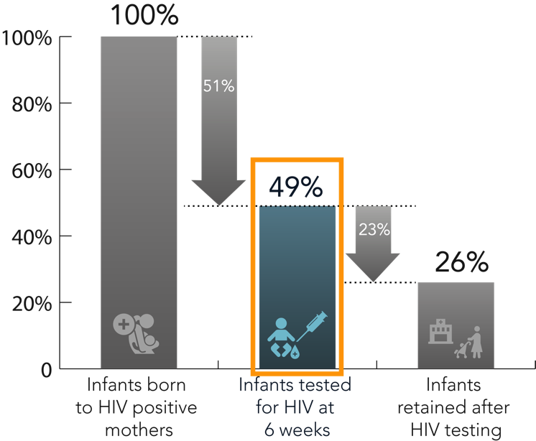
THE CASCADE OF SERVICES For Preventing Mother-to-Child Transmission of HIV
(PMTCT)
Notes:
For example, only 49% of infants born to these women were tested for HIV at the recommended 6 weeks, and even fewer remained in care after HIV testing

Slide 28


EFFECT OF THIS
COMPLEX
CASCADE
50%
of untreated infants die within 1 year
Notes:
Unfortunately, HIV-positive children who are not identified through testing will remain untreated. Left untreated, 50% of HIV-infected children die in the first year of life.

Slide 29

CLOSING THE
RETE NTION
: mHealth
GAP
EVIDENCE
That mHealth interventions can improve retention
Notes:
So from our previous work and that of others there was emerging evidence that mobile phone technology for health, or mHealth, could play an important role in bridging the retention gaps in PMTCT

Slide 30
Stages of translational epidemiology (adapted from Khoury et al.)
Discovery
(T0 – T1)
Development
(T2)
Delivery
(T3)
Population Health
(T4)
Characterize and describe intervention
Assess efficacy of intervention using observational and experimental studies
Implementation science to assess dissemination into practice
Assess effectiveness of intervention on population-level outcomes
Mapping the TextIT strategy onto the stages of translational epidemiology
Discovery
(T0 – T1)
Development
(T2)
Delivery
(T3)
Population Health
(T4)
Theory-based SMS developed from formative qualitative studies (focus groups, motivational interviews)
RCT to demonstrate efficacy of theory-based SMS (TextIT); Parallel-cohort RCT to assess potential for facility-level dissemination
Cluster-randomized stepped-wedge trial to show real-world effectiveness of TextIT; Implement with fidelity; SOPs, training guides, checklists;
Public health impact evaluation of TextIT
Notes:
For this study, we wanted to follow a more systematic approach to scale up, so we mapped out our next steps onto the stages of translational epidemiology
These stages begin with the discovery stage of T0-T1 where an intervention is characterized and described.

Slide 31


THEORY-BASED, INDIVIDUALLY TAILORED
TWO-WAY SMS
Promote postpartum retention in PMTCT
Increase uptake of infant HIV virologic testing
Notes:
So we used qualitative research methods to co-design a theory-based, individually-tailored two-way text messaging intervention to improve retention in postpartum care, as well as increase uptake of infant HIV testing at 6 weeks

Slide 32
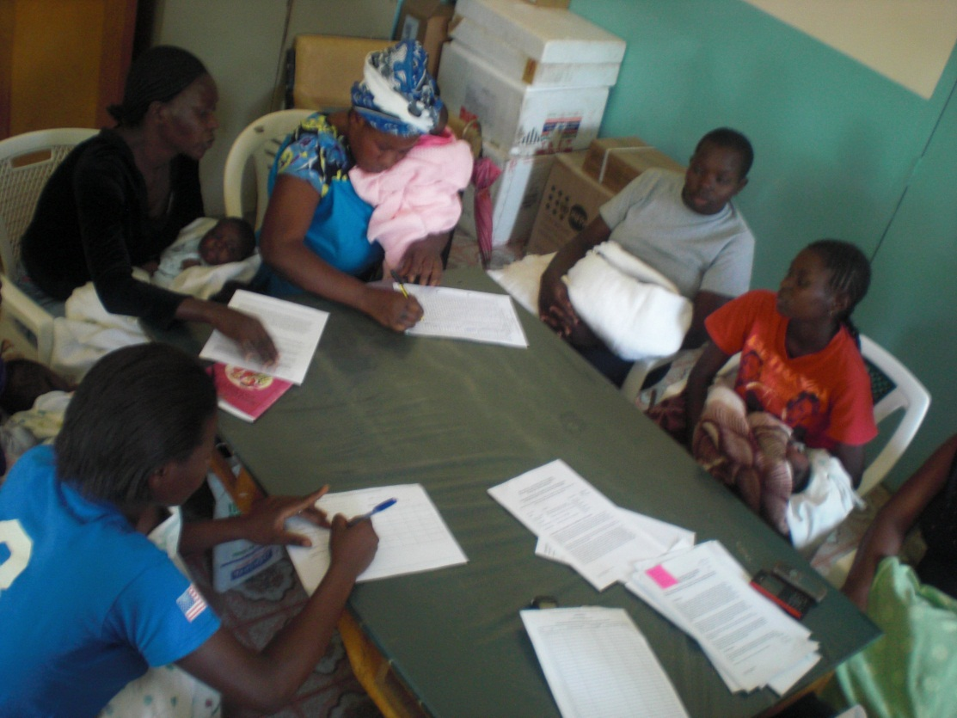
Co-Design of Intervention SMS
Focus Group Discussions:
  Health Workers
  ANC clients
  PMTCT clients
  PNC clients
Notes:
One lesson we learned from our male circumcision study was the importance of intervention co-design
In the male circumcision study, post-intervention interviews suggested that the lack of involvement of patients in design of the intervention likely contributed to the lack of efficacy of SMS for delaying early resumption of sex after circumcision

Slide 33
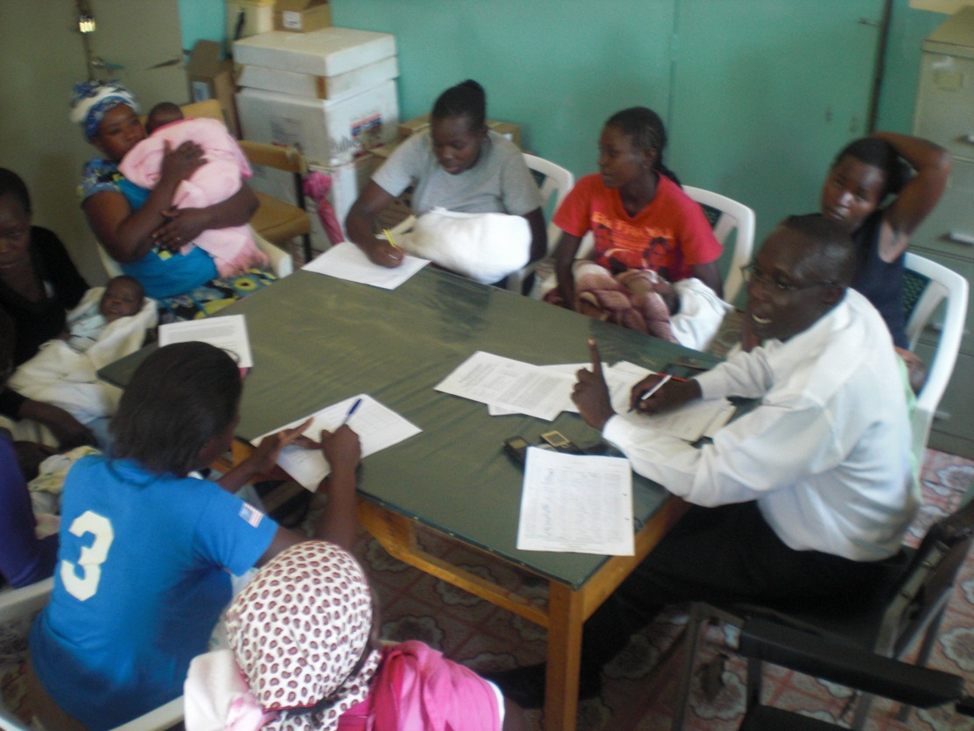
Co-Design of Intervention SMS
Focus Group Discussions:
  SMS content
  Frequency
  Timing
Notes:
So, based on those findings, we used theory-based focus groups to co-design a new SMS intervention

Slide 34
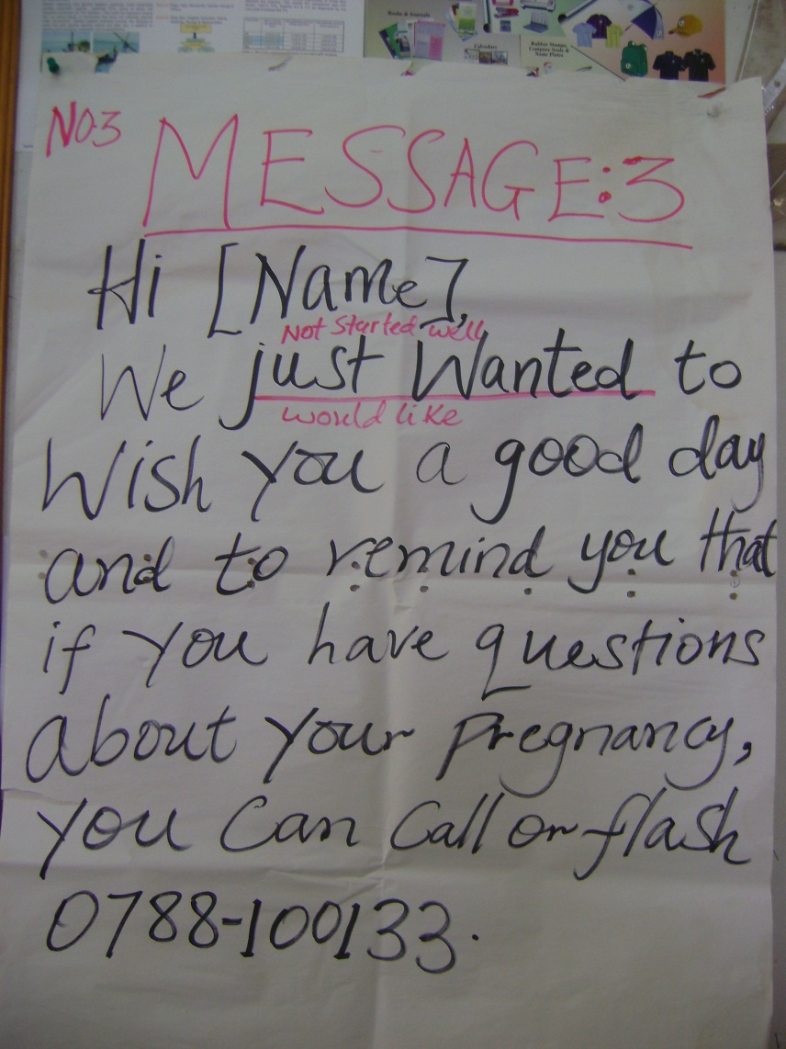
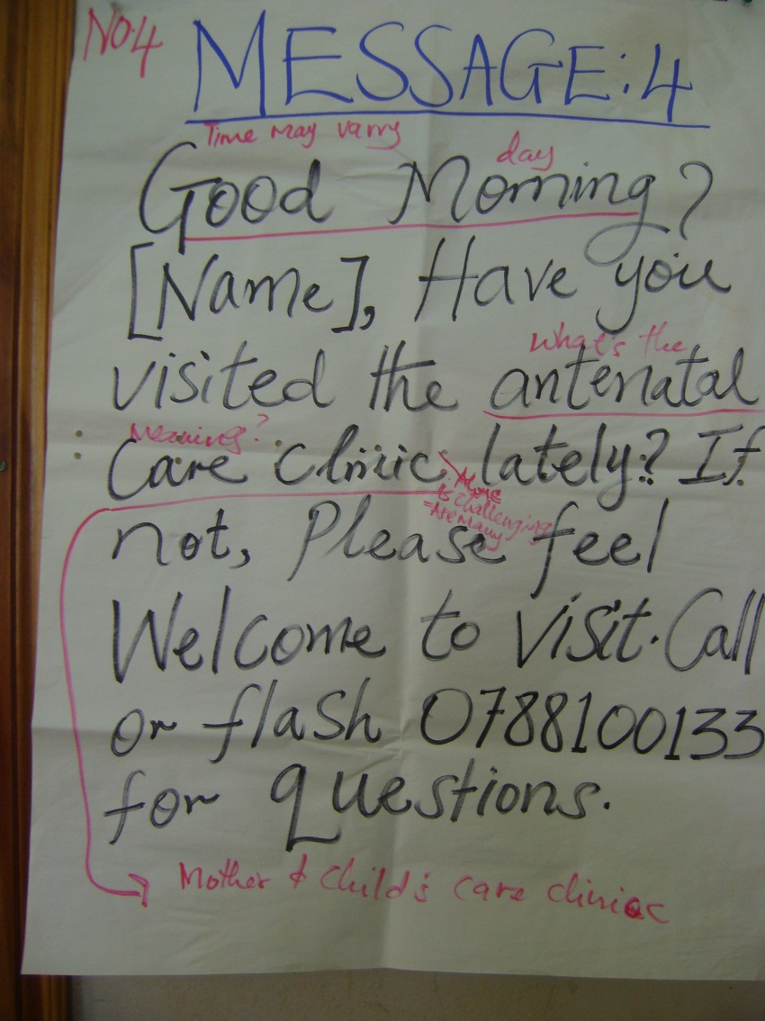
Pilot of Intervention SMS
Notes:
Following the focus groups, we conducted rapidly iterative human-centered design sessions to refine the message content

Slide 35
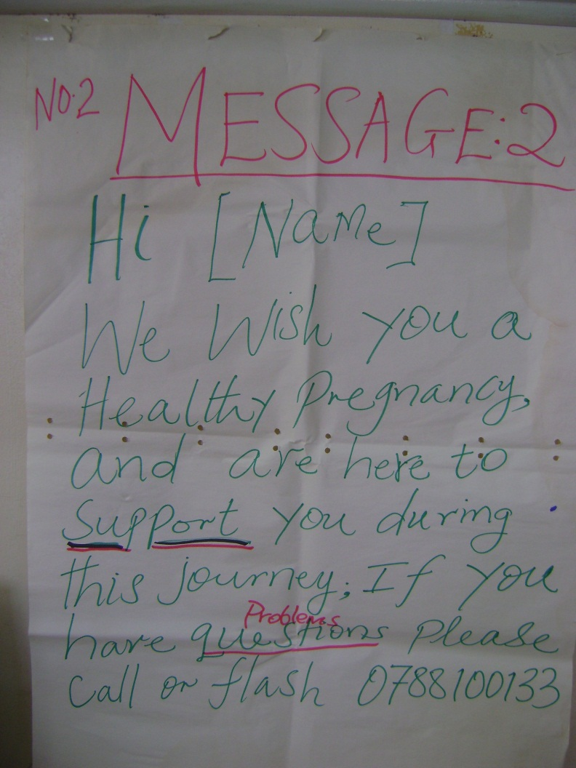
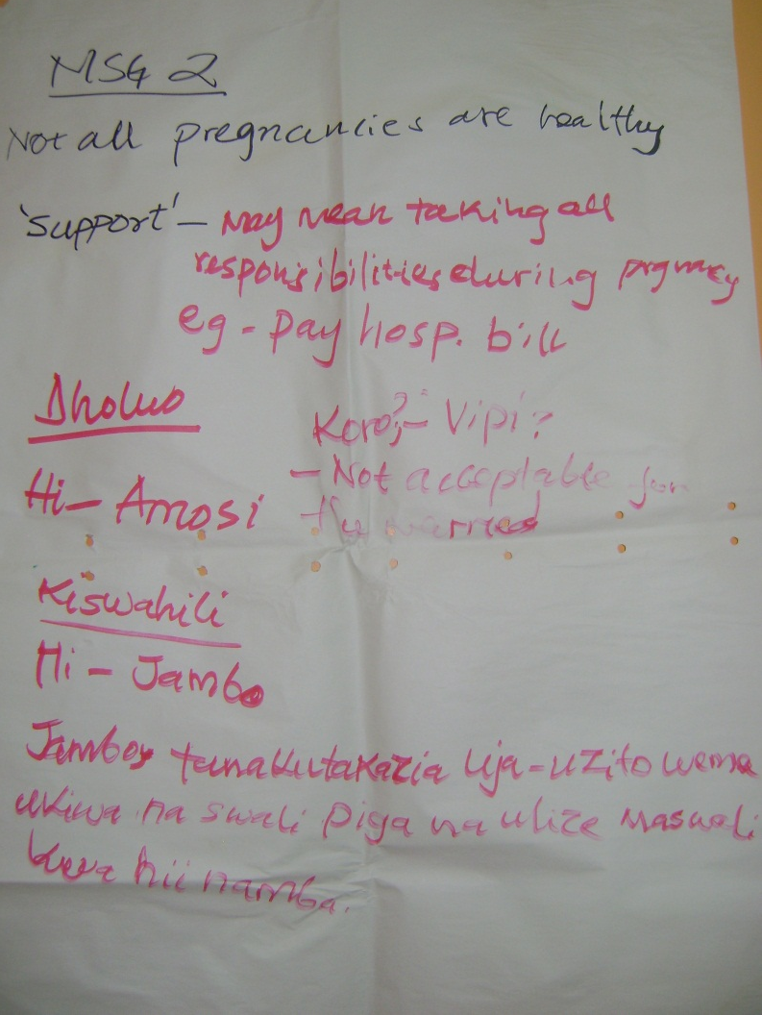
Pilot of Intervention SMS

Slide 36

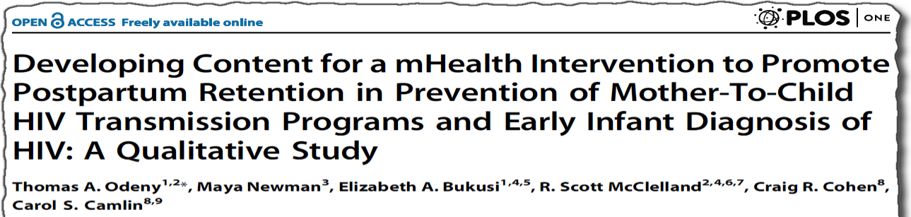
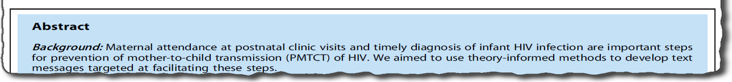
Hi [name]! Congratulations for visiting clinic this week! Please call or flash 0788100133 if you have questions about your pregnancy. We're here to help you!
Hi [name], We wish you a healthy pregnancy and safe delivery! If you would like to plan your delivery, call or flash or send please call me to 0788100133
Dear [name], congratulations on the birth of baby [babyname]! We treasure you both! If you have questions about baby’s health please call or flash 0788100133
Hi [name]! This week, please bring baby [babyname] to clinic for important immunizations to prevent childhood diseases and make sure [babyname] grows up healthy and strong.
Notes:
In the end, we developed a set of text messages tailored to be sent at specific points during the pregnancy and postpartum period.

Slide 37
Stages of translational epidemiology (adapted from Khoury et al.)
Discovery
(T0 – T1)
Development
(T2)
Delivery
(T3)
Population Health
(T4)
Characterize and describe intervention
Assess efficacy of intervention using observational and experimental studies
Implementation science to assess dissemination into practice
Assess effectiveness of intervention on population-level outcomes
Mapping the TextIT strategy onto the stages of translational epidemiology
Discovery
(T0 – T1)
Development
(T2)
Delivery
(T3)
Population Health
(T4)
Theory-based SMS developed from formative qualitative studies (focus groups, motivational interviews)
RCT to demonstrate efficacy of theory-based SMS (TextIT); Parallel-cohort RCT to assess potential for facility-level dissemination
Cluster-randomized stepped-wedge trial to show real-world effectiveness of TextIT; Implement with fidelity; SOPs, training guides, checklists;
Public health impact evaluation of TextIT
Notes:
In the development stage of T2, after co-designing and piloting the intervention, we conducted a randomized trial to assess the efficacy of the intervention.

Slide 38
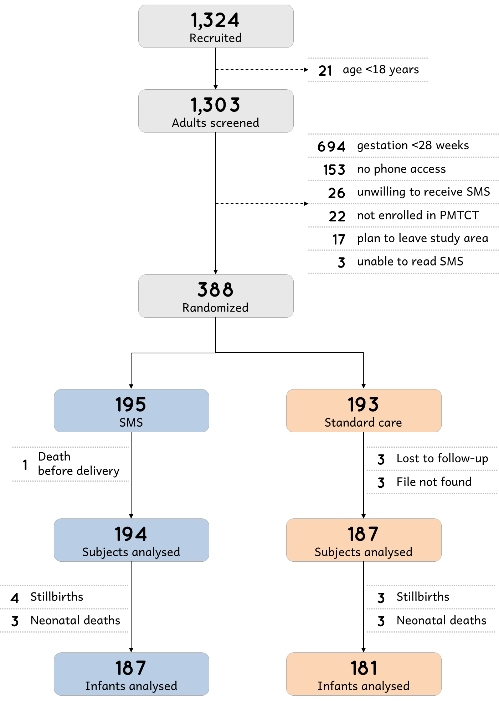
Notes:
In that trial, we screened about 1,300 pregnant women with HIV and randomized 388 to receive SMS or standard care

Slide 39
Notes:
And followed up participants for retention in care, as well as infant HIV testing after delivery

Slide 40
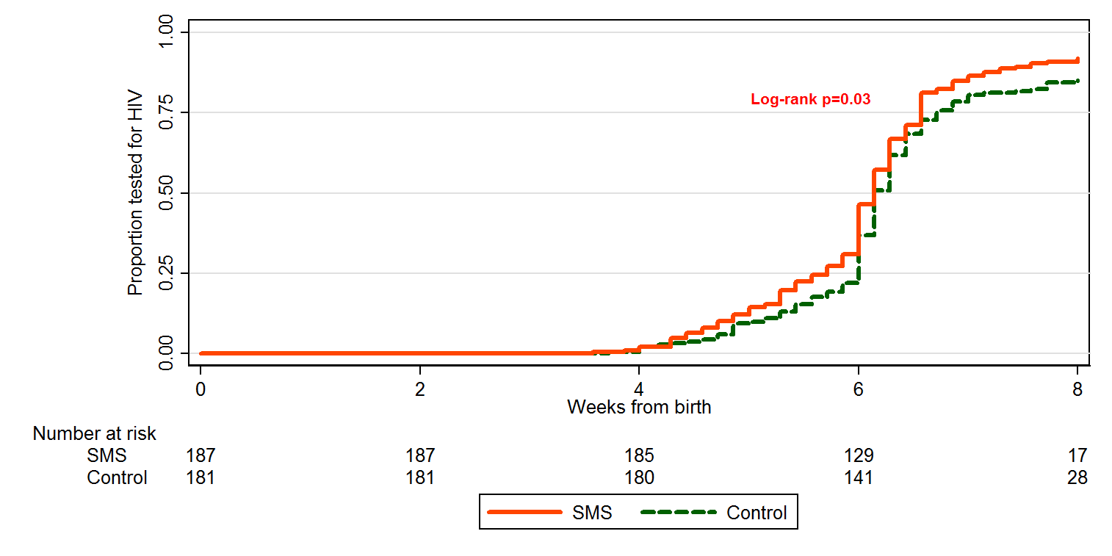
Time to infant HIV testing
Log-rank p=0.03
Notes:
The cumulative probability of infant HIV testing by 8 weeks was significantly higher in the SMS group than the control group as shown in this Kaplan-Meier plot

Slide 41
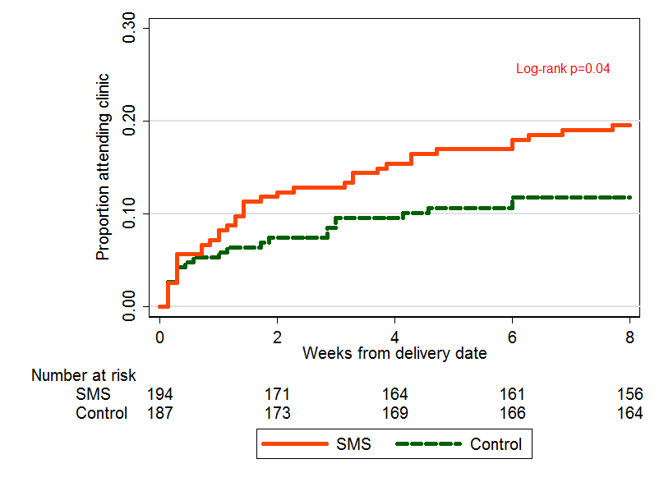
Time to clinic attendance
Log-rank p=0.04
Notes:
Similarly, the cumulative probability of clinic attendance by 8 weeks was significantly higher in the SMS group than the control group as shown in this Kaplan-Meier plot

Slide 42

Theory based, co-designed, individually tailored two-way SMS text messaging led to
a significant increase in infant HIV testing within 8 weeks after birth
a significant increase in maternal postpartum clinic attendance
Notes:
In summary, we found that…

Slide 43

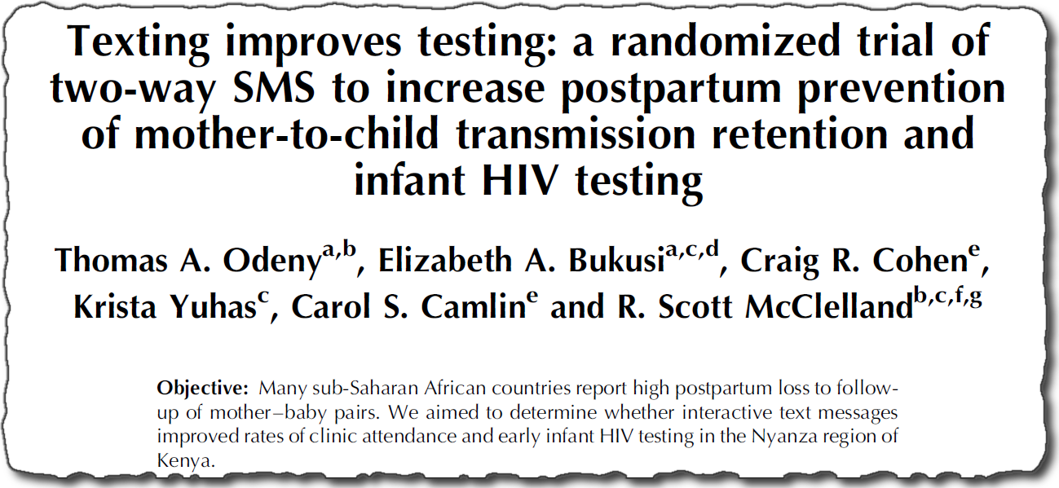
Notes:
And those findings have been described in greater detail in this AIDS article.

Slide 44
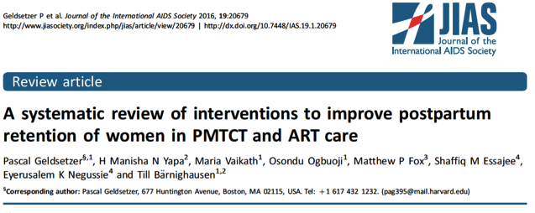
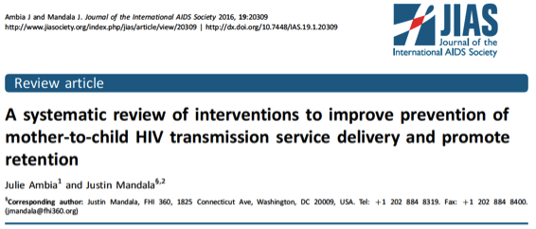
EVIDENCE FROM
SYSTEMATIC REVIEWS
Ambia et al. JIAS 2016 (34 studies); Geldsetzer et al. JIAS 2016 (10 studies)
Notes:
Two systematic reviews in 2016 later concluded that of all interventions, only mobile phone-based interventions were effective in increasing rates of infant HIV testing and improving retention in postpartum PMTCT care.

Slide 45
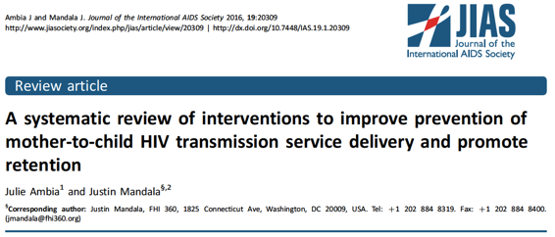
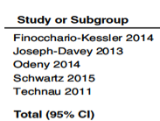
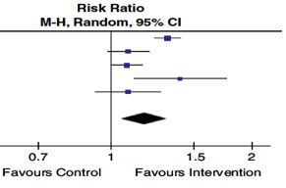
EVIDENCE FROM
SYSTEMATIC REVIEWS
Pooled RR 1. 18 [1.05, 1.32]
Ambia et al. JIAS 2016 (34 studies); Geldsetzer et al. JIAS 2016 (10 studies)
Notes:
And this Forest plot from one of the systematic reviews summarizes the evidence for mobile phone-based interventions to increase uptake of infant HIV testing

Slide 46
Text Messaging after Adult Male Circumcision
Improving Uptake of Early Infant Diagnosis of HIV
Closing the know-do gap
Conclusions
OUTLINE
Notes:
Given these findings, that SMS can be leveraged to bridge important gaps in the cascade of care for mother-baby pairs in PMTCT programs in Africa, our next step was to expand this efficacious intervention;
Essentially to deliver the intervention more broadly

Slide 47
Stages of translational epidemiology (adapted from Khoury et al.)
Discovery
(T0 – T1)
Development
(T2)
Delivery
(T3)
Population Health
(T4)
Characterize and describe intervention
Assess efficacy of intervention using observational and experimental studies
Implementation science to assess dissemination into practice
Assess effectiveness of intervention on population-level outcomes
Mapping the TextIT strategy onto the stages of translational epidemiology
Discovery
(T0 – T1)
Development
(T2)
Delivery
(T3)
Population Health
(T4)
Theory-based SMS developed from formative qualitative studies (focus groups, motivational interviews)
RCT to demonstrate efficacy of theory-based SMS (TextIT); Parallel-cohort RCT to assess potential for facility-level dissemination
Cluster-randomized stepped-wedge trial to show real-world effectiveness of TextIT; Implement with fidelity; SOPs, training guides, checklists;
Public health impact evaluation of TextIT
Notes:
To direct our next step, we went back to the stages of translational epidemiology.
And so, in stage T3, or delivery, the unanswered question was whether the TextIT intervention would be effective in real-world routine care situations

Slide 48
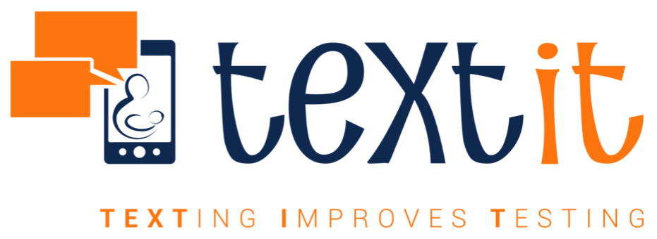
A pragmatic cluster randomized, stepped-wedge trial of text messaging to improve retention in care for women living with HIV and their children
Notes:
To answer this question, we developed a project called TextIT, or Texting to Improve Testing where we used a pragmatic cluster randomized, stepped wedge trial to expand this intervention to 20 clinics in western Kenya

Slide 49
TextIT intervention
Notes:
The text messaging software, text message content, frequency, and customization features were exactly the same as for the efficacy trial that I described earlier

Slide 50

Effect on infant HIV virologic testing within eight weeks after birth
SMS | Control | RR [95% CI] | P
1,466/1,613 (90.9%) | 609/713 (84.4%) | 1.03 [0.97–1.10] | 0.3
Notes:
The proportion of infants tested for HIV was 91% in the intervention group and 84% in the control group.
This difference, however, was not statistically significant

Slide 51

Increase in postpartum retention within eight weeks after delivery
SMS | Control | RR [95% CI] | P
1,548/1,725 (90%) | 571/747 (76%) | 1.12 [0.97–1.30] | 0.1
Notes:
We also found that 90% of women in the intervention group were retained in postpartum care, compared to 76% in the control group
This difference also was not statistically significant

Slide 52
High retention and testing proportions among control group participants
“Contamination” of usual care procedures
Awareness of health workers about ongoing monitoring for the trial
Other ongoing efforts within the health system to achieve eMTCT
Notes:
We interpreted the results here in the context of the earlier efficacy trial as well as other ongoing public health efforts to improve retention
For example, health workers at control facilities were aware of ongoing monitoring and therefore likely made the extra effort to counsel women about the importance of engagement in care
But more importantly, at the time of this trial there were multiple concerted efforts by programs in Kenya aimed at increasing infant HIV testing to meet the deadlines for achieve elimination of mother-to-child HIV transmission

Slide 53
Lack of evidence to support effectiveness of TextIT for infant HIV testing
Does a modest increase in proportion of infants tested have public health significance?
Could pairing of SMS with health system strengthening achieve >90% retention and testing in real world?
Notes:
An important question was whether the small absolute increase in proportion of infants tested and women retained has a public health significance.
AND THE ANSWER IS YES!
This is important because we know that there are other structural barriers that cannot be overcome by text messaging alone.
And so we concluded that pairing of system improvements with SMS could achieve >90% testing under real-world routine care conditions

Slide 54
Text Messaging after Adult Male Circumcision
Improving Uptake of Early Infant Diagnosis of HIV
Closing the know-do gap
Conclusions
OUTLINE
Notes:
So in conclusion:

Slide 55
SMS Text Messaging:
From Evidence to Practice
High-mobile phone coverage make SMS a low hanging fruit to deliver personalized messaging
Co-design of text messaging interventions is crucial for efficacy and effectiveness
SMS is a powerful adjunct if paired with health system strengthening to achieve retention in care
Notes:
Our journey of SMS text messaging showed us that:
And I’ll just end with some examples of how we have since gone on to pair SMS with other health system strengthening interventions to improve engagement and retention in HIV care.

Slide 56
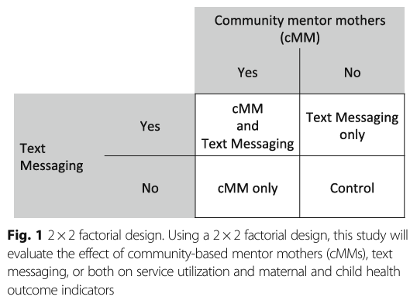
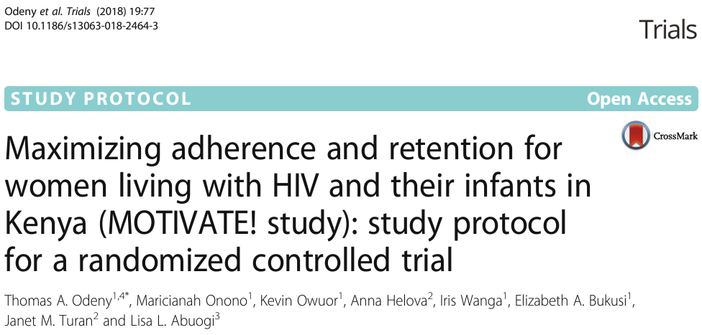
SMS is a powerful adjunct to other health system strengthening interventions
Notes:
In this example we paired SMS text messaging with peer support in the form of community mentor mothers, in a factorial cluster-randomized trial

Slide 57
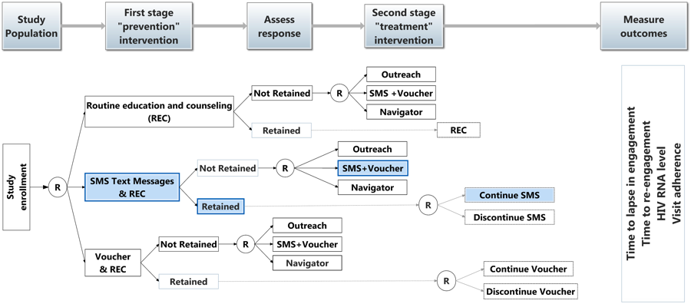
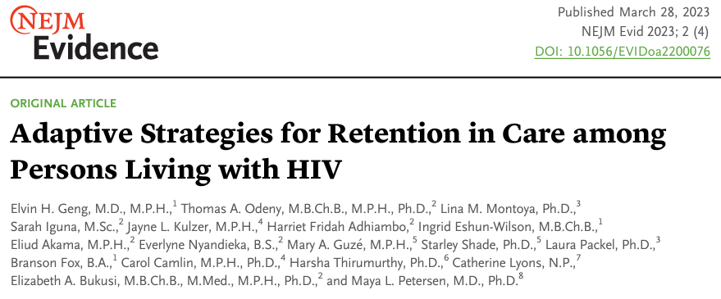
SMS is a powerful adjunct to other health system strengthening interventions
Notes:
And in this other example just published last year, we paired SMS text messaging with conditional cash transfers to overcome structural barriers to engagement in HIV care, using a sequential multiple assignment randomized trial

Slide 58

SMS Text Messaging for Retention:
From Evidence to Practice
OR
“The best way to eat an elephant is to cut him to pieces.” – African proverb
Notes:
In other words, we are continuing to eat the elephant in small pieces.

Slide 59
Acknowledgements
Notes:
I want to thank the following individuals who all played important roles in helping me complete this research.

Slide 60
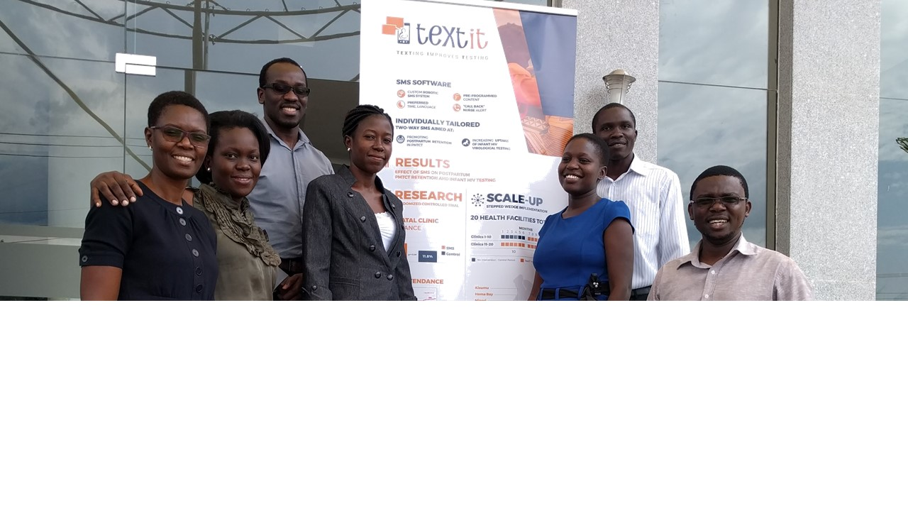





ELIUD
AKAMA
HARRIET
FRIDAH
PEREZ
OCHWAL
ALLOYS
K'OLOO
HARRY LAGAT
The TextIT Team
Notes:
The TextIT study team who worked tirelessly to make these studies succeed

Slide 61
Thank you!
Washington University
Elvin Geng
Kenya Medical Research Institute (KEMRI)
Elizabeth Bukusi
University of Washington
Scott McClelland
King Holmes
Jim Hughes
Jane Simoni
Nyanza Reproductive Health Society
Robert Bailey
UCSF
Carol Camlin
NASCOP Kenya
Sarah Masyuko
Funding
UN Foundation
UW International AIDS Research Training Program
Fogarty International Clinical Research Fellowship
Notes:
And my mentors and collaborators, in particular Elvin Geng and Elizabeth Bukusi

