Slide 1
Researcher and Implementer: Two Sides of the Same Coin?
Peter Cherutich, PhD, MBChB, MPH
Reaching national scale: A focus on the Kenyan experience

Slide 2
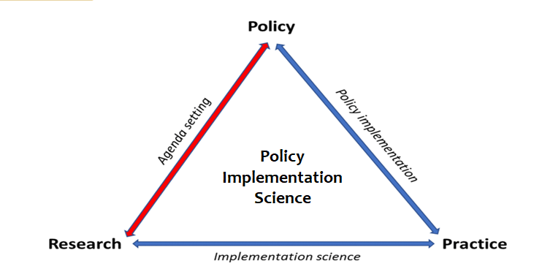
Three or more sides of a coin!!

Slide 3
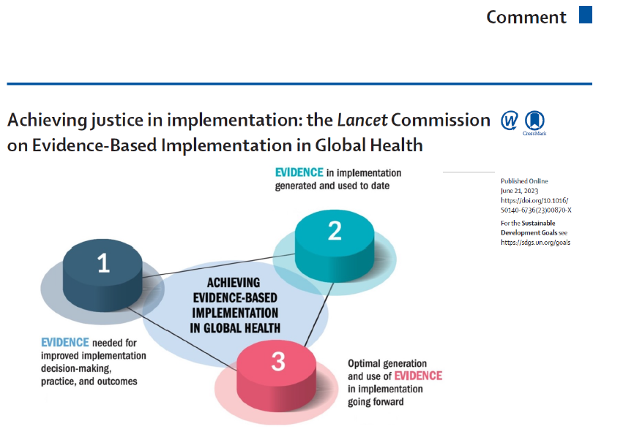
Nexus Between Implementation and Research
Peterson HB et al, ; Lancet Commission on Evidence-Based Implementation in Global Health. Achieving justice in implementation: the Lancet Commission on Evidence-Based Implementation in Global Health. Lancet. 2023 Jul 15;402(10397):168-170.

Slide 4
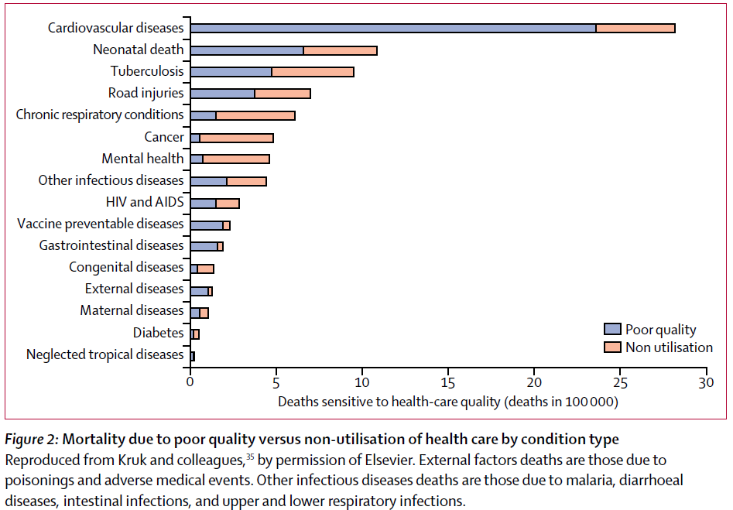
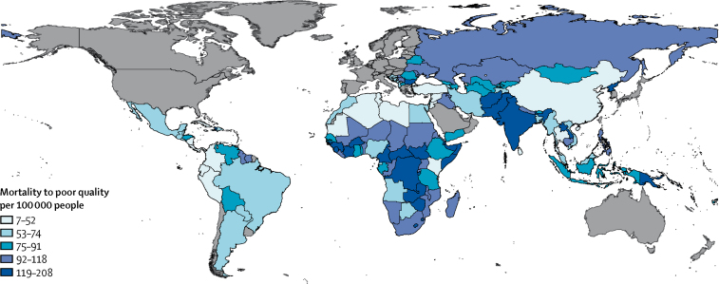
Why bother about evidence-based implementation?
Kruk ME et al,. Mortality due to low-quality health systems in the universal health coverage era: a systematic analysis of amenable deaths in 137 countries. Lancet. 2018 Nov 17;392(10160):2203-2212. doi: 10.1016/S0140-6736(18)31668-4. Epub 2018 Sep 5. Erratum in: Lancet. 2018 Nov 17;392(10160):2170.

Slide 5

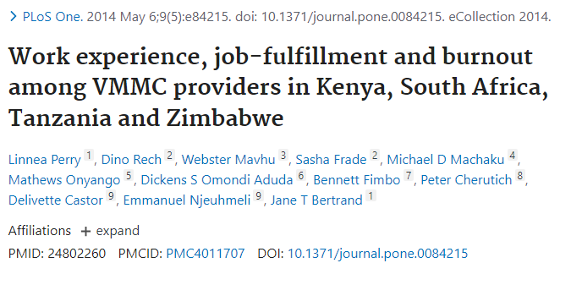
Implementing as you generate evidence
Quality of Implementation
The Health Provider: The goose that lays the golden egg

Slide 6
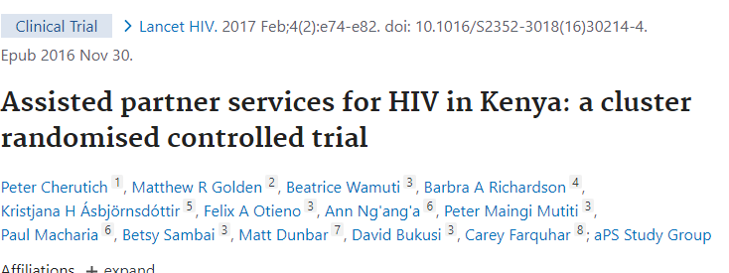
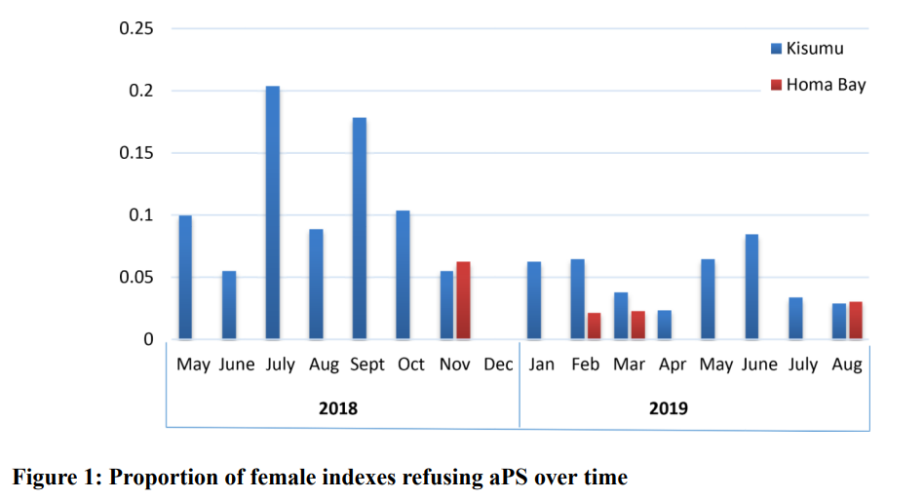
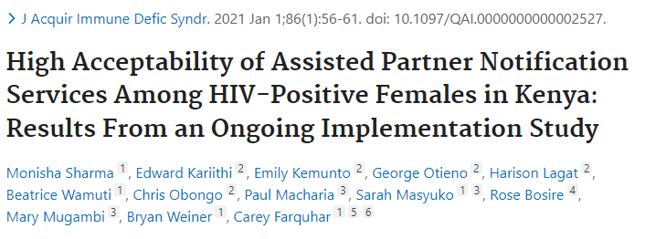
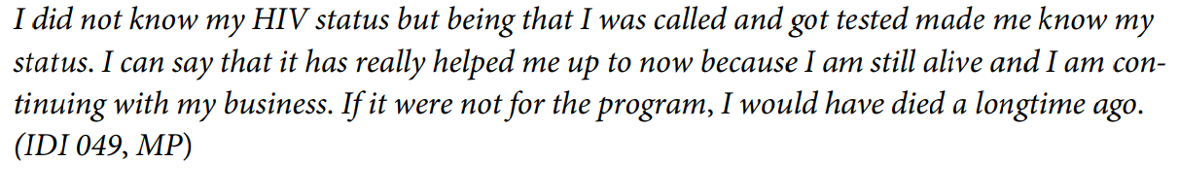
From Research to Implementation: A gratifying experience
Naughton B et al,"I feel good because I have saved their lives": Acceptability of assisted partner services among female index clients and male sexual partners in Kenya. PLOS Glob Public Health. 2023 May 24;3(5):e0001842.

Slide 7
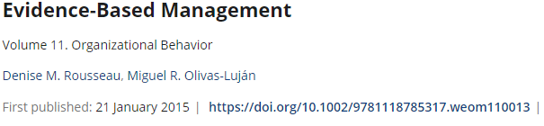
What evidence do implementers require?
Ask
Acquire
Appraise
Aggregate
Apply
Assess
Scientific Literature
Stakeholderss
Organizational
Data
Practitioners/
Implementers
Scientific literature
Implementers
Organizational data
Stakeholders

Slide 8
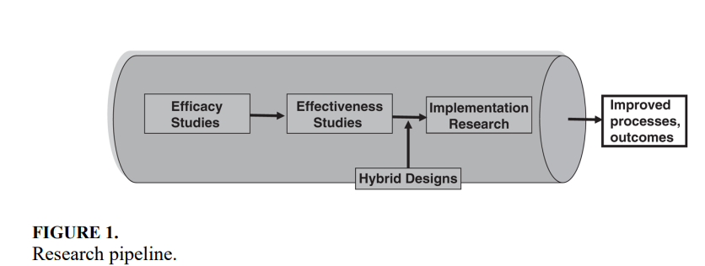
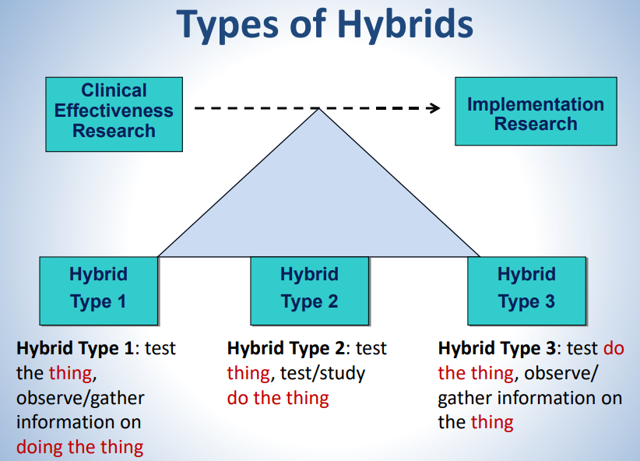
Hybrid Study Designs to bridge the research-implementation gap
Curran GM et al,. Med Care. 2012 Mar;50(3):217-26.

Slide 9
Researcher-Implementer Interphase
Why implementers should understand research
Why researchers should engage implementers
To ask right questions-what, who, how?
Impact evaluation
When to de-implement
Refine research questions
Be responsive to stakeholders or community needs
Advantages of wearing both/all hats
Faster research pipeline
Better quality of implementation and scale up
Progress towards equity

Slide 10

In Summary
Important advantages of wearing both (all) hats
De-emphasize puritanism
Capacity building
  Implementers on critical thinking and appraisal
  Researchers on asking the relevant questions for implementers and policy makers
Integrate hybrid designs to meet implementer needs
Advocacy for Ministries of Health (Ministries of Implementation Science)
Evidence-based implementation should be the norm

