Slide 1


ACCELERATED EVIDENCE TO POLICY AND PRACTICE JOURNEY: Examples From Kenya’s HIV Response
Cyrus Mugo, MBChB, MPH, PhD
Senior Research Scientist, Kenyatta National Hospital
July 2024
AIDS 2024 PRE-CONFERENCE, MUNICH, GERMANY

Slide 2

Exemplars of evidence to policy/practice
Breastfeeding for children of HIV infected mothers
  KESHO BORA study
Strategy for Pediatric HIV treatment
  PUSH study
Developing Adolescent Strategies for HIV testing
  DASH study
Strategy for Pediatric HIV testing
  CATCH study
Transitioning Adolescents to Adult HIV Care
  ATTACH study

Slide 3
Appetizers
Kesho Bora Studies
Breastfed infants of women living with HIV had lower morbidity and mortality
Mixed feeding and early weaning resulted in higher transmission, morbidity and mortality
Pediatric Urgent Start of Highly Active Antiretroviral Treatment (PUSH)
Children <2 years diagnosed during hospitalization had a high mortality despite treatment
No differences in mortality/ other SAEs between early and delayed HAART
POLICY IMPACT: Early infant feeding guidelines between 2010 and 2016
POLICY IMPACT: HAART initiation for hospitalized children from 2016
DASH Study
Introduced continuous quality improvement as a strategy to improve adolescent HIV testing experience
CQI activities resulted in improved HIV knowledge and satisfaction with testing
PRACTICE IMPACT: HIV Prevention Unit adopted CQI as a standard process

Slide 4


COUNSELING AND TESTING OF CHILDREN AT HOME (CATCH) STUDY
PEDIATRIC HIV INDEX CASE TESTING
Photo credit: Elizabeth Glaser Pediatric AIDS Foundation:
http://www.independent.co.uk/news/world/africa/preventing-mothertochild-transmission-of-hivaids-2147367.html

Slide 5
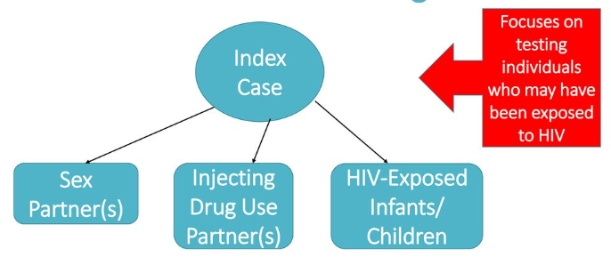

Definition
>50% OF PLWHIV DID NOT KNOW THE HIV STATUS OF THEIR CHILDREN

Slide 6


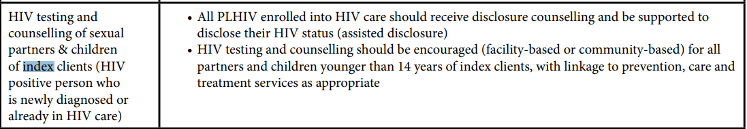
Policy

Slide 7

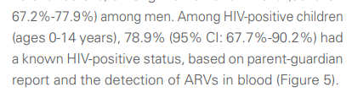
Practice & Impact
>500,000 children tested
CLOSE TO 80% OF PARENTS KNEW THE HIV STATUS OF THEIR CHILD

Slide 8
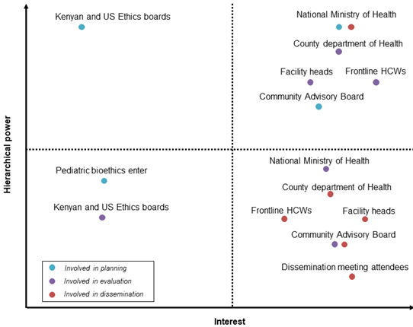
What worked?
PRELIMINARY RESULTS TO RRI AND GUIDELINES: 9 MONTHS – 1 YEAR
Co-design with stakeholders
Map stakeholders to determine engagement investment
Utilize pragmatic/adaptive designs in implementation
Dissemination plan: Make it count during implementation

Slide 9


Adolescent Transition to Adult Care for HIV infected
Adolescents (ATTACH) Study

Slide 10
RCT tools
Adolescent transition package

Slide 11
RCT tools
Effectiveness of ATP
Intervention sites
Control sites
NULL RESULTS ON IMPACT OF ATP ON VIRAL SUPPRESSION

Slide 12


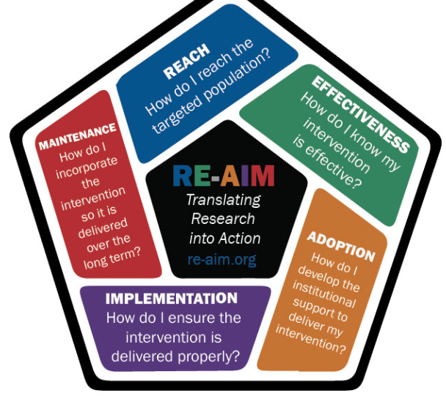
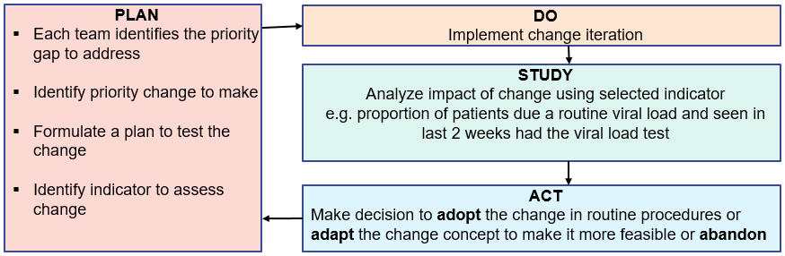
Implementation, cost, sustainability and scale up
NEW NIH R01 ON SCALE UP:
MOH AND COUNTY HIV PROGRAM LEADERSHIP AS CO-INVESTIGATORS
YOUNG PEOPLE LIVING WITH HIV AS CHAMPIONS AND STUDY STAFF

Slide 13


Journey to policy
2024
REVISION
The Ministry and county departments of health, and implementing partners were provided with ATP tools
Research team is available to train providers supported by different partners

Slide 14
What worked?
Co-design with stakeholders
Align research to program interest & priorities
WHAT DO PEOPLE CARE ABOUT?
NULL RESULTS ON IMPACT OF ATP ON VIRAL SUPPRESSION
Local adaptation
Two ATTACH research leads are members of the national pediatric and adolescent HIV TWG
ATTACH research team part of the team involved by the HIV program in developing the HIV guidelines 2022 and revising the transition and mental health sections of the adolescent package of care
Dissemination: Actively target stakeholders
Researchers available for programming
Moderator: Program teams understand research
Role of researchers in creating this research capacity: E.g., D43s, Global Scholars and Fellows Programs, HIGH IRI

Slide 15

Questions

