Slide 1
Leadership and implementation globally in public health: state of the art
Kristjana Ásbjörnsdóttir, Associate Professor, University of Iceland
Centering the healthcare worker and public health workforce

Slide 2
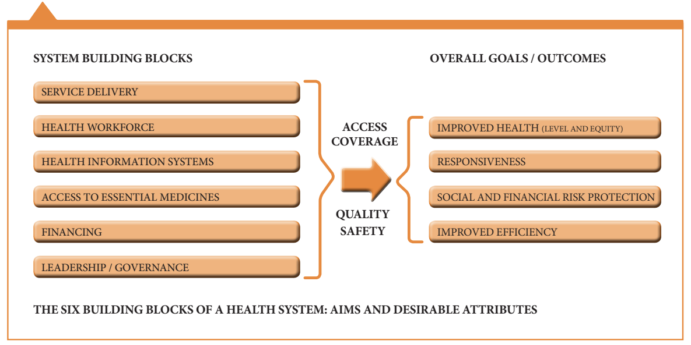
Leadership and Human Resources for Health
Notes:
The World Health Organization recognizes Leadership and Governance as one of the six building blocks of health systems, and although in this context leaderhsip refers to the very top of the org chart or most central part of a generally centralized system, leadership at all levels impacts the responsiveness and outcomes of a health system. A second building block here is the Health Workforce.

Slide 3
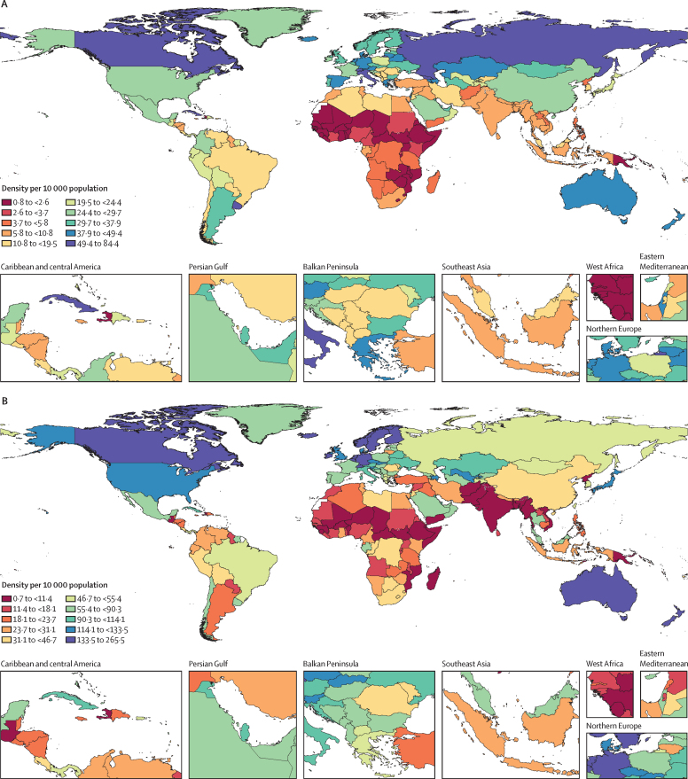
Leadership and Human Resources for Health
Density of physicians
Minimal thresholds for Sustainable Development Goals or universal healthcare:
2018 World Health Organization: 44.5/10,000
2022 Global Disease Burden: 91.3/10,000
Consequences of insufficient human resources:
High turnover, out-migration
Leadership responsibilities assigned without training
Density of nurses and midwives
GBD 2019 Human Resources for Health Collaborators, Lancet 2022

Slide 4
Effective health systems leadership
Develops and implements an organization‘s vision
Alliance for Health Policy and Systems Research 2016:
Health systems are complex and call for participatory leadership
Key attributes of leaders: adaptive, knowledgeable, team player
Importance of context and environment
  Centralized decision-making
  Lack of bidirectional knowledge-sharing
  Strongly hierarchical structure and culture
Gilson 2018; Figueroa 2019; Witter 2022
Notes:
Alliance for Health Policy and Systems Research
2014 Third Global Symposium on Health Systems Research. Key atributes of leaders that create effective health systems. Most commonly adaptive, knowledgeable, team player.
2015 survey across 65 countries, plus IDIs with 22 prominent leaders, about components of leadership for health.
Context and enabling environments as important as individual traits
A complex system cannot be efficiently driven by linear, hierarchical decision-making and must draw upon conjoined perspectives and diverse strengths across the system for non-linear but well-coordinated functioning. ‚Distributed but not disconnected‘ describes the model of participatory leadership.
In the context of these challenges, Individual leaders often exercise power in quite authoritarian and hierarchical ways; existing public sector context and centralized decision-making provides barriers to participatory leadership (Gilson 2018)
A dominant hierarchical culture and lack of collaborative and distributed culture can limit the performance of healthcare organizations (Figueroa 2019)

Slide 5
Organizational readiness for change
Broadly accepted importance for implementation success
Various definitions:
Psychological and behavioral preparedness to implement change (ORIC)
Motivation, general capacity, innovation-specific capacity (R=MC²)
Tool development and validation in high-income settings
Prospective studies found associations with acceptability, feasibility and fidelity
Change commit-ment
Change efficacy
Readiness
Shea 2014; Scaccia and Wandersman 2015
Notes:
Weiner defines organizational readiness in psychological terms, as "psychological and behavioral preparedness to implement change". In this definition, organizational readiness is divided into the constructs of change commitment and change efficacy, with the former describing collective willingness by organizational members to implement a change and the latter their perceived ability to do so.[2–4] Other definitions include psychological readiness but incorporate appropriateness of the proposed change, management support, and personal valence (the belief that the proposed change is beneficial to organizational members)[5], which Weiner considers to be contextual factors promoting or contributing to organizational readiness but not part of its definition.
Scaccia conceives of organizational readiness as having three components: motivation, similar to change commitment in Weiner's definition, as well as general capacity of the organization and innovation-specific capacity to implement a particular intervention with quality.[6] Availability of human resources, financial support, technology or other resources considered prerequisites for implementing the change. In this model, the factors are thought of as multiplicative, so that if any component is zero, readiness is insufficient to implement an innovation.[6]
There‘s fairly broad consensus on the importance of organizational readiness, with a frequently cited estimate that 50% of implementation failures come down to insufficient readiness. This is despite the fact that until the last couple of years, there was a lack of prospective studies linking readiness to implementation. Recent studies from the US Veterans Affairs hospital system and from Australia do demonstrate that baseline organizational readiness is associated with implementation outcomes such as acceptability, feasibility and fidelity.

Slide 6
Assessing organizational readiness globally
Challenges:
Perception that personal valence is not relevant to the organization‘s priorities
Frontline worker discomfort commenting on others' motivations
Possible perception that motivation / change commitment is secondary
Dearing 2018: tools developed for global health focus on organizational capacity to implement change
Organizational attributes, management & governance, and collaboration most frequently assessed
Means 2021; Yoo 2019; Leslie 2020; Dearing 2018
Notes:
Several publications have highlighted the hierarchical nature of health systems in low- and middle income settings as a challenge to the use of organizational readiness measures developed and validated in higher-income countries. In systems where decision making is centralized and top-down, implementers may not perceive personal valence or their own comfort or commitment as relevant to the organization's priorities.[12] In a study of readiness to implement a medicine dispensing and distribution program in South Africa, over 40% of providers responded "not applicable" to the item "We want to implement this program". [9]
Another challenge is the requirement to comment on the motivations of others. In Means et al's work, respondents in Kenya were uncomfortable reporting on others' readiness. This was addressed by adding the qualifier "I have observed" to questions contained in the original ORIC survey instrument, for example "I have observed that my co-workers are generally supportive [of this intervention]."[10]
In our work in Mozambique, commenting on the motivations and commitment of supervisors was particularly challenging. This was addressed by adding factual questions on supervisors' attendance at meetings and their participation in implementation of the intervention.
A 2018 review described 30 tools created for organizations working in global health or international development to address organizational capacity or motivation. Interestingly, all of these focused on the question of capacity; were there adequate resources, infrastructure, leadership and management in place to implement change?
Some definitions focus only on organizational capacity, with such objectively measurable factors as availability of human resources, financial support, technology or other resources considered prerequisites for implementing the change.[1]

Slide 7
Organizational readiness, climate and culture
Management support
Relative priority
Most constructs were associated with organizational readiness
Organizational readiness was not associated with implementation fidelity
Principal components representing organizational citizenship behavior and personnel satistfaction & supervisor support were associated with implementation fideility
NS
**
Personnel Commitment
**
Organizational Readiness for Implementing Change
Implementation fidelity
Upward Communication
*
*
Supervisory Support
**
Innovation & Flexibility
NS
NS
Effort
Organizational Citizenship
Behavior
Ásbjörnsdóttir 2022; Leslie 2022

Slide 8
Clinical champions
Highly ranked as a strategy by implementation science researchers and practicioners
Champions:
Highly respected and influential
Strong communicators
Demonstrate horizontal and collective leadership style
May or may not hold formal leadership positions
Waltz 2019; Demes 2020; Morena 2022

Slide 9
Promoting health leadership
Promoting effective leadership is key to successful implementation of new interventions and evidence-based practices
Growing focus on strategies to promote health leadership capability in low- and middle-income countries
World Health Organization‘s Workforce 2030
Recent reviews of leadership interventions in low- and middle-income countries generally (Effa 2021) and in sub-Saharan Africa (Johnson 2020)
  Variable and complex approaches
  No single conceptual definition of leadership
Witter 2022; Lizandro 2018; Johnson 2020; Effa 2021
Notes:
And in a study of barriers and facilitators to implementing evidence across 20 projects in African health care, support from the organization‘s management was one of only two facilitators identified, while the other was positive attitude of practicioners (Lizandro 2018)

Slide 10


Acknowledgements
Mozambique Ministry of Health / Manica Provincial Health Directorate
University of Washington
Fermino Jaqueta (Provincial Health Director)
Esperança Tavede (MCH Director)
Aneth Dinis (National Public Health Directorate)
District MCH Supervisors
Frontline Healthcare Workers
Joana Coutinho
Mery Agostinho
Melita Cruz
Fernando Amaral
Kenny Sherr
Jonny Crocker
Sarah Gimbel
Celso Inguane
Grace John-Stewart
Bryan Weiner
Fatima Cuembelo
Eduardo Mondlane University
Health Alliance International /
Comitê para Saúde de Moçambique
SAIA Consortium
NIMH/NIH: R01MH113435
Notes:
KS

