Slide 1




The Public Health Workforce:
Crisis or Opportunity?
Matifadza Hlatshwayo Davis, MD, MPH, FIDSA
Director of Health,
City of St. Louis
Notes:
Title Slide –
The Public Health Workforce – Crisis or Opportunity?
July 20, 2024

Slide 2
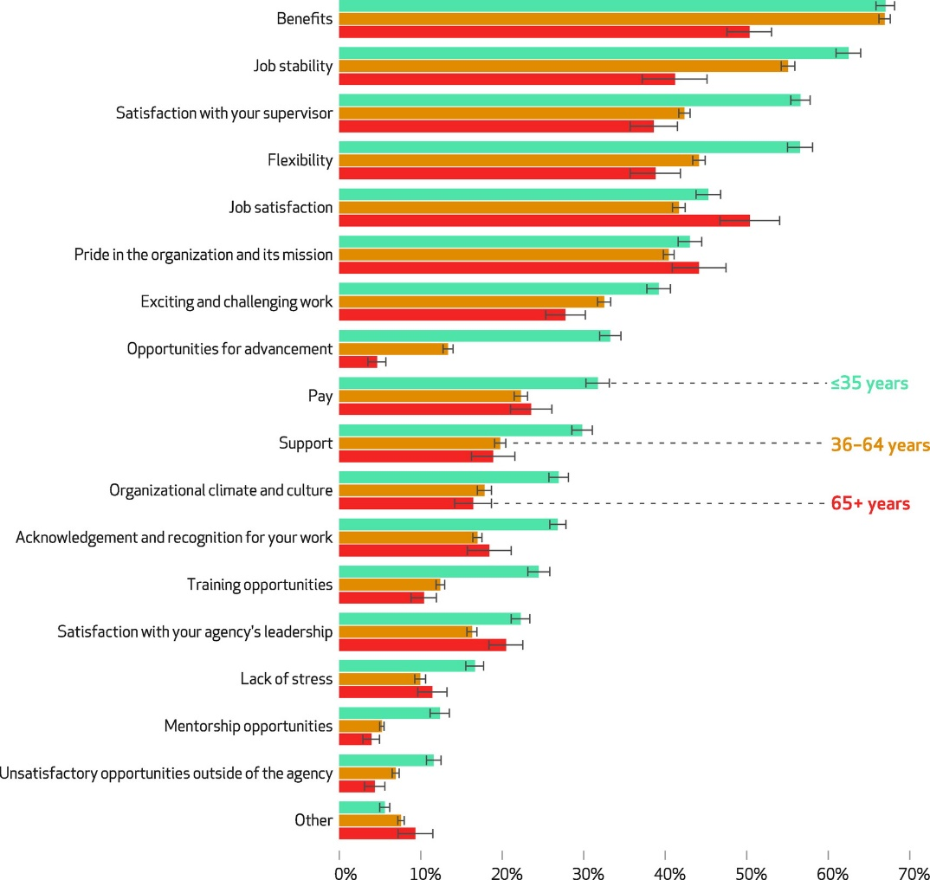
The State of
Public Health
46% of state and local public health employees left their jobs
  75% were 35 or younger or
  with shorter tenures
  Primarily white and female, lacking in diversity
  Reason: PAY
If current rate of attrition continues:
Potential loss of 129,000 workers
Notes:
So let’s talk about the State of Public Health…
A critical need to promote and protect the public’s health; however, the COVID-19 pandemic –
46 percent of state and local public health employees nationwide leave the field between 2017 and 2021.
For individuals aged 35 and younger – that proportion rose to three-quarters of workforce turnover.
If this separation trend continues,
Public health could see a loss of more than 100-thousand by 2025
Approximately half of the governmental public health workforce
The graph here is from the Public Health Workforce Interests and Needs Survey fielded in 2017 and 2021 –
Looks at reasons for remaining employed in public health among the group with the highest projected separations.
Benefits were most frequently selected as a reason for staying (67 percent),
job stability (62 percent),
Satisfaction with one’s supervisor (57 percent),
Flexibility (57 percent),
Job satisfaction (45 percent),
Pride in the organization and its mission (43 percent).
Those aged 65 and older cited similar reasons for staying in the public health profession.
What’s not here - those ages 35 and younger with intent to leave
Pay was the most frequently cited reason for considering leaving (63 percent),
Lack of opportunities for advancement (51 percent),
Work overload and burnout (44 percent),
Job satisfaction (41 percent),
Stress (39 percent)

Slide 3
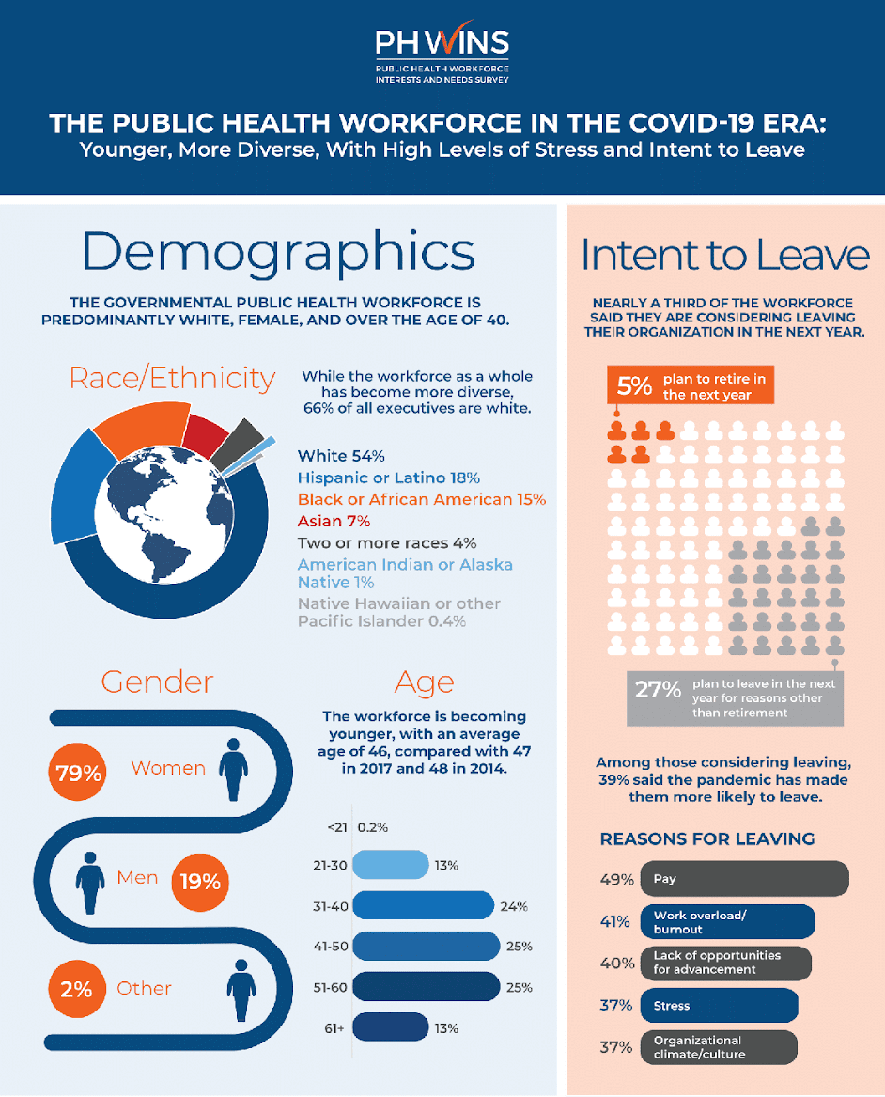
Public Health Workforce
2021 Survey
COVID-19 Impact on the Workforce
Majority of workers are white, female, and 40+ years old
32% of workforce intends to leave in the next year
  5% to retire, 27% for other reasons
44% considering leaving in 5 years
Notes:
The 2021 Public Health Workforce Interests and Needs Survey (PH WINS) shows the public health workforce
Primarily white
Female
Over the age of 40
The workforce has become more diverse and mirrors the U.S. population more
However - there is less diversity at senior levels
66 percent of all executives identify as white
We’re also bleeding – as nearly one-third of state and local public health employees (32%) said they are considering leaving their organization in the next year
Five percent plan to retire
27 percent will leave for another reason
Looking out further, 44-percent said they are considering leaving within the next five years.
The biggest reason for leaving – Pay.
It’s something I’m tackling one step at a time in St. Louis, but investing in public health needs to be looked at across the board and the nation.
Among those who said they’re considering leaving, 39-percent said the pandemic has made them more likely to leave.

Slide 4
Public Health Funding/Person
2005-2021 Trends
Source: State Health Access Data Assistance Center
Notes:
Missouri spends just $7 per person every year. This number has remained constant since 2018, pre-COVID.
Comparing Missouri to surrounding states - all surrounding states spend more per person in public health funding
Iowa seeing some aggressive peaks in 2016 and again in 2019 and 2020.
Lack of funding lead to a slow response to the COVID-19 pandemic
Exacerbated its impact, particularly in low-income communities, communities of color, and for older Americans
These populations experience higher rates of chronic disease and have fewer resources to recover from an emergency.

Slide 5
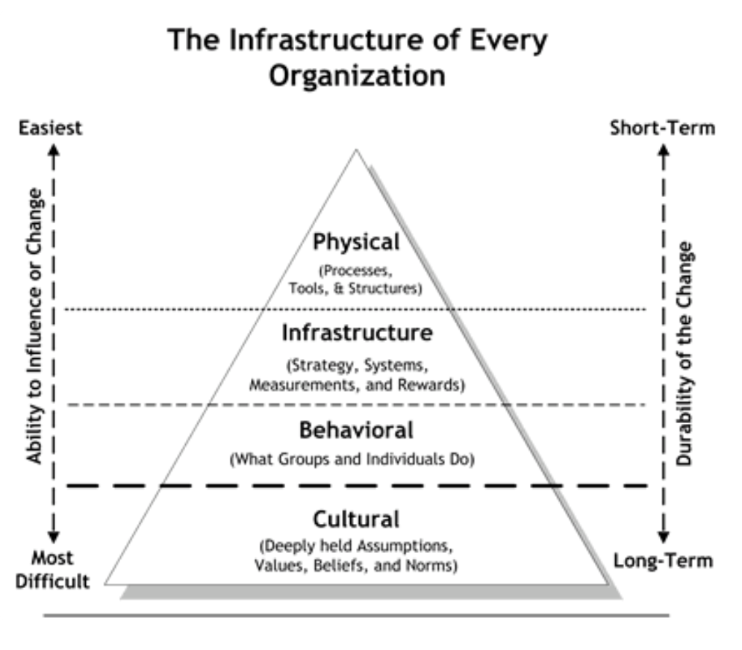
Priorities
City of St. Louis Department of Health
Internalized
  Value
  Culture
  Infrastructure
Externalized
  COVID-19
  Violence Prevention
  Behavioral Health
  Maternal Child Health
  EVERYTHING
HEALTH EQUITY
Notes:
As Director of the City of St. Louis Department of Health
I established priorities to move forward.
Internally, creating a culture of openness – and establishing an infrastructure of policies and protocols.
Externally, Continue our COVID-19 response efforts,
Developed a pediatric vaccine roll-out plan in my first three weeks on the job.
Finally – I have championed the department’s development of its first policy on Health Equity.

Slide 6
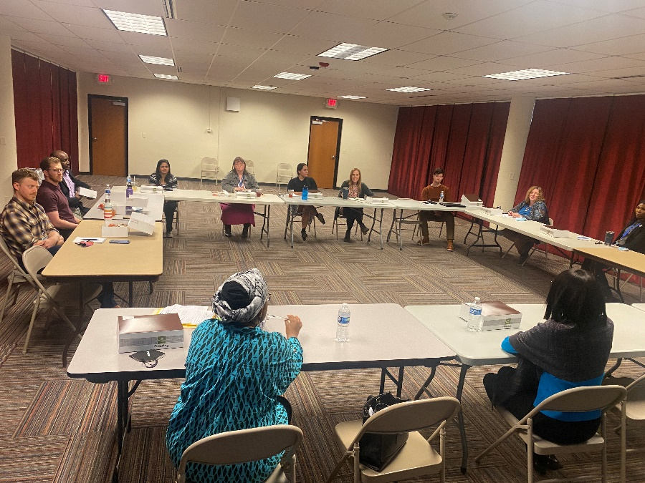
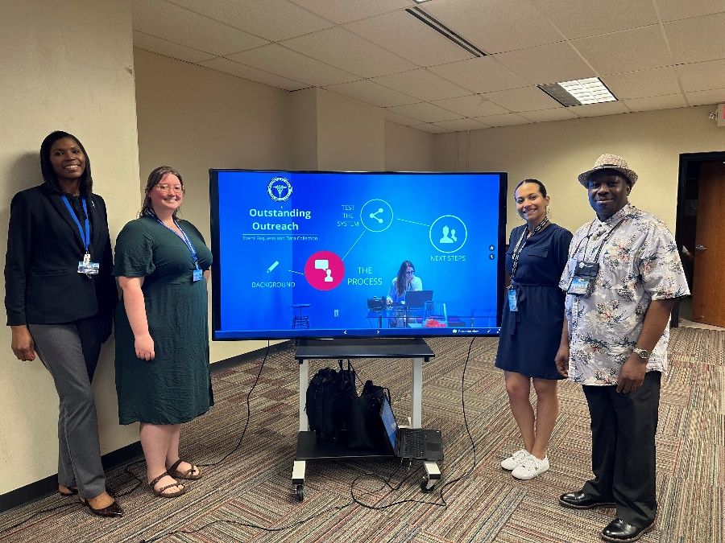
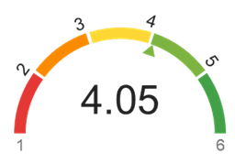
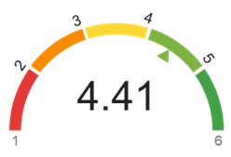
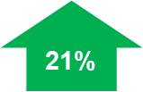
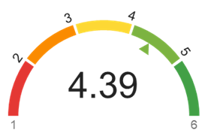
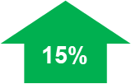
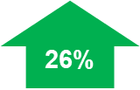
Quality Improvement
City of St. Louis Department of Health
← Section Meetings
QI Team Development →
Culture of Quality Survey Outcomes: Top three areas of improvement.
Senior leadership routinely communicates the organization's QI vision and goals to staff.
Staff collaborate on projects or ideas to improve quality and performance through formal QI projects or other improvement methods.
Staff are recognized for contributions and successes.
Notes:
We talked about the culture.
To improve – we initiated section meetings and quality improvement projects
Worked to understand what our team needed or wanted through culture of quality surveys.
At the bottom of this image – you see the results from a recent survey – with the comparison from the first survey in 2021. Key highlights include:
A 15-percent increase in staff who feel that senior leadership routinely communicate the DOH QI vision and goals to staff
A 21-percent increase in staff who agree that staff collaborate to improve quality in the department
Most significantly, there was a 26-percent increase in staff who feel recognized for contributions and successes

Slide 7



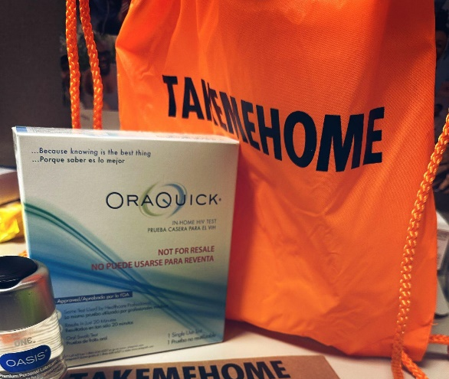
Innovative Approaches
At-Home HIV Test Kits & Testing Clinic
951 kits distributed in 2021-2024
  Survey data indicates clients overwhelmingly referred by Grindr
  Majority of clients chose TMH because it is free
5 Confirmed positive
154 onsite tests performed Pride weekend with 1 positive
Learn about HIV/STIs and PrEP
Find testing (28 locations)
Request at-home test kits
Locate free condoms (103 sites)
Notes:
DOH works to make HIV testing more convenient through Take Me Home program.
Qualifying residents can have kits mailed, or they can pick them up at DOH’s testing and referral clinic.
421 at-home test kits were passed out during our recent 2023 Pride Weekend.
Testing kits have resulted in five confirmed positive results.
We have a direct website that allows clients to schedule a testing appointment and sexual health resources at our Health Stop Testing and Referral Clinic.
At the website, HealthstopSTL.com, someone can:
Book Health Stop clinic appointments
Learn more about HIV/STIs and PrEP
Find at-home HIV/STI test kits and 28 additional partner locations for testing
Get answers to questions about testing, prevention, and more
Connect to local resources for various community needs
Locate where to get free condoms from one of our 103 (highest ever) partner sites

