Slide 1




Building Local Capacity: Strategies for Transitioning Human Resources for Health and Technical Support in HIV Programs within Resource Constrained Settings
Centering the healthcare worker and public health workforce
José Tique MD, MPH
Technical Director
Friends in Global Health (FGH), Mozambique

Slide 2
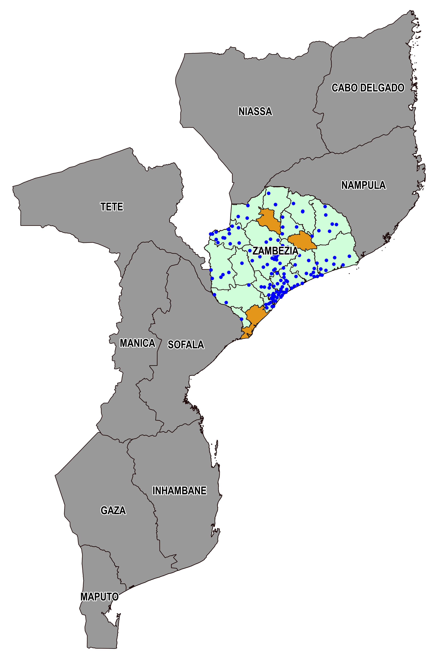
Friends in Global Health –
Avante Program
Friends in Global Health is a fully owned subsidiary of Vanderbilt University Medical Center, operating in Mozambique since 2006.
The Avante program assists the Government of Mozambique to control the HIV epidemic through delivery of high quality, evidence-based HIV and TB services.
  Financed by CDC/PEPFAR
  147 Health facilities supported in Zambézia Province (the province with the highest burden of HIV in country)
  A total of 376,000 persons living with HIV on antiretroviral therapy where supported at the end of 2023
  Programmatic supported areas
    Human Resources for Health
    HIV Prevention
    HIV and TB Care and Treatment (C&T) Cascade
    Laboratory networks
    Data systems
    Site-level Quality Improvement
    Health Information Systems
    Evaluations
Avante program supported districts
Avante program supported Health facilities

Slide 3
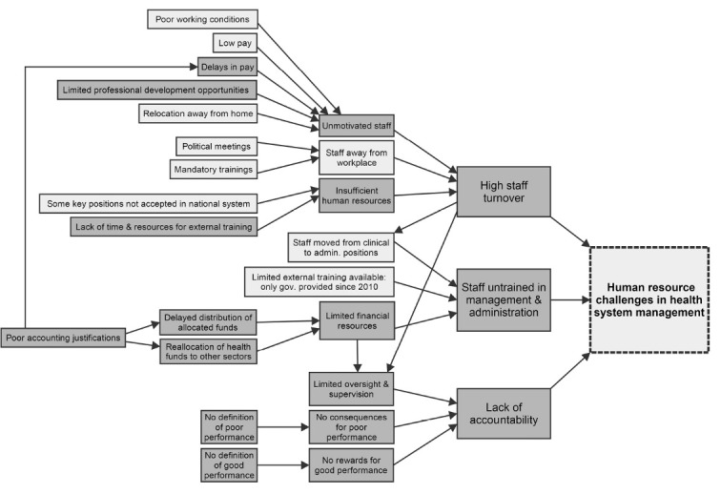
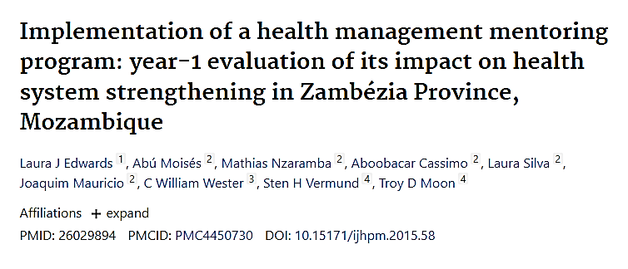
FGH Health Management Mentoring Program Findings in 2015
As part of the Health Management Mentoring program planning process, numerous interrelated constraints to effective HR management were identified through conversations between members of the FGH leadership and local government health workers
Identified Human Resource challenges leading to poor performance in health system management. Darker gray represents areas amenable to change through targeted interventions by the Health Management Mentorship (HMM) program.

Slide 4
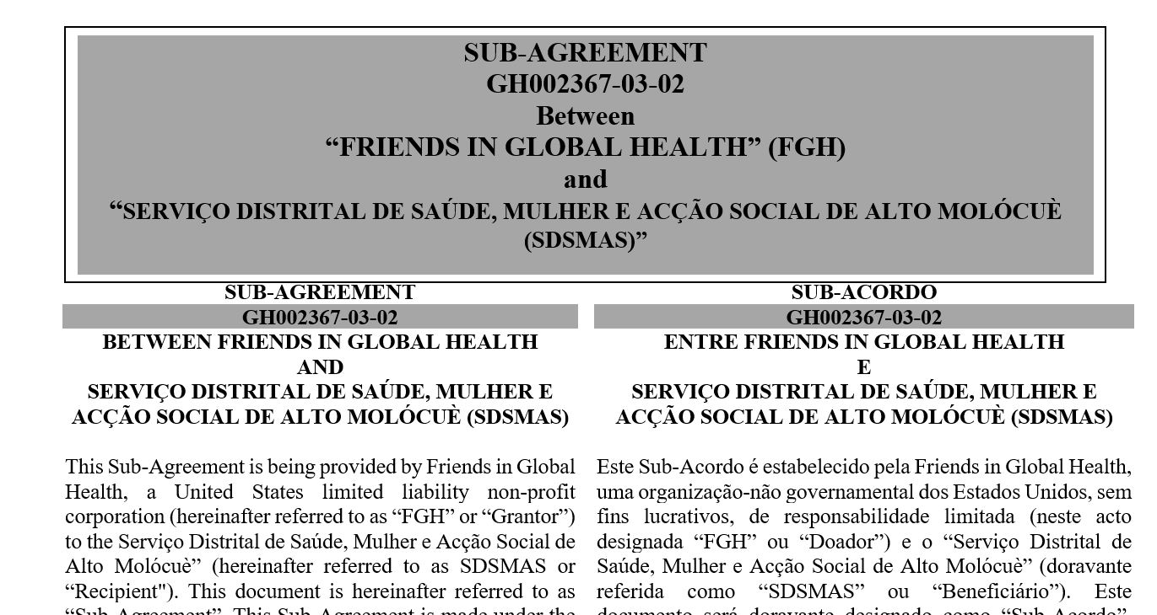
FGH Strategy for Sustainable HRH and Financial Management Support
Strategy developed to mitigate identified barriers leading to poor performance in health systems management
  Initiated in 2014 and enhanced in 2015
Provision of supplementary financing to support Human Resources for Health (HRH) and other operational expenses through direct sub-agreements with district health authorities
Establishment of a Health Management Mentoring Program to enhance administrative and financial capacity
Implementation of a Clinical Mentoring Program to enhance providers skills

Slide 5
Sub-agreements with District Health Authorities for HRH Support
Recruitment and remuneration
Recruitment conducted by district health authorities (DHA) after agreeing on needs with FGH
Personnel contracts are signed between DHA and the employee
Salaries and benefits follow Government of Mozambique rules and limits and are paid by DHA using FGH/PEPFAR funds.
Replacement
Personnel transfers to other health facilities require FGH agreement.
Once an employee funded by the sub-agreement is absorbed into the National Health System payroll, the position is replaced based on need.
Placement and Service Provision
Hired for direct service delivery at Maternal Child Health, Pediatric, Adolescent, Adult care and treatment ambulatory services.
Mentoring and Supervision
FGH district team members mentor the health professionals supported by this sub-agreement.
FGH, along with Provincial Health Authorities conduct supervision visits to these health professionals

Slide 6
Health Management Mentoring Program
Mobile team that provides mentoring for HRH and financial management to DHA
Joint regular visits with Provincial Health Authorities to district teams
Ensure Adherence to budget provisions
Ensure funds are used within stipulated limits
Audits/documentation review
Procedural/management support and mentoring

Slide 7

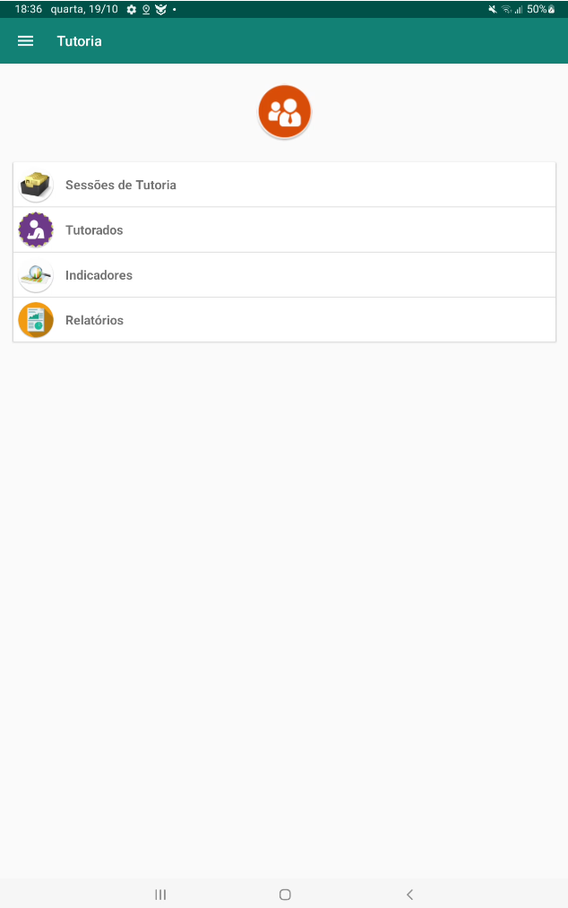
Clinical Mentoring Program
FGH district-based team provides clinical mentoring to enhance technical skills of employees hired through sub-agreements.
Team includes physicians, clinical officers, psychologists, maternal and child health nurses, and pharmacy and laboratory officers.
Use of an internally developed mobile application for mentoring based on MOH-approved tools.
Mentoring mobile applications is now being adapted for nationwide implementation under the leadership of the MOH

Slide 8
Number of HRH Supported Through Sub-agreements
The number of HRH supported saw a significant increase in 2021 as a response to the COVID-19 pandemic.
Health providers were allocated to perform community ART distribution and support activities at health facilities to mitigate the impact of the pandemic.
Absorption rates of HRH into the National Health System are dependent on existing vacancies. This fluctuates annually based on the capacity of the health system.

Slide 9
Transition of PEPFAR Support from FGH to Local Entities
Zambézia Province has advanced significantly in epidemic control against other provinces in the north of Mozambique.
Pilot intervention to transition CDC support from international NGOs to local entities
Since October 2023, FGH is piloting the complete transition of funding to Provincial and District Health Authorities in one district
District health authorities sub-agreement to support HRH transitioned from FGH to Provincial Health Authorities which now directly receive CDC/PEPFAR Funds
  Districts already have experience with management of these sub-agreements
FGH Health Management Mentoring team now supports provincial health authorities in the management of the sub-agreement
FGH Clinical Mentoring team now supports district health authorities mentors who provide direct mentoring to staff from graduated health facilities
Intervention will be expanded to a total of five districts in the next funding cycle

Slide 10
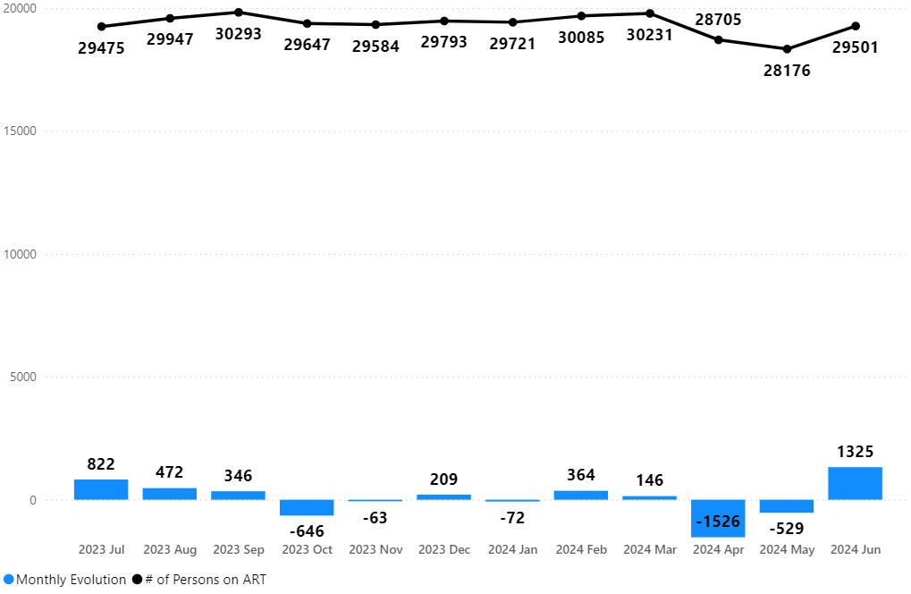
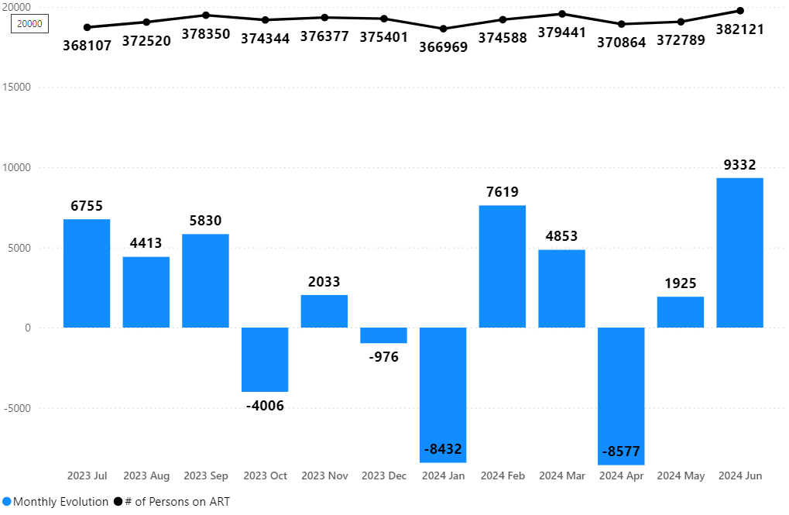
Number of Persons on ART in Transitioned District
Transitioned District
Provincial Trend

Slide 11
Conclusions and Next Steps
Successful collaboration between FGH and district health authorities through sub-agreements has strengthened HRH.
Supplementary financing and strategic support have ensured that HRH and operational expenses are managed more efficiently, aiding in the sustainability of health services.
Use of internally developed mobile applications for mentoring has streamlined processes and ensured the use of MOH-approved tools.
Pilot interventions are transitioning support from international NGOs to local health authorities, potentially demonstrating a viable model for sustainable health system strengthening.
Continued focus on capacity building and sustainable financing will be crucial in maintaining and expanding high-quality health services within resource-constrained settings.

Slide 12

Acknowledgements
Irene Benech, CDC Mozambique
Ishani Pathmanathan, CDC Mozambique
Leide Dique, CDC Mozambique
C. William Wester, VUMC, TN, USA
Julie Lankford, VUMC, TN, USA
Oscar Awad, SPS Zambézia, Mozambique
Blayton Caetano, DPS Zambézia, Mozambique
Efthymios (Themos) Ntasis, FGH Mozambique
Julieta Matsimbe, FGH Mozambique

