Slide 1

Implementation Science for the Public Health Workforce
Dr. Eleanor Namusoke Magongo
MBChB, MMED Pediatrics and Child Health
Paediatrics & Adolescent HIV Team Lead
Ministry of Health Uganda

Slide 2
Presentation Lay Out
3 Dimensions of the public health work force/worker
Definitions of implementation science
Key steps required to translate research findings into policy & practice
Barriers and solutions to implementation of EBI and strategies with Uganda specific examples

Slide 3
3 Dimensions of the Public Health Workforce/Worker
The worker; defined by formal education attained - doctors, nurses etc
The work setting; defined by where one works such as local, regional, or at national level
The work; defined as the goal of work or responsibility like policy makers, infection control, health promotion and curative services
Kristine Gebbie, Jacqueline Merrill and Hugh H. Tilson, The Public Health Work Force Health Affairs, 21, no.6 (2002):57-67, doi: 10.1377/hlthaff.21.6.57

Slide 4
Implementation Science Definitions
The scientific study of methods and strategies that facilitate the uptake of evidence-based practice and research into regular use by practitioners and policymakers - University of Washington
The study of methods to promote the adoption and integration of evidence-based practices, interventions, and policies into routine health care and public health settings to improve our impact on population health – National Cancer Institute, NIH
The study of methods and strategies to promote the uptake of interventions that have proven effective into routine practice, with the aim of improving health- NIHR, Applied Research Collaboration, North London

Slide 5
3 Key Steps
-Policies & guidelines
-HRH
-Capacity building
-tools
-Supervision & mentorship
Adoption & Integration of evidence-based practices, interventions into policy
Implementation of the evidence-based practices and interventions
Continuous evaluation to assess impact on health
-Stakeholder engagement
-Policy briefs
-Policy review and development
Policy
makers
Implementers
-Clear program deliverables
-Basic research skills
Researchers

Slide 6
Step 1: Adoption into policy to implementation
Some key Barriers
Possible solutions
Stakeholder input in intervention design
Prioritize funding for implementation of EBIs
Utilize technology to disseminate policies; virtual vs in-person meetings, Apps
Align policy reviews and review of data tools
Innovative accountability platforms like ECHO meetings
Intervention characteristics and context of implementation
Inadequate funding
Ineffective dissemination of policies and lack of tools
Mismatch between policy reviews and revision of data tools
Limited supervisions following policy reviews – resource constrains
Implementation Science and Its Application to Population Health, Rebecca Lobb and Graham A. Colditz Annu Rev Public Health. 2013; 34: 235–251.

Slide 7

Paediatrics & Adolescent HIV Learning Collaborative for Africa (PAHLCA)
To foster learning, innovation, & collaboration among countries on the African continent
Provide a platform for sharing materials that can be used to improve pediatric & adolescent HIV programs, e.g. Guidelines, Curricula, job aids, toolkits, implementation frameworks etc.
Maintain an updated directory of Ministry of health paediatric & adolescent HIV focal persons to ease communication, coordination & sharing across countries
Facilitate networking among country teams to form research collaborations for multi-country studies to improve pediatric & adolescent HIV services
5th PAHLCA Meeting, Maputo Mozambique on the 7th-8th May 2023

Slide 8
Step 2:Implementation to Research/Evaluation
Barrier
Limited research experience among policy makers & program implementers
Lack of access to research funds
Researchers and policy maker work in silos, with most policy makers & implementers involved at the tail end of the research process
Research questions are not based on program needs & not applicable to the program
Possible Solution
Research capacity building intiatives targeting the public health workforce; policy makers & program implementers
Change funding modalities to consider governments institutions
Form meaningful research collaborations between researchers & policy makers, and implementers

Slide 9


International Paediatric HIV/AIDS Symposium for Africa (IPHASA)
Abstract-driven meeting
Held every 2 years
Implementation science oriented
ISR grants offer including a peer-peer learning visit
Partnering with HIGH IRI to deliver the ISR capacity building session for IPHASA
Welcome to Uganda- IPHASA 2024
Dates: 3rd -5th December 2024
Where: Kampala, Uganda
Venue: Mestil Hotel
Format: In-person
Colour theme: Green

Slide 10
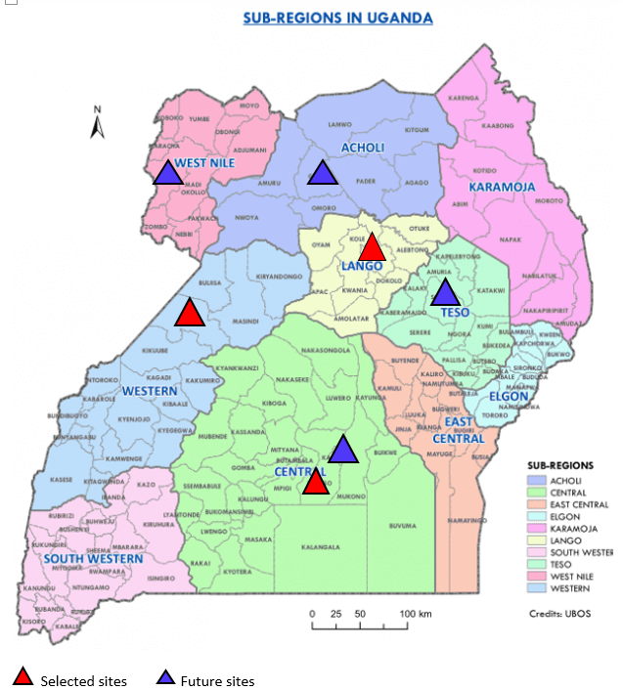
Uganda Pediatrics ART (UPART) Cohort
Aim: To establish an observational cohort in representative facilities to assess the uptake and impact of new treatments in children, building upon existing data systems to inform national programme planning and global research and to strengthen capacity
Led by the Ugandan Ministry of Health (MoH) with support from EPPICC team at University College London
Seed funding: International AIDS Society (IAS), WHO, UNICEF and UCL
Phase 2 funding from ViiV Health Care ( confirmed) and UNITAID ( yet to be confirmed)

Slide 11
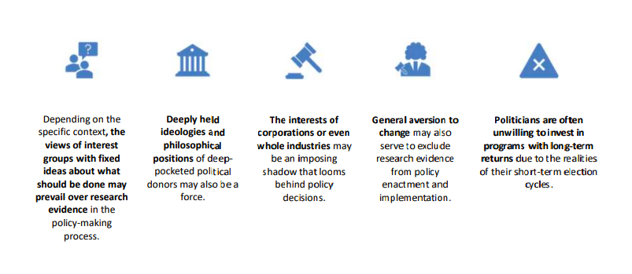
Step 3: Evaluation/Research findings to Policy
Why policy making goes wrong
Notes:
Most HIV programs

Slide 12

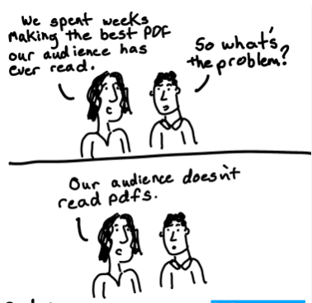
What are they talking about?
-Cox Regression
-P-Value
-Time to event analysis
-Kaplan Meier curve
-Intention to treat analysis
The Researcher
The Policy Makers
Solution: Disseminate research findings in a language that is understandable to policy makers
Notes:
Research findings are usually presented in a format that is sometimes difficult for policy makers to comprehend.

Slide 13

Mismatch between research dissemination and policy review periods
Solutions: Co-opt researchers to technical working groups that review policies to allign research results dissemination to policy review period

Slide 14

Capacity building opportunities for the public health workforce
One- year online course in collaboration with UCSF
11 weeks course in collaboration with University of Washington
Monthly ISR Journal clubs
Developing a diploma course in Implementation science research

Slide 15


Uganda HIV/AIDS Implementation Alliance (U-AHISA)
Inaugural Meeting of the National Implementation Science Alliance 2020

Slide 16
Summary
There is need to train the public health workforce in research skills
Stakeholder engagement is critical across the 3 steps above
Meaningful collaborations between the policy makers, implementers and researchers

Slide 17
Acknowledgements
Ministry of Health Uganda
Afya Bora Global Health Leadership Training team
Makerere Implementation Science (MAK-IMS) Project
Adolescent HIV Prevention, Care and Treatment Implementation Science Alliance (AHISA)
HIV, Infectious Disease and Global Health Implementation Research Institute (HIGH-IRI)
University College of London team
UN family, PEPFAR, CHAI, EGPAF, PATA and all the Paediatric & Adolescent HIV Stakeholders
Funders: ViiV Health Care, Johnson & Johnson, IMPAACT

Slide 18
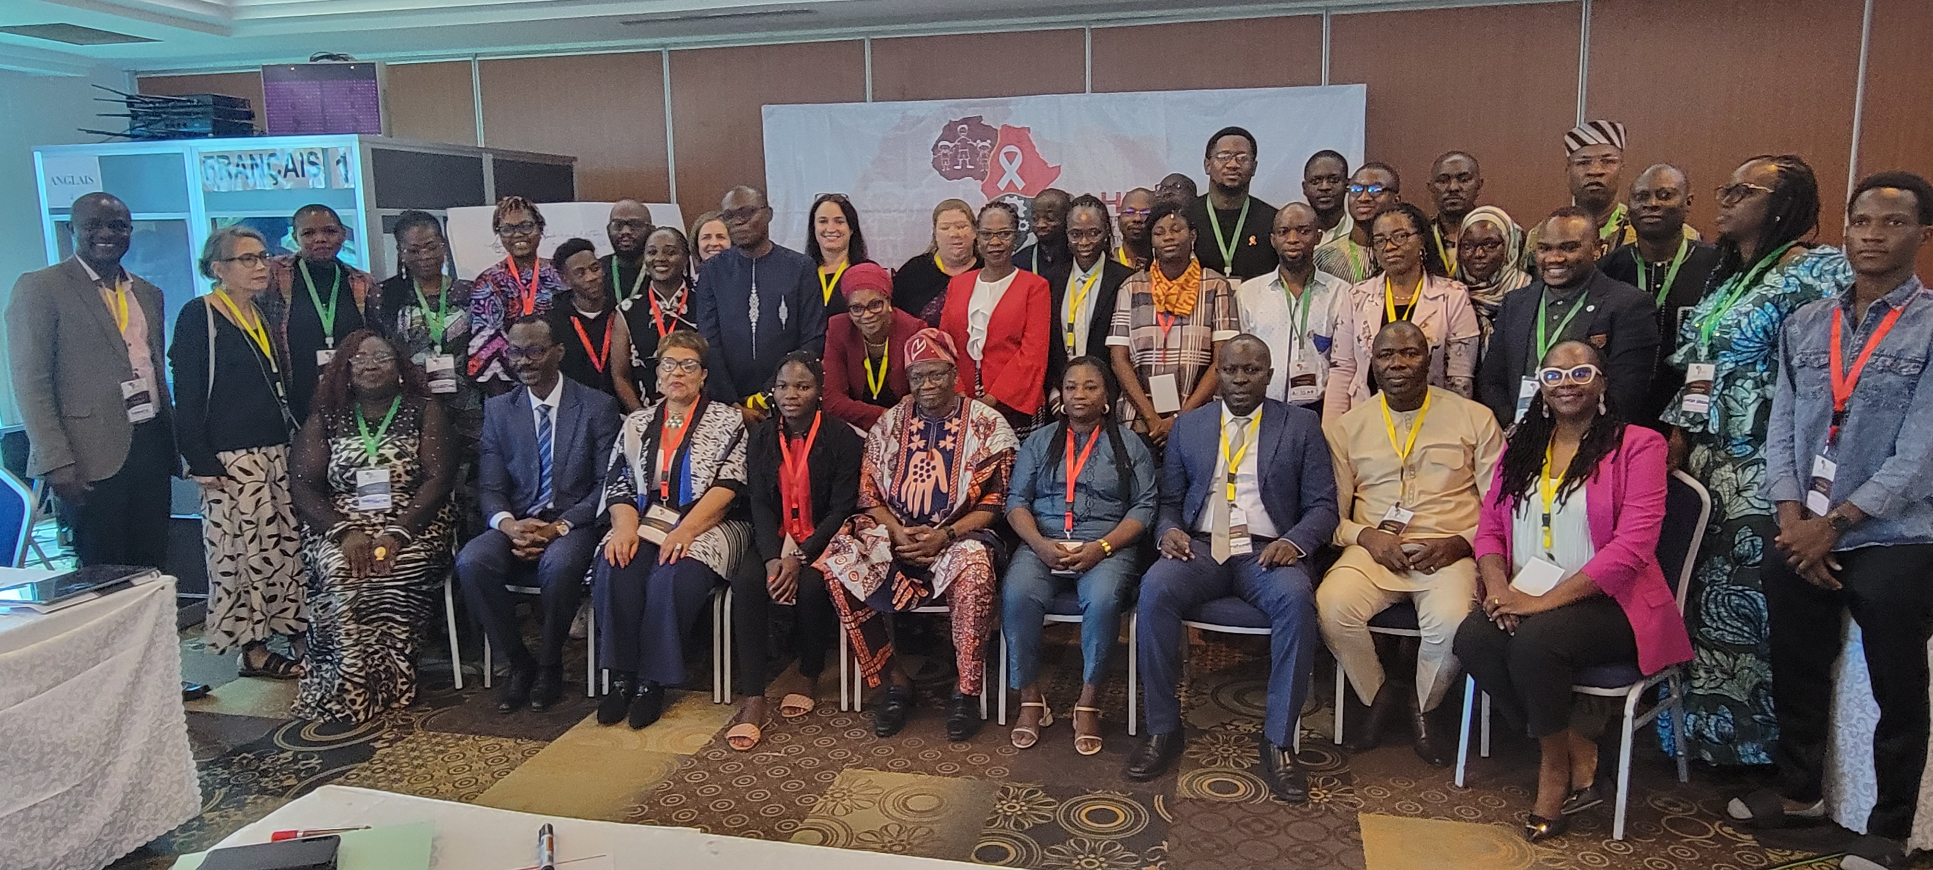
THANK YOU

