Slide 1

Beyond Academia:
How Community-led Science can Deliver at Scale
Solange Baptiste, ITPC Global
Securing progress and extending impact: Implementation science & the HIV response

Slide 2
By show of hands, how many of you self-identify as a researcher and/or a scientist?

Slide 3
As a researcher or scientist, how many of you have been part of a research project where the community led and supervised the research design, implementation, and analysis?

Slide 4

What is Science?
A systematic approach to understanding the natural world through observation, experimentation, and evidence-based reasoning.
Observation: Carefully observing phenomena and gathering data.
Hypothesis: Formulating testable predictions based on observations.
Experimentation: Conducting controlled experiments to test hypotheses.
Analysis: Analyzing data to determine whether the evidence supports or refutes the hypothesis.
Conclusion: Drawing conclusions and refining theories based on the evidence.
Peer Review: Sharing findings with the scientific community for evaluation and validation.
Repeatability: Ensuring that experiments and results can be repeated and verified by others.
https://www.euroschoolindia.com/blogs/what-is-learning-science-why-does-it-matter/
Science is a collaborative and iterative process that seeks to explain how things work,
predict future outcomes and solve practical problems.

Slide 5

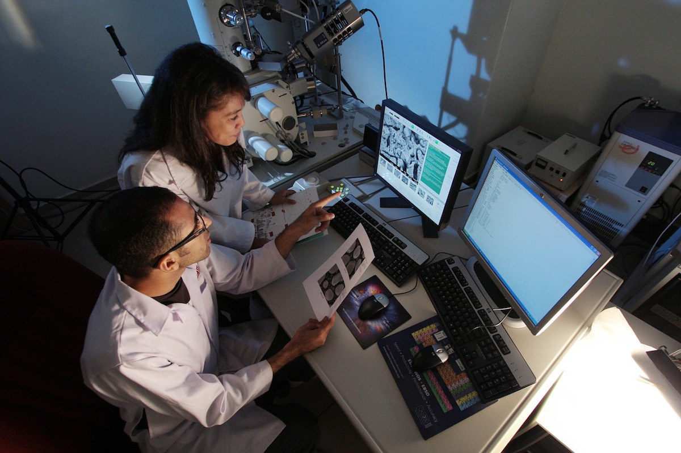
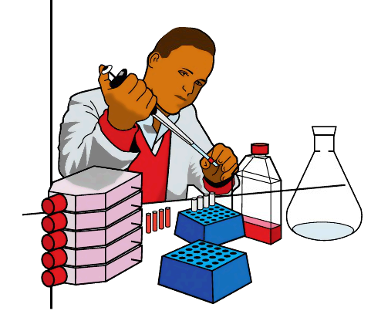

Who owns Science?
Everyone and no one!
https://graduate.northeastern.edu/resources/working-in-industry-vs-academia/
https://www.eiu.com/n/how-will-the-coronavirus-affect-outbound-chinese-students/
https://clipart-library.com/clipart/968544.htm
Traditionally dominated by:
Academic Institutions: Universities and research institutions conduct a significant portion of scientific research and contribute to the body of scientific knowledge.
Government Agencies: Government-funded organizations and agencies (e.g., NASA, NIH) support and regulate scientific research, ensuring it serves public interests.
Private Sector: Companies and private research organizations conduct research, often focused on applied science and technology development.
https://80000hours.org/career-reviews/academic-research/
Notes:
Science, in its ideal form, is owned by no one and belongs to everyone. It is a collective endeavor driven by curiosity, inquiry, and the pursuit of knowledge for the benefit of all humanity. However, several entities play key roles in the practice and dissemination of science:
Academic Institutions: Universities and research institutions conduct a significant portion of scientific research and contribute to the body of scientific knowledge.
Government Agencies: Government-funded organizations and agencies (e.g., NASA, NIH) support and regulate scientific research, ensuring it serves public interests.
Private Sector: Companies and private research organizations conduct research, often focused on applied science and technology development.
Non-Profit Organizations: Various non-profit and non-governmental organizations fund and conduct research, particularly in areas that may be underfunded by other sectors.
Individual Scientists: Researchers and scientists contribute to the body of scientific knowledge through their work, publications, and discoveries.
The Public: Public engagement, citizen science initiatives, and community-led science efforts ensure that science remains connected to and benefits society at large.

Slide 6
Who is often missing or an afterthought …in Science?
The Public
Public engagement, citizen science initiatives, and community-led science efforts ensure that science remains connected to and benefits society at large.
https://80000hours.org/career-reviews/academic-research/
Notes:
Science, in its ideal form, is owned by no one and belongs to everyone. It is a collective endeavor driven by curiosity, inquiry, and the pursuit of knowledge for the benefit of all humanity. However, several entities play key roles in the practice and dissemination of science:
Non-Profit Organizations: Various non-profit and non-governmental organizations fund and conduct research, particularly in areas that may be underfunded by other sectors.
Individual Scientists: Researchers and scientists contribute to the body of scientific knowledge through their work, publications, and discoveries.
The Public: Public engagement, citizen science initiatives, and community-led science efforts ensure that science remains connected to and benefits society at large.

Slide 7
What is Community-led Science?
Community Leadership
Community-led interventions
Community-led strategy
Community-led science
Community-led implementation
Community-led research
Community-led monitoring
Notes:
Strategies: Community-led strategic planning and decision-making to address local needs and priorities. Community-Driven Policy Advocacy Community groups gathering evidence to influence public policy. For example …Advocacy groups conducting surveys and collecting testimonies to push for better healthcare policies for marginalized groups.
Science: Community-led research initiatives such as Community-Led Monitoring (CLM), Citizen Science, Participatory Action Research (PAR), and Community-Based Participatory Research (CBPR).
Implementation: Community-driven efforts to put strategies, designs, and policies into practice, managing projects, delivering services, and ensuring effective execution

Slide 8

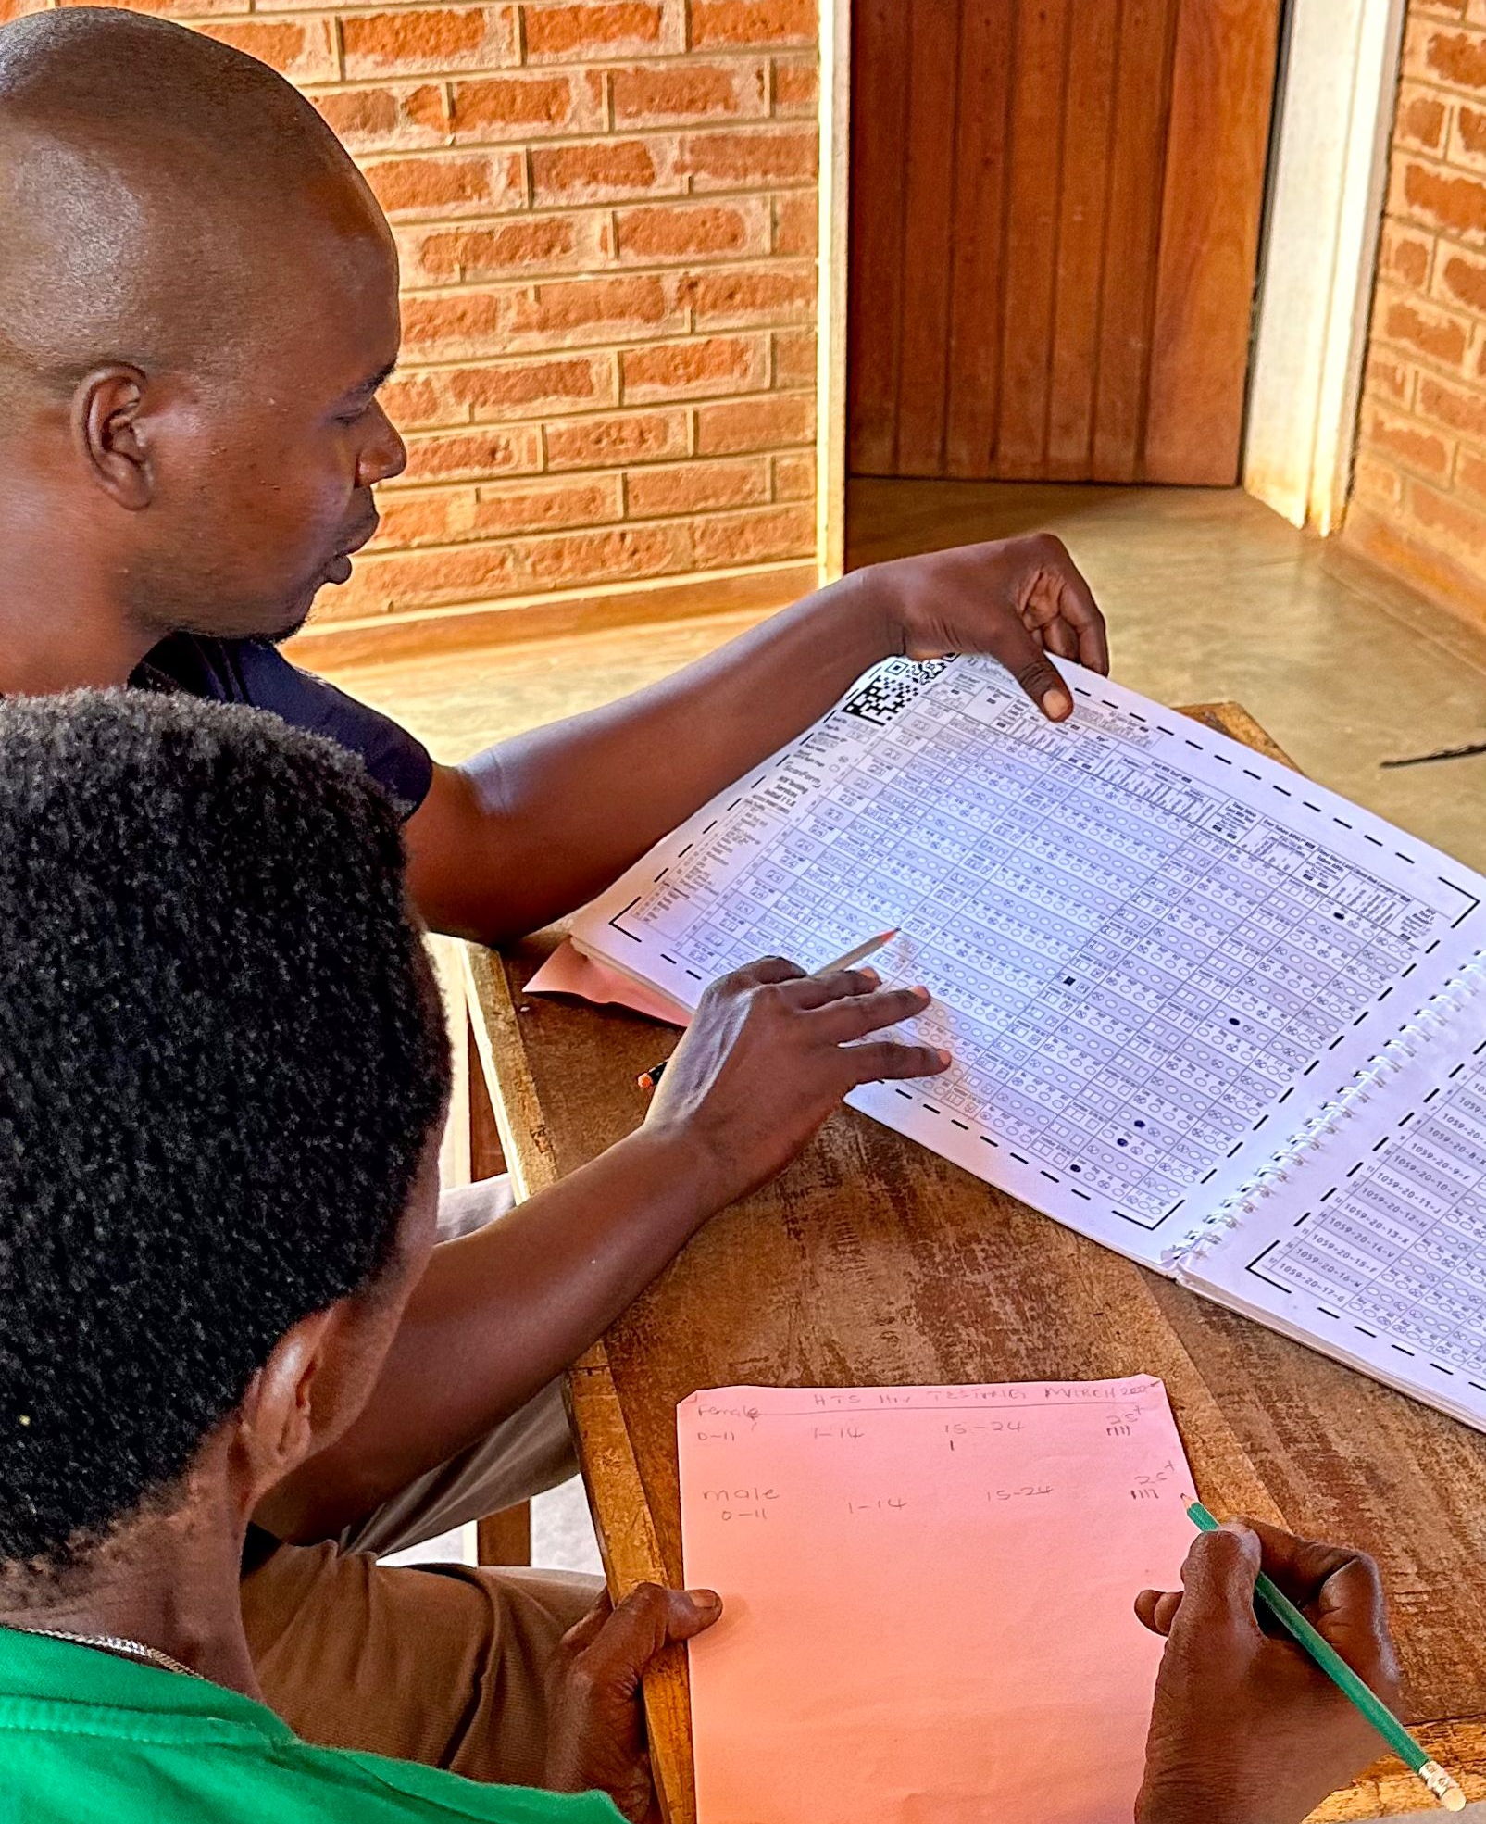
Community-led monitoring is
…a science-based accountability innovation that puts communities first.
Notes:
CLM is a process where communities take the lead to routinely monitor issues that matter to them.
Communities then work alongside policymakers to co-create solutions to the problems they have identified.
When problems uncovered through CLM aren’t resolved, communities escalate with evidence-based advocacy and campaigning until they achieve implementation of corrective actions by duty bearers.

Slide 9

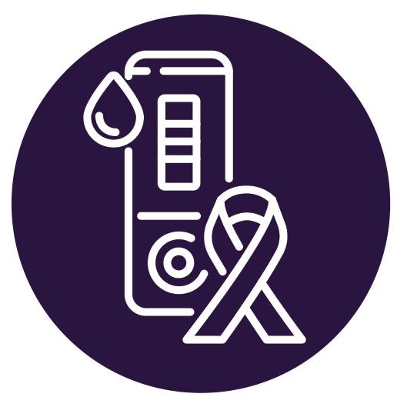
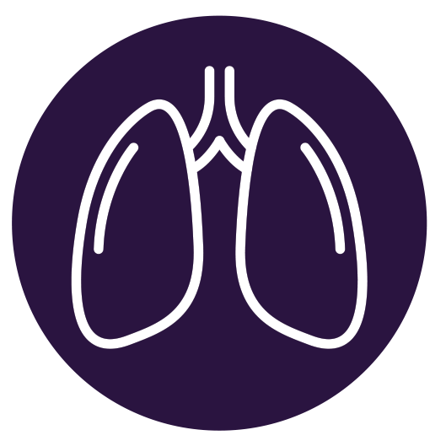




Top-line Outcomes from CLM in 2023
SOUTH AFRICA
🌟
Following PrEP-related CLM feedback sessions with facility managers, people who visited our 19 monitored sites were 32% more likely to initiate PrEP following an HIV test compared to the other 70 West Rand health facilities (1.32 OR 95% CI 1.27-1.38).
The percentage of older men living with HIV who know their status increased from 86.8% in 2022 to 88.9% in 2023, following a CLM data-driven campaign to increase community-led HIV testing from 20.4% in 2022 to 33.6% in 2023 (UN target achieved).
After using CLM data to alleviate stockouts of TB medicines, the treatment success rate at our CLM sites increased from 88% in 2022 to 91% in 2023, surpassing the End TB target of 90% by 2025 as well as South Africa’s national treatment success rate of 79%.
Enhanced patient tracking for pregnant foreign nationals was implemented based on CLM insights. In 2023, women at our monitored sites were twice as likely to deliver in the health facility as compared to other West Rand facilities (1.99 OR 95% CI 1.51-2.62), reducing risk of vertical transmission.
When CLM data suggested HIV/SRHR service integration would increase HIV testing uptake (r = 0.36, p = < 0.001), we promoted this approach. In 2023, the cost to diagnose one AGYW living with HIV was cheaper at our CLM sites, at $2,852, compared with $4,154 at non-CLM sites (in terms of numbers needed to test).
Notes:
PrEP: Our 2022 CLM data show that 20-24-year-olds had the lowest PrEP uptake among women, despite having the highest HIV incidence rate. CLM data indicated. We reviewed interview transcripts to identify barriers. Many young women showed limited to no understanding of PrEP (especially new forms), and most had never been offered the service. Two said they were offered it only during their pregnancy. We advocated with facility managers (and also held a meeting with the Department of health) to increase PrEP initiations, especially among young women.
Men and HIV Testing: Through our CLM, we discovered a strong preference for community-led HIV testing services among men aged 25 years and older. At our monitored government sites, just 5.6% of HIV tests in 2022 were among men aged 25 years and older, compared to 35.5% of tests at our monitored community-led sites. We analyzed 47 interview transcripts among men aged 25-34 years to understand their barriers to HIV testing. Participants expressed views that the non-governmental organizations are ‘specialists’ in HIV testing, so they prefer to go there. Increasing community-led testing appeared to be a good strategy to reach and diagnose more men living with HIV. we used our CLM data to further promote community-led HIV testing among older men, recommending the strategic placement of community-led testing sites along busy transport routes, reaching long-distance truck drivers. We also advocated for health facilities to distribute more test kits through community organizations with whom they work in partnership. The district prioritized community-led testing in 2023. The number of HIV tests at community-led sites more than doubled, from 20,191 in 2022 to 46,891 in 2023.
TB Stockouts: Recurring stockouts at 2 facilities in particular. Urged them to move to a proactive (rather than reactive) approach to stock monitoring, including forecasting, so that orders are placed before stockouts occur. Treatment success rates rebounded accordingly.
Early access to facility-based antenatal care (ANC) is important for optimal prevention of mother-to-child transmission (PMTCT), including ART for pregnant women living with HIV. Women who deliver outside of health facilities are less likely to receive ART and quality obstetric care and may suffer complications leading to vertical HIV transmission. We began closely monitoring PMTCT indicators after South Africa joined the Global Alliance to end AIDS in Children in February 2023. Major theme emerged: many of the late visits were from foreign nationals. We encouraged health talks for women of childbearing age and improved tracking. Early ANC presentation at our monitored sites increased from 71% in the first half of 2023 to 75% in the second half.
Our CLM data showed a moderate correlation between (a) HIV testing and (b) provision of contraceptive services among AGYW 15-24 years at our CLM sites in 2023 – so we worked to integrate these services, AND to offer moonlight testing (extended hours as many young women could not access health services during school hours). In 2023, our 19 CLM sites needed to do 92 HIV tests among young women aged 15-24 years to diagnose one living with HIV. The remaining 69 non-CLM West Rand sites had to do 134 tests for the same result. With a unit cost of US $31, the cost to diagnose one AGYW living with HIV (in terms of numbers needed to test) at our CLM sites was $2,852, compared with $4,154 at non-CLM sites

Slide 10



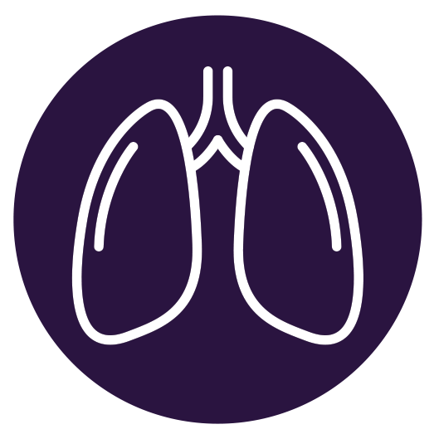



Top-line Outcomes from CLM in 2023
MALAWI
🌟
People accessing ART at sites with a CLM-informed DSD strengthening intervention were six times more likely to be in a DSD model (6.79 OR 95% CI 6.04-7.63) and twice as likely to be virally suppressed (2.34 OR 95% CI 2.16-2.54) as sites without DSD strengthening.
The number of HIV tests among young sex workers doubled (from 217 in 2022 to 434 in 2023), as did HIV positivity (from 1.7% to 2.4%), following CLM engagements with district hospitals to designate key population focal points and KP clinic spaces.
CLM data was used to engage District Condom Coordinators and train condom distributors, which led to a 23.4%
increase in condom distribution in 2023. This contributed to fewer new infections in the two districts, which fell from 868 in 2022 to 632 in 2023.
CLM advocacy secured a commitment from the Global Fund to procure 50 new GeneXpert machines. As a result, 39% of TB tests at our CLM sites in 2023 were Xpert tests, up from 18% in 2022. People diagnosed with TB and enrolled onto treatment nearly tripled, from 320 in 2022 to 907 in 2023.
Following CLM advocacy to expand static VMMC sites, the proportion of circumcisions among men aged 15 years and older increased from 77% in 2022 to 82% in 2023. According to the Naomi model, there were 205 new HIV infections among men in this age group in the two districts in 2023, down from 284 in 2022.
Notes:
DSD uptake: Differentiated service delivery (DSD) models have been shown to improve viral load suppression. In Malawi, DSD guidelines exist but coverage of DSD models remains low. We monitored those accessing ART through DSD models, including 6-month dispensing, teen clubs, after hours, and alternative pick-up points – the percentage was low, just 27% at our 14 monitored sites. In 2023, in collaboration with the HIV Coverage, Quality, and Impact Network (CQUIN), we supported three DSD strengthening interventions in 7 of our 14 monitored sites. We supported the establishment of 14 community-level platforms aimed at gathering the views of people living with HIV on various DSD models, organized 25 trainings for peer educators and people living with HIV on DSD, and implemented 8 community score cards and/or client satisfaction surveys for DSD.
Increasing HIV testing among young sex workers: In Malawi’s most recent integrated biological and behavioral survey among sex workers, 18.1% of 15-19-year-olds and 21.5% of 20-24-year-olds, respectively, tested HIV-positive for the first time during the survey. Identifying and treating young sex workers living with HIV is essential to leaving nobody. We engaged with government hospitals about creating safe spaces for sex workers to encourage service uptake. HIV tests among young sex workers doubled at our monitored sites.
Condom uptake: In the last half of 2022, 1,841,472 condoms were distributed at our monitored sites, only 3,870 of which were female condoms. According to UNFPA, advisable distribution is 450 female condoms per 10,000 population for a three-month period. The catchment area of our 24 facilities is an estimated 559,427 people. This means that ideal distribution should have been more like 50,348 female condoms. Many recipients of care that we interviewed spoke about difficulty accessing female condoms. In the second half of 2023, 2,272,597 condoms were distributed at our 14 monitored sites, including 21,593 female condoms. This represents a 23.4% increase in total condom distribution, and a more than 5-fold increase in female condom distribution
TB and GeneXpert machines: In 2022, there were 589 TB tests at our 14 monitored sites, but just 108 (18%) of these were done using GeneXpert. Data collectors’ field notes shed light on the reasons. A total of 24 out of 58 clinic records surveys indicate a lack of health equipment as the main reason for limited GeneXpert and Urine LAM testing. One data collector recorded that “healthcare workers have been trained for Urine Lam and are waiting for equipment for the service” (Data collector EK, MW08, September 2022).
In 2022, 23% of all circumcisions at our monitored sites were among boys aged 14 years and younger and 77% were among men and boys aged 15 years and older (Figure 21). We realized that VMMC services were limited to the two District Hospitals only (MW01 & MW07), with the others only providing VMMC through mobile clinics that rely on donor funding and availability of the project implementing partners. For instance, one healthcare worker said “VMMC, we had a provider who was doing this but as of now we don’t have one” (female, 42, MW08, 26 November 2022). Another said, “as of now we are no longer doing we VMMC, but it used to happen in the past” (healthcare worker, male, 32, MW06, 15 May 2022). Our data suggested that demand for VMMC services was not properly matched with supply, which was impacting negatively on client experiences and deterring clients from referring their peers for circumcision. This is especially true for older men, who may have taken time off work to seek a service that is suddenly no longer offered.

Slide 11
Three Considerations for Delivery at Scale

Slide 12
Right-sizing for Scale
1️⃣
How much data? Too much or little?
What form of data is strategic?
Data: timeliness vs. completeness?

Slide 13
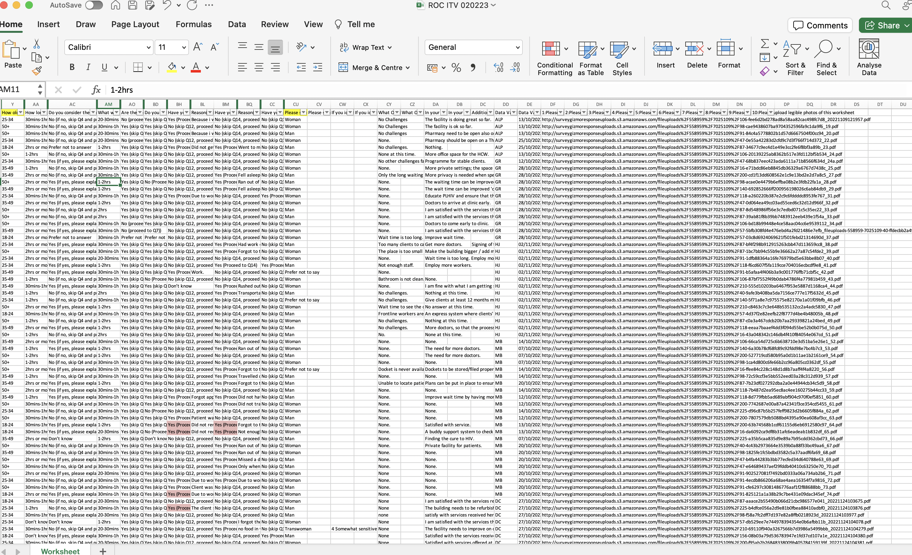


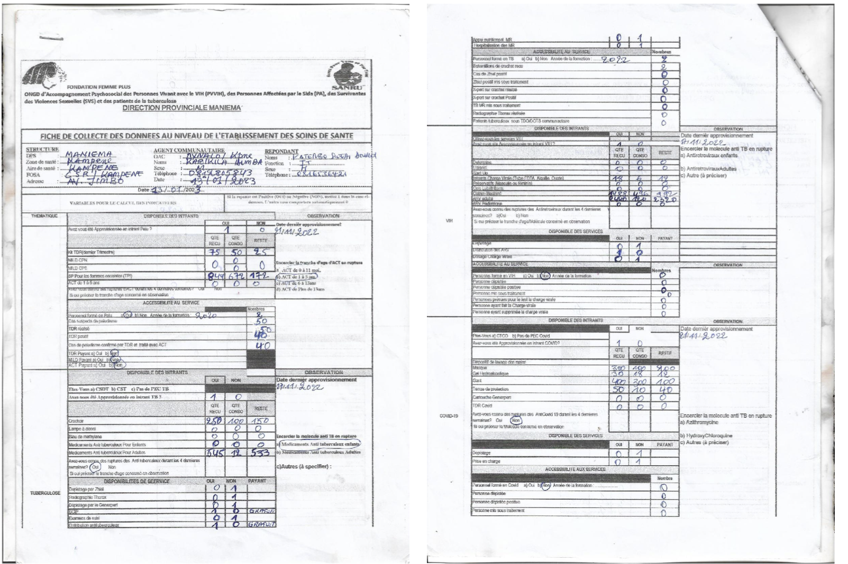
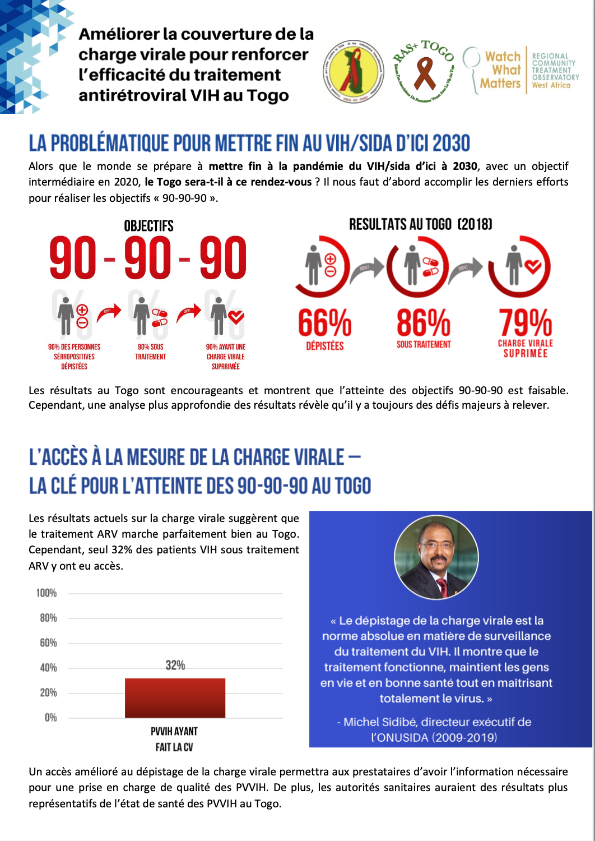
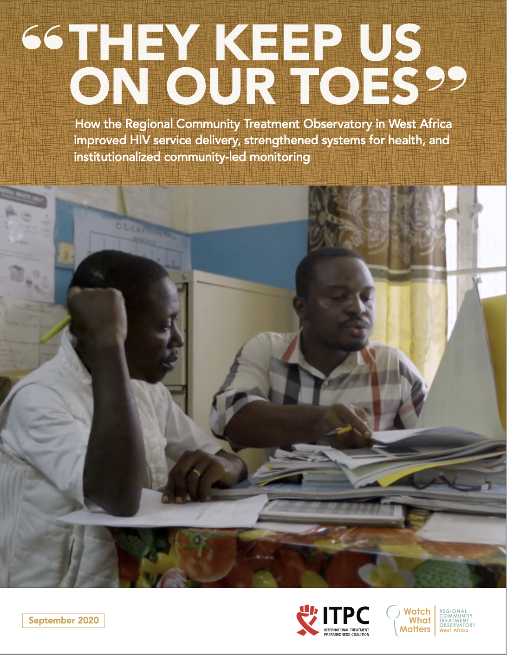
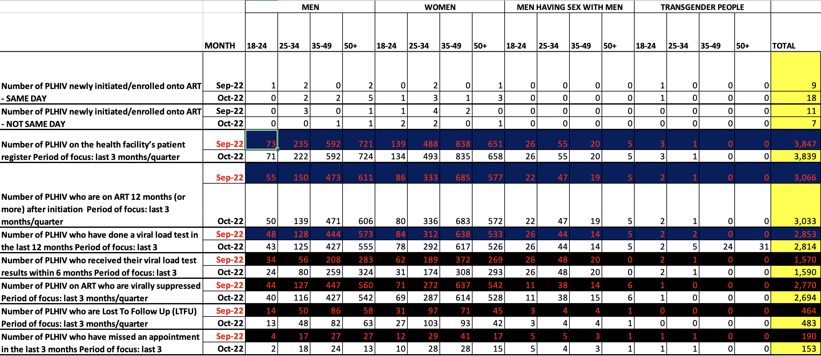
Data collection tool
Database
Data
Overwhelm?
Reports and material for advocacy & change
Cleaned data ready to analyse

Slide 14
Right-sizing Considerations for Scale
Insights:
More indicators = more cost & time
Not all indicators demonstrate findings or changes
Data overwhelm is common; unanalyzed findings or analyzed findings that aren’t used for decision-making
Adjustments
Fewer indicators > many indicators
Toggle indicators ON and OFF
  Turn off if not providing insights
Re-think data collection strategies
  Annual themes to align with policy cycles?
  Planning to ensure robust community data is available when decisions on key topics are being made?

Slide 15
Costs & Sustainability for Scale
2️⃣
How many sites should be monitored?
Who should fund/funds community-led efforts?
What level of effort is sustainable?

Slide 16
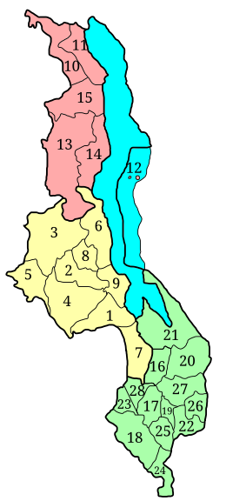
Monitoring Approaches
Fewer, indicative monitoring sites
Many, concentrated monitoring sites
Notes:
Two different monitoring approach models (using Malawi as a demonstration country example – this is illustrative, not representative of the location or density of actual monitoring sites)

Slide 17
Costs & Sustainability Scale Considerations
Insights:
More sites = more cost & time
Primarily local data for local change (so far)
Lack of nationally coordinated monitoring approach
  Many different sites supported by different funders operating in siloes
Establishing new dialogue and advocacy spaces
Adjustments
Fewer sites > many sites (?)
  Site graduation?
  Site rotation?
Regional data to inform national decision-making?
Planning and coordination to make the most of ongoing monitoring efforts
  Central planning
Strengthen existing dialogue and advocacy spaces (clinic committees?)

Slide 18
Collaboration & Community Data Integration for Scale
3️⃣
Are decision-makers using community data?
What are the barriers to community data use?
What can we learn from positive examples?

Slide 19
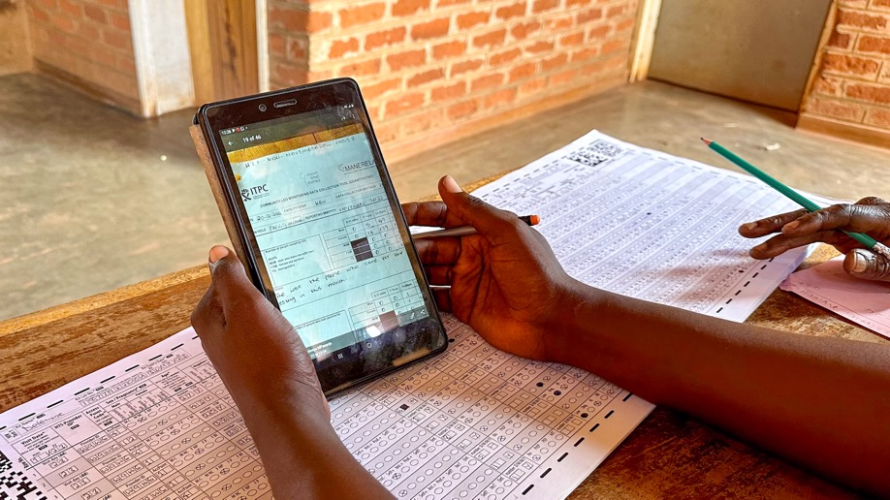

Analytical Power
Government Information Systems
Community-led Information Systems
Photo: Citizen Science data collectors analysing HIV registers at the Bua Health Center in Kasungi, Malawi, April 2023
Notes:
Combining the analytical power of government health information systems and community data can bring forward highly strategic insights that help better tailor programs and services for recipients of care. For example, in the West Rand, South Africa, our implementation partner NACOSA established a partnership with the Department of Health that allowed for greater data transparency, including access to government health information systems (DHIS2). This enabled the ability to compare outcomes at CLM-monitored sites vs. non-monitored sites, and the analysis was used to develop new programs that addressed identified gaps (For example: Community data indicated a low HIV testing rates among older men, coupled with a preference for community-based rather than facility-based HIV testing among this group. The percentage of older men living with HIV who know their status increased from 86.8% in 2022 to 88.9% in 2023, following a CLM data-driven campaign to increase community-led HIV testing (community0-led testing went from 20.4% in 2022 to 33.6% in 2023 thanks to this community-government collaboration, which also met and exceeded the UN target of 30% community-led testing sites. (UN target achieved).

Slide 20
Scale Considerations:
Collaboration and Integration
Insights:
Valuable community data is being unused
Community-led science pinpoints health system problems faster and offers practical solutions from end users
Perception that communities are separate (and only antagonistic) toward duty-bearers such as government health systems, elected officials
Adjustments
Greater data transparency needed
  Public Dashboards for community data
  More strategic data collection cycles
  Community access to govt data
Evidence of targeted solutions brought forth by community-govt partnerships
Further publicize examples of highly effective collaborations for positive outcomes

Slide 21
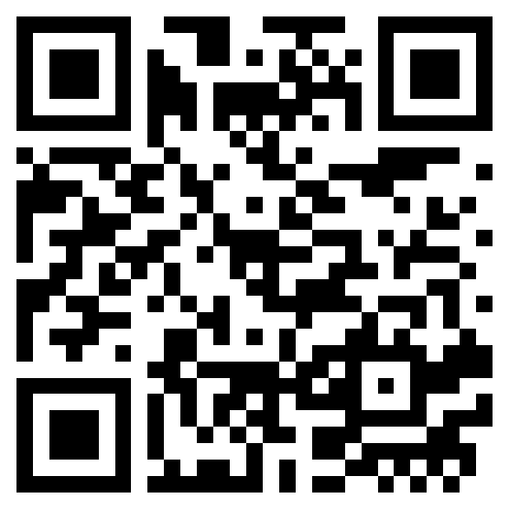
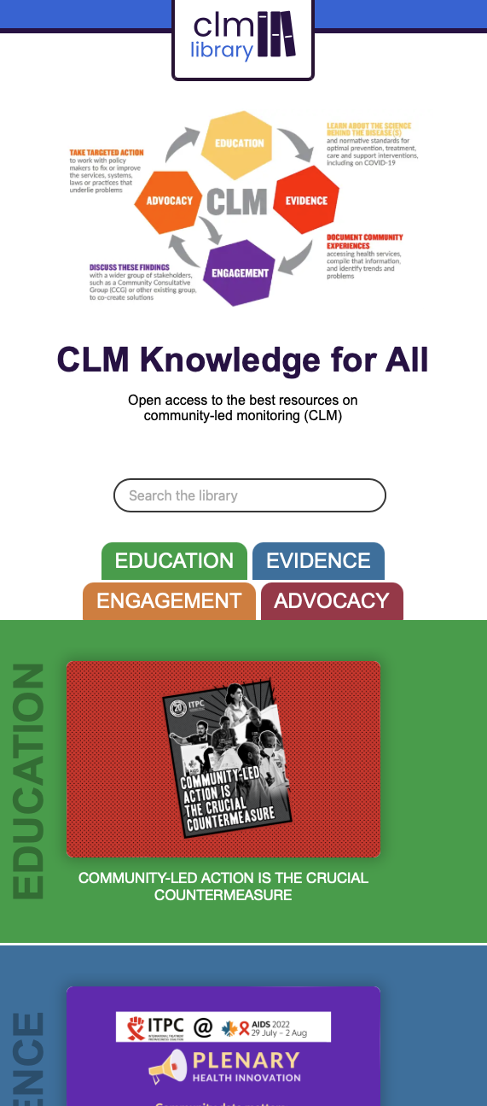
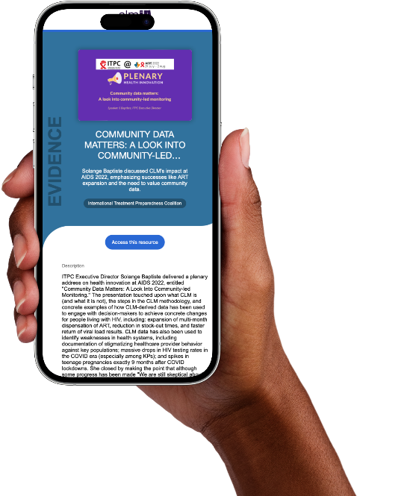

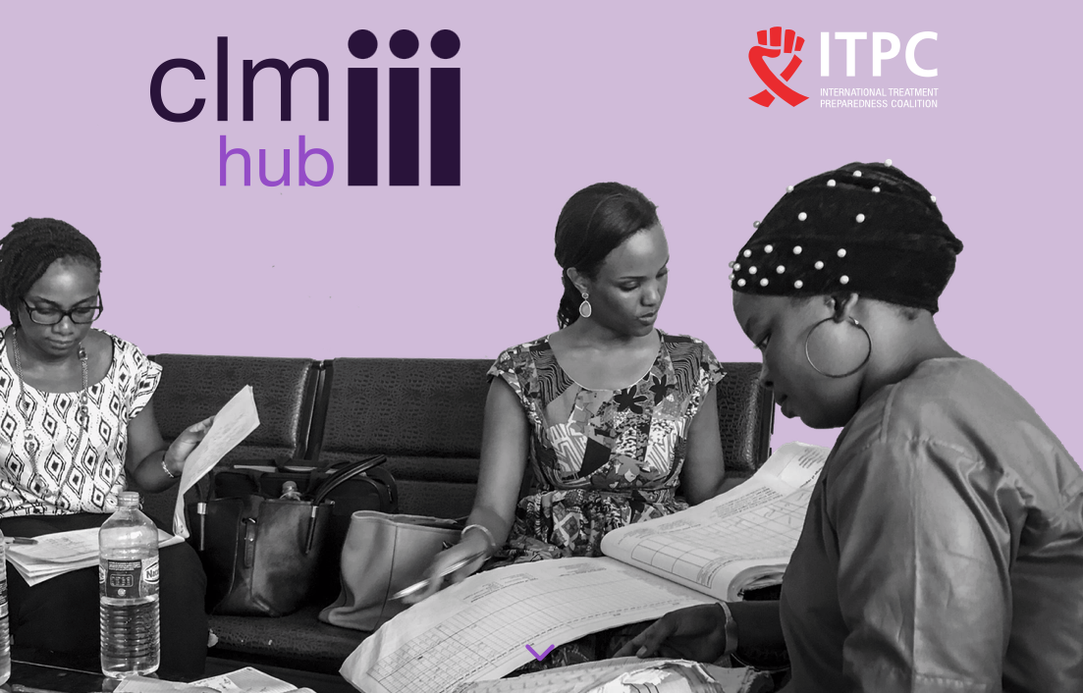
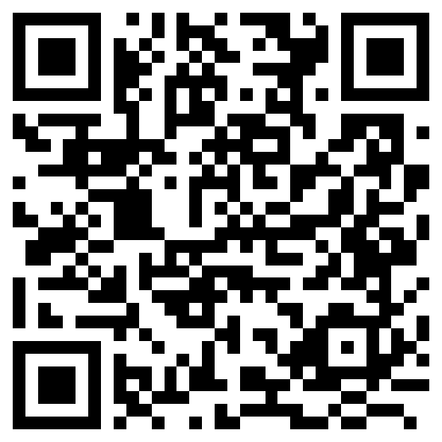

CLMHub.org
Learn more at
Notes:
The CLM Hub includes the principles of CLM, methodology, best practices, toolkits and guides and is divided into easy-to-use sections

