Slide 1

Changing Policy Through Science
Gregorio Millett
Director of Public Policy
amfAR, Foundation for AIDS Research
July 20, 2024

Slide 2
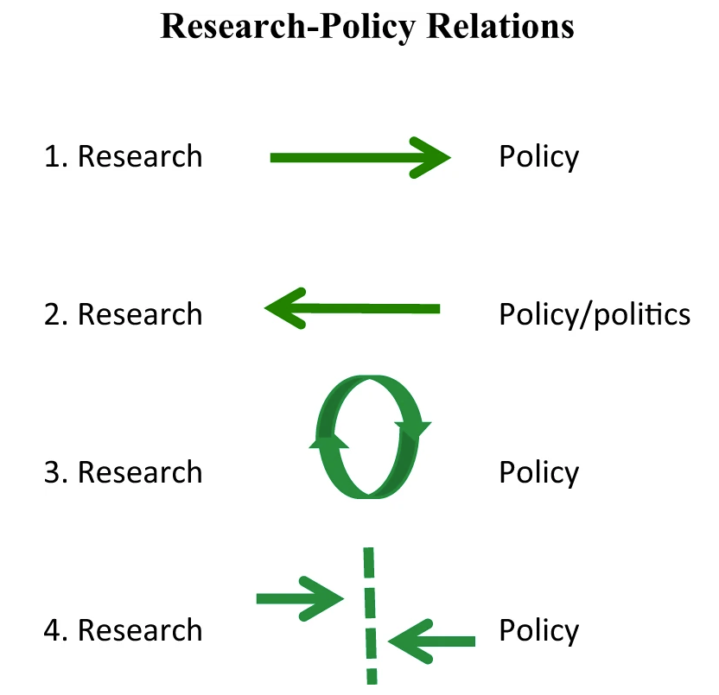
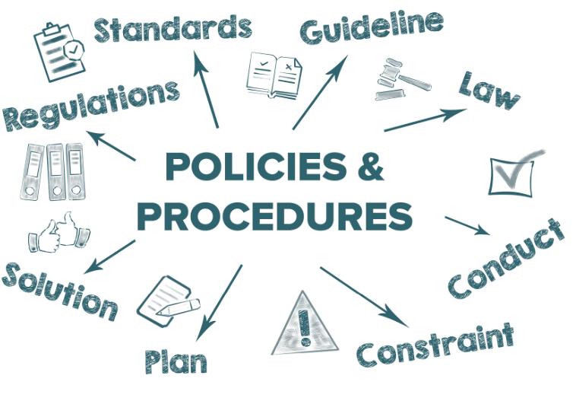
What is policy?
Policy
a plan of action adopted or pursued by a government, party, organization, etc
(Boswell& Smith, 2017)

Slide 3
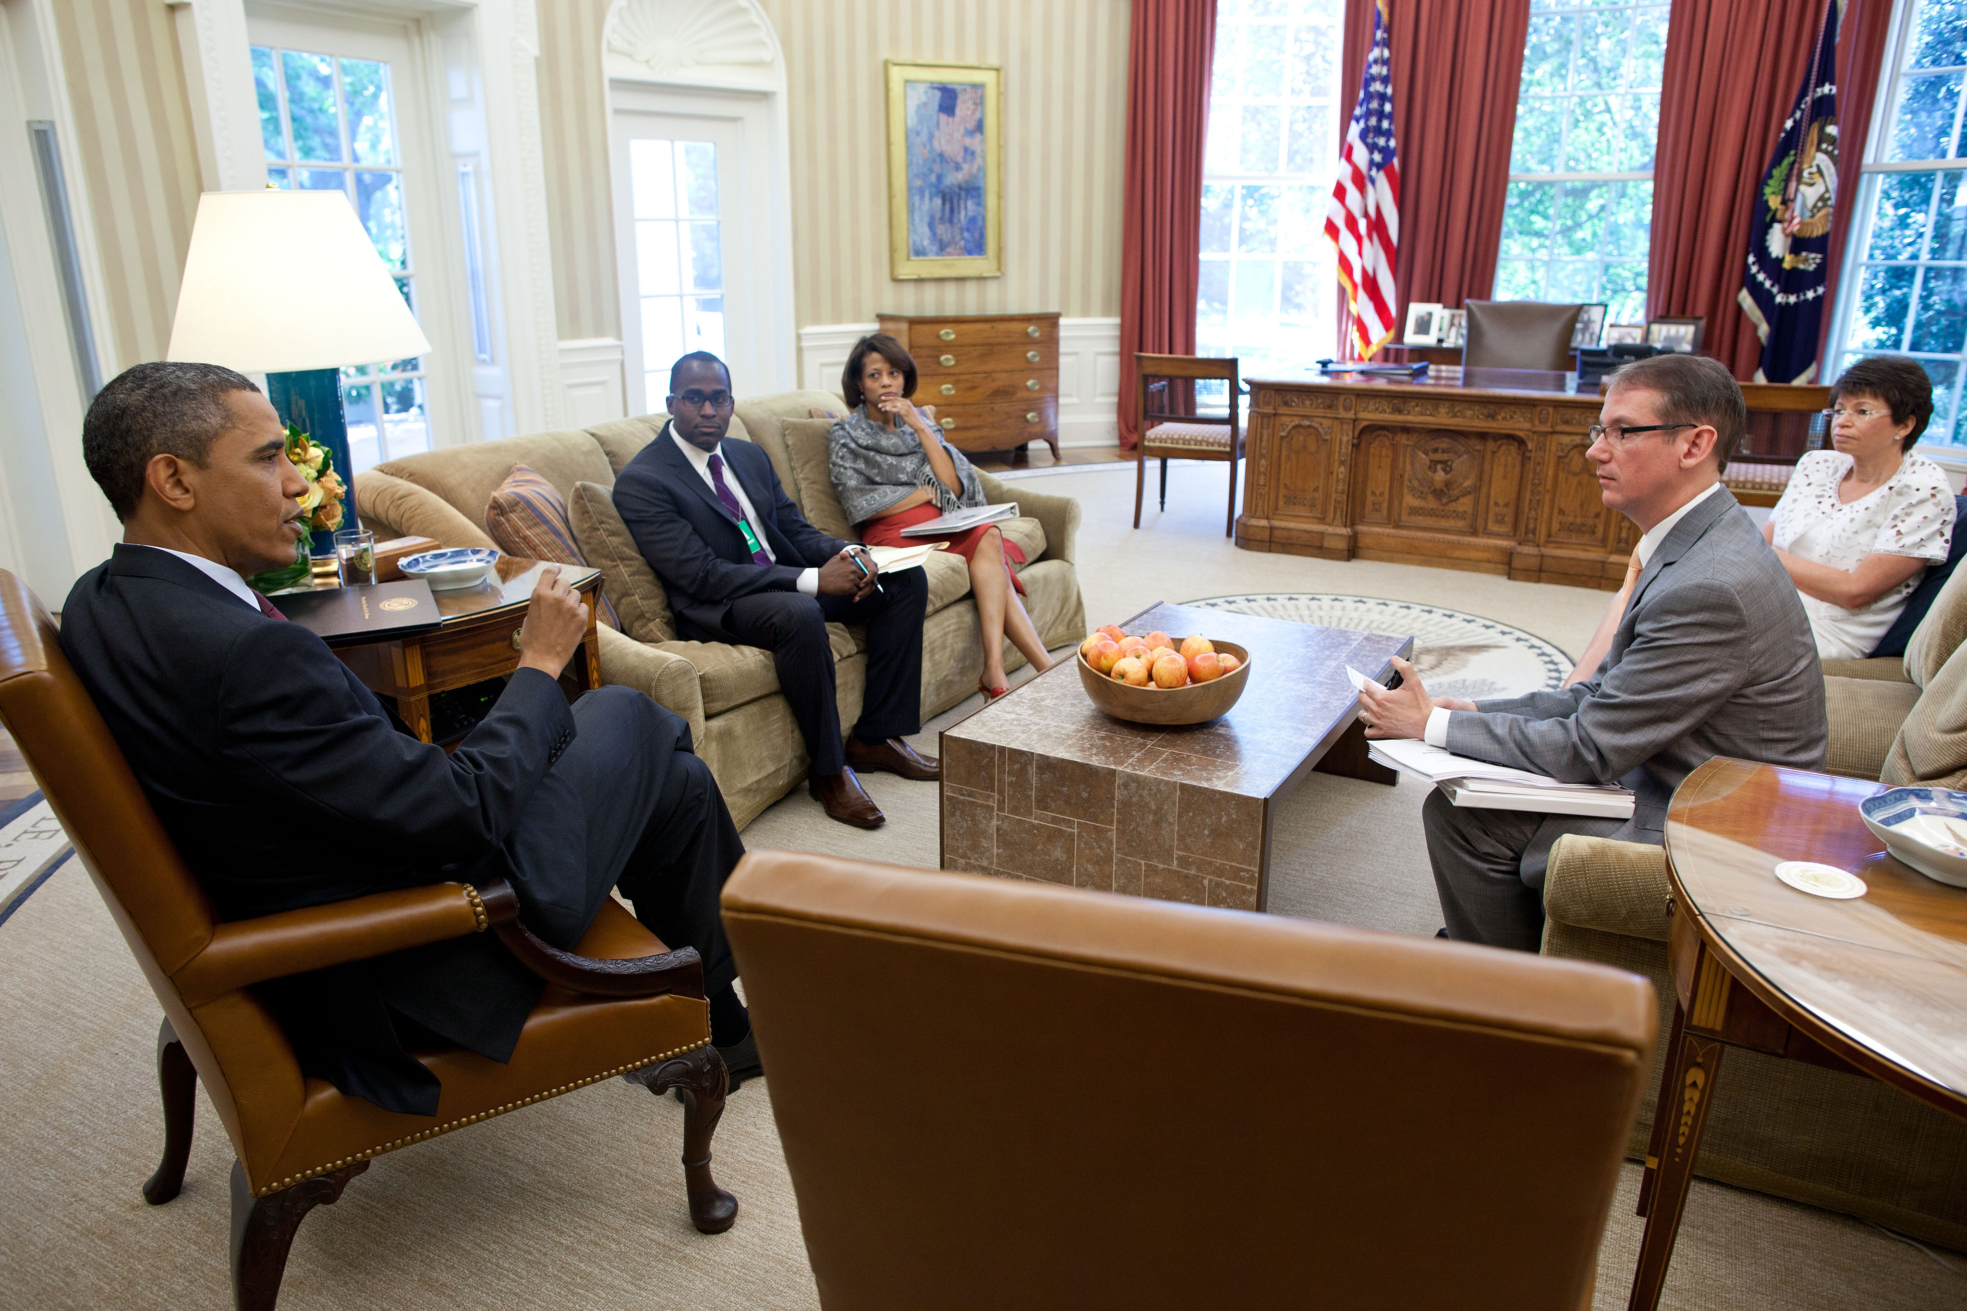
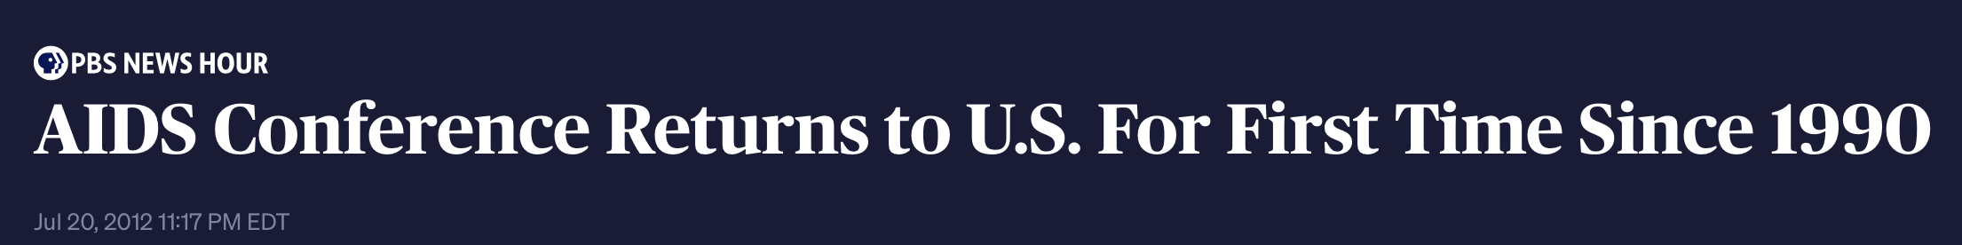


Oval Office Meeting to Discuss the Release of the White House National HIV/AIDS Strategy

Slide 4

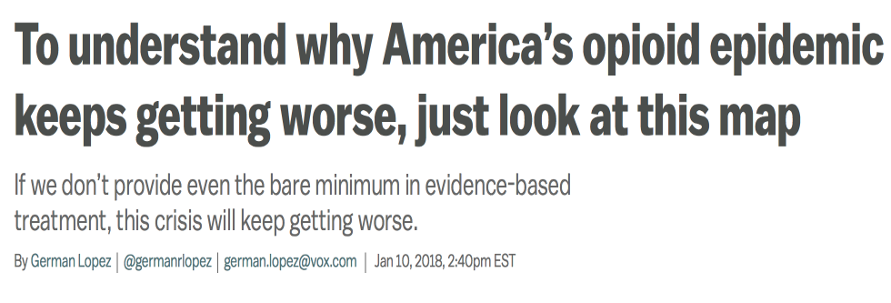
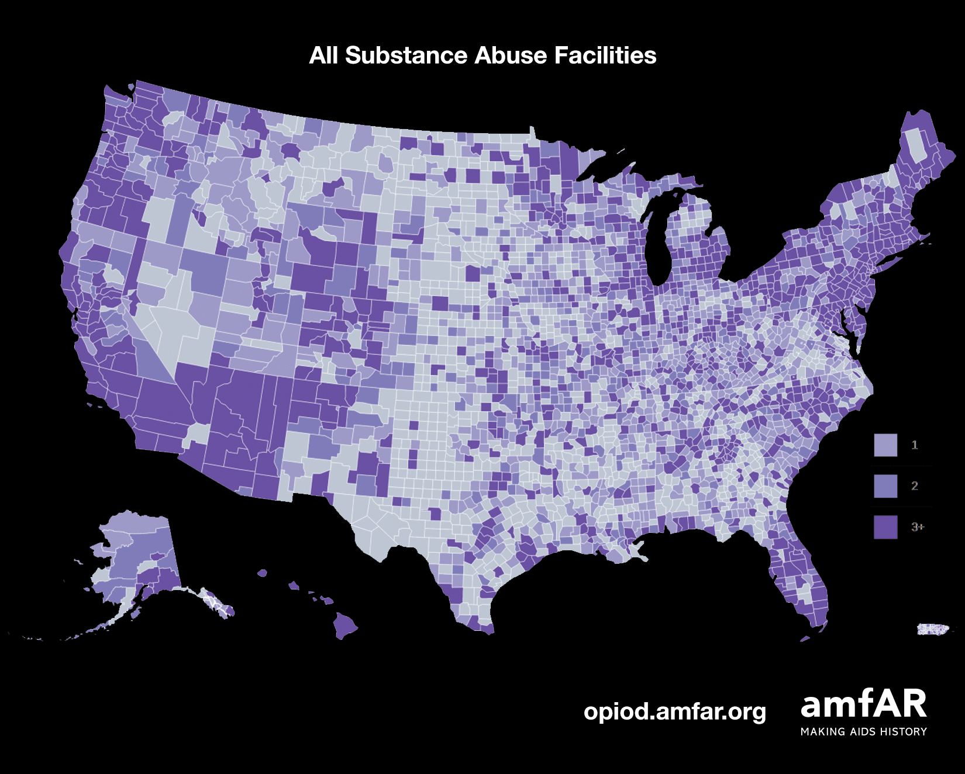
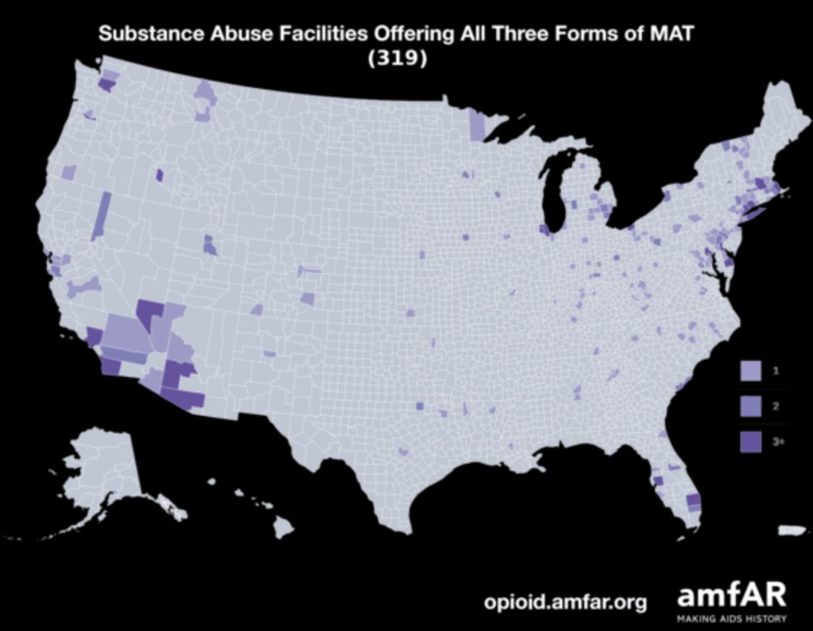
amfAR analysis of drug treatment facilities

Slide 5
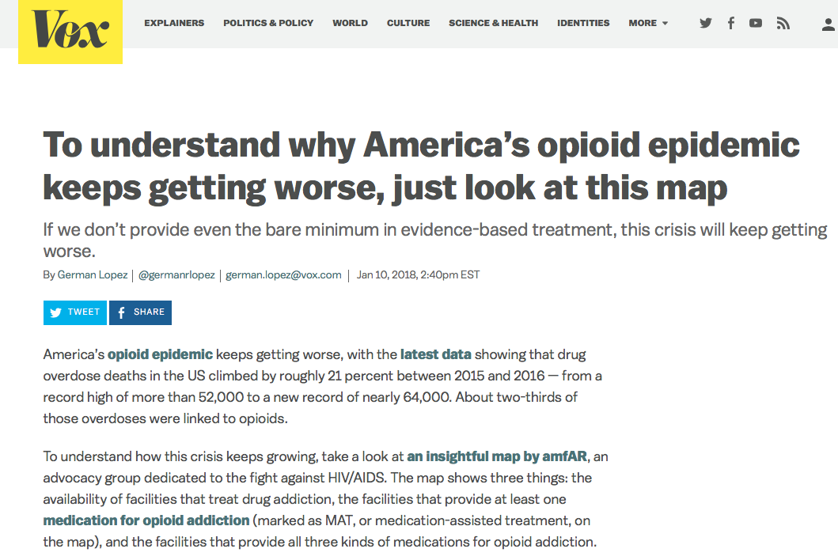

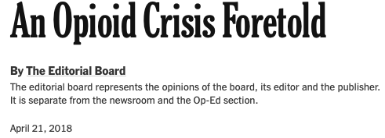
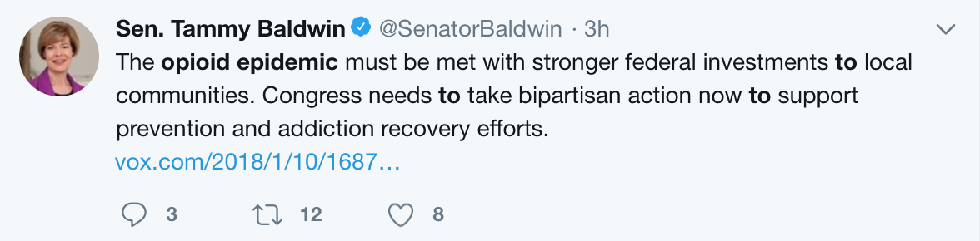
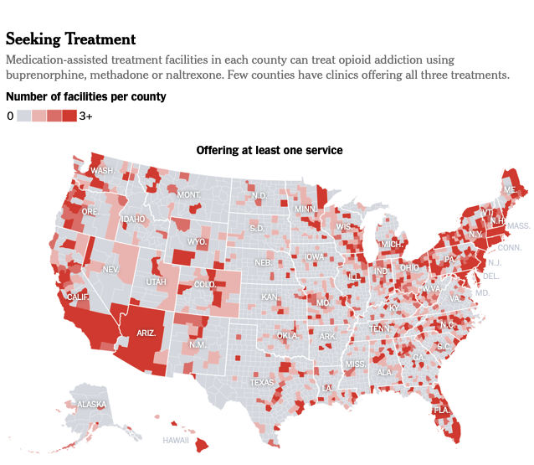
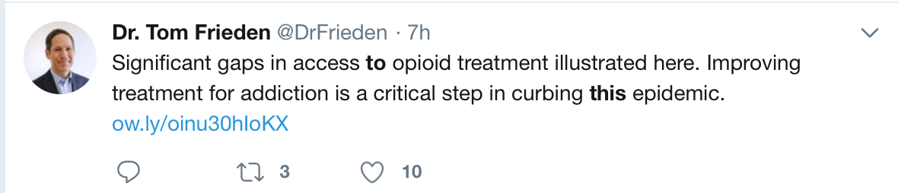
Notes:
-Our analysis was picked up by Vox and quickly went viral
-It has been retweeted hundreds of times in social media, including Tom Frieden (former CDC director) and by Senator Tammy Baldwin of WI

Slide 6
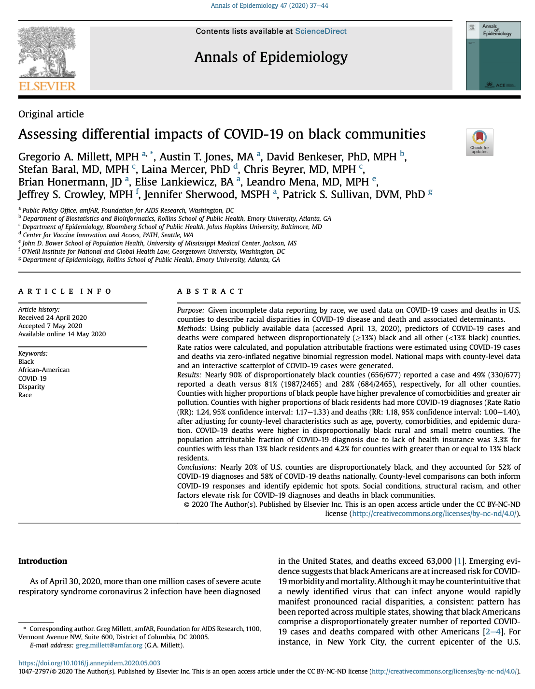
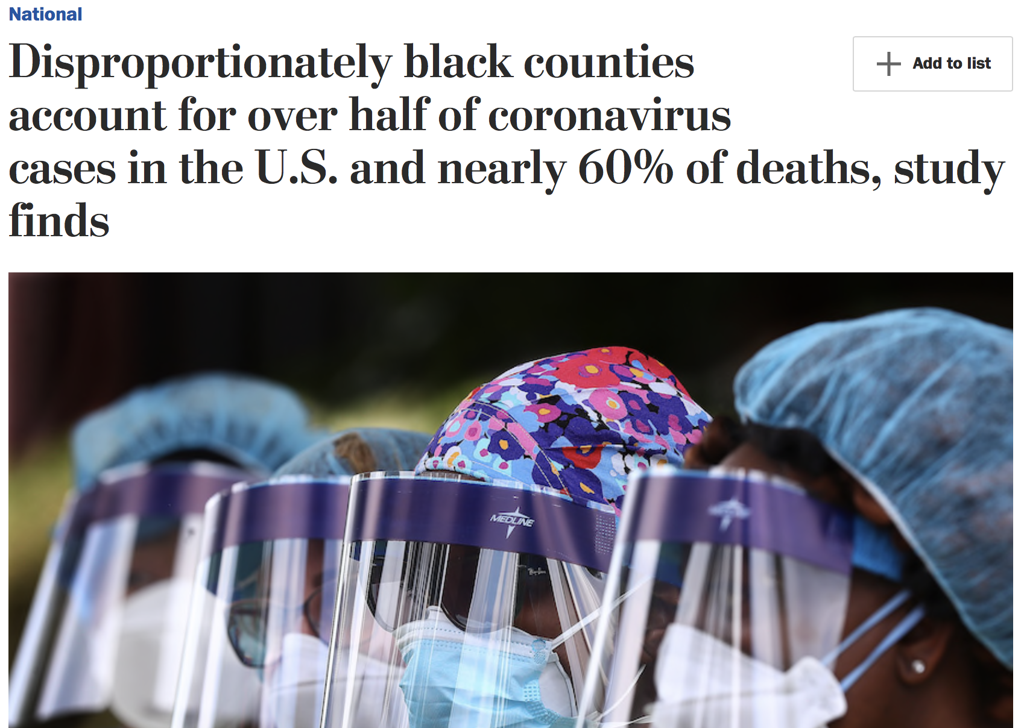
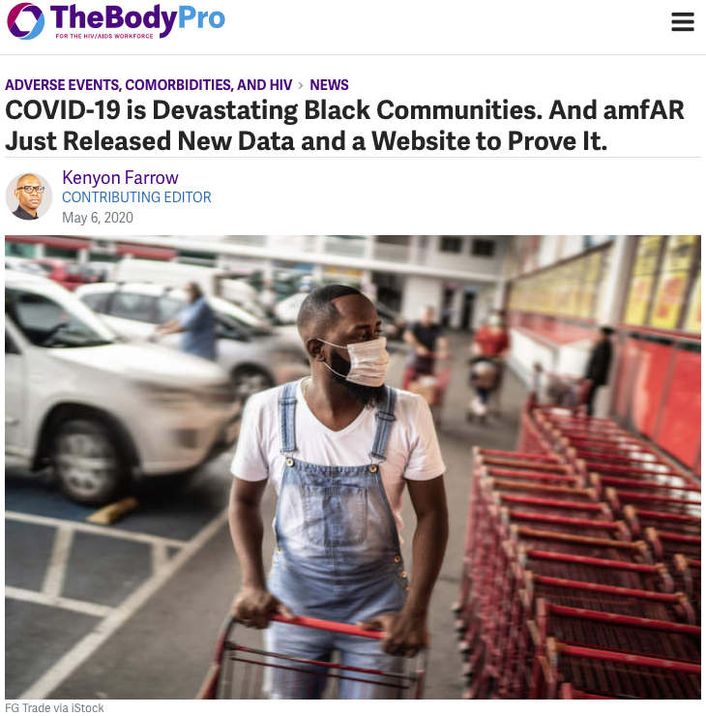
amfAR Study of COVID-19 Impact in Counties with Greater than Average Black Residents
Notes:
91% of disproportionately black counties are located in the southern US
COVID-19 cases and deaths increased with proportion of blacks residents in counties
COVID-19 diagnoses greater in black counties irrespective of urbanicity urban area, small urban area, or a rural area
COVID-19 deaths were higher in black rural and small metro counties
Underlying conditions did not explain these disparities
Health care access
# people in shared housing
Unemployment

Slide 7
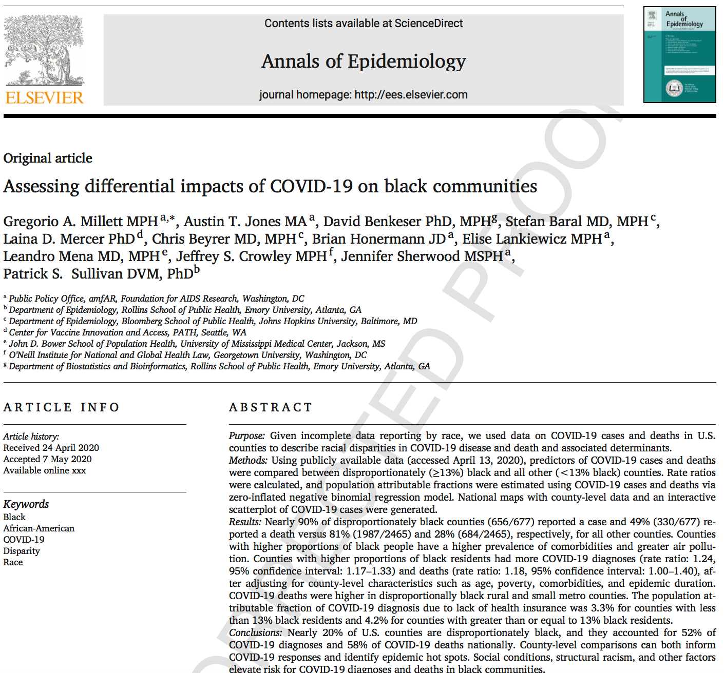
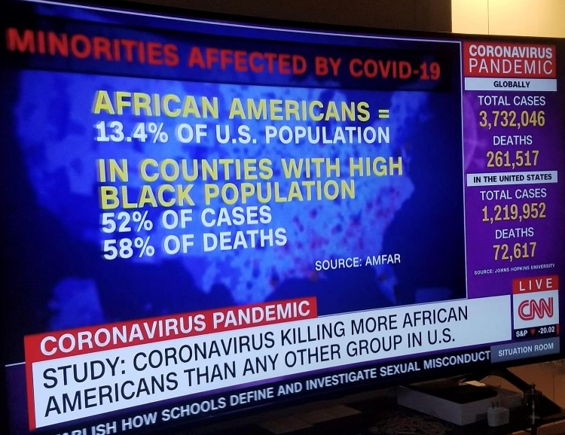
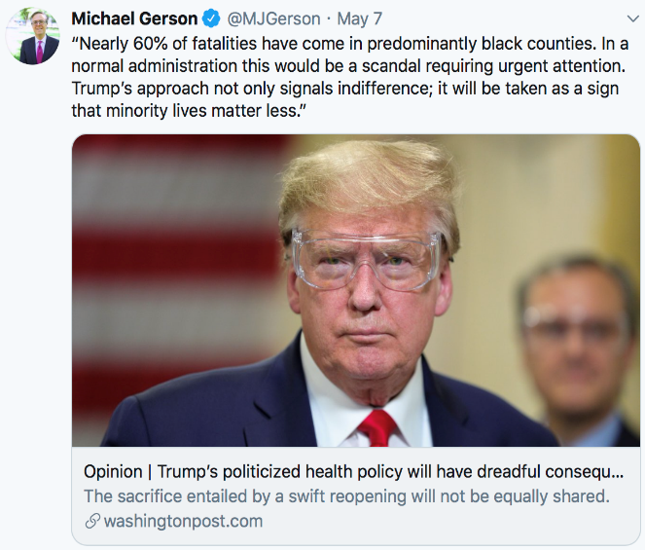
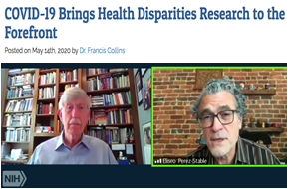
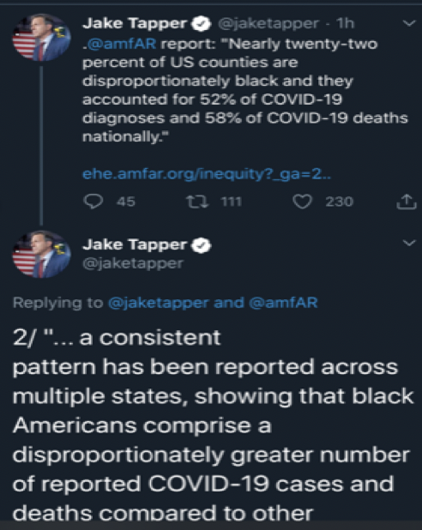
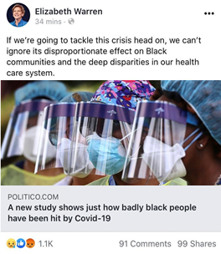
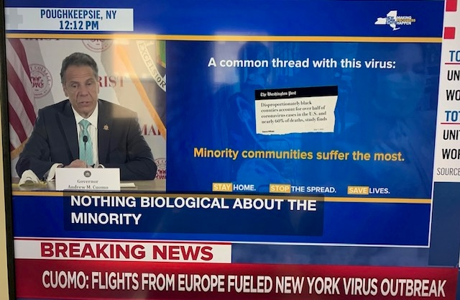

Media Pickup of COVID-19 Study in Black Communities

Slide 8
Lessons Learned
Capitalize on crises (especially when there are a lack of data or major gaps that must be resolved to address a crisis)
Make communications materials understandable at a glance
Create graphics that the press can readily use and will get policymaker’s attention
Pitch it to national, state, local levels--don’t ignore smaller media outlets that serves a policy member’s district or base
Be brief in the points you try to make with materials to match
Do not use scientific jargon or speak/ write the way you do for journals or conferences
Explain why the issue is timely

Slide 9
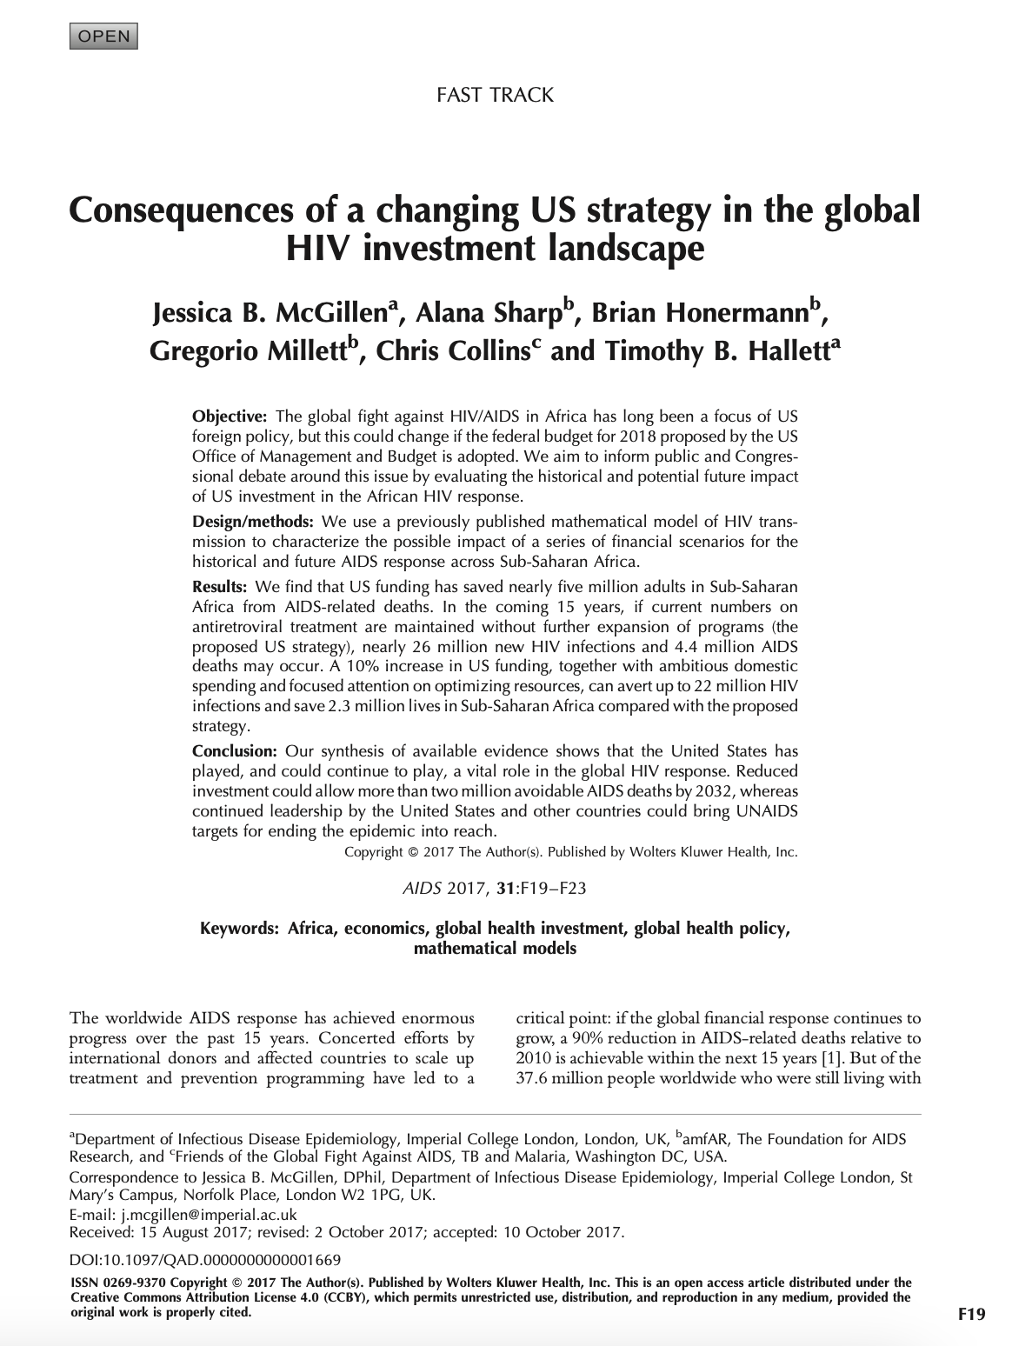
Modeling U.S. Investments in Global HIV
what did happen
  ~4 million more HIV infections by the end of 2016

Slide 10


Slide 11
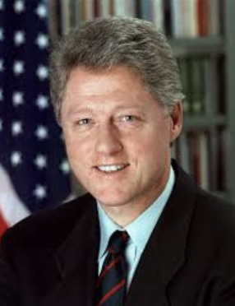
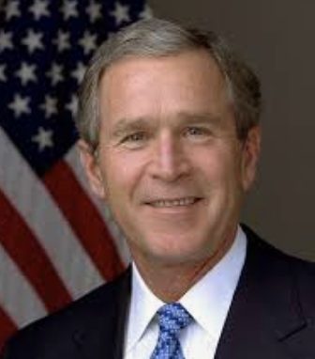
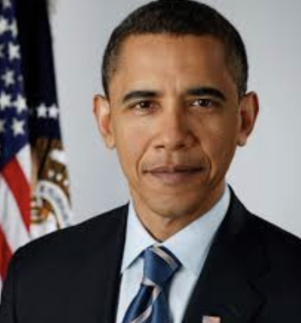
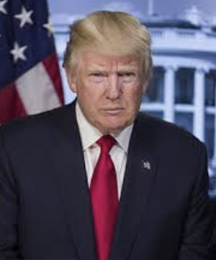
Priorities Change from Administration to Administration
Priority: First domestic HIV plan; increase in domestic HIV prevention; establishes ONAP; Minority AIDS Initiative launched; implements Americans with Disabilities Act
Priority: Global HIV (Introduces PEPFAR program)
De-prioritized: Domestic HIV programs/ research; ONAP left unstaffed for period of presidency
Priority: Domestic HIV: National HIV/AIDS Strategy and Affordable Care Act;
De-prioritized: PEPFAR (flat funded/ established Global Health Initiative)
Priority: Domestic HIV: EHE initiative
De-prioritized: National HIV/AIDS Strategy (now a HHS ‘Plan’); ONAP defunct; Affordable Care Act (dismantling); PEPFAR (flat funded in WH budgets)
Notes:
11% policymakers involved in PEPFAR

Slide 12

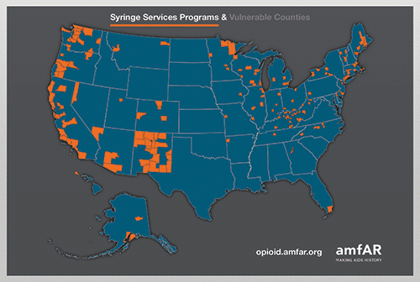

Slide 13
National Polls and Harm Reduction Interventions
Do you support legalizing safe injection sites and NSPs?
Do you support legalizing safe consumption sites and syringe service programs in your community?
POLITICO/Harvard Poll
(June-July 2018)¹
Hopkins Bloomberg Survey
(July-August 2017)²
Support (%)
Support (%)
NSP=needle-and-syringe exchange program.
1. POLITICO/Harvard T.H. Chan School of Public Health. https://static.politico.com/50/19/6924fa8d4f238f1b9fc155a275a3/drug-pricing-poll.pdf.
2. McGinty EE, et al. Prev Med. 2018;111:73-77.
Notes:
Key Messages
Why do we have so few SSPs despite their efficacy? Public opinion
We see in these 2 public opinion polls that there is not large public support for effective harm reduction interventions
[READ POLLS]
Bright spot in the future: govt is committed to scaling up SSPs
How many of you know where the closest SSP is to you to refer your patients?

Slide 14


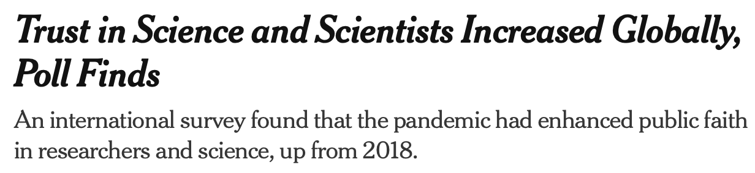
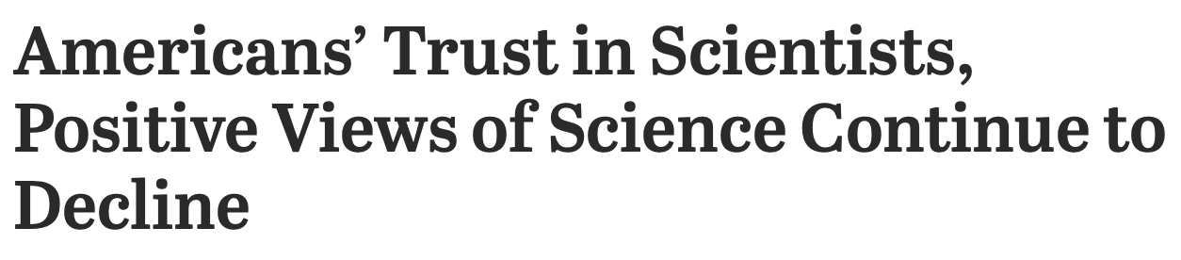

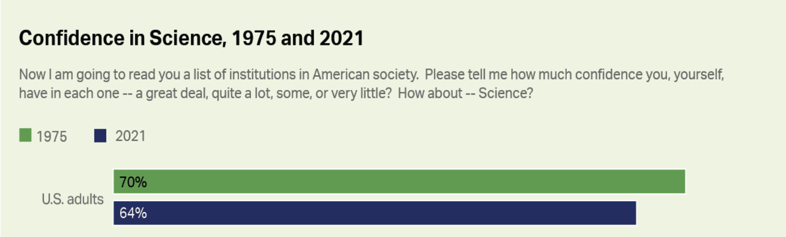
US Trust in Science/ Scientists vs Other Countries
Notes:
about 80 percent of people from 113 countries said they trusted science either “a lot” or “some.” About three-fourths of the 119,000 surveyed said they trusted scientists, either “a lot” or “some.”

Slide 15
In Sum
What works
Keep in mind
Science can be used to change public policy
Enlisting the media can help raise issues and garner the attention of policymakers
Eye-catching and simple graphics and jargon free language draw attention
Do not be afraid to use crises to help garner attention for your issue
Policies do not remain changed and can revert back or evolve into something different
Champions and administrations change and policy priorities change
Public opinion influences policy makers
Trust in science is becoming an impediment to using science to change policy

Slide 16

Greg Millett
amfAR
Greg.Millett@amfAR.org

