Slide 1


Accelerating PEPFAR Science:
Doing Science more swiftly
(& Sustainably)
Dr. mike Reid
Chief Science Officer
July 20
Notes:
Let me start by expressing privilege

Slide 2
PEPFAR’s Impact
Source: Kaiser Family Foundation
Notes:
Many of you are very familiar with PEPFARs work, so I wont spend too much time reflecting on its collective impact
Except to highlight some of the more notable achievements.
There are more than 20 million people on treatmemnt, nearly 6 million children have been born with HIV because of PPEFAR
Moreover the positive externalities of PEFPAR’s investment have been trermendous
Compared to countries that did receive PEPFAR funds, countries that did noted a 2.1% increase in their GDP over a 14 year period
And over the same timline, the impact on childhood mortality was massive: with a 35% decrease between 2004-2018 in 90 supported countries
[also a 25% reduction in maternal mortality over the same period]

Slide 3
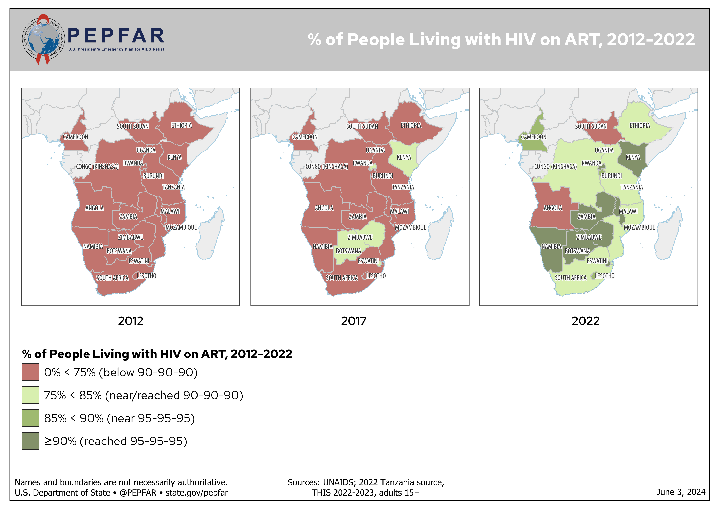
In 2012, most PEPFAR supported countries had less than 60% of PLHIV on ART
In 2022, many are above 80% coverage
Notes:
Epidemiologically and programmatically, the impact of that has been tremendous.
Between 2012 and 2022 the proportion of people with HIV on ART has increased by 10 million.
And there are now more than 20 million people on treatment.
Much of this is because of the application of rigorous implementation science.
Using data drive strateiges, we have closed stubborn know-do gaps that had previously undermined progress.

Slide 4
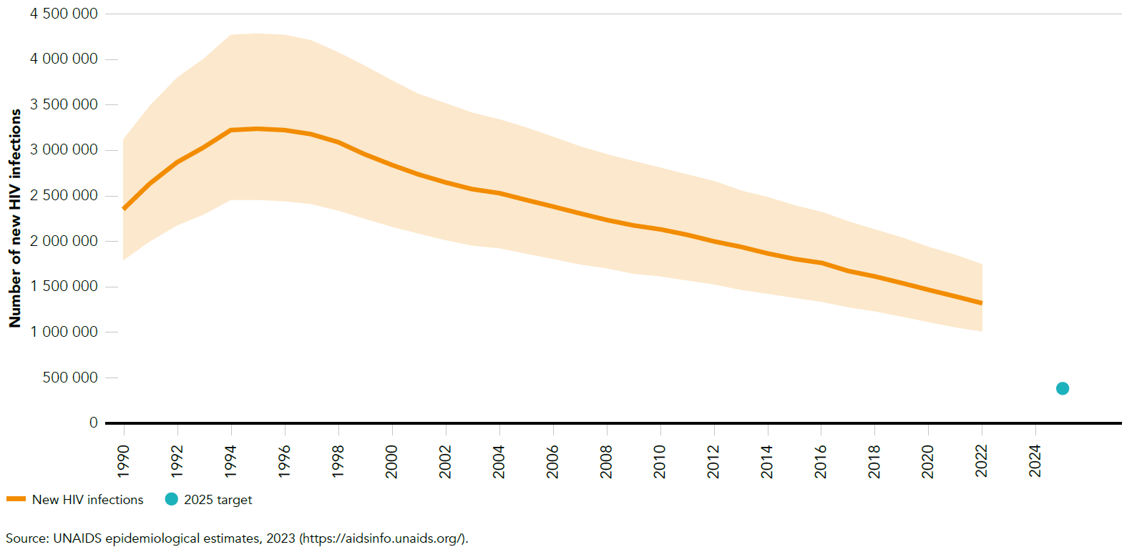
Still substantial progress needed to end HIV epidemic
New HIV infections are not yet declining at a fast enough pace to reach our 2030 goals
2025 target
Notes:
Unfortunately, we are still a way away from our stated goal.
And there is an urgent need to close program gaps if we are to advance toward our shared goals.

Slide 5

Our need to simultaneously sustain the gains and accelerate are driven by two fundamental challenges for the HIV program going forward
SUSTAIN THE GAINS:
Preventing treatment interruptions
ACCELERATE:
Knowing and closing our gaps
To control HIV/AIDS we need to keep >20 million PLHIV on treatment and virally suppressed – and reduce interruptions in treatment (which increase the risk of death, HIV transmission, and drug resistance)
Requires closing the most difficult gaps that remain in the program:
Men
Youth
Key Populations
Children

Slide 6
SUSTAIN THE GAINS: Example from South Africa shows as ART coverage increases our greatest transmission risk is treatment interruption
South Africa: % of transmission by care cascade stage (Thembisa 4.6)
100% —
75% —
50% —
25% —
0% —
In South Africa, even now and growing into the future, a majority of HIV transmission is coming from PLHIV who know their status and have been initiated on treatment at some point or another
Undiagnosed
Diagnosed, never treated
On ART, unsuppressed
Percentage of HIV transmission
Treatment interrupted
2005 2010 2015 2020
Moolla, personal communication; Johnson et al. JAIDS 2022

Slide 7
ACCELERATE: Large gaps remain amongst specific population group
3x
10-20
Youth
Percentage points lower known status amongst 15-24 relative to all adults
Men
Likelihood of Men (25-40) to transmit HIV to other PLHIV
3-11x
40%
Children
Lower rate of population
Viral Load Suppression for children relative to adults
Key Populations
Higher incidence rate ratio
for KPs relative to all adults in high prevalence countries
Korenromp EL,et al. New HIV Infections Among Key Populations and Their Partners in 2010 and 2022, by World Region: A Multisources Estimation. J Acquir Immune Defic Syndr. 2024 Jan 1;95(1S):e34-e45. doi: 10.1097/QAI.0000000000003340. Epub 2024 Jan 4. PMID: 38180737; PMCID: PMC10769164.
Source: ICAP Data Visualizer 2024; PHIA Data Manager (columbia.edu) | Image Created by M.Davis
AFRICOS data, unpublished, courtesy of Capt. N. Shah, WRAIR.
UNAIDS Spectrum
Notes:
This is not an exhaustive list
But we know we have to do a better job of reaching and engaging men
Moreover we are failing to reach youth: who up to 20% less likely to know their HIV status
KPs are consistenty estranged from programming
And efforts to reach children and keep them on treatment are lacking.
In all of these domains – there is a sound evidence base to support programming, and yet our ability to implement the evidence is limited.
Implementation Science – ie usin science to systematically close the gap between what we know and what we do by identifying and addressing the barriers that slow or halt the uptake of proven health interventions – is critically needed

Slide 8
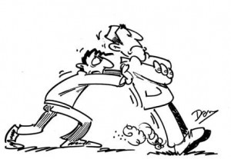


Implementation Science: central role for science to sustain and accelerate programs
Delivering client-centered programs
Seeking generalizable insights
IMPLEMENTATION
SCIENCE
Scaling New Tools
Service Integration & Sustainability
Biomedical tools (i.e., long-acting PrEP)
AI tools for client support, prediction analytics, HRH job aids, etc
Effective science is 1) fast, 2) focused on high-impact program priorities, 3) integrated within the core program PEPFAR supports, and 4) locally manage by NPHIs / local academics
Notes:
As such, when we think about Implementation science - and I recognize there are many different priorities,we think there are some really critical applications that can belp us sustain and accelerate:
First, and perhaps most obvious: generate insights that are relevant across countries, so that we can rapidly promulgate relevant insights
Second consider how and where we can improve our programming. So often the frictions in our health system make it hard to deliver effective programming and IMP SCI has a critical role to better understand where and for whom that friction is greatest
Thirdly there are some tremendously exciting new tools on the horitizon – long acting agents for PREV and Treatment, as well as AI tools - but figuring out how and where to scale those tools is critical.
Finally, we also need to use implementation science to answer all of these questions sustainability.There is much buzz about service integration – however, unless we study how to do that effectively, our best efforst may fail

Slide 9


True or not, Implementation Science has reputation for being too slow….
OUT OF OUR CONTROL
OUT OF SYNC
OUT OF THE LOOP
OUR
⁁
Ex. Unable to evaluate intro of CAB-LA because access to commodity delayed
Ex. Asking right questions, but outside of program settings ( & timelines)
Ex. Getting the wrong balance between Rigor and Relevance!
Notes:
Unfortunately, implementation science has a reputation for being too slow.
Some times its too slow for reason completely out of our hands – like efforts to evaluate the role

Slide 10
Accelerating Progress: PEPFAR's Commitment to Swift Implementation Science
Rapid (to impact near-term programming)
Targeted at top priority program gaps
Informed by and integrated within programs​ themselves
Leveraging local partners (i.e., NPHI, local academia) where feasible
Going forward we will evolve the review of science investments within COP25 process to ensure science we support is timely, impactful and widely disseminated

Slide 11
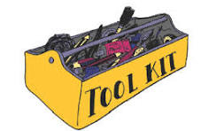
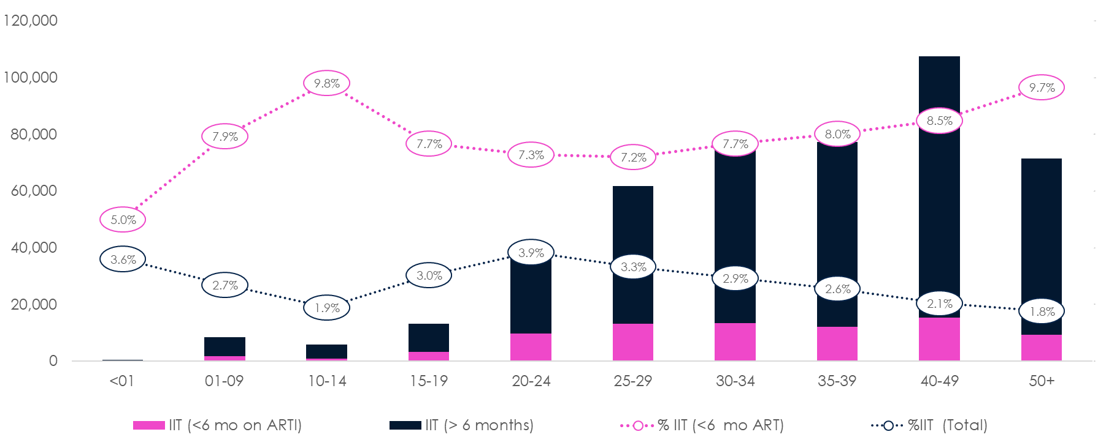
Implications:
Rapid Methodologies
Program
Science
Enabling Environment
Notes:
So what are the implications for PEPFAR,
Well we are starting to think about rapid methodogies that can help generate meaningful insights relevant on program timelines,
Its not just about a set of methods though, its about embedding the science in our programs and ensuring that programs is where the science is happening in the programs.
Finally PEPFAR needs to create the enabling environment to support swifter science – and that is key thrust of our the science guidance that we ill be forthcoming in our COP guidance. Our programs need to understand the merits of facter science and the agencies that support our science need to be compelled to support faster science, including speeding up clearance proceses, building capacity for protocol development and protocol review and strengthing the capacity of local IRBs to make NRD, etc

Slide 12

Thank You
Notes:
Close there
Thank you.
Lots to be excited about and look forward ot chatting with you more during the converence.

Slide 13


PEPFAR at AIDS 2024 Munich
Follow state.gov/pepfar-aids-2024/ or use or use QR code below for the latest resources and announcements leading up to AIDS 2024.

