Slide 1

Citizen Science, Community Groups
— A View from Southeast Asia
Rayner Kay Jin TAN, Ph.D.
Assistant Professor, Saw Swee Hock School of Public Health, National University of Singapore (NUS)
Visiting Research Fellow, National Centre for Infectious Diseases, Singapore
Affiliate, Centre for Behavioural and Implementation Science Interventions, NUS
Research Associate, Centre for Family and Population Research, Faculty of Arts and Social Sciences, NUS
Consultant, FHI360, Thailand

Slide 2
Why Engage Communities?

Slide 3
Rationale for community engagement
Legal Requirements
  United Kingdom: National Institutes of Health Research (NIHR) mandates public and patient involvement in health research.
  United States: Belmont Report; National Institutes of Health mandates to include women and racial minorities in research.

Slide 4

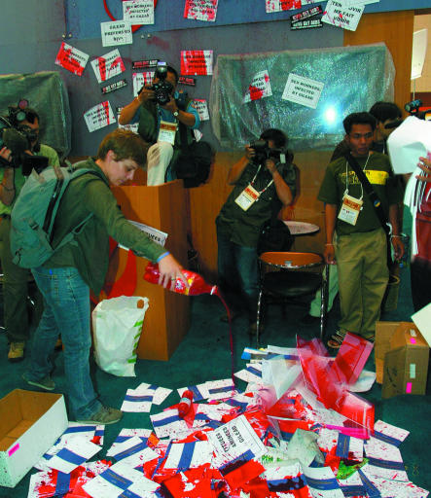
Rationale for community engagement
Cambodia: In August 2004, HIV pre-exposure prophylaxis trials for sex workers halted by Cambodian government following protests by communities.
  Poor engagement of communities
  Distrust between communities and NGOs
  Top-down: Rationale for trial to take place in Cambodia not explained
  Side effects not properly communicated; compensation insufficient etc.
https://www.nhvmas-ng.org/publication/TDF2.pdf
Mills EJ, Singh S, Singh JA, Orbinski JJ, Warren M, Upshur RE. Designing research in vulnerable populations: lessons from HIV prevention trials that stopped early. BMJ. 2005 Dec 10;331(7529):1403-6. doi: 10.1136/bmj.331.7529.1403. PMID: 16339256; PMCID: PMC1309660.

Slide 5

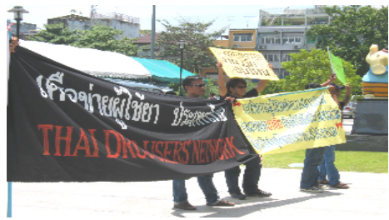
Rationale for community engagement
Thailand: HIV pre-exposure prophylaxis trials among intravenous drug users halted early:
  Lack of representation on working group
  Lack of willingness to revise trial protocol by researchers
“Community representatives were told that the protocol had already been submitted to the institutional review boards required for the trial, and at best, an amendment might be made on a specific topic later; but at this juncture, nothing could effectively be done to alter the protocol. This was a shock to the community advocates. “Why weren’t we brought in earlier?,” some thought.”
https://www.nhvmas-ng.org/publication/TDF2.pdf

Slide 6

Rationale for community engagement
Diagnosing upstream determinants of health
Diagnose upstream, prescribe downstream (Douglas et al. 2020)
Foster dialogue between local stakeholders and political support for work (Rajan et al., 2019)
Power sharing and shared governance of health policies (Kohler & Martinez, 2015)
Tan R. K. J., Lourdesamy M. (2023). Social determinants of health and global public health. Springer Research Handbook: Handbook of Social Sciences and Global Public Health

Slide 7
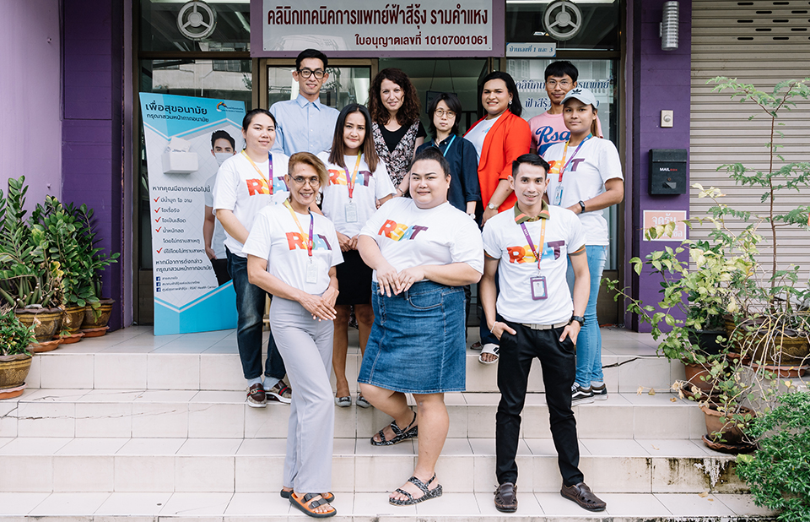
Rationale for community engagement
Key population-led services:
Scoping review by Ayala and colleagues (2019) found that community-led and peer-led services:
Have comparative advantages over traditional services in terms of reaching key populations
Communities can effectively implement services for their own communities
Source: UNAIDS (2020)
UNAIDS. (2020). Key population-led organizations delivering health services in Bangkok. Retrieved from https://www.unaids.org/en/resources/presscentre/featurestories/2020/january/20200127_rsat

Slide 8
Definitions and ‘Theory’ of
Community-Based Participatory Research

Slide 9

Definitions
Citizen Science
Community-Based Participatory Research
Co-Creation/
Co-Design
Patient Advocacy
Participatory Action Research
Community Engagement

Slide 10
Community-Based Participatory Research
Approach / Theoretical Orientation:
Community-Based Participatory Research
Principles
Method:
Citizen Science
Method:
Participatory Action Research
Method:
Some Forms of Qualitative Research
Method:
Crowdsourcing and Co-Creation/Co-Production
Deepening Engagement

Slide 11
Principles of CBPR
Co‐learning and reciprocal transfer of expertise, by all research partners, with particular emphasis on the issues that can be studied with CBPR methods.
Shared decisionmaking power.
Mutual ownership of the processes and products of the research enterprise.
Viswanathan, M., Ammerman, A., Eng, E., Garlehner, G., Lohr, K. N., Griffith, D., ... & Whitener, L. (2004). Community‐based participatory research: Assessing the evidence: Summary. AHRQ evidence report summaries.

Slide 12
Fostering Citizen-Engaged
HIV Implementation Science

Slide 13










Phase 1:
Phase 2:
Phase 3:
Phase 4:
Developing a research and implementation pipeline
Stakeholder and Resource Mapping
Delegation of Expertise
Creating Plans for Equity
To assess resources required (human, technological, and monetary resources), and to map how each stakeholder can leverage existing networks to fulfil such needs.
Recognising how academic and community partners are equal partners who bring diverse forms of expertise to the table; these should align with the resources required (identified in Phase 2)
Considerations for equitable engagement of participants (reimbursements, anonymity, recruitment strategy), as well as recognition of all stakeholders and volunteers.
Discussing academic priorities vis-a-vis community needs, personnel involved in each team, and funding considerations.
8 key phases to citizen science model
Phase 8:
Phase 7:
Phase 6:
Phase 5:
Plans for Sustainability and Impact
Dissemination and Translation
Generating Evidence and Analysis
Developing a Research Plan
Sustainability and impact are vital to communities involved; discussions on how work can tie in to future programs or used in advocacy (and the resources needed in future to support this) are needed.
Accountability to the community through supporting research outputs; planning of community-facing reports and dissemination plans.
Conducting the research (e.g., via in-depth interviews, survey instruments etc.) as a team; ensuring equitable analytic approaches that grant autonomy to both academic and community partners.
Developing a core team of lead researchers and a wider research team to support the research; developing flexible timelines for investigation; submitting protocols for ethics approval; ensuring safety.

Slide 14
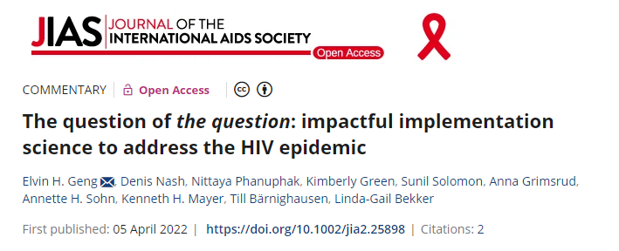
The Question of The Question
Whose perspectives?
Start with the end in mind
What questions are being asked?
Go beyond effectiveness studies
Incorporate a range of end-user voices in formulating scientific questions
Interrogate systems
Study de-implementation
Ask questions about context to make implementation strategies relevant to diverse settings
How are questions asked?
Use shared terminology and measurements
Seek generalizable insights
Draw from a broad range of methodologies
Geng, E.H., Nash, D., Phanuphak, N., Green, K., Solomon, S., Grimsrud, A., Sohn, A.H., Mayer, K.H., Bärnighausen, T. and Bekker, L.-G. (2022), The question of the question: impactful implementation science to address the HIV epidemic. J Int AIDS Soc., 25: e25898. https://doi.org/10.1002/jia2.25898

Slide 15
The Question of The Question
Areas of focus | HIV Implementation Science | Citizen-Engaged HIV Implementation Science
Whose perspectives? | Ensuring that end-users are represented in question-generating processes. Needs of relevant stakeholders are centred at every stage of the implementation research process. | Using participatory tools, such as co-creation, co-production, and crowdsourcing approaches, to engage public in identifying problems, solve health problems, and implement solutions.
What questions are being asked? | Going beyond research on effectiveness of interventions, towards research on implementation strategies, de-implementation of harmful or low-value strategies, and implementation contexts. | Synthesizing citizen or community-led approaches with existing implementation science frameworks and approaches (e.g. CFIR, RE-AIM); ensuring communities have a say in interrogating and deconstructing such frameworks and adapting them to local contexts.
How are questions asked? | Despite unique implementation contexts, ensuring that research insights are standardized and offer lessons learnt that can be generalized and applied across contexts. | Adopting broad, guiding principles and frameworks that account for dynamic contexts to promote citizen-engaged research in HIV implementation science. Avoiding narrow definitions that limit the creativity, innovation, and ground-up wisdom of local citizens

Slide 16
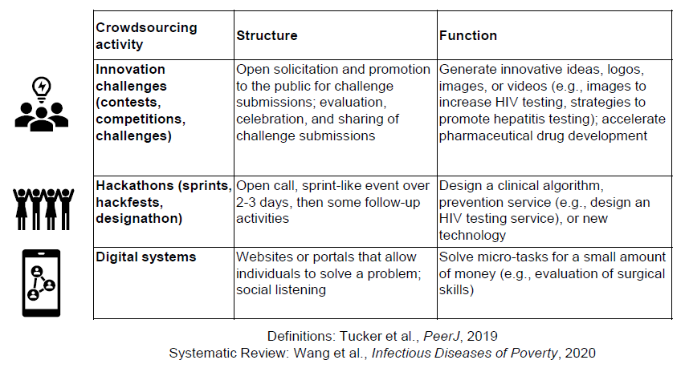
Whose Perspectives? Participatory Tools

Slide 17
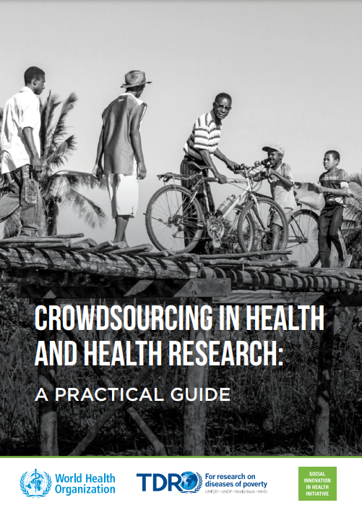
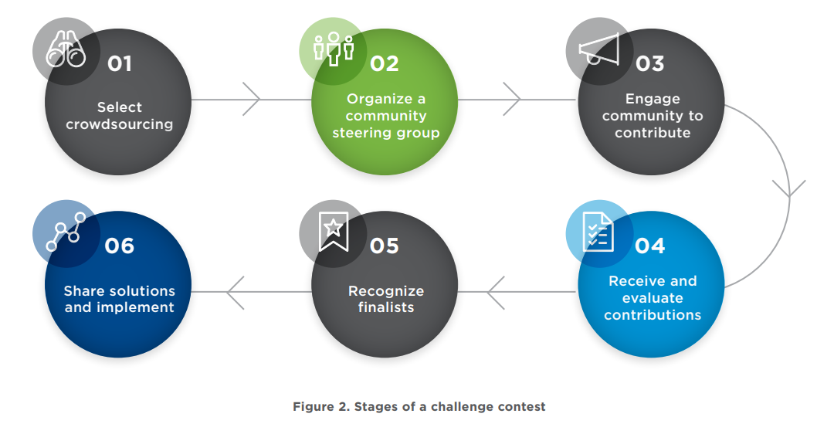
Whose Perspectives? Participatory Tools
WHO/TDR. (2018). Crowdsourcing in Health and Health Research: A Practical Guide. World Health Organization. https://apps.who.int/iris/bitstream/handle/10665/273039/TDR-STRA-18.4-eng.pdf

Slide 18
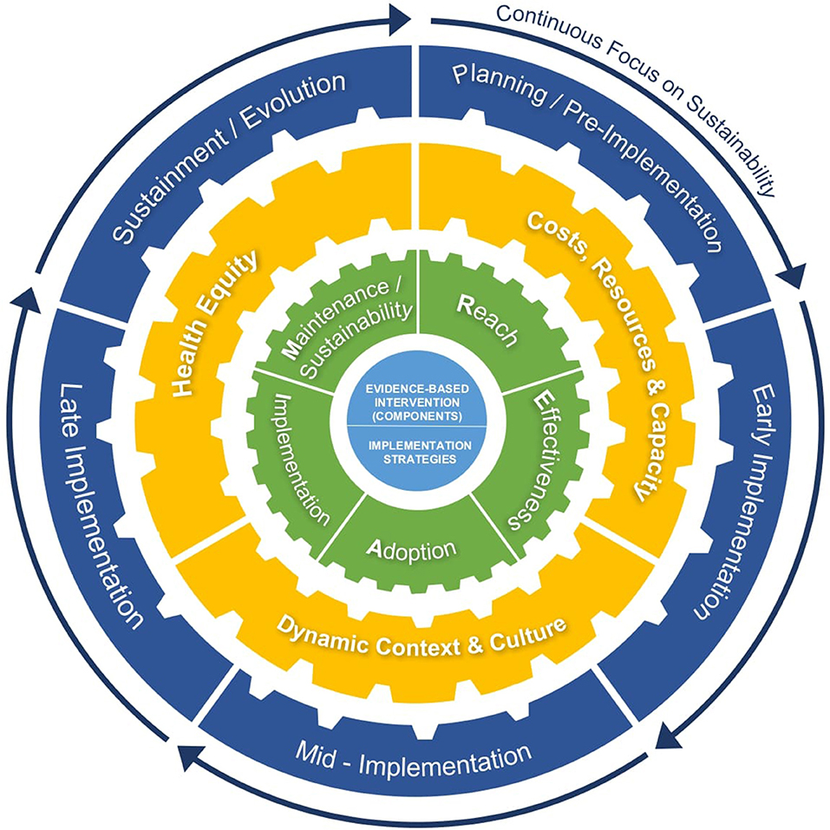
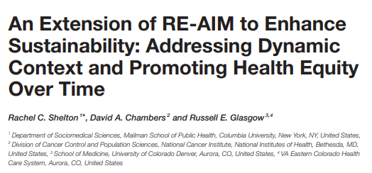
What Questions are Being Asked?
Shelton RC, Chambers DA and Glasgow RE (2020) An Extension of RE-AIM to Enhance Sustainability: Addressing Dynamic Context and Promoting Health Equity Over Time. Front. Public Health 8:134. doi: 10.3389/fpubh.2020.00134

Slide 19
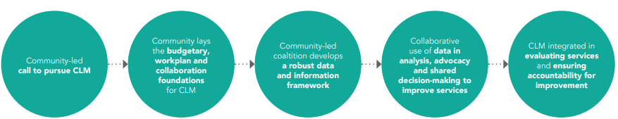
How are Questions Asked?
Suggested stages for affected communities establishing community-led monitoring
UNAIDS. Establishing community-led monitoring of HIV services. 2021.

Slide 20

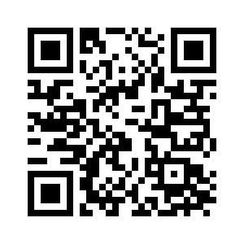
Thank You

