Slide 1

Impact: Beyond the numbers
Kneeshe Parkinson, C-CHW, BA

Slide 2

What we are know for

Slide 3



Community Health Worker-Cetified

Slide 4
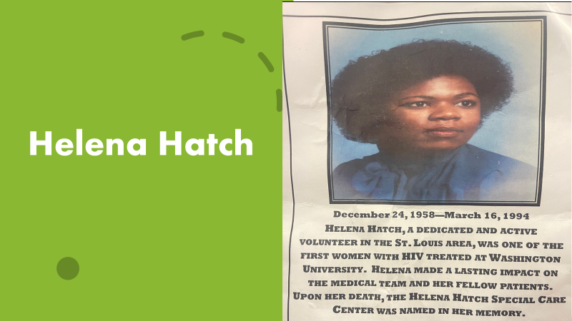
Who was Helena Hatch?

Slide 5
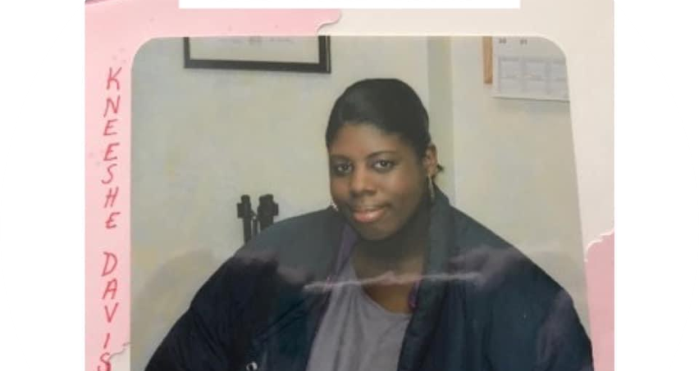
In the Beginning…1997

Slide 6
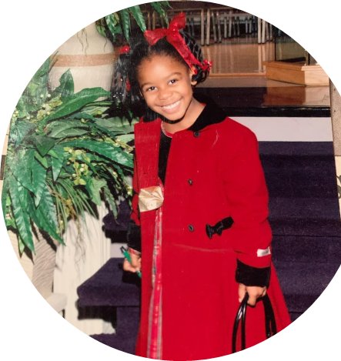
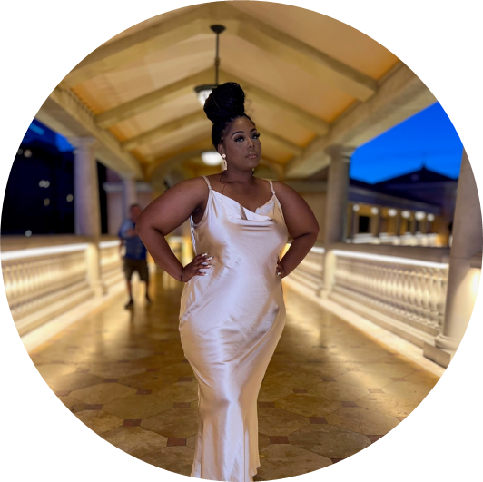
The Journey over 2 Decades
In the beginning of the epidemic mother’s where afraid to have children. Due to possible transmission from mom to baby.
Kneeshe, was able to have a successful healthily baby girl in 2002
Mariah Senior in college, HIV - ; future Anaesthesiologist

Slide 7
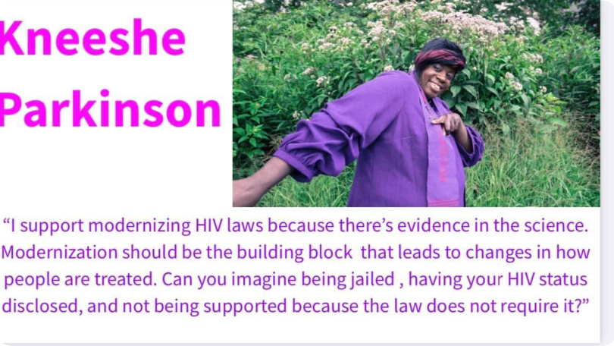
Advocacy Movement

Slide 8

Taking a Breath
Life after switching from HIV Pill
6 injections a year
Flexible treatment options
Long acting injectable

Slide 9
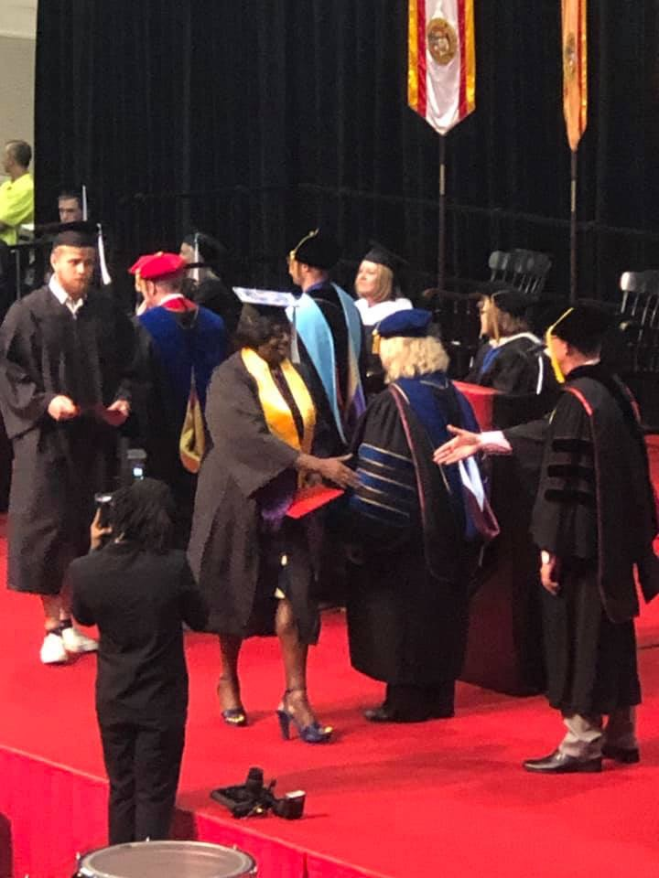
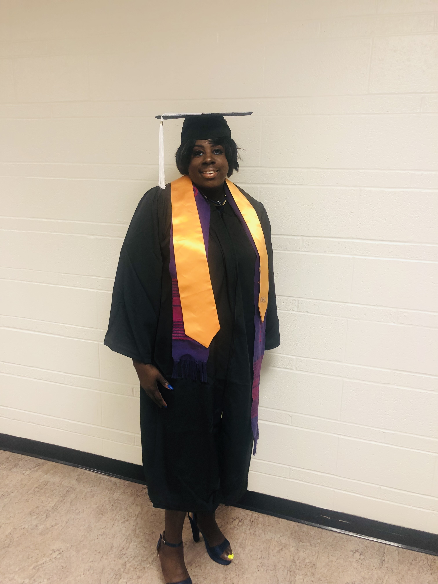
The Pivotal Moments..

Slide 10
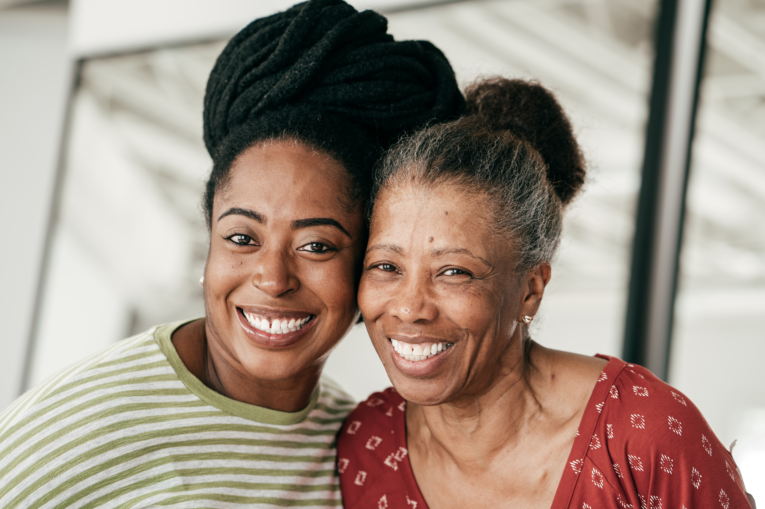



The Call TO ACTION

Slide 11
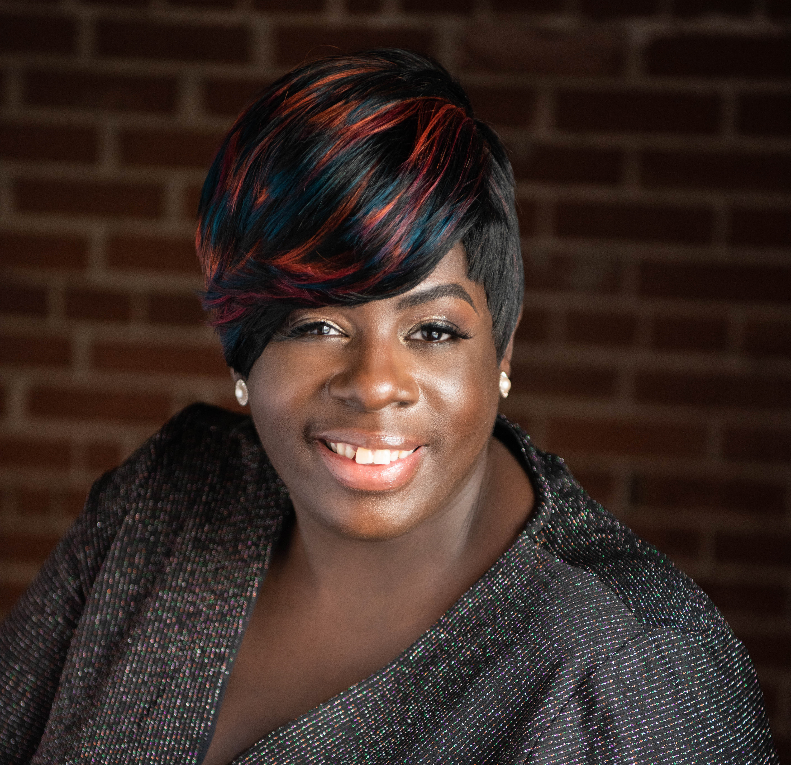
Thank You !
Kneeshe Parkinson, C-CHW, BA
Email address: davis_k@wustl.edu
Or
LinkedIn Kneeshe Parkinson
Kneesheparkinson@gmail.com
Book Launch: “ The Battle of Choices”
Navigating Life’s Crossroads and Consequences
“Never forget the person beyond the numbers”

