Slide 1
10th Symposium on Children and Adolescents with Perinatal HIV Exposure
Priscilla Tsondai, International AIDS Society
AIDS 2024 pre-conference

Slide 2
Celebrating 10 years
1st Workshop
Vancouver, CA
2015
2017
2019
2023
2016
2018
2024
2nd Workshop
Durban, SA
Children with Perinatal Exposure
Research

Slide 3
Celebrating 10 years
1st Workshop
Vancouver, CA
3rd Workshop
Paris, FR
2015
2017
2019
2023
2016
2018
2024
2nd Workshop
Durban, SA
Advocacy
Children with Perinatal Exposure
Research

Slide 4
Celebrating 10 years
1st Workshop
Vancouver, CA
3rd Workshop
Paris, FR
2015
2017
2019
2023
2016
2018
2024
2nd Workshop
Durban, SA
4th Workshop
Amsterdam, NL
Advocacy
Policy
Programming
Children with Perinatal Exposure
Research

Slide 5
Celebrating 10 years
1st Workshop
Vancouver, CA
3rd Workshop
Paris, FR
5th Workshop
Mexico City, MX
7th Workshop
Virtual
9th Workshop
Brisbane, AU
2015
2017
2019
2021
2023
2016
2018
2020
2022
2024
2nd Workshop
Durban, SA
4th Workshop
Amsterdam, NL
6th Workshop
Virtual
8th Workshop
Montreal, CA
Advocacy
Policy
Programming
Children with Perinatal Exposure
Research
Funding

Slide 6
Celebrating 10 years
1st Workshop
Vancouver, CA
3rd Workshop
Paris, FR
5th Workshop
Mexico City, MX
7th Workshop
Virtual
9th Workshop
Brisbane, AU
2015
2017
2019
2021
2023
2016
2018
2020
2022
2024
2nd Workshop
Durban, SA
4th Workshop
Amsterdam, NL
6th Workshop
Virtual
8th Workshop
Montreal, CA
10th Symposium
Munich, DE
Advocacy
Policy
Programming
Children with Perinatal Exposure
Developing
Early Career Researchers
Research
Funding

Slide 7
Outline
Session 1: 8:00 – 9:00
Optimizing health for infants with perinatal HIV exposure
Break
Session 2: 9:30 – 11:00
Supporting children and adolescents with perinatal HIV exposure to thrive
Break
Session 3: 11:30 – 12:30
Research to inform the care agenda for children and adolescents with perinatal HIV exposure

Slide 8
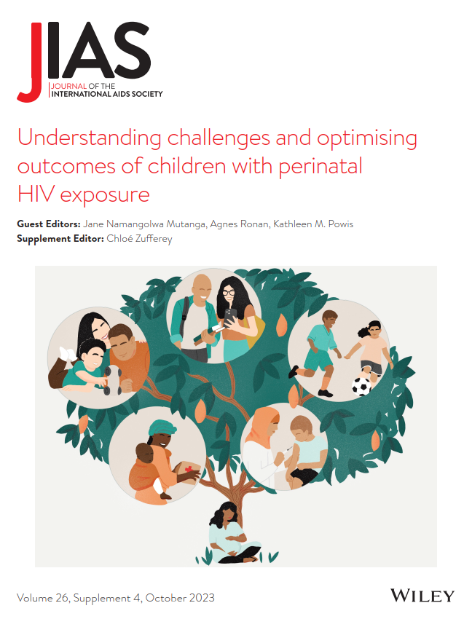
Engage with the Guest Editors and Authors of the Supplement
During the first break at 9.00-9.30

Slide 9

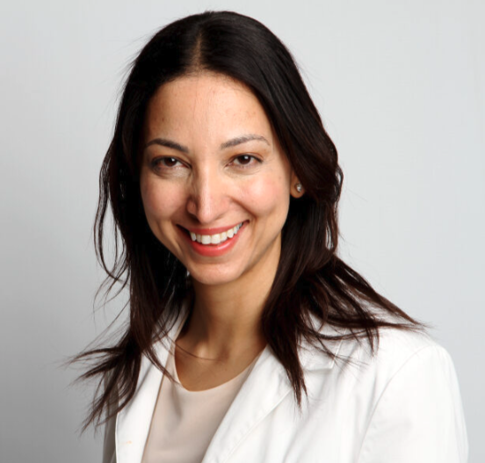
Scholarship recipients
Michelle A. Bulterys​
Abstract title: Father engagement and caregiver relationship dynamics impact early child neurodevelopment
Fatima Kakkar
Abstract title: Inadequate serologic response following vaccination against hepatitis B virus in children who were exposed to HIV

Slide 10
Please note
This event is being recorded.
Participation in the event signals your consent to have the recording posted.
Recordings will be available on the conference portal and on IAS+ soon after the event.
Participants joining online are muted.
We welcome your questions.
  For those joining online, please use the Q&A function
  If you are in the room, we welcome you to use one of the microphones along the aisles

Slide 11






Thank you!
Organizing Committee
Agnes Ronan
Catherine Wedderburn
Corinna Csaky
Ivy Kasirye
Jane Mutanga
Kate Powis
Laurie Gulaid
Pim Brouwers
Renata Sanders
Shaffiq Essajee
Sonia Lee
Ute Feucht
Wole Ameyan

Slide 12
Session 1
Optimizing health for infants with perinatal HIV exposure

Slide 13
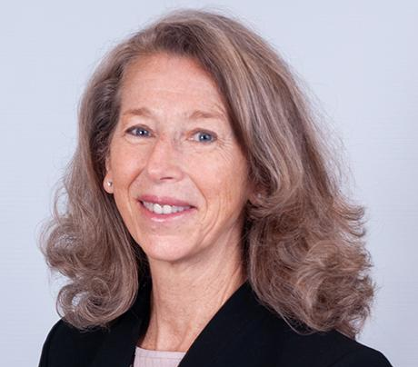
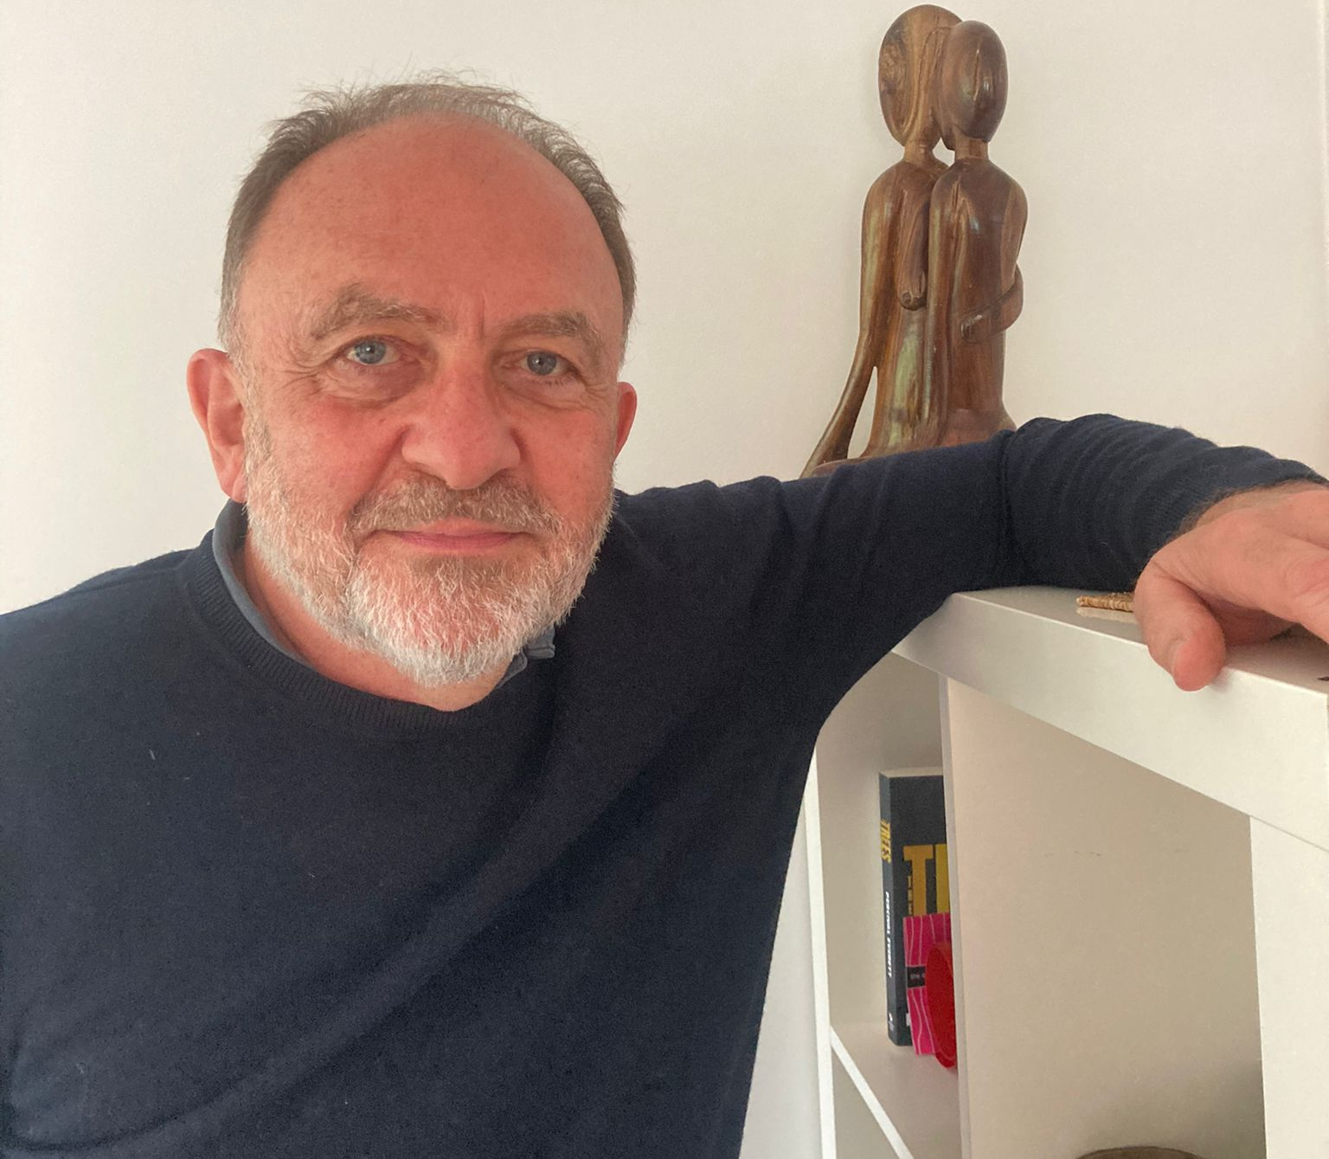
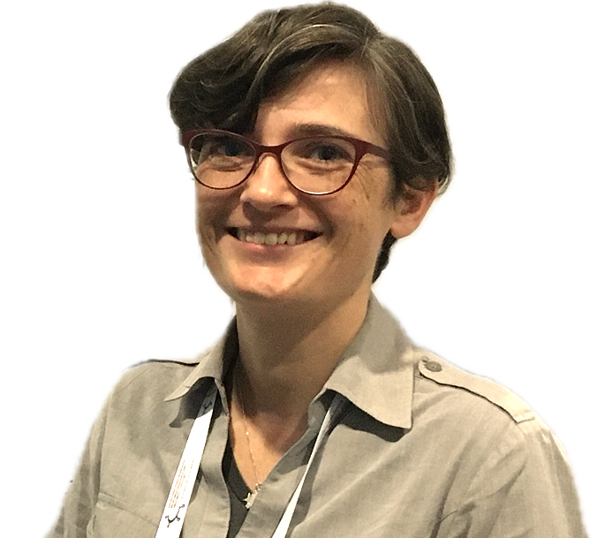
Presenters
Kate Powis, Harvard University
Not all children with perinatal HIV exposure are the same
Nigel Rollins, WHO
Supporting infant feeding choice and practices for pregnant and postpartum persons
Natasha Davies, Anova
An adapted post-natal club model in South Africa: Outcomes and lessons learnt
Notes:
During the panel

