Slide 1
Not all children with perinatal HIV exposure are the same
Kathleen Powis, MD, MPH, MBA
Harvard T.H. Chan School of Public Health
10th Symposium on Children and Adolescents with Perinatal HIV Exposure

Slide 2
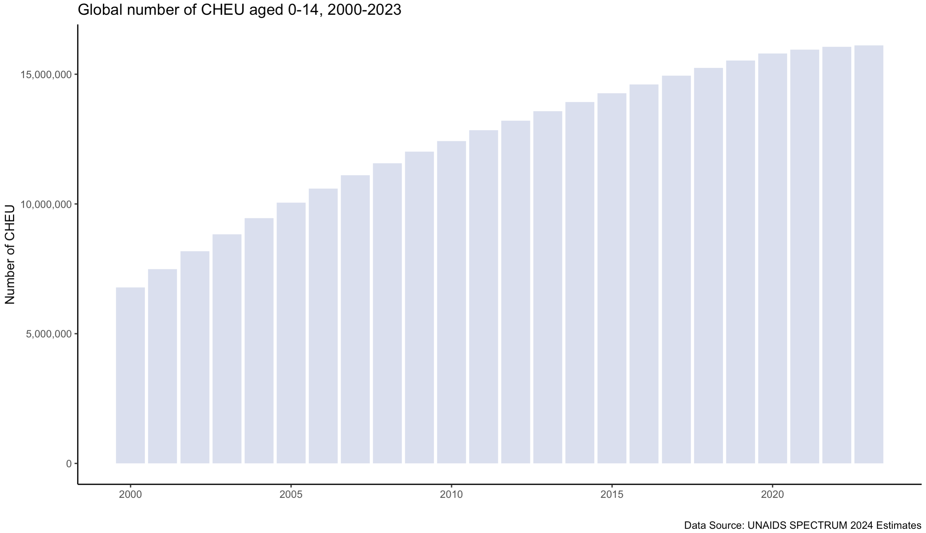
Global Number of Children ≤ 14 years of age with Perinatal HIV Exposure Born HIV Free - 2000 - 2023
16.1 million (2023)
Number Children with Perinatal HIV-Exposure born HIV-free
Prepared by Dr. Michelle Bulterys

Slide 3
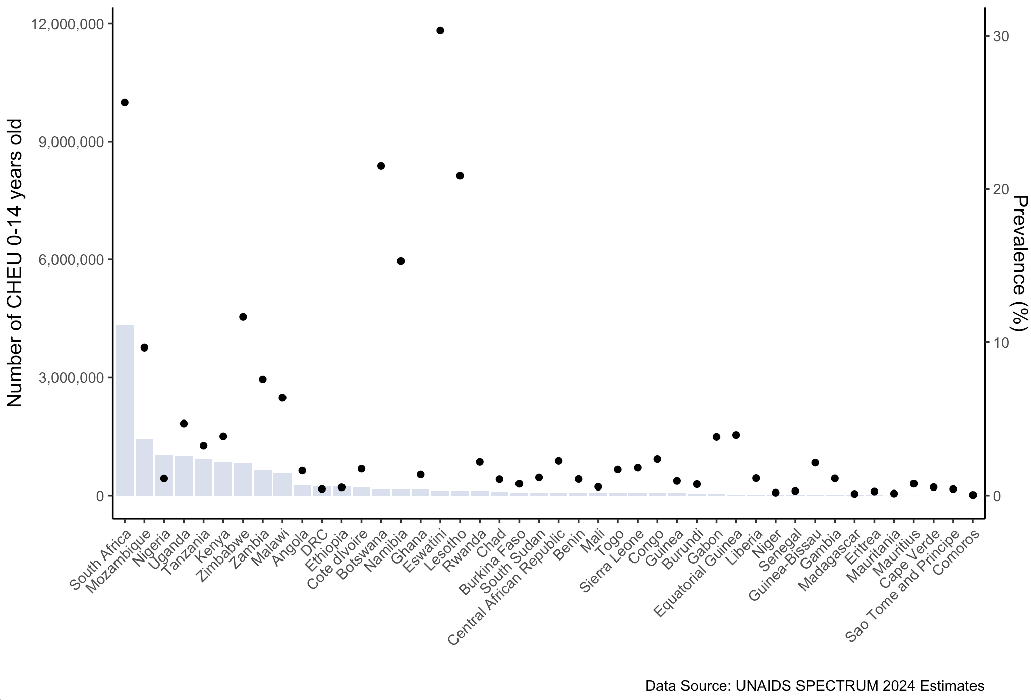
Counts and Prevalence of Children ≤ 14 years of age with Perinatal HIV Exposure Born HIV Free In Eastern and Southern Africa - 2023
Eswatini
South Africa
Botswana
Lesotho
Number Children with Perinatal HIV-Exposure born HIV-free
Prepared by Dr. Michelle Bulterys

Slide 4
Global Number of Children ≤ 14 years of age with Perinatal HIV Exposure Born HIV Free - 2000 - 2023
16.1 million (2023)
Number Children with Perinatal HIV-Exposure born HIV-free
Prepared by Dr. Michelle Bulterys

Slide 5
Diversity of Exposures in the Maturing HIV Epidemic
ART for CD4 ≤ 350 cell/mm^{3,} otherwise AZT +/- sdNVP in labour
ART for CD4 ≤ 350 cells/mm³,
otherwise Option A or
Option B (ART with use of PIs)
ART for CD4 ≤ 500 cells/mm³,
otherwise Option A or
Option B (ART with use of PIs)
PREP
Treat All
2006
2010
2012
2013
2015
2018
WHO recommends EFV for use in Pregnancy
WHO recommends DTG for use in pregnancy
15-18 years old
13-14 years old
12 years old
10-11 years old
7-9 years old
<7 years old

Slide 6
Other Exposure Differences Associated with Risk of Infectious Morbidity, Mortality, Poorer Growth and Developmental Delays

Slide 7

Conclusions
Factors that place children, adolescents and young adults with perinatal exposure at risk of poor health, suboptimal developmental outcomes, or mental health challenges include biological, social, and structural.
In the maturing HIV epidemic, many of the biological exposures differ significantly over time.
Having health systems or research cohorts that accurately characterize these exposures is critical to understanding children, adolescents, and young adults in need of support.

