Slide 1
An Adapted Post-Natal Club Model in South Africa: Outcomes and Lessons Learnt
Dr Natasha Davies, Anova Health Institute, South Africa
10th Symposium on Children and Adolescents with Perinatal HIV Exposure

Slide 2
Background
Annually in South Africa:
275 500 pregnancies
amongst women with HIV
+/- 8000-9000 (3%)
infants acquire HIV
+/- 268,000
infants who are HIV exposed but uninfected

Slide 3
Routes of Transmission
1 in 3 infant infections arise from new maternal infections
New
Known
Notes:
Speak to maternal seroconversions as 30% contribution of infant infections

Slide 4
Supporting Breastfeeding in the context of HIV
Childhood leukaemia
Social Isolation
Childhood admissions
HIV
Infant ART exposure
Onward trans- missions in adulthood
Lifelong ART
Stigma
ART resistance
Chronic inflamm-ation
Preterm NEC
Parental NCDs (DM, HPT, CVD)
Under 5 Mortality
Economic Burden
Parental Cancers
Coeliac Disease
Growth and Develop-ment
Postnatal depression
Inad-
vertent sharing of HIV status
NCDs in Adulthood
Chronic Otitis Media
SIDS
Obesity in Adult- hood
Osteo- porosis
Childhood Asthma/ Eczema
Behav- ioural Issues
Bonding
Poor Dentition

Slide 5

Improving Infant Outcomes:
Breastfeeding Support
Infants who are HIV-exposed and uninfected have improved childhood outcomes when they are breastfed
Initiating and sustaining breastfeeding is not always easy
Peer-led support groups are a model to support breastfeeding for parents living with HIV
Stock image

Slide 6
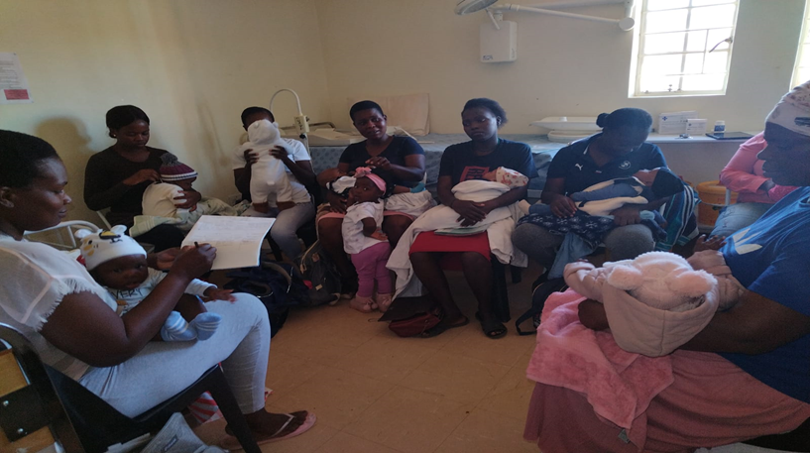

An Adapted Post-Natal Club Model
Model Components
Trained peer counsellor/mentor mother facilitates
Mother-infant pair (MIP) recruited at day 3, week 6 or week 10 well-baby visit
Integrated mother/baby care:
  Maternal viral load monitoring
  Breastfeeding support
  Peer-driven mental health support
  Reliable post-partum contraception (family spacing)
  Infant testing
  Immunisations
  Basic early childhood development (ECD) screening
  Basic nutrition screening
  Referral to community-based organisations (where available) that support maternal-infant bonding e.g. Flourish, ububele
Adapted from original MSF model originally developed in South Africa
Flourish – Empowering mothers and their babies (flourishnetwork.org.za)
https://www.ububele.org/familiesdata/home-visiting-service
Notes:
Define a club – what actually happens? Meet according to EPI visits – so 10 weeks, 14 weeks
Women bring their babies to a group room where they meet and are taken through a guided session.
Baby play mat so that babies can be put down and observed for gross motor development.

Slide 7
Post-natal club outcomes
84 facilities had PNC model implemented across Johannesburg, Capricorn, Mopani districts
Primary goal = vertical transmission prevention
Not all mother-infant pairs at facilities with clubs enrol in clubs – some transmissions occur in unenrolled pairs
Notes:
10 weeks test and 6 month test - stipulate

Slide 8
Postnatal Club Outcomes in 3 South African Districts (Jan-March 2024)
District | No. clinics with Post natal clubs | Total no. of MIP in clubs | No. Mothers due for VL | No. Mothers collected VL | No. due for contra-ceptive | No. given contra-ceptive | No. children seen | No. PCR Due | No. PCR Done | No. PCR Neg | No. PCR Pos | No. 18 months test done | No. 18 months test Neg
Capricorn | 39 | 297 | 194 | 194 | 58 | 58 | 222 | 69 | 69 | 68 | 1 | 24 | 24
Mopani | 28 | 786 | 160 | 160 | 191 | 191 | 786 | 124 | 124 | 124 | 0 | 65 | 65
Johannes-burg | 17 | 1558 | 389 | 375 | no data | no data | 1558 | 553 | 553 | 553 | 0 | 155 | 155
Total | 84 | 2641 | 743 | 729 (98%) | 249 | 249 | 2566 | 746 | 746 | 745 | 1 | 244 | 244
VL suppression: 94% <1000 copies (Jhb data only), 77% <50 copies (Cap + Jhb data only)

Slide 9
Lessons Learnt
Benefits
Challenges
Efficient use of time for mothers
Peer-led (low cost, user-friendly)
Retains all infants so infants who remain HIV free can benefit from continued health visits up to 18 month ‘graduation’
Supports mothers to attain optimal health, positive impact for mother and baby (healthier mothers = healthier babies)
Encourages longer duration of safe breastfeeding, with associated health gains
Space
Facilitator availability and broad skills set
Identification and recruitment early post-partum – some MIPs missed
Cohorting into similar infant age groups to enable scheduling according to immunisations
Sustaining all components, especially mental health and ECD
High mobility of mothers = challenge to retention – data only for retained MIPs
Timing of clubs for mothers returning to work
Limited referral options when problems identified

Slide 10
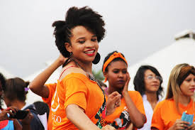

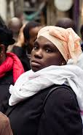




Future Opportunities
Expand post-natal clubs to more facilities
Strengthen ECD, infant nutrition, maternal mental health components through facilitator training
Improve reporting and monitoring/outcomes evaluations to assess broader maternal and infant outcomes
Offer post-natal clubs to all women regardless of HIV status to support breastfeeding uptake and duration
  Status neutral approach to recruitment and counselling
  Support PrEP continuation for women without HIV – low PrEP uptake/continuation resulting in 30% of all infant infections arising from new maternal seroconversions
Establish dedicated groups for adolescent girls and young mothers with specific vulnerabilities and needs
Explore expansion to community-based models and inclusion of fathers
Commons license images
Notes:
Pictures still being sourced

Slide 11
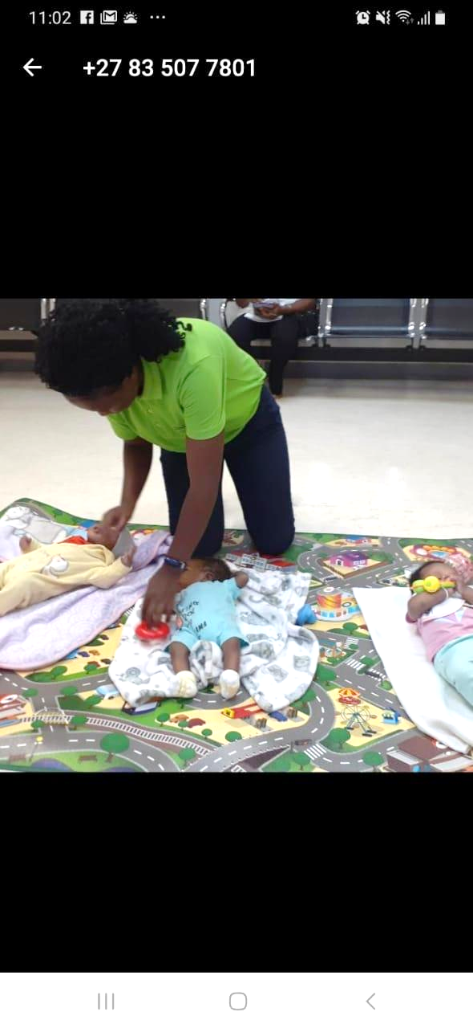
Conclusion
Post-natal clubs were primarily established to reduce vertical transmission rates during breastfeeding
However, with decreasing vertical transmission rates, post-natal clubs proving valuable in enhancing health outcomes for mothers and their infants who remain HIV free
Maternal health more closely monitored and supported
Infants retained in regular clinic follow up for longer to detect other health issues
Peer-led breastfeeding support may increase breastfeeding duration, yielding wider health benefits for mother and child (to be evaluated)

Slide 12
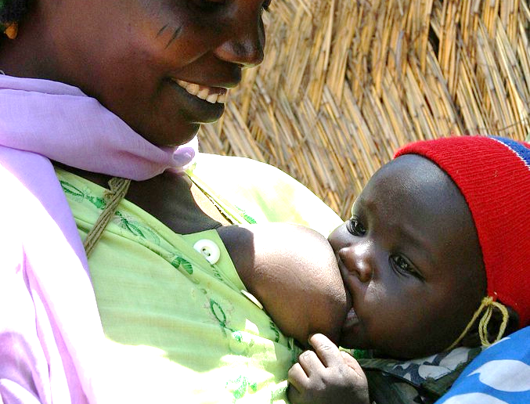
Acknowledgements
All the mothers who attend clubs
All the staff supporting clubs
DoH managers advocating for expansion
Anova technical advisors and public health team
IAS conference and IAS DSD teams for sponsoring my attendance at AIDS 2024
Commons license image

Slide 13
January-March 2024
Sub-district | # Clinics with PNC | # Mother- Infant Pairs seen (MIPs) | Maternal VL due/done (coverage) | # Due for contraceptive | # Contraceptive | # Babies seen | # PCR done | # PCR Neg | # PCR pos | # 18 month rapid test done | # 18 month rapid neg
Ba-Phalaborwa | 5 | 210 | 27/27 (100%) | 26 | 26 | 210 | 30 | 30 | 0 | 20 | 20
Greater Giyani | 6 | 91 | 20/20 (100%) | 28 | 28 | 91 | 16 | 16 | 0 | 36 | 36
Greater Letaba | 6 | 70 | 14/14 (100% | 59 | 59 | 70 | 24 | 24 | 0 | 6 | 6
Greater Tzaneen | 6 | 353 | 70/70 (100%) | 65 | 65 | 353 | 45 | 45 | 0 | 3 | 3
Maruleng | 5 | 62 | 29/29 (100%) | 13 | 13 | 62 | 9 | 9 | 0 | 0 | 0
Total | 28 | 786 | 160/160 (100%) | 191 | 191 | 786 | 124 | 124 | 0 | 65 | 65

Slide 14
Johannesburg Post-Natal Club Enrolments and Monitoring
January-March 2024
Regional Cluster | # Clinics with PNC | # Mother- Infant Pairs seen (MIPs) | Maternal VL due/done (coverage) | # Babies seen | # PCR due | # PCR done | # PCR neg | # PCR pos | # 18 month rapid test done | # 18 month rapid neg
ABC | 7/36 | 979 | 158/153 (97%) | 979 | 307 | 307 | 307 | 0 | 95 | 95
DG | 4/55 | 408 | 132/123 (93%) | 408 | 113 | 113 | 113 | 0 | 22 | 22
EF | 6/25 | 171 | 99/99 (100%) | 171 | 133 | 133 | 133 | 0 | 38 | 38
CoJ | 17/116 | 1558 | 389/375 (96%) | 1558 | 553 | 553 | 553 | 0 | 155 | 155
Notes:
Johannesburg and Limpopo data separate because data elements differ slightly
Also note the number of PCRs is lower than the number of infants seen because this is data from a 3 month period and so some infants will not have been due for a PCR during this short time period.

Slide 15
Post-Natal Club Viral Load Suppression Outcomes
District | All VLs done | VL <1000 copies/ml³ | % VL <1000 copies/ml³ | VL< 50 copies/ml³ | % VL<50 copies/ml³
Mopani | 160 | Not captured | Not captured | 127 | 79%
CoJ | 375 | 352 | 94% | 284 | 76%
 | 535 |  |  | 411 | 77%
Capricorn VL data
Notes:
Because focus is on VTP, immunisation and contraception coverage has not been, to date, well captured but babies are brought according to EPI scheduling and the clinician assigned to cover the clubs provides all infants attending with scheduled immunisations on day of visit and all women are counselled about contraception and offered support to access family planning services

