Slide 1
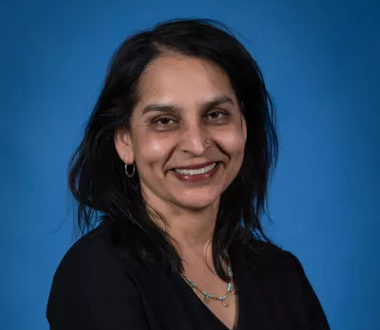
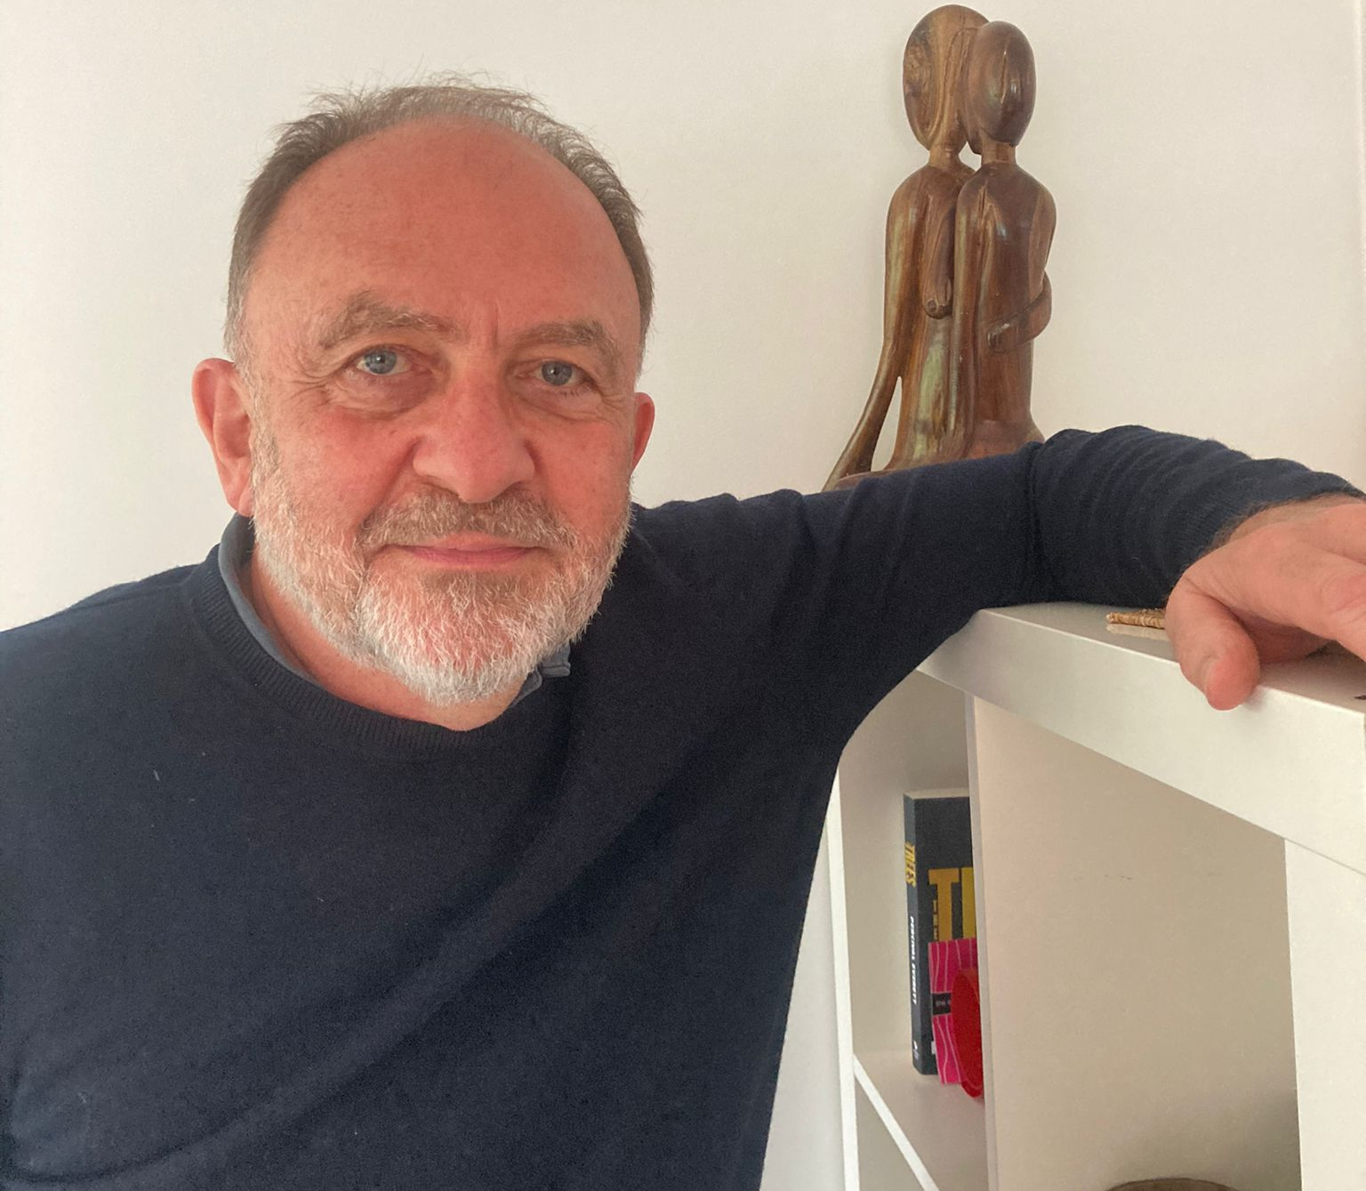
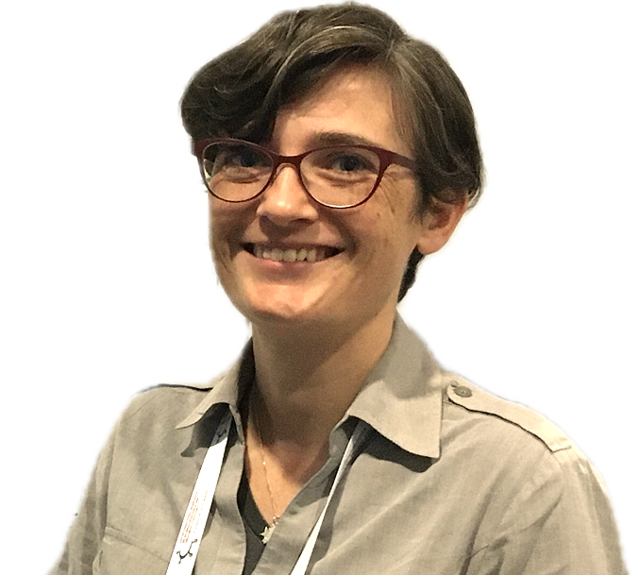
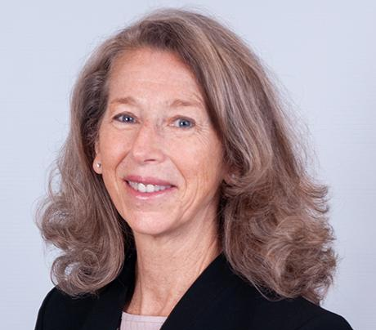
Panel discussion
Anurita Bains, UNICEF
Facilitator
Nigel Rollins, WHO
Natasha Davies, Anova
Kate Powis, Harvard University
Notes:
During the panel

Slide 2

Engage with the Guest Editors and Authors of the Supplement
During the first break at 9.00-9.30
Notes:
Slide after the panel discussion

